Slide 1
School Finance Reform:
Money and Choice
A Short Course Prepared for the
National Tax Association
Santa Fe
November 15, 2014
by
Dennis Epple
Carnegie Mellon University, NBER, & CESifo

Slide 2

Feel Free To Make Comments, Ask Questions, and Correct Me If I’m Wrong!
Cartoon Reproduced
with Permission

Slide 3
Table of Contents
Overview of Presentation
School Finance & Charter Schools
Evaluating School Effectiveness
Educational Finance & Vouchers
Education Finance and Public School Choice
Conclusion
References

Slide 4
Education Matters
The most troubling development in the US economy since the great depression is the relentless increase in earnings inequality in recent decades.
Education should play an important role in countering this march of inequality.

Slide 5
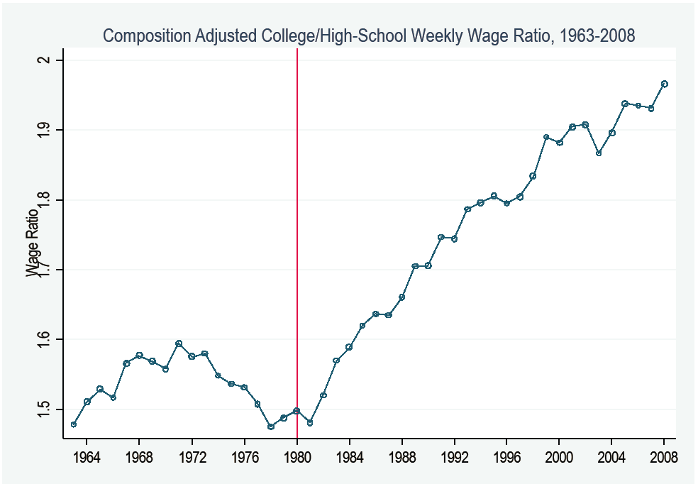
Education Matters
The Ratio of College Grad to High School Grad Earnings
Increased From 1.5 to 2 Since 1980
Source: David Autor, 2010

Slide 6
Overview of Presentation
1. School finance and charter schools
What is a charter school?
Where do charter schools locate and whom do they serve?
How does competition influence charter school location and clientele?
Are charter schools more effective than traditional public schools?
How does charter entry impact traditional public schools?
Click Here to Return to Table of Contents

Slide 7
Overview of Presentation Cont’d
2. Educational Vouchers
What is the status of educational vouchers?
What does theory say about alternative voucher designs?
Are voucher schools more effective that traditional public schools?
Does competition from vouchers make public schools better?

Slide 8
Overview of Presentation Cont’d
3. Education Finance and Public School Choice
Metropolitan Fiscal Decentralization
Do we observe “Tiebout sorting”?
Is Tiebout sorting efficient?
What are equity-efficiency tradeoffs in expenditure equalization?
Micro Evidence: The Michigan Reform

Slide 9
Overview of Presentation Cont’d
Still a fourth form of choice is via centralized school assignment mechanisms now in use in some large districts (Boston, New York, Charlotte-Mecklenburg).
This is an interesting development, but I will not attempt to tackle this in my presentation today. See:
  Abdulkadiroğlu, Sönmez, AER, 2003.
  Abdulkadiroglu, Pathak, Roth, AER, 2010.
Also, I will not discuss intra-district open enrollment policies. See:
  Cullen, Jacob, Levitt, Econometrica, 2006.
The No Child Left Behind (NCLB) legislation requires that students in a school failing to make adequate yearly progress in two successive years be permitted to transfer to a district school that is not under NCLB sanctions.
  I will not discuss this directly, but will briefly discuss related work on school responses when they are threatened with loss of students.

Slide 10
Citation of The Literature
I draw heavily on two review papers that coauthors and I have written:
“School Vouchers: A Survey of the Economics Literature,” coauthored with Richard Romano and Miguel Urquiola, under revision for JEL.
“Charter Schools: A Survey of Research on Their Characteristics and Effectiveness,” coauthored with Richard Romano and Ron Zimmer, written for Handbook of Economics of Education.
In addition, I draw on a review of theory of educational vouchers coauthored with Richard Romano:
“Economic Modeling and Analysis of Educational Vouchers,” Annual Review of Economics 2012. 4:15.1–15.25
It is impossible to cite all of the valuable contributions to the literature that have advanced research in the areas I discuss.
I provide citations when I refer to individual contributions, with associated references provided at the end of the slides.
The three review papers above provide extensive citations to other contributions to the literature .
Click Here to Return to Table of Contents

Slide 11

School Choice Poses Challenges
Cartoon Reproduced with Permission

Slide 12
1. School Finance & Charter Schools
A charter school is a public school chartered by entities designated by state legislation.
Approved authorizers vary across states and may be one or more of the following: a state board, local boards, districts, counties, cities, other approved organizations (e.g., non-profits, universities).
Charter laws vary across states, but defining characteristics of charter schools are:
Charter schools cannot charge tuition.
Charter schools are not permitted to impose admission requirements.
  If it is oversubscribed, a charter school must select from its applicants by lottery.
Click Here to Return to Table of Contents

Slide 13
Charter School Location
Charters schools are located disproportionately in urban areas.
Charter school penetration varies greatly across states and cities:
Seven states account for 61% of total charter enrollments;
30 metropolitan areas account for 63% of total charter enrollments.
Cities where charters have grown to significant share of publicly funded enrollment:
New Orleans switched entirely to charter schools,
Washington DC, 45%
Detroit 33%
Philadelphia 28%
Note: Much of the data for comparison of charter and public schools is drawn from the National Alliance for Public Charter Schools web page.

Slide 14
Charter School Demographics
Concern that charter schools would induce white flight from public schools has proven to be largely unfounded:
The charter sector enrolls higher proportions of African-American and Hispanic students than TPSs.
Charters enroll proportionately fewer special needs students than TPSs.
More detail on next slide…

Slide 15
Comparison of Charter and
Traditional Public Schools
 | Charter | Traditional Public
Expenditure per Student | $10,011 | $14,014
Demographics (as % of enrollment)
§ African American | 29% | 16%
§ Hispanic | 27% | 23%
§ White non-Hispanic | 36% | 53%
§ Other | 8% | 9%
Percent Eligible for Free/Reduced Price Lunch | 51% | 48%
Location
§ % urban (central city districts) | 56% | 28%
§ % suburban | 29% | 47%
§ % rural | 15% | 25%
Epple, Romano, and Zimmer, 2014; Data drawn from
http://dashboard.publiccharters.org/dashboard/home

Slide 16
Charter Schools Currently Serve Approximately 5% of US Students
Epple, Romano, and Zimmer, 2014; Data drawn from
http://dashboard.publiccharters.org/dashboard/home

Slide 17
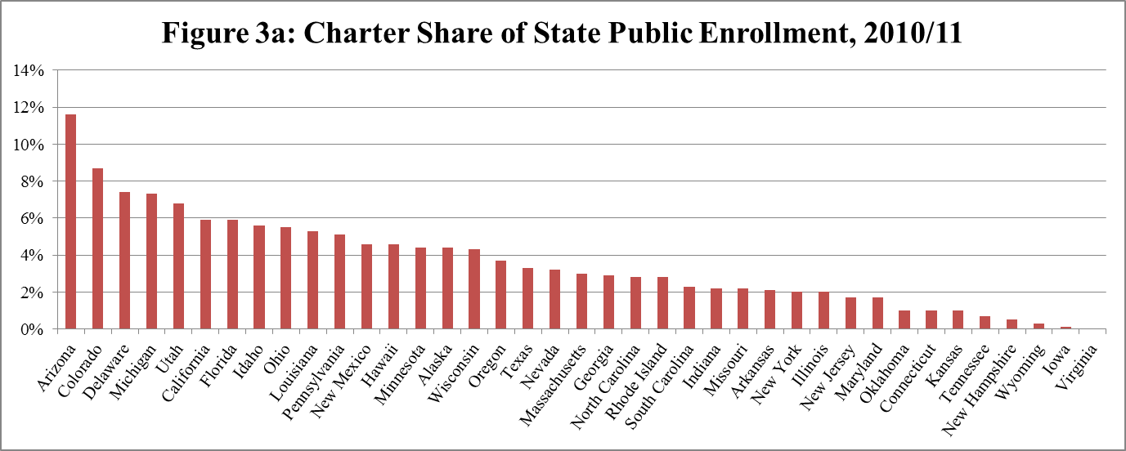
Charter School Market Share Across States Ranges From 0 to 12 %
Epple, Romano, and Zimmer, 2014; Data drawn from
http://dashboard.publiccharters.org/dashboard/home

Slide 18
Charter School Funding
Charter schools typically receive on the order of 80% of per student expenditure in the student’s home school district, but there is variation across states.
Payment to the charter school typically comes from the student’s home public school district, i.e., money follows the student.
Hence, charter schools directly impact budgets of school districts from which they draw students.
A given charter school may draw from more than one district, and hence may receive different payment amounts for different students.

Slide 19
Teacher Characteristics in Traditional Public and Charter Schools, 2011/12
 | Traditional Public | Charter
Percent White, Non-Hispanic | 82 | 70
Percent African American | 7 | 12
Percent Hispanic | 8 | 13
Percent Male | 24 | 25
Average Age | 43 | 37
Average Teaching Experience (Years) | 14 | 9
Average Years at Current School | 8 | 4
Percent Less than 4 Years' Teaching Experience | 11 | 26
Percent Highest Degree=Bachelor's | 39 | 52
Percent Regular Full Time | 93 | 91
Percent Unionized | 50 | 12
Required Hours (Typical Week) | 31 | 32
Total Hours per Week | 52 | 54
Average School Year Earnings | $55,400 | $46,300
Percent Teachers Receiving Supplemental Pay for Student Performance & Average Amount | 4%/$1,400 | 16%/$1,300
Source: Goldring, Gray, and Bitterman (2013)

Slide 20
Summary Regarding Charter School Teachers…
On the whole, teachers in charter schools are:
less experienced,
less credentialed,
less white,
less unionized,
have fewer advanced degrees,
paid less,
in less secure jobs, and
turnover with higher frequency.
Value added estimates of teacher effectiveness shows charter school teachers to be weaker in increasing test scores, but…
Research on effects of teacher differences between Charter and TPSs is at an early stage
  Hence, largely an open question.

Slide 21
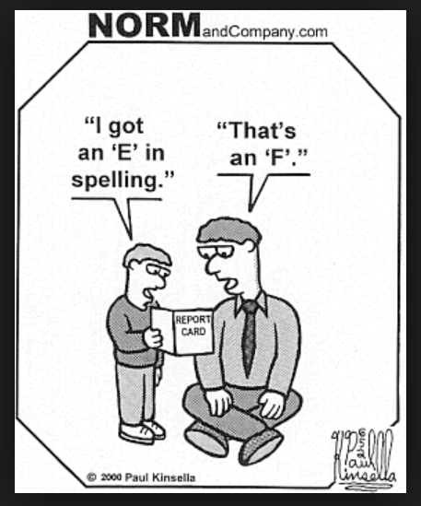
Evaluating Performance
Cartoon Reproduced
with Permission

Slide 22
Evaluation: Assessing Causal Effects
Similar issues arise in evaluating both charter and voucher schools.
Hence, I discuss here evaluation with respect to both types of schools, and then return to discussion of charter schools.
In the language of experimental design, we wish to compare outcomes for a “treatment” (e.g., attending a charter school) to an alternative (e.g., attending a TPS school).
Outcomes of interest may be achievement on a standardized exam, behavior (e.g., absenteeism), high school graduation, and/or college attendance.
Assessment of causal effects gives rise to two issues regarding validity:
  Internal validity: Does the evaluation yield valid estimates of the treatment being studied?
  External validity: Do the findings generalize to other settings?
Click Here to Return to Table of Contents

Slide 23
Randomization to Treatment and Control Provides High Internal Validity
Some voucher programs have been designed as experiments to permit evaluation of effectiveness. (See Peterson, et. al., 2003, available online).
These experiments have proven valuable in providing a template for experimental design and evaluation of school choice.
Results of these experiments will be discussed later in the discussion of voucher research.
When charter schools are oversubscribed, they must select among applicants by lotteries.
This randomization provides conditions akin to an experiment, yielding high internal validity.
However, oversubscribed schools may be better than undersubscribed schools.
This raises the issue of external validity: Do the findings for oversubscribed schools generalize to undersubscribed schools?
How can we do evaluation in the absence of randomization?

Slide 24
Evaluation When Schools Are Not Oversubscribed
When schools are undersubscribed, evaluation cannot exploit randomization.
Methods of evaluation in such contexts include:
Controlling for observables using regression methods when comparing achievement of charter and TPS students.
Fixed-effect methods that compare achievement gain of a student before and after the student switches from a TPS to a charter or from a charter to a TPS.
Matching charter students to TPS students based on student location and observed student characteristics, by one of the following methods:
  Exact Matching: Each charter student is matched to a TPS student with the same observed characteristics.
  Propensity Score Matching: A model is estimated to predict charter attendance based on student observed characteristics. Then a charter student to a TPS student with similar estimated probability of attending the charter.
Studies using these approaches are called Observational Studies

Slide 25
Assessing Internal Validity of Observational Methods
One strategy for evaluating observational methods is to apply those methods to settings with randomization.
If an observational method gives similar findings to the result obtained exploiting the randomized design, this provides some support for the internal validity of the observational method.
Fortson et. al. (2012) evaluate four observational methods against an experimental benchmark:
  The difference between the observational and experimental result for each method is summarized in the graph that follows.
  A superior method will tend to have a small difference between observational and experimental estimate with a narrow confidence bound that includes zero.
As the graph shows, the two matching approaches perform better in this instance relative to regression and fixed-effects alternatives.

Slide 26
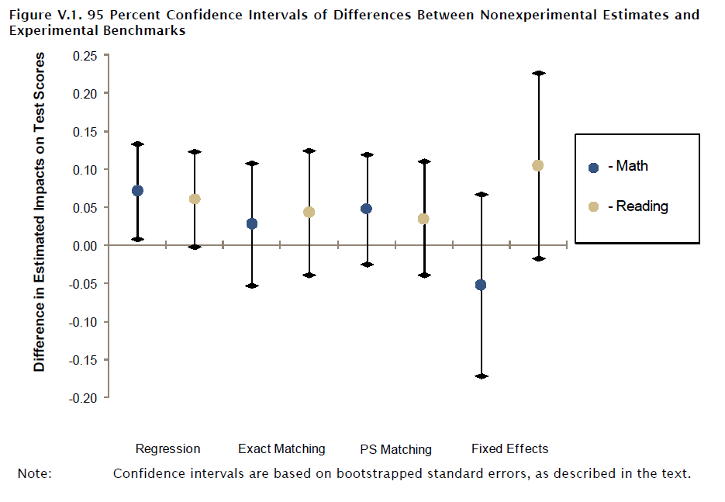
Difference Between Observational and Experimental Estimates for Math and Reading
Source: Fortson, et. al. , Mathematica 2012.

Slide 27
Comparing Lottery and Observational Methods: NYC
Dobbie and Fryer (AEJ, 2013) use exact matching of students attending charters in their New York City sample to a control sample of traditional public school students using the school public school attendance zone of the student, cohort, gender, race, limited English proficiency status, and free and reduced-price lunch eligibility.
Charter students are included in the observational analysis if they are matched to at least one TPS student.
TPS students are included if they are matched to at least one charter student.
This yields matches for 94.3 percent of charter students in the sample.
Dobbie and Fryer find their observational estimates are qualitatively similar to the lottery estimates, though smaller in magnitude.
These smaller observational estimates indicate that matching on observables does not completely control for student differences in their sample.

Slide 28
Comparing Lottery and Observational Methods: Boston
Abdulkadiroglu et. al. (2011) compare observational and lottery findings for oversubscribed charter schools and District-operated Pilot Schools.
Controls in their observational analysis were demographic and background characteristics and students' lagged test scores.
They find that the observational estimates are “…remarkably similar to the lottery-based estimates when carried out in the sample of charter schools that have lotteries.”
This lends support to validity of the observational analysis for their sample.
Applying the observational approach to charters that were not oversubscribed, they find that oversubscribed charter schools are better in generating achievement gains than the charters that were not over-subscribed.
Hence, regarding external validity, as authors point out, the results obtained for over-subscribed charter schools should not be considered representative of all charter schools.

Slide 29
National Charter School Study (NCSS)
In the slides that follow, I discuss results from randomization and results from observational studies.
The most comprehensive study of charters is the NCSS observational analysis of 27 states Raymond, et al. (2013).
This is known as the CREDO study. [Center for Research on Education Outcomes (CREDO), Stanford University].
CREDO employs exact matching, with each charter student matched to seven TPS students.
Using multiple matching students enhances statistical power.
Matching is on grade level, gender, race/ethnicity, free or reduced-price lunch eligibility, English language learner status, special education status, prior test score on state achievement tests, and TPS “feeder school” attendance zone.

Slide 30
Evaluation Results for Charter Schools
I now return to discussion of findings with respect to charter school impacts.
Then I turn to discussion of vouchers.

Slide 31
Charter School Effectiveness Is Far From Uniform
Lottery studies of oversubscribed charter schools generally find favorable effects on achievement, often very large effects. (Abdulkadiroglu, et. al., QJE 2011; Dobbie and Fryer, AEJ, 2013).
The “No Excuses” model, in particular, has been found to deliver large gains. As summarized in Abdulkadiroglu, et. al. :
“No Excuses schools are characterized by small size, frequent testing, a long school day and year, selective teacher hiring, and a strong student work ethic.
“Other features include an emphasis on discipline and comportment, teacher-led whole-class instruction, and the absence of computer-aided instruction.”
The invention of this educational model is arguably the most important innovation of the charter movement.

Slide 32
Can No-Excuses Innovations Be Transferred to TPSs?
Whether no-excuses type models can be implemented with comparable gains in non-selective TPSs remains very much an open issue.
Dobbie and Fryer (AEJ 2011) provide empirical evidence on importance of various features of effective charter schools.
A recent, remarkable experiment in the Houston school district by Roland Fryer (NBER WP 17632) suggests that implementing these features in poorly performing public schools does indeed enhance effectiveness.
Fryer’s experiment also illustrates the daunting challenges facing such implementation.

Slide 33

Cyber Schools
Cartoon Reproduced
with Permission

Slide 34
The Opposite End of The Performance Spectrum
In contrast to “no excuses” charter schools, online “cyber” charter schools appear to be a failed innovation.
These schools have been found to perform particularly poorly (e.g., CREDO 2011).
Charter authorizes should seriously consider withdrawing authorization for most of these schools.

Slide 35
Charter School Effectiveness Overall
The evidence suggests that:
Individual charter schools tend to improve as they mature.
The charter school sector as a whole is improving over time, largely from closure of underperforming schools.
Charter authorizers can play an important role in weeding out ineffective charter schools, but many charter authorizers have yet to embrace this role.
Accounting for differences in population served:
Charters are not producing achievement gains better than TPSs.
Some recent findings suggest that charter school effects on behavior and attainment (years of schooling) may be stronger than on achievement.

Slide 36
Impact of Charters on TPSs Effectiveness
Research on the impacts of charter schools on the academic performance of TPS through competitive pressures has generally found modest effects.
However, a recent study by Cremata and Raymond (2104) in Washington DC provides evidence that TPSs produce larger achievement gains when confronted with competition from high quality charter schools.

Slide 37
Charters Have Large Impacts On TPS Operations
Charters draw enrollments and funds from TPSs
TPSs then confront the task of closing schools and reducing administrative and teaching staff levels while minimizing adversely effects on students.
  The Washington DC district has closed 38 schools thus far, with more to come.
  Philadelphia has closed 24 schools.
Often a given charter school will draw students from multiple TPS schools, resulting in declining class sizes in multiple TPS schools.
Hence, closing TPS schools typically requires reassignment of many students.

Slide 38
Charters Also Have Other Disruptive Effects on TPS Districts
Students at a troubled charter school in Philadelphia got a surprise Monday (Oct 27, 2014) morning - they found the high school portion of it closed.
Some say they received a robo call last night telling them not to come to class. Others say they showed up ready for school only to be turned away.
Student Samir Crowley says, "I just went in there, nobody in there. Empty. They didn't call my mom or nothing."
Spokesperson Fernando Gallard from the School District of Philadelphia says last month the district was informed by the charter school of an eventual closing. So they created a tab on their website and began helping students transition into their school communities. However, this abrupt closing even took them by surprise and they are now anticipating a rush of calls.
Source: ABC News WPVI Philadelphia

Slide 39
Thoughts on Welfare Effects of Charter Entry
As economists, we tend to be inclined to encourage competition and let chips fall where they may, but…
When a charter school enters, we know from revealed preference:
Some parents prefer the charter.
Some parents prefer to remain in their TPSs.
As charter sector expands, TPS schools close:
Parents preferring the TPS school are then forced to relocate to a less preferred school.
Do the benefits of charter competition exceed the costs?
As yet, we do not have research on this question.
Part of the rationale for providing charters less that 100% of TPS per student expenditure is to cover costs districts bear that charter schools do not.
This clearly is relevant such a cost-benefit analysis.

Slide 40

Policy
Cartoon Reproduced with Permission

Slide 41
The Bottom Line on Charter Schools
The charter school movement as a whole has yet to live up to the expectations of its founders.
There are, however, some positive developments in the charter sector, as noted on previous slides.
The jury is still out.

Slide 42
2. Educational Finance & Vouchers
How do vouchers differ from charters?
What would Milton Friedman say?
Vouchers could be used at private schools with no requirement for a publicly granted charter.
Private schools would be largely unfettered and could, for example,
  Impose admission restrictions and
  Grant financial aid to attract able students.
Click Here to Return to Table of Contents

Slide 43
Private and Public School Competition
Theory (Epple and Romano, AER, 1998) tells us that equilibrium would be characterized by cream skimming.
Private schools would provide lower tuition (financial aid) to attract able students.
Higher income households would pay a premium to get their less able kids into schools with more able kids.
This leads to diagonal stratification with private schools skimming the more able and higher income types.
Next page illustrates.

Slide 44
Public-Private Competition and The School Quality Hierarchy
• Cream Skimming Arises in Equilibrium: In private schools, higher income households with lower ability students cross-subsidize lower income households with higher ability students.

Slide 45
Detailed Predictions: Public-Private School Competition
In private schools, financial aid increases with student ability.
Equilibrium exhibits
Stratification by income and stratification by ability between the public and private school sectors,
A strict quality hierarchy across private schools, and
  Propensity to attend private school increases with income and ability.
  Among private schools the propensity to attend the highest-tuition schools rises with both income and ability.
Diagonal stratification across private schools.
Correlation between income and ability is greater in public than in private schools.
Expenditure in private schools increases as expenditure in public schools increases.
We tested these predictions using data for US high schools and all predictions were supported. (Epple, Figlio, Romano, JPubE, 2004).

Slide 46
Implications for Voucher Program With Universal Eligibility
Vouchers will induce private school entry.
Entering schools will cream skim a “diagonal slice” of the highest income and highest ability students from the public sector.
Increasing the voucher amount increases private school entry and associated cream skimming.
This is illustrated next slide for three different voucher levels.

Slide 48
Chilean Voucher Is Closest To The Theoretical Framework
Chilean voucher and Cream Skimming:
Hsieh and Urquiola (2006) find a “middle class” exodus from public schools generally consistent with cream skimming.
Hsieh and Urquiola (2006) apply a difference-in-differences approach to municipal-level data for 1982 to 1996, finding that areas with greater private sector growth display evidence of greater sorting.

Slide 49
Chilean Voucher and
Educational Outcomes
Hsieh and Urquiola (2006) also use difference-in-differences to study effects of private schools on educational outcomes.
They find no advantage for outcomes including achievement on standardized tests and years of schooling.
Hsieh and Urquiola point out that a key identification issue is that private entry into school markets is endogenous.
  If outcomes had been declining in areas where the private sector grew more, these effects might underestimate the benefits of competition.
  Estimation using instruments (e.g. population density) preserves their results, but they note that no ideal instruments are available.

Slide 50
International Test Results
After dropping by 5 and 7 points respectively between 1999 & 2003, Chile’s 8th grade math and science scores increased substantially—by 29 points and 48 points respectively between 2003 & 2011.
Hanushek, Peterson, and Woessman (2013) estimate that Chile had the second-highest growth rate among 49 countries they studied.
Over the same period, the Chilean voucher program expanded from one third to roughly one half of the student population.
Over the same period, Chile also underwent changes including substantial increases in GDP per capita and in educational expenditures, expansions in pre-school enrollments, and reforms to rules governing university admissions and also the voucher system.
Thus, while the recent test results are very good news for Chile, the causal connection between recent test score improvements and vouchers is an open question because of the other changes enumerated above.

Slide 51
US Voucher Programs
Publicly funded US voucher programs differ markedly from the Friedman proposal.
Programs are typically one of two types:
The voucher is available to students based on an income-eligibility cutoff (e.g., Milwaukee)
These programs often do not permit private schools to impose admission criteria and instead require lotteries when private schools are over-subscribed.
2. The voucher becomes available to students in a public school that is designated as failing (e.g., Florida, Ohio)
Some of these require a lottery if private schools are over-subscribed (e.g., Florida) and some do not (e.g. Ohio).
Note: Florida Supreme Court declared Florida program unconstitutional.

Slide 52
Milwaukee: Longest Running and Most Studied US Voucher Program
Introduced in 1990 and initially limited to students in households with Incomes less than 175% of US poverty level.
Income Limit has been increased, now 300% of poverty level.
  85% of Milwaukee Public School students are eligible for free or reduced priced lunch, which is 185% of poverty level.
  Hence, with 300% limit, the vast majority of MPS students are voucher eligible.
Voucher pays the lesser of private school tuition or standard district allocation.
Voucher enrollment has grown steadily over time and presently:
  Approximately 24,000 students receive vouchers.
  Approximately 80,000 students attend Milwaukee TPSs.
Astonishingly, in a random sample of Milwaukee parents, 41% were unaware of the voucher program (Fleming, et. al., 2013).
With more than 20% of students in voucher schools, this suggests that half of parents using Milwaukee TPSs were unaware of the voucher.

Slide 53
Milwaukee Criteria for Private Schools to Participate
Private schools must be accredited by one of several agencies.
Initially not available to attend religious schools but expanded to permit religious schools in 1998.
Private schools must meet at least one of the following four performance standards:
at least 70% of voucher-supported students must advance a grade level,
attendance by voucher students must be at least 90%;
at least 80% of program students must demonstrate significant academic progress, or
at least 70% of voucher-student families must meet parental involvement criteria set by the school.
There are presently 110 schools accepting voucher students.

Slide 54
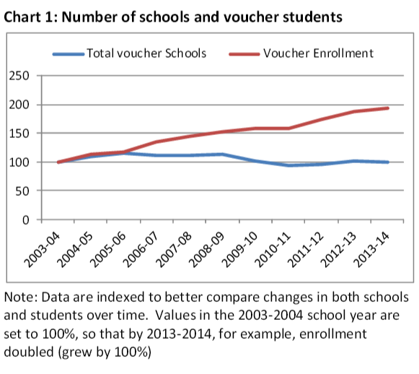
Voucher Enrollment Doubled Since 2005 Number of Voucher Schools Unchanged
Source: Public Policy Forum, Research Brief 102, 1, April 2014

Slide 55
Milwaukee Voucher Effects on Educational Outcomes: Early Years
In early years of program, the number of vouchers was limited to 1.5% of students.
Vouchers were awarded to applicants by lottery.
Rouse (QJE, 1998) exploited this randomization to study effectiveness of voucher schools finding:
  Little effect on reading
  Significant improvement in mathematics on the order of .3 to .5 standard deviations over four years—a quite large effect.

Slide 56
Milwaukee Voucher Effects on Educational Outcomes: More Recent Years
Cap on number of vouchers was greatly relaxed rising to 22,500 by 2005; the cap was then eliminated.
Hence evaluation can no long exploit randomization.
The primary method of evaluation for recent years is through matching, as described next.

Slide 57
Milwaukee Voucher Evaluation
Recent Years
Milwaukee evaluation by Woff, et al. (2008) uses matching.
In fall 2006, each of 1,926 randomly selected voucher participants in grades 3–8 were matched with comparison students from Milwaukee Public Schools.
Matching was done as follows. For each voucher student:
MPS students were chosen who were within the same grade and census tract and within the same 5 percentile bandwidth of baseline test scores on Wisconsin standardized exam.
If there was more that one such MPS, an MPS student with the closest propensity scores to the voucher student was chosen.
Propensity score was estimated using mean of math and reading baseline test scores, gender, race and an indicator for students with English Language Learning (ELL) status.

Slide 58
Effectiveness of Milwaukee Voucher Schools
Using matched sample as described on previous slide, Witte, et. al. (2012) find:
  Little if any effects of voucher schools on achievement.
  Some recent evidence of positive effects of voucher schools on years of school completed.

Slide 59
Cream Skimming Milwaukee
The income eligibility limit coupled with requirement that over-subscribed private schools select by lottery reduces potential for for cream skimming. In 2006:
Compared to population of Milwaukee students, voucher students were more likely to be black or Hispanic, English language learners, and female.
Voucher recipients also had a higher rate of attending religious services (Fleming, et. al., 2013).
Scope for cream skimming in the future may be greater because of two recent changes:
Increase of income eligibility limit to 300% of poverty level .
Voucher schools can charge a tuition premium for high school students above 220% of the poverty limit.
Howard Fuller (2011), former Milwaukee School Superintendent and advocate of the Milwaukee voucher program, supported the 300% limit as advancing the objective of serving low-income families, while strenuously objecting to fully eliminating the eligibility income limit.

Slide 60
Household Location in Milwaukee Metro Area
Nechyba (AER, 2000) and Ferreyra (AER, 2007) emphasize the potential for vouchers to impact household location.
The higher income eligibility limit and permission for private schools to “top up” tuition may induce higher income suburban households to relocate to city of Milwaukee.
This might benefit the city by increasing the tax base, but renters might face higher rental prices.
Research has not yet studied the extent of these relocation effects.

Slide 61
Other US Voucher Programs
Carefully designed publicly funded (Washington DC) and privately funded (New York City) voucher experiments have been conducted to exploit randomization:
Results vary, but overall little effect found for achievement.
Two recent studies look at other outcomes
The Washington DC voucher had significant, large effects on high school completion (Wolf et al, 2010).
The privately funded New York City voucher experiment had significant large effects on college enrollment for African American students (Chingos and Peterson, 2012).

Slide 62
Voucher Impacts on Public School Achievement
Identification problems are challenging. Hoxby (2003) measured the intensity of voucher treatment of a Milwaukee public school using the proportion of students in the school eligible for vouchers:
This measure varies because eligibility for a voucher is dependent on students’ income.
Schools with a higher proportion of poor students receive more intensive treatment.
Schools with a low proportion of poor students serve as the control group.
As an additional control, Hoxby chooses a set of low income public schools outside of Milwaukee.
She finds that more intensively treated public schools have higher rates of productivity growth (measured as achievement on a standardized exam relative to expenditure).

Slide 63
Voucher Impacts on Public Schools Cont’d
Chakrabarti (JPubE, 2008) builds on Hoxby’s approach exploiting expansion of Milwaukee voucher eligibility in 1998 (increase in income eligibility limit and eligibility of religious schools).
She found:
Little evidence that voucher program affected public schools prior to 1998.
For 1998-2002, voucher threats induced:
  Significant gains in reading on the order of 0.15 std. dev.
  Insignificant but generally positive impact on math on order of .1 std. dev.

Slide 64
Voucher Impacts on Public Schools Cont’d
Figlio and Rouse (2006) studied the effect of the Florida School Accountability Program (FSA) using a difference-in-difference strategy with student level data to estimate whether being designated as a failing school improves subsequent achievement.
For high-stakes tests they find an increase of 0.25 standard deviations in mathematics.
They note that they are unable to disentangle the two effects of the FSA program:
  Stigma (designation as a failing school) and
  The school’s students become eligible for voucher.

Slide 65
Other Voucher Impacts on Public Schools
Since 2005, the Milwaukee Public School District has closed 25 schools.
By its assessment, the district still has a great deal of excess capacity.

Slide 66
The Bottom Line on Voucher Programs
In contrast to charter school programs, vouchers have not been widely adopted in US.
Voucher programs have not fared well at the ballet box (e.g. California and Michigan).
Relative to hopes of advocates, vouchers have not proven to have a transformative effect on school performance.
There is little evidence that voucher programs improve educational achievement of voucher recipients.
On the positive side, recent evidence suggests that voucher programs may improve high school completion and college enrollment.
There is some evidence that voucher threats prompt improvement of threatened public schools.

Slide 67
3. Education Finance and Public School Choice
What is the status of expenditure equalization efforts?
Metropolitan Fiscal and Political Decentralization
Do we observe “Tiebout sorting”?
Is Tiebout sorting efficient?
What are equity-efficiency tradeoffs in expenditure equalization?
Click Here to Return to Table of Contents

Slide 68
Expenditures
How have expenditures changed over time?
What levels of government provide revenues?
Are expenditures becoming more equal?

Slide 69
Corcoran and Evans
Figure 1. Real Revenues per Student, by Source,
1919-20 to 2010-11
Source: Corcoran and Evans (2014)

Slide 70
Figure 1: Real Current Expenditures per Pupil,
Public K-12 Schools, 1970/71 to 2010/11 (in 2013$)
Real expenditure per student increased
at a compound annual rate of 2% between
1970 and 2010.
Source: Evans, Schwab, Walker (2014)

Slide 71
Source of Revenues for K-12 Education
1970/71 – 2010/11 School Years
Source: Evans, Schwab, Walker (2014)

Slide 72
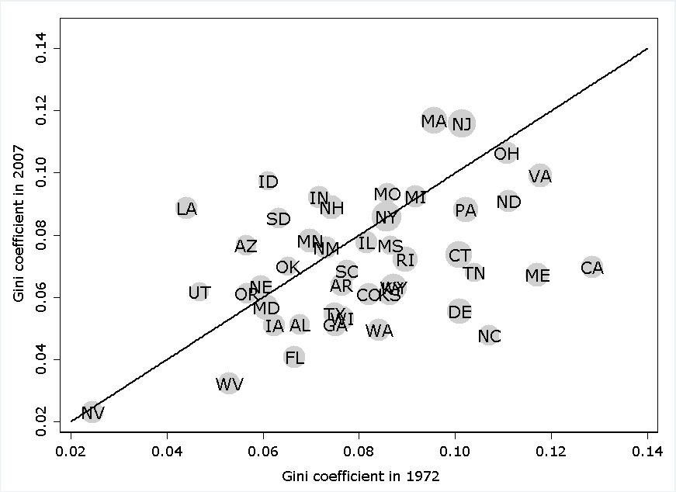
Per Student Expenditures Have Become More Equal in Roughly Two Thirds of The States
Gini Coefficients 1972 & 2007
Above 45º line spending inequality increased
between 1972 and 2007.
Below 45º line spending inequality
decreased between 1972 and 2007.
Source: Corcoran and Evans (2014)

Slide 73
Source: Plotted from data in Corcoran and Evans (2014)

Slide 74
Summary of Equalization Trends
Within most states, expenditures per student have become substantially more equal over recent decades.
What are the implications of equalization?
The answer depends importantly on the nature of decentralized education provision by school districts within states.

Slide 75
Do We Observe Tiebout Sorting?
Yes!
We observe Tiebout sorting across jurisdictions in a metro area.
We also observe sorting across school attendance zones within jurisdictions.
The next several slides illustrate sorting across municipalities in Boston Metro area.

Slide 76
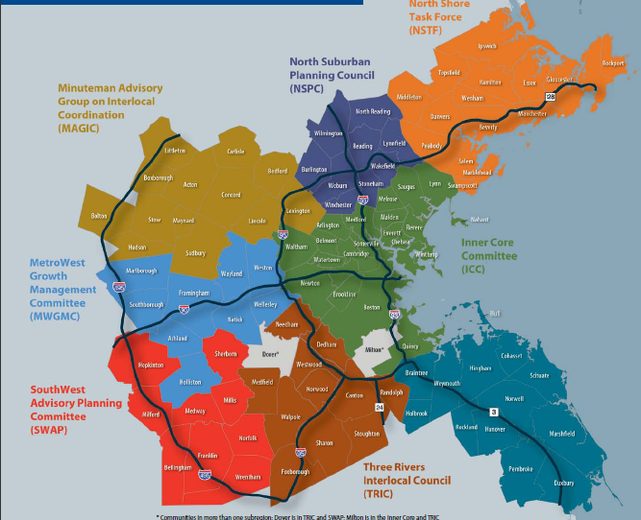
The Boston Metropolitan Area

Slide 77
Residential Choice Leads to Income Stratification

Slide 79
Notes:
It is a challenging task to think how this persistence would occur without households moving.

Slide 80
Correlation of Median Community Incomes
Over Decades In Boston Metro Area
 | 1970 | 1980 | 1990 | 2000 | 2010
1970 | 1.00 | 0.94 | 0.92 | 0.93 | 0.91
1980 |  | 1.00 | 0.98 | 0.97 | 0.93
1990 |  |  | 1.00 | 0.98 | 0.96
2000 |  |  |  | 1.00 | 0.97
2010 |  |  |  |  | 1.00

Slide 82
Tiebout At Work
It is difficult to think of a way this four-decade persistence of the income hierarchy across communities and variation in the proportion of school age kids across communities could arise if there were no household mobility.
Direct evidence on mobility is also available.

Slide 83
Intra-Metropolitan Migration by Age
Young Households Move to Higher Income Communities
Empty Nesters Move to Lower Income Communities
Epple, Romano, Sieg, JPubE, 2012

Slide 85
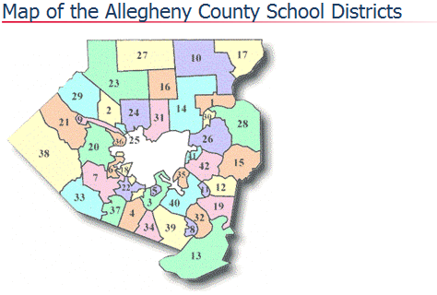
Pittsburgh Metro Area

Slide 86
Achievement Ascends with School District Income
Pittsburgh Metro Area
Source: Clark, Leah (2014)
Notes:
[Describe each graph]
Though by no means equivalent to school quality, test scores probably offer some indication of peer quality, school quality, or a combination of the two. Clearly, school district mean test scores are highly correlated with school district median income.
The orange dot is Pittsburgh Public Schools.

Slide 87
Tiebout Stratification Need Not Be Efficient:
An Illustrative Example
Two Jurisdictions, j=1,2 with land areas L₁=L₂=.5
Constant Elasticity Housing Supply in Each
Three goods: Numeraire (x), housing (h), public good (g)
Households have CES preferences: U(x,h,g)= [β_{x}x^{ρ} +β_{h}h^{ρ} +β_{g}g^{ρ} ] ^{1/ρ}
Incomes (y):
  75% of metropolitan population has income $25,000 per capita
  25% of metropolitan population has $100,000 per capita
Each household chooses community, housing, and numeraire.
Public good g_{j} chosen by majority rule of residents in each jurisdiction.
Parameters chosen to match empirical estimates.

Slide 88
Equilibria for Example
Centralized Equilibrium:
Housing price ph = $16.74, tax t=.35, spending g=$3,490
Low and high income types pay property taxes of $1,745 and $6,890 respectively
Decentralized Equilibrium:
Housing Prices: ph,1 = $14.03, ph,2 = $18.60
Property tax rates: t1 = .35, t2 = .35
Public expenditures per capita: g1 = $1,758, g2 = $5,217
In C1 per capita property taxes are $1,758
In C2 low income types pay $1,762 and high income types pay $7,047

Slide 89
Comparison of Centralized and Decentralized Equilibria
All households are worse off in the decentralized equilibrium in the example.
Property owners are also worse off; aggregate land rents are lower in the decentralized equilibrium.
Why the inefficiency?
  Housing price rations access to housing and access to communities offering different qualities of education.
  It does not perform either of these two functions well.

Slide 90
Comparison of Centralized and Decentralized Equilibria
The example is not pathological.
Calabrese, Epple, Romano (ReStud, 2012) develop the theory and provide extensive evidence using a calibrated computational model that decentralization is likely to be inefficient.
Comparison of centralized and decentralized equilibrium in structural econometric model estimate for Boston also reveals decentralization to be inefficient.
  Some details follow…

Slide 91
More Evidence of Inefficiency of Tiebout Decentralization
Structural model for Boston estimated for Boston metro area summarized next three slides.
This is followed by implications for (in)efficiency of decentralization.

Slide 92
Structural Model Estimated
Using Data From Boston Metro Area
Conditional on the observed income ordering of communities and observed community populations, the equilibrium is unique.
Estimation proceeds as follows:
Step 1: Fit model to Income distributions for 92 municipalities.
Step 2: Estimate by full solution (solving for equilibrium during estimation) fitting actual and equilibrium predictions for 92 communities of:
Education spending
Property tax rates
House values
References:
Epple-Sieg, JPE, 1999
Epple, Romer, Sieg, Econometrica, 2001;
Calabrese, Epple, Romer, Sieg, JPubE, 2006.
Graphs that follow illustrate fit of model.

Slide 93
Sketch of Econometric Model
Preferences:
With ρ<0 (as found empirically), this preference function
satisfies single-crossing.
By Roy’s Identity, the housing demand function has price elasticity η and income elasticity ν:
Joint distribution of income
and tastes lognormal:
School quality is determined by expenditure and peer average income:
Jurisdiction j Budget Balance:

Slide 94
Epple and Sieg, JPE, 1999.

Slide 95
Calabrese, Epple, Romer, Sieg, JPubE, 2006.

Slide 96
The Welfare Effects of Equalizing Spending in Estimated Model
Equilibrium is computed with equalization of per students expenditures across all communities.
Centralized tax rate and expenditure chosen by majority rule.
Households optimally choose community of residence, housing, and numeraire consumption.
Housing prices adjust to equilibrate supply and demand in all jurisdictions.
The results are compared to equilibrium with 92 communities each choosing its tax and expenditure policy (i.e., the observed equilibrium).

Slide 97
The Welfare Effects of Equalizing Spending Continued
Compared to decentralized equilibrium with 92 communities, equalization of spending yields the following:
The welfare effect of centralization is a gain of 1.2% of mean income.
Equilibrium continues to exhibit stratification by income because households sort based on preferences for peer achievement:
  Achievement is positively correlated with income.
  Higher income neighborhoods will then have higher average achievement.
  Housing price differentials will preserve the income ordering as prices are higher were achievement is higher (Black, 1999).
  Some modest movement of higher incomes into lower income districts occurs as expenditures are equalized
As we have seen, movement toward more equal expenditure has been occurring in the majority of US states
Such equalization may well be efficient!

Slide 98
Finance Reform
Evidence from Michigan
In 1994, Michigan made a sweeping change in school finance:
reducing reliance on local property taxes,
increasing state share of education funding from ≈30% to ≈75%, and
increasing spending in low relative to high-income districts.
This change has been the subject of research investigating impacts on:
Stratification across districts
Achievement
Attainment

Slide 99
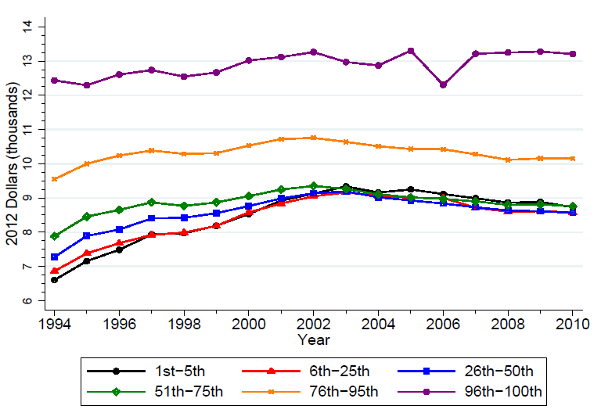
Per-Pupil Operating Expenditures Over Time by 1994 Revenue Percentile
Note approximate equalization
of expenditure for lowest 75%
Source: Joshua Hyman, 2014

Slide 100
The Michigan Reform and Stratification
Chakrabarti and Roy (JPubE, forthcoming) investigate effects of the reform on stratification, before (1990-1994) and after (1995-2001) the reform.
Comparing the highest-spending quintile of districts to the lowest-spending quintile they find the reform narrowed the spending gap from $2,400 to $1,600.
By several SES measures, they find some improvement in low- relative to high-spending districts. For example:
  The gap in median incomes remained unchanged whereas the gap was growing prior to reform.
  The gap in percent on public assistance dropped from 3.3% to 1.6%
  Difference in rate of growth in housing values narrowed, but growth continued to be higher in high spending districts.
  Equalization will improve achievement in lower income districts.
These findings confirm expectations from previous slides that spending equalization will lead to some modest reduction in income differences across districts, but will preserve the previous hierarchy across districts.

Slide 101
The Michigan Reform and Achievement
Roy (2011) studied effects of the Michigan reform on achievement.
She found modest but generally significant positive effects on student scores on state tests in the lowest-spending districts. Estimated impact of a $500 spending increase:
  Between 3 and 4 percentage points in fourth-grade math pass rates.
  Between 1 and 3 percentage point gain for reading
  No improvement in low-spending districts either in rates of taking the ACT or in ACT performance.

Slide 102
The Michigan Reform and Attainment
Joshua Hyman (2014) studies effects on high school graduation and college entry.
Student-level panel data following students from primary school to outcomes for high school graduation and college entry.
Controls for a students’ standardized test scores prior to the spending increases.
Focusing on the lowest-spending half of districts, he estimates:
An additional $1,000 of spending in grades 4 through 7 led to increases in rates of high school graduation and college entry of 2.5 and 3.9 percentage points respectively.

Slide 103
The Michigan Experience
Overall, the findings of empirical research to date conform with expectations:
Increasing expenditures in low-income communities modestly reduced SES stratification.
Increasing expenditures resulted in some gains in achievement and attainment.
Money makes a difference, but not as much as we would like.

Slide 104
Conclusion
New forms of choice (charters and vouchers) have yet to prove themselves.
Little evidence overall of substantial effects on achievement.
Recent evidence on high school completion and college attendance give some encouragement, but more evidence is needed.
Traditional choice across districts (voting with feet) likely leads to inefficiencies, but:
There are reasons to believe that expenditure equalization reduces inefficiencies of decentralization.
This suggests that recent trend to expenditure equalization within states is enhancing both equity and efficiency!
Click Here to Return to Table of Contents

Slide 105
Thank You For Being Here!

Slide 106
References
Abdulkadiroglu, A., Sönmez, T. “School Choice: A Mechanism Design Approach,“ American Economic Review, Volume 93, Number 3, 1 June 2003, pp. 729-747(19)
Abdulkadiroglu, A., Pathak, Roth, A.,"Strategy-proofness versus Efficiency in Matching with Indifferences: Redesigning the NYC High School Match," American Economic Review 41 (5), 2010.
Abdulkadiroğlu, A., Angrist, J. D., Dynarski, S. M., Kane, T. J., & Pathak, P. A. (2011). Accountability and flexibility in public schools: Evidence from Boston's charters and pilots. The Quarterly Journal of Economics, 126(2), 699-748.
Angrist, J. D., Pathak, P. A., & Walters, C. R. (2013). Explaining charter school effectiveness. American Economic Journal: Applied Economics. 5(4): 1-27.
Autor, David, "U.S.Labor Market Challenges over the Longer Term," MIT Working Paper, October 5 2010 . http://economics.mit.edu/files/6341
Baum-Snow, N., M. Freedman, and R. Pavan, "Why Has Urban Inequality Increased?," October, 2014.
Berry Cullen, J., Jacob, b. and Levitt, S., "The Effect of School Choice on Participants: Evidence from Randomized Lotteries," Econometrica, 74, 5, pp. 1191–1230, September 2006.
Black, S. "Do Better Schools Matter? Parental Valuation of Elementary Education," The Quarterly Journal of Economics, Vol. 114, No. 2 (May, 1999), pp. 577-599.
Calabrese, S, D. Epple and R. Romano, “Inefficiencies from Metropolitan Political and Fiscal Decentralization: Failures of Tiebout Competition,” Review of Economic Studies, 79(3), 2012: 1081-1111.
Calabrese, S., D. Epple, T. Romer, and H. Sieg, "Local Public Good Provision: Voting, Peer Effects, and Mobility,” Journal of Public Economics, v90, n6-7 (August 2006): 959-81.
Click Here to Return to Table of Contents

Slide 107
Chakrabarti, R., “Can Increasing Private School Participation and Monetary Loss in a Voucher Program Affect Public School Performance? Evidence from Milwaukee,” Journal of Public Economics, Vol. 92, pp 1371–1393, 2008.
Chakrabarti, R. and J. Roy, Segregation; School finance reform; Tiebout sorting, Peer effects,” Journal of Public Economics, forthcoming.
Chingos, M. and Peterson, P. Effects of School Vouchers on College Enrollment: Experimental Evidence from New York City, August, 2012.
Corcoran, S. W. Evans, "Equity, Adequacy and the Evolving State Role in Education Finance,“ draft Handbook Chapter, 2014.
CREDO. (2011). Charter School Performance Pennsylvania. http://credo.stanford.edu/reports/PA%20State%20Report_20110404_FINAL.pdf
CREDO. (2103). National Charter School Study. http://credo.stanford.edu/documents/NCSS%202013%20Final%20Draft.pdf
Cremata, E.J. & Raymond, M. (2014). The Competitive Effects of Charter Schools: Evidence from the District of Columbia. http://www.aefpweb.org/annualconference/download-39th
Dobbie, W., & Fryer, R. G., Jr. (2011). “Getting Beneath the Veil of Effective Schools: Evidence from New York City.” American Economic Journal: Applied Economics 2013,5(4) 28–60.
Epple, D., Figlio, D. and Romano, R., “Competition between Private and Public Schools: Testing Stratification and Pricing Predictions,” Journal of Public Economics, Vol. 88, pp 1215–1245, July 2004.
Epple D, Romano R. 1998. Competition between private and public schools, vouchers, and peer group effects. American Economic Review. 88(1):33-62.
Epple R, Romano R. 2008. Educational vouchers and cream skimming. International Economic Review. 49:1395–435
Epple, D. and R. Romano, Neighborhood Schools, Choice, and the Distribution of Educational Benefits, in The Economics of School Choice (C. Hoxby, Ed.), National Bureau of Economic Research, 2003.
Epple, D, R. Romano and M. Urquiola, “School Vouchers: A Survey of the Economics Literature,” under revision for JEL.
Epple, D. R. Romano and R. Zimmer, “Charter Schools: A Survey of Research on Their Characteristics and Effectiveness,” , written for Handbook of Economics of Education.
Epple, E. and R. Romano, “Economic Modeling and Analysis of Educational Vouchers,” Annual Review of Economics 2012. 4:15.1–15.25
Epple, D, R. Romano and H. Sieg, “The Intergenerational Conflict over the Provision of Public Education,”, Journal of Public Economics, 96 (3-4), April 2012, 255–268.

Slide 108
Epple, D. and H. Sieg, "Estimating Equilibrium Models of Local Jurisdictions,” Journal of Political Economy, August 1999.
D. Epple, d., T. Romer, and H. Sieg, "Interjurisdictional Sorting and Majority Rule: An Empirical Analysis,” Econometrica, November 2001.
Evans, W. R. Schwab and K. Wagner, "The Great Recession and Public Education," September 2014.
Ferreyra, M., “Estimating the Effects of Private School Vouchers in Multi-District Economies,” American Economic Review, Vol. 97, pp 789-817, 2007
Figlio, D. and Rouse, C., “Do Accountability and Voucher Threats Improve Low-Performing Schools?” Journal of Public Economics, Vol. 90, pp 239–255, 2006
Fleming, D.J., Cowen, J.M., Witte, J.F., and Wolf, P.J., “Similar Students, Different Choices: Who Uses a School Voucher in an Otherwise Similar Population of Students?” Education and Urban Society, forthcoming.
Fortson, Kenneth, Natalya Verbitsky-Savitz, Emma Kopa, Philip Gleason, "Using an Experimental Evaluation of Charter Schools to Test Whether Nonexperimental Comparison Group Methods Can Replicate Experimental Impact Estimates," April 2012 Mathematica Policy Research.
Fryer, Roland G., “Injecting Charter School Best Practices into Traditional Public Schools: Evidence from Field Experiments,” Harvard University, April 1, 2014.
Fuller, H., “Keep intact the mission of choice program,” Milwaukee Journal Sentinel, April 23, 2011. http://www.jsonline.com/news/opinion/120515559.html
Goldring, R., Gray, L., and Bitterman, A. “Characteristics of Public and Private Elementary and Secondary School Teachers in the U.S.: Results From the 2011-12 Schools and Staffing Survey, First Look,” National Center for Education Statistics 2013-314, Department of Education, August 2013.
Hanushek, Eric A., Paul E. Peterson, Ludger Woessmann, “Achievement Growth: International and U.S. State Trends in Student Performance,” Program on Education Policy and Government Report No.: 12-03, Taubman Center for State and Local Government, Harvard Kennedy School, July 2012.
Hoxby, C.M. (2003). School Choice and School Productivity: Could School Choice Be a Tide That Lifts All Boats? In The Economics of School Choice, edited by Caroline M. Hoxby, 287–342. Chicago: University of Chicago Press.
Hsieh Chang-Tai and Miguel Urquiola, "The effects of generalized school choice on achievement and stratification: Evidence from Chile’s voucher program," Journal of Public Economics 90 (2006) 1477– 1503.

Slide 109
Hyman, J. "Does Money Matter in the Long Run? E ects of School Spending on Educational Attainment," September 15, 2014
Nechyba, T., “Mobility, Targeting, and Private School Vouchers,” American Economic Review, Vol. 90 (1), pp 130-146, 2000
Peterson, P., W. Howell, P. J. Wolf, and D Campbell "School Vouchers. Results from Randomized Experiments," in The Economics of School Choice (C. Hoxby, Ed.), National Bureau of Economic Research, 2003.
Rouse, C.E., “Private School Vouchers and Student Achievement: Evidence from the Milwaukee Choice Program,” Quarterly Journal of Economics, Vol. 113 (2), pp 553–602, 1998.
Rouse, C.E., Hannaway, J., Goldhaber, D. and Figlio, D., “Feeling the Florida Heat? How Low-Performing Schools Respond to Voucher and Accountability Pressure,” American Economic Journal: Economic Policy, 5(2): 251–281, 2013.
Roy, J. "Impact of School Finance Reform on Resource Equalization and Academic Performance, Evidence from Michigan, Education Finance and Policy, 2011, pp. 137-167.
Witte, J.F., Carlson, D., Cowen, J.M, Fleming, D.J., Wolf, P.J., “Voucher Longitudinal Educational Growth Study Fifth Year Report,” (SCDP Milwaukee Evaluation, Report #29), February 2012.
Wolf, Patrick J., Joshua M. Cowen, David J. Fleming, Juanita Lucas-McLean, "MPCP Longitudinal Educational Growth Study Baseline Report," SCDP Milwaukee Evaluation Report #5, February 2008.
Wolf, P., Gutmann, B., Puma, M., Kisida, B., Rizzo, L., Eissa, N. and Carr, M., “Evaluation of the DC Opportunity Scholarship Program Final Report June,” Institute of Education Science, National Center for Education Evaluation 2010-4018 U.S. Department of Education, 2010.
Zimmer, R., B. Gill, K. Booker, S. Lavertu, T. Sass, and J. Witte. “Charter Schools in Eight States: Effects on Achievement, Attainment, Integration, and Competition.” Rand Education Monograph. Santa Monica, CA: Rand Corporation, 2009.

