Slide 1


How do I know if my idea is a good one?
Kit Needham
Director, Project Olympus
Asst Dean for Entrepreneurial Initiatives

Slide 2
Ask
your
Customer!

Slide 3
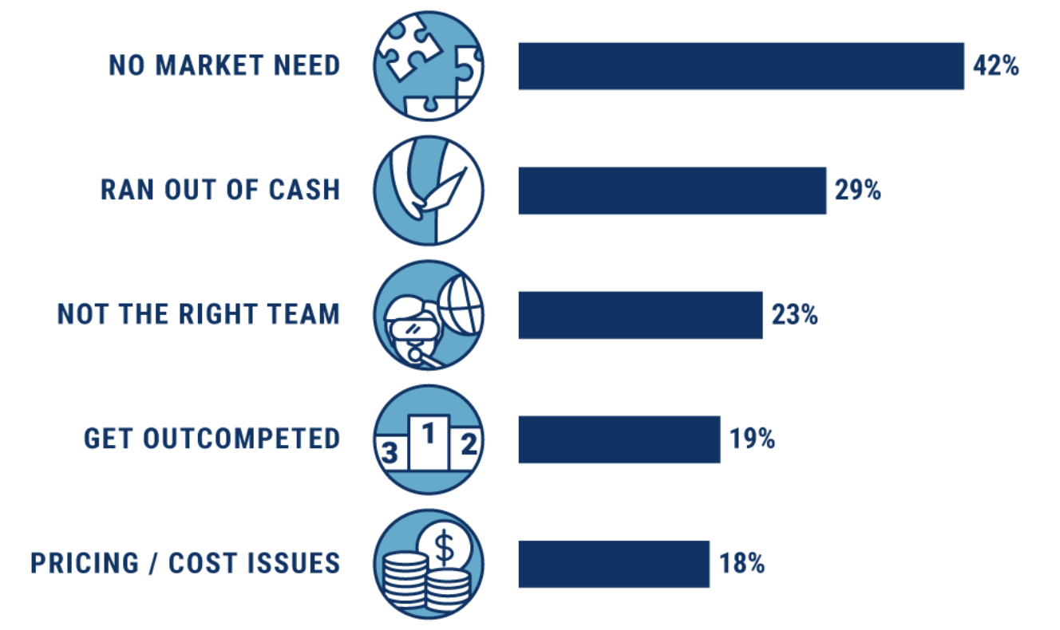
Top 5 Reasons Startups Fail
https://www.cbinsights.com/research/startup-failure-reasons-top/

Slide 4
Wrong Way
“Death by Demo”
“Here’s my idea. What do you think?”
“How would you solve the problem?

Slide 5
Right Way
This is called
Customer Discovery

Slide 6
Customer Relationship Phases
Phase 1 Customer Discovery
Is this a big problem that a lot of people have where the current solution isn’t working e.g. am I solving the right problem?
Phase 2 Customer Validation
I am solving the right problem. Am I solving it the right way?
Phase 3 Customer Acquisition
Strategy and methods for getting customers to buy your product or service at a price where you can be profitable.

Slide 7
What is Customer Discovery
Phase I
What is the pain/problem
Who is having the pain/problem
How bad is the pain
How are the “who” currently dealing with it
How is that solution working for them

Slide 8
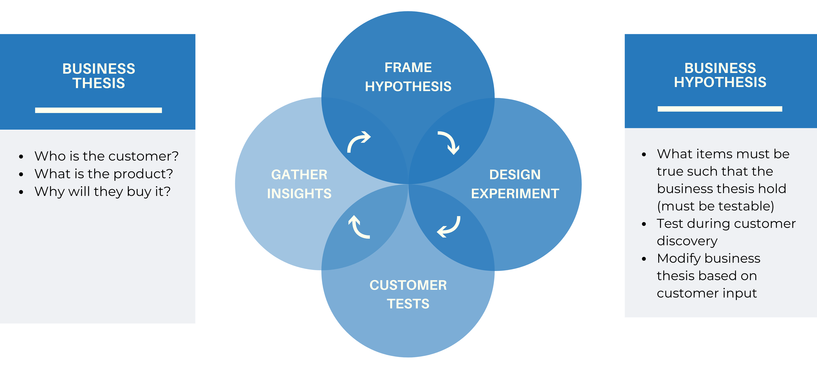
Methodology is Hypothesis Driven
Notes:
Example of the Business Thesis: Hospital Administrators will lease our smart watches to reduce the costs of patients injuring themselves due to delayed responses to calls for help.

Slide 9
Start with your Business Thesis
Notes:
Example of the Business Thesis: Hospital Administrators will lease our smart watches to reduce the costs of patients injuring themselves due to delayed responses to calls for help.

Slide 10
What is a Business Thesis
Who is the customer?
What is your product/solution?
Why will they buy it?

Slide 11
Who is/are Your Customer(s)?
Ecosystem of people you need to understand, satisfy and appeal to in order to buy your product
Also called Stakeholders

Slide 12
Who is/are Your Customer(s)?
Ecosystem of people you need to understand, satisfy and appeal to in order to buy your product
Also called Stakeholders
Most important are generally the users and buyers

Slide 13
Creating a Business Thesis
Who is the customer?
  This is a person with a role and/or title (e.g. not a hospital, university….)
  “This specific customer will buy? lease? license?........
What is your solution?
  What specifically are your proposing to offer?
  ….my product/service that does (this specific thing(s)….”
Why would they buy it?
  What does the customer value? What problem does the customer want to solve? This is often called The Value Proposition
  “…..that will reduce the cost by X? Increase sales by Y? Reduce the error rate by Z? Allow the customer to access in one-step....”

Slide 14
Value Propositions – Alert!
Customers/stakeholders are not buying your technology…
Customers/Stakeholders are buying a solution to their problem!

Slide 15
Value Propositions
Questions to Ask Yourself
What do we do for our customer/stakeholder that they value?
What really matters to our customer/stakeholder?
What problem are you solving for our customer/stakeholder?
What job is our customer/stakeholder trying to get done?

Slide 16
What Makes a Great Value Proposition?
Performance: do something better than it’s been done before
Increase Profits: charge more or increase margins
Cost Reduction: lower your customer’s costs
Customization: more closely align a service or product to an individual customer need
“Getting the Job Done”: making a customer’s non-core task or problem go away
Newness: solving a problem people don’t yet know they have
Notes:
Alton Lane uses traditional tailoring tools and a 3D body scanner to make custom fit clothing
Imagekind allows artists to focus on making art, while Imagekind does the online sales and creation of duplication
Vertu makes ultra-luxury mobile phones

Slide 17
What Makes a Great Value Proposition?
Price: offering an existing service or product for a lower cost
Risk Reduction: reducing or eliminating operating risks
Accessibility: eliminating barriers to access
Convenience & Usability: making something currently difficult to get easier to obtain or use
Brand & Status: a signaling tool for your customers
Design: aesthetic pleasure
Notes:
Warby Parker figured out how to navigate the Luxotica 80% market share
EnerNoc makes energy efficiency/intelligence software
ZipCar founder Robin Chase saw that cars are used less than 5% of the time, and the rest of the time they are an expensive burden

Slide 18
Exercise #1
Create Your Business Thesis
Who is the customer?
  This is a person with a role and/or title (e.g. not a hospital, university….)
  “This specific customer will buy? lease? license?........
What is your solution?
  What specifically are your proposing to offer?
  ….my product/service that does this specific thing(s)….”
Why would they buy it?
  What does the customer value? What problem does the customer want to solve? This is often called The Value Proposition
  “…..that will reduce the cost by X? Increase sales by Y? Reduce the error rate by Z? Allow the customer to access in one-step....”

Slide 19
Hypotheses Test the Business Thesis
Notes:
Example of the Business Thesis: Hospital Administrators will lease our smart watches to reduce the costs of patients injuring themselves due to delayed responses to calls for help.

Slide 20
Business Hypotheses
Your Business Thesis has some assumptions
These assumptions must be true for your business to succeed.
How do you know if they are true?
1. Develop Business hypotheses
2. Develop questions to test these hypotheses

Slide 21
What Makes a Good Hypothesis
Clear and concise
Specific
Testable/measurable
Notes:
AirB&B, Tik tok, door Dash, Hello Fresh, Stitch Fix, Duolingo, Modcloth

Slide 22
Sample Hypotheses
What assumptions do we have that if proven wrong would cause us to fail.
The problem my stakeholder wants to solve is …..?
My target stakeholder will be….?
Why can’t my stakeholder solve this today?
The measurable outcome my stakeholder wants is…?
I will make money/revenue by doing….?
I will beat my competitors because……?
My biggest financial/technical/engineering ….risk is…?
My stakeholder has money and would be willing to buy….

Slide 23
How to Prepare to Test Your Hypotheses

Slide 24
Prepping
Identify possible customer segments and specific stakeholders
Create a Business Thesis for each customer/stakeholder in that segment (start with highest priority)
Develop hypotheses you need to test (what has to be true for your business to be successful)
Develop 5-7 key priority questions for each stakeholder to test the hypotheses.

Slide 25
Identify possible segments
Are there multiple industries that could use your product/service?
Would your product or service be solving the same or different problems in each segment?
Is your product/service a ‘two-sided” business e.g. you need two different segments to participate for this business to succeed? (Examples – Air B&B, Open Table, Etsy, Hertz…..)
You will need to prioritize which segment to pursue first based upon market size, how bad the problem is, competition, etc.

Slide 26
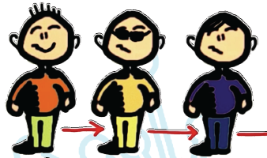
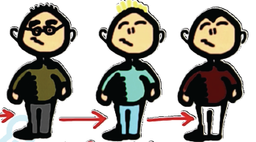
Who Is Your Customer/Stakeholder?
User
Influencer
Recommender
Decision
Maker
Economic
Buyer
Saboteur
Ecosystem of people you need to understand, satisfy and appeal to in order to buy your product.

Slide 27
How to do this
Write down key hypotheses/assumptions
Brainstorm possible questions to prove/disprove hypotheses/assumptions
Identify what stakeholders you need to interview
Prioritize 5-7 questions and at least 5-10 backup questions (see Customer Interview Guide)
  Use questions that are measurable
    E.g. “on a scale of 1-10…”; “how many times in the past three months…?” “what are the steps you need to take to….?” “how much do you pay for…..”
  Include questions that are qualitative
    “What do you like most about …..; Least about….” ”Can you give an example of……”

Slide 28
Customer Interview Guide
Segment:
Title/Job:
Key Hypotheses to test (what assumptions do we have that if proven wrong would cause us to fail)
Key Questions to ask (to prove/disprove the hypotheses)
1 – 5 questions per hypotheses

Slide 29
Sample Hypotheses
What assumptions do we have that if proven wrong would cause us to fail.
The problem my stakeholder wants to solve is …..?
My target stakeholder will be….?
Why can’t my stakeholder solve this today?
The measurable outcome my stakeholder wants is…?
I will make money/revenue by doing….?
I will beat my competitors because……?
My biggest financial/technical/engineering ….risk is…?
My stakeholder has money and would be willing to buy….

Slide 30
Sample Questions
What are the top 3 challenges related to _____? How often do they occur?
How much time do you spend on those challenges?
Can you tell me a story about the last time that challenge happened and what you did?
What, if anything, have you done to solve these challenges?
What don’t you like about the solutions you tried? OR On a scale of 1-10, how would you rate each solution? Why did you give it that number?
Who has to approve purchases? Do you need any approval to try them?
Who else should I talk to?

Slide 31
Hints for Questions
Asking job title/position and how long someone has been in the job/position or status helps you to judge the level of experience (and doesn’t count in the ‘5-7 question quota).
You will need a different set of questions for the different stakeholders.

Slide 32
Hints for Questions
Avoid “Have you ever…..?” Better - ”How often in the (pick a relevant time period) have you….?”
Careful of “Would you ever….?” type questions. Instead, try to frame your question on past behavior which is a much more reliable predicter of how the customer will actually act.
  “When was the last time...?
  “How many apps have you paid for...?
  In the 3 past weeks, which apps...?; how often..? Why?

Slide 33
Exercise #2
Testing Your Hypothesis
For your chosen segment, pick one customer/stakeholder.
Create a hypothesis to test. (What must be true for the stakeholder for your business to succeed).
Identify 1-2 questions to test that hypothesis

Slide 34
Exercise #2 Template
Customer Segment
Business Thesis to test
  Who
  Your solution
  Why would they buy it (value proposition)
Stakeholders
1-2 Questions (more if you have time)

Slide 35
Who to interview
Plan who you want to interview
  Demographics that describes your stakeholders
    Buyers/Decision-makers
    Users
    Influencers (including possible saboteurs)
Where will you find them?

Slide 36

Where to Find them
Start with people you know directly
Olympus Domain Experts
Ask local organizations (LS examples)
Jewish Health Foundation
Innovation Works/ AL Health
LifeX Office Hours Experts
UPMC Enterprise Solutions
LinkedIn (look for alums)
National Organizations
Speakers or authors

Slide 37
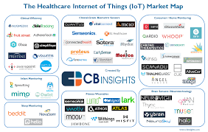
Search “Healthcare Industry Maps”

Slide 38
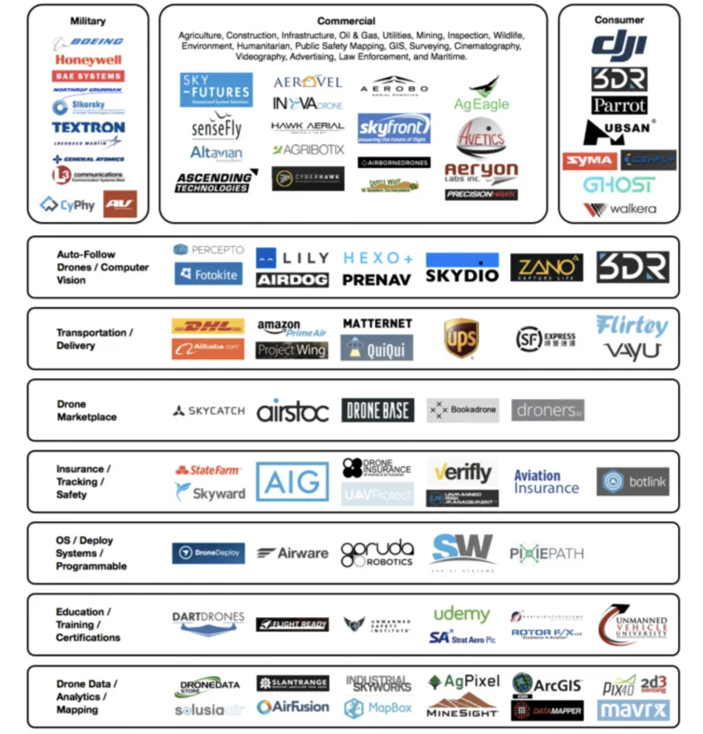
DRONES

Slide 39
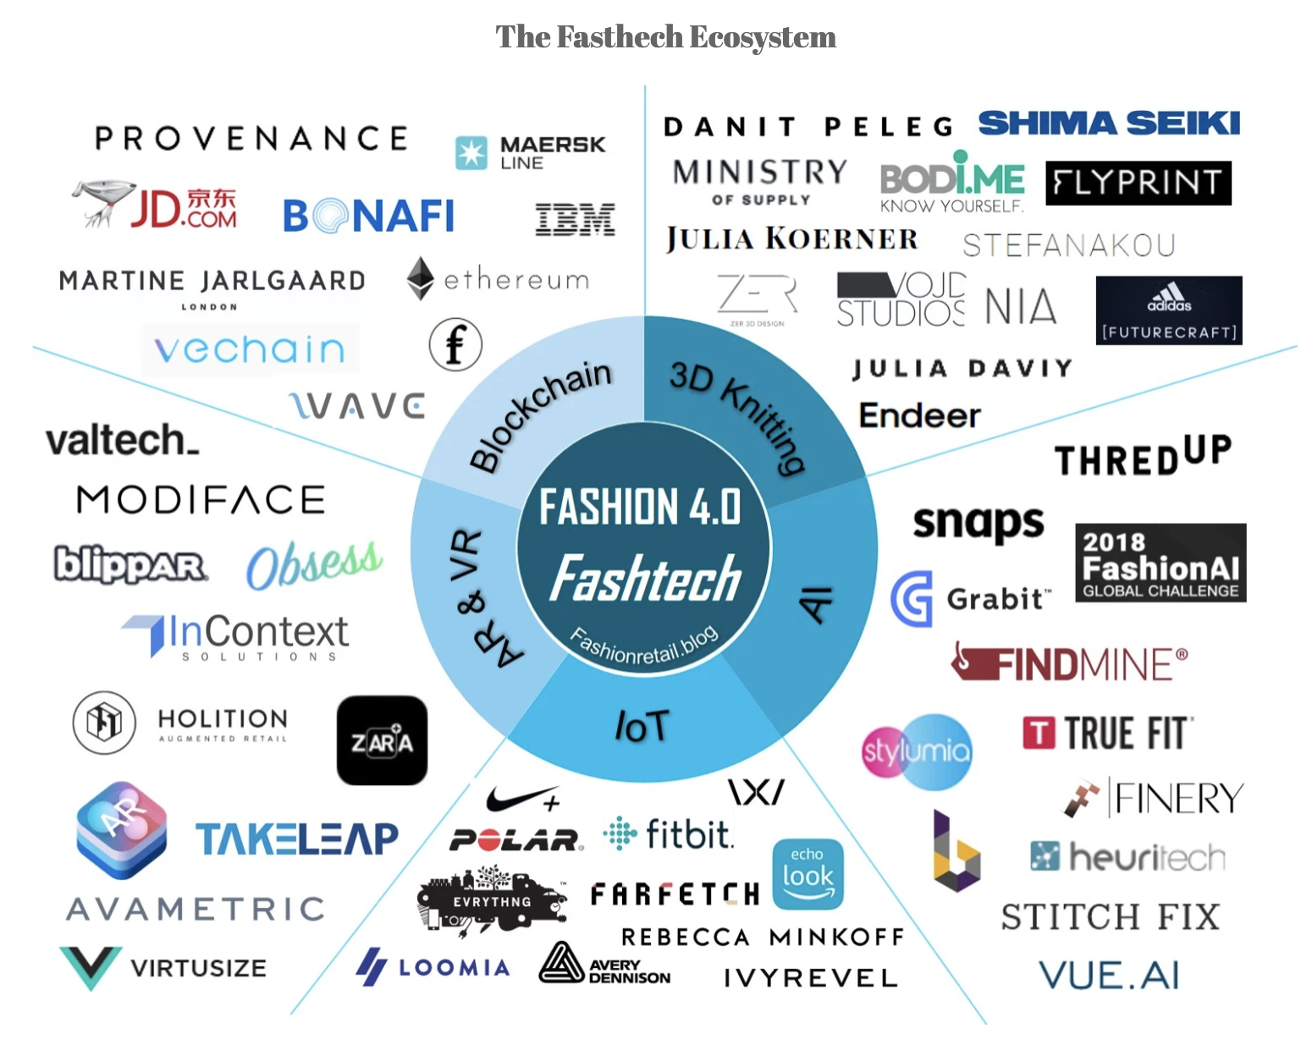
FASHION

Slide 40
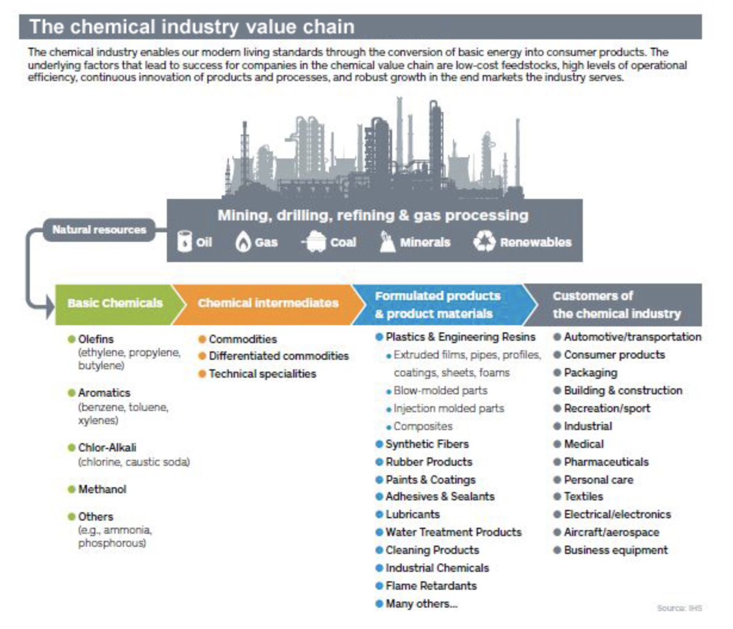
CHEMICALS

Slide 41
SELF-DRIVING AUTOS

Slide 42
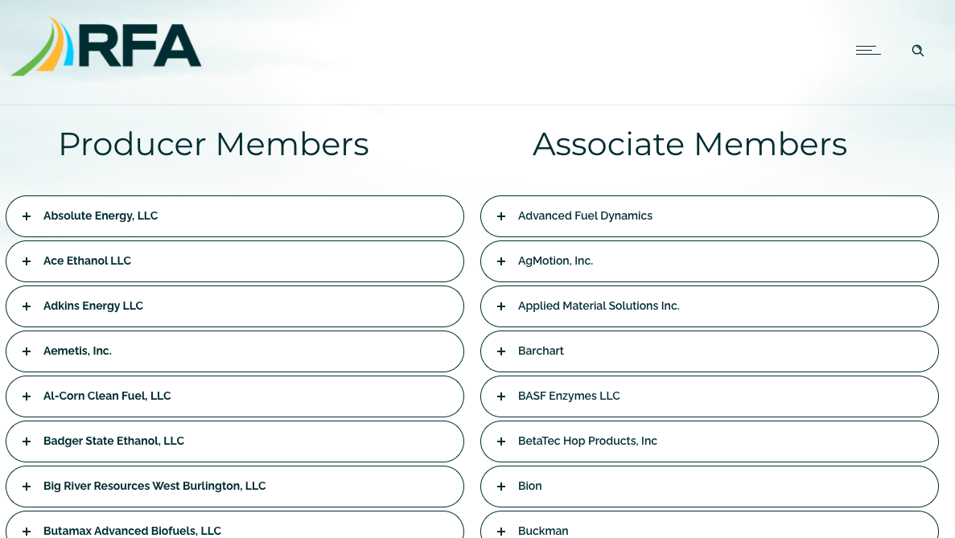
Renewable Fuels Association

Slide 43
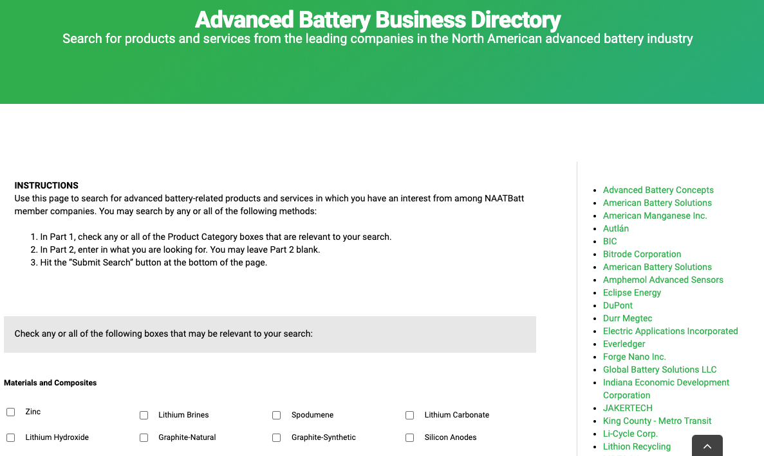
NAATBatt International

Slide 44
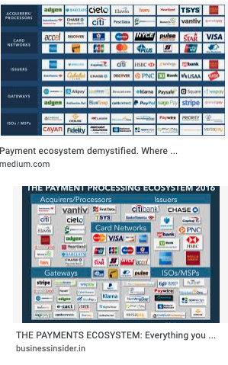
Payment
EcoSystem
Diagram

Slide 45
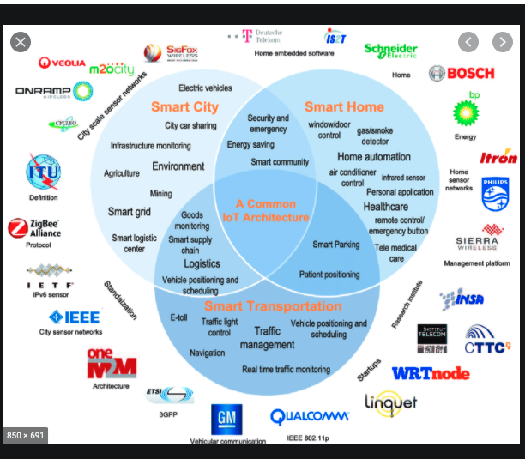
Smart Traffic Ecosystem Diagram

Slide 46
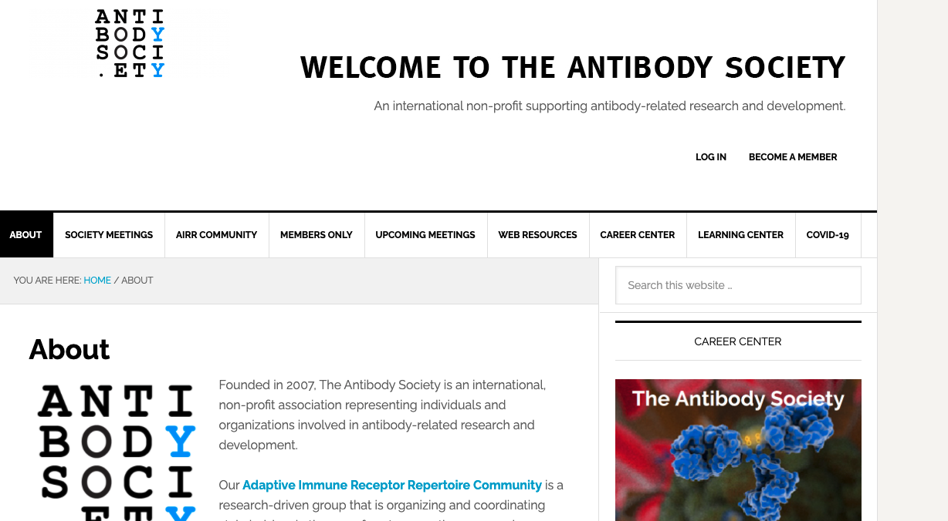

Slide 47
How to do Interviews to test your hypotheses

Slide 48
Best Way to
Validate your Hypotheses
“Get out of the Building!”
Steve Blank
Face to face interviews – Best
Zoom/Skype
Shadowing
Telephone/Facetime
Online surveys
X

Slide 49
The technique
15 Minutes
5-7 questions

Slide 50
Rule: You are not allowed
to talk about your idea!

Slide 51
Get Started
“I am doing some research on XXX. Do you have 15 minutes to answer a few questions” or “I have 5-7 questions…”
  - ‘Student Card’ works well
  - May need to say “this is not a sales call”
Start with a few Friends/Friendlies to practice
Then go after people you don’t know
  For B-B, C-level is not always the best
Consider asking
  Who else should I talk to?
  What else should I have asked?

Slide 52
Best Resources
“Talking to Humans”
“Testing with Humans”
by
Giff Constable
Premium Version of LinkedIn

Slide 53
Hints for Questions
The questions are not a checklist. They are a prompt to possibly explore another aspect.
Be open to iterate and follow up and explore more deeply on what the interviewee is saying.

Slide 54
Where the magic happens #1
Always ask
“How are you solving it now (or tried to solve the problem in the past)”
“On a scale of 1-10, how would you rate that solution?” “Why did you give it that number”.
Write down
- Everything they say,
  In the order they are saying it
  In their words.

Slide 55
Here’s Why
They are giving you the feature list – what they view as really important.
They are giving you the feature priority
They are giving you marketing language
They are giving you deeper knowledge of the competition

Slide 56
Where the magic happens #2
Listen for the unexpected.
If they said something you weren’t expecting but seems relevant, ask “tell me more”.
If there seems to be substance
  Include it in future interviews
  Go back and ask past interviewees

Slide 57
Here’s Why
This is where pivots happen!
(before you’ve wasted time and money)

Slide 58
B to B Case Study

Slide 59
RistCall

Slide 60
RistCall Business Thesis
Who is the customer: Hospital Administrators will…..
What is my solution: ….lease the Ristcall Smart Watches (that let patients call for aid from anywhere and nurses receive immediate notification) and response time tracking platform ……
Why will they buy it: ……in order to reduce the number of injuries patients incur when not responded to quickly (within a certain time frame?)

Slide 61
RistCall Hypotheses
Slow response leads to serious and expensive injuries
Nurses are not responding faster because of lack of awareness that the patient needs help
Hospital Administrators want (would pay for) a new product or service to reduce injuries
Hospital Administrators want (would pay for) data on # of requests and response time

Slide 62
How RistCall Tested the Hypotheses
Identified potential target segment(s)
Hospitals
Nursing Homes
Identified potential stakeholders in target segments (these are people with titles/jobs)
Users: Nurses and Patients
Influencers: Patient’s families,
Recommenders: Nurses, Patients, Nurse Administrator
Decision Maker/Economic buyer ?; Insurance Companies?
Saboteur (Potential): IT Manager
Used Industry Survey Data to learn the size of the problem
.

Slide 63
How RistCall Tested the Hypotheses
-On site “shadowing/ observing”
-Interviewing in-person using hypothesis-validating questions.
-Asking who else to interview
Different set of hypothesis and questions for different stakeholders
Patients
Nurses
Nurse Schedulers
Patients’ family/caregivers
Insurance companies
Doctors
Buyers/Decision Makers
Hospital CFO/ Accountants
IT Manager
.

Slide 64
Sample Hypotheses Testing Questions
Hypothesis: Slow response leads to serious and expensive injuries
Stakeholder: Nurse Administrator (Staffing scheduler)
How do you learn that a patient needs help? (current solution)
What do you like most? What do you like least? (competitive assessment)
How often in the past week was the Response Platform unmanned because the nurse was helping a patient? (Follow up from the answer to the first question; measurable)
Can you give me an example of a recent issue because no one quickly responded? (Qualitative)
Who else should I talk to? (may be other stakeholders you need to talk to that you don’t know about)

Slide 65
Sample Hypotheses Testing Questions
Hypothesis: Nurses are not responding faster because of lack of awareness that the patient needs help
Stakeholder: Nurses
How do you learn when a patient needs attention? (current solution)
On a scale of 1- 10, how is that system working for you?
Why did you give it that number? ( what they like most/least about the current solution, also gives you the features they value or are missing)
What happens when a patient injures him/herself? (Maybe ask about a recent example)

Slide 66
Sample Hypotheses Testing Questions
Hospital Insurance/Cost Manager: Slow response leads to serious and expensive injuries
Stakeholder: CFO/Account Management
What happens when patients injure themselves while in hospital?
Who pays for these injuries?
In the past month, can you give me an idea of how many times this occurs? Why?
What have you tried to reduce the injuries or improve response time?
What were the results?

Slide 67
RistCall Shadowing, Interview and Research Learnings from Customer Discovery
It’s a $1.2B annual problem for hospitals (secondary research)
Injuries occur when patients are not responded to within 2.5 minutes.
Insurance companies don’t reimburse hospitals for on-site injuries.
Medicare is beginning to reimburse hospitals in general based upon Patient Satisfaction ratings.
Hospitals were actively seeking ways to improve their ratings.
Patient Satisfaction Manager was a huge influencer/recommender.
Nursing homes have the need but not the financial incentive.
IT personnel don’t care – RistCall only accessed existing Internet.
The buyer/decision maker was the CFO.
Hospitals were willing to pay $5k to test RistCall!

Slide 68
RistCall’s Revised Business Thesis
Who: CFO/Hospital Administrators will…..
Solution: ….lease RistCall’s smart watches and platform…..
Why will they buy it: ……in order to reduce the number and cost of injuries that patients incur when not responded to quickly 2.5 minutes and increase patient satisfaction ratings.

Slide 69
How Many?

Slide 70
Recommended
100+
Stakeholders

Slide 71
Making it Work
Keep notes – you’ll forget.
Stop and assess periodically
Modify Business thesis based upon feedback
Adjust questions and who to interview as needed

Slide 72
Benefits
Avoids unnecessary ‘pivots’ (lost time and money)
Potential customers are ‘giving’ you the compelling sales pitch
Helps prioritize what is most important
Learn more about the competition

Slide 73
More Benefits
Get first-hand knowledge of your target audience
Can measure degree of enthusiasm and interest through observation
Starts to build the relationship
Helps identify potential reference customers/pilot participants
Investors (and judges) will want to know…..

Slide 74
Words to Live By
Fall in love with the problem….
….not your solution!

Slide 75
Customer Segments
Phase 1 Customer Discovery
Is this a big problem that a lot of people have where the current solution isn’t working e.g. am I solving the right problem?
Phase 2 Customer Validation
I now know I am solving the right problem. Am I solving it the right way?
Phase 3 Customer Acquisition
What do I know about the strategies and methods for getting customers to buy my product or service at a price where I can be profitable.

Slide 76
Customer Validation
Go back to those you interviewed who were the most interested or helpful
Ask for their feedback on your proposed solution
At least one will ask if they can try it!

Slide 77
Appendix
Competitive Analysis (80)
Ask Yourself …(after Customer Discovery and Competitive Analysis) (87)
FlagTag: Business to Consumer (B to C) Case Study (96)
Hyliion: Business to Business B to B) Case Study (111)
Beatbots: Pivot from B to B to B to C Case Study (119)
What Investors are looking for (125)

Slide 78
Competitive Analysis

Slide 79
Competitive Analysis
Any way the customer
is solving the problem now is competition

Slide 80
DIRECT vs INDIRECT
DIRECT – similar products and services
INDIRECT – solving same problem for same target market with a different product or service

Slide 81
Who are Uber’s competitors?
Direct?
Indirect?

Slide 82
Template
 | Feature 1 | Feature 2 | Feature 3 | Feature 4 | Feature 4
You
Competitor 1
Competitor 2
Competitor 3
Competitor 4

Slide 83
Examples of Features
Price
Benefits
Quality
Durability
Image/style
Service
Warranties
Location
Convenience
Sales/Distribution
Ease of Use
# of features
Type of features
Wow factor
Size/Weight
Availability
Security
Safety
Endorsements
Certifications

Slide 84
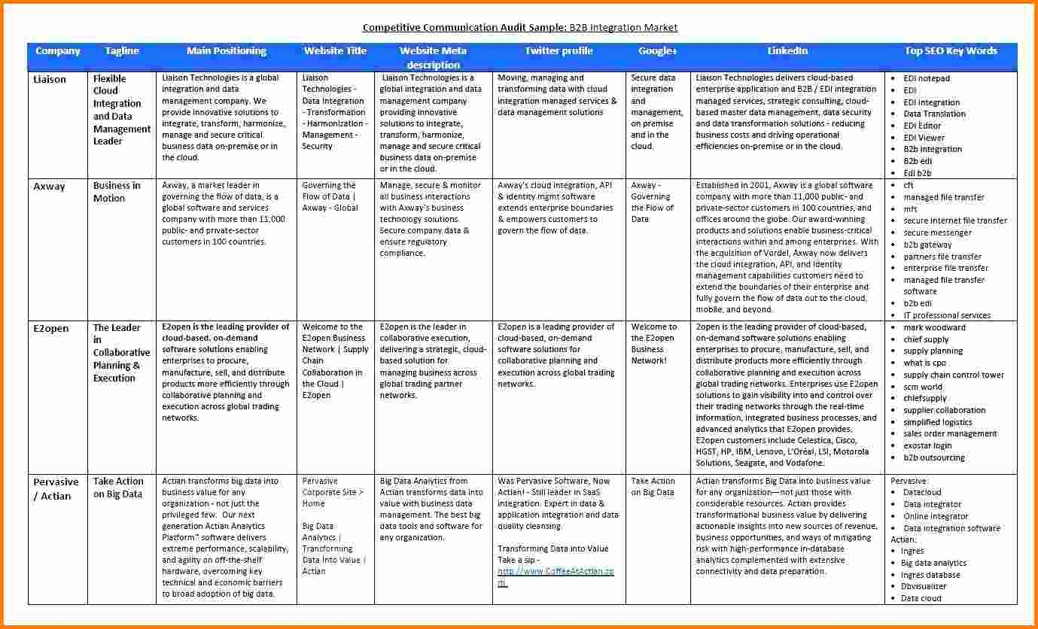
Example of Detailed Analysis

Slide 86
Ask yourself……

Slide 87
…Is it a REALLY Big
Problem?

Slide 88
…Is it a Really Big Problem?
How many people or companies have this problem? (Is it a big target market?)
How much time or money is spent (or lost) each year because of this problem? (The more it costs them, the more they are motivated to pay for your solution)
How well is their current solution working for them? (They will happily switch to your solution because their current one isn’t working very well.)

Slide 89
Ask Yourself…..
Is your solution 10X better than the alternatives or 3X cheaper?
Is it a “Need-to-Have” vs “Nice-to-Have?”
Will it be a big opportunity that will attract investors?

Slide 90
Ask Yourself…..
“…… will it scale?”

Slide 91
Ask Yourself….
Do your product/service margins increase with volume?
- COGs
- Installation/Customization
- Service/maintenance
- Staff ratio to sales

Slide 92
Examples of Businesses/Products that Scale Well
Software (MS Word, Excel, Quickbooks)
Apps (Pandora, Twitter, BudgetSimple)
Mass Market items (My Keepon, FitBit)
Hardware that is standardized or uses standard parts (Air conditioners, remote controls)

Slide 93
Ask Yourself….
….. How will I sell this?

Slide 94
How will this be done?
Who will do this?
Start thinking about this on DAY 1

Slide 95
Business to Consumer
(B to C)
Case Study

Slide 96


Slide 97
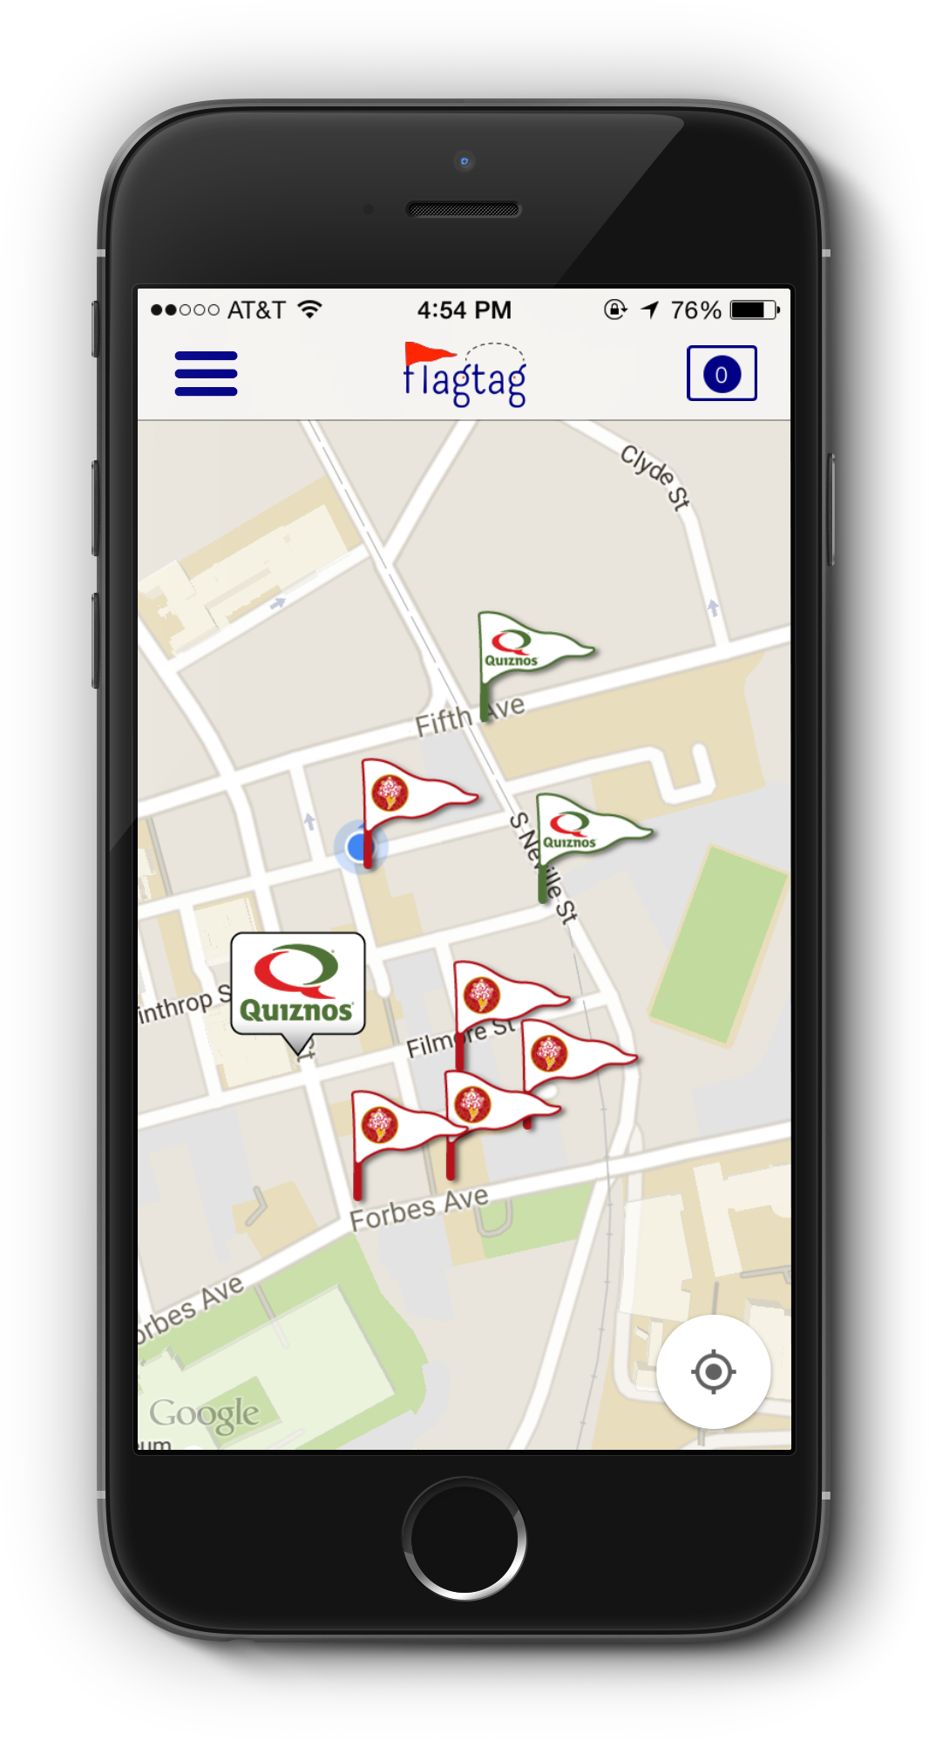
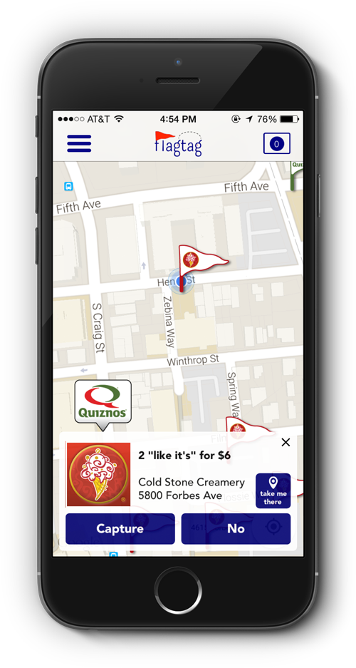
Users earn real-life prizes in a gamified, augmented reality, Easter egg hunt

Slide 98


How we add value
Consumers
(targeting students)
  Leverage an efficient marketing scheme
  Bring new faces through the door
  Receive analytics with respect to user habits and coupon efficiency
Businesses
  Find discounts
  Discover new businesses
  Have fun while saving via gamified incentives

Slide 99
Customer Discovery
Survey Results
Key Demographics for Student Stakeholders
CMU: 100 Interviewed – 56 male, 44 Female
Pitt: 50 Interviewed – 25 Male, 25 Female
Chatham: 50 Interviewed – 3 Male, 47 Female
(Later interviewed 100+ more at Carlow, Duquesne and Point Park Universities)

Slide 100
Sample questions
“On a scale of 1-10, how likely are you to deviate from your go-to restaurant for a better deal at a competing restaurant?”
“On a scale of 1-10, how difficult would you say it is for you to organize a bunch of your friends in a group activity or outing?”
“How many apps on your phone have you paid for?”
“When was the last time you played CTF?” (why not more often?)
“Would you play CTF if it were an IM here?”

Slide 101
Key Findings
“On a scale of 1-10, how likely are you to deviate from your go-to restaurant for a better deal at a competing restaurant?”
Takeaway: College students are more likely to seek a deal than commit to a restaurant.
Product Design: Make sure a key component to the game is interaction with businesses.
Marketing Message: “Capture the flag, but also capture great deals”

Slide 102
Key Findings
“On a scale of 1-10, how difficult would you say it is for you to organize a bunch of your friends in a group activity or outing?”
Takeaway: Organizing groups of friends is a pain point for college students
Product Design: The game setup in the app needs to be intuitive so it is a helper, not a pain.
Marketing message: “You make the friends; we’ll make sure they are organized.”

Slide 103
Key Findings
“How many apps on your phone have you paid for? What are they? (if answered yes).”
Results:
No females at CMU, Pitt or Chatham paid for any apps.
22% of males at CMU and Pitt had any paid apps on their phones – all were for games
Takeaway: Fees from app is not part of the revenue model. (nor were they planning on it –just wanted to check.)
Notes:
The team didn’t think they could get anyone to pay for the app but thought they would get validation that it was so.

Slide 104
Key Findings
“When was the last time you played CTF?” (why not more often?)
Takeaway: Students had not played recently and the reason was because of lack of time.
Product Design: Spread game over longer time period where you don’t have to commit a block of time.
Marketing Message: “Play on your own schedule.”
Notes:
This was the beginning of the weakness in their Customer Discovery that led to the flaw in the app design.

Slide 105
Key Findings
“Would you play CTF if it were an IM here?”
Responses: CMU: 80% - yes, 10% - maybe
Pitt: 48% - yes; 24% - maybe
Chatham: 2% - yes, 98% - no
Conclusions:
Key was Time, Friends, …. And Incentives
Chatham was not an active group
Notes:
This was the second weakness in their Customer Discovery process that convinced them they were on the right track with their proposed design.

Slide 106
Customer Discovery
What they did right:
Interviewed a large number of students from a variety of campuses
Results helped to significantly restructure initial game design
Derived key marketing messages from the interviews that were successful in getting students to download the app

Slide 107
Customer Discovery
Where they missed the mark
Misinterpreted the concern for time to mean ‘design a shorter game time’ rather than less time for games at all.
Asked an ‘aspirational’ question i.e. “Would you play……?” Responders meant well but simply didn’t act as they said they would.

Slide 108
What They Learned
After going through AlphaLab and launching the app:
Students:
  Very willing to download the app and open it
  Mostly interested in capturing the flag for the discounts but not at all in the game aspect.
  A little slow to redeem the coupons (flagtag is paid a bonus for each redemption)
Businesses
  Very well received
  Most effective of all the coupon options they had tried by 3X
Notes:
Past behavior is a much better predictor of future behavior. Flagtag should have paid more attention to how infrequently anyone was playing CTF once on campus and the reason. An IM version, even if shorter, still had similar time constraints.

Slide 109
End Result
Fall 2016
  Verified the business model
  Revised the app
    Simply capture coupons – no game aspect
    Provided an incentive to redeem the coupons more quickly
    Relaunched Spring 2017
    Folded Summer 2017

Slide 110
Business to Business
(B to B)
Case Study

Slide 111

Proposed Product
Add-on hybrid system for tractor trailers
  Uses regenerative braking to capture power when the vehicle is slowing down that can be reused to accelerate.
Value proposition to the customer: Reduces fuel consumption by over 30% with an ROI of less than 1 year.

Slide 112
Sample Questions
How much on average do you spend on fuel? % of annual budget?
Have you done analysis on fuel usage that you can share?
What are you currently doing now to reduce your fuel costs?
On a scale of 1-10, how well are those techniques working?
Why did you give each that number?

Slide 113
Interviewed
Fleet managers
Fleet truck drivers
Independent truck drivers
Trailer manufacturers
Mechanics that service the fleet
Companies with proprietary fleets
Industry association staff

Slide 114
Where did they find them
Industry conventions
Truck stops
Fleet owners’ headquarters
Trailer sales offices
Telephone

Slide 115
Findings
6 million trailers in the USA
Each trailer averages 6.5 mpg = $85,000 fuel costs per year per trailer
52 Billion gallons of fuel consumed yearly
31% = $46 B in potential fuel savings
$25k per unit x 6M trailers = $150B potential market

Slide 116
Findings
Largest value/ROI for long-haul fleets
15% of fuel is used to run the cab at night for heat/AC and electronics
  Shaking cab results in poor sleep – which can lead to accidents
  (This was the ‘outlier’) that helped sell management
Less wear and tear on the diesel engine
Reduced emissions

Slide 117
Conclusion
  Big Problem
  Big Market
  Great Product
  Great Business

Slide 118
Pivot from B to B to
B to C
Case Study

Slide 119
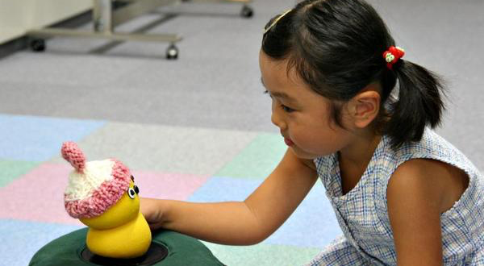
BeatBots

Slide 120
BeatBots
Initial Hypothesis
Therapy tool for therapists who work with severely autistic children
Price: $25k (includes hardware and software)
Target audience: Clinics that specialize in therapy for severely autistic children

Slide 121
BeatBots
Product worked extremely well as a therapy tool to engage highly autistic children
However…..
Size of Target Market: 100 clinics worldwide
Great Product
Lousy Business

Slide 122
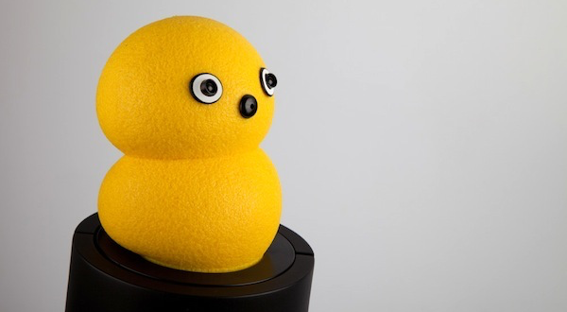

BeatBots
Pivoted to a retail product for mass market for $50 and
licensed it a toy company that would manufacture, package
and get BeatBots on the shelves of major retailers.

Slide 123
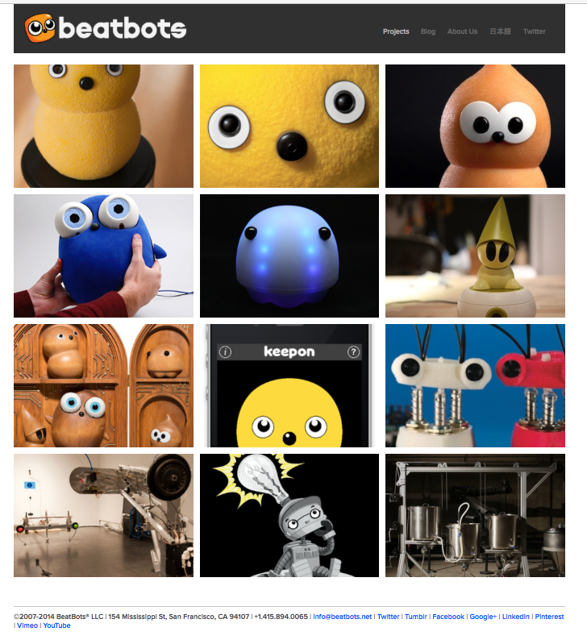

Slide 124
What investors are looking for

Slide 125


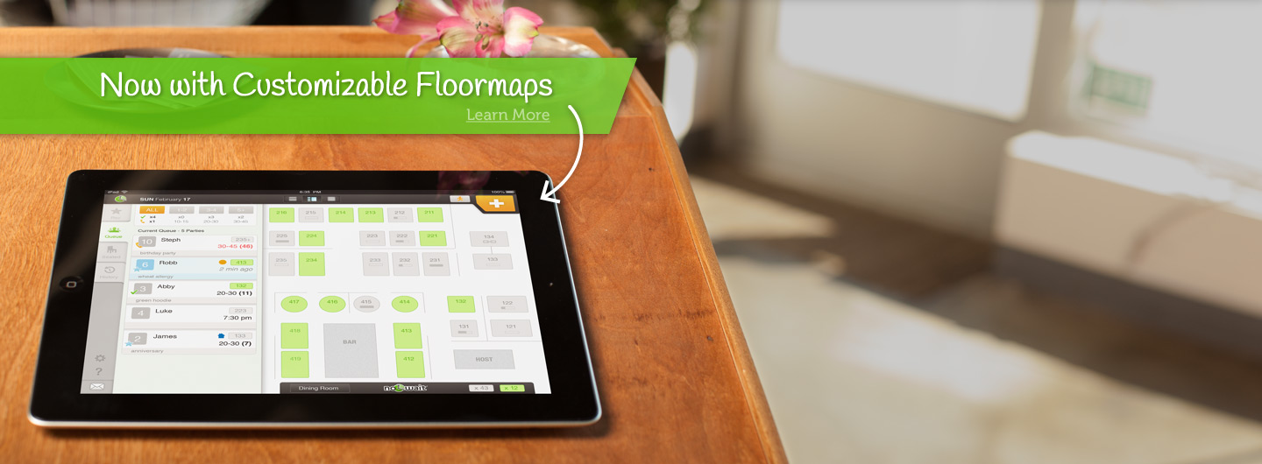


Slide 126
Why was a good investment
“ We want to invest in large markets, …if you have a fantastic team with fantastic products but …… it’s in a small market, there’s a smaller type of outcome that can happen e.g they’re swimming in a smaller pond. If you have a big and expanding market, it’s great to have a great team and product, but if you don’t, you still have a chance. “
“…..We focus on investing in trends shaping the landscape over the next 10 years. Casual dining is a multi-hundred-billion business in the U.S. alone. Everybody’s got to eat.”
“……What they’re doing solves an acute point, waiting to get in line, waiting to get a check. They have a very elegant solution.”
Nick Solaro of Drive Capital, a Columbus, Ohio-based $250M VC fund on their $10M investment in NoWait in May 2014 (Source: Pgh Business Times)

Slide 127
Sold to Yelp for $40M

Slide 128
Q&A
kit@cs.cmu.edu

