Slide 1


Building a Successful Team

Slide 2
Fly solo or as a co-founder?

Slide 3
Do Form a Team
CEO
Tech Design
Market Research
Operations

Slide 4
Do Form a Team
Too much for one person to do
Investors prefer teams
Need various expertise
Helps keep momentum
CEO (You)
Tech Design (You)
Market Research (You)
Operations (You)

Slide 5
Do Form a Team
60% of successful startups have 2-3 founders
Raise more money
  30% more investment in early years
Faster customer growth
  3x faster growth vs single founder ventures
Better odds of success
  More knowledge
Better experience
  Share effort, stress, …
Challenges of shared decision making
  Choose wisely!

Slide 6
Who is part of your team?
Co-founders
Contractors vs Employees vs Interns
Advisors
Board of Directors
Service Providers/Partners

Slide 7
Founder responsibilities broad and deep
Product roadmap and development
Business development
Sales and marketing
HR, company culture
Raising and managing cash
Lead extraordinary amount of change

Slide 8
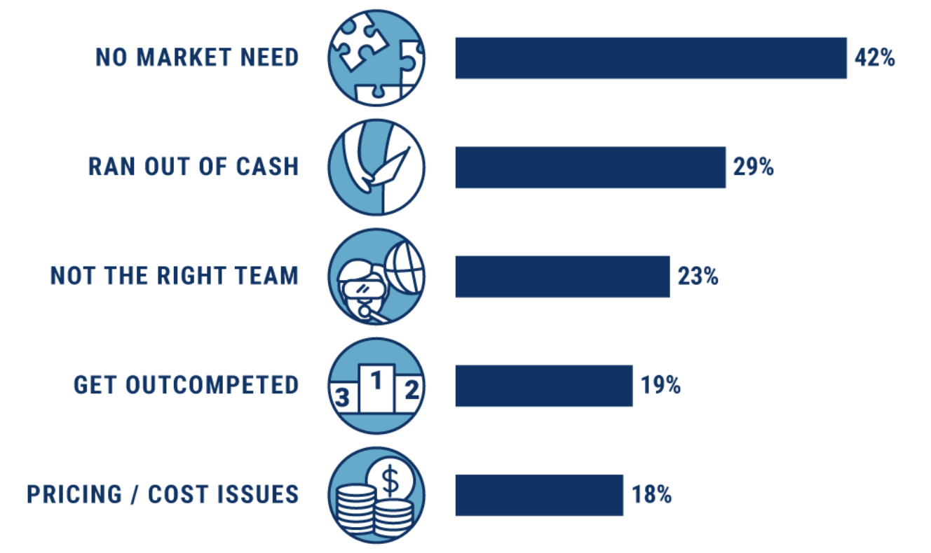
Top 5 Reasons Startups Fail
https://www.cbinsights.com/research/startup-failure-reasons-top/

Slide 9
Key Criteria You should Consider
Skills
  Tech, business, people, etc.
Networks
  Distinct networks allow you to draw on wide range of expertise, introductions
Personal
  Values/ethics
  Personal goals
Company
  What should the company be?
  Product vision
  Criteria for success

Slide 10
Good founders disagree agreeably
It is OK to have some big/complex disagreements
  In fact, it is guaranteed that this will happen
Can you and your partner have productive disagreements?
  Did these turn nasty/personal?
  Did you gain respect (or, at least, appreciation) of each other?
  Do you still hang out afterward?

Slide 11
Friends, partners, or both?
Do friends make good partners?
Can you be friends with your partners?
  Should you be?

Slide 12
Suggestions
A sound Founder’s Agreement early on addresses these problems.
Specifies ownership, how to separate, vesting
  Similar to a prenuptial agreement. Absolutely necessary.
When would you put an agreement in place?
  What are the problems with timing of doing this (early or late)?
Details beyond the scope of this talk
  Lot’s of good resources, use experts (attorneys) when executing
Example from U Penn law school here
Absent that: Discussions in writing
Notes:
Example: 4 founders, all owned 25%. Two were very active, did most of the work after the first 3 months. Only got them down to 1% equity when they didn’t want to pay their share of the legal fees for restructuring and investment agreements.

Slide 13
Founders vs. Early Employees
Founders “own” the business
  Employees earn options (right to purchase, years from now)
Founders make all the big decisions
  Early employees observe/suggest, but don’t decide
Early employees get larger options than later employees
  More risk means more reward potential

Slide 14
Employee ….. Or Not?
Why does it matter
Many laws apply to employees but not other types of workers
  W2 with payroll tax withholding and reporting
  Workman’s Compensation insurance
  ERISA/Benefits
  Employment Discrimination
  Labor Laws
Treatment of worker may change

Slide 15
Start with Contractors
Not an employee
Hired to do specific job(s)
Invoices you for work performed or according to deliverables/set schedule
Still need NDA, non-compete, assignment of IP
Issue 1099 at end of year
Benefits
Avoids payroll and social security expense
Hiring/firing is much easier

Slide 16
Boards vs Service Providers vs Advisors

Slide 17
Advisors vs Advisory Team
Advisors
  Volunteers who give you advice on an as-needed basis
  No fiduciary responsibility
  Diverse background – legal, PR, domain, financial
  Not paid – think of them as mentors/coaches/experts
Advisory Team
  Volunteers who give advice on a regular basis
  Can give investors confidence
  May get equity but generally under 1% and vests over time
  No fiduciary responsibility

Slide 18
Keeping Advisors Informed and Engaged
One-on-one meetings (time-consuming but best for sensitive or complicated issues)
Periodic Advisor meetings
  Requires more organization
  Helps to avoid ‘mentor whiplash’
Email Updates
  Every two-four weeks
  Include other founders and employees
  3-4 bullet points
  Can include an ”ask”
”Managing” your advisors

Slide 19
Board of Directors
Boards
  Fiduciary responsibility (e.g. legal)
  Obligated to do what is best for the company and shareholders
  Keep it small
Board responsibilities
  Hire and fire the CEO
  Approve strategic direction
  Assess benefits and risks of the company’s activities
  Help with raising funds

Slide 20
Service providers
Accountants, attorneys, etc. are NOT employees
  And generally should not be board members
Attorneys formally incorporate the company
  Also provide boiler-plate docs, patent/IP work
  Remember: they work for the company, not you
    You will eventually need a personal attorney
Payroll is almost always outsourced

Slide 21
Where to Find Team Members
Customer Discovery Interviews
CONNECTS - (check the Bulletin)
Other CMU events – (check the Bulletin)
Events on campus – (check the Bulletin)
Want ads - (check the Bulletin)
Events off campus - Hack-a-Thons, TiE, IW/AL/ALG coffee hours and events, Startup Job Fair (paying positions), etc.
CMU classes

Slide 22
Where to Find Team Members
Handshake (CMU and Pitt)
Classmates and Friends
Entrepreneur clubs
Startup Job Fair (Spring – paying positions only)
Other universities
Faculty, TAs
Network, network, network

Slide 23

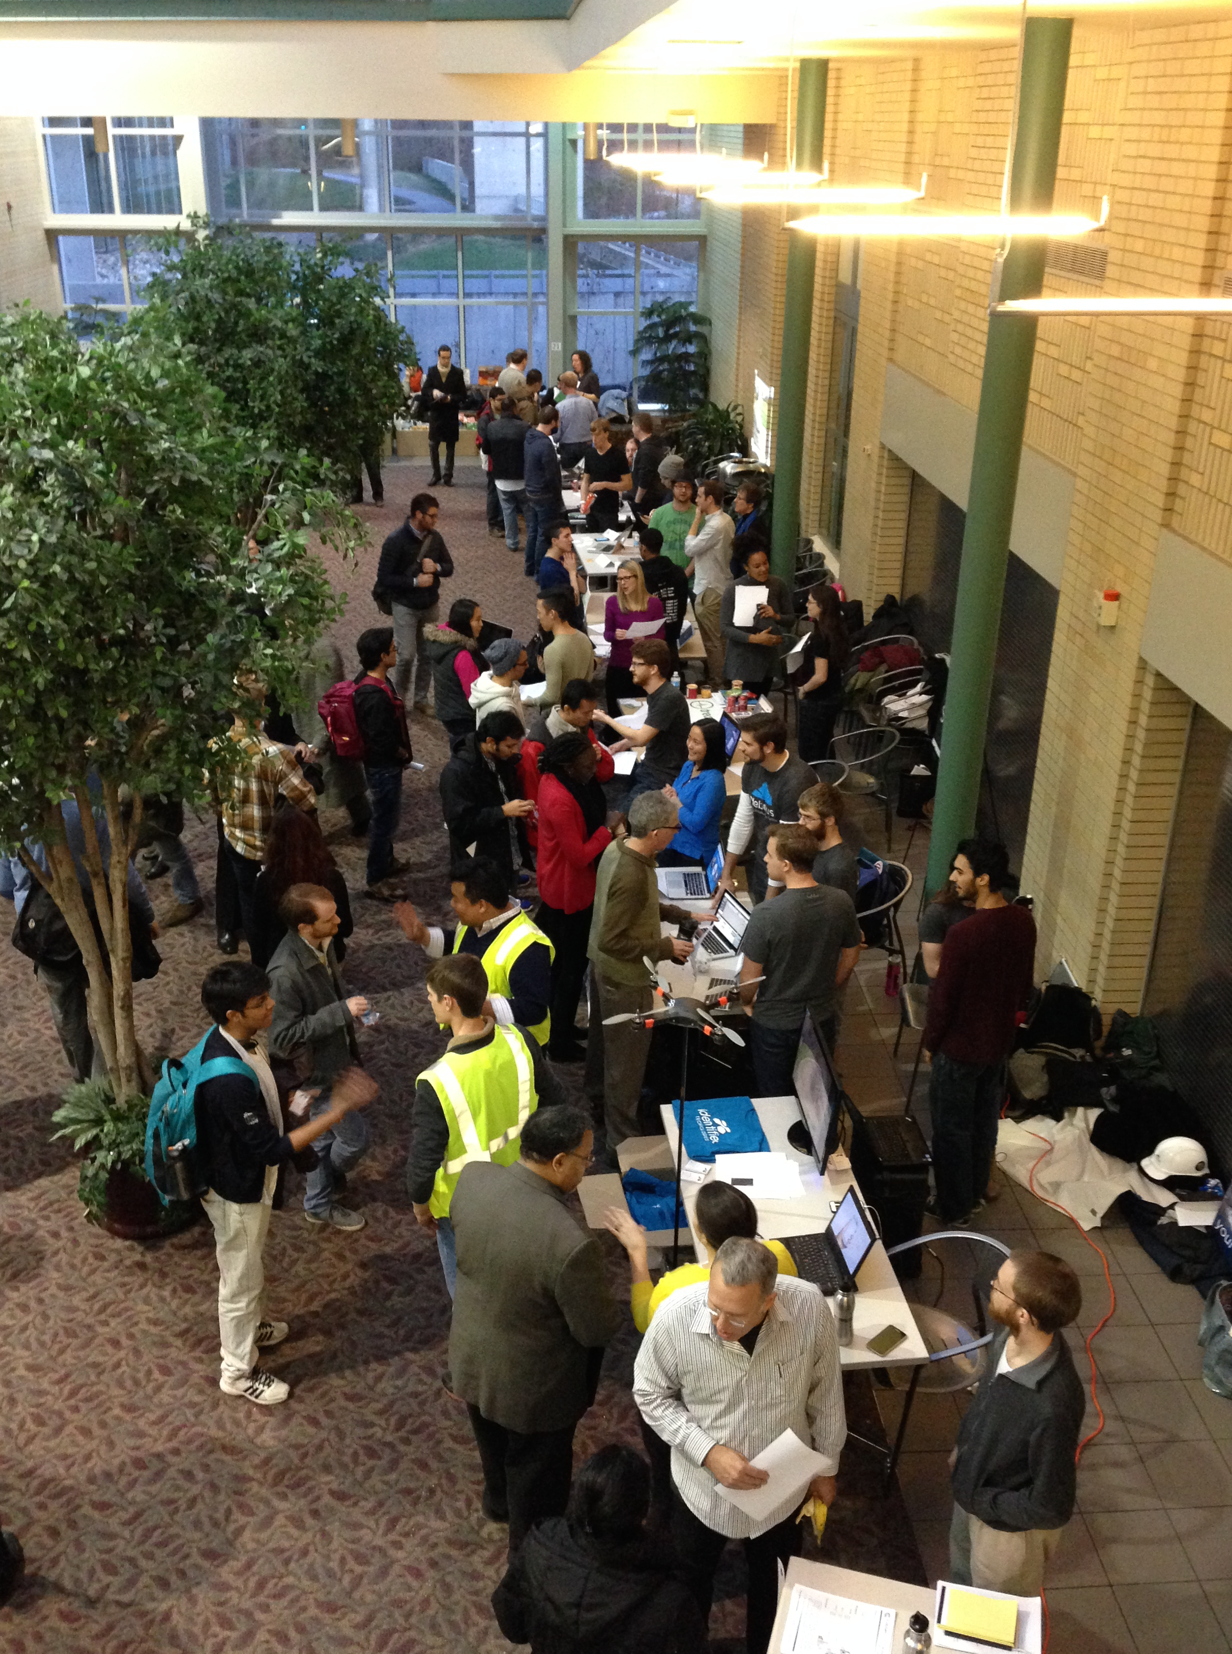

Slide 24
Common Questions
“I am talking with other students about joining my team to work on my business idea.”
“Should I get them to sign a Non-Disclosure Agreement (NDA)?
A Non-Compete?”

Slide 25
Suggestions
No. NDAs and non-competes are not necessary at this stage.
Need to learn how to describe your idea without giving away ‘the secret sauce’
Ability to execute on the idea is far more important than the idea itself.

Slide 26
Common Questions
“I found someone who is interested in my idea and willing to help.”
“How do I know if she is a good fit?
What do I look for?"

Slide 27
Suggestions
“Date before you marry”
Pick a project that needs to be done
Agree on the time frame and deliverables
“How did that work out?”

Slide 28
Common Questions
“I met someone who may be a good fit and wants to know if becoming a co-founder is possible. ”
“What should I do/say before I decide to invite this person to join my venture?”

Slide 29
Suggestions
“Date before you marry” still applies
“Co-founder status may be available for the right fit. Lets work together for awhile”
Pick a project that needs to be done
Agree on the time frame and deliverables
“How did that work out?”

Slide 30
Handling Equity
Equity does not have to be equally divided.
  Investors like having a decision maker
  OK to retain controlling interest if you are the initiator and prime driver.
Important to have equity ‘earned’ over time or by milestones (called ‘vesting’)
“Founders Pie” CONNECTS (Workshop Archives) and Olympus’ website (Entrepreneurial Resources)
Careful about giving equity to ‘one-timers’ or short termers

Slide 31
Common Questions
“I want to bring other students onto the team but not all are bringing equal contributions (and I have no funding).”
“What are my choices to offer them?"

Slide 32
Suggestions
Choices:
  Equity
  Cash: Immediate or deferred
  Experience
  Academic Credit
  References

Slide 33
Common Questions
“We want to bring others on to the team, but not as founders.”
“I want some volunteers to be interns over the summer and have some candidates.”
“Do we need them to sign anything?”

Slide 34
Suggestions
Yes. They need to sign an agreement:
IP Assignment: What they produce is owned by you or the company and can be transferred
Non-disclosure (can’t tell other companies or competitors what you are doing)
Non-compete (they can’t use what they’ve learned to set up or work for a competing business).
(Olympus has some templates you can use).

Slide 35
Suggestions
F-1 visa students: May be best to apply for CPT if available for your curriculum and/or apply for OPT after graduation. See OIE!!!!
Note: F-1 students generally cannot be paid.
Come to the Spring ‘Start Smarts’ (Dates TBD):
“Starting a Business on an F-1 Student Visa”
“Hiring and Firing”

Slide 36
Growing Beyond Founders

Slide 37
Unpaid Interns/Trainees
Six criteria must be met per DOL (WHD):
1. Activities similar to training in an educational setting (but may include operation of employer facilities)
2. Experience is for the benefit of the intern
3. Intern/Trainee does not displace regular employees, but works under close supervision of existing staff
4. Employer derives no immediate advantage from work of intern/trainee (and occasionally operations actually may be impeded)
5. Intern/Trainee not necessarily entitled to job at conclusion of internship/training
6. Understanding that position is unpaid.

Slide 38
Hiring mistakes are very expensive
Takes a large amount of time to get it right
  Mistakes take a toll on staff, $, timeline. Be picky!
  Get rid of bad employees quickly, learn from your mistakes
Use your network
  Referrals are often the best candidates
Understand candidate’s motivation
  Get rich vs change the world

Slide 39
Hiring Levels and Speed
Hiring speed is important
  Too fast: you lay people off, get a bad reputation, run out of cash
  Too slow: you burn people out, risk company’s growth
Company’s needs will change over time
  Ideally, hire people who can change/grow with the company

Slide 40
Onboarding of Employees
Founders: Agreement in place (Founders Agreement, Bylaws or Operating Agreement)
All: NDA and invention assignment agreements in place
Visas:
  Think carefully about time/cost/legal entanglements
  Consult attorney and/or CMU’s Office of Intl Education (OIE)
  Founders generally not eligible for H-1Bs
  Attend Spring Starting a Business with an F-1 visa
  Office Hours with Immigration Attorneys

Slide 41
Questions?
Kit Needham
kit@cs.cmu.edu

Slide 42
Appendix

Slide 43
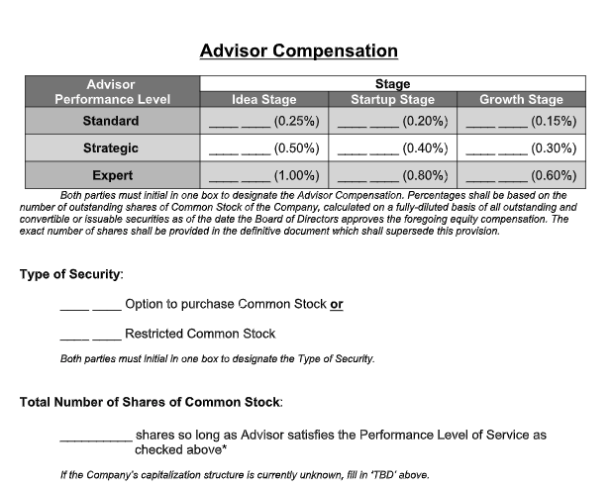
From the Founders Institute

Slide 44
Thank you for attending!

