Slide 1


Customer Discovery Kickstart
How to find out if my idea is a good one
Kit Needham
Director, Project Olympus
Asst Dean for Entrepreneurial Initiatives

Slide 2
Best recommended way
Ask
your
Customer!

Slide 3
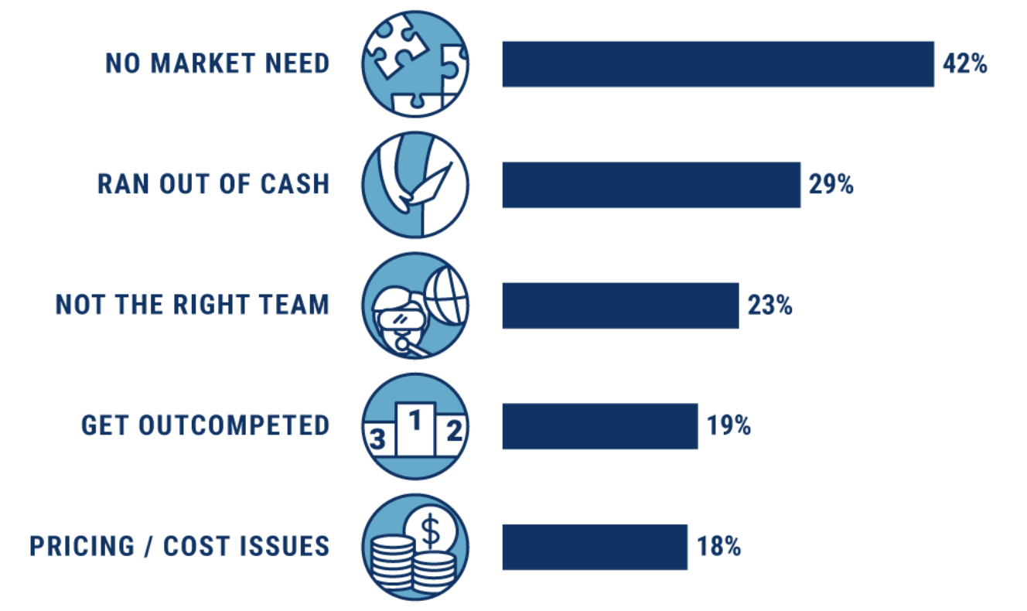
Top 5 Reasons Startups Fail
https://www.cbinsights.com/research/startup-failure-reasons-top/

Slide 4
What is
Customer Discovery

Slide 5
Customer Relationship Phases
Phase 1 Customer Discovery
Is this a big problem that a lot of people have where the current solution isn’t working e.g. am I solving the right problem?
Phase 2 Customer Validation
I now know I am solving the right problem. Am I solving it the right way?
Phase 3 Customer Acquisition
Strategy and methods for getting customers to buy your product or service at a price where you can be profitable.

Slide 6
What is Customer Discovery
Phase I
What is the pain/problem
Who is having the pain/problem
How bad is the pain
How are the “who” currently dealing with it
How is that solution working for them

Slide 7
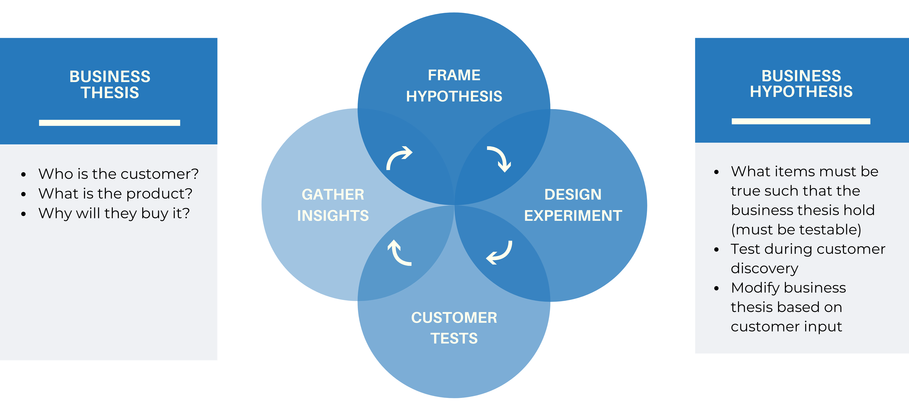
Methodology is Hypothesis Driven
Notes:
Example of the Business Thesis: Hospital Administrators will lease our smart watches to reduce the costs of patients injuring themselves due to delayed responses to calls for help.

Slide 8
Start with your Business Thesis
Notes:
Example of the Business Thesis: Hospital Administrators will lease our smart watches to reduce the costs of patients injuring themselves due to delayed responses to calls for help.

Slide 9
What is a Business Thesis
Who is the customer?
What is your product/solution?
Why will they buy it?

Slide 10
Who is/are Your Customer(s)?
Ecosystem of people you need to understand, satisfy and appeal to in order to buy your product
Also called Stakeholders

Slide 11
Creating Your Business Thesis
Who is the customer?
  This is a person with a specific demographic or persona (age, profession, location, etc)
  “This specific customer will buy? lease? license?........
What is your solution?
  What specifically are your proposing to offer?
  ….my product/service that does this specific thing(s)….”
Why would they buy it?
  What does the customer value? What problem does the customer want to solve? This is often called The Value Proposition
  “…..that will reduce the cost by X? Increase sales by Y? Reduce the error rate by Z? Allow the customer to access in one-step....”

Slide 12
Value Propositions – Alert!
Customers/stakeholders are not buying your technology…
Customers/Stakeholders are buying a solution to their problem!

Slide 13
Value Propositions
Questions to Ask Yourself
What do we do for your customer/stakeholder that they value?
What really matters to your customer/stakeholder?
What problem are you solving for your customer/stakeholder?
What job is your customer/stakeholder trying to get done?

Slide 14
Examples of B to B Theses
(Who) County municipal managers responsible for road maintenance will subscribe to
(What) Roadbotics which maps the status and condition of a region’s infrastructure
Why) to enable objective, data-driven decisions regarding what to repair and replacement at a significant cost savings.
(Who) School administrators (Grades 6-12)will license
(What) Lightside Labs writing platform that provides automated writing feedback and suggestions as students write essays
(Why)to more efficiently provide individual guidance real time to each student.

Slide 15
Examples of B to C Business Theses (DTC)
(Who) Consumers who search for and read news online will subscribe
(What) to Newsage which recommends news based upon a reader’s instructions and provides interactive chats on the content
(Why) to provide interactive, personalized, summarized news.
(Who) Consumers just diagnosed with new allergies will subscribe
(What) to Allervision which provides a tool to easily identify potential allergens in various products
(Why ) to prevent acute suffering, often facing anaphylactic reactions necessitating immediate medical attention with epinephrine and emergency room visits.

Slide 16
Homework #1
Create Your Business Thesis
What is the problem you are proposing to solve? (One sentence – simple and short as possible)
Who is the customer?
  This is a person with a specific demographic or persona (age, profession, location, etc)
  “This specific customer will buy? lease? license? subscribe?........
What is your solution?
  What specifically are your proposing to offer?
  ….my product/service that does this specific thing(s)….”
Why would they buy it?
  What does the customer value? What problem does the customer want to solve? This is often called The Value Proposition
  “…..that will reduce the cost by X? Increase sales by Y? Reduce the error rate by Z? Allow the customer to access in one-step....”

Slide 17
Hypotheses Test the Business Thesis
Notes:
Example of the Business Thesis: Hospital Administrators will lease our smart watches to reduce the costs of patients injuring themselves due to delayed responses to calls for help.

Slide 18
Business Hypotheses
Your Business Thesis has some assumptions
These assumptions must be true for your business to succeed.
How do you know if they are true?
1. Develop Business hypotheses
2. Develop questions to test these hypotheses
3. Identify Customers to interview
(Use Landing Pages to attract potential B to C customers)

Slide 19
What Makes a Good Hypothesis
Clear and concise
Specific
Testable/measurable
Hint: Use simple declarative sentences
Notes:
AirB&B, Tik tok, door Dash, Hello Fresh, Stitch Fix, Duolingo, Modcloth

Slide 20
Sample Hypotheses
What assumptions do we have that if proven wrong
would cause us to fail.
The problem my stakeholder wants to solve is …..
My target stakeholder will be….
My stakeholder can’t solve this today because ……..
The measurable outcome my stakeholder wants is…
I will make money/revenue by ….
I will beat my competitors because……
My biggest financial/technical/engineering risk is…
My stakeholder has money and would be willing to buy….

Slide 21
How to Prepare to Test Your Hypotheses
Identify an industry segment (B to B) or customer segment (B to C)
Identify 1-2 specific stakeholders in that segment
Create a Business Thesis for a stakeholder in that segment (start with highest priority – e.g. buyer/decision maker or user
Develop hypotheses you need to test (what must be true for your business to be successful)

Slide 22
How to Prepare to Test Your Hypotheses
Prioritize 1-3 Hypotheses to test.
Develop 3-5 key priority questions to test each hypotheses.
  Use questions that are measurable
    E.g. “on a scale of 1-10…”; “how many times in the past three months…?” “what are the steps you need to take to….?” “how much do you pay for…..”
  Include questions that are qualitative
    “What do you like most about …..; Least about….” ”Can you give an example of……”

Slide 23
Who is/are Your Customer(s)?
For B to B, many stakeholders could be involved in the buying decision.
For B to C, or DTC, the user is usually also the buyer/decision maker

Slide 24
Sample Questions
What are the top 3 challenges related to _____? How often do they occur?
How much time do you spend on those challenges?
Can you tell me a story about the last time that challenge happened and what you did?
What, if anything, have you done to solve these challenges?
What don’t you like about the solutions you tried? OR On a scale of 1-10, how would you rate your current solution? Why did you give it that number?
Who has to approve purchases? Do you need any approval to try a new product or serve?
Who else should I talk to?

Slide 25
Hints for Questions
Asking job title/position and how long someone has been in the job/position or status helps you to judge the level of experience (and doesn’t count in the ‘5-7 question quota). This is a good way to begin the discussion/warm-up. “Tell me about your background and current role...“
You will need a different set of questions for the different stakeholders.

Slide 26
Hints for Questions
Avoid “Have you ever…..?” Better - ”How often in the (pick a relevant time period) have you….?”
Careful of “Would you ever….?” type questions. Instead, try to frame your question on past behavior which is a much more reliable predicter of how the customer will actually act.
  “When was the last time...?
  “How many apps have you paid for...?
  In the 3 past weeks, which apps...?; how often..? Why?

Slide 27
Homework #2
Testing Your Hypothesis
For your chosen segment, pick one customer/stakeholder.
Create 1-3 hypotheses to test. (What must be true for your business to succeed).
Identify 1-5 questions to test each hypothesis
Use the Customer Interview Guide to do this

Slide 28
Homework #2 – Part 1 for B2B and B2C
Customer Interview Guide
Industry Segment (B2B) or Customer Segment (B2C)
Stakeholder:
Key Hypotheses to test (what assumptions do we have that if proven wrong would cause us to fail)
Hypothesis #1
3-5 questions to ask (to prove/disprove the hypotheses)
Hypothesis #2
3-5 questions to ask (to prove/disprove the hypotheses)
Hypothesis #3
3-5 questions to ask (to prove/disprove the hypotheses)
Hypothesis (n)
3-5 questions to ask (to prove/disprove the hypotheses)

Slide 29
Homework #2 – Part 2 for B2B
Customer Interview Guide
Potential Interviewees
 | Name | Title | Company | email (if possible)
1. | Sarah Mendelson | Brookings Nonresident Senior Fellow – Global Economy and Development, Center for Sustainable Development | Brookings Institute | smendel2@andrew.cmu.edu
2. | Sayeed Choudhury | Associate Dean for Digital Infrastructure, Carnegie Mellon University | Carnegie Mellon University | gchoudhu@andrew.cmu.edu
3. | Grant Ervin | Vice President of External Affairs and Sustainability | S&B USA Construction – Fay – Fay Southeast
4. | Jeanne Holm | Deputy Mayor for Budget and Innovation | City of Los Angeles | jholm@g.ucla.edu
5. | Gaea Morales | Ph.D. in Department of Political Science and International Relations | University of Southern California | gaeapatr@usc.edu

Slide 30
Where to Find Interviewees

Slide 31
Where to Find them B to B
Start with people you know directly
Olympus Domain Experts
Ask local organizations (LS examples)
Jewish Health Foundation
Innovation Works/ AL Health
LifeX Office Hours Experts
UPMC Enterprise Solutions
LinkedIn (look for alums)
National Organizations
Speakers or authors

Slide 32

Industry/Domain Experts
150+ industry experts in over 50 fields
Administrative/Operations
Industry/Specialty
Accounting
Banking
Early Stage Startups & Ideas
Funding-General
Funding-SBIR/STTR
HR/Payroll/Benefits
Insurance
Management
Manufacturing
Marketing
Pitching/Public Speaking
Real Estate
Sales
Start-up Strategy
Taxes
UX/I Research & Strategy
Web Design
Advanced Materials
African Markets
Bio/BioTech
Blockchain/Cryptocurrency
Chemistry
Cloud/AI Systems
Consumer Products/Retail
CTTEC/ Commercialization
Cybersecurity
DoD/Defense
EdTech
Energy
Esports/Gaming
FinTech
Global Commerce
Hardware
Internet of Things (IoT)
Robotics
Smart Cities
Social Enterprise
Software as a Service (SAAS)
Legal/Regulatory
Life Science
FDA Regulations
Immigration Law & F-1 Visas
Law for Startups
Intellectual Property
Medical Devices
Medical Software
Medical Markets & Strategy
Pharmaceutical
Scientific Communication
Funding/Funders
Advice
Funders
SBIR/STTR Programs

Slide 33

There is a trade association for everything….

Slide 34
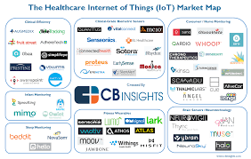
Search “______ Industry Maps”

Slide 35
Search “______ Industry Maps”

Slide 36
Search “______ Industry Maps”

Slide 38
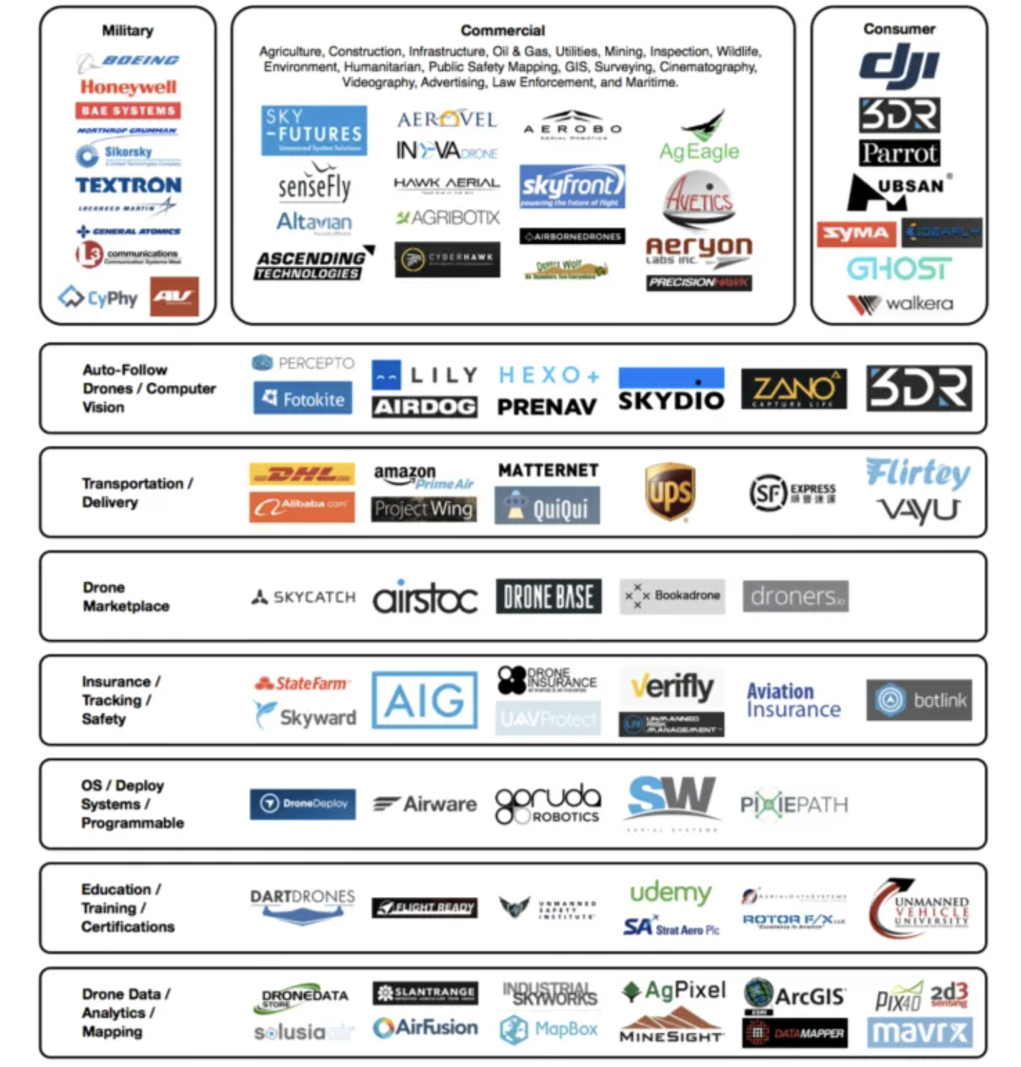
DRONES

Slide 39
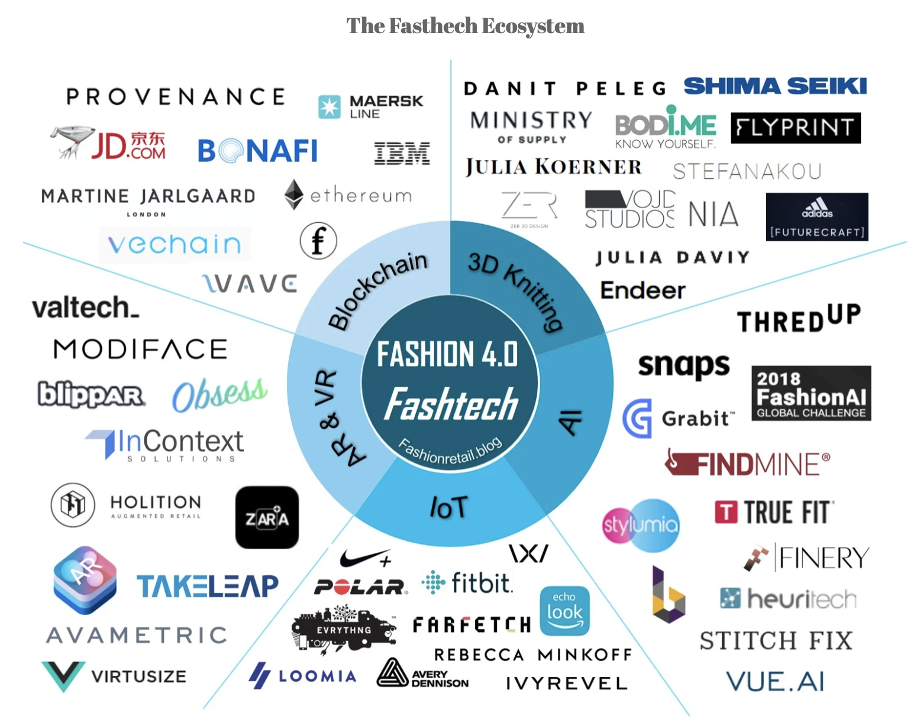
FASHION

Slide 40
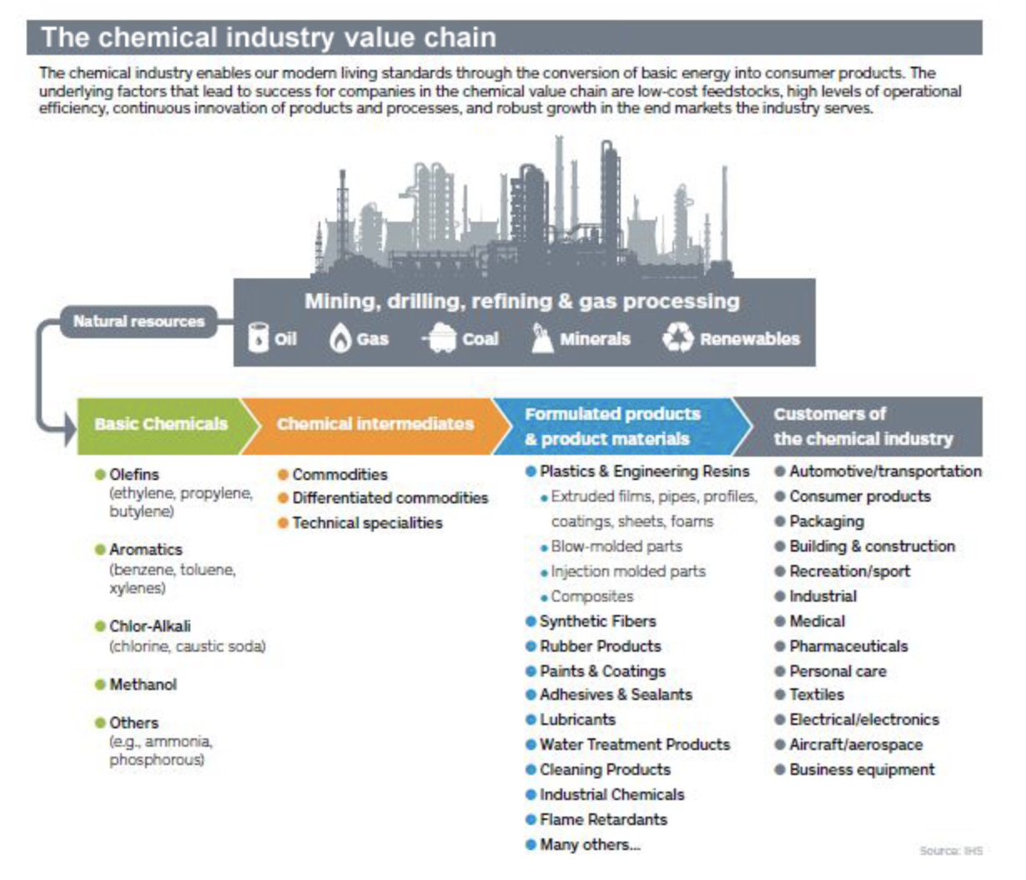
CHEMICALS

Slide 41
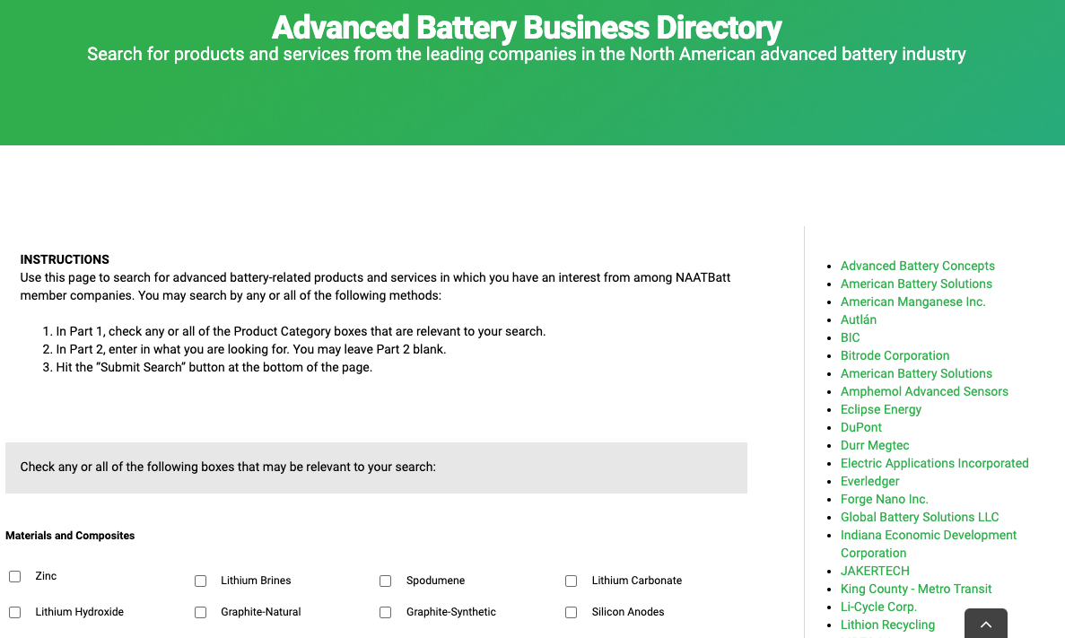
NAATBatt International

Slide 42
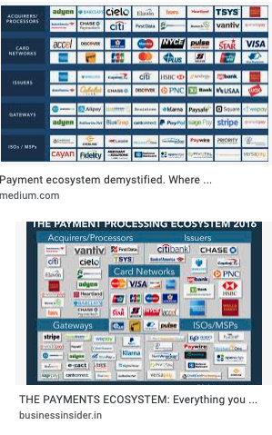
Payment
EcoSystem
Diagram

Slide 43
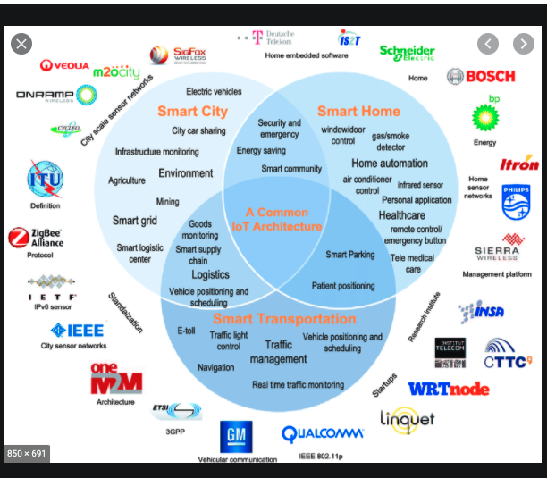
Smart Traffic Ecosystem Diagram

Slide 44
If you are selling B to C using the internet
Another way of finding interviewees for customer discovery is to use
Landing Pages
and
A/B Testing

Slide 45
What is a Landing Page
A simple webpage that:
Is customized for a specific campaign, offer, or purpose
Guides visitors towards a single call to action.
    Sign up for a newsletter
    Purchase a product
    RSVP for a launch
    Provide some information about themselves

Slide 46
Landing Pages can be used to tell you
Is anyone searching for your product/solution?
What are the key words they are using to search with?
What are some characteristics of your customer?

Slide 47
Identify Key search words
Brainstorm all the potential words that a customer may use to conduct a Google search.
Why?
Google algorithms prioritize recommended sites based upon matches to keywords your customers are looking for and what is on your landing page. (SEO).
Search engines crawl and rank content based upon:
  Location of the keywords
  How often the keyword words are used
  Size of the keywords

Slide 48
Create a ‘call to action’ button
Have a ‘call-to-action’ button that the customer can click.
Create a simple questionnaire (3-5 questions) that you ask the customer to complete.
Last question: Add an option to include an email at the end if the customer wants to:
Be notified when the website/product is launched
Be willing to chat more about why they were looking at the website. (No obligation, helps with research and make sure you are providing the best product/service.)

Slide 49
Set up google analytics
Track:
  How many people showed up
  How long they stayed
  Whether they clicked the button
  Whether they completed the questionnaire
  Whether they included their email

Slide 50
Use A/B Testing to improve results
What is A/B testing:
A/B testing (also called split testing) is comparing two versions of a web page to figure out the better performing variation.

Slide 51
What to do
Create a Site B.
Vary the content from Site A
  Use different keywords
  Place keywords in different positions
  Try a different ‘call-to-action’ type of button
  Vary colors or pictures (if relevant)
Can also vary questions (3-5) that you ask the customer to complete. Always have an option to include an email at the end.
Set up Google analytics that track the same metrics as Site A

Slide 52
Compare: Which site is getting…..
The most visits?
The most clicks on the ‘call-to-action’ button?
The most responses to the questionnaire?
The most email signups?

Slide 53
Then ‘rinse, wash, repeat….’
Modify the site that is not performing as well to look more like the site that is performing well – but experiment with changes.
Continuously modify the sites to always attract more people and have more conversions.

Slide 54
Questions should test hypotheses
Questions designed to test Allervision’s hypotheses/assumptions of what must be true for the business to be successful:
Assumptions:
  Buyer is a person with allergies
  Buyer is a parent/caregiver of a child with allergies
  Buyer has recently been diagnosed
  Some allergies have fewer or less helpful resources that should be high priority for competitive differentiation (what are they?)

Slide 55
Sample questions to test hypotheses
Allervision: App to help manage allergies
Are you searching for (choose) yourself, a child, other ______?
Are the allergies (choose) new or been known for awhile?
  Less than a year, 1-3 years, more than 3
What type of allergies are you looking for help to manage?
  (Open-ended)
What resources are you currently using to help manage the allergies? (open-ended)
Please add your email if (check all boxes that apply)
  you want to be notified when (the product) is available – estimate 3Q of 2024
  If you would be willing to have a 15-minute interview (chat).

Slide 56
Goal is to get interviewees
Last question:
Please add your email if (check all boxes that apply)
  you want to be notified when (the product) is available
  If you would be willing to have a 15-minute interview (chat?) to help us design the best resource for you.
  Option: We are researchers from Carnegie Mellon University who are developing a resource to help allergy management. This no-obligation confidential interview will help us to better design this resource.

Slide 57
Resources
Carrd to make simple websites
Glide Glideapps to make simple webapps
Webflow to make really nice websites (but slightly more expensive and harder)
Unbounce.ai Unbounce = for ab testing

Slide 58
Homework #3 B to C:
Create 1-2 landing pages
1. Subscribe to at least two inexpensive urls (e.g. GoDaddy) or use carrd which offers no-cost options for multiple urls.
2. Identify key words that customers could use to search for your product or service.
3. Create a simple one-page landing page for one url that uses some of these key words and a ‘call to action’ button to click.
4. Create 3-5 questions to ask.
5. Set up google analytics.
After you get feedback, create a second Landing Page with some variations. Be sure to use Google analytics on both sites.

Slide 59
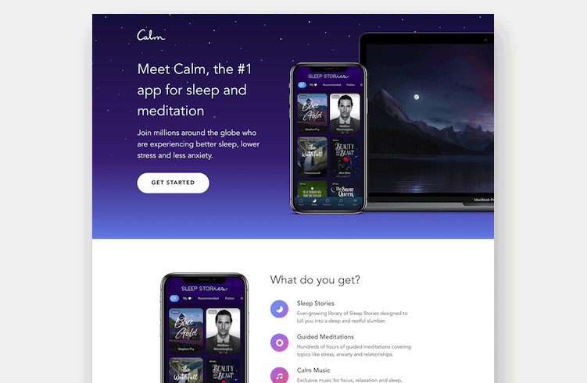

Slide 60
How to do Interviews to test your hypotheses

Slide 61
Best Way to
Validate your Hypotheses
“Get out of the Building!”
Steve Blank
Face to face interviews – Best
Zoom/Skype
Shadowing
Telephone/Facetime
Online surveys
X

Slide 62
The technique
15 Minutes
5-7 questions

Slide 63
Rule: You are not allowed
to talk about your idea!

Slide 64
Get Started
“I am doing some research on XXX. Do you have 15 minutes to answer a few questions” or “I have 5-7 questions…”
  - ‘Student Card’ works well
  - May need to say “this is not a sales call”
Can start with a few Friends/Friendlies to practice
Then go after people you don’t know
  For B-B, C-level is not always the best
Consider asking
  Who else should I talk to?
  What else should I have asked?

Slide 65
Best Resources
“Talking to Humans”
“Testing with Humans”
by
Giff Constable
Premium Version of LinkedIn

Slide 66
Hints for Interviews
The questions are not a checklist. They are a prompt to possibly explore another aspect.
Be open to iterate and follow up and explore more deeply on what the interviewee is saying.
The above are the biggest mistakes in conducting interviews!!!!!!!

Slide 67
Where the magic happens #1
Always ask
“How are you solving it now (or tried to solve the problem in the past)”
“On a scale of 1-10, how would you rate that solution?” “Why did you give it that number”.
Write down
- Everything they say,
  In the order they are saying it
  In their words.

Slide 68
Here’s Why
They are giving you the feature list – what they view as really important.
They are giving you the feature priority
They are giving you marketing language
They are giving you deeper knowledge of the competition

Slide 69
Where the magic happens #2
Listen for the unexpected.
If they said something you weren’t expecting but seems relevant, ask “tell me more”.
If there seems to be substance
  Include it in future interviews
  Go back and ask past interviewees

Slide 70
Here’s Why!
This is where pivots happen!
(before you’ve wasted time and money)

Slide 71
Business to Business
(B to B)
Case Study

Slide 72
RistCall

Slide 73
RistCall Business Thesis
Who is the customer: Hospital Administrators will lease…..
What is my solution: ….the Ristcall Smart Watches and platform (that let patients call for aid from anywhere and nurses receive immediate notification) and tracks response time ……
Why will they buy it: ……in order to reduce the number of injuries patients incur when not responded to quickly (within a certain time frame?)

Slide 74
RistCall Hypotheses
Slow response leads to serious and expensive injuries
Nurses are not responding faster because of lack of awareness that the patient needs help
Hospital Administrators want (would pay for) a new product or service to reduce injuries
Hospital Administrators want (would pay for) data on # of requests and response time

Slide 75
How RistCall Tested the Hypotheses
Identified potential target segment(s)
Hospitals
Nursing Homes
Identified potential stakeholders in target segments (these are people with titles/jobs)
Users: Nurses and Patients
Influencers: Patient’s families,
Recommenders: Nurses, Patients, Nurse Administrator
Decision Maker/Economic buyer: Insurance Companies? Board?, ?
Saboteur (Potential): IT Manager
Used Industry Survey Data to learn the size of the problem
.

Slide 76
How RistCall Tested the Hypotheses
-On site “shadowing/ observing”
-Interviewing in-person using hypothesis-validating questions.
-Asking who else to interview
Different set of hypothesis and questions for different stakeholders
Patients
Nurses
Nurse Schedulers
Patients’ family/caregivers
Insurance companies
Doctors
Buyers/Decision Makers
Hospital CFO/ Accountants
IT Manager
.

Slide 77
Sample Hypotheses Testing Questions
Hypothesis: Slow response leads to serious and expensive injuries
Stakeholder: Nurse Administrator (Staffing scheduler)
How do you learn that a patient needs help? (current solution)
What do you like most? What do you like least? (competitive assessment)
How often in the past week was the Response Platform unmanned because the nurse was helping a patient? (Follow up from the answer to the first question; measurable)
Can you give me an example of a recent issue because no one quickly responded? (Qualitative)
Who else should I talk to? (may be other stakeholders you need to talk to that you don’t know about)

Slide 78
Sample Hypotheses Testing Questions
Hypothesis: Nurses are not responding faster because of lack of awareness that the patient needs help
Stakeholder: Nurses
How do you learn when a patient needs attention? (current solution)
On a scale of 1- 10, how is that system working for you?
Why did you give it that number? ( what they like most/least about the current solution, also gives you the features they value or are missing)
What happens when a patient injures him/herself? (Maybe ask about a recent example)

Slide 79
Sample Hypotheses Testing Questions
Hospital Insurance/Cost Manager: Slow response leads to serious and expensive injuries
Stakeholder: CFO/Account Management
What happens when patients injure themselves while in hospital?
Who pays for these injuries?
In the past month, can you give me an idea of how many times this occurs? Why?
What methods have you tried to reduce the injuries or improve response time?
What were the results?

Slide 80
RistCall Shadowing, Interview and Research Learnings from Customer Discovery
It’s a $1.2B annual problem for hospitals (secondary research)
Injuries occur when patients are not responded to within 2.5 minutes.
Insurance companies don’t reimburse hospitals for on-site injuries.
Medicare is beginning to reimburse hospitals in general based upon Patient Satisfaction ratings.
Hospitals were actively seeking ways to improve their ratings.
Patient Satisfaction Manager was a huge influencer/recommender.
Nursing homes have the need but not the financial incentive.
IT personnel don’t care – RistCall only accessed existing Internet.
The buyer/decision maker was the CFO.
Hospitals were willing to pay $5k to test RistCall!

Slide 81
RistCall’s Revised Business Thesis
Who: CFO/Hospital Administrators will lease…..
What: ….RistCall’s smart watches and platform…..
Why: ……in order to reduce the number and cost of injuries that patients incur when not responded to within 2.5 minutes and increase patient satisfaction ratings.

Slide 82
Business to Consumer
(B to C)
Case Study

Slide 83


Slide 84
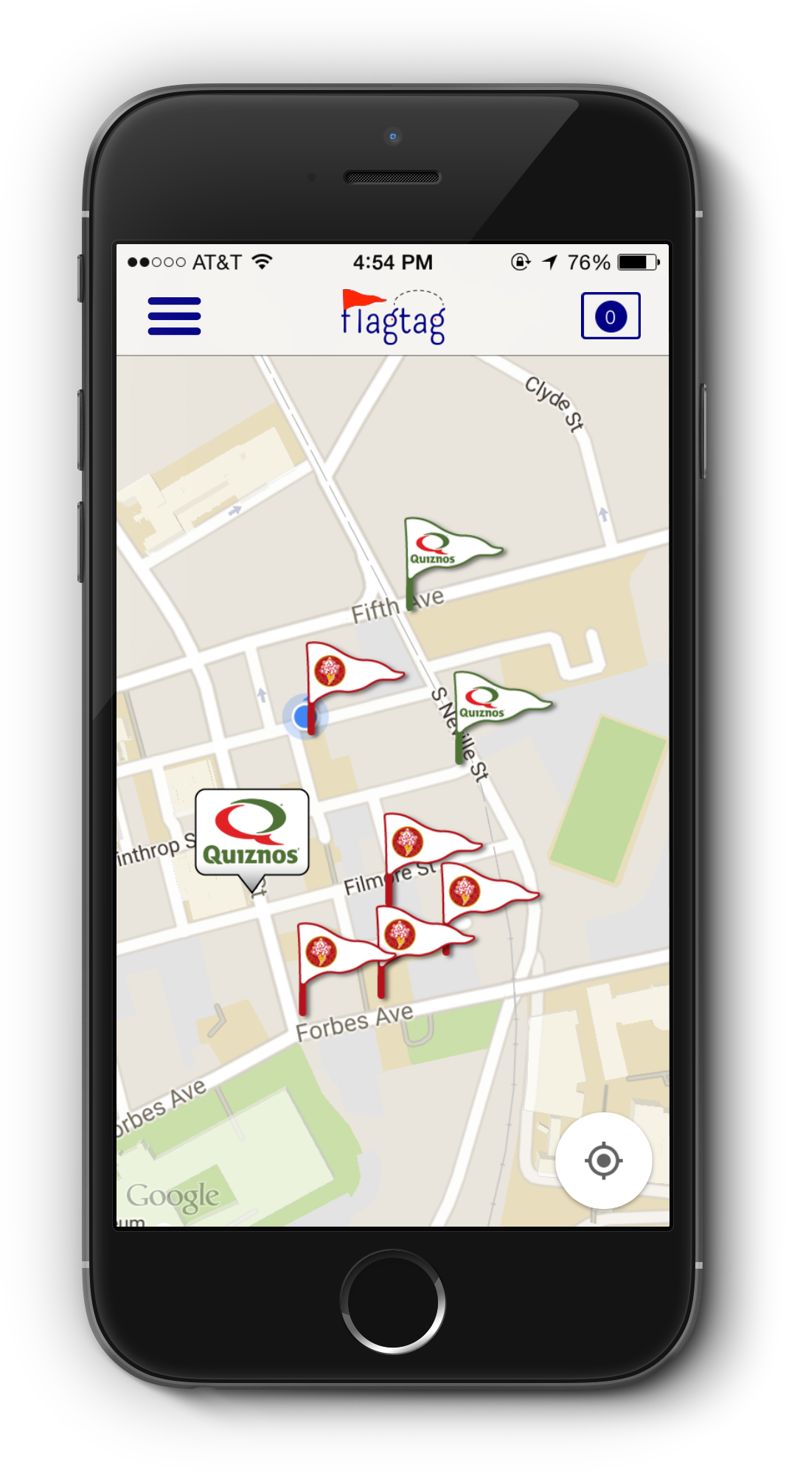
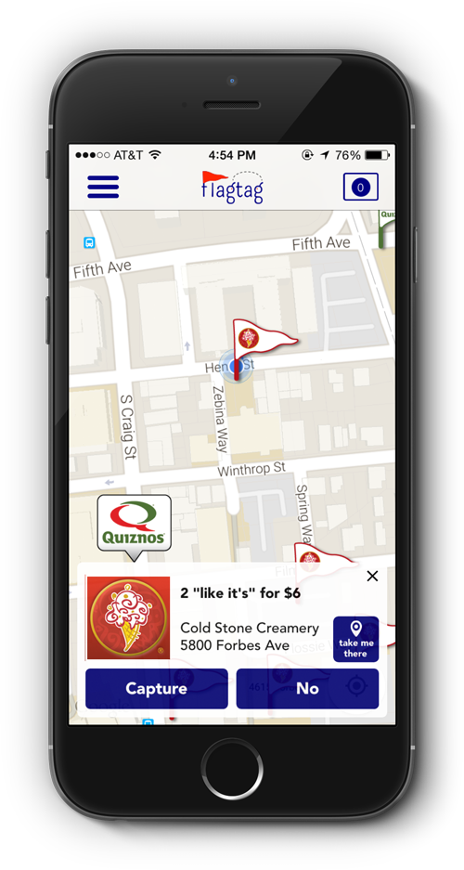
Users earn real-life prizes in a gamified, augmented reality, Easter egg hunt

Slide 85


Consumers
(targeting students)
  Leverage an efficient marketing scheme
  Bring new faces through the door
  Receive analytics with respect to user habits and coupon efficiency
Businesses
  Find discounts
  Discover new businesses
  Have fun while saving via gamified incentives

Slide 86
Customer Discovery
Survey Results
Key Demographics for Student Stakeholders
CMU: 100 Interviewed – 56 male, 44 Female
Pitt: 50 Interviewed – 25 Male, 25 Female
Chatham: 50 Interviewed – 3 Male, 47 Female
(Later interviewed 100+ more at Carlow, Duquesne and Point Park Universities)

Slide 87
Sample questions
“On a scale of 1-10, how likely are you to deviate from your go-to restaurant for a better deal at a competing restaurant?”
“On a scale of 1-10, how difficult would you say it is for you to organize a bunch of your friends in a group activity or outing?”
“How many apps on your phone have you paid for?”
“When was the last time you played CTF?” (why not more often?)
“Would you play CTF if it were an IM here?”

Slide 88
Key Findings
“On a scale of 1-10, how likely are you to deviate from your go-to restaurant for a better deal at a competing restaurant?”
Takeaway: College students are more likely to seek a deal than commit to a restaurant.
Product Design: Make sure a key component to the game is interaction with businesses.
Marketing Message: “Capture the flag, but also capture great deals”

Slide 89
Key Findings
“On a scale of 1-10, how difficult would you say it is for you to organize a bunch of your friends in a group activity or outing?”
Takeaway: Organizing groups of friends is a pain point for college students
Product Design: The game setup in the app needs to be intuitive so it is a helper, not a pain.
Marketing message: “You make the friends; we’ll make sure they are organized.”

Slide 90
Key Findings
“How many apps on your phone have you paid for? What are they? (if answered yes).”
Results:
No females at CMU, Pitt or Chatham paid for any apps.
22% of males at CMU and Pitt had any paid apps on their phones – all were for games
Takeaway: Fees from app is not part of the revenue model. (nor were they planning on it –they just wanted to check.)
Notes:
The team didn’t think they could get anyone to pay for the app but thought they would get validation that it was so.

Slide 91
Key Findings
“When was the last time you played CTF?” (why not more often?)
Takeaway: Students had not played recently and the reason was because of lack of time.
Product Design: Spread game over longer time period where you don’t have to commit a block of time.
Marketing Message: “Play on your own schedule.”
Notes:
This was the beginning of the weakness in their Customer Discovery that led to the flaw in the app design.

Slide 92
Key Findings
“Would you play CTF if it were an IM here?”
Responses: CMU: 80% - yes, 10% - maybe
Pitt: 48% - yes; 24% - maybe
Chatham: 2% - yes, 98% - no
Conclusions:
Key was Time, Friends, …. And Incentives
Chatham was not an active group
Notes:
This was the second weakness in their Customer Discovery process that convinced them they were on the right track with their proposed design.

Slide 93
Customer Discovery
What they did right:
Interviewed a large number of students from a variety of campuses
Results helped to significantly restructure initial game design
Derived key marketing messages from the interviews that were successful in getting students to download the app

Slide 94
Customer Discovery
Where they missed the mark
Misinterpreted the concern for time to mean ‘design a shorter game time’ rather than less time for games at all.
This is called Confirmation Bias –
2nd biggest mistake
Asked an ‘aspirational’ question i.e. “Would you play……?” Responders meant well but simply didn’t act as they said they would.

Slide 95
What They Learned
After going through AlphaLab and launching the app:
Students:
  Very willing to download the app and open it
  Mostly interested in capturing the flag for the discounts but not at all in the game aspect.
  A little slow to redeem the coupons (flagtag is paid a bonus for each redemption)
Businesses
  Very well received
  Most effective of all the coupon options they had tried by 3X
Notes:
Past behavior is a much better predictor of future behavior. Flagtag should have paid more attention to how infrequently anyone was playing CTF once on campus and the reason. An IM version, even if shorter, still had similar time constraints.

Slide 96
End Result
Fall 2016
  Verified the business model
  Revised the app
    Simply capture coupons – no game aspect
    Provided an incentive to redeem the coupons more quickly
    Relaunched Spring 2017
    Folded Summer 2017

Slide 97
How Many?

Slide 98
Recommended
100+
Stakeholders
For CDK
Goal is 20 interviews

Slide 99
Making it Work
Keep notes – you’ll forget.
Stop and assess periodically
Modify Business thesis based upon feedback
Adjust questions and who to interview as needed

Slide 100
Benefits
Avoids unnecessary ‘pivots’ (lost time and money)
Potential customers are ‘giving’ you the compelling sales pitch
Helps prioritize what is most important
Learn more about the competition

Slide 101
More Benefits
Get first-hand knowledge of your target audience
Can measure degree of enthusiasm and interest through observation
Starts to build the relationship
Helps identify potential reference customers/pilot participants
Investors (and judges) will want to know…..

Slide 102
Words to Live By
Fall in love with the problem….
….not your solution!

Slide 103
Customer Segments
Phase 1 Customer Discovery
Is this a big problem that a lot of people have where the current solution isn’t working e.g. am I solving the right problem?
Phase 2 Customer Validation
I now know I am solving the right problem. Am I solving it the right way?
Phase 3 Customer Acquisition
What do I know about the strategies and methods for getting customers to buy my product or service at a price where I can be profitable.

Slide 104
Customer Validation
Go back to those you interviewed who were the most interested or helpful
Ask for their feedback on your proposed solution
At least one will ask if they can try it!

Slide 105
Appendix
About Project Olympus (107)
Competitive Analysis (110)
Ask Yourself …(after Customer Discovery and Competitive Analysis) (118)
Hyliion: Business to Business B to B) Case Study (127)
Beatbots: Pivot from B to B to B to C Case Study (134)
What Investors are looking for (141)

Slide 106

Project Olympus
Startup Incubator for CMU
One page application
Customer Discovery Kickstart program
Personalized Work plan and assigned EIR
at conclusion of program
‘In business’ since 2007
1400+ startup ideas
$804M+ follow on funding
21 exits

Slide 107
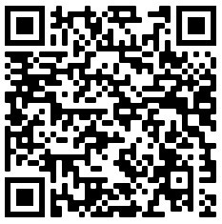
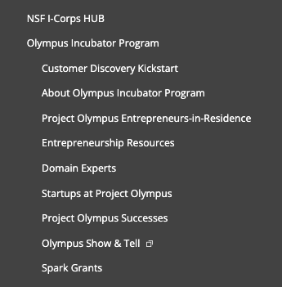
Resources
Join Project Olympus
  www/cmu.edu/Olympus
  Domain Experts
  Entrepreneurship Resources

Slide 108
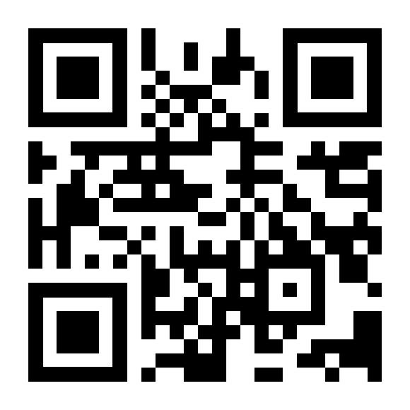

Programs
Customer Discovery Kickstart
Innovation Commercialization Fellows
NSF ICorps Regional and National Programs

Slide 109
Competitive Analysis

Slide 110
Competitive Analysis
Any way the customer
is solving the problem now is competition

Slide 111
DIRECT vs INDIRECT
DIRECT – similar products and services
INDIRECT – solving same problem for same target market with a different product or service

Slide 112
Who are Uber’s competitors?
Direct?
Indirect?

Slide 113
Template
 | Feature 1 | Feature 2 | Feature 3 | Feature 4 | Feature 4
You
Competitor 1
Competitor 2
Competitor 3
Competitor 4

Slide 114
Examples of Features
Price
Benefits
Quality
Durability
Image/style
Service
Warranties
Location
Convenience
Sales/Distribution
Ease of Use
# of features
Type of features
Wow factor
Size/Weight
Availability
Security
Safety
Endorsements
Certifications

Slide 115
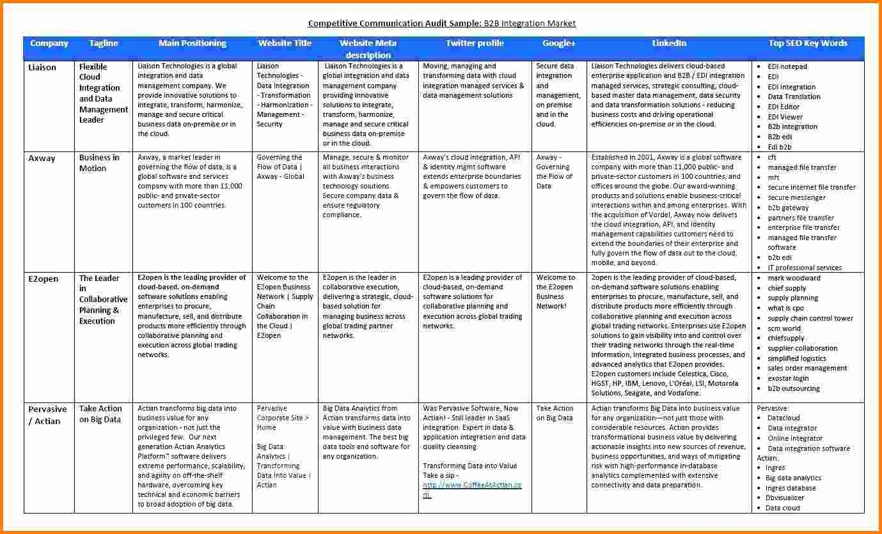
Example of Detailed Analysis

Slide 117
Ask yourself……

Slide 118
…Is it a REALLY Big
Problem?

Slide 119
…Is it a Really Big Problem?
How many people or companies have this problem? (Is it a big target market?)
How much time or money is spent (or lost) each year because of this problem? (The more it costs them, the more they are motivated to pay for your solution)
How well is their current solution working for them? (They will happily switch to your solution because their current one isn’t working very well.)

Slide 120
Ask Yourself…..
Is your solution 10X better than the alternatives or 3X cheaper?
Is it a “Need-to-Have” vs “Nice-to-Have?”
Will it be a big opportunity that will attract investors?

Slide 121
Ask Yourself…..
“…… will it scale?”

Slide 122
Ask Yourself….
Do your product/service margins increase with volume?
- COGs
- Installation/Customization
- Service/maintenance
- Staff ratio to sales

Slide 123
Examples of Businesses/Products that Scale Well
Software (MS Word, Excel, Quickbooks)
Apps (Pandora, Twitter, BudgetSimple)
Mass Market items (My Keepon, FitBit)
Hardware that is standardized or uses standard parts (Air conditioners, remote controls)

Slide 124
Ask Yourself….
….. How will I sell this?

Slide 125
How will this be done?
Who will do this?
Start thinking about this on DAY 1

Slide 126
Business to Business
(B to B)
Case Study

Slide 127

Proposed Product
Add-on hybrid system for tractor trailers
  Uses regenerative braking to capture power when the vehicle is slowing down that can be reused to accelerate.
Value proposition to the customer: Reduces fuel consumption by over 30% with an ROI of less than 1 year.

Slide 128
Sample Questions
How much on average do you spend on fuel? % of annual budget?
Have you done analysis on fuel usage that you can share?
What are you currently doing now to reduce your fuel costs?
On a scale of 1-10, how well are those techniques working?
Why did you give each that number?

Slide 129
Interviewed
Fleet managers
Fleet truck drivers
Independent truck drivers
Trailer manufacturers
Mechanics that service the fleet
Companies with proprietary fleets
Industry association staff

Slide 130
Where did they find them
Industry conventions
Truck stops
Fleet owners’ headquarters
Trailer sales offices
Telephone

Slide 131
Findings
6 million trailers in the USA
Each trailer averages 6.5 mpg = $85,000 fuel costs per year per trailer
52 Billion gallons of fuel consumed yearly
31% = $46 B in potential fuel savings
$25k per unit x 6M trailers = $150B potential market

Slide 132
Findings
Largest value/ROI for long-haul fleets
15% of fuel is used to run the cab at night for heat/AC and electronics
  Shaking cab results in poor sleep – which can lead to accidents
  (This was the ‘outlier’) that helped sell management
Less wear and tear on the diesel engine
Reduced emissions

Slide 133
Conclusion
  Big Problem
  Big Market
  Great Product
  Great Business

Slide 134
Pivot from B to B to
B to C
Case Study

Slide 135
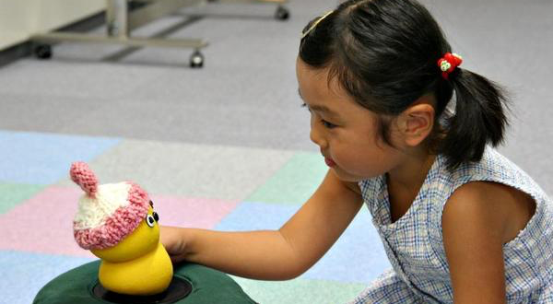
BeatBots

Slide 136
BeatBots
Initial Hypothesis
Therapy tool for therapists who work with severely autistic children
Price: $25k (includes hardware and software)
Target audience: Clinics that specialize in therapy for severely autistic children

Slide 137
BeatBots
Product worked extremely well as a therapy tool to engage highly autistic children
However…..
Size of Target Market: 100 clinics worldwide
Great Product
Lousy Business

Slide 138
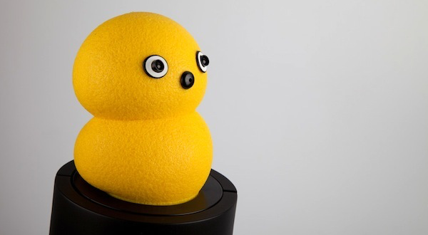

BeatBots
Pivoted to a retail product for mass market for $50 and
licensed it a toy company that would manufacture, package
and get BeatBots on the shelves of major retailers.

Slide 139
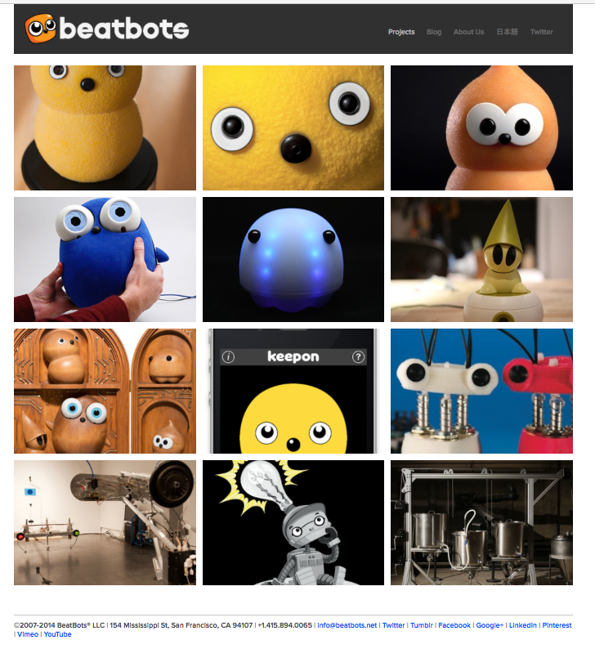

Slide 140
What investors are looking for

Slide 141


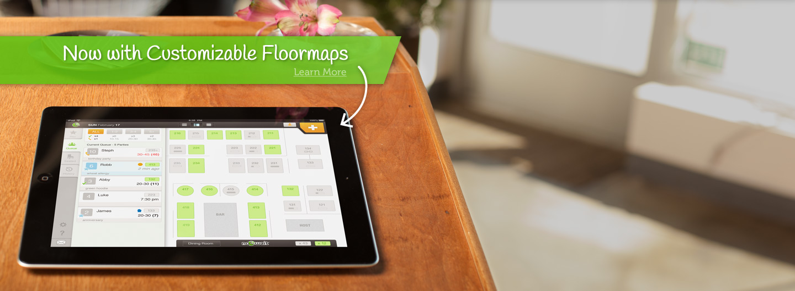


Slide 142
Why was a good investment
“ We want to invest in large markets, …if you have a fantastic team with fantastic products but …… it’s in a small market, there’s a smaller type of outcome that can happen e.g they’re swimming in a smaller pond. If you have a big and expanding market, it’s great to have a great team and product, but if you don’t, you still have a chance. “
“…..We focus on investing in trends shaping the landscape over the next 10 years. Casual dining is a multi-hundred-billion business in the U.S. alone. Everybody’s got to eat.”
“……What they’re doing solves an acute point, waiting to get in line, waiting to get a check. They have a very elegant solution.”
Nick Solaro of Drive Capital, a Columbus, Ohio-based $250M VC fund on their $10M investment in NoWait in May 2014 (Source: Pgh Business Times)

Slide 143
Sold to Yelp for $40M

Slide 144
Q&A
kit@cs.cmu.edu

