Slide 1
The Case for Women-Focused Angel Investing
Christine Ferguson
3/21/2019

Slide 2
Why Angel Investing?
Angel investing is an active and essential part of the American economy In 2017, angel investors funded over 61,000 companies and invested over $23B in these businesses. *
*Center for Venture Research, University of New Hampshire
Why

Slide 3
Why

Slide 4
Why Angel Investing?
Angel investors, sometimes individually but often acting in groups, can supply a young company with sums ranging from tens of thousands to a million dollars or more
Why

Slide 5
Who are Angel Investors?
Angels are high-net worth individuals who make equity investments in start-up and early-stage companies
Who

Slide 6
Who are Angel Investors?
Angels fill a gap in the ecosystem of support; they step in at the critical early stages, when companies are taking shape or beginning to grow.
Who

Slide 7
Angel Investors Provide More than Money:
Mentoring and advice to entrepreneurial teams
Experience as veteran entrepreneurs themselves
Business experience
Special expertise that equips them to mentor a new company or to serve on its board
Who

Slide 8
Who

Slide 9
Who Gets Funding?
Venture capital funding overall has surged in recent years, but the numbers haven't leapt forward for female founders at the same pace. In 2018 companies founded solely by women garnered 2.3% of the total capital invested in venture-backed startups in the US last year
Who

Slide 10
Women Angel Investors are Increasing
Who

Slide 11
Women Entrepreneurs Get Larger Share of Angel Funding
Where

Slide 12
Angels are Everywhere . . .
63% of angel investors in the study are located outside of San Francisco, New York, and Boston, with large percentages in the Great Lakes (16.2%), Southeast (15.4%), and Mid-Atlantic (10.7%)
The American Angel Study, ACA, November 2017
Where

Slide 13
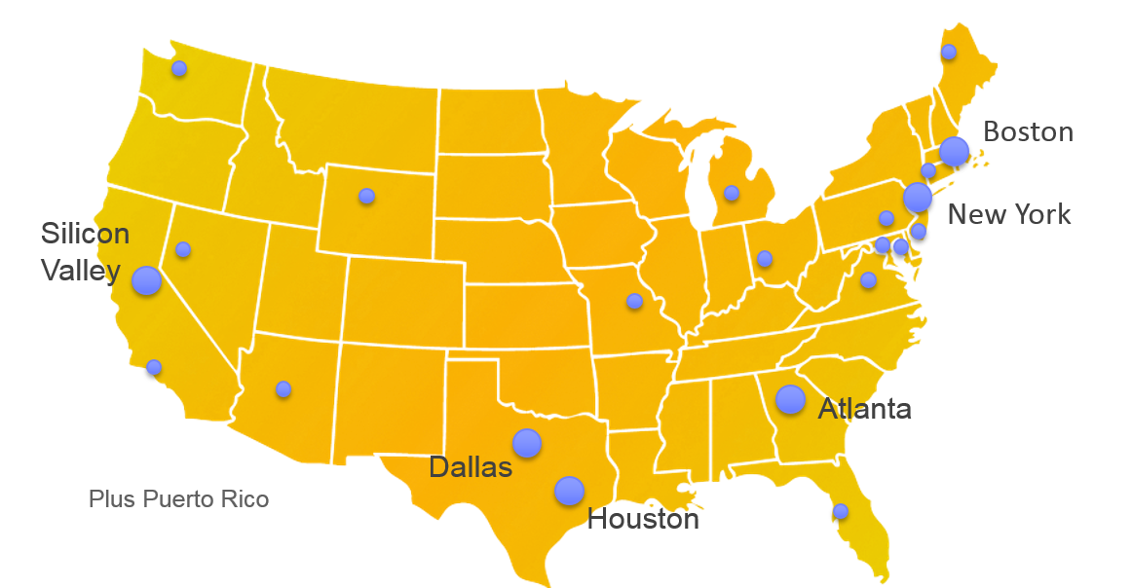
Golden Seeds Angel Network
Where

Slide 14
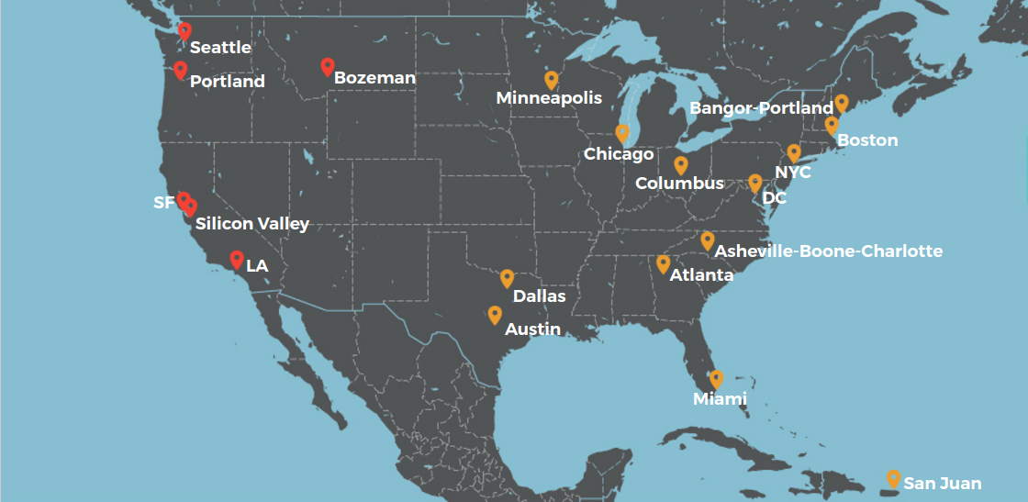
Pipeline Angels Locations
Where

Slide 15
How Female Investors Invest
Angels that invest with a gender lens focus solely on women-led companies
Angels increasingly practice inclusion on their teams; having other women in the room increases the odds of securing funding for women entrepreneurs.
Gender diversity among decision-makers improves the chances that women entrepreneurs will be funded.
How

Slide 16
How Female investors Differ
“Women often create businesses that are born of their own life experiences -- experiences other women may be particularly likely to recognize and calibrate as large opportunities.”
Loretta McCarthy,
Managing Partner Golden Seeds
How

Slide 17
Investments in Women Founded Companies are increasing
More Capital was invested in companies founded or
co-founded by women in the fourth quarter of 2018 than in any other quarter in the past decade
How

Slide 18
Women in VC = 2X Funding for Women-Owned Start-ups
The well-regarded Diana Project, a study by Babson College, concluded that venture capital firms with women partners were more than twice as likely to invest in companies with women on their management teams than those without women partners.
How

Slide 19
What Increased Investing by Female Investors means for Women Entrepreneurs
What

Slide 20
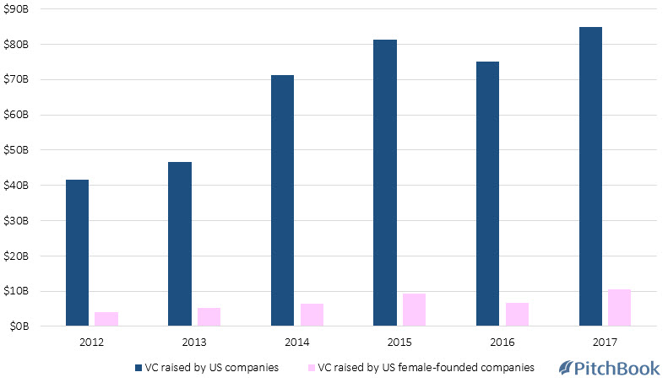
Share of Capital Raised by Female-Founded US Companies
What

Slide 21
Women Angels: 5% of Investors in 2004;26% of investors in 2016
What

Slide 22
Women Focused Funds
Funds

Slide 23
Thank You
It is a promising time for Female Entrepreneurs and Angel Investors!

