Slide 1
Today’s Agenda
IP as a source of innovation
A bit about the process
How to search and read patents
Strategic development of IP portfolio

Slide 2
Intellectual Property (from the entrepreneur’s perspective)

Slide 3
Intellectual Property – 5 types
Copyrights
Creative works in tangible form
Trademarks
Words, symbols, colors, sounds or smells
Pepsi, Pink, Price’s trademark, the sound of a Harley, fragrances
Trade Secrets
Coca Cola’s recipe
Algorithms
Right of publicity
Your photo or name
Patents
Copyrights generally protect original creative works, such as books, movies, songs, paintings, photographs, web content, and choreography. Trademarks, on the other hand, generally protect brand names, slogans, and logos that are used in the marketplace, and help consumers distinguish among products. LegalZoom.com

Slide 4
Origins of the US Patent & Trademark office:
From the Venetian Statute of 1474
English Statute of Monopolies in 1624
US Constitution, Art. I, Sec. 8, Cl. 8 - 1787
1st US Patent Law - 1790
Federal system founded in 1871

Slide 5
Why does the patent office exist?

Slide 6
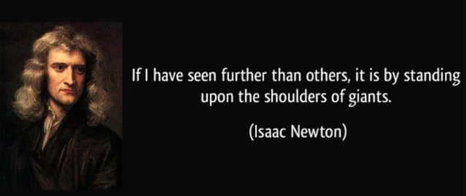
According to the patent office:
The premise of our patent system lies in its mutual benefit to both the inventor and our country. In return for full public disclosure, a U.S. patent offers certain rights to an inventor for up to twenty years, during which time the inventor may exclude all others from making, using, importing or selling his or her invention. The patent is published and disseminated to the public so that others may study the invention and improve upon it. The constant evolution of science and technology, spurred by the monetary incentive the U.S. patent system offers to inventors, strengthens our nation's economy. New inventions lead to new technologies, create new jobs, and improve our quality of life.

Slide 7
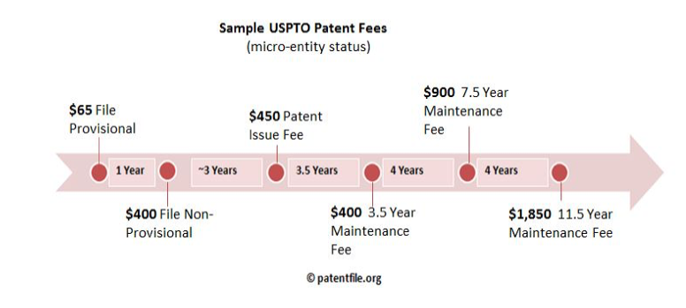
Should you file for patent protection?
Is it strategic?
Is it defendable?
What markets really matter?
Filing patents are cheap
Issuing (& defending) patents is “expensive”
$22,000 in US (on average)
$30,000 in EU
$26,000 in Japan
$21,000 in Canada
Australia, Malesia, China, etc., etc.

Slide 8
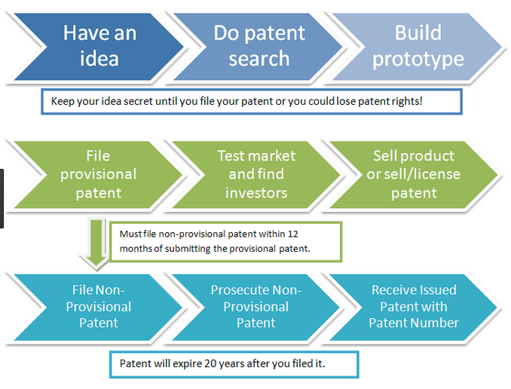
Patent Process

Slide 9
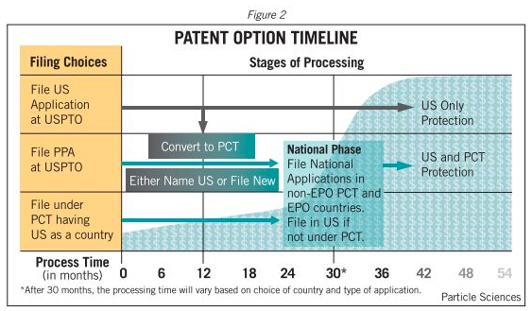
Patent Process

Slide 10
First some important concepts
Important Dates
File Date
Grant Date
Abstract
Description
Independent claims
Dependent claims
Prior art
Patent “wrapper”
Alerts
Cease and desist
Now, Let’s look at a patent
Set up Alerts

Slide 11
Strategically Developing Your IP Portfolio
How to make your Intellectual Property drive returns for your business

Slide 12
Business Strategy Must Drive IP Strategy
Intellectual Property Should NOT be viewed as a legal issue separate from the business
Instead, Intellecual Propety Strategy and Business strategy should be integrated, so that IP Reinforces the Business
Intellectual Property should be a Window into Your Business Future
Patent applications show your technology roadmap
Trademarks show brand strategy

Slide 13
Know your Technology and Business before Working with IP Counsel
Even if you don’t understand the competitive landscape, you should know how your product works and how you plan to make money
Your attorney(s) need(s) to know your risk tolerance(s) to provide effective counsel.

Slide 14
The Ultimate Question
“What drives economic value for your business?”

Slide 15
Is the Economic Value Derived From Your:
Brand?
Software Code?
Product Design?
Technology Features?
Relationships/Contracts?

Slide 16
Determine How IP Protection Supports This
How do you protect your business drivers?
How will your IP strategy need to change as your Business Evolves?
Sound IP Strategy Today Allows for Your Business to Evolve Tomorrow

Slide 17
Caution: Don’t Fall In Love With Your IP
Even if you don’t understand the competitive landscape, you should know how your product works and how you plan to make money
Your attorney(s) need(s) to know your risk tolerance(s) to provide effective counsel.

