Slide 1





WELCOME TO
Outreach Roadshow
presented by
Notes:
Hello everyone and welcome to the Carnegie Mellon School of Computer Science Roadshow.
Maybe one day we will see you and do the Roadshow together, for now we’ll take you through our presentation online.
By the way, it might help to have pen and paper ready for a couple of the fun exercises later on.

Slide 2



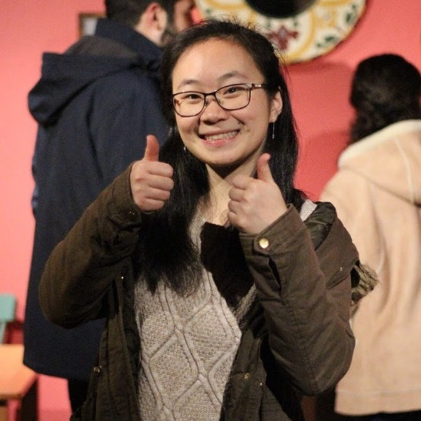
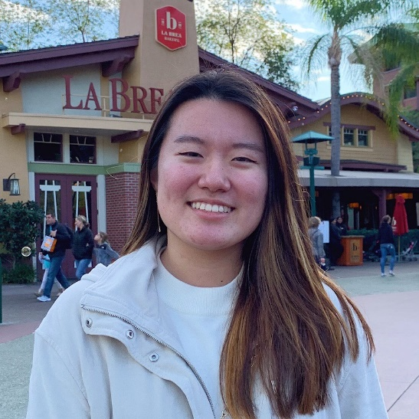
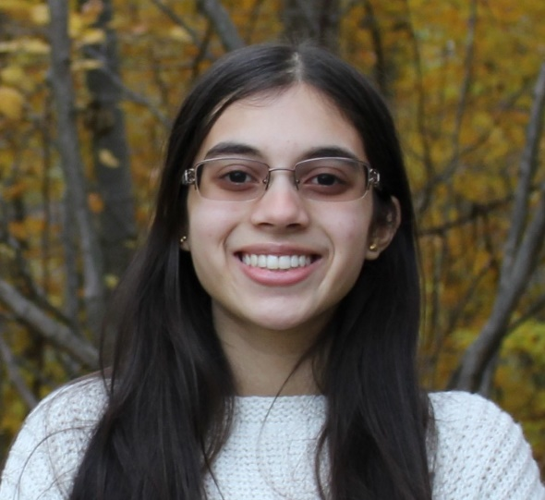
WHO WE ARE
Crystal
Angela
Ishika
Kayla
Notes:
My name is Kayla, my picture is on the left and here you can see 3 others in our team: Angela, Crystal and Ishika.

Slide 3
let's play a game...
WHO IS A
COMPUTER SCIENTIST?
Notes:
Let’s start with a guessing game.
We will show you a photo and you have to guess if the person is a computer scientist or not.

Slide 4

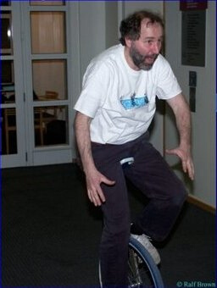


Notes:
Here’s the first one, he’s riding a unicycle and looks a little nervous.
Do you think he’s a computer scientist?

Slide 5

CMU Computer Science
Professor Danny Sleator
Notes:
If you thought yes you are correct.
This is one of my professors.

Slide 6
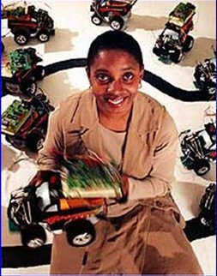
Notes:
Here’s another, is she a computer scientist?
What do you think?

Slide 7
Texas A&M Computer Science
Professor Valerie Taylor
Notes:
Yes she is, but not at Carnegie Mellon, she works at Texas A&M, a big university in (as you might guess)-Texas in Houston.

Slide 8
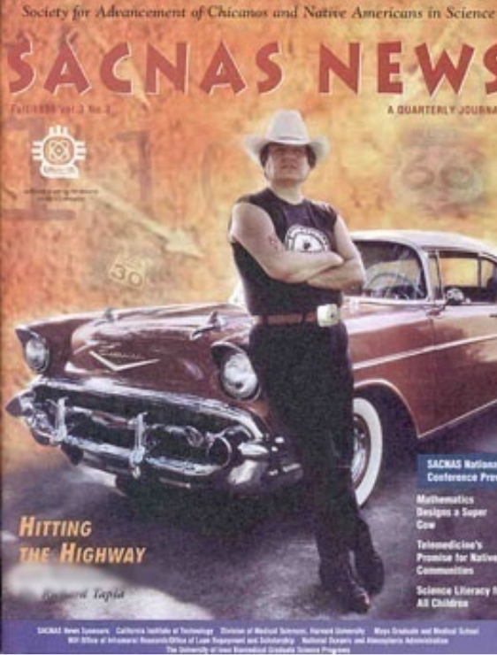
Notes:
What about this guy with the cool antique looking car?

Slide 9
Rice University Computer Science
Professor Richard Tapia
Notes:
He is a computer scientist, he works at Rice University also in Houston, Texas

Slide 10
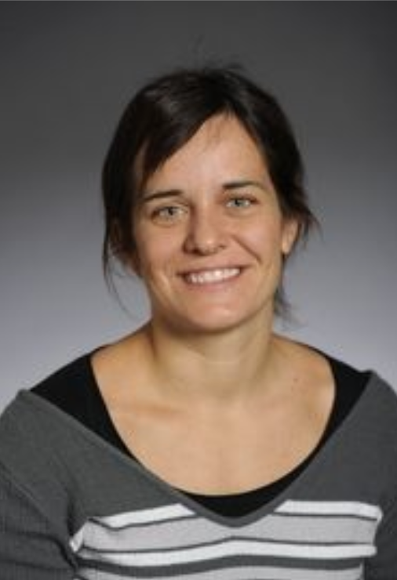
Notes:
Here’s another – is she a computer scientist?

Slide 11

CMU Astro Physicist
Professor Tiziana Di Matteo
Notes:
Did we catch you?
She is a professor at CMU but she is not a computer scientist– she’s an astro physicist
How are doing so far? Did you get them all correct or just a few?

Slide 12
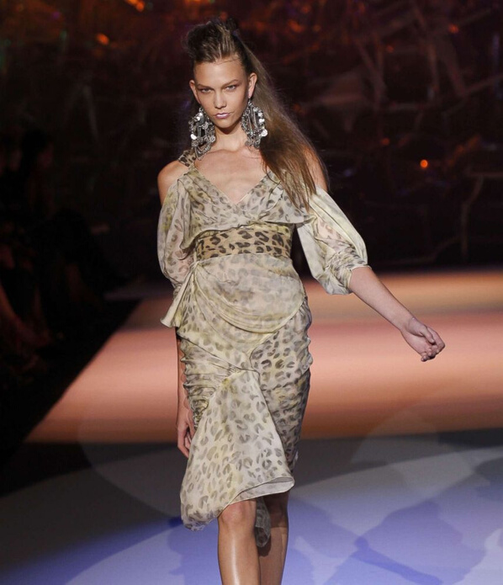
Notes:
Well what about this woman? What do you think? A bit tricky maybe?

Slide 13
Model and Coding Advocate
Karlie Kloss
Notes:
This is model Karlie Kloss --we put her in the yes group because she knows how to code in fact she runs a coding camp for kids.

Slide 14
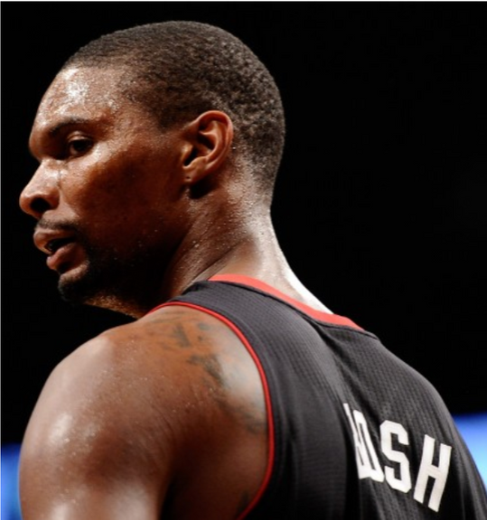
Notes:
What about this guy?
Computer scientist, yes or no?

Slide 15
Computer Science Grad and
Code.org Advocate Chris Bosh
Notes:
Here’s Chris Bosh, another promoter of coding who goes in our yes group.
Also, quite a well known basket ball player!

Slide 16
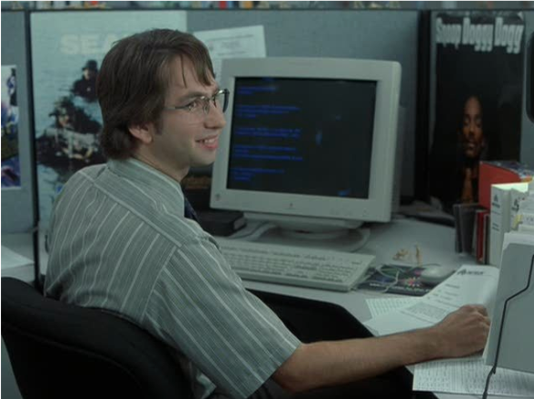
Notes:
Here’s our last one. What do you think?

Slide 17
Actor in Office Space Playing
the part of a Programmer
Notes:
He’s not a computer scientists – he’s an actor in the show Offfice Spcae playing the part of a programmer.
So how did you do?
We hoped we showed you that there are many kinds of people who are computer scientists – maybe you will be one too!

Slide 18
so if these are computer scientists...
WHAT IS COMPUTER SCIENCE?
Notes:
We’ve seen some computer scientists but what is computer science?

Slide 19

Computer Science is all about problem solving
let's see this in action...
Notes:
Computer science is all about solving problems.
And we mean all sorts of problems, (give a couple of examples) and try to find the best solutions.
They make software that enables you to search the internet.
They work on security whether it’s for your cell phone or for banks.

Slide 20

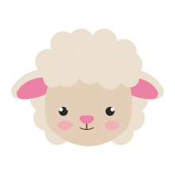


Crossing the
River Problem
A farmer has to get a sheep, a carrot and a wolf over the river to the grassy field.
BUT
he can only take one with him at a time …
Notes:
When computer scientists solve problems they often use algorithms– these are step by step ways of working towards a solution.
Let’s try this one.
A farmer has to get a sheep, a carrot and a wolf over the river to the grassy field BUT he can only take one with him at a time …

Slide 21
But if left alone...
The wolf will eat the sheep
The sheep will eat the carrot
Notes:
That sounds easy BUT the farmer’s job is quite complicated.
If the wolf is left alone with the sheep she will eat it!
If the carrot is left alone with the carrot he will eat it.
How can the farmer get them across to the grassy field one at a time without the wolf eating the sheep or the sheep eating the carrot.

Slide 22



Getting Everyone Across River Alive!
Notes:
Take a little time to think about this.
It might help to have pen and paper to work it out.
In the next slides we will walk you through a solution.
You may have come up with another solution that also works.

Slide 23
Getting Everyone Across River Alive!

Slide 24
Getting Everyone Across River Alive!

Slide 25
Getting Everyone Across River Alive!

Slide 26
Getting Everyone Across River Alive!

Slide 27
Getting Everyone Across River Alive!

Slide 28
Getting Everyone Across River Alive!
Notes:
We hoped you enjoyed solving that problem, --we think problem solving can be a lot of fun.

Slide 29
so if these are computer scientists...
WHAT CAN YOU DO WITH COMPUTER SCIENCE?
Notes:
Now let’s think about the kinds of applications we can do with computer science.

Slide 30
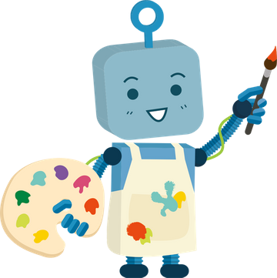

Computer Science and Art
Notes:
We are sure you’ve seen computer animation.

Slide 31
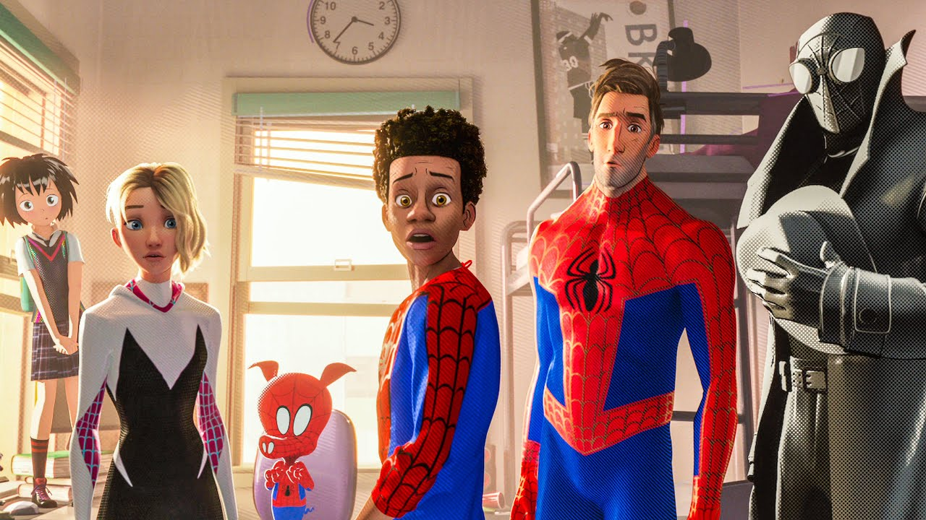
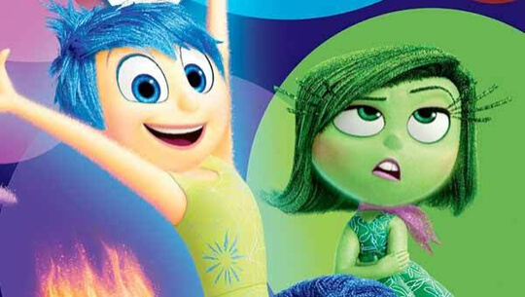

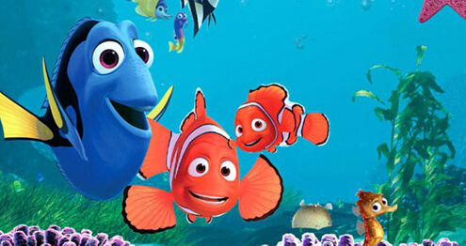
Computer Animated Films
Notes:
Can you name the films seen here?
Many computer scientists specialize in using computers to animate characters.
Answers:
top left is ???
Top right is ??
Bottom left is Nemo
Bottom right is

Slide 32

Notes:
Here’s another character
Carnegie Mellon research on soft robotics inspired Disney’s Baymax, a robot hero in the movie Big Hero 6.

Slide 33
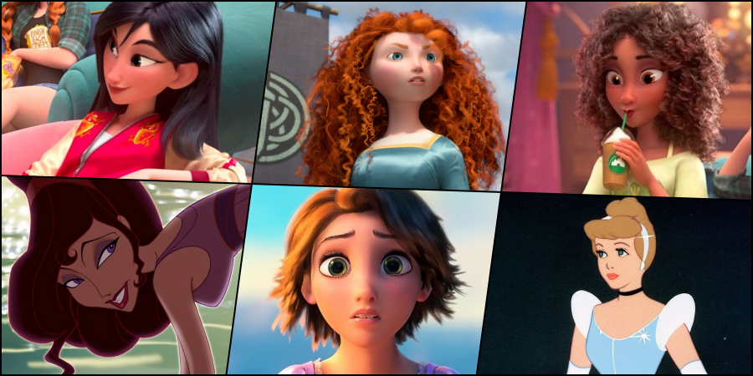
What do you think is probably the most difficult thing for animators to work on?
Notes:
Take a few minutes to guess what is the most difficult thing for animators to make look real.
These characters all have this.
Yes Hair is really hardtop make it look real.
Do you recognize the characters? What about the movies?

Slide 34

Computer Science and the Environment
Notes:
Now let’s look at another application of computer science.
What has computer science to do with the environment?

Slide 35
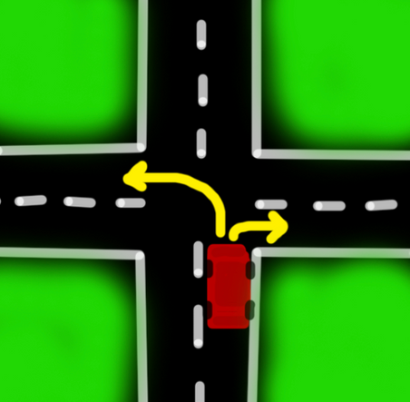
Going for a drive...
You drive to an intersection where you can turn left or right.
Which turn is faster to make?
Notes:
Imagine you are in a car going for a drive with your family.
You need to make a turn., left or right.
Which turn is the faster to make?

Slide 36
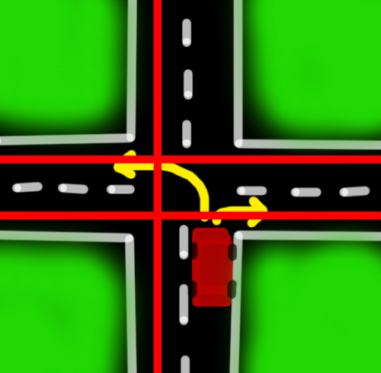
Going for a drive...
If you turn left, how many lanes do you have to cross?
Notes:
Let’s break it down into steps.
If we go left how may lanes do we have to cross?
We have to cross3 lanes.

Slide 37
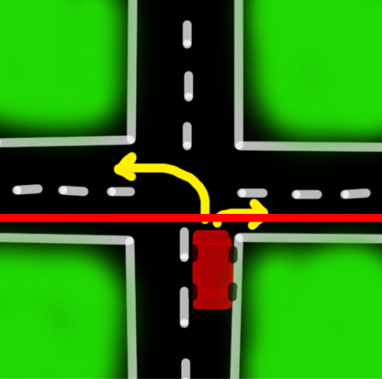
Going for a drive...
How about a right turn?
Notes:
Now what if we turn right?
We just have to cross into the right turn lane.

Slide 38

By not going left...
  Saves a little gas every turn
  UPS uses computer algorithms to figure out how to go right 90% of the time saves 3,000,000 gallons of gas per year
Notes:
So turning right is faster.
This is not just a fun exercise.
Can you think of someone who needs to make lots of right turns in their daily work?
Have you noticed the steering wheel on some of the US mail trucks is on the right?
They make as many right turns in their route and as few left turns as possible.
This makes them more efficient AND by going right 90% of the time saves 3,000,000 gallons of gas per year
This helps them to make and other Parcel services

Slide 39
WHAT IS PROGRAMMING?
a set of instructions telling a machine what to do

Slide 40




Program the robot to put on a scarf
(a hat, and gloves)
Notes:
Your task is to program the robot to put on a scarf.
You or your helper should be the robot.
You are your helper gives the robot instructions.
The robot can only understand precise instructions.
Also it can only follow one instruction at a time.
Let’s give you an example.
If the instruction is lift the scarf off the table the robot cannot understand.
You would have to say something like this:
Lower your right arm by 90 degrees from your shoulder”
Put your hand on the table.
Move your hand 10 in to the left.
Put your hand on the scarf.
Grip the scarf with your fingers.
Lift your arm by 90 degrees…
…and so on. Wrapping the scarf round the neck is so hard for the robot, so many little instructions.
See how many steps it takes – a lot!!

Slide 41
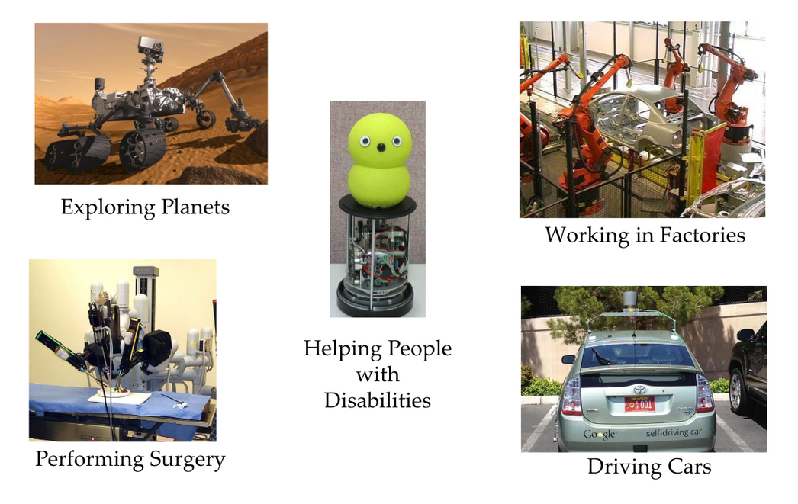
Robotics: Sense - Plan - Act
Notes:
Robots are everywhere.
They are used to explore planets and go into situations too dangerous for humans.
They do tasks in factories that humans used to do.
They can help doctors with micro surgery and help children with disabilities.
Have you seen the self-driving cars– these robots.

Slide 42
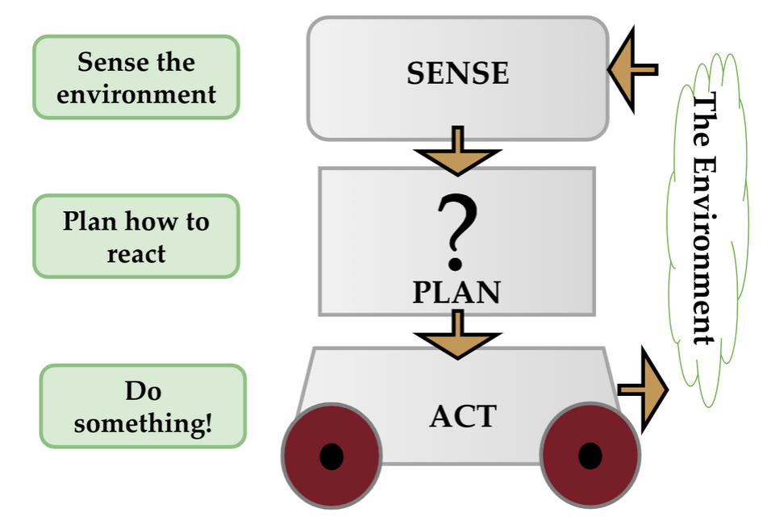
Robotics: Sense - Plan - Act
Notes:
This slide shows you a guide to how robots work.
They have to sense the environment (this could be with a camera).
Then they use the computer program to plan what they will do.
Then they need to act so they need some way of moving (this could be wheels).

Slide 43
CHALLENGE:
WHERE’S THE CS?
Notes:
We have a challenge for you.
Can you think of a career than does not involve computer science?
Nowadays there are very few.

Slide 44
HOW CAN YOU
GET STARTED?!
Notes:
So now you know more about computer science let’s give you a few ideas for finding out more.

Slide 45
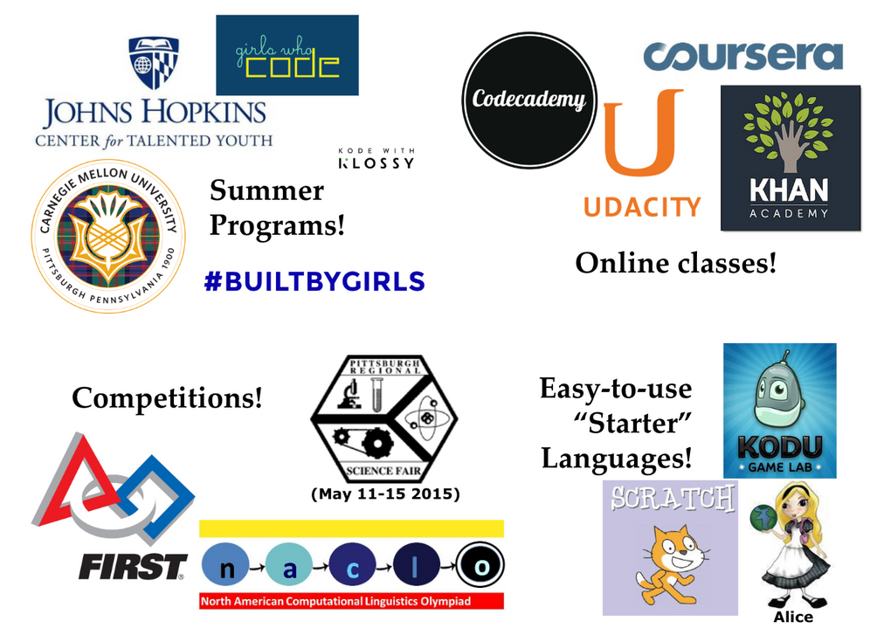
Notes:
You might want to ask someone in your family to join you to see these next few slides.
All of these companies and programs can be good starting points.

Slide 46

Mobile Apps
Notes:
Look online and find an organization that helps you build a mobile app.

Slide 47
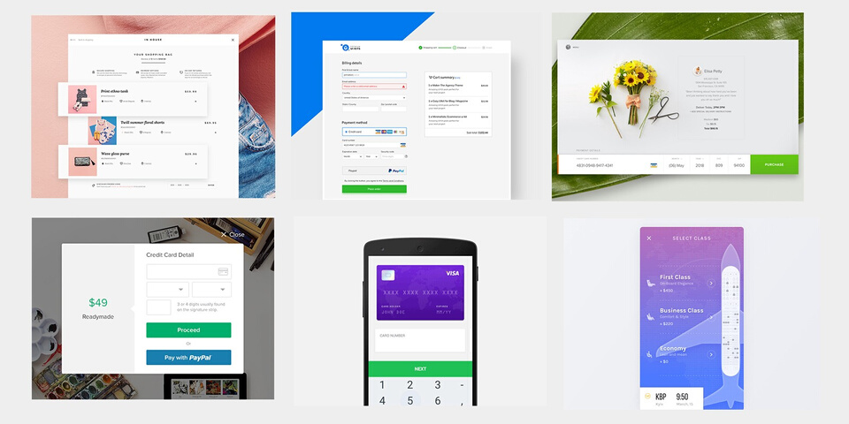

Web Development
Notes:
There are many programs online to help make a website.

Slide 48

Computer Science Grads Could Work here...
and Startups or Graduate School...
Notes:
These are the cool places where you can work when you study computer science and graduate.

Slide 49
THANK YOU!
Notes:
Thank you for joining our Roadshow online—we hope you’ve had fun and learned a lot.

