Slide 1
Home
Home | Getting Started | Programming the Hub | Robot Movement | Wait Until & Sensors | Loops
Here’s your morning digest!
The next lesson: Exploring a disaster site

Slide 2
Home | Getting Started | Programming the Hub | Robot Movement | Wait Until & Sensors | Loops
Check out the correct solution before you go over and help
 | Wait Until Near | Try It! Change the Threshold Value | Move Until Near | Try It! Changed Starting Point | Try It! Reverse Until Far | Mini-Challenge: Investigating the Collapsed Building | Wait For Green | Move Until Red | Mini-Challenge: Forward Until Stop Line (Part 1) | Mini-Challenge: Forward Until Stop Line (Part 2) | Move Until Pressed | Try It! Changed Starting Point | Try It! Wait Until Arm | Try It! Move Until Hard-Pressed | Try It! Move Until Released | Mini-Challenge: Vacuum | Challenge: Exploring a Disaster Site | Unit Quiz: Wait Until & Sensors with SPIKE Prime
Reference the correct solution: | Correct solution | Correct solution | Correct solution | Correct solution | Correct solution | Correct solution | Correct solution | Correct solution | Correct solution | Correct solution | Correct solution | Correct solution | Correct solution | Correct solution | Correct solution | Correct solution | Correct solution | Correct solution
Melina Benitez | 1 | 1 | 1 | 1 | 1 | 2 | 1 | 1 | 1 | 1 | 1 | 1 | 1 | 1 | 1 | 1 | 4
Efa Burton | 1 | 1 | 1 | 1 | 1 | 5 | 1 | 1 | 1 | 1 | 1 | 1 | 1 | 1 | 1 | 5 | 2
Alessio Sheehan | 1 | 1 | 1 | 1 | 1 | 6 | 1 | 1 | 1 | 1 | 1 | 1 | 1 | 1 | 1 | 3 | 4
Dilara Prosser | 1 | 1 | 1 | 1 | 1 | 3 | 1 | 1 | 2 | 1 | 1 | 1 | 1 | 1 | 1 | 7 | 1
!

Slide 3
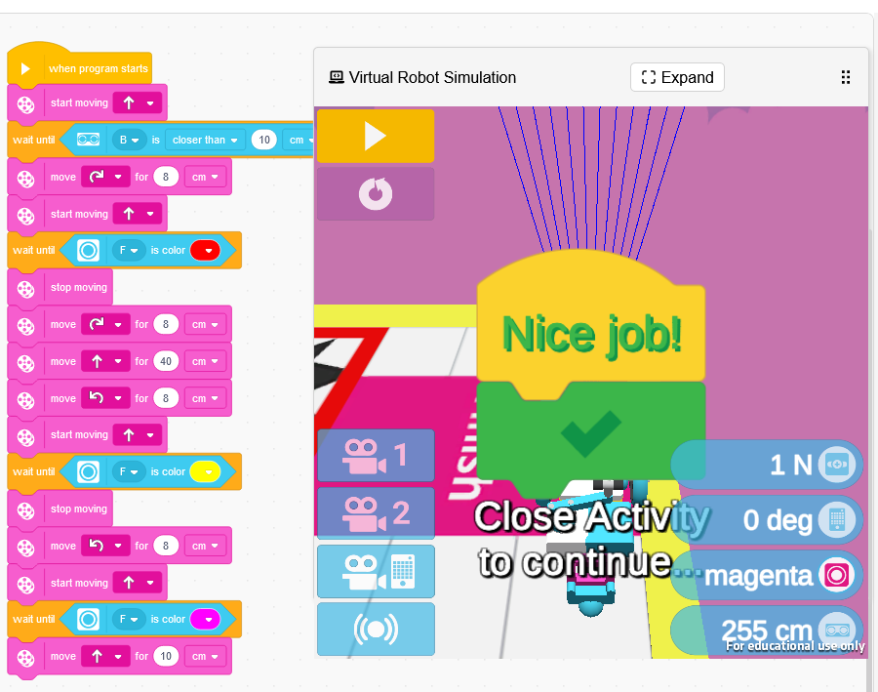
Correct Solution for Exploring a Disaster Site
(back)

Slide 4
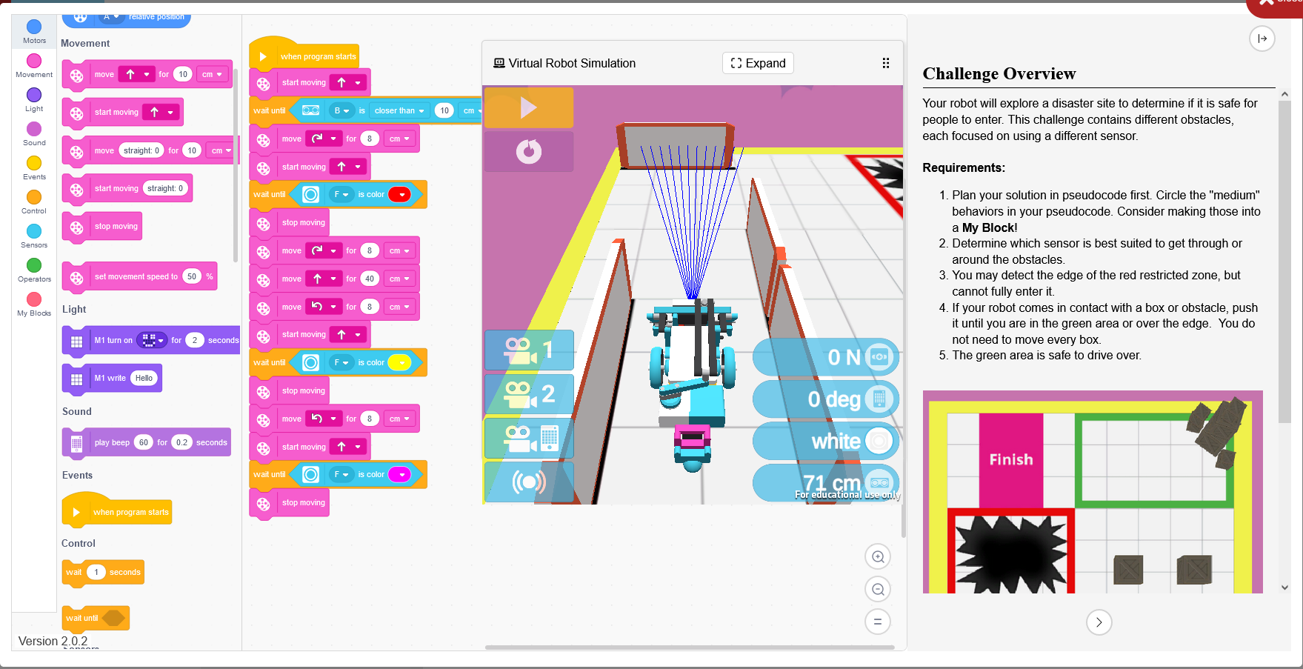
(You walk over to the student, this is their screen)

Slide 5
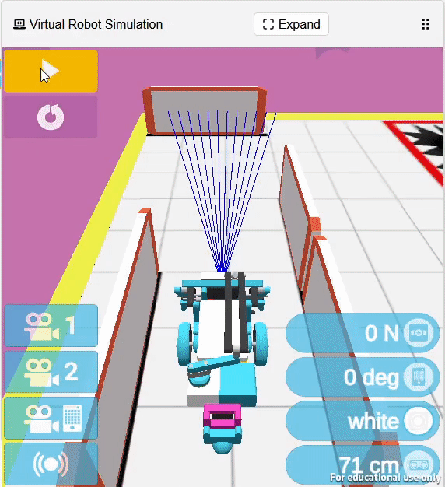
(You walk over to the student, this is their screen)

