Slide 1
Home
Home | Getting Started | Programming the Hub | Robot Movement | Wait Until & Sensors | Loops
The next lesson: Vacuum Challenge

Slide 2
Home | Getting Started | Programming the Hub | Robot Movement | Wait Until & Sensors | Loops
 | Wait Until Near | Try It! Change the Threshold Value | Move Until Near | Try It! Changed Starting Point | Try It! Reverse Until Far | Mini-Challenge: Investigating the Collapsed Building | Wait For Green | Move Until Red | Mini-Challenge: Forward Until Stop Line (Part 1) | Mini-Challenge: Forward Until Stop Line (Part 2) | Move Until Pressed | Try It! Changed Starting Point | Try It! Wait Until Arm | Try It! Move Until Hard-Pressed | Try It! Move Until Released | Mini-Challenge: Vacuum | Challenge: Exploring a Disaster Site | Unit Quiz: Wait Until & Sensors with SPIKE Prime
Melina Benitez | 1 | 1 | 1 | 1 | 1 | 2 | 1 | 1 | 1 | 1 | 1 | 1 | 1 | 1 | 1 | 1 | 1
Efa Burton | 1 | 1 | 1 | 1 | 1 | 5 | 1 | 1 | 1 | 1 | 1 | 1 | 1 | 1 | 1 | 2
Alessio Sheehan | 1 | 1 | 1 | 1 | 1 | 6 | 1 | 1 | 1 | 1 | 1 | 1 | 1 | 1 | 1 | 3 | 1
Dilara Prosser | 1 | 1 | 1 | 1 | 1 | 3 | 1 | 1 | 2 | 1 | 1 | 1 | 1 | 1 | 1 | 3
!
This student has activated “debugging/hint mode” and may need help.

Slide 3
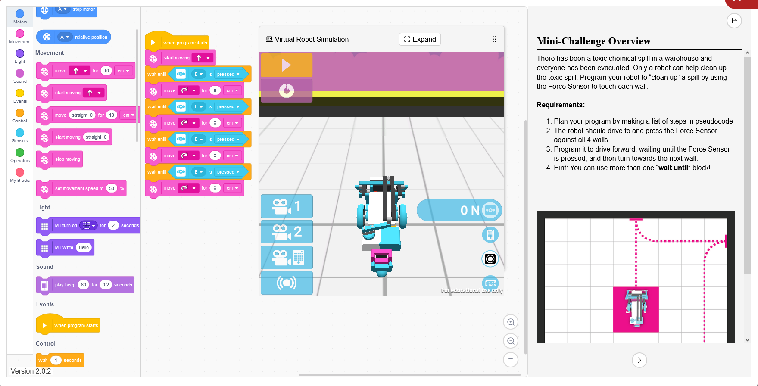
(You walk over to the student, this is their screen)

Slide 4
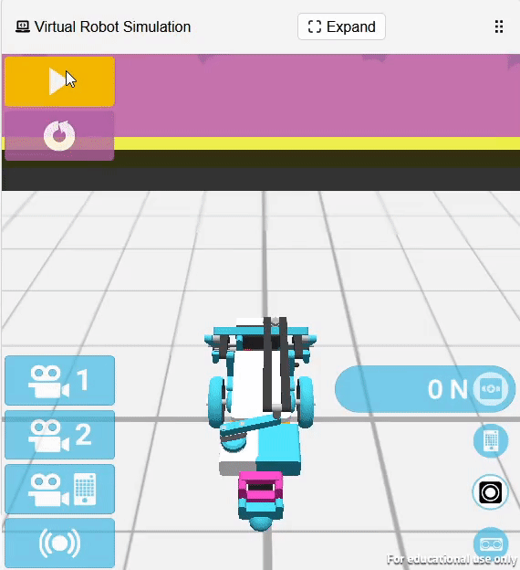
(You walk over to the student, this is their screen)

