Slide 1
Global Public Health Brigades
Nicaragua 2018

Slide 2
GPHB 2018 Trip
Brigade of 13 Carnegie Mellon students and 11 West Virginia University/University of Tennessee students
The first four days we worked with five families living in San Rafael del Norte, Jinotega.
This public health brigade consisted of constructing a sanitation station, called a latrine, for each of the family homes
The latrines included a toilet, shower, and an area to hand-wash clothing.
We also dug trenches from the bathroom area to bury all the pipes, which were for waste removal.
Charla: Upon the completion of each project, we celebrated with the families. We gave the children toys and taught the members of the community basic hygiene tips through games and songs.

Slide 3
Water Brigade
The last day consisted of a water brigade.
We dug trenches from a clean water provider at the top of a mountain down to the respective community, so the families in the community can have clean water.
This trench is miles long, which means this is a long-term project where the trench is an accumulative effort of multiple brigades throughout the year.

Slide 4
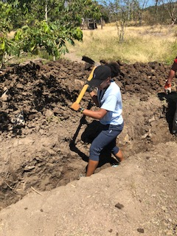
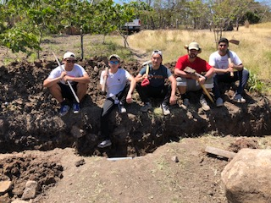

Slide 5
San Expedito Cooperative
This cooperative is made up of talented local artisans from the Las Cureñas community in the Department of Jinotega. These women utilize traditional methods and designs to make Black Pottery the same way their ancestors did centuries ago.
From harvesting the clay in local mines, to firing each piece in hand-built artisan kilns, each piece is meticulously made by hand, and the complete process pays tribute to their heritage and the authentic production of Nicaraguan Black Pottery.

Slide 6
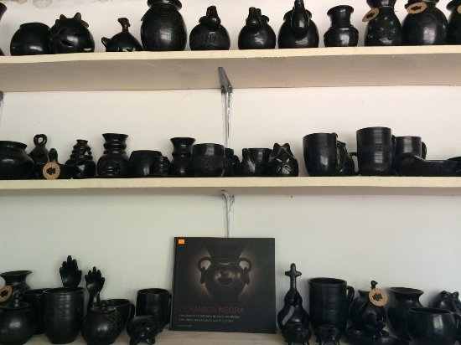
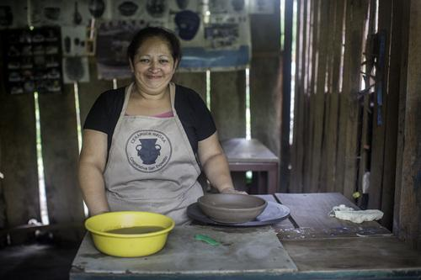

Slide 7
Reflections
Each workday was followed by an hour commute back to La Campiña, the compound we stayed at in Estilí, Nicaragua. Each evening we:
Ate a delicious dinner from the compound and reflected upon the events of the day with the brigade members.
Followed by relaxation time where the colleges of the University of Tennessee, Carnegie Mellon, and West Virginia University
No phone service and social media, so we focused on creating new friendships and memories
Played games and had long reflective talks about our project

Slide 8
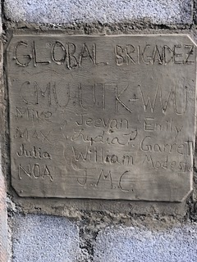
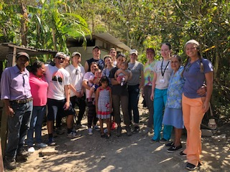

Slide 9
Importance of the Brigades
The importance of these brigades lie not only in the construction of latrines and digging trenches, but also in:
Bonding with the families and hearing their stories to really understand their situations
Share their stories
Convince people to join a brigade/contribute
One of our fellow brigaders reflected, “Where we’re from it seems as if people talk about what they don’t have. For the Nicaraguans, the emphasis is on what they do have.”
What they do have is love and human interaction and they really cherish it.

Slide 10
Video Link: https://www.youtube.com/watch?v=F9rq7jvuDU0

