Slide 1
League of Immuno-Legends
Created and edited by:
Claire Kenny,
Materials Science & Engineering, Biomedical Engineering, 2021
Notes:
Main title: 40 pt. Arial
Presenter Name: 16 pt. Arial
Presenters Title: 16 pt. Arial Italic

Slide 2
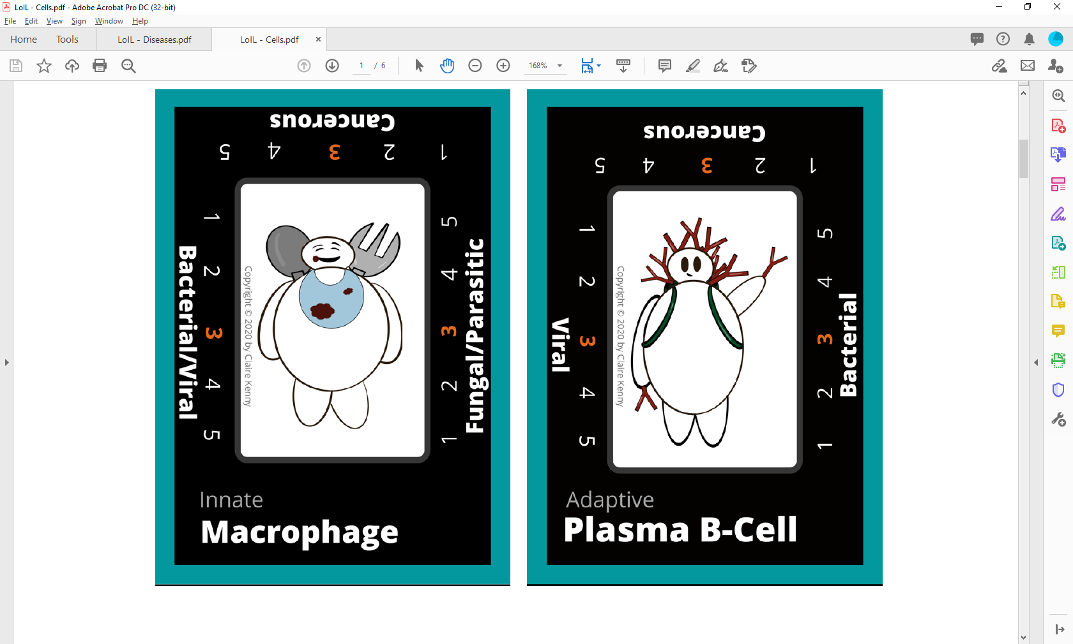
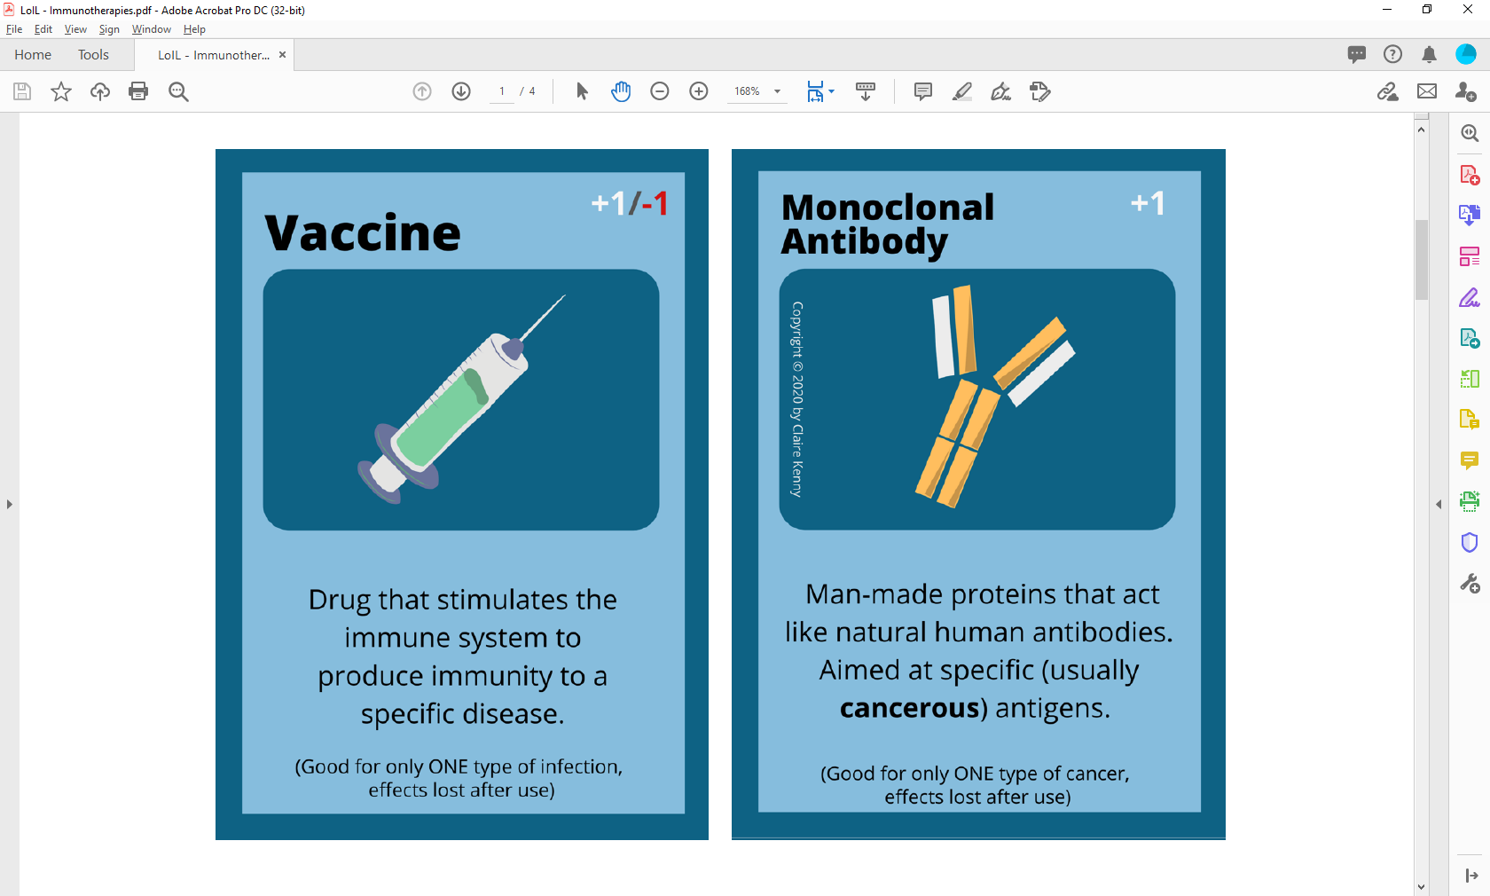
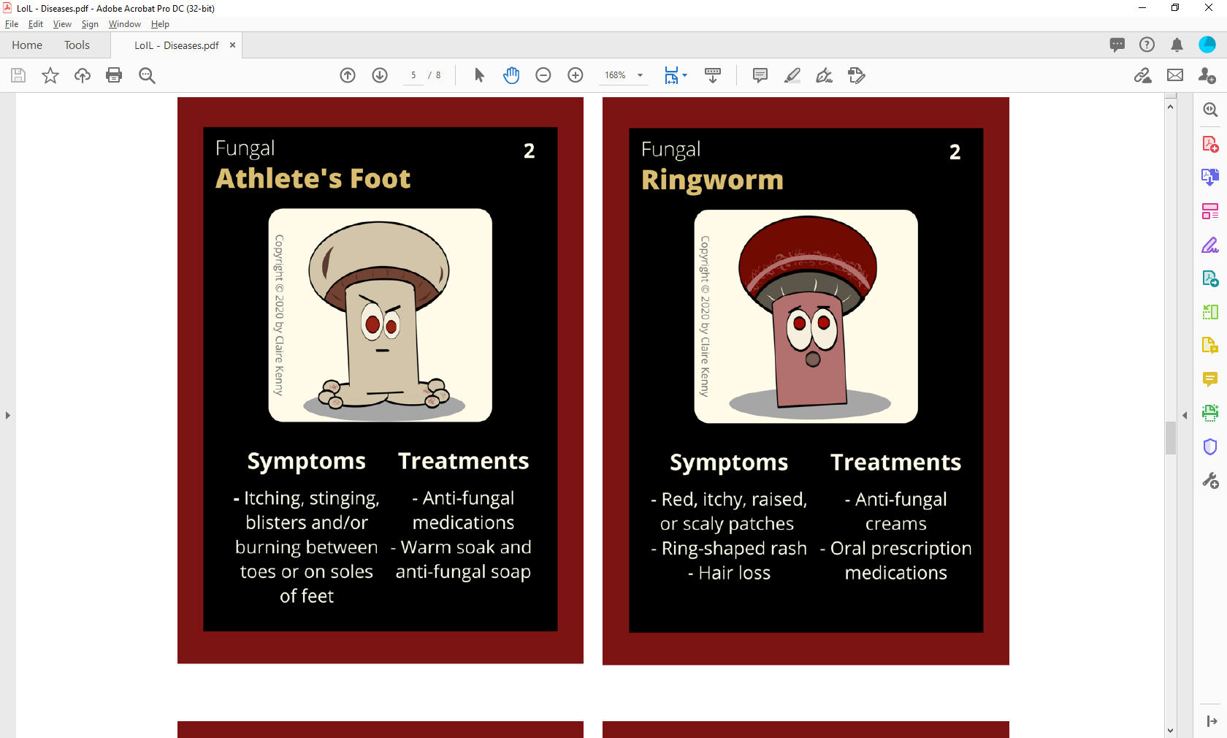
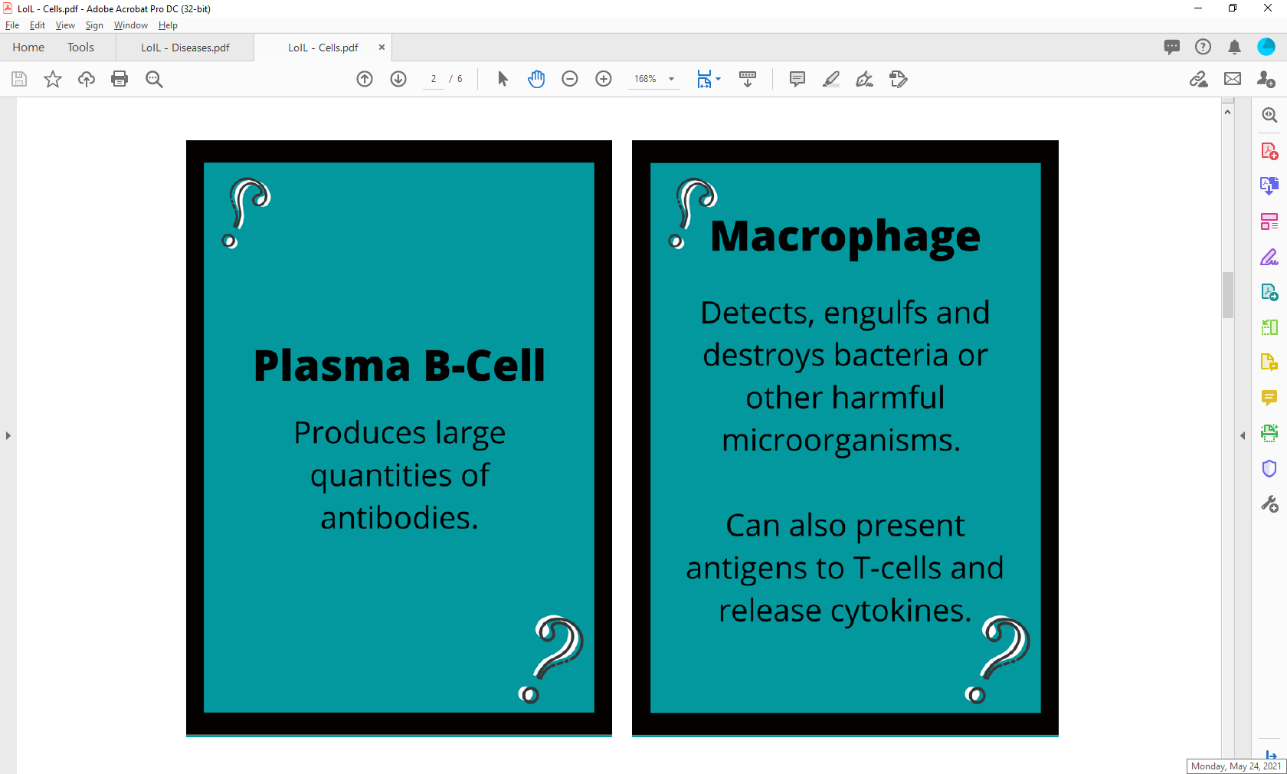
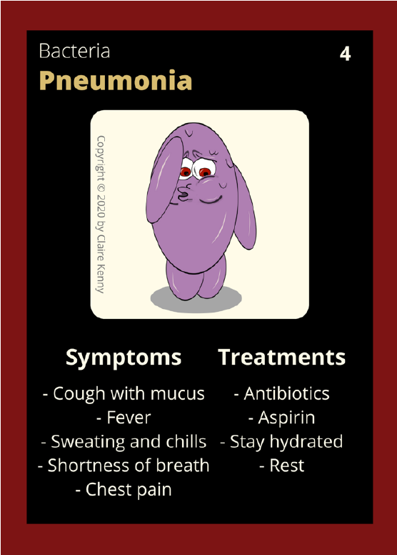
This educational resource for high school audiences was developed as a project by Carnegie Mellon student, Claire Kenny, for the course Experiential Learning through Projects, Section O, taught by Dr. Conrad Zapanta and
Dr. Judith Hallinen during the summer of 2020.

Slide 3
CAUTION: When you are attempting any experiment, it is important to make sure that you are following all safety steps. All experiments should be completed with supervision of an adult. Weather permitting, we recommend taking messy experiments outside. Remember to wear safety gear like gloves, aprons, and goggles, especially for experiments with chemical reactions!
The materials and information presented made be used for educational purposes as described in the Terms of Use at www.cmu.edu/gelfand and parents/legal guardians are responsible for taking all necessary safety precautions for the experiments. To the maximum extent allowed under law, Carnegie Mellon University is not responsible for any claims, damages or other liability arising from using the materials or conducting the experiments.
Be SAFE and enjoy the information that is presented here!

Slide 4
Outline
What is the immune system?
  What are the main components of the immune system?
  How does the immune system combat different attacks?
  What happens when the immune system fails?
How can biomedical engineering address problems that arise?
  Immunoengineering
  Applications
    Antibiotics
    Vaccines
    Cancer Therapy

Slide 5
Vocabulary
Antibody: (also known as immunoglobulins) Y-shaped proteins that can recognize and bind to antigens, further signaling to others involved in the immune system responses
Antigen: Molecules capable of stimulating an immune response, could be proteins on the surfaces of bacteria, fungi and viruses
Cytokine: Protein involved in cell signaling, especially between immune cells
Cytotoxic: Substance or process that results in cell damage or cell death
Heparin: Anticoagulant that inhibits blood clotting and promotes the movement of white blood cells in an area
Histamine: Chemical that widens blood vessels and increases the flow of blood to injured tissue
Pathogen: Organisms or infectious agents that invade the body and can cause health issues
Notes:
Anticoagulant – prevent blood clot formation

Slide 6
What is the Immune System?
The role of the immune system — a collection of structures and processes within the body — is to protect against disease or other potentially damaging foreign bodies.
4 main functions to accomplish this:
Immune Effector Functions
Immune Recognition
Immune Regulation
Immune Memory

Slide 7
Two Main Categories
Innate Immunity
Adaptive Immunity
Specificity
Non-specific
No memory
Duration
Initiates in minutes to hours
Lasts days to weeks
Components
The skin & all mucous membranes
Different defensive white blood cells
Various substances in blood and body fluids
Specificity
Antigen specific
Has memory
Duration
Initiates in days to weeks
Components
T and B cells
Lasts months to years
Cytokines
Antibodies

Slide 8
Meet the players:
Natural Killer Cells
Cytotoxic T-Cells
Helper T-Cells
Regulatory T-Cells
Also known as: Killer T-Cells or CD8+
Produce toxic granules containing enzymes that induce the death of pathogen-infected cells
Adaptive
Adaptive
Adaptive
Also known as: CD4+
Produce cytokines to direct an immune response against a pathogen
Necessary to activate B-cells and Cytotoxic T-Cells
Act to suppress immune response
Help maintain homeostasis and self-tolerance
Able to inhibit T-cell proliferation, cytokine production and autoimmunity
Innate
Defend the host from tumors and virally infected cells
Do not require prior activation
Release cytotoxic granules that destroy altered cells
Note: See speaker notes for full image citations
Notes:
Note: Clicking on images during slideshow will take you to the source website
Natural Killer Cells
Gitig, Diana. GenEng News. Visited July 2020. https://www.genengnews.com/insights/natural-killer-cells-emerge-as-an-anticancer-alternative-to-t-cells/
Cytotoxic T Cells
British Society for Immunology. Visited July 2020. https://www.immunology.org/public-information/bitesized-immunology/cells/helper-and-cytotoxic-t-cells
Helper T Cells
Thing Link. Visited July 2020. https://www.thinglink.com/scene/632999878879870977
Regulatory T Cells
Yu, Yu. Endonews, Visited July 2020. https://www.endonews.com/immune-response-in-endometriosis-andregulatory-t-cells

Slide 9
Meet the players:
Macrophages
Dendritic Cells
Plasma B-Cells
Memory-B Cells
Innate
Innate
Adaptive
Detect, consume by phagocytosis and destroy bacteria and other harmful organisms
Can present antigens to T-Cells
Can release cytokines to initiate an inflammation response
Bind and retain antigens to be presented to T-Cells
Induce the differentiation of germinal B-cells into memory B-cells
Adaptive
Important for maintaining immunity
Makes any secondary exposures to an antigen quicker (and possibly stronger), sometimes before you even feel sick again
Activated B-cells that produce antibodies specialized for one pathogen
Can release several thousands of antibodies in response to an antigen
Note: See speaker notes for full image citations
Notes:
Note: Clicking on images during slideshow will take you to the source website
Macrophages
Archoncology. Visited July 2020. https://archoncology.com/science/figure-3-macrophage-consumes-tumor/
Dendritic Cells
Rees, Victoria. Drug Target Review. Visited July 2020. https://www.drugtargetreview.com/news/53501/previously-unknown-role-of-dendritic-cells-in-inflammation-revealed/
B Cells
Burgstedt, Christoph. Science Photo Library. Shared on Thought Co. Visited July 2020. https://www.thoughtco.com/b-cells-meaning-373351
Memory B Cells
Katarina, Zimmer. The Scientist. Visited July 2020. https://www.the-scientist.com/news-opinion/crispred-b-cells-produce-antibodies-against-hard-to-treat-viruses-65904

Slide 10
Meet the players:
Mast Cells
Basophils
Neutrophils
Eosinophils
Important for allergic and antigen response
Innate
Innate
Excrete histamine and heparin
Can also release chemical signals to attract eosinophils and neutrophils to an infection site
Innate
Usually first responder to a microbial infection
Effective against bacterial or fungal infections
Active in the phagocytosis of bacteria and can be found in pus
Lifetime: Hours to days
Lifetime: Hours to days
Responds to allergies, parasitic infections, collagen diseases, and diseases of the spleen and central nervous system.
Secretes chemicals to destroy large parasites
Lifetime: 8-12 days
Innate
Carry granules containing histamine and heparin
Play a role in the inflammatory process
Note: See speaker notes for full image citations
Notes:
Note: Clicking on images during slideshow will take you to the source website
Mast Cells
Mast Cell Aware. Visited July 2020. http://www.mastcellaware.com/mast-cells/about-mast-cells.html
Basophils
Blausen.com staff (2014). "Medical gallery of Blausen Medical 2014". WikiJournal of Medicine 1 (2). DOI:10.15347/wjm/2014.010. ISSN 2002-4436.
Neutrophils
Blausen.com staff (2014). "Medical gallery of Blausen Medical 2014". WikiJournal of Medicine 1 (2). DOI:10.15347/wjm/2014.010. ISSN 2002-4436.
Eosinophils
Blausen.com staff (2014). "Medical gallery of Blausen Medical 2014". WikiJournal of Medicine 1 (2). DOI:10.15347/wjm/2014.010. ISSN 2002-4436.

Slide 11
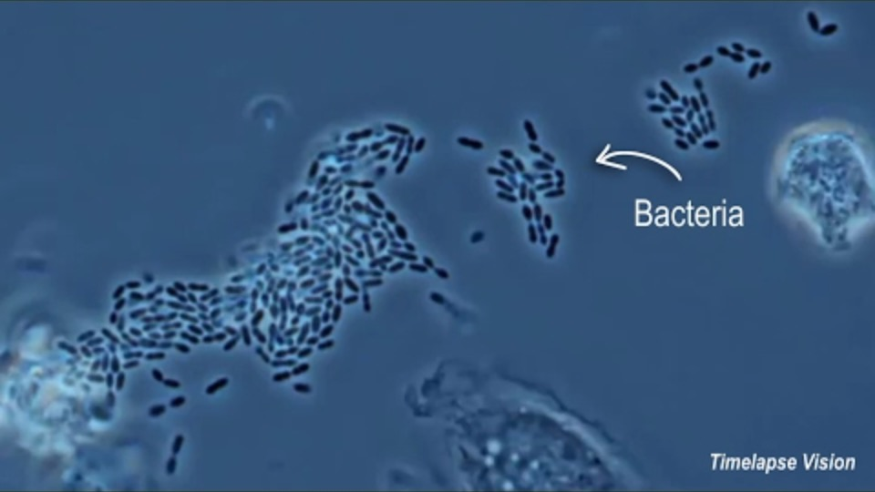
Macrophages at work!
Note: See speaker notes for full image citations
Notes:
Only need to show the first couple seconds
Credit: Curtis Sleve
Animation by: Fusion Medial Animation
Microscopy by: Timelapse Vision
Link: https://youtu.be/iZYLeIJwe4w

Slide 12
Viral Infections
Virus infects cell(s)
Dendritc cell consumes infected cell
Dendritic cell presents antigens and releases cytokines
Helper T-cells and cytotoxic t-cells are activated
Helper T-cells proliferate and produce more cytokines
Cytokines activate B-cells
Naïve cytotoxic T-cells proliferate, differentiate and produce cytokines
Cytotoxic T-cells find and destroy infected cells
B-cells make memory B-cells
B-cells proliferate (after 14 days)
B-cells make antibodies
Antibodies neutralize the virus and mark infected cells for destruction by cytotoxic T-cells
This is a simplified version of the body’s immune response to viral infections
This is a simplified version of the body’s immune response to
Viral Infections
Notes:
Diagram is of primary infection

Slide 13
Bacterial Infections
Bacteria enters cell(s)
Macrophage finds and consumes pathogen
Macrophage presents antigens and releases cytokines
Macrophages proliferate and helper t-cells are activated
Helper T-cells produce cytokines
Naive B-cells are activated
Macrophages proliferate
Macrophages find, engulf, and destroy pathogens
B-cells proliferate (after 14 days)
B-cells make memory B-cells
B-cells make antibodies
Antibodies label pathogens for detection by phagocytes
This is a simplified version of the body’s immune response to
Bacterial Infections
Notes:
Diagram is of primary infection

Slide 14

Other Infections
Parasitic Infections
Many of these infections occur in developing parts of the world
Established when the innate immune system fails to eliminate the parasite
The adaptive immune system will, in turn, begin a cascade of events to make antibodies against the parasite
Macrophages, mast cells, basophils, neutrophils, eosinophils and NK cells will then bind to and eliminate the antibody coated parasite
Fungal Infections
There are many fungi in the world but only some can cause an infection
Infectious fungi are opportunistic pathogens, meaning they wait for optimal conditions, such as when the immune system is weakened
Recognized by innate immune system (dendritic cells and macrophages)
Note: See speaker notes for full image citations
Notes:
Image made with free online tool Canva

Slide 15

Immune System Failures -
Allergies
Allergies are one of the unwanted reactions of the immune system.
  Caused by an overreaction to different substances or allergens
  The body produces antibodies that "attack" the allergen
  Symptoms can include:
    Wheezing
    Itching, runny nose
    Watery or itchy eyes
    And more
  Anaphylactic shock is a life-threatening reaction to an allergen, can cause trouble breathing, shock, vomiting, and more
Note: See speaker notes for full image citations

Slide 16
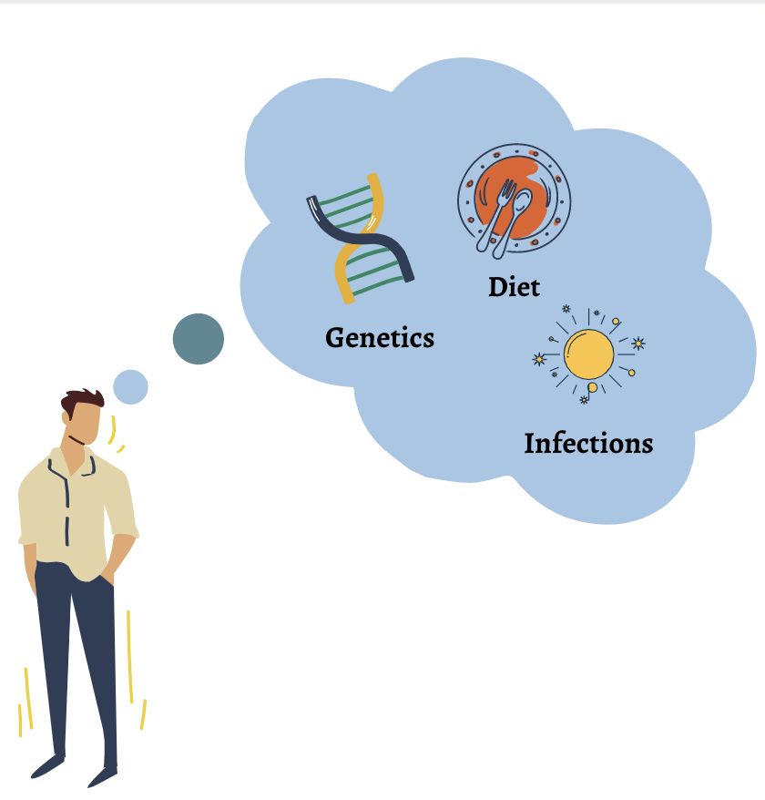
Immune System Failures -
Autoimmune Diseases
Conditions where the immune system mistakenly attacks the body.
The immune system mistakes the body as foreign, and releases proteins, known as autoantibodies, to attack healthy cells.
Common autoimmune diseases include:
  Type 1 Diabetes
  Rheumatoid Arthritis
  Psoriasis
  Celiac Disease
  HIV/AIDS
Note: See speaker notes for full image citations
Notes:
Picture indicates common causes/risk factors

Slide 17
Immune System Failures -
Cancer
Cancer is a very large and broad term that can be summed up as a disease where the “body’s cells begin to divide without stopping and spread into surrounding tissues.”
Usually, the immune system can regulate cell survival and production. However, cancer sees old or damaged cells surviving, and new cells forming when they are not needed.
The greatest challenge with cancer is the immune systems inability to recognize cancer, as the cancerous cells “hide”.
Note: See speaker notes for full image citations
Note: See speaker notes for full image citations
Notes:
Buchholz, K. (2020, February 03). Infographic: The Most Common Types of Cancer in the U.S. Retrieved July 28, 2020, from https://www.statista.com/chart/20692/most-common-types-of-cancer-us/

Slide 18


Georgia Tech Defines Immunoengineering as …
An emerging area that involves the application of engineering tools and principles to quantitatively study the immune system in health and diseases and to develop therapeutic interventions for precisely controlling and modulating a patient’s immune response.

Slide 19
Immunoengineering applications -
Vaccines, antibiotics, and antivirals
Antibiotics
  Helps fight bacterial infections
  Can kill or inhibit the growth of bacteria
  Attacks cell wall coating the bacteria, interferes with or blocks production of a molecule that the cell needs to live in a body
  Antibiotic resistance occurs when bacteria adapt and become accustomed to an antibiotic, making the antibiotic ineffective
Antivirals
  Less common as most viral infections can be taken care of by the immune system
  Work by inhibiting replication of virus
  Limited number of diseases treatable by antivirals
  Most antivirals work on specific infections, meaning one does not solve all
Vaccines
  A small amount of a specially treated antigen or pathogen often injected
  Goal is that the individual does not get sick but will still produce antibodies
  Prepares the immune system and leads to a more rapid response in the future
  Heavily reduces possibility of individual getting sick

Slide 20
Immunoengineering applications - Cancer Therapy
There are numerous cancer therapies out, or in-the-making.
The newer approaches commonly used are the following:
  Adoptive Cell Therapy:
    Expanding immune cell numbers or genetically modifying
  Cancer Vaccines:
    Educate the immune system about what cancer cells “look like”
    Mainly for prevention
  Immunomodulators:
    Modulates “brakes and gas pedals” of the immune system
  Targeted Antibodies:
    Creating and customizing antibodies against specific cancer targets
Note: See speaker notes for full image citations
Notes:
Types of cancer immunotherapy. (2019, October 07). Retrieved July 28, 2020, from https://healthscientific.net/types-of-cancer-immunotherapy/

Slide 21
Cancer therapies: CAR-t Cell Therapy
Is an adoptive cell therapy that stands for: Chimeric Antigen Receptor-T cell therapy
The process includes:
  Extracting T-cells from the patient’s body
  Genetically modifying the T-cells to develop additional characteristics to recognize cancer cells
  Growing those cells in large numbers
  Placing the cells back into the body
Note: See speaker notes for full image citations
Note: See speaker notes for full image citations
Notes:
Kavanagh, D. (2019, May 13). Ethical and Biosafety Oversight of New CAR T-Cell Products. Retrieved July 28, 2020, from https://www.genengnews.com/insights/ethical-and-biosafety-oversight-of-new-car-t-cell-products/

Slide 22
Cancer therapies : Monoclonal Antibodies [mAb]
Can be identified as any therapy ending –mAb
Could be Murine: (mouse), Chimeric (part mouse, part human), Humanized (small parts mouse attached to human proteins) or Human
The process includes:
  Injecting an antigen and extracting the resulting B-cells
  Fusing the B-cells with tumor cells to make hybridoma cells
  Culturing the newly made cells and and purifying the resulting antibodies
Note: See speaker notes for full image citations
Notes:
Monoclonal Antibodies. (n.d.). Retrieved July 28, 2020, from https://ib.bioninja.com.au/higher-level/topic-11-animal-physiology/111-antibody-production-and/monoclonal-antibodies.html

Slide 23
References
G. (n.d.). Immunoengineering. Retrieved June 26, 2020, from https://bme.gatech.edu/bme/areas/immunoengineering
Zimmermann, K. (2018, October 17). Immune System: Diseases, Disorders & Function. Retrieved June 26, 2020, from https://www.livescience.com/26579-immune-system.html
InformedHealth.org [Internet]. Cologne, Germany: Institute for Quality and Efficiency in Health Care (IQWiG); 2006-. The innate and adaptive immune systems. 2010 Dec 7 [Updated 2016 Aug 4]. Available from: https://www.ncbi.nlm.nih.gov/books/NBK279396/
Allergies and the Immune System. (n.d.). Retrieved July 26, 2020, from https://www.hopkinsmedicine.org/health/conditions-and-diseases/allergies-and-the-immune-system
Watson, S. (2002, May 15). Autoimmune Diseases: Types, Symptoms, Causes, Diagnosis & More. Retrieved July 26, 2020, from https://www.healthline.com/health/autoimmune-disorders
Department of Health & Human Services. (2014, March 30). Immune system. Retrieved July 27, 2020, from https://www.betterhealth.vic.gov.au/health/conditionsandtreatments/immune-system
Immune Deficiency Foundation. (2013). Retrieved July 27, 2020, from https://primaryimmune.org/immune-system-and-primary-immunodeficiency
The immune system: Cells, tissues, function, and disease. (2018, July 11). Retrieved July 27, 2020, from https://www.medicalnewstoday.com/articles/320101
Network, H. (2003, October 16). How Do Antibiotics Work? How Long They Take to Work and More. Retrieved July 27, 2020, from https://www.healthline.com/health/how-do-antibiotics-work
Iallonardo, M. (2020, May 18). Antivirals work in a couple of ways that can prevent the virus from spreading once inside you or by preventing infection from ever taking hold. Retrieved July 28, 2020, from https://www.insider.com/how-antivirals-work
Types of cancer immunotherapy. (2019, October 07). Retrieved July 28, 2020, from https://healthscientific.net/types-of-cancer-immunotherapy/
What Is Cancer? (n.d.). Retrieved July 28, 2020, from https://www.cancer.gov/about-cancer/understanding/what-is-cancer
Drummond, R. (n.d.). Immune responses to fungal pathogens. Retrieved July 28, 2020, from https://www.immunology.org/public-information/bitesized-immunology/pathogens-and-disease/immune-responses-fungal-pathogens
Stewart, J. (2012, May 24). Parasitic infections: Pathogenesis and immunity. Retrieved July 28, 2020, from https://www.sciencedirect.com/science/article/pii/B9780702040894000263

