Slide 1
Vaccine Development and the COVID-19 Pandemic
Created by: Avika Bansal and Claire Kenny
Edited by: Claire Kenny
Notes:
Main title: 40 pt. Arial
Presenter Name: 16 pt. Arial
Presenters Title: 16 pt. Arial Italic

Slide 2
This educational resource for high school audiences was developed as a project by Carnegie Mellon student, Avika Bansal and Claire Kenny, for the course Experiential Learning through Projects, Section O, taught by Dr. Conrad Zapanta and Dr. Judith Hallinen during the summer of 2020. Editing and additional project development was completed by Claire Kenny.

Slide 3
CAUTION: If you are attempting an experiment, it is important to make sure that you are following all safety steps. All experiments should be completed with supervision of a adult. Weather permitting, we recommend taking messy experiments outside. Remember to wear safety gear like gloves, aprons, and goggles, especially for experiments with chemical reactions!
The materials and information presented made be used for educational purposes as described in the Terms of Use at www.cmu.edu/gelfand and parents/legal guardians are responsible for taking all necessary safety precautions for the experiments. To the maximum extent allowed under law, Carnegie Mellon University is not responsible for any claims, damages or other liability arising from using the materials or conducting the experiments.
Be SAFE and enjoy the modules!

Slide 4
Outline
Vaccine Development
Key Terms
Areas of Focus
The Vaccine Development Process
Funding
COVID-19
Analyzing Viruses
COVID-19 Background
Symptoms and Treatment Plans
COVID-19 Vaccines
Current Situation
Plans in the US
Risks
Potential Vaccines to be Investigated
Distribution and allocation

Slide 5
Vaccine Development: Key Terms
Vaccine ¹: A product that stimulates a person’s immune system to produce immunity to a specific disease, protecting the person from that disease.
Vaccine Engineering ²: Engineering approach to discover novel antigens, epitopes, and adjuvants that can stimulate and manipulate the immune system, as well as their targeted delivery, for the prevention and treatment of important diseases such as cancer and infectious diseases
Antigen ³: Molecules capable of stimulating an immune response, with each having distinct surface features (or epitopes) resulting in specific responses
Antibody ³: (also known as immunoglobulins) Y-shaped proteins that have the ability to recognize and bind to antigens
Adjuvants ⁴: Components capable of enhancing and/or shaping antigen-specific immune responses.
Immunogenicity ⁵: A therapy’s tendency to trigger an unwanted immune response against themselves

Slide 6
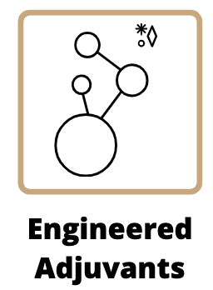
Vaccine Engineering: Areas of Focus
Largely done by computer scientists and bioinformaticians
Need to curate and standardize existing and new data
Stabilize vaccines
Can double as an adjuvant
Regulate the route of entry into antigen presenting cells
Enhance and stabilize vaccine-induced responses
Selectively add well-defined molecules, formulations or both
Notes:
Images made using the free online tool, Canva

Slide 7
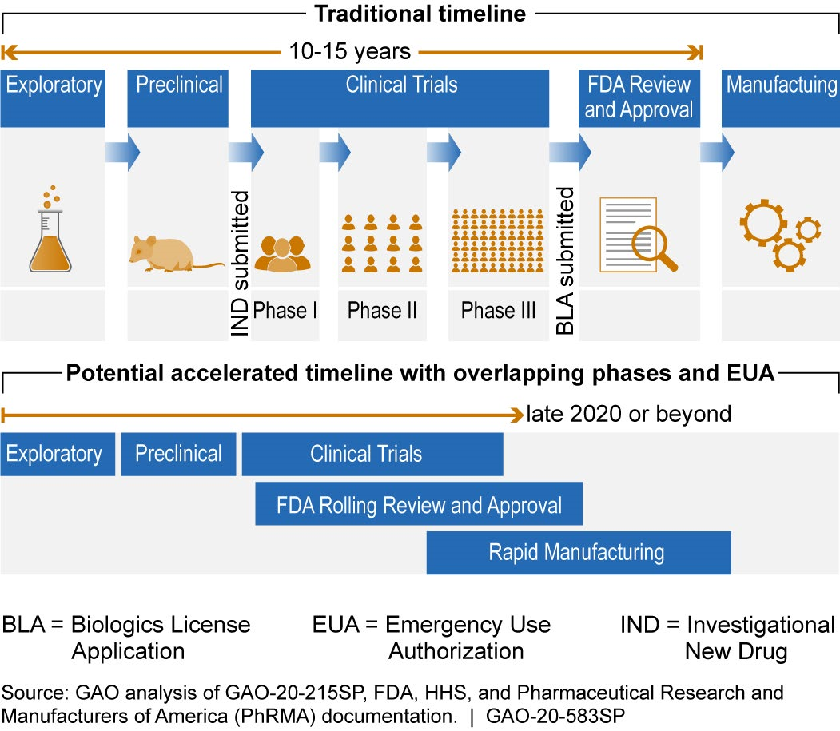
The Vaccine Development Process
(Can take 10-15 years)
General vaccine development steps as given by the CDC:
Exploratory stage
Pre-clinical stage
Clinical development (3 Phase Process)
Regulatory review and approval
Manufacturing
Quality control
Notes:
Image:
SCIENCE & TECH SPOTLIGHT: COVID-19 VACCINE DEVELOPMENT [PDF]. (2020, May 26). U.S. Government Accountability Office.

Slide 8
Step 1: An Investigational New Drug Application (IND)
Describes the vaccine, its method of manufacture, and quality control tests for release
Step 3: A Biologics License Application (BLA)
Must provide the multidisciplinary FDA reviewer team with the efficacy and safety information necessary to make a risk/benefit assessment and to recommend or oppose the approval of a vaccine
Step 5: Presentation of Findings to FDA’s Vaccines and Related Biological Products Advisory Committee External (VRBPAC)
Non-FDA expert committee provides advice to the Agency regarding the safety and efficacy of the vaccine for the proposed indication
3-6 Years
6-12 Years
10-15 Years
Step 0: Pre-Clinical Trials
Assessment as to whether the product is reasonably safe for initial testing in humans
Step 2: Pre-licensure Vaccine Clinical Trials
Includes 3 stages to determine the safety and efficacy of the vaccine, must provide benefits that outweigh the costs
Step 4: Inspection of the Manufacturing Facility
During this stage, the proposed manufacturing facility undergoes a pre-approval inspection during which production of the vaccine as it is in progress is examined in detail.
Step 6: Usability testing of product labeling
Includes potential benefits and risks, to communicate with patients and parents, and to safely deliver the vaccine to the public
Let’s Take a Closer Look at the Timeline...

Slide 9
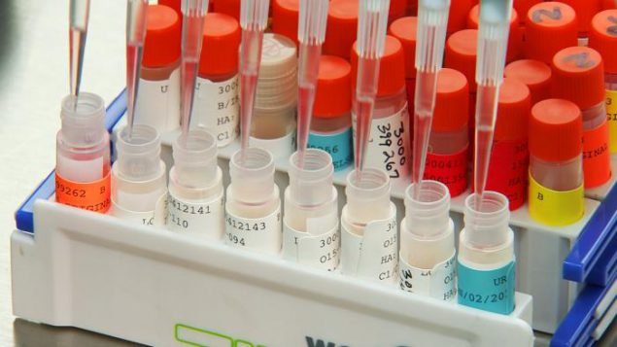
Exploratory Stage
(2-4 years)
Pre-Clinical Stage
(1-2 years)
Basic laboratory research
Can include identifying natural or synthetic antigens that might help prevent or treat a disease
Tissue-culture or cell-culture systems
Animal testing
Assess the safety of the candidate vaccine and its immunogenicity, or ability to provoke an immune response
Rats and monkeys
Notes:
Image:
Cell-Based flu vaccines. (2021, January 25). Retrieved March 01, 2021, from https://www.cdc.gov/flu/prevent/cell-based.htm

Slide 10
Clinical Development
Phase I
(several months)
Phase II
(up to 2 years)
Phase III
(1-3 years)
Small group of adults (20-80 subjects)
Non-blinded
Goal: Assess the safety and determine the type and extent of immune response
Larger group of subjects (several hundred)
Randomized and well controlled
Goal: Study the vaccine’s safety, immunogenicity, proposed doses, schedule of immunizations, and method of delivery.
Thousands to tens of thousands of subjects
Randomized and double blind
Followed by a Biologics License Application to the FDA
Goal: Assess vaccine safety in a large group of people, vaccine efficacy

Slide 11
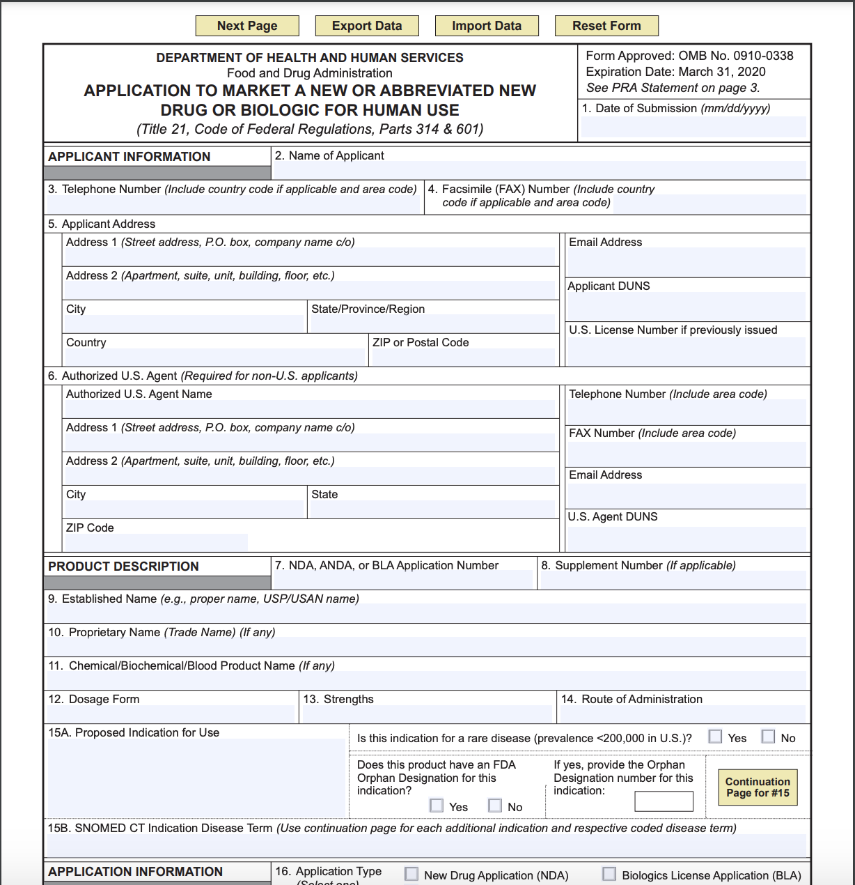
Regulatory Review and Approval
(up to 3 years)
Includes a Biologics License Application (BLA) and Product License Application (PLA)
Presentation of clinical trial findings
Presentation to a non-expert audience
Notes:
Image taken from FDA form found at https://www.fda.gov/about-fda/reports-manuals-forms/forms

Slide 12
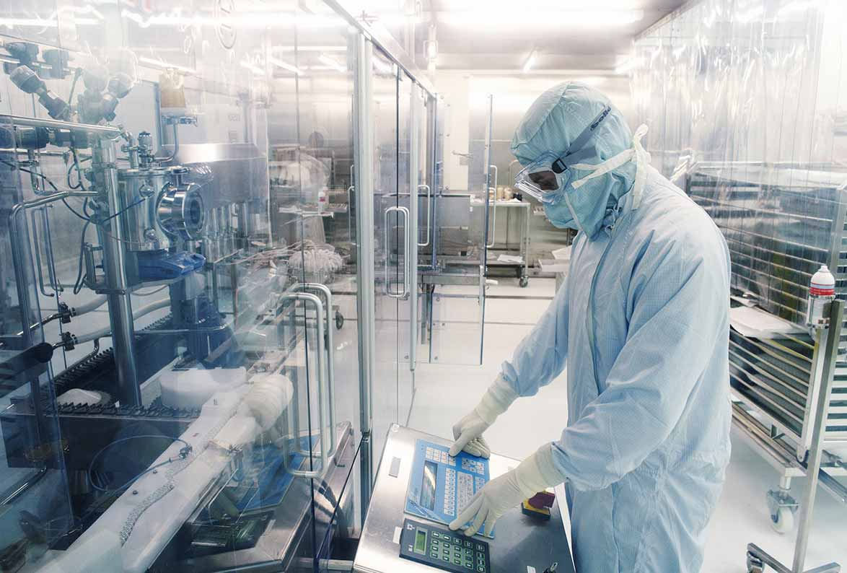
Manufacturing
Proposed manufacturing facility undergoes a pre-approval inspection
Upon approval the company begins production of the actual vaccine
Notes:
Image:
Sanofi. (2019, September). Manufacturing vaccines is a complex journey. Retrieved March 01, 2021, from https://www.sanofi.com/en/your-health/vaccines/production

Slide 13
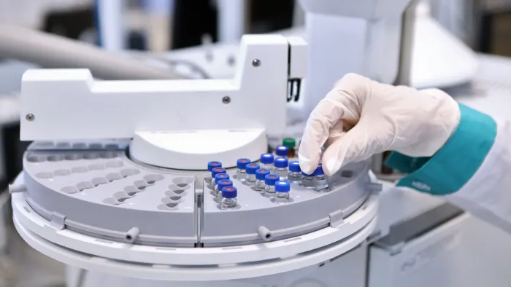
Quality Control
Check the consistency in the production of vaccine
Each batch of the product is of the same quality and specifications of the batch that has been tested
Each batch is shown to be safe and efficacious in research
Notes:
Image:
Miller, J., &amp; Kuchler, H. (2020, April 27). Drugmakers race to scale UP vaccine capacity. Retrieved March 01, 2021, from https://www.ft.com/content/87d1170a-78bc-11ea-bd25-7fd923850377

Slide 14
Pharmaceutical Industry:
Research contracts
Licensing
National Institutes of Health (NIH):
multi-PI grants
PPG
NCRR
RFAs
Contracts (IEDB)
All of this needs funding…
Where would we look?²
?
Biotech Industry:
Funding for IP
Startups
Angel investors
Venture capitalist companies

Slide 15
So how does this relate to the SARS/COVID-19 pandemic?
Notes:
Image:
Pti. (2020, April 24). Zone of comfort: THREE MAHARASHTRA Districts Keep CORONAVIRUS at bay. Retrieved March 01, 2021, from https://www.deccanherald.com/national/west/zone-of-comfort-three-maharashtra-districts-keep-coronavirus-at-bay-829308.html

Slide 16
Analyzing a Virus to Determine Treatment
Where Viruses are in the Environment
How they jump from animals to people
How they spread through a population
How they interact with the human body

Slide 17
Coronavirus Background
Coronaviruses are respiratory diseases, and the cause of the common cold, otherwise known as “mild upper respiratory tract infection”
Severe Rcute Respiratory Syndrome (SARS) | 2003 | Animals to people | Severe symptoms but not easily spread
Middle East Respiratory Syndrome (MERS) | 2012 | Camels to people | Severe symptoms but not easily spread
SARS coronavirus-2 (SARS2) | 2019 | Animals to people | Severe symptoms, and easily spread
Contained in the Middle East
Emerging infectious disease means humans have no immunity

Slide 18
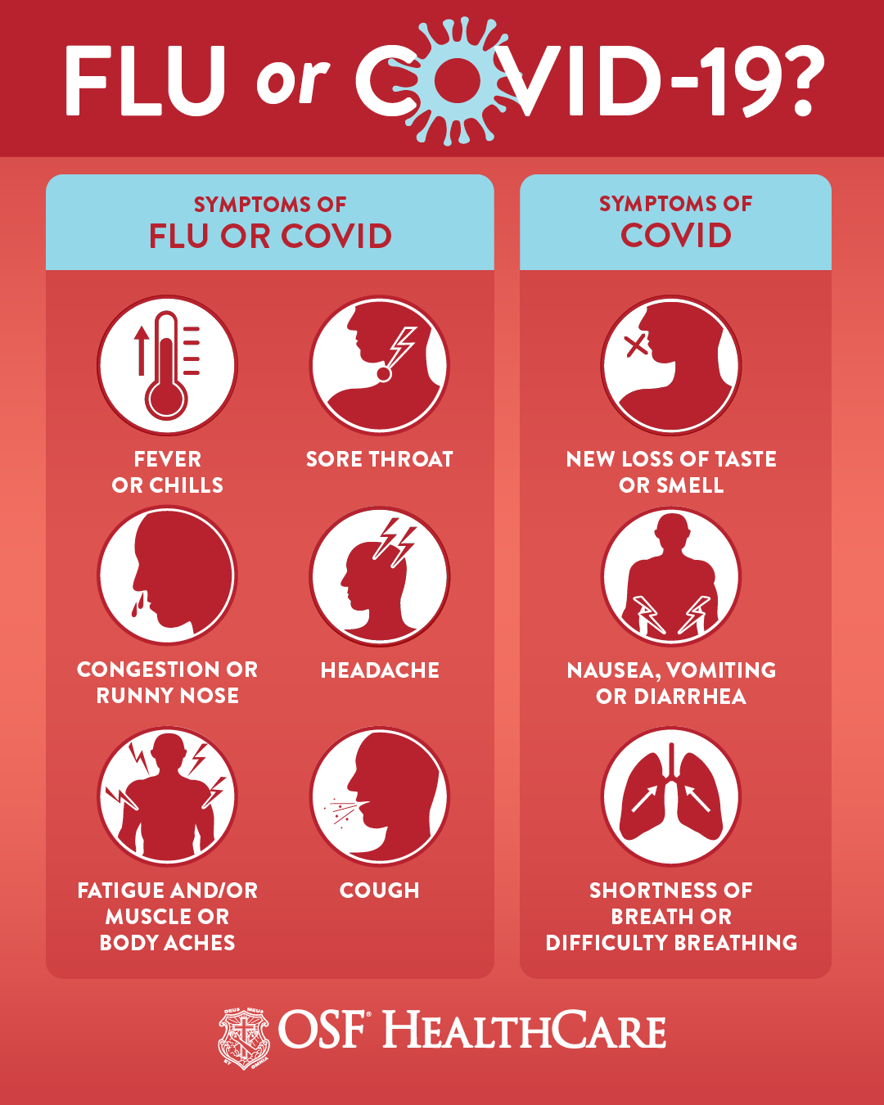
COVID-19 symptoms
2-14 day incubation period before symptoms show
Fever/chills
Cough
Loss of taste/smell
Nausea
Diarrhea
Difficulty breathing *
Bluish fingers *
Pain in chest *
*signs to go to hospital
Notes:
Image:
Wessler, K. (2020, October 03). COVID-19 and the flu are not the same. Retrieved March 01, 2021, from https://www.osfhealthcare.org/blog/covid-19-and-the-flu-are-not-the-same/

Slide 19
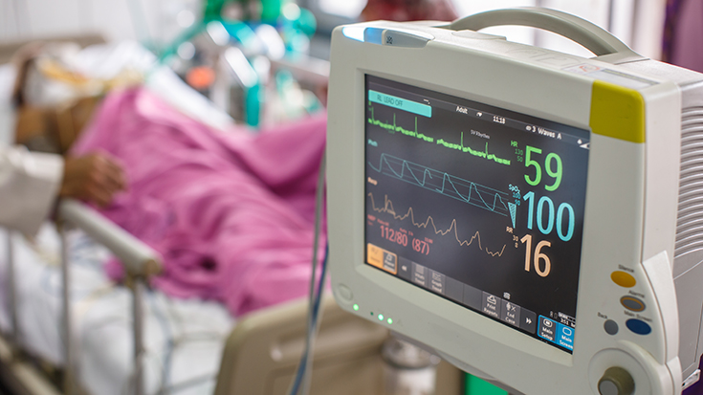
Treatment Plans
Doctors will perform:
Chest x ray
CT scan to view lung tissue
Blood tests
Etc.
To determine if these are needed:
Supplemental oxygen
Mechanical ventilation
Antibiotics
IV fluids
Etc.
Notes:
Image:
Willden, H. (2020, November 02). Mechanical ventilation pre-course: What every rt can learn. Retrieved March 01, 2021, from https://www.aarc.org/nn18-mechanical-ventilation-pre-course-what-every-rt-can-learn/

Slide 20
Risks of the SARS/COVID-19 Vaccine
The SARS/COVID-19 Vaccine comes with the potential issues of:
Antibody-dependent enhancement (ADE), in which a vaccine may actually worsen the consequences of the disease rather than protect
Those most at risk are over 60, with resistance to vaccination beginning as early as 30
May reduce the chance of getting the disease (and its symptoms) but not prevent infection
New variants being less susceptible

Slide 21
“The moment you get a vaccine doesn’t mean you’re going to put your mask in the trash. The reality is there’s probably going to have to be different generations of vaccines”
Maria Elena Bottazzi
Vaccine Developer at Baylor College of Medicine

Slide 22
SARS/COVID-19 Vaccine in the US
Research:
Funding is plentiful
There are many different approaches being studied
High amount of collaboration between small firms developing the vaccines and large drug companies that can mass produce
Original Plan for the Vaccine:
The administration has promised to give the vaccine free to “vulnerable” people who cannot afford it
There will be a tiered approach to distribute the vaccine: older people, people with pre-existing conditions, and health care workers.
3 Main Vaccines Currently Approved in the US
ModernaTX, Inc.
Pfizer Inc.
Johnson & Johnson
* There are other vaccines in use in other countries.

Slide 23
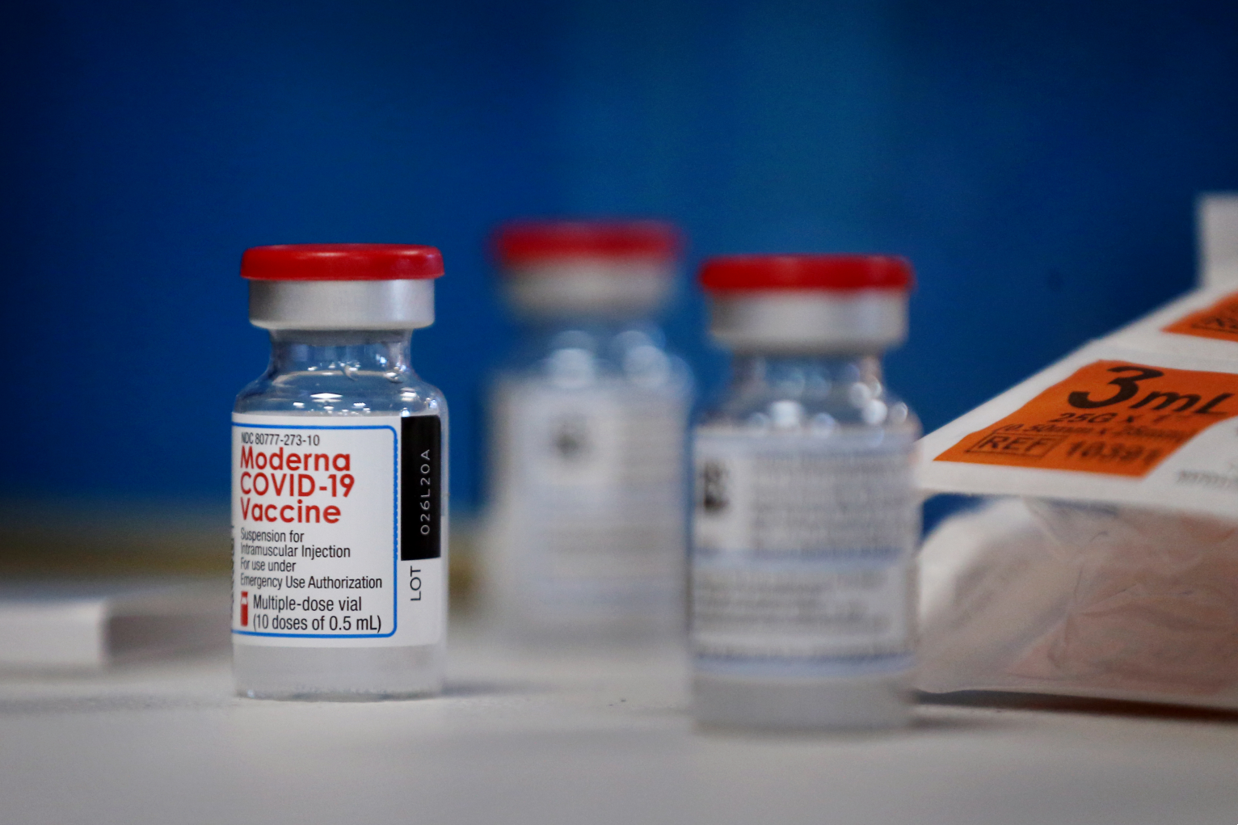
mRNA-1273
ModernaTX, Inc.
Uses messenger RNA, an approach that does not require a virus to make the vaccine
Dosage: 2 shots, one month (28 days) apart
Effectiveness: 94.1%
Minimum Age: 18+
Common Side Effects: Chills, tiredness, headache, pain in area of shot
Duration of Protection: Unknown
Notes:
Image: Lardieri, A. (2021, January 22). Less than 1% of people experienced side effects From Moderna Coronavirus VACCINE, CDC Says. Retrieved March 01, 2021, from https://www.usnews.com/news/health-news/articles/2021-01-22/less-than-1-of-people-experienced-side-effects-from-moderna-coronavirus-vaccine-cdc-says
Slide Guide: mRNA goes to immune cells and instructs them to make copies of the COVID-19 spike protein, acting as if the cells have been infected with the coronavirus.

Slide 24
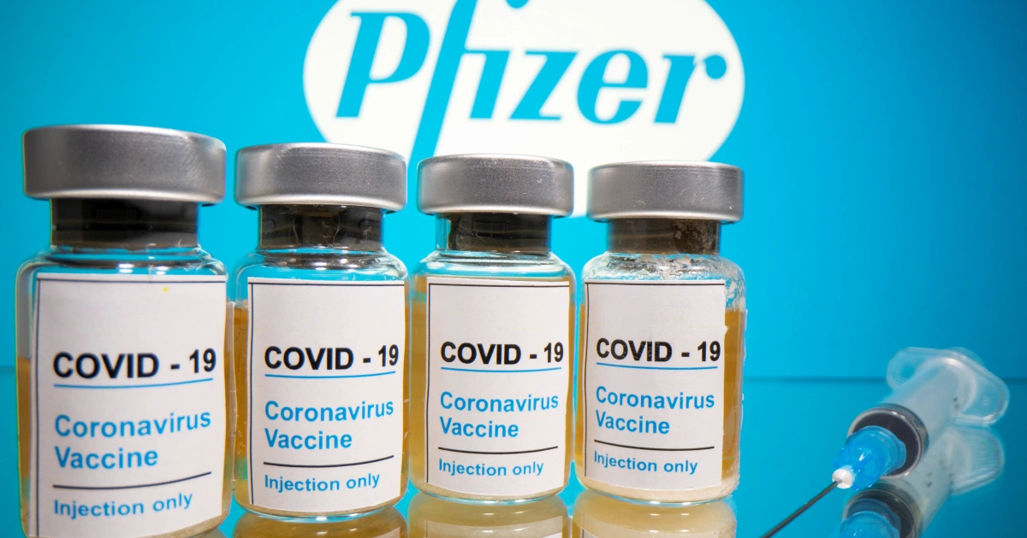
BNT162b2
Pfizer-BioNTech
Uses messenger RNA, an approach that does not require a virus to make the vaccine
Dosage: 2 shots, 21 days apart
Effectiveness: 95%
Minimum Age: 16+
Common Side Effects: Chills, tiredness, headache, pain in area of shot
Duration of Protection: Unknown
Notes:
Image: All you need to know about PFIZER'S COVID-19 vaccine in 600 words. (2020, November 09). Retrieved March 01, 2021, from https://www.aljazeera.com/news/2020/11/9/everything-you-need-to-know-about-the-pfizer-vaccine

Slide 25
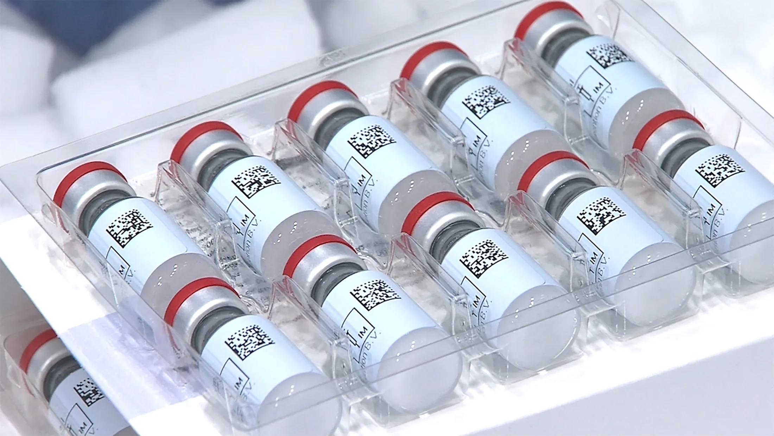
JNJ-78436735 or Ad26.COV2.S.
Johnson & Johnson
Is an Adenovirus-Based Vaccine, which uses non-enveloped, double-stranded DNA viruses
Dosage: 1 shot
Effectiveness: 62% against moderate-severe cases, ~100% against hospitalization and death
Minimum Age: 18+
Common Side Effects: Chills, tiredness, headache, nausea, pain in area of shot
Duration of Protection: Unknown
Notes:
Image:
Johnson &amp; johnson's one-shot COVID vaccine approved in US. (2021, February 28). Retrieved March 01, 2021, from https://asia.nikkei.com/Spotlight/Coronavirus/Johnson-Johnson-s-one-shot-COVID-vaccine-approved-in-US

Slide 26
Decisions, Decisions
So how do we decide the best way to distribute the vaccine?

Slide 27
Allocation Considerations
The allocation of the vaccine shifts depending on the...
Supply
Demand
Vaccine characteristics
Disease epidemiology
The federal government determined the amount of vaccines designated for each jurisdiction, with each jurisdiction’s immunization program responsible for managing and approving the orders and implementation.
Notes:
Image:
Kwwl. (2021, February 11). Plan your Vaccine: NBC launches new site WITH state-specific and Personalized VACCINE INFORMATION. Retrieved March 08, 2021, from https://kwwl.com/2021/02/11/plan-your-vaccine-nbc-launches-new-site-with-state-specific-and-personalized-vaccine-information/

Slide 28
Allocation Disparities
Looking at the spring 2021 system of vaccine allocation and distribution: there were numerous disparities seen between different areas. Examples include the following:
Oregon is prioritizing teachers over the elderly (approach that could help schools and businesses reopen)
New Jersey has put smokers ahead of educators (which could save lives)
Why might these disparities occur?
There are different circumstances and situations
Federal, states, and local health departments as well as medical centers have each developed different allocation formulas, based on a variety of ethical and political considerations
Some areas may have greater numbers of a certain population, such as there being more elderly than educators

Slide 29
The United States used a phased approach.
Phase 1
Phase 2
Phase 3
Potentially limited supply of COVID-19 vaccine doses available
Focus on critical populations
Ensure vaccination locations can reach populations and manage cold chain requirements
Large number of vaccine doses available
Access to vaccine for all critical populations not vaccinated in Phase 1
Attempt to reach the general population
Expand provider network
Surplus of doses
Ensure equitable vaccination across the entire population
Monitor vaccine situation
Reassess strategy to increase uptake in areas with low coverage

Slide 30
Currently, the United States has been using a phased approach.
Healthcare personnel with potential for direct or indirect exposure
Non-healthcare essential workers
Adults with high-risk medical conditions
People 65 years of age and older
X
Phase 1
Phase 2
Phase 3
Potentially limited supply of COVID-19 vaccine doses available
Focus on critical populations
Ensure vaccination locations can reach populations and manage cold chain requirements
Large number of vaccine doses available
Access to vaccine for all critical populations not vaccinated in Phase 1
Attempt to reach the general population
Expand provider network
Surplus of doses
Ensure equitable vaccination across the entire population
Monitor vaccine situation
Reassess strategy to increase uptake in areas with low coverage

Slide 31
The United States used a phased approach.
Testing and approval for children as young as 12 years
Distributions programs held in schools and at community organizations
Ongoing PR to encourage more citizens to get vaccinated.
Incentives such as giveaways, lotteries and raffles
Testing of vaccines for children under 12 – still underway [Summer 2021]
Schools are determining how to handle safety protocols if young students cannot be vaccinated.

Slide 32
For more information on the COVID-19 Vaccines please visit https://www.cdc.gov/vaccines/covid-19/index.html

Slide 33
References
Vaccines: Vac-Gen/Imz Basics main page. (2018, May 16). Retrieved July 30, 2020, from https://www.cdc.gov/vaccines/vac-gen/imz-basics.htm
UC San Diego. (n.d.). Vaccine Engineering Center (VEC). Retrieved July 30, 2020, from https://iem.ucsd.edu/centers/vec-vaccine-engineering.html
MacDonald, A. (2020, July 06). Antigen vs Antibody – What Are the Differences? Retrieved July 30, 2020, from https://www.technologynetworks.com/immunology/articles/antigen-vs-antibody-what-are-the-differences-293550
Reed, S., Orr, M. & Fox, C. Key roles of adjuvants in modern vaccines. Nat Med 19, 1597–1608 (2013). https://doi.org/10.1038/nm.3409
Sauna, Z. E., PhD. (n.d.). Immunogenicity of Protein-based Therapeutics. Retrieved July 30, 2020, from https://www.fda.gov/vaccines-blood-biologics/biologics-research-projects/immunogenicity-protein-based-therapeutics
Doheny, K. (2020, June 22). COVID-19 Vaccine: Latest Updates. Retrieved July 30, 2020, from https://www.webmd.com/lung/news/20200610/covid-19-latest-updates
Haseltine, W. A. (2020, June 22). The Risks of Rushing a COVID-19 Vaccine. Retrieved July 30, 2020, from https://www.scientificamerican.com/article/the-risks-of-rushing-a-covid-19-vaccine/

Slide 34
References
Moderna's Work on a COVID-19 Vaccine Candidate. (1970, July 27). Retrieved July 30, 2020, from https://www.modernatx.com/modernas-work-potential-vaccine-against-covid-19
Kumar, S., Singh, M. P., Bharti, V. K., & Pandey, R. P. (2018). Quality control of vaccines-A journey from classical approach to 3Rs. Microbiology: Current Research, 02(03). doi:10.4066/2591-8036.18-369
Information about the Moderna Covid-19 Vaccine. (2021, January 25). Retrieved March 01, 2021, from https://www.cdc.gov/coronavirus/2019-ncov/vaccines/different-vaccines/Moderna.html
Information about THE Pfizer-BioNTech Covid-19 Vaccine. (2021, January 25). Retrieved March 01, 2021, from https://www.cdc.gov/coronavirus/2019-ncov/vaccines/different-vaccines/Pfizer-BioNTech.html
Corum, J., &amp; Zimmer, C. (2021, February 27). How the Johnson &amp; Johnson vaccine works. Retrieved March 01, 2021, from https://www.nytimes.com/interactive/2020/health/johnson-johnson-covid-19-vaccine.html
U.S. Department of Health & Human Services. (2020, October 29). COVID-19 Vaccination Program Interim Playbook for Jurisdictions Operations Annex [PDF].

