Slide 1
Vaccine Development
Game Idea : Claire Kenny and Avika Bansal
Game Implementation and Editing: Claire Kenny
Begin
Instructions
Disclaimer: Information within this game was collected during the Spring of 2021 and is subject to change.
Notes:
Images used in this game were made by the editor, found on Pexels a free image gallery that requires no accreditation, or formally cited in the speaker notes

Slide 2
How to Play
Work through the interactive game by using the information on vaccine development you learned in class
Click on highlighted words or in the main text to see more information
You can go back home or to the previous page at anytime
As you go through the activity, fill out the given worksheet
For help, reference the hand-out containing the vaccine development process
This symbol will always take you to the previous page (go back button)
This symbol will always take you to the home page

Slide 3
How to Play
This is an example of what clicking on a highlighted word will do.
Work through the interactive game by using the information on vaccine development you learned in class
Click on highlighted words in the main text to see more information
You can go back home or to the previous page at anytime
As you go through the activity, fill out the given worksheet
For help, reference the hand-out containing the vaccine development process

Slide 4
MAIL
now
Notes:
Chambers, B. (2019, September 15). How well does Desktop Safari work on iPad in Ipados 13? Retrieved May 09, 2021, from https://9to5mac.com/2019/09/15/desktop-safari-ipad/

Slide 5
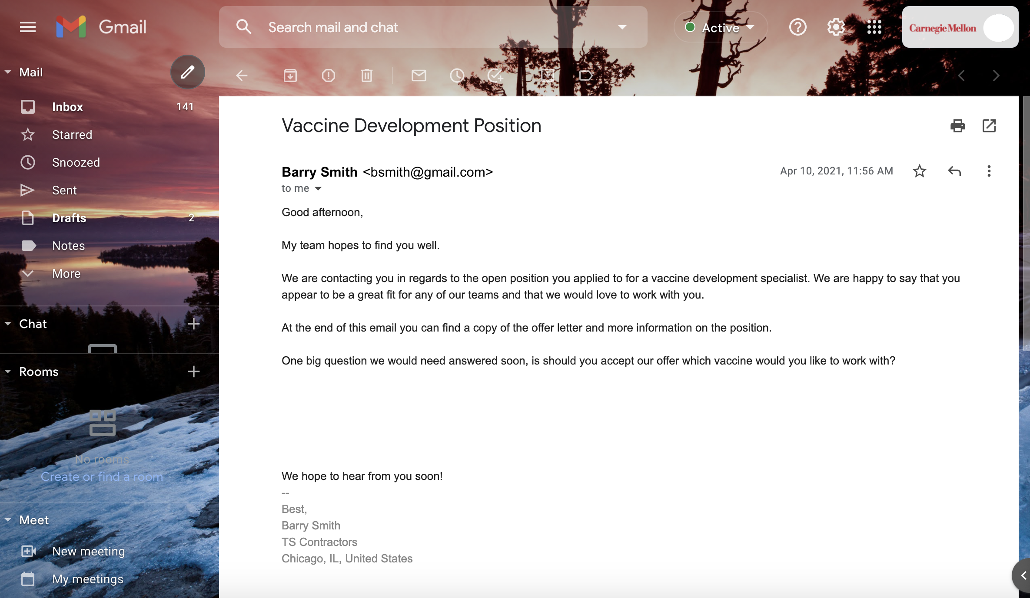
mRNA-1273 ModernaTX, Inc.
BNT162b2 Pfizer-BioNTech
JNJ-7843673 Johnson & Johnson

Slide 6
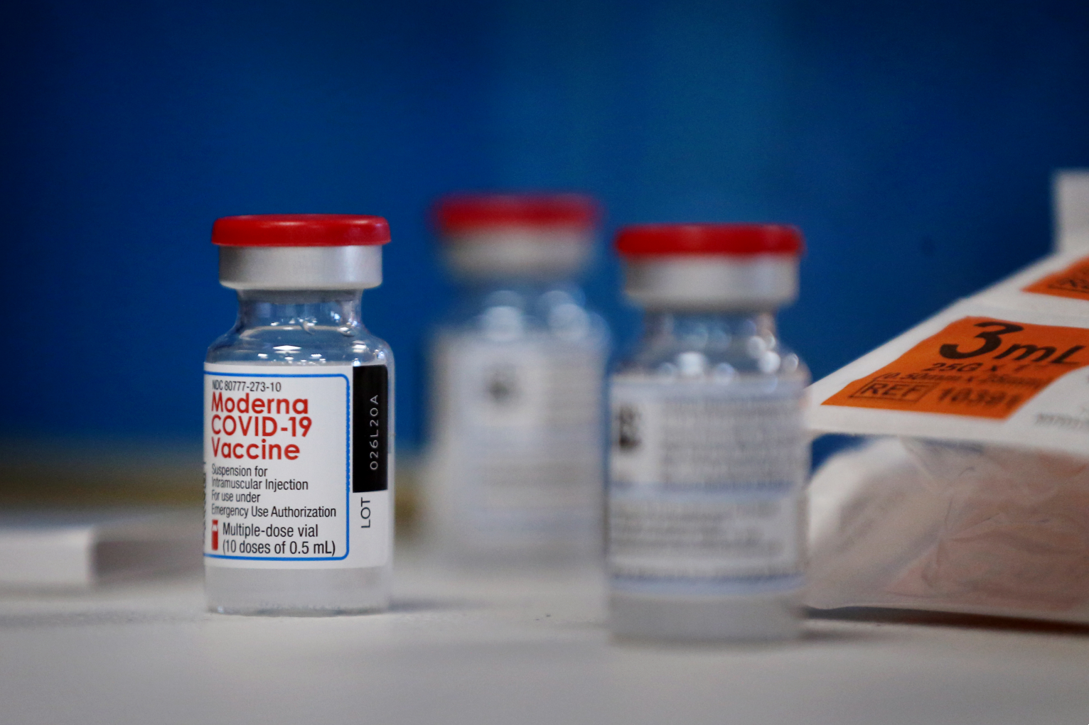
Welcome to ModernaTX, Inc! You have chosen to work on the mRNA-1273 vaccine. We are excited to have you on our team!
Please make sure to read and take note of the information below about our vaccine.
Uses messenger RNA, an approach that does not require a virus to make the vaccine
Dosage: 2 shots, one month (28 days) apart
Effectiveness: 94.1%
Minimum Age: 18+ [as of June 2021]
Common Side Effects: Chills, tiredness, headache, pain in area of shot
Duration of Protection: Unknown
CONTINUE
Notes:
Lardieri, A. (2021, January 22). Less than 1% of people experienced side effects From Moderna Coronavirus VACCINE, CDC Says. Retrieved May 09, 2021, from https://www.usnews.com/news/health-news/articles/2021-01-22/less-than-1-of-people-experienced-side-effects-from-moderna-coronavirus-vaccine-cdc-says

Slide 7
Vaccine method that uses mRNA to immune cells instruct immune cells to make copies of the COVID-19 spike protein, acting as if the cells have been infected with the coronavirus
Welcome to ModernaTX, Inc! You have chosen to work on the mRNA-1273 vaccine. We are excited to have you on our team!
Please make sure to read and take note of the information below about our vaccine.
Uses messenger RNA, an approach that does not require a virus to make the vaccine
Dosage: 2 shots, one month (28 days) apart
Effectiveness: 94.1%
Minimum Age: 18+ [as of June 2021]
Common Side Effects: Chills, tiredness, headache, pain in area of shot
Duration of Protection: Unknown

Slide 8
Welcome to Pfizer-BioNTech! You have chosen to work on the BNT162b2 vaccine. We are excited to have you on our team!
Please make sure to read and take note of the information below about our vaccine.
Uses messenger RNA, an approach that does not require a virus to make the vaccine
Dosage: 2 shots, 21 days apart
Effectiveness: 95%
Minimum Age: 12+ [as of 6/2021; may be expanded]
Common Side Effects: Chills, tiredness, headache, pain in area of shot
Duration of Protection: Unknown
CONTINUE
Notes:
Pfizer and BioNTech could make $13bn FROM Coronavirus vaccine. (2020, November 10). Retrieved May 09, 2021, from https://www.theguardian.com/business/2020/nov/10/pfizer-and-biontech-could-make-13bn-from-coronavirus-vaccine

Slide 9
Welcome to Pfizer-BioNTech! You have chosen to work on the BNT162b2 vaccine. We are excited to have you on our team!
Vaccine method that uses mRNA to immune cells instruct immune cells to make copies of the COVID-19 spike protein, acting as if the cells have been infected with the coronavirus
Please make sure to read and take note of the information below about our vaccine.
Uses messenger RNA, an approach that does not require a virus to make the vaccine
Dosage: 2 shots, 21 days apart
Effectiveness: 95%
Minimum Age: 16+ [as of 6/2021; may be expanded]
Common Side Effects: Chills, tiredness, headache, pain in area of shot
Duration of Protection: Unknown

Slide 10
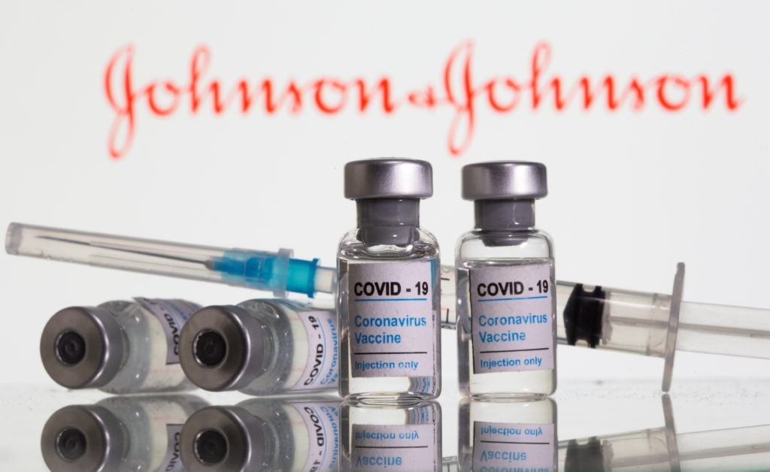
Welcome to Johnson & Johnson! You have chosen to work on the JNJ-7843673 vaccine. We are excited to have you on our team!
Please make sure to read and take note of the information below about our vaccine.
Is an Adenovirus-Based Vaccine, which uses non-enveloped, double-stranded DNA viruses
Dosage: 1 shot
Effectiveness: 62% against moderate-severe cases, ~100% against hospitalization and death
Minimum Age: 18+
Common Side Effects: Chills, tiredness, headache, nausea, pain in area of shot
Duration of Protection: Unknown
CONTINUE
Notes:
Lardner, R., & Johnson, L. A. (2021, April 01). Company at heart of Johnson & Johnson vaccine woes Has series of citations. Retrieved May 09, 2021, from https://www.pbs.org/newshour/health/company-at-heart-of-johnson-johnson-vaccine-woes-has-series-of-citations

Slide 11
Welcome to Johnson & Johnson! You have chosen to work on the JNJ-7843673 vaccine. We are excited to have you on our team!
Vaccine method that uses modified, non-enveloped, double-stranded DNA viruses to deliver genetic material that can produce the COVID-19 spike protein. They are highly researched, and easy to design and mass produce.
Please make sure to read and take note of the information below about our vaccine.
Is an Adenovirus-Based Vaccine, which uses non-enveloped, double-stranded DNA viruses
Dosage: 1 shot
Effectiveness: 62% against moderate-severe cases, ~100% against hospitalization and death
Minimum Age: 18+
Common Side Effects: Chills, tiredness, headache, nausea, pain in area of shot
Duration of Protection: Unknown

Slide 12
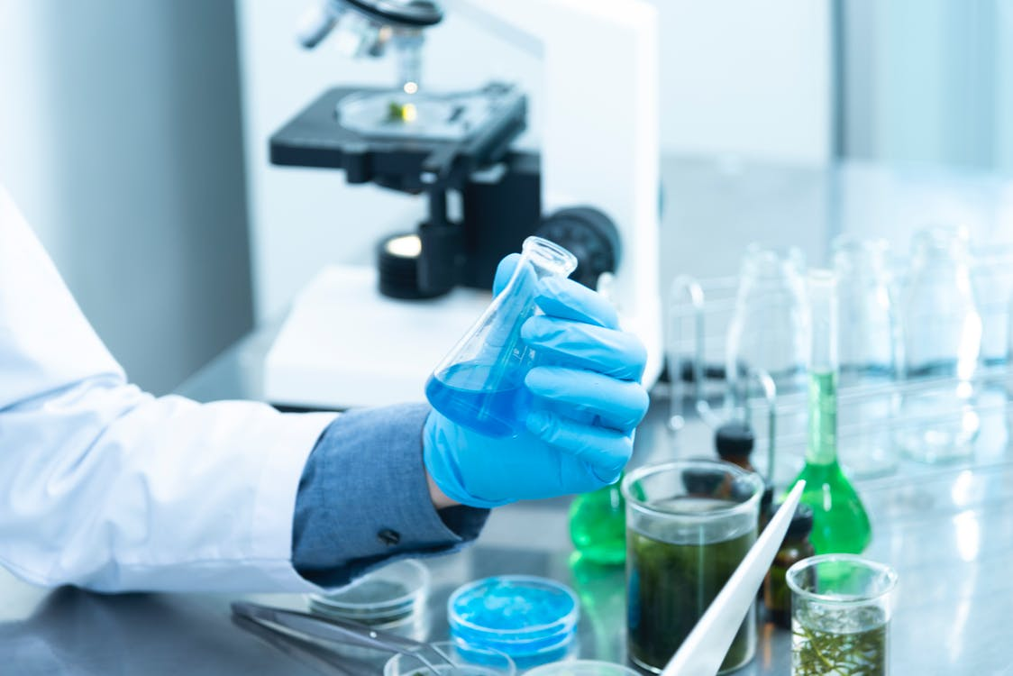
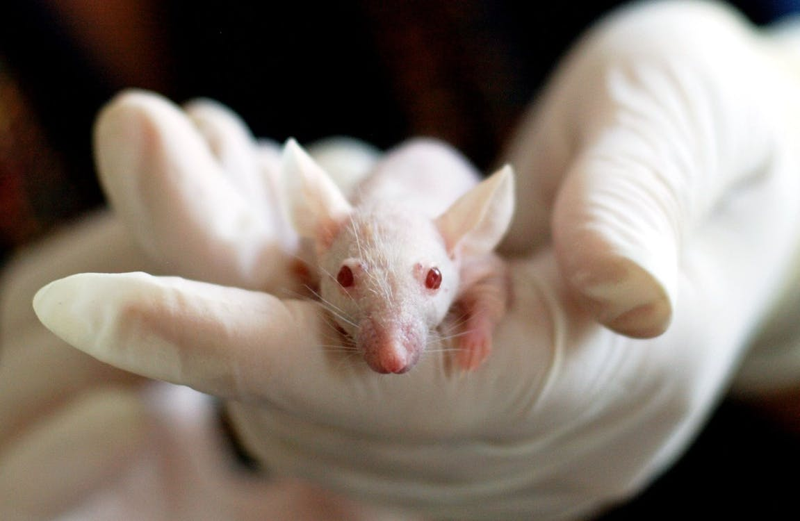
Our first step is to perform preclinical trials, which group would you like to work with?
Cell and Tissue Cultures
Animal Testing
More Info
More Info

Slide 13
Our first step is to perform preclinical trials, which group would you like to work with?
Candidate vaccine viruses are grown in mammalian tissue culture of cells with a finite lifespan. The virus is then extracted, purified, and tested or modified.
Cell and Tissue Cultures
Animal Testing
More Info
More Info

Slide 14
Our first step is to perform preclinical trials, which group would you like to work with?
Researchers administer the vaccine to animals, and later try to infect them with the targeted pathogen. The appropriate animal model can be valuable in determining the potential immune response in humans.
Cell and Tissue Cultures
Animal Testing
More Info
More Info

Slide 16
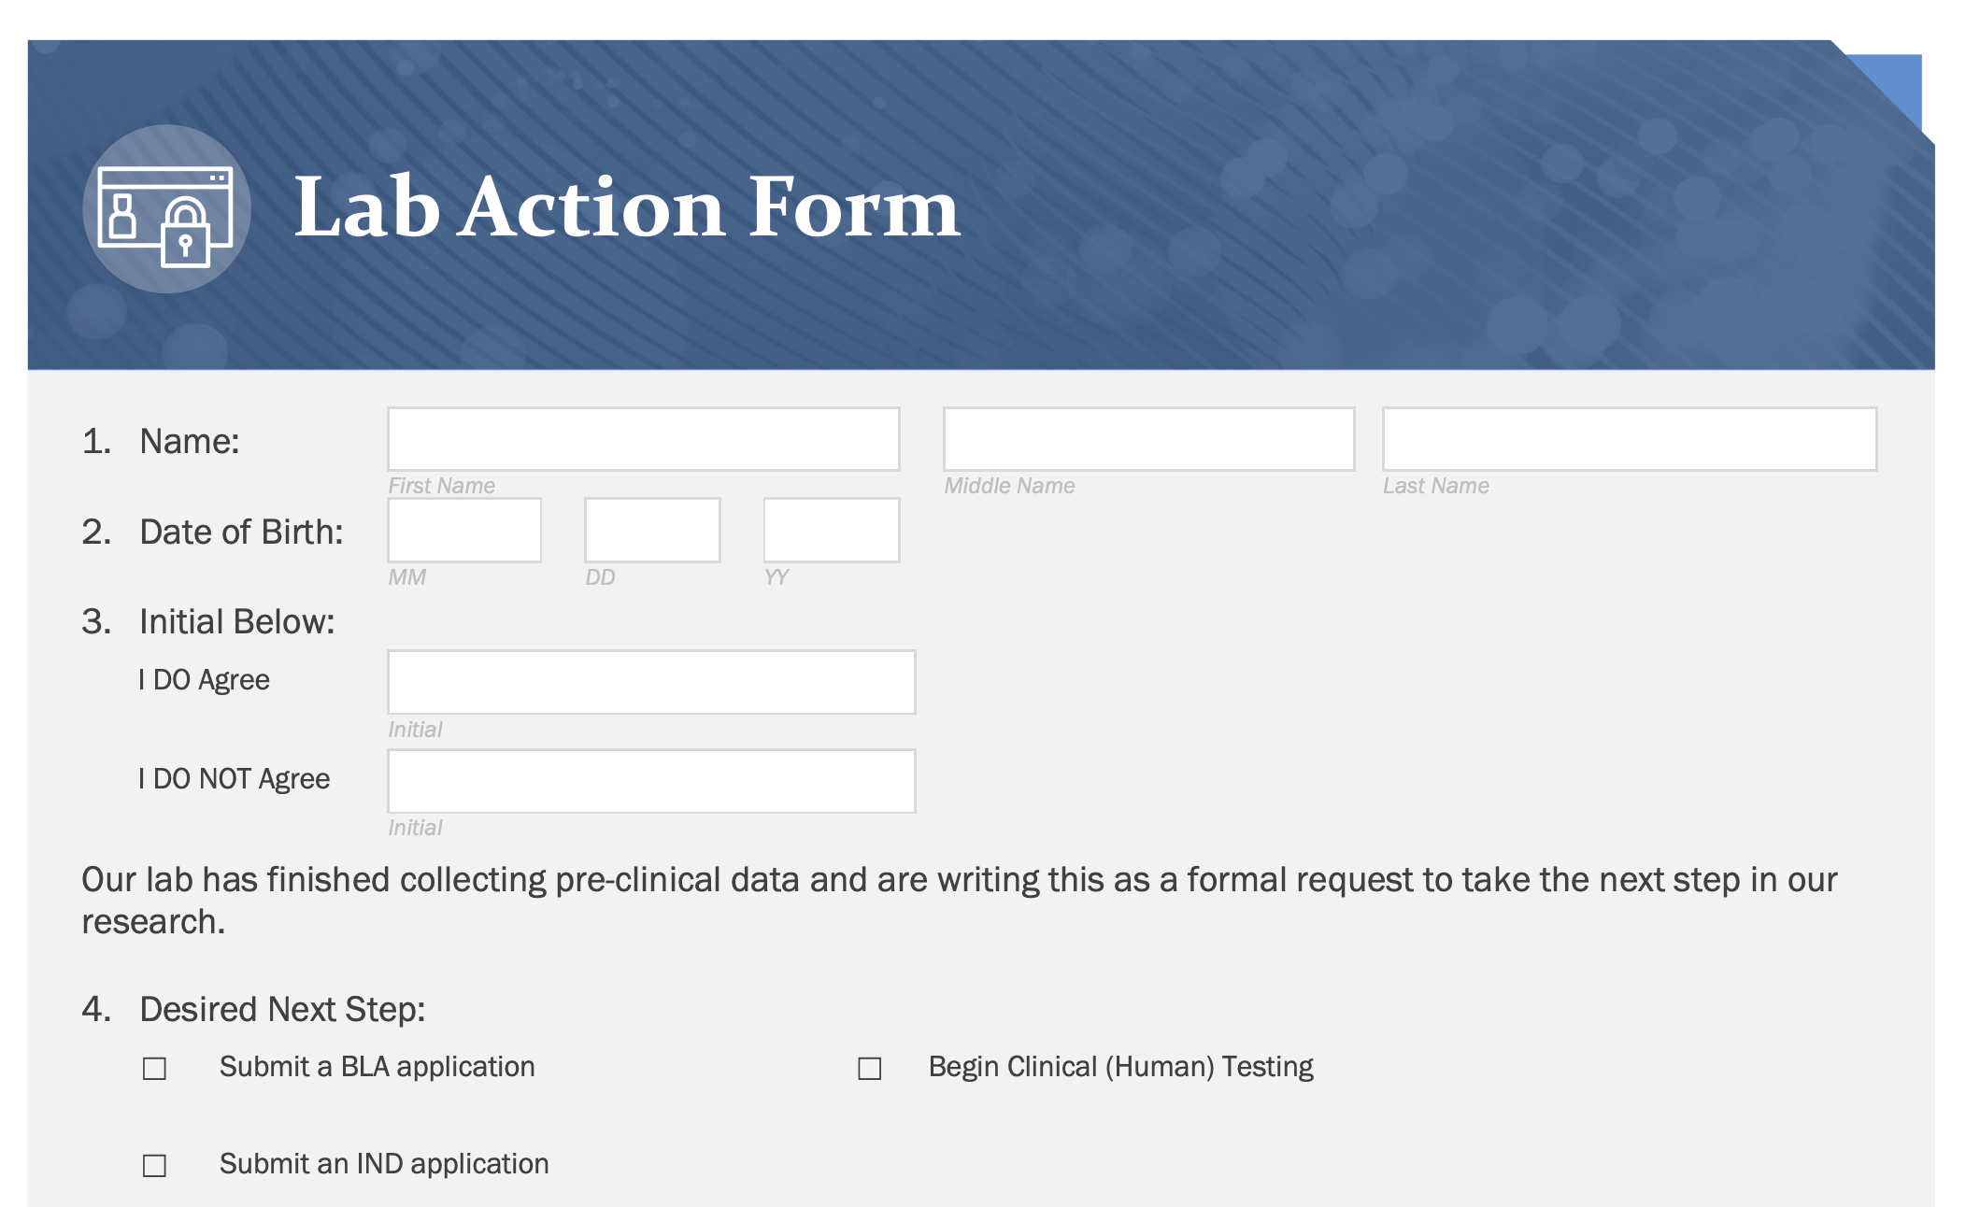

Slide 17
BLA: A form provided to a multidisciplinary FDA reviewer team who can approve or deny further studies. A BLA must contain information on the efficacy and safety information necessary to make a risk/benefit assessment.

Slide 18
IND: A document containing a description of our vaccine, its method of manufacture, and quality control tests for release. This document is constantly being updated throughout the development process and is actually part of the BLA form used after clinical trials.

Slide 19
Oops! We did not have any clinical data to submit a BLA application. Try again!

Slide 20
So close! We have not yet submitted a form containing our pre-clinical findings, and therefore did not receive clearance to begin human trials just yet.

Slide 22
Good choice! We submitted an IND application and have been given the clearance to begin human trials! What group of participants should we choose for Phase I?
Group of 46 adults, from different regions of the US, ranging in ages 21-70, non-blinded study
Group of 72 adults, from different regions, ranging ages 18-45, blinded study
Group of 16 adults, all from 1 Pennsylvania hospital, all above 50 years, non-blinded study
Group of 62 adults, from different regions of the US, ages 40-75, non-blinded study

Slide 23
Good choice! We submitted an IND application and have been given the clearance to begin human trials! What group of participants should we choose for Phase I?
Oh no! It looks like you chose a group that either lacked randomness or was a blinded study. Try again!
Group of 46 adults, from different regions of the US, ranging in ages 21-70, non-blinded study
Group of 72 adults, from different regions, ranging ages 18-45, blinded study
Group of 16 adults, all from 1 Pennsylvania hospital, all above 50 years, non-blinded study
Group of 62 adults, from different regions of the US, ages 40-75, non-blinded study

Slide 24
Group of 900 from all regions of the us, between the ages of 25-70 years
Group of 230 from all regions of the US, above the ages of 16
Awesome! Now we can move to Phase II test subjects! What are we looking for?
Group of 800 all from Florida and Georgia, all below the age of 60

Slide 25
Oh no! It looks like you chose a Phase II group that lacked randomness. Try again!
Group of 900 from all regions of the us, between the ages of 25-70 years
Group of 230 from all regions of the US, above the ages of 16
Awesome! Now we can move to Phase II test subjects! What are we looking for?
Group of 800 all from Florida and Georgia, all below the age of 60

Slide 26
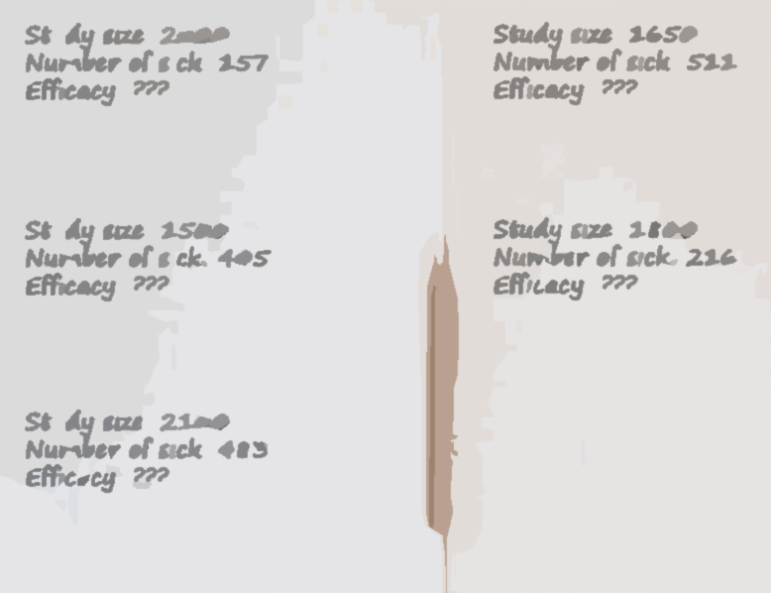

Slide 27
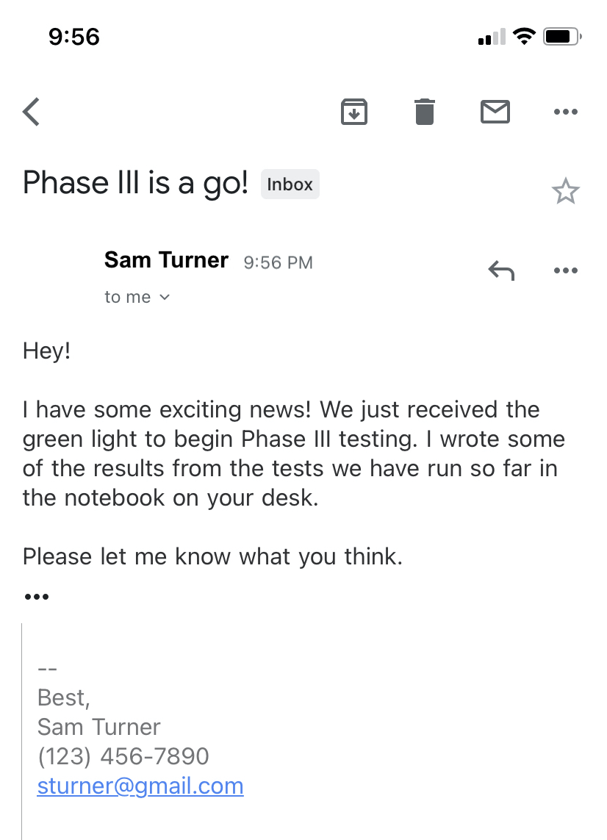
notebook

Slide 28
Study size: 2000
Number of sick: 157
Efficacy: ???
Study size: 1650
Number of sick: 511
Efficacy: ???
Study size: 1500
Number of sick: 405
Efficacy: ???
Study size: 1800
Number of sick: 216
Efficacy: ???
Study size: 2100
Number of sick: 483
Efficacy: ???

Slide 29
Study size: 2000
Number of sick: 157
Efficacy: ???
Study size: 1650
Number of sick: 511
Efficacy: ???
Looks like we may need to check our numbers again. The efficacy of that group was not high enough for approval.
Study size: 1500
Number of sick: 405
Efficacy: ???
Study size: 1800
Number of sick: 216
Efficacy: ???
Study size: 2100
Number of sick: 483
Efficacy: ???

Slide 30
Pause
Please ask your teacher for a
BLA Form before continuing
CONTINUE

Slide 31
VAXLAB
Home About Analyze Results Next Steps Sign In/Register
Next Steps
Click on what we should do next!
Present our findings to the VRBPAC (a non-FDA expert committee)
Request an inspection of our manufacturing site
Release our vaccine to the public
Begin manufacturing the vaccine
Notes:
This Photo by Unknown Author is licensed under CC BY-SA-NC

Slide 32
VAXLAB
Home About Analyze Results Next Steps Sign In/Register
Uh oh! We have skipped over quite a few steps and have not been given clearance to officially begin manufacturing our vaccine or release it to the public.
Present our findings to the VRBPAC (a non-FDA expert committee)
Request an inspection of our manufacturing site
Release our vaccine to the public
Begin manufacturing the vaccine
Notes:
This Photo by Unknown Author is licensed under CC BY-SA-NC

Slide 33
VAXLAB
Home About Analyze Results Next Steps Sign In/Register
Next Steps
Click on what we should do next!
Present our findings to the VRBPAC (a non-FDA expert committee)
Release our vaccine to the public
Notes:
This Photo by Unknown Author is licensed under CC BY-SA-NC

Slide 34
VAXLAB
Home About Analyze Results Next Steps Sign In/Register
Next Steps
Click on what we should do next!
Request an inspection of our manufacturing site
Release our vaccine to the public
Notes:
This Photo by Unknown Author is licensed under CC BY-SA-NC

Slide 35
VAXLAB
Home About Analyze Results Next Steps Sign In/Register
Next Steps
Click on what we should do next!
We tried to release our vaccine to the public too early! We skipped a couple of steps before we could be officially approved for use by the public.
Request an inspection of our manufacturing site
Release our vaccine to the public
Notes:
This Photo by Unknown Author is licensed under CC BY-SA-NC

Slide 36
VAXLAB
Home About Analyze Results Next Steps Sign In/Register
Next Steps
Click on what we should do next!
We tried to release our vaccine to the public too early! We skipped a couple of steps before we could be officially approved for use by the public.
Request an inspection of our manufacturing site
Release our vaccine to the public
Notes:
This Photo by Unknown Author is licensed under CC BY-SA-NC

Slide 37
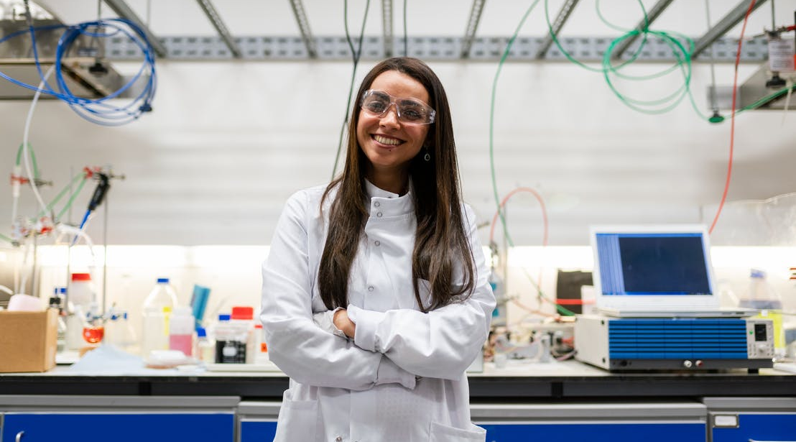
Great! A non-FDA committee has now given their insight on our vaccine and approved the efficacy and safety. Also, our manufacturing facility has been inspected and approved for commercial use.
Now we can focus in on quality control.
Continue

Slide 38
Great! A non-FDA committee has now given their insight on our vaccine and approved the efficacy and safety. Also, our manufacturing facility has been inspected and approved for commercial use.
Now we can focus in on quality control.
Procedure or set of procedures intended to ensure the manufactured product continues to deliver the same set of quality criteria (safety, efficacy, etc.) Essentially we would like to ensure the process we use results in every batch we produce being the same.
Continue

Slide 39
!

Slide 40
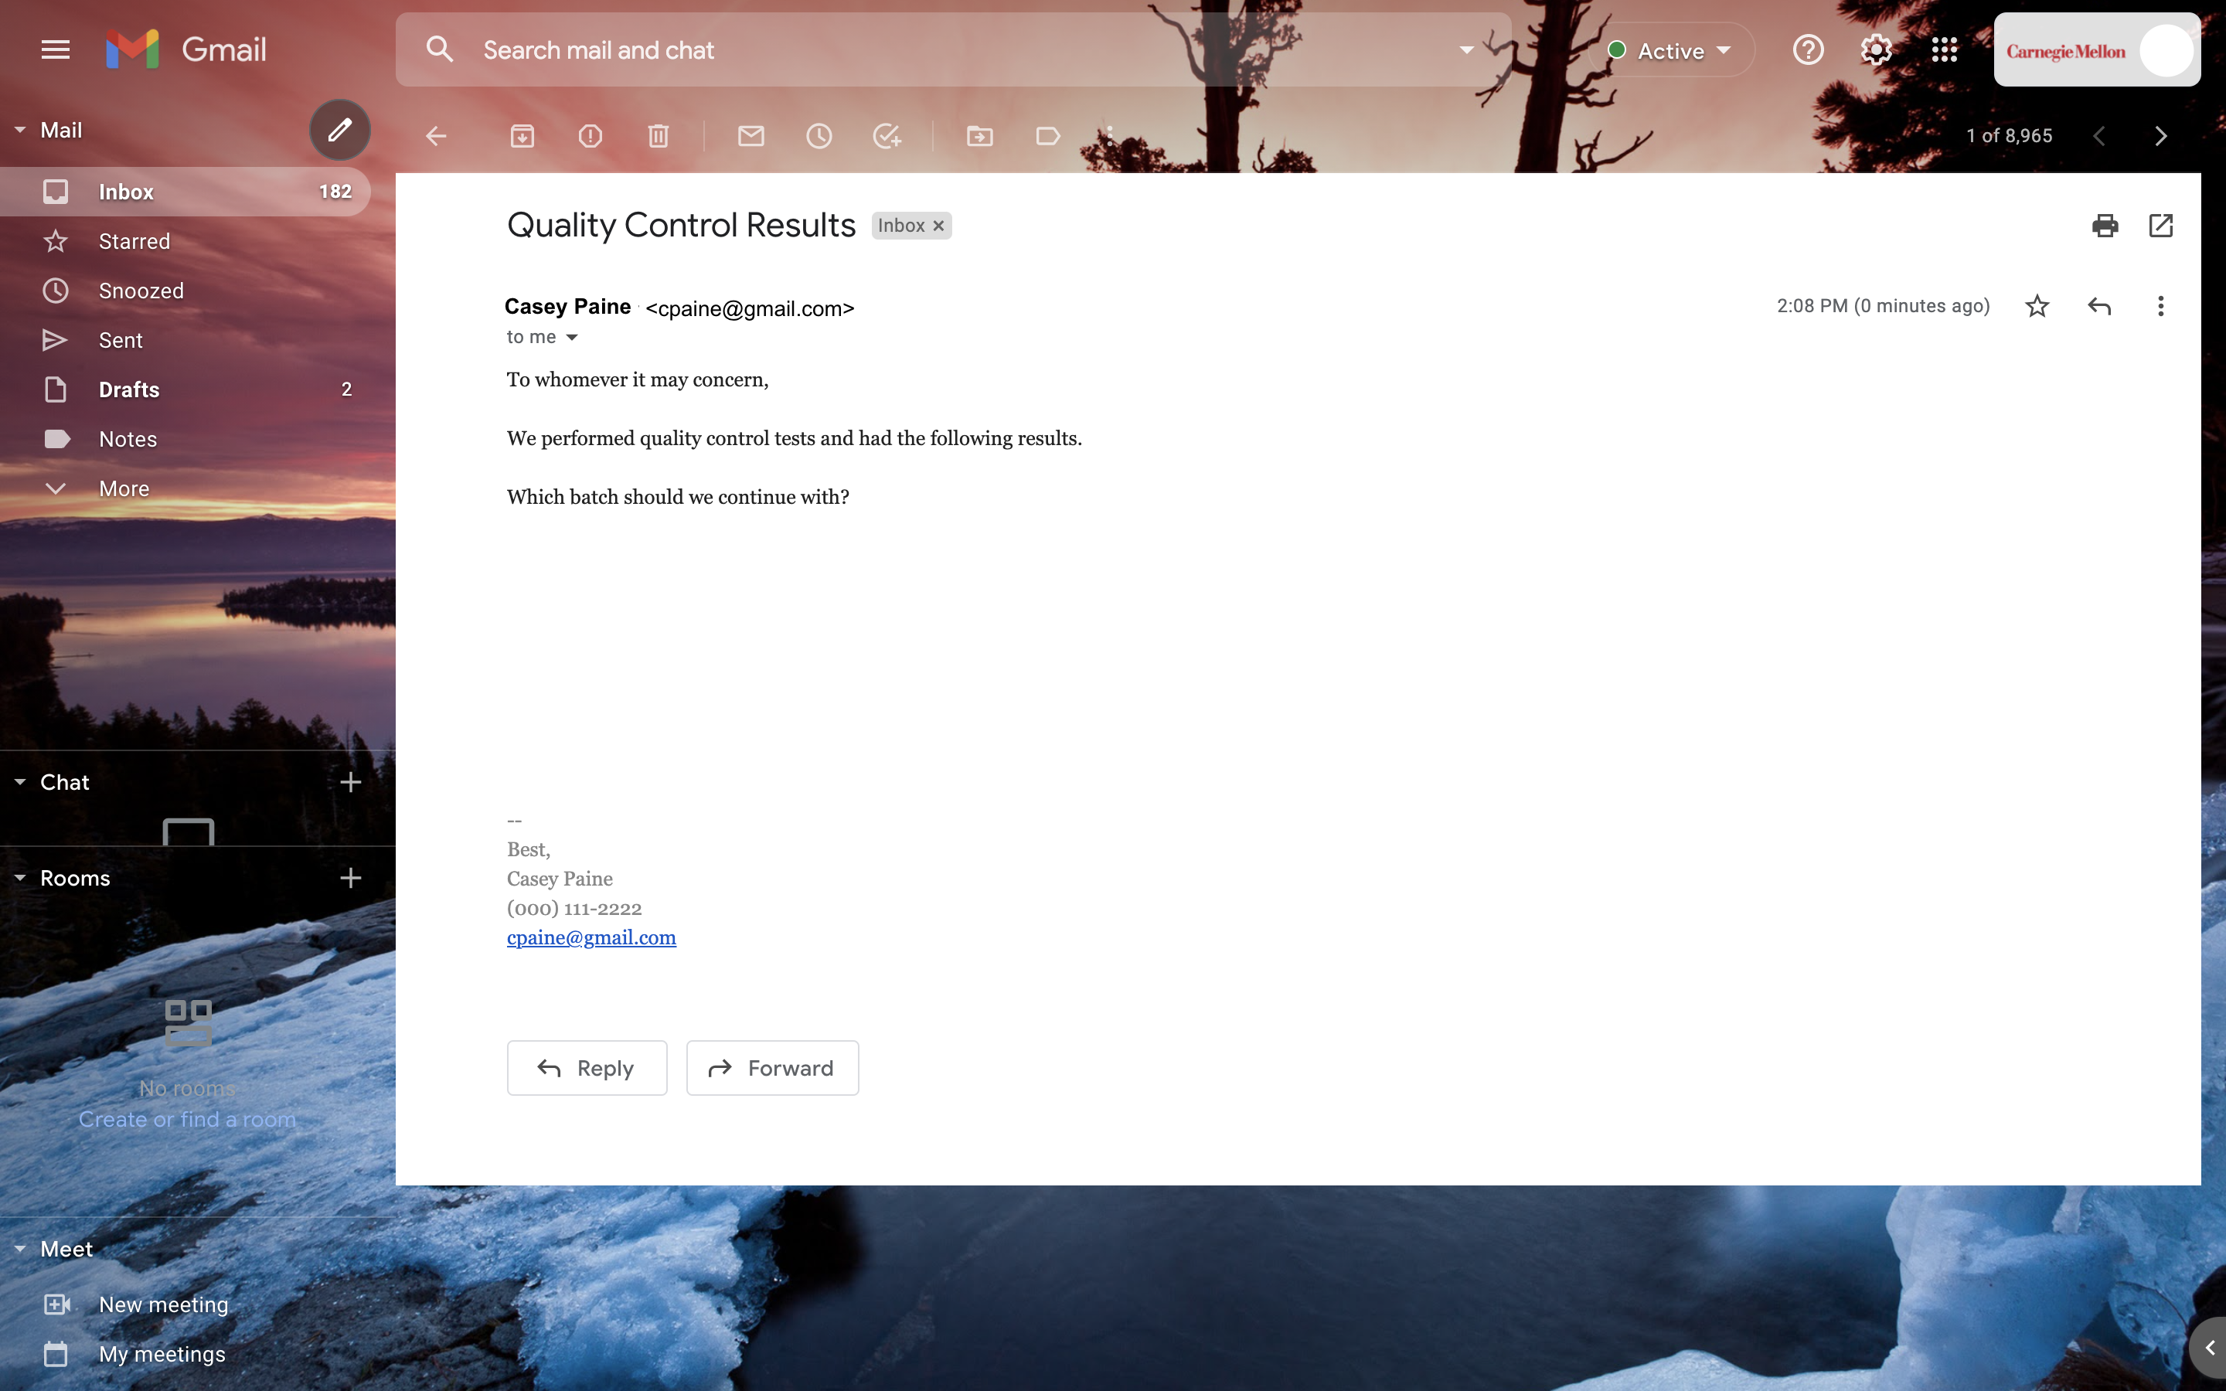
After testing 4,730 vaccine batches, 1,419 batches have congealed After testing 30 vaccine batches, 6 batches have a slightly higher temperature After testing 3,120 vaccine batches, 140 batches have a different color After testing 400 batches, 48 batches have been corrupted by a miscommunication between two employees

Slide 41
Oh no! The different batches indicate there being a major error in the production process, with the percentage of errors being too high to be considered negligible.
After testing 4,730 vaccine batches, 1,419 batches have congealed After testing 30 vaccine batches, 4 batches have a slightly higher temperature After testing 3,120 vaccine batches, 140 batches have a different color After testing 400 batches, 48 batches have been corrupted by a miscommunication between two employees

Slide 42
After testing 3,120 vaccine batches, 140 batches have a different color
This batch indicates a mistake was made during the production process, however the failure rate is quite low and we can continue to print labels.
To begin making labels click on the printer!

Slide 43
After testing 400 batches, 48 batches have been corrupted by a miscommunication between two employees
Mistakes were made, but not in the process, but by human error. Therefore, those employees should be reprimanded, and we should go back and retest our formula. Once doing so we can continue to print labels.
To begin making labels click on the printer!

Slide 44
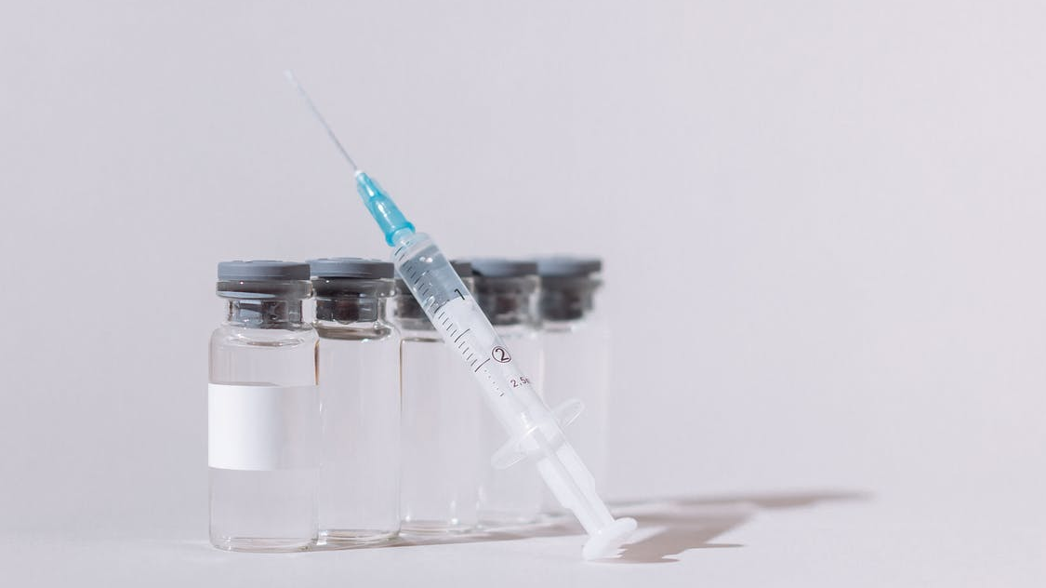
Vaccine labels must contain the following information:
Highlights limitation statement
Drug names, dosage form, route of administration, and controlled substance symbol
Initial U.S. approval
Boxed warning
Recent major changes
Indications and usage
Dosage and administration
Dosage forms and strengths
Contraindications
Warnings and precautions
Adverse reactions.

Slide 45
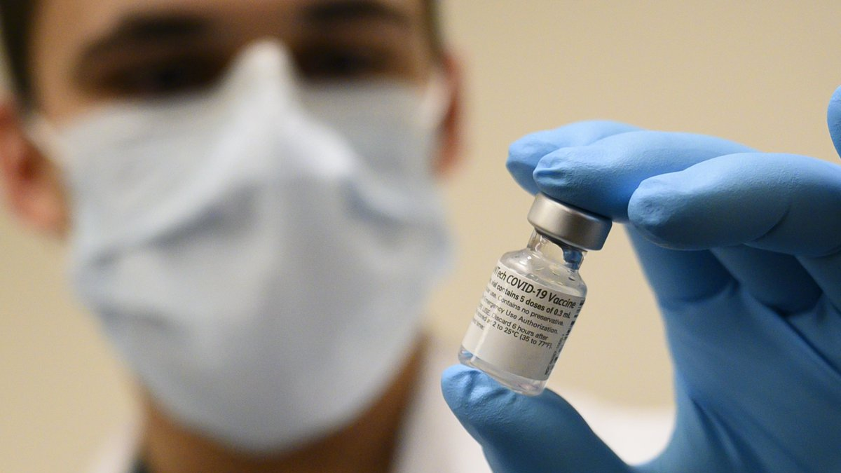
Our labels have been approved! We are now in the last stretch. What would you like to do next?
Release our vaccine to the public
Continue testing
Notes:
Verga, D. (2021, February 10). Mrna and the future of vaccine manufacturing. Retrieved May 09, 2021, from https://www.path.org/articles/mrna-and-future-vaccine-manufacturing/

Slide 46
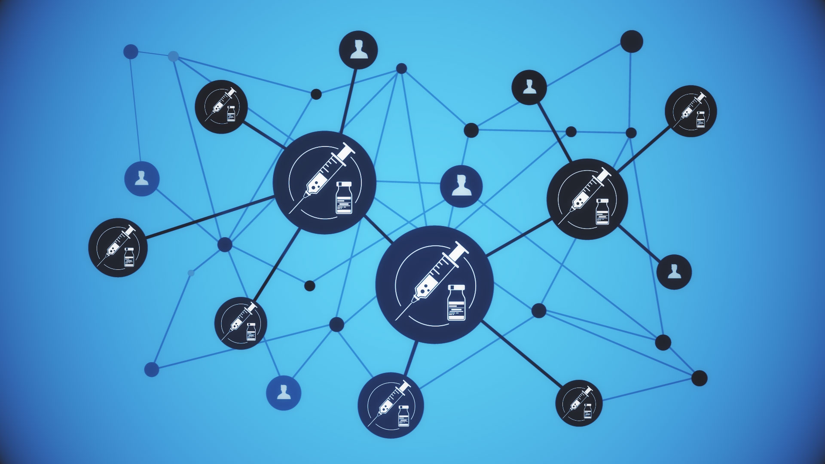
Technically both choices were correct. When making a vaccine we can never be sure that our formula is the best, or that the disease in question will not change. Therefore, we should always continue testing to ensure continuous efficacy, safety, and quality control.
Release Vaccine
Notes:
Lakey, D., & Auerbach [email protected] @HealthyAmerica1, J. (2020, September 14). The key to efficient vaccine distribution: Start preparing early. Retrieved May 09, 2021, from https://www.statnews.com/2020/09/14/key-to-efficient-vaccine-distribution-start-preparing-early/

Slide 47
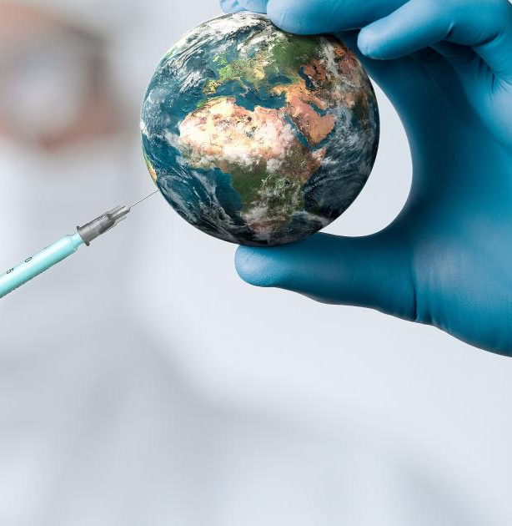
Congratulations!
Our vaccine has finally been released; however, this is not the end. There is no "final" or "best" vaccine, as a disease can change, and everyone is different.
We may need to adjust our formula in the future and take into consideration different disease variants. We still want to ensure quality control of our product and stay up-to-date with the public. The FDA will also be conducting further evaluations down the road, so we will need to be prepared for those. Thank you for all your help!
End
Notes:
Scharper, J. (2020, July 6). Protection for all: Equitable distribution of covid-19 vaccines. Retrieved May 09, 2021, from https://magazine.jhsph.edu/2020/protection-all-equitable-distribution-covid-19-vaccines

