Slide 1
Stem Cells
What are stem cells and what is stem cell therapy?
Created by: Isabel Joyce and Cassandra Dodson
Notes:
Main title: 40 pt. Arial
Presenter Name: 16 pt. Arial
Presenters Title: 16 pt. Arial Italic

Slide 2
This educational resource for high school audiences was developed as a project by Carnegie Mellon student[s], Isabel Joyce and Cassandra Dodson, for the course Biomedical Engineering Directed Study, taught by Dr. Conrad Zapanta in spring 2022. Dr. Judith Hallinen served as a consultant.

Slide 3
CAUTION: If you are attempting an experiment, it is important to make sure that you are following all safety steps. All experiments should be completed with supervision of a adult. Weather permitting, we recommend taking messy experiments outside. Remember to wear safety gear like gloves, aprons, and goggles, especially for experiments with chemical reactions!
The materials and information presented made be used for educational purposes as described in the Terms of Use at www.cmu.edu/gelfand and parents/legal guardians are responsible for taking all necessary safety precautions for the experiments. To the maximum extent allowed under law, Carnegie Mellon University is not responsible for any claims, damages or other liability arising from using the materials or conducting the experiments.
Be SAFE and enjoy the modules!

Slide 4
Sources for content and for images that are included in these slides can be found in the accompanying script and on the slides at the end of the file.
You can use the Stem Cell Vocabulary Worksheet to take notes throughout the presentation.

Slide 5
Table of contents
01
02
What are stem cells?
What do stem cells do?
Learn what stem cells are and how they differ from other cell types.
Learn what role stem cells play in the body. What is their job?
03
04
Types of stem cells?
Why do we care in medicine?
Learn the different types of stem cells and why they’re important.
Learn the current research. How can we leverage the functionality of stem cells in therapies?

Slide 6
Cell Review
Let’s do a quick review on what a cell is, before we delve into stem cells!

Slide 7
Mammalian Cell Review
Cell are the smallest unit of life.
Cells are composed of four main parts:
Nucleus
Membrane
Organelles
Cytoplasm
There are different types of cells with different functions, depending on the organ they live in!

Slide 8
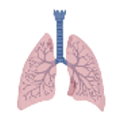
Levels of Organization in the Body
Tissue
Organism
DNA
Cell
Comprised of many cells, to form a functional unit.
Organ
Comprised of many organs, to form a human!
Genetic information, stored in the nucleus of the cell.
Smallest unit of life in the body.
Comprised of many tissues, to form a functional unit.

Slide 9
01
What are stem cells?
Learn what stem cells are and how they differ from other cell types.

Slide 10
Imagine…
You are a high school senior, right about to graduate with plans to go to college. Whatever major you choose to study, you will develop your skills in that area. When you graduate, imagine you find a job related to your major. That job will have a specific role and contribution to society…

Slide 11
You’re just like a stem cell!
Stem cells start off as functionally non-specific, however they differentiate and grow into cells with specific functions and roles in the body.

Slide 12
What is the definition of a stem cell?
Differentiation
Self-Renewal
The ability of the stem cell to develop into many different types of cells in the body.
The ability of the stem cell to self-regenerate many times. This contributes to the stock of stem cells in the body.
Google Image: https://www.yourgenome.org/facts/what-is-a-stem-cell

Slide 13
02
What do stem cells do?
Learn what role stem cells play in the body. What is their job?

Slide 14
Think…
Remember the last time you got a cut? What did your body do to repair the injury?

Slide 15
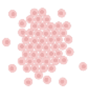
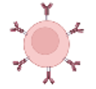
The Healing Process
Injury
Proliferation
Clot is formed to stop the bleeding.
Inflammatory
New cells are formed and move to the site of healing.
Remodeling
Immune cells fight any infection and get rid of debris.
New tissue continues to mature and increase strength.
Notes:
functional (good tissue) vs non functional (scar) remodeling

Slide 16
In the proliferation phase, how were new skin and blood cells created?
Answer: stem cells!

Slide 17
What do stem cells do?
They create new functionally-specific cells!
Reminder that stem cells:
1) differentiate (become more specific) AND
2) self-renew
We see stem cells becoming fully differentiated cells in wound healing to create new skin and blood cells… can you think of any other situations in the body where you would need to generate new cells?

Slide 18
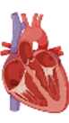
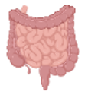
Other stem cell functions in the body:
Broken Bone
Heart Attack
Regrow bone cells after a broken bone.
Heart muscle regrowth after a heart attack.
Hair Regrowth
Intestinal Lining
Grow new hair cells daily.
Damage to intestinal lining repaired frequently.

Slide 19
03
Types of stem cells?
Learn the different types of stem cells and why they’re important.

Slide 20
Embryonic Stem Cells
What are they?
Where do we find these cells?
Embryonic stem cells are pluripotent cells that can differentiate into any cell of the human body
Embryonic stem cells are found in the blastocyst of a human embryo (4-7 days after fertilization)
Pros and Cons
Easy to find/isolate
Pluripotent
Immortal
Ethical concerns
Potential of tumor formation

Slide 21
Adult Stem Cells
These cells are multipotent and can be partially or fully differentiated
Important in wound healing, maintaining cell populations, and renewing cells
Stem Cell Niche
Pros and Cons
This is a specific region in the body where adult stem cells live and grow
Adult stem cells are isolated from these regions for research, treatment, etc.
Ethically sound method of stem cell use
Multipotent
Difficult to locate/isolate

Slide 22
Adult Stem Cell Types
Epithelial
Neural
Become skin, intestinal gland and vessel lining,
Found in the niches of the skin, hair, etc.
Become neurons & neural support cells
Found in subventricular and subgranular zones
Mesenchymal
Hematopoietic
Differentiate into cells of the cartilage, fat, muscle, etc.
Found in bone marrow, adipose tissue, and umbilical cord blood
Various cells of the blood.
Found in the bone marrow and umbilical cord blood

Slide 23
Induced Pluripotent Stem Cells (iPS)
iPS cells are produced through transdifferentiation (reprogramming) of somatic cells
Where are they found?
How are they reprogrammed?
What cells can they become?
iPS cells are taken from skin or blood cells
Transcription factors are introduced into the cell to change gene expression
Reprogrammed iPS cells are pluripotent and can differentiate into any cell type
Pros and Cons
Teratoma formation
Pluripotent
Immortal
Easy to create

Slide 24
04
Why do we care in medicine?
Learn the current research. How can we leverage the functionality of stem cells in therapies?

Slide 25
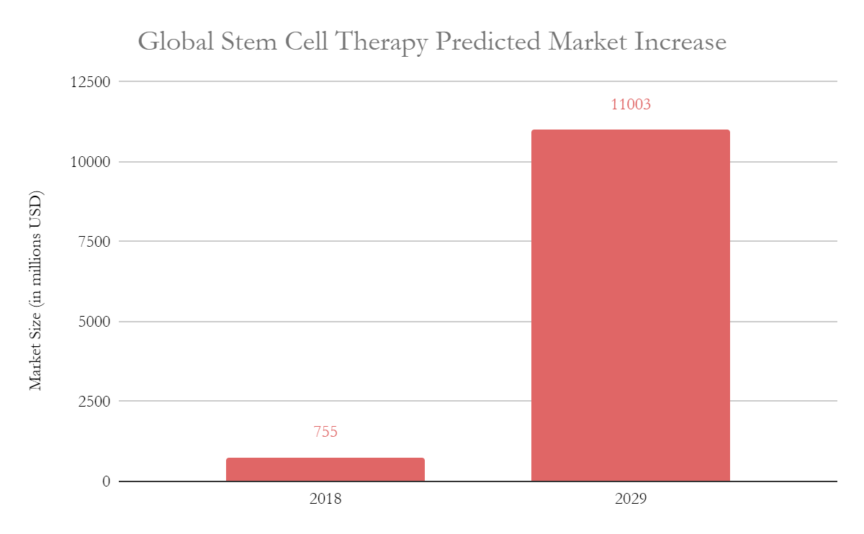
The stem cell therapy market is growing!

Slide 26
What do stem cells do in the body?
Answer: create new cells to maintain functionality of cells in tissues For example: creating new bone cells after a broken bone.

Slide 27
Can you think of any ways stem cells can be used as therapies?

Slide 28
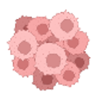
Stem Cell Therapies
Alzheimer’s
Diabetes
Replace diseased neural cells with new neurons.
Replace insulin pancreas cells.
Blindness
Heart Attack
Replace dead retinal cells with new cells.
Regrow heart muscle cells.
Cancer
Vascular Grafts
Creation of medical devices with stem cells reduces inflammatory response.
Utilize regenerative ability to study cancer growth.

Slide 29
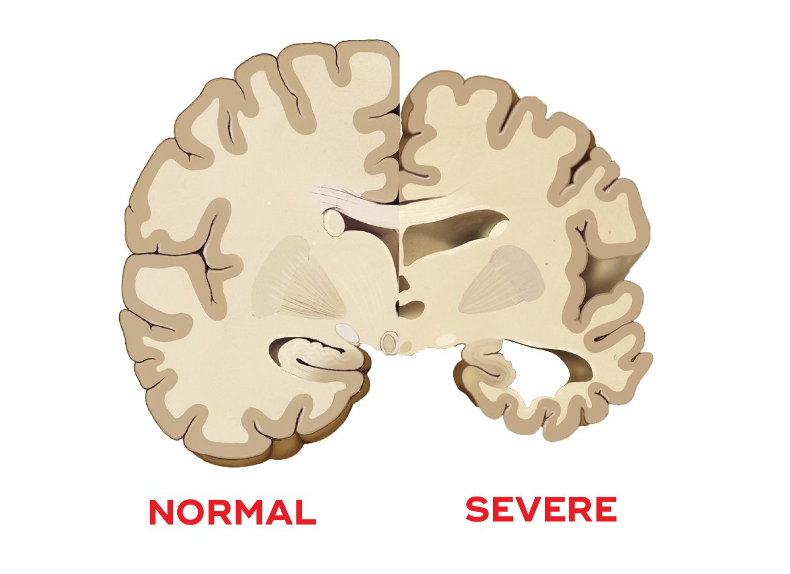
The Alzheimer’s Brain
Alzheimer’s involves the degeneration of neurons, which causes memory loss.
Over 6 million people are living with Alzheimer’s dementia.
Notice the loss in mass of the Alzheimer’s brain?
Stem cell therapy offers potential cures to Alzheimer’s, by regrowing the neurons!

Slide 30
Thanks for using this Stem Cell Presentation!
Credited with BioRender.com.

Slide 31
References
Note: details about references can be found in the associated Instructor Slide Guide!
ScienceDaily. (n.d.). Embryonic stem cell. ScienceDaily. Retrieved May 5, 2022, from https://www.sciencedaily.com/terms/embryonic_stem_cell.htm
What are mesenchymal stem cells (mscs)? What are Mesenchymal Stem Cells (MSCs)? (n.d.). Retrieved May 4, 2022, from https://www.dvcstem.com/post/what-are-mesenchymal-stem-cells
Name*. (2021, January 31). Steady-state hematopoietic stem cells for transplantation. Research Features. Retrieved May 5, 2022, from https://researchfeatures.com/steady-state-hematopoietic-stem-cells-transplantation/
Maintaining epithelial stemness with p63 - science.org. (n.d.). Retrieved May 4, 2022, from https://www.science.org/doi/10.1126/scisignal.aaa1033
Authors Janet Y. Le, Authors Udochukwu Amanamba, Authors Hiba Hasan, & Authors Bianca Westhoff. (n.d.). What are neural stem cells, and why are they important? Frontiers for Young Minds. Retrieved May 3, 2022, from https://kids.frontiersin.org/articles/10.3389/frym.2016.00020
Ye, L., Swingen, C., & Zhang, J. (2013, February 1). Induced pluripotent stem cells and their potential for basic and Clinical Sciences. Current cardiology reviews. Retrieved May 5, 2022, from https://www.ncbi.nlm.nih.gov/pmc/articles/PMC3584308/
Global stem cell therapy market in 2018 and a forecast for 2029 (in millions of U.S. dollars). Statistica.
What are the seven stages of Dementia? SunDowners Syndrome.
Alzheimer’s Facts and Figures Report. Alzheimer’s Association.
Images created with BioRender.com.
Notes:
details can be found in associated slide guide

