Slide 1


Interactive Ovarian Histology Lab
Created by: Claire Kenny, Materials Science & Engineering, Biomedical Engineering, 2021
Building on an activity developed by Meghan McGraw, Chemical Engineering, Biomedical Engineering, 2022

Slide 2

This educational resource for high school audiences was created as a project by Carnegie Mellon student Meghan McGraw for the course Experiential Learning through Projects, Section O, taught by Dr. Conrad Zapanta and Dr. Judith Hallinen during the summer of 2020. Claire Kenny, also a Carnegie Mellon student translated the original virtual lab into this interactive PowerPoint presentation.
Click on the links on the next slide to get information and to begin the lab.
Note: sources for the information and images are included on slides at the end of this file.
www.cmu.edu/gelfand
www.cmu.edu/bme

Slide 3
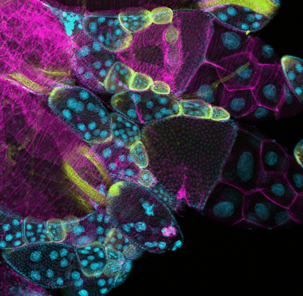
Interactive Ovarian Histology Lab
Enter Lab
Contents
How to Play
Notes:
Collins, F. (2019, February 21). Students contribute to research through ovarian art. Retrieved February 09, 2021, from https://directorsblog.nih.gov/2019/02/21/students-contribute-to-research-through-ovarian-art/

Slide 4


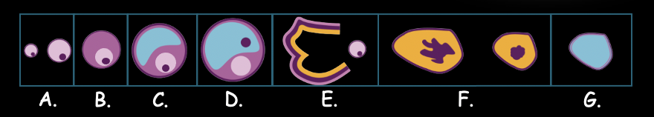
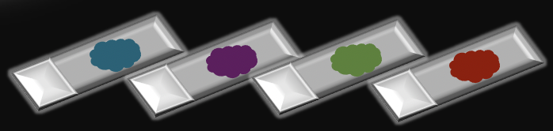

How to Play
Walk through this game by reading each passage and interacting with the different scenes. Many actions include clicking and scrolling over.
There are two main sections (1) healthy ovarian tissue and (2) diseased ovarian tissue
Return to the home screen at any point in the game
Return to the previous/last visited page
Move through different examples of healthy ovarian tissue
Move through different examples of diseased ovarian tissue
Go Back

Slide 5
Table of Contents
Return to any section of the lab using the following buttons
1. Introduction
2. Healthy Tissues
3. Diseased Tissues
4. Sources
Go Back

Slide 6

Welcome to the histology lab!
​
Histology is the study of the microscopic aspects of tissues.
In order to begin to make an artificial ovary, we must study ovarian tissue. By understanding its structure, we can try to mimic the tissue.
​
In order to interact with the lab equipment, just click on it!
Click on the microscope to begin.
​
Home
Go Back
Notes:
How to choose the right microscope table. (2020, August 26). Retrieved February 09, 2021, from https://formaspace.com/articles/sample-processing/choose-the-right-microscope-table/

Slide 7

Home
To understand how to make artificial ovaries, we need to understand how normally functioning ovarian cells work.
One of the most important aspects of fertility is the ovarian cycle, so we are going to focus in on what cells at each stage of the cycle look like.
​​
Click on the microscope slide to take a closer look!
Go Back
Notes:
Brown, R. (2018, February 22). You can now turn your camera phone into a microscope. Retrieved February 09, 2021, from https://www.createdigital.org.au/camera-phone-microscope/

Slide 8

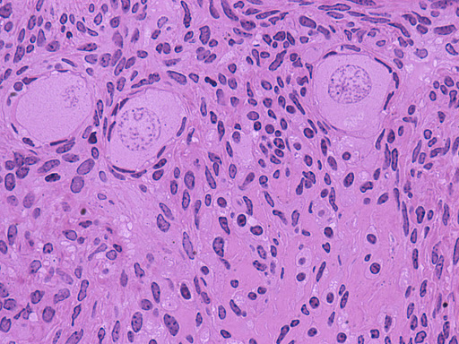
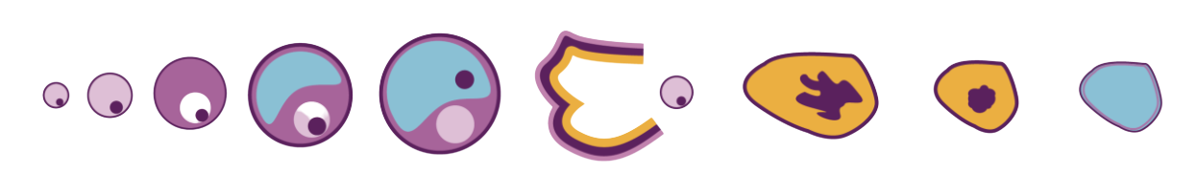
Home
A. Primordial Follicle
This is a primordial follicle. When eggs first form, they are made in a dormant state and remain this way until triggered by the menstrual cycle.
It consists of an oocyte (egg cell) and a single layer of granulosa cells, which are squamous (flat).
Scroll over the microscope image to identify these features.
Go Back
Diagnoses
A.
B.
C.
D.
E.
F.
G.
Notes:
Primordial follicles. (n.d.). Retrieved February 09, 2021, from http://medcell.med.yale.edu/histology/female_reproductive_system_lab/primordial_follicles.php
Menstruation – menstrual disorder yoga cure. (n.d.). Retrieved February 09, 2021, from https://theholisticcare.com/menstruation-menstrual-disorder-yoga-cure/

Slide 9
Home
A. Primordial Follicle
This is a primordial follicle. When eggs first form, they are made in a dormant state and remain this way until triggered by the menstrual cycle.
It consists of an oocyte (egg cell) and a single layer of granulosa cells, which are squamous (flat).
Scroll over the microscope image to identify these features.
Go Back
Diagnoses
A.
B.
C.
D.
E.
F.
G.
Notes:
Primordial follicles. (n.d.). Retrieved February 09, 2021, from http://medcell.med.yale.edu/histology/female_reproductive_system_lab/primordial_follicles.php
Menstruation – menstrual disorder yoga cure. (n.d.). Retrieved February 09, 2021, from https://theholisticcare.com/menstruation-menstrual-disorder-yoga-cure/

Slide 10

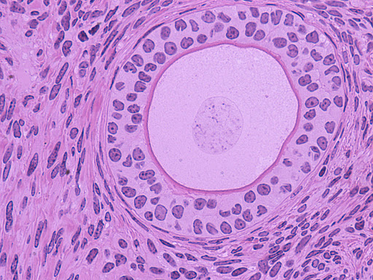
Home
B. Primary Follicle
This is a primary follicle. It consists of a single oocyte surrounded by a glycoprotein coating called the zona pellucida (a recognition coating for sperm cells). The oocyte is surrounded by a layer of granulosa cells (cuboidal/cube shaped cells) .
​
Primary follicle development is triggered at the start of the menstrual cycle. The oocyte is developing follicle-stimulating hormone (FSH) receptors. FSH is used to trigger ovulation (the release of the egg into the Fallopian tubes and uterus, where it can potentially be fertilized).
​
Scroll over the microscope image to identify these features.
Go Back
Diagnoses
A.
B.
C.
D.
E.
F.
G.
Notes:
Late primary follicle. (n.d.). Retrieved February 09, 2021, from http://medcell.med.yale.edu/histology/female_reproductive_system_lab/late_primary_follicle.php
Menstruation – menstrual disorder yoga cure. (n.d.). Retrieved February 09, 2021, from https://theholisticcare.com/menstruation-menstrual-disorder-yoga-cure/

Slide 11
Home
B. Primary Follicle
This is a primary follicle. It consists of a single oocyte surrounded by a glycoprotein coating called the zona pellucida (a recognition coating for sperm cells). The oocyte is surrounded by a layer of granulosa cells (cuboidal/cube shaped cells) .
​
Primary follicle development is triggered at the start of the menstrual cycle. The oocyte is developing follicle-stimulating hormone (FSH) receptors. FSH is used to trigger ovulation (the release of the egg into the Fallopian tubes and uterus, where it can potentially be fertilized).
​
Scroll over the microscope image to identify these features.
Go Back
Diagnoses
A.
B.
C.
D.
E.
F.
G.
Notes:
Late primary follicle. (n.d.). Retrieved February 09, 2021, from http://medcell.med.yale.edu/histology/female_reproductive_system_lab/late_primary_follicle.php
Menstruation – menstrual disorder yoga cure. (n.d.). Retrieved February 09, 2021, from https://theholisticcare.com/menstruation-menstrual-disorder-yoga-cure/

Slide 12
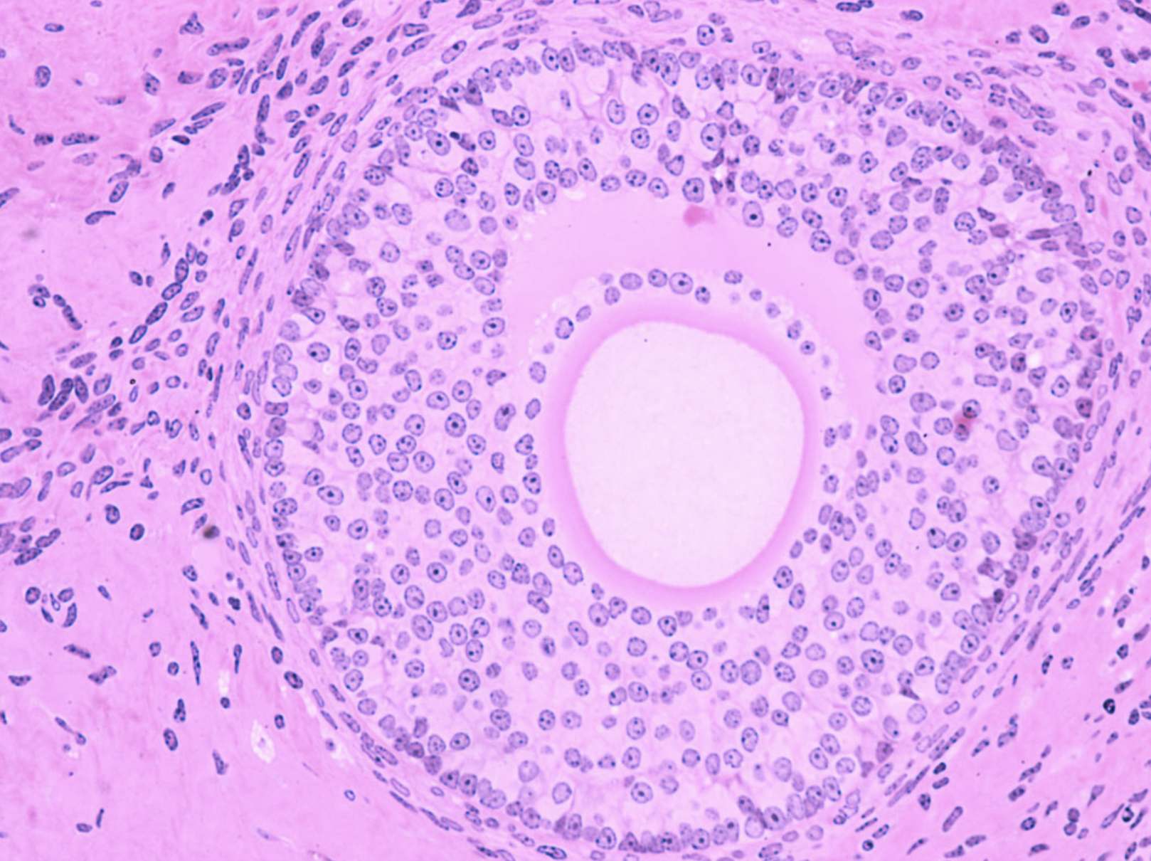

Home
C. Secondary Follicle
This is a secondary follicle.
The zona pellucida is expanding in size around the oocyte, as well as the granulosa layer. The antrum, a large fluid-filled sack, is starting to develop. Thecal cells, which interact with granulosa cells, have started to develop on the outside. Granulosa cells convert androgens (male hormones) produced by thecal cells into estradiol, a type of estrogen.
Scroll over the microscope image to identify these features.
Go Back
Diagnoses
A.
B.
C.
D.
E.
F.
G.
Notes:
Secondary follicle. (n.d.). Retrieved February 14, 2021, from http://medcell.med.yale.edu/histology/female_reproductive_system_lab/secondary_follicle.php

Slide 13
Home
C. Secondary Follicle
This is a secondary follicle.
The zona pellucida is expanding in size around the oocyte, as well as the granulosa layer. The antrum, a large fluid-filled sack, is starting to develop. Thecal cells, which interact with granulosa cells, have started to develop on the outside. Granulosa cells convert androgens (male hormones) produced by thecal cells into estradiol, a type of estrogen.
Scroll over the microscope image to identify these features.
Go Back
Diagnoses
A.
B.
C.
D.
E.
F.
G.
Notes:
Secondary follicle. (n.d.). Retrieved February 14, 2021, from http://medcell.med.yale.edu/histology/female_reproductive_system_lab/secondary_follicle.php

Slide 14
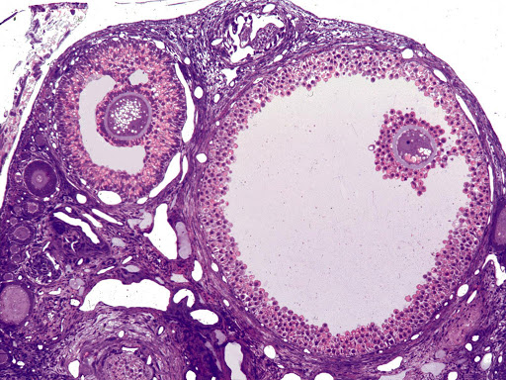

Home
D. Tertiary Follicle
This is a tertiary follicle (Graafian follicle). The oocyte is surrounded the zona pellucida and corona radiata . The zona granulosa will separate from the corona radiata upon ovulation and will continue to line the antrum. The corona radiata supplies nutrients such as proteins to the egg when it leaves the ovary so it can survive outside of the ovary.
Scroll over the microscope image to identify these features.
Go Back
Diagnoses
A.
B.
C.
D.
E.
F.
G.
Notes:
Graafian follicle. (n.d.). Retrieved February 14, 2021, from http://medcell.med.yale.edu/histology/female_reproductive_system_lab/graafian_follicle.php

Slide 15
Home
D. Tertiary Follicle
This is a tertiary follicle (Graafian follicle). The oocyte is surrounded the zona pellucida and corona radiata . The zona granulosa will separate from the corona radiata upon ovulation and will continue to line the antrum. The corona radiata supplies nutrients such as proteins to the egg when it leaves the ovary so it can survive outside of the ovary.
Scroll over the microscope image to identify these features.
Go Back
Diagnoses
A.
B.
C.
D.
E.
F.
G.
Notes:
Graafian follicle. (n.d.). Retrieved February 14, 2021, from http://medcell.med.yale.edu/histology/female_reproductive_system_lab/graafian_follicle.php

Slide 16
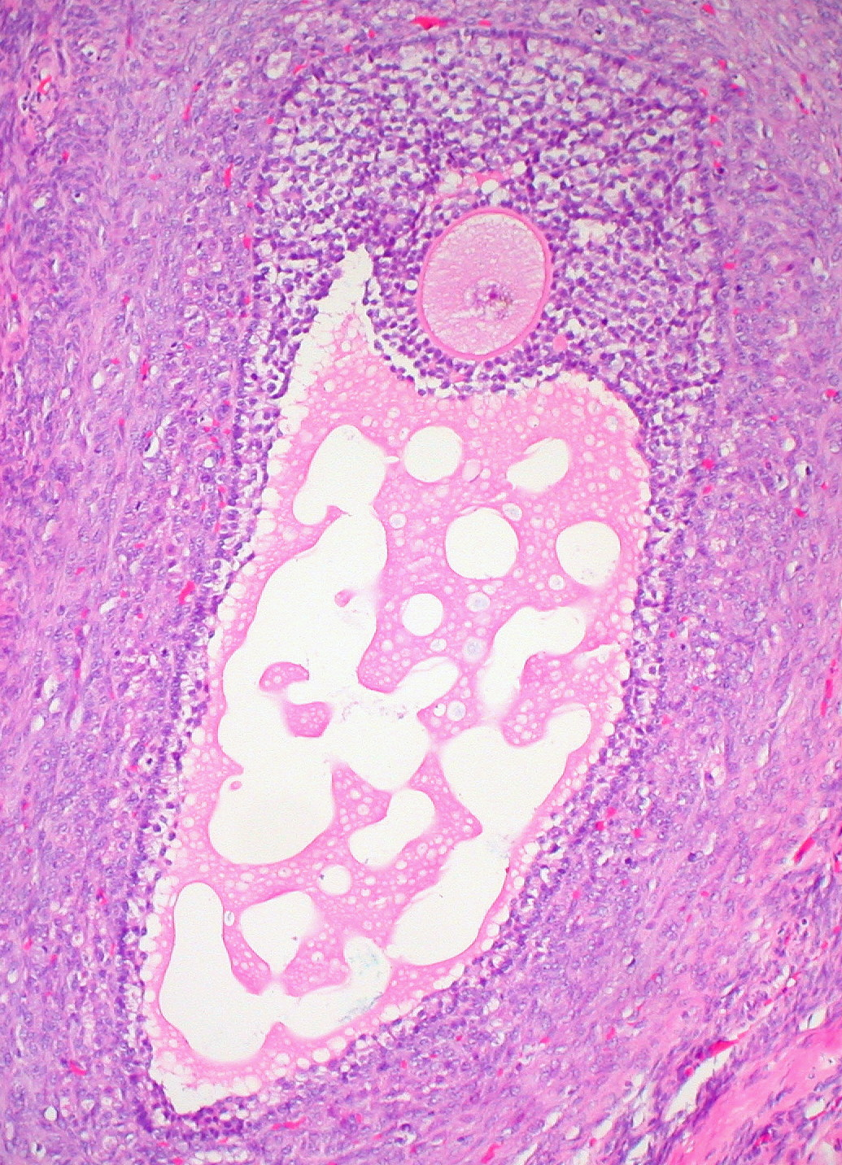

Home
E. Ovulation
The newly Graafian (mature) ovarian follicle ruptures and releases an ovum so the process of fertilization can begin.
When released from the Graafian follicle and into the oviduct, the ovum will contain three layers: oocyte, zona pellucida and corona radiata
Scroll over the microscope image to identify these features.
Go Back
Diagnoses
A.
B.
C.
D.
E.
F.
G.
Notes:
Ovarian follicle. (n.d.). Retrieved February 11, 2021, from https://en.wikipedia.org/wiki/Ovarian_follicle

Slide 17
Home
E. Ovulation
The newly Graafian (mature) ovarian follicle ruptures and releases an ovum so the process of fertilization can begin.
When released from the Graafian follicle and into the oviduct, the ovum will contain three layers: oocyte, zona pellucida and corona radiata
Scroll over the microscope image to identify these features.
Go Back
Diagnoses
A.
B.
C.
D.
E.
F.
G.
Notes:
Ovarian follicle. (n.d.). Retrieved February 11, 2021, from https://en.wikipedia.org/wiki/Ovarian_follicle

Slide 18
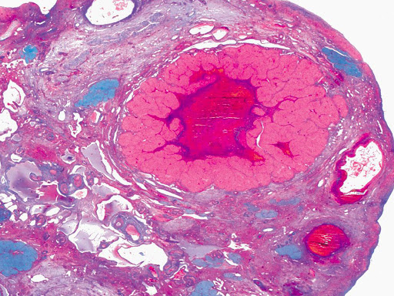

Home
F. Corpus Luteum
After ovulation, the corpus luteum is left behind in the ovary. Granulosa lutein and theca lutein cells surround a blood clot that forms inside.
The corpus luteum produces progesterone, which helps keep the uterine lining thickened. The corpus luteum is 2-5 cm in diameter.
Scroll over the microscope image to identify these features.
Go Back
Diagnoses
A.
B.
C.
D.
E.
F.
G.
Notes:
Corpus luteum. (n.d.). Retrieved February 14, 2021, from http://medcell.med.yale.edu/histology/female_reproductive_system_lab/corpus_luteum.php

Slide 19
Home
F. Corpus Luteum
After ovulation, the corpus luteum is left behind in the ovary. Granulosa lutein and theca lutein cells surround a blood clot that forms inside.
The corpus luteum produces progesterone, which helps keep the uterine lining thickened. The corpus luteum is 2-5 cm in diameter.
Scroll over the microscope image to identify these features.
Go Back
Diagnoses
A.
B.
C.
D.
E.
F.
G.
Notes:
Corpus luteum. (n.d.). Retrieved February 14, 2021, from http://medcell.med.yale.edu/histology/female_reproductive_system_lab/corpus_luteum.php

Slide 20
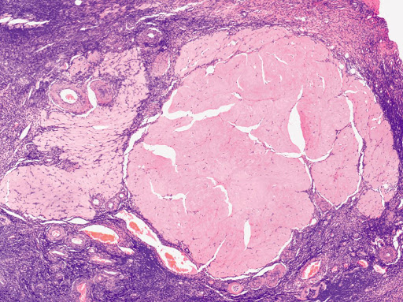

Home
G. Corpus Albicans
If fertilization does not occur, luteinizing hormone (LH) levels fall and the corpus luteum involutes to form the corpus albicans that is filled with fibrous tissue.
The secretory cells of the corpus luteum degenerate and are phagocytoses by macrophages. Over time, all that is left of the original egg is a small scar on the ovary.
Scroll over the microscope image to identify these features.
Go Back
Diagnoses
A.
B.
C.
D.
E.
F.
G.
Notes:
Corpus albicans. (n.d.). Retrieved February 14, 2021, from http://medcell.med.yale.edu/histology/female_reproductive_system_lab/corpus_albicans.php

Slide 21
Home
G. Corpus Albicans
If fertilization does not occur, luteinizing hormone (LH) levels fall and the corpus luteum involutes to form the corpus albicans that is filled with fibrous tissue.
The secretory cells of the corpus luteum degenerate and are phagocytoses by macrophages. Over time, all that is left of the original egg is a small scar on the ovary.
Scroll over the microscope image to identify these features.
Go Back
Diagnoses
A.
B.
C.
D.
E.
F.
G.
Notes:
Corpus albicans. (n.d.). Retrieved February 14, 2021, from http://medcell.med.yale.edu/histology/female_reproductive_system_lab/corpus_albicans.php

Slide 22


Diagnoses
Home
Now that you know what normal functioning ovarian tissue and cells look like, we are going to look at diseased tissue, which would require medical intervention.
Patients with these conditions are some of the good candidates for artificial ovaries.
Click on the microscope slide to take a look!
Go Back
Notes:
Choosing the BEST Microscopy solution for your lab. (2016, August 15). Retrieved February 12, 2021, from https://www.labmanager.com/purchasing-guides/choosing-the-best-microscopy-solution-for-your-lab-4622

Slide 23
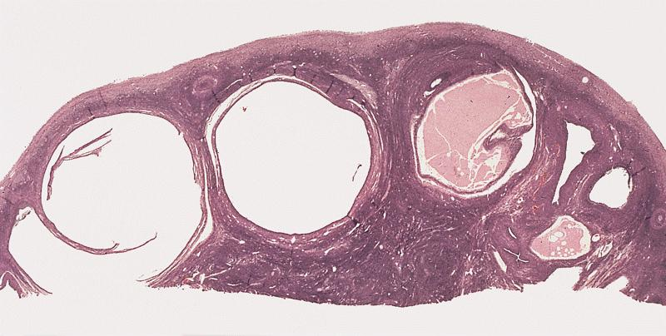
Polycystic Ovary Syndrome (PCOS)
This is an image from a patient suffering from polycystic ovary syndrome (PCOS).
​
The follicle does not break open to ovulate, and instead gets larger and tough (hence the appearance of cysts).
Visual features of PCOS include large ovaries, fibrotic, large vascularization (blood vessels) and lipid (fat) accumulation. It is like a large and prolonged corpus luteum.
Scroll over the slide to see more.
Home
Go Back
Done
i.
ii.
iii.
iv.
Notes:
Islam S. Polycystic ovary disease. PathologyOutlines.com website. https://www.pathologyoutlines.com/topic/ovaryPCO.html. Accessed February 13th, 2021.

Slide 24
Polycystic Ovary Syndrome (PCOS)
This is an image from a patient suffering from polycystic ovary syndrome (PCOS).
​
The follicle does not break open to ovulate, and instead gets larger and tough (hence the appearance of cysts).
Visual features of PCOS include large ovaries, fibrotic, large vascularization (blood vessels) and lipid (fat) accumulation. It is like a large and prolonged corpus luteum.
Scroll over the slide to see more.
Home
Go Back
Done
i.
ii.
iii.
iv.
Notes:
Islam S. Polycystic ovary disease. PathologyOutlines.com website. https://www.pathologyoutlines.com/topic/ovaryPCO.html. Accessed February 13th, 2021.

Slide 25
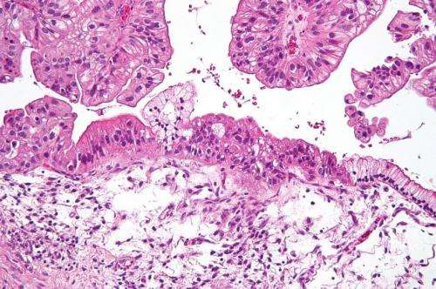
Ovarian Cancer
This is tissue from a patient suffering from ovarian cancer. If you look at the epithelial cells (the covering), there is a mass (tumor) growing there.
Tumors are found on histology slides by looking at the shapes of cells. If the adjacent cells are irregularly shaped, it usually signifies tumor cells.
In order to get rid of the tumor, the ovaries must be removed and/or radiated. If not, the tumor will grow and metastasize (spread) to other parts of the body.
​
Scroll over the slide to see more.
Home
Go Back
Done
i.
ii.
iii.
iv.
Notes:
From Mayo Clinic News Network, Mayo Clinic News Network. (2018, May 12). Ovarian cancer is hard to detect. Retrieved February 14, 2021, from https://medicalxpress.com/news/2018-05-ovarian-cancer-hard.html

Slide 26
Ovarian Cancer
This is tissue from a patient suffering from ovarian cancer. If you look at the epithelial cells (the covering), there is a mass (tumor) growing there.
Tumors are found on histology slides by looking at the shapes of cells. If the adjacent cells are irregularly shaped, it usually signifies tumor cells.
In order to get rid of the tumor, the ovaries must be removed and/or radiated. If not, the tumor will grow and metastasize (spread) to other parts of the body.
​
Scroll over the slide to see more.
Home
Go Back
Done
i.
ii.
iii.
iv.
Notes:
From Mayo Clinic News Network, Mayo Clinic News Network. (2018, May 12). Ovarian cancer is hard to detect. Retrieved February 14, 2021, from https://medicalxpress.com/news/2018-05-ovarian-cancer-hard.html

Slide 27
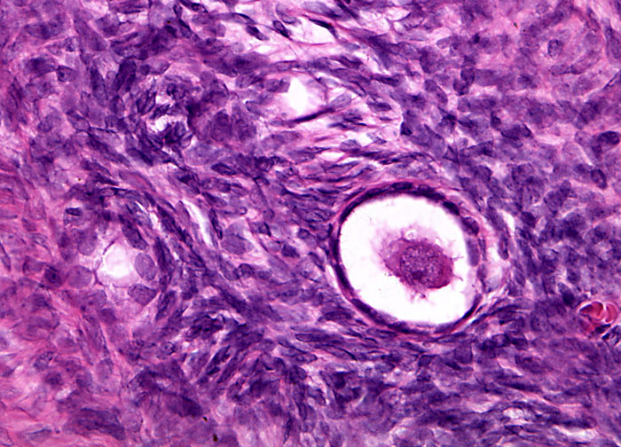
Home
Endometriosis
This slide is from a patient suffering from endometriosis.​ It occurs when the uterine lining (endometrium) grows outside the uterus, causing inflammation.
The tissue has two main components: the epithelium and the stroma (supportive tissue for the epithelium).
Go Back
Done
i.
ii.
iii.
iv.
Notes:
Galleries: Ovarian endometriosis at 40x magnification. (n.d.). Retrieved February 14, 2021, from https://www.microscopyu.com/gallery-images/ovarian-endometriosis-at-40x-magnification

Slide 28
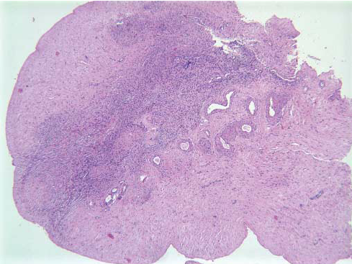
Home
Sterilization from Cancer Treatments
This slide is from a patient who has undergone radiation and chemotherapy.
Due to the cytotoxic (poisonous to cells) nature of these treatments, the patient's ovaries have no viable follicles, meaning that the patient is permanently infertile.
Go Back
Done
i.
ii.
iii.
iv.
Notes:
Meirow, D., et al. “Cortical Fibrosis and Blood-Vessels Damage in Human Ovaries Exposed to Chemotherapy.” ​Cortical Fibrosis and Blood-Vessels Damage in Human Ovaries Exposed to Chemotherapy. Potential Mechanisms of Ovarian Injury​, Research Gate, 2007, www.researchgate.net/publication/6481366_Cortical_fibrosis_and_blood-vessels_damage _in_human_ovaries_exposed_to_chemotherapy_Potential_mechanisms_of_ovarian_injur y.

Slide 29
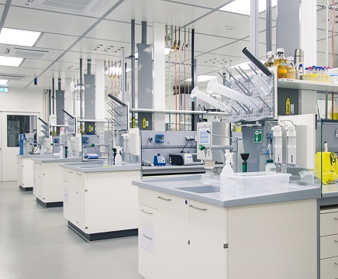
Great! You have finished taking a deeper dive into ovarian tissue histology.
Hopefully from your time with us you have a better understanding of both healthy and diseased ovarian tissue structures.
You can use this knowledge to do so many great things.
We hope you had fun and that we see you again!
Leave Lab
Notes:
Biology lab (xbi). (n.d.). Retrieved February 14, 2021, from https://www.xfel.eu/facility/user_laboratories/laboratories/biology_lab_xbi/index_eng.html

Slide 30
Sources
Home
Collins, F. (2019, February 21). Students contribute to research through ovarian art. Retrieved February 09, 2021, from https://directorsblog.nih.gov/2019/02/21/students-contribute-to-research-through-ovarian-art/
How to choose the right microscope table. (2020, August 26). Retrieved February 09, 2021, from https://formaspace.com/articles/sample-processing/choose-the-right-microscope-table/
Brown, R. (2018, February 22). You can now turn your camera phone into a microscope. Retrieved February 09, 2021, from https://www.createdigital.org.au/camera-phone-microscope/
Primordial follicles. (n.d.). Retrieved February 09, 2021, from http://medcell.med.yale.edu/histology/female_reproductive_system_lab/primordial_follicles.php
Late primary follicle. (n.d.). Retrieved February 09, 2021, from http://medcell.med.yale.edu/histology/female_reproductive_system_lab/late_primary_follicle.php
Menstruation – menstrual disorder yoga cure. (n.d.). Retrieved February 09, 2021, from https://theholisticcare.com/menstruation-menstrual-disorder-yoga-cure/
Webb, C. N., MD. (2018, December 20). Ovarian Cyst Rupture. Retrieved February 11, 2021, from https://emedicine.medscape.com/article/253620-overview#:~:text=Each%20month%2C%20a%20mature%20ovarian,the%20rupture%20site%20following%20ovulation.
Ovarian follicle. (n.d.). Retrieved February 11, 2021, from https://en.wikipedia.org/wiki/Ovarian_follicle
Secondary follicle. (n.d.). Retrieved February 14, 2021, from http://medcell.med.yale.edu/histology/female_reproductive_system_lab/secondary_follicle.php
Go Back
Next Page

Slide 31
Sources
Home
Biology lab (xbi). (n.d.). Retrieved February 14, 2021, from https://www.xfel.eu/facility/user_laboratories/laboratories/biology_lab_xbi/index_eng.html
Meirow, D., et al. “Cortical Fibrosis and Blood-Vessels Damage in Human Ovaries Exposed to Chemotherapy.” ​Cortical Fibrosis and Blood-Vessels Damage in Human Ovaries Exposed to Chemotherapy. Potential Mechanisms of Ovarian Injury​, Research Gate, 2007, www.researchgate.net/publication/6481366_Cortical_fibrosis_and_blood-vessels_damage _in_human_ovaries_exposed_to_chemotherapy_Potential_mechanisms_of_ovarian_injury.
Graafian follicle. (n.d.). Retrieved February 14, 2021, from http://medcell.med.yale.edu/histology/female_reproductive_system_lab/graafian_follicle.php
Corpus albicans. (n.d.). Retrieved February 14, 2021, from http://medcell.med.yale.edu/histology/female_reproductive_system_lab/corpus_albicans.php
Islam S. Polycystic ovary disease. PathologyOutlines.com website. https://www.pathologyoutlines.com/topic/ovaryPCO.html. Accessed February 13th, 2021.
From Mayo Clinic News Network, Mayo Clinic News Network. (2018, May 12). Ovarian cancer is hard to detect. Retrieved February 14, 2021, from https://medicalxpress.com/news/2018-05-ovarian-cancer-hard.html
Galleries: Ovarian endometriosis at 40x magnification. (n.d.). Retrieved February 14, 2021, from https://www.microscopyu.com/gallery-images/ovarian-endometriosis-at-40x-magnification
Choosing the BEST Microscopy solution for your lab. (2016, August 15). Retrieved February 12, 2021, from https://www.labmanager.com/purchasing-guides/choosing-the-best-microscopy-solution-for-your-lab-4622
Go Back

