Slide 1
Artificial Ovaries Design
Created by: Meghan McGraw, ‘22 Chemical Engineering, Biomedical Engineering
Edited by: Claire Kenny, ‘21 Materials Science and Engineering, Biomedical Engineering
Notes:
Main title: 40 pt. Arial
Presenter Name: 16 pt. Arial
Presenters Title: 16 pt. Arial Italic

Slide 2
This educational resource for high school audiences was developed as a project by Carnegie Mellon student, Meghan McGraw, for the course Experiential Learning through Projects, Section O, taught by Dr. Conrad Zapanta and Dr. Judith Hallinen during the summer of 2020. Editing and additional project development was completed by Carnegie Mellon student Claire Kenny.

Slide 3
CAUTION: If you are attempting an experiment, it is important to make sure that you are following all safety steps. All experiments should be completed with supervision of a adult. Weather permitting, we recommend taking messy experiments outside. Remember to wear safety gear like gloves, aprons, and goggles, especially for experiments with chemical reactions!
The materials and information presented may be used for educational purposes as described in the Terms of Use at www.cmu.edu/gelfand and parents/legal guardians are responsible for taking all necessary safety precautions for the experiments. To the maximum extent allowed under law, Carnegie Mellon University is not responsible for any claims, damages or other liability arising from using the materials or conducting the experiments.
Be SAFE and enjoy the modules!

Slide 4
Learning Goals
Demonstrate knowledge of basic ovarian anatomy and physiology.
Identify the causes and consequences of ovarian damage
Describe the stages of tissue engineering and identify how it can be used to solve infertility problems
Name the components of an artificial ovary
Discuss who can benefit from the technology

Slide 5
What are the Ovaries?

Slide 6
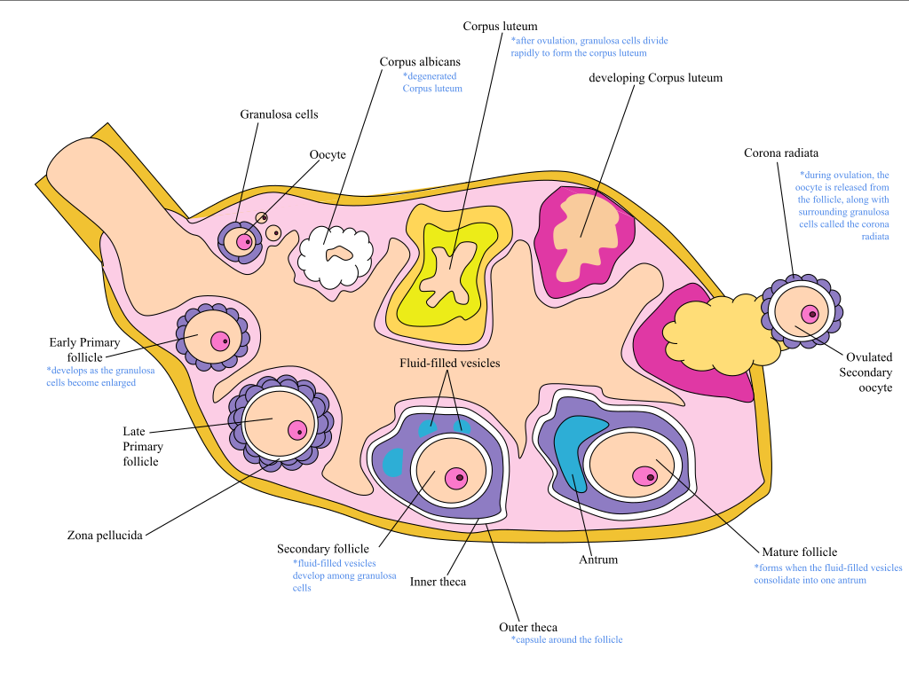
Overview of the Ovaries: What?
An organ in the female reproductive system (and endocrine system) that...
Produces/ develops eggs (oogenesis)
Releases eggs (ovulation)
Produces progesterone and estrogen
Note: See speaker notes for image citations
Notes:
Garcia, Alexandra. “Oogenesis Labeled.” ​Ovary​, Wikipedia, 2020,
https://en.wikipedia.org/wiki/File:Oogenesis_Labeled.svg

Slide 7
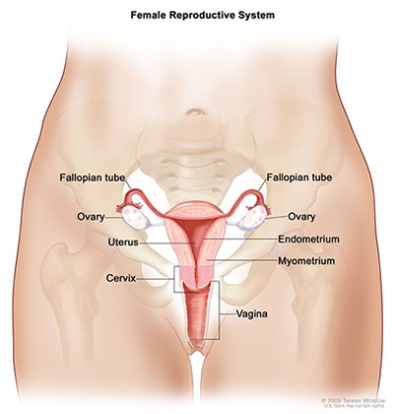
Overview of the Ovaries: Where?
Right below the belly button
Protected by the pelvis
Almond-sized organs on either side of the uterus
Note: See speaker notes for image citations
Notes:
Winslow, T. “Reproductive System, Female, Anatomy.” Salpingo-Ovarian & Peritoneal, ​National Cancer Institute,​ 8 June, 2018, ​https://training.seer.cancer.gov/ovarian/intro/

Slide 8
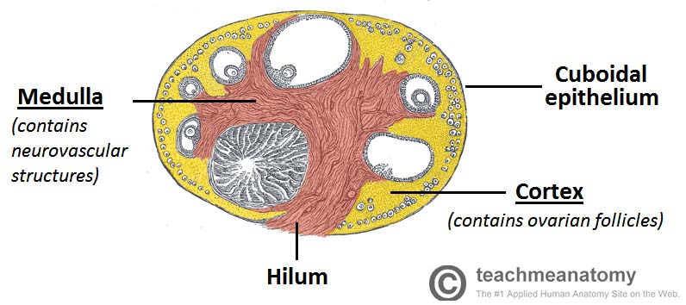
Overview of the Ovaries: Ovarian Tissue Anatomy
Surface
Epithelium and connective tissue
Cortex
Connective tissue and follicles
Medulla
Connective tissue and neurovascular structures
Note: See speaker notes for image citations
Notes:
Thompson, L. (2020, April 9). The Ovaries. Retrieved January 29, 2021, from https://teachmeanatomy.info/pelvis/female-reproductive-tract/ovaries/

Slide 9
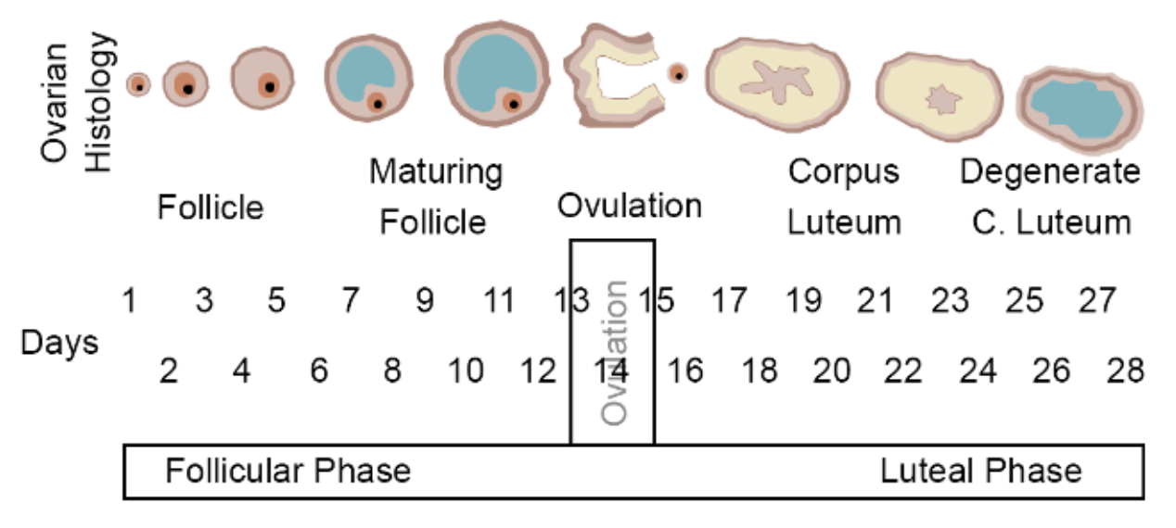
The Menstrual Cycle
The menstrual cycle can be divided into four main phases:
Menstrual Phase
Follicular Phase
Ovulation
Luteal Phase
Note: See speaker notes for image citations
Notes:
Wakim, S. and Grewal, M.”Ovarian Cycle.” ​22.7 Menstrual Cycle,​ LibreTexts. 2020, https://bio.libretexts.org/Bookshelves/Human_Biology/Book%3A_Human_Biology_(Wakim_and _Grewal)/22%3A_Reproductive_System/22.07%3A_Menstrual_Cycle

Slide 10
1. Menstrual Phase
This phase is when a female's period occurs:
Begins when an egg from the previous cycle isn’t fertilized
The thickened lining of the uterus is shed through the vagina and a combination of blood, mucus, and tissue from the uterus
Estrogen and progesterone levels drop
Length: On average 3-7 days
Note: See speaker notes for image citations
Notes:
Almazon, M. (2019, December 06). Supercharge your cycle: Expert reveals how planning your life around your PERIOD can make your more successful at work and boost personal relationships. Retrieved January 29, 2021, from https://www.dailymail.co.uk/femail/article-7760747/Expert-reveals-plan-life-period-make-day-month.html

Slide 11
2. Follicular Phase
Starts on the first day of a woman’s period (some overlap with the menstrual phase) and ends during ovulation.
Follicle-stimulating hormone (FSH) is released to mature follicles
This leads to about 5-20 follicles being produced, each containing an immature egg (oocyte)
1 healthy egg (ovum) matures
Length: On average 11-27 days
Note: See speaker notes for image citations
Notes:
Almazon, M. (2019, December 06). Supercharge your cycle: Expert reveals how planning your life around your PERIOD can make your more successful at work and boost personal relationships. Retrieved January 29, 2021, from https://www.dailymail.co.uk/femail/article-7760747/Expert-reveals-plan-life-period-make-day-month.html

Slide 12
3. Ovulation
Occurs when luteinizing hormone (LH) encourages the release of the ovum into the Fallopian tubes.
The ovary releases a mature egg, which travels down the fallopian tube toward the uterus to be fertilized by sperm
After a day, the egg will die or dissolve if it isn’t fertilized.
Occurs around day 14 of a 28-day cycle (right in the middle of the menstrual cycle)
Length: On average 24 hours
Note: See speaker notes for image citations
Notes:
Almazon, M. (2019, December 06). Supercharge your cycle: Expert reveals how planning your life around your PERIOD can make your more successful at work and boost personal relationships. Retrieved January 29, 2021, from https://www.dailymail.co.uk/femail/article-7760747/Expert-reveals-plan-life-period-make-day-month.html

Slide 13
4. Luteal Phase
Involves the leftover follicle being turned into the corpus luteum, a structure in charge of releasing hormones.
Progesterone and estrogen are released to keep the uterine lining thick and ready for a fertilized egg to be implanted
If fertilization does not occur,
Human chorionic gonadotropin (hCG) is released
The corpus luteum will shrink and be resorbed
Levels of estrogen and progesterone decrease, leading to a woman’s period
Length: On average 11-17 days
Note: See speaker notes for image citations
Notes:
Almazon, M. (2019, December 06). Supercharge your cycle: Expert reveals how planning your life around your PERIOD can make your more successful at work and boost personal relationships. Retrieved January 29, 2021, from https://www.dailymail.co.uk/femail/article-7760747/Expert-reveals-plan-life-period-make-day-month.html

Slide 14
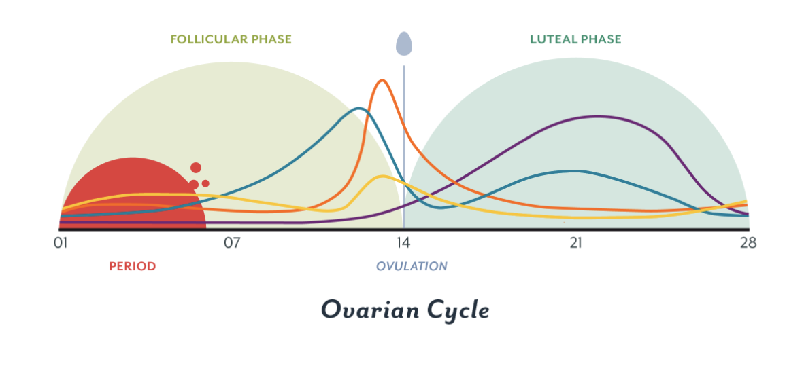
Let’s talk about hormones,
Note: See speaker notes for image citations
Notes:
Ray, L., DNP. (2018, December 11). The menstrual cycle: More than just your period. Retrieved January 29, 2021, from https://helloclue.com/articles/cycle-a-z/the-menstrual-cycle-more-than-just-the-period

Slide 15
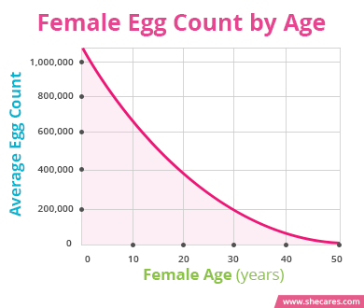
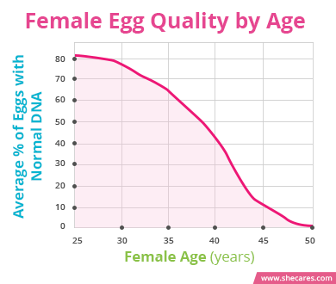
IMPORTANT FACT: Females are born with a limited number of oocytes, no more are created throughout their lifetime, with the count and quality decreasing with age
Note: See speaker notes for image citations
Notes:
SheCares Editorial Team. (2019, September 10). Fertility and Age (1170734478 877946263 L. F MD, Ed.). Retrieved January 29, 2021, from https://www.shecares.com/pregnancy/fertility/fertility-and-age

Slide 16
What is female fertility?
By definition, fertility is the ability to conceive a biological child
Biological, environmental, and lifestyle factors may cause ovarian infertility
Note: See speaker notes for image citations
Notes:
L. (2017, August 11). IVF: The Pregnancy Tests: Pregnancy Tests During the IVF Process. Retrieved February 01, 2021, from https://www.lifeloveandsugar.com/ivf-the-pregnancy-tests/

Slide 17
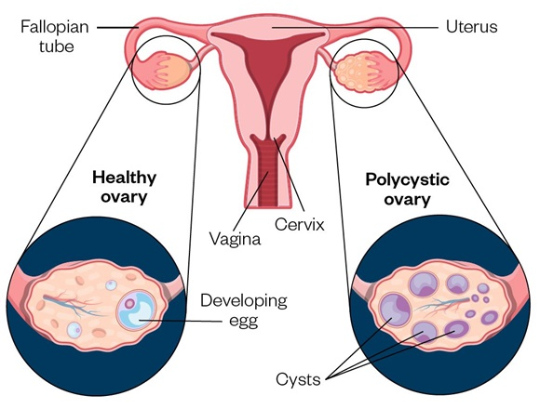
Ovarian Infertility: Polycystic Ovary Syndrome (PCOS)
Syndrome that affects the ovaries and ovulation.
Has 3 main features/symptoms:
Women produce excess amounts of androgens (male hormones)
Disrupt periods/ovulation
Presence of ‘cysts’ in ovaries
Cysts are follicles whose growth is incomplete, leading to large fibrous structures
Irregular or skipped periods
Note: See speaker notes for image citations
Notes:
Chorro-Mari, V. (2020, March 24). Case-based learning: Management of polycystic ovary syndrome. Retrieved February 01, 2021, from https://www.pharmaceutical-journal.com/cpd-and-learning/learning-article/case-based-learning-management-of-polycystic-ovary-syndrome/20207804.article?firstPass=false

Slide 18
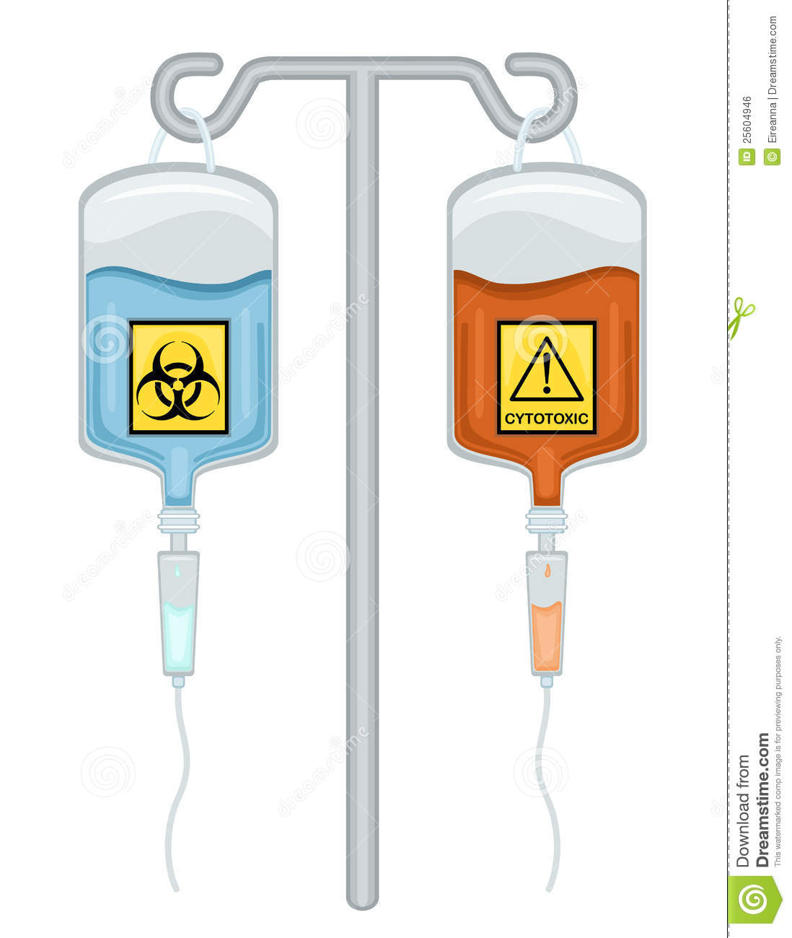
Ovarian Infertility: Cancer Treatments
Cancer treatments may lead to infertility issues.
Radiation: application of X-ray light to parts of the body
Pelvic radiation leads to the direct killing of the ovarian cells
Brain radiation prevents the pituitary (an endocrine gland) from releasing hormones important to the menstrual cycle
Chemotherapy: infusion of anti-cancer drugs into the body
Chemotherapeutic drugs target fast dividing cells, like oocytes
Note: See speaker notes for image citations
Notes:
Stock image found at https://www.dreamstime.com/royalty-free-stock-image-chemotherapy-drugs-biohazard-cy totoxic-image25604946

Slide 19
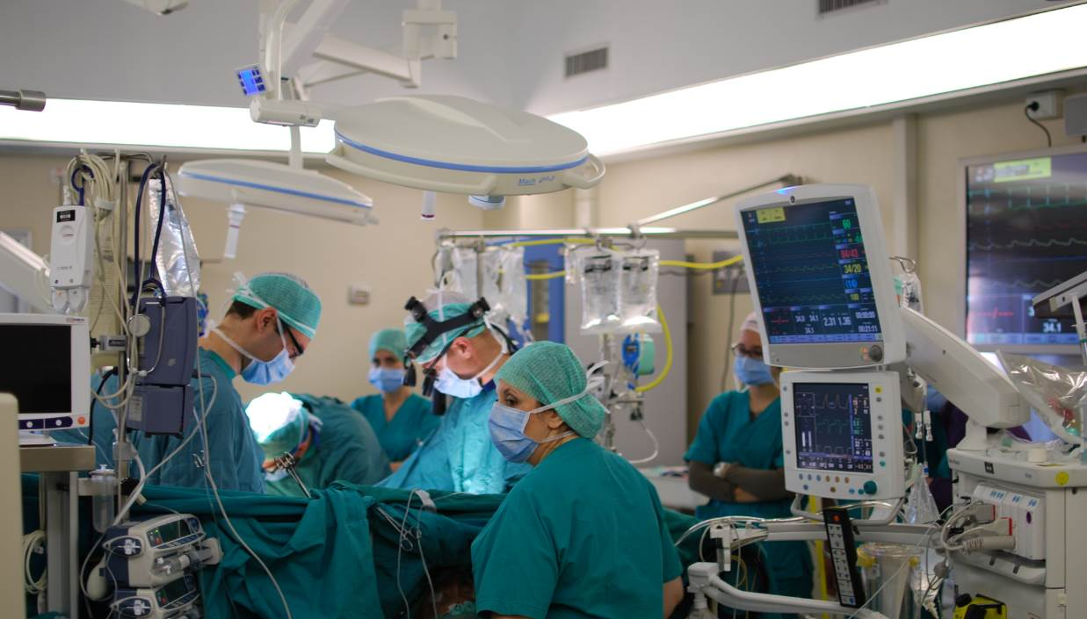
Ovarian Infertility: Scarred Ovaries
May lead to complications in fertilization or a blocked fallopian tube (egg cannot travel to the uterus).
Caused by:
Multiple surgeries
Autoimmune disorders
Endometriosis: Growth of uterine tissue outside of the uterus
Note: See speaker notes for image citations
Notes:
“CardiacSurgeryOperatingRoom.”​Surgery,​ Wikipedia,2014, https://upload.wikimedia.org/wikipedia/commons/2/2e/Cardiac_surgery_operating_room.jpg

Slide 20
What is Tissue Engineering, and how can we use it?

Slide 21
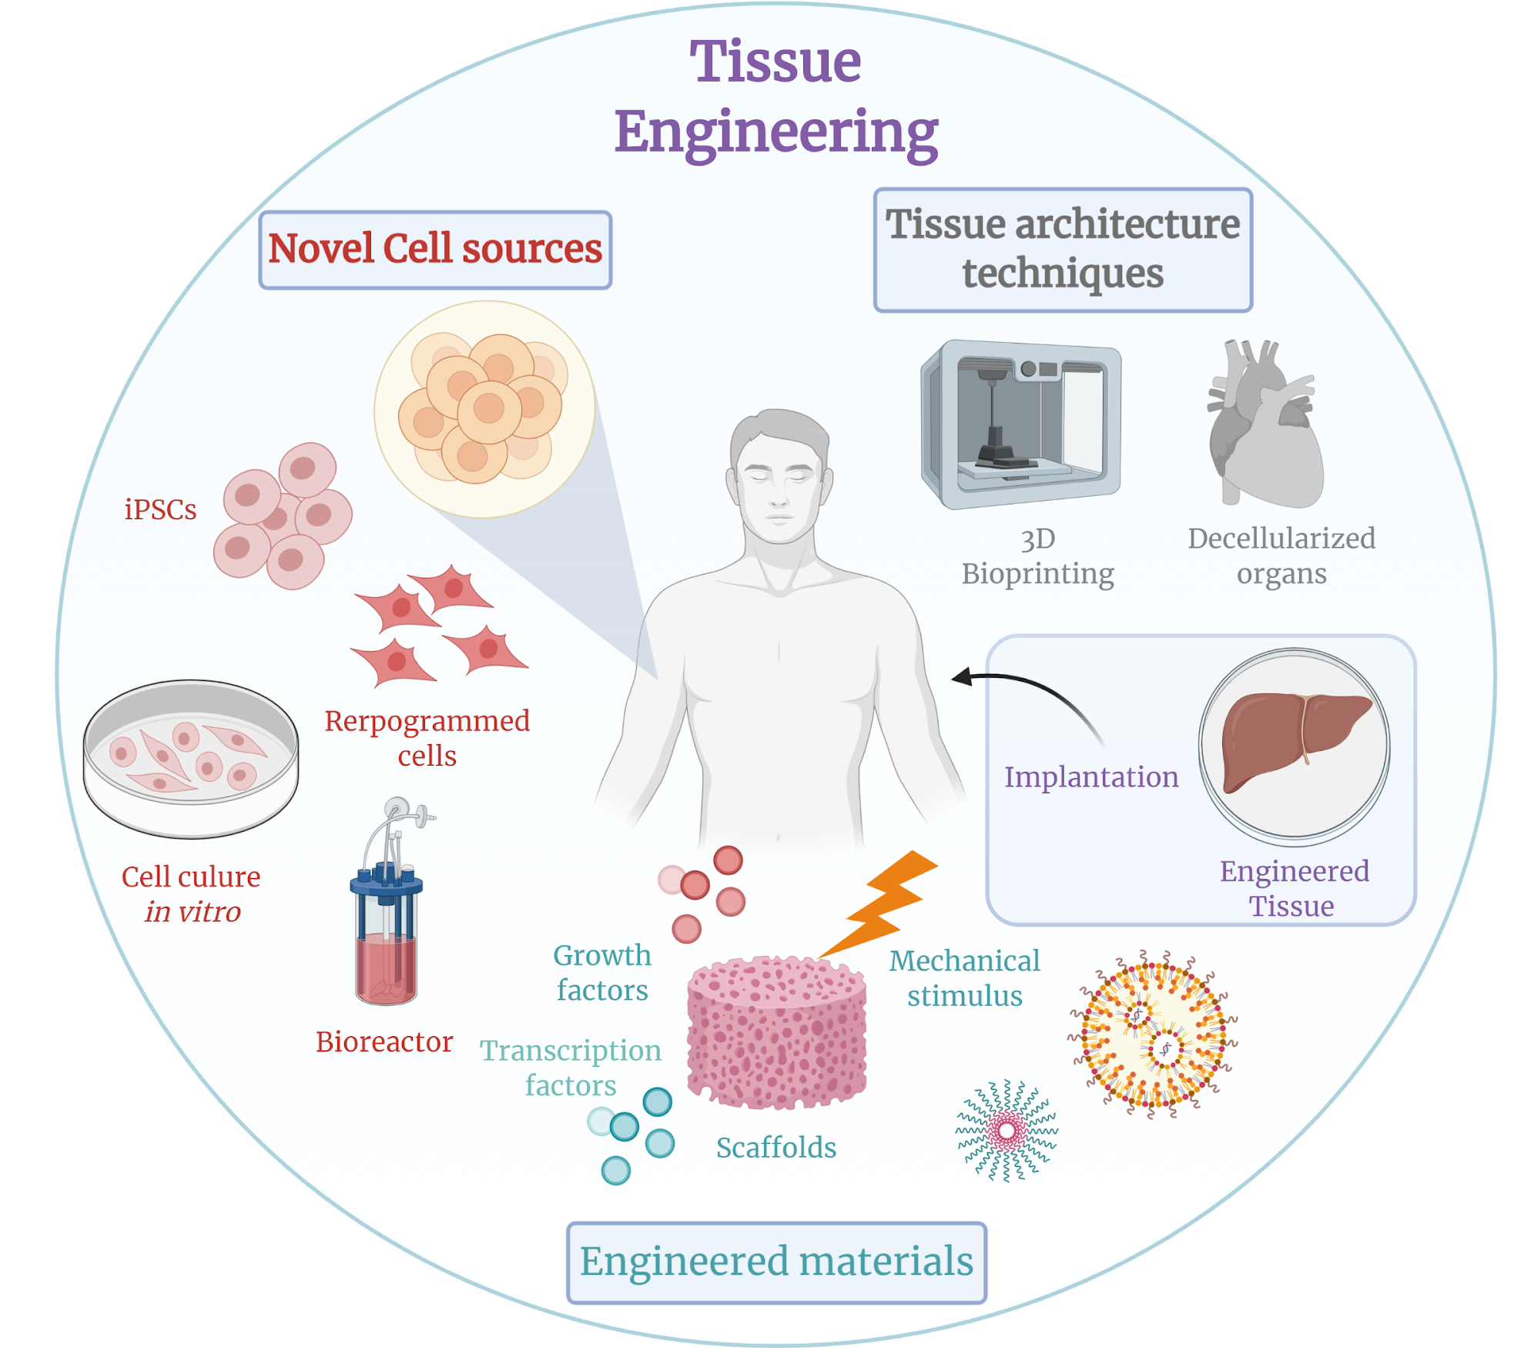
Tissue Engineering
Involves: Combining scaffolds, cells, and biologically active molecules into functional tissues
Goal: Restore, maintain, or replace damaged tissue or whole organs
Examples:
Artificial skin and cartilage
Skin grafts
Supplemental bladders
Small arteries
Note: See speaker notes for image citations
Notes:
Tissue engineering. (n.d.). Retrieved February 01, 2021, from https://en.wikipedia.org/wiki/Tissue_engineering

Slide 22
Artificial Ovaries and Tissue Engineering
Tissue engineering may address the diseases and disorders that can lead to infertility.
Why?
Decreases complications of organ transplantations (long waiting lists) and medical devices (tissue rejection, bridge to transplant solutions)
How?
Aim to create transplantable scaffolds or/and ovarian hydrogels that imitate the ovarian microenvironment and/or achieve in vitro folliculogenesis
Five steps of the process:
Scaffolding
Isolation of oocytes
Seeding
Growth
Surgical placement inside of patient

Slide 23
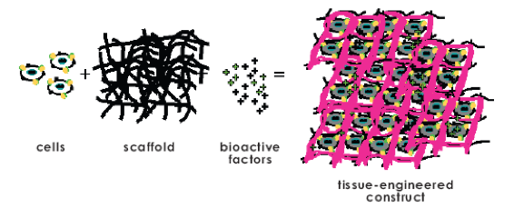
Scaffolding
Structures consisting of artificial or natural substances that act as a shape on which cells can grow
Can be inert (do not interact with cells growing on/within) or active (actively help cell grow using chemical signals)
Quite useful in helping rebuild or replace lost tissue
Note: See speaker notes for image citations
Notes:
Tissue Engineered Scaffold for a Multiple Tissue Junction. (n.d.). Retrieved February 02, 2021, from https://biotextiles2018.wordpress.com/team-9/

Slide 24
Scaffolding (Cont.)
Two main ways to create a scaffold:
3D Printing
Print different materials into desired shape
Can use materials such as:
Gelatin
Polyethylene glycol (PEG)
Collagen
Fibrin
Decellularization
Isolating the extracellular matrix from preexisting ovaries
Can use detergents or enzymes to do so

Slide 25
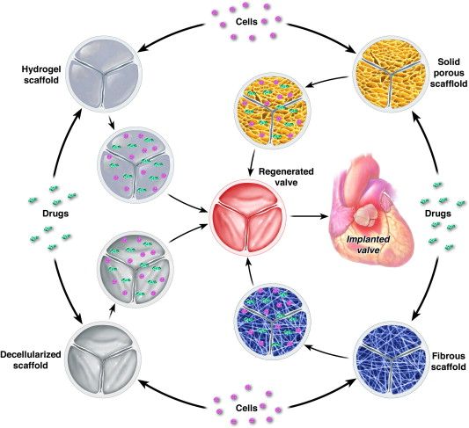
Types of Scaffolds
1.
2.
4.
3.
Note: See speaker notes for image citations
Notes:
Jana, S., Tefft, B., Spoon, D., &amp; Simari, R. (2014). Scaffolds for tissue engineering of cardiac valves (article) Author. Acta Biomaterialia, 10(7), 2877-2893. doi:https://doi.org/10.1016/j.actbio.2014.03.014

Slide 26
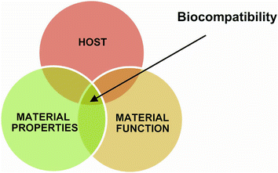
Scaffolding Considerations
When producing a scaffold there are numerous points to be considered
Shape and size of the implant
Chemical reactivity
Mechanism, rate and by-products of degradation
Material choice and characteristics
Oocytes radically change in size
Biocompatibility: “the ability of a material to perform with an appropriate host response in a specific application”
Note: See speaker notes for image citations
Notes:
Siswomihardjo, Widowati. (2016). Biocompatibility Issues of Biomaterials. 10.1007/978-3-319-14845-8_3.

Slide 27
Isolation of Oocytes
Seeding
Mechanical and chemical breakdown of patient’s ovarian tissue to obtain oocytes
Can be done manually or using filtering and enzyme treatments
Living cells can be fluorescently marked
Aims to adhere cells on scaffold for cell culturing
Oocytes are pipetted onto the scaffold
The cells attach to surfaces via surface receptors called integrins
Note: See speaker notes for image citations
Notes:
Image made by editor

Slide 28
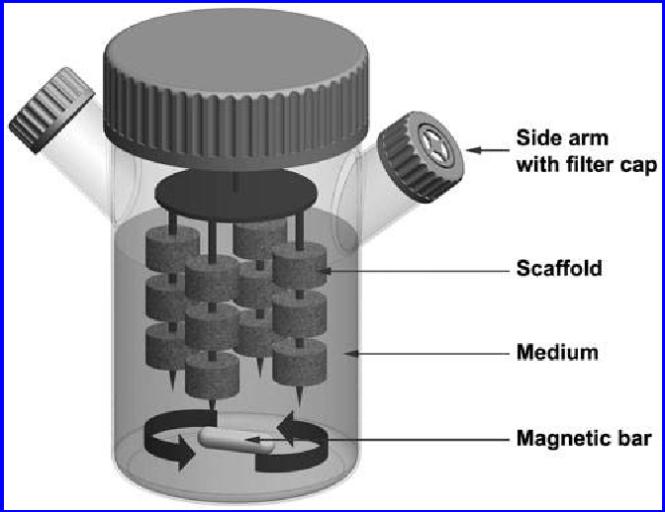
Growth
Bioreactor: Chamber that supports cell growth under specific conditions that simulate the human body environment
For tissue engineering, bioreactors are used in 3 main ways:
In vitro: Mimic in vivo environment so as to understand normal cell and molecular physiology
Expand cells for potential clinical use: Cell scaffolds, recellularization and decellularization of tissues
Serve as more realistic setting than simple in vitro conventional culture: Help establish new therapeutic targets and test potential new treatments
Note: See speaker notes for image citations
Notes:
Rauh, J. et al. “Bioreactor systems for bone tissue engineering.” Tissue engineering. Part B, Reviews 17 4 (2011): 263-80 .

Slide 29
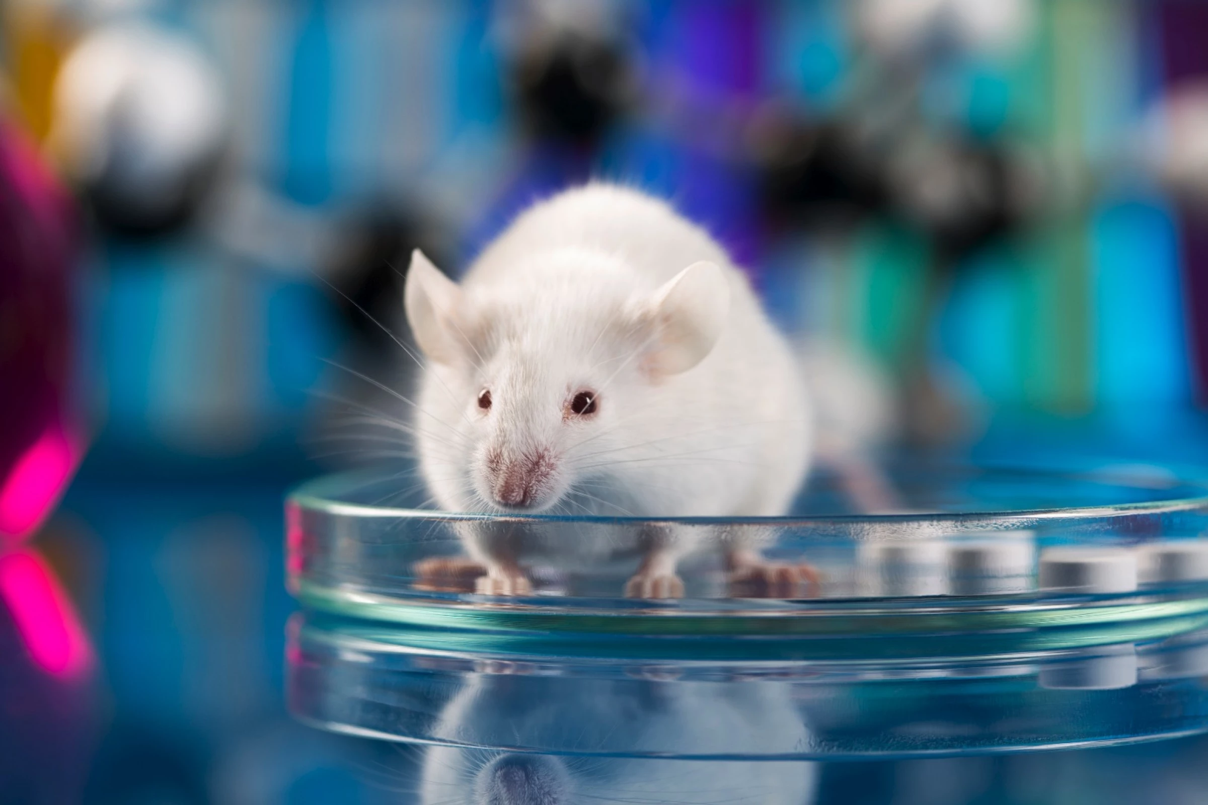
In real life...
In 2017, researchers at Northwestern University 3D-printed a gelatin matrix, and seeded follicles on it.
The ovary was implanted into an infertile female mouse, who was then able to ovulate and have healthy litters.
Hormonal levels were also altered by the presence of the ovaries.
In Copenhagen, a team used a chemical to strip a mouse ovary (decellularize) and implant it with human follicles
Note: See speaker notes for image citations
Notes:
Franco, M. (2017, March 21). Tail or tunnel? Mouse-handling methods could influence experiments. Retrieved February 06, 2021, from https://newatlas.com/mouse-transport-influences-study-results/48512/

Slide 30
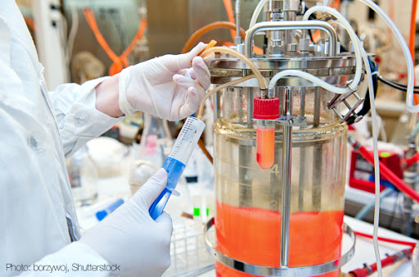
Problems
The follicles don’t live very long
Due to the shape of the scaffold, cells die somewhat quickly (within weeks) because the eggs are not able to be supported by the stromal (support) cells.
Younger patients would need the follicles to last several years!
Mouse tissue does not behave exactly like human tissues
Ethical and moral conflicts
Note: See speaker notes for image citations
Notes:
Anderson, S., Ph.D. (2014, April 25). 9 exciting advances in tissue engineering. Retrieved February 06, 2021, from http://sjabioscience.com/9-exciting-advances-in-tissue-engineering/

Slide 31
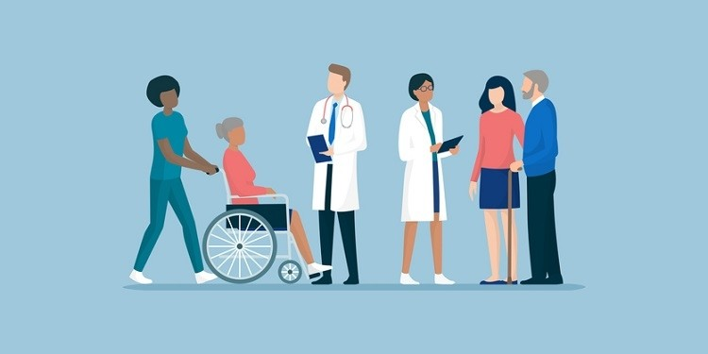
Possible Recipients
Cancer patients
Patients with diseases that render them infertile
Polycystic ovary syndrome
Endometriosis
Patients in need of hormone therapy
Transgender patients
Note: See speaker notes for image citations
Notes:
Spinner, J. (2020, February 27). BBK: Patients, trial participants share a voice. Retrieved February 06, 2021, from https://www.outsourcing-pharma.com/Article/2020/02/27/Survey-on-patients-and-trial-participants-voices

Slide 32
Sources
“Ovaries.” ​You and Your Hormones​, 2018, www.yourhormones.info/glands/ovaries/.
Winslow, T. “Reproductive System, Female, Anatomy.” Salpingo-Ovarian & Peritoneal, ​National Cancer Institute,​ 8 June, 2018, ​https://training.seer.cancer.gov/ovarian/intro/
Thompson, L. (2020, April 9). The Ovaries. Retrieved January 29, 2021, from https://teachmeanatomy.info/pelvis/female-reproductive-tract/ovaries/
Watson, Stephanie. “Stages of Menstrual Cycle: Menstruation, Ovulation, Hormones, Mor.” ​Healthline,​ Healthline Media, 23 Oct. 2010, www.healthline.com/health/womens-health/stages-of-menstrual-cycle.
Watson, S. (2019, March 29). Please accept our privacy policy Healthline uses cookies to improve your experience and to show you personalized ads. Privacy Policy. More information Polycystic Ovary Syndrome (PCOS): Symptoms, Causes, and Treatment. Retrieved February 01, 2021, from https://www.healthline.com/health/polycystic-ovary-disease
How Cancer and Cancer Treatment Can Affect Fertility in Females. (2020, February 6). Retrieved February 01, 2021, from https://www.cancer.org/treatment/treatments-and-side-effects/physical-side-effects/fertility-and-sexual-side-effects/fertility-and-women-with-cancer/how-cancer-treatments-affect-fertility.html
Mohamed, A. W. (2019, July 2). Endometriosis. Retrieved February 01, 2021, from https://www.healthline.com/health/endometriosis
Scar Tissue &amp; Adhesions: The Unknown Cause of Infertility. (n.d.). Retrieved February 01, 2021, from https://circlebloom.com/scar-tissue-adhesions-the-unknown-cause-of-infertility/
Tissue Engineering and Regenerative Medicine. (n.d.). Retrieved February 02, 2021, from https://www.nibib.nih.gov/science-education/science-topics/tissue-engineering-and-regenerative-medicine
Cervelló, I., Ph.D. (2018, November 30). Why create an artificial ovary? Retrieved February 02, 2021, from https://www.ivi-rmainnovation.com/why-create-artificial-ovary/

Slide 33
Sources
Keeffe, J. O. (2021, January 30). What are Tissue Engineering Scaffolds? Retrieved February 03, 2021, from https://www.wisegeek.com/what-are-tissue-engineering-scaffolds.htm
Jana, S., et al. "Scaffolds for tissue engineering of cardiac valves." Acta biomaterialia 10.7 (2014): 2877-2893.
Rana, Deepti, et al. "Considerations on designing scaffold for tissue engineering." Stem Cell Biology and Tissue Engineering in Dental Sciences. Academic Press, 2015. 133-148.
Williams, David F. "Specifications for innovative, enabling biomaterials based on the principles of biocompatibility mechanisms." Frontiers in bioengineering and biotechnology 7 (2019): 255.
Liu Z, Tamaddon M, Gu Y, Yu J, Xu N, Gang F, Sun X, Liu C. Cell Seeding Process Experiment and Simulation on Three-Dimensional Polyhedron and Cross-Link Design Scaffolds. Front Bioeng Biotechnol. 2020 Mar 4;8:104. doi: 10.3389/fbioe.2020.00104. PMID: 32195229; PMCID: PMC7064471.
Selden, Clare, and Barry Fuller. “Role of Bioreactor Technology in Tissue Engineering for Clinical Use and Therapeutic Target Design.” Bioengineering (Basel, Switzerland) vol. 5,2 32. 24 Apr. 2018, doi:10.3390/bioengineering5020032

