Slide 1
Biomedical Engineering: An Introduction
Created and edited by: Olivia Olshevski, BME, MS 2021
Renee Morton, BME, MS 2020
Some material provided by Professor Rosalyn Abbott, BME, PhD

Slide 2
This educational resource for middle and high school audiences was developed as a project by Carnegie Mellon student, Renee Morton, for the course Experiential Learning through Projects, taught by Dr. Conrad Zapanta and Dr. Judith Hallinen during the summer of 2020.
The content was edited and additional content was added by Olivia Olshevski for the course Directed Study during the fall of 2021.

Slide 3
NOTICE: If you are attempting an experiment, it is important to make sure that you are following all safety steps. All experiments should be completed with supervision of a adult. Weather permitting, we recommend taking messy experiments outside. Remember to wear safety gear like gloves, aprons, and goggles, especially for experiments with chemical reactions!
The materials and information presented may be used for educational purposes as described in the Terms of Use at www.cmu.edu/gelfand and parents/legal guardians are responsible for taking all necessary safety precautions for the experiments. To the maximum extent allowed under law, Carnegie Mellon University is not responsible for any claims, damages or other liability arising from using the materials or conducting the experiments.
Be SAFE and enjoy the module!

Slide 4
Sources for content and for images that are included in these slides can be found in the accompanying script and on the slides at the end of the file.

Slide 5
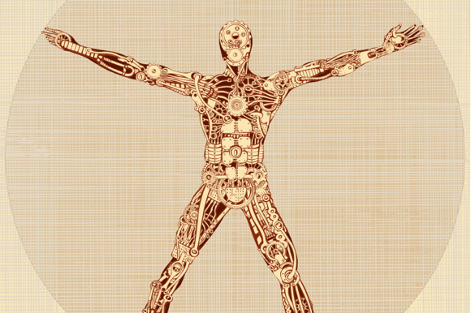
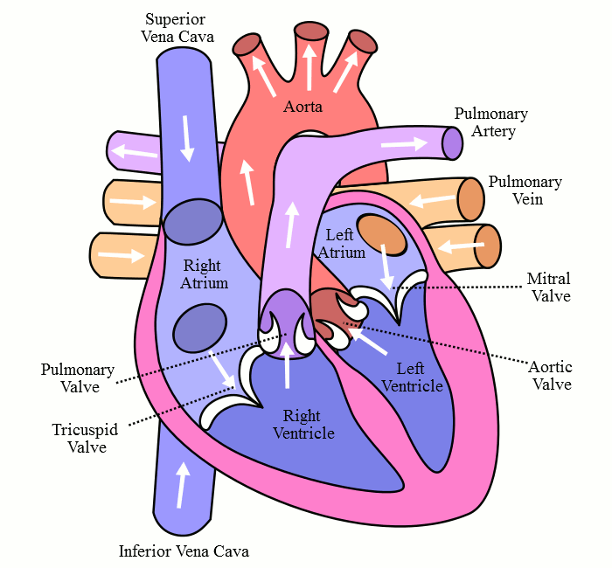
The Body is the “Ultimate Machine”
The body is the “ultimate machine”
650 skeletal muscles and 206 bones
Powered by the ultimate pump
Heart circulates fluids and beats ~2.5 billion times in a lifetime
Anticipates when you’ll be active, capable of speeding up / slowing down to give you fuel you need
Notes:
https://singularityhub.com/wp-content/uploads/2014/07/de-grey-body-is-a-machine-1.jpg
https://upload.wikimedia.org/wikipedia/commons/7/77/Blood_Circulation.gif

Slide 6
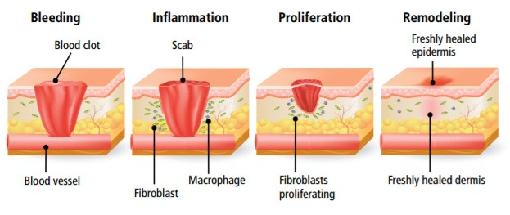
The Body is the “Ultimate Machine”
Capable of self-repair
Skin cells have lifespan of 2-3 weeks
Colon cells: 4 days
Notes:
https://www.inovanewsroom.org/wp-content/uploads/2017/05/wound-healing-steps-bleeding-inflammation-scab-proliferation-remodeling-epidermis.jpg

Slide 7
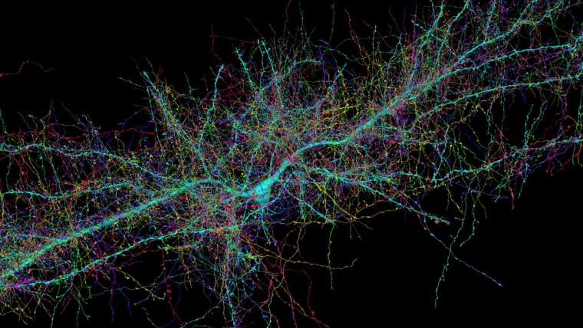
The Body is the “Ultimate Machine”
Is intelligent
~86 billion neurons (each capable of sending pulses of electricity to other neurons)
Each neuron makes ~1000 connections with other neurons (100 trillion connections in total)
Notes:
https://media-cldnry.s-nbcnews.com/image/upload/t_fit-760w,f_auto,q_auto:best/rockcms/2021-06/210614-harvard-brain-image-se-1158a-a3d7a0.jpg

Slide 8
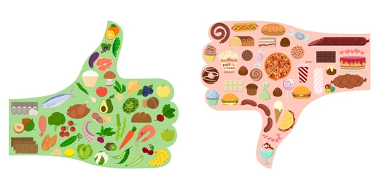
The Body is the “Ultimate Machine”
Powered by food
Food broken down into smaller molecules:
Proteins → amino acids
Polysaccharides → sugars
Lipids → fatty acids and glycerol
Smaller molecules generate energy for your body
Notes:
https://image.shutterstock.com/image-vector/good-bad-food-thumbs-silhouette-260nw-1069892234.jpg

Slide 9
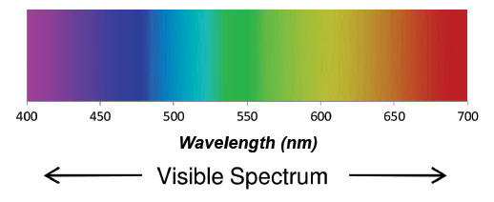
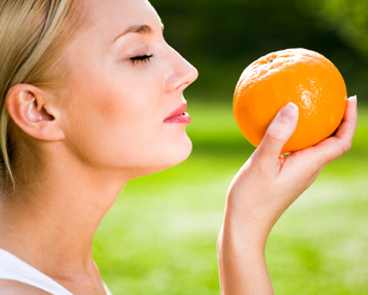
The Body is the “Ultimate Machine”
Can sense its environment
Sight: eyes detect single photons of light
Dilate to let more light in
High sensitivity range
3 different color sensitive photoreceptors (we can distinguish ~10 million colors)
Smell: nose detects ~1000 different chemical compounds → 10,000 different odors
Notes:
https://kaleela.com/wp-content/uploads/2019/08/The-Five-Senses-In-Arabic.jpg
https://www.orcagrowfilm.com/v/vspfiles/templates/taste/images/wavelength-nm.jpg
https://naturescent.com/wp-content/uploads/2013/05/photogallery-fake-awake-woman-smelling-orange.jpg

Slide 10
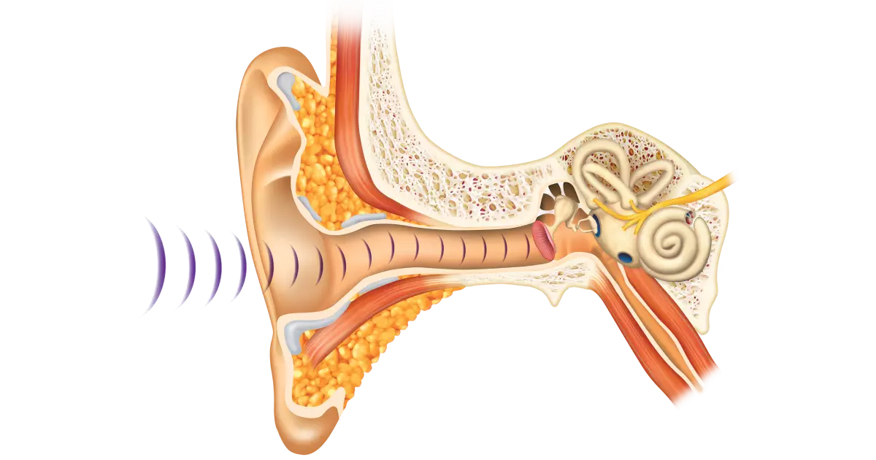
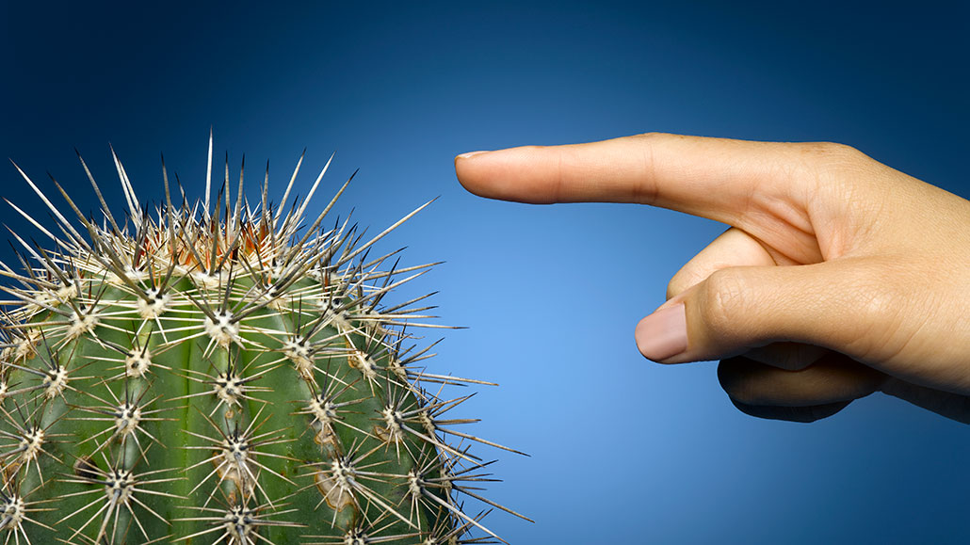
The Body is the “Ultimate Machine”
Can sense its environment
Hearing: ears sense vibrations in the air over a large range of amplitude
Frequencies between 20 and 20,000 Hz
Sensors: fingers and skin detect heat, pressure, vibration, and texture
Knows where its limbs are in space
Can infer the passage of time
Notes:
https://kaleela.com/wp-content/uploads/2019/08/The-Five-Senses-In-Arabic.jpg
https://www.dkfindout.com/us/human-body/senses/ears-and-hearing/
https://www.sciencenewsforstudents.org/wp-content/uploads/2021/05/1030_LL_touch_feat.jpg

Slide 11
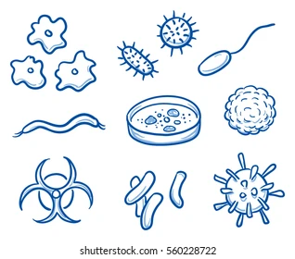
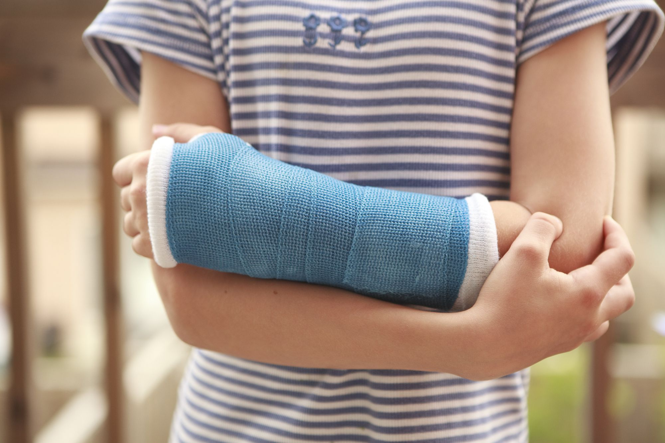
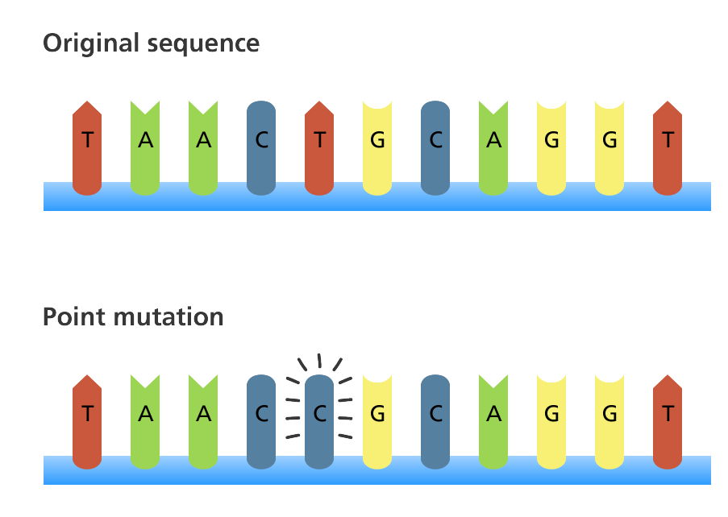
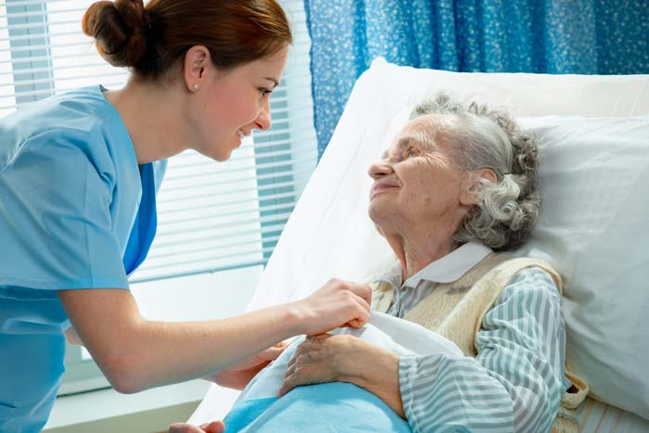
But it’s not perfect...
Susceptible to disease
Viruses
Bacteria
Injuries
Key genetic mutations
Age
Notes:
https://image.shutterstock.com/image-vector/set-different-bacteria-viruses-medical-260nw-560228722.jpg
https://www.verywellhealth.com/thmb/GbUOrfey-R1_75uQa3lnbxfjNfE=/2000x1333/filters:fill(87E3EF,1)/GettyImages-169591412-7e0ad8348328430ba16047a9df41ae17.jpg
https://cdn.massagemag.com/wordpress/wp-content/uploads/hospice-movement-AdobeStock_31062610.jpg
https://www.yourgenome.org/sites/default/files/illustrations/diagram/dna_mutations_point_mutation_yourgenome.png

Slide 12
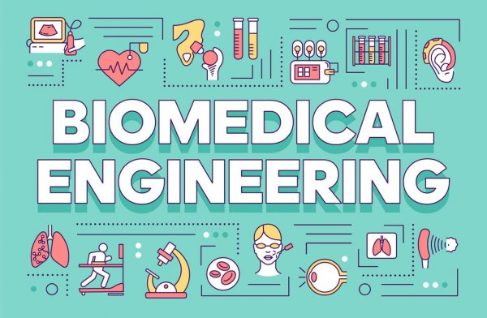
What is biomedical engineering?
The application of engineering principles to medicine and biology for health purposes. It is the study of biological systems.
Notes:
https://st3.depositphotos.com/4177785/32182/v/600/depositphotos_321824840-stock-illustration-biomedical-engineering-word-concepts-banner.jpg

Slide 13
BME = Medicine + Engineering
Medicine
Diagnosis
Prognosis
Treatment
Prevention
Engineering
Identify the problem
Define the constraints
Generate ideas
Select approach
Develop design
Test solution
Notes:
https://www.kindpng.com/picc/m/757-7575566_10-science-clipart-images-download-for-free-hd.png
https://www.pngkit.com/png/detail/7-70105_bot-gears-mechanical-engineering-clipart.png

Slide 14
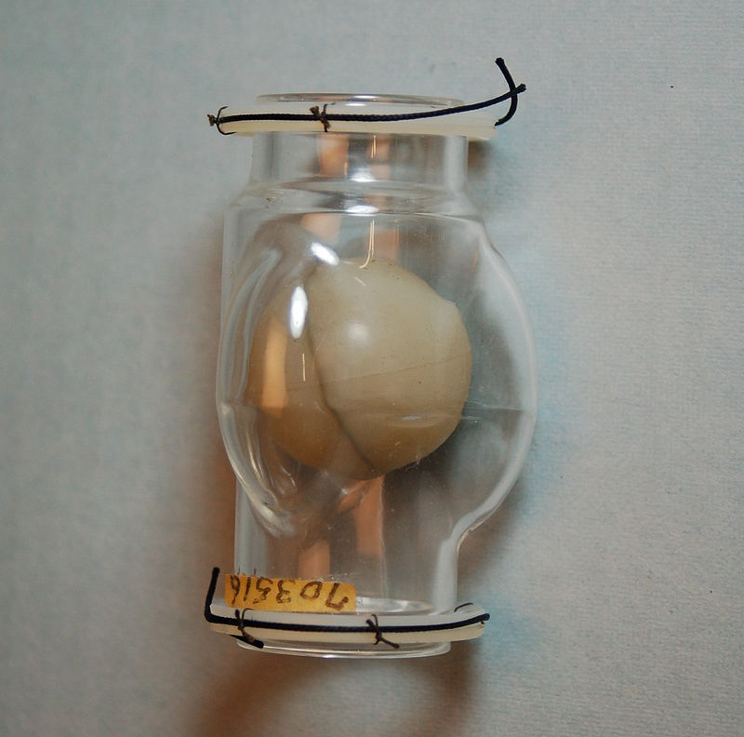
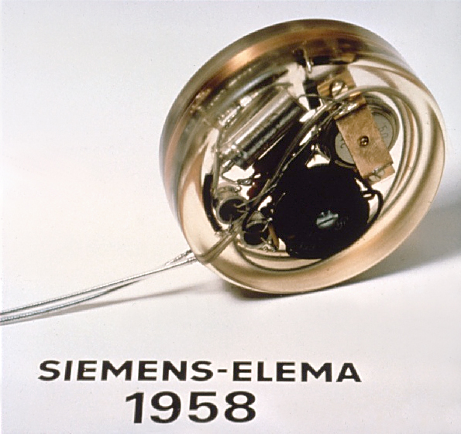
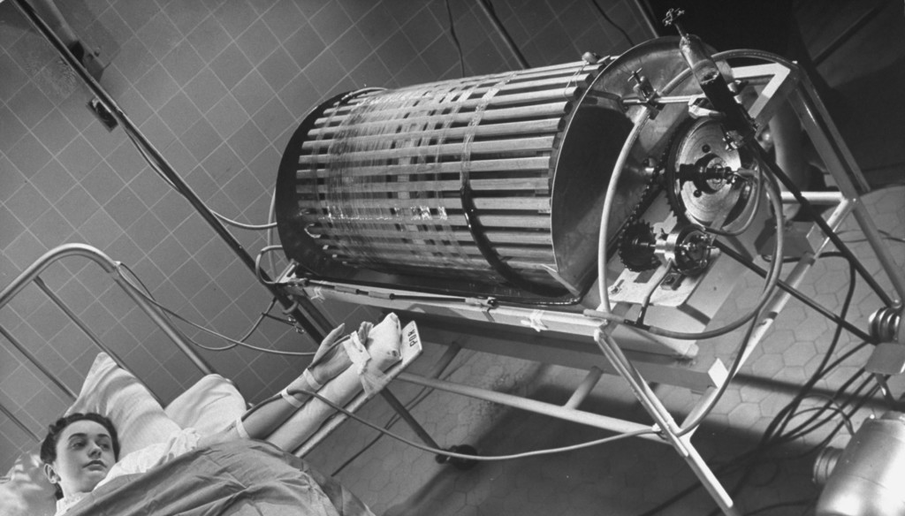
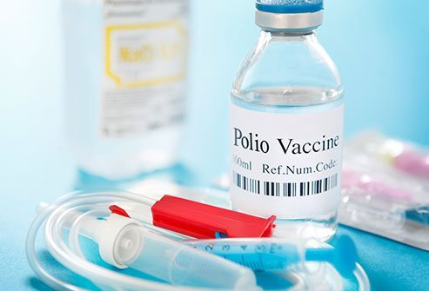
Historical Perspective
Only engineering discipline developed post-WWII
Kidney dialysis -Willem Kolff (1940s)
Polio vaccines - Jonas Salk (1940s and 50s)
Artificial heart valve -Charles A. Hufnagel (1952)
First external cardiac pacemaker (1958)
Notes:
https://navigate.aimbe.org/why-bioengineering/history/
https://www.kidneynews.org/view/journals/kidney-news/1/2/full-4f1.jpg
https://commons.wikimedia.org/wiki/File:First_pacemaker_(Siemens-Elema_1958).jpg
https://upload.wikimedia.org/wikipedia/commons/thumb/a/a6/Hufnagel_heart_Valve15111214-photos_309.jpg/220px-Hufnagel_heart_Valve15111214-photos_309.jpg
https://www.emedicinehealth.com/images/article/main_image/polio-vaccine.jpg
https://www.ncbi.nlm.nih.gov/pmc/articles/PMC3782271/

Slide 15
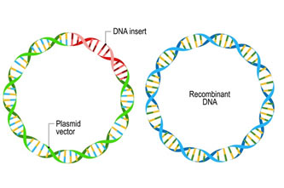
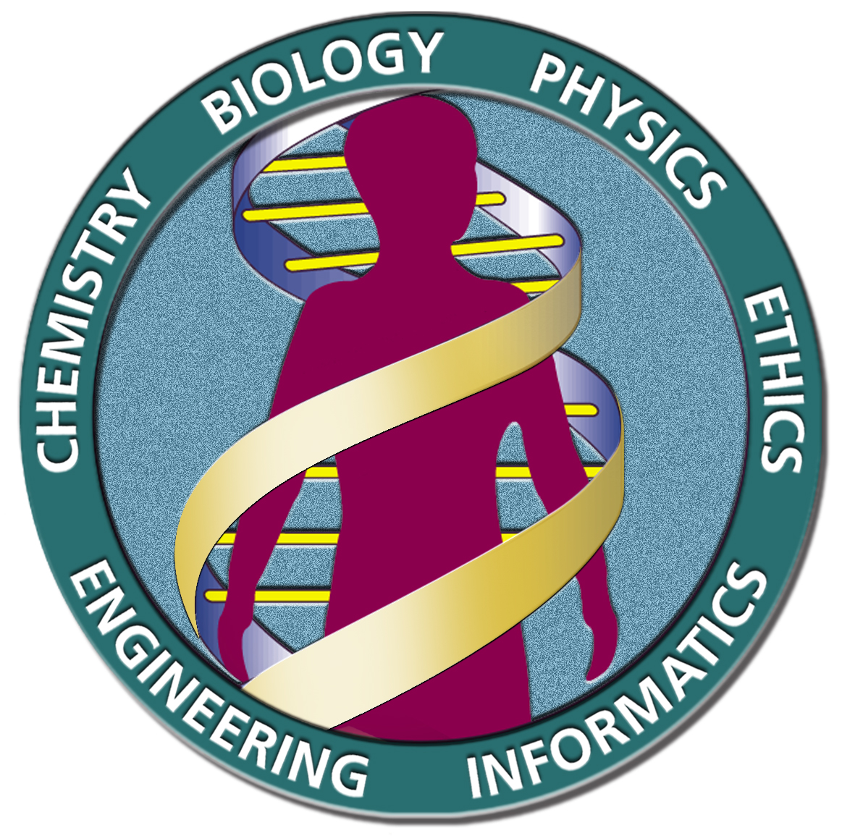
Historical Perspective
First biomedical engineering departments formed (late 1960s)
University of Virginia
Case Western Reserve University
Johns Hopkins University
Duke University
Recombinant DNA technology (1970s)
Human Genome Project (later 20th century)
Notes:
https://navigate.aimbe.org/why-bioengineering/history/
https://manuelcorpas.com/wp-content/uploads/2020/09/Logo_HGP.jpg
https://www.genome.gov/25520302/online-education-kit-1972-first-recombinant-dna#:~:text=The%20first%20production%20of%20recombinant,host%20cell%2C%20often%20a%20bacterium.
https://www.guyhowto.com/wp-content/uploads/2020/12/102_1-Recombinant-DNA-Techn.jpg

Slide 16
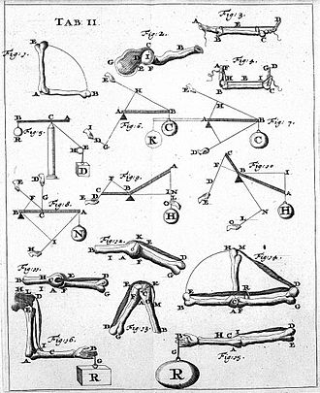
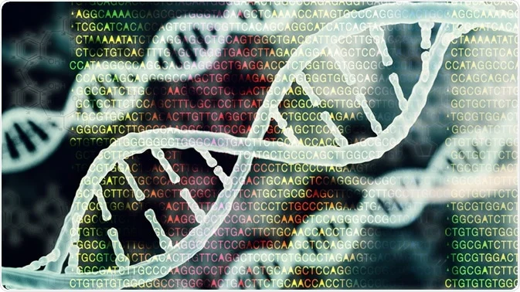
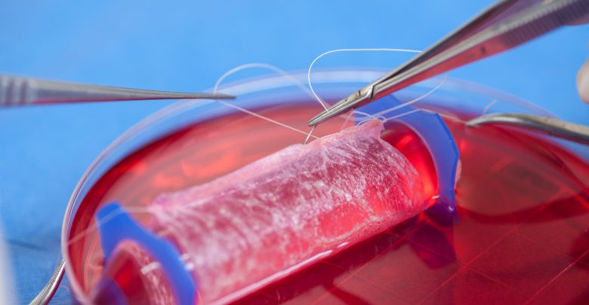
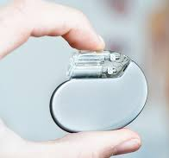
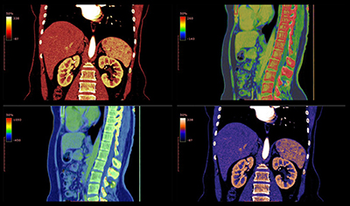
What do biomedical engineers do?
BME Focus Areas
Biomechanics
Biomaterials and Tissue Engineering
Biomedical Devices
Bioimaging and Signal Processing
Cellular and Molecular Biotechnology
Neuroengineering
Notes:
https://upload.wikimedia.org/wikipedia/commons/thumb/d/d5/Giovanni_Borelli_-_lim_joints_%28De_Motu_Animalium%29.jpg/330px-Giovanni_Borelli_-_lim_joints_%28De_Motu_Animalium%29.jpg
https://encrypted-tbn0.gstatic.com/images?q=tbn:ANd9GcQI8EQKBULQ7TrIN1wUT-VfCGwcGG-dCfL3og&usqp=CAU
https://www.azolifesciences.com/image.axd?picture=2020%2F10%2Fshutterstock_671206474.jpg
https://www.automate.org/userAssets/aiaUploads/image/AIA-LS-MAR2020-T4-1128537982-BLOG.jpg
https://www.medgadget.com/wp-content/uploads/2019/06/Tissue-Engineering-Market.jpg

Slide 17
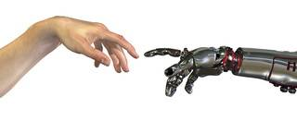
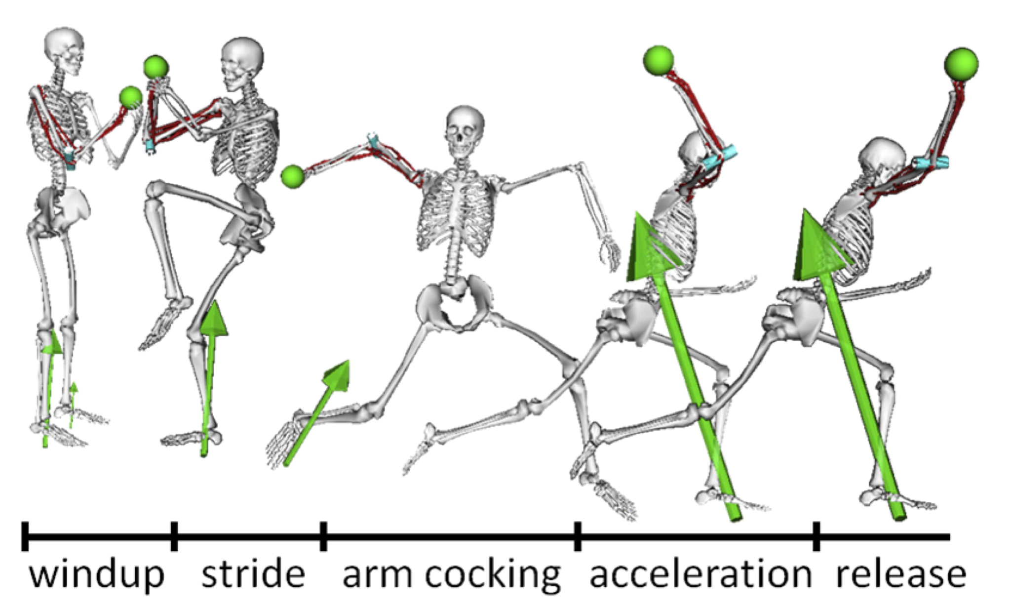
Focus Area: Biomechanics
The scientific study of the mechanics of living structures (or of structures produced by organisms) -Nature definition
What you study
Mechanical properties of tissues (macro and micro)
Micromechanics
Solid mechanics
Viscoelasticity
Fluid mechanics
Entropic force, diffusive force, osmotic force
Notes:
https://www.mccormick.northwestern.edu/biomedical/images/baseball-min.jpg
https://www.cedtechnologies.com/wp-content/uploads/2013/02/b2ap3_thumbnail_bio.jpg

Slide 18
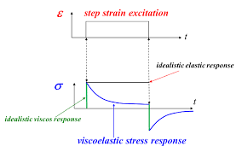
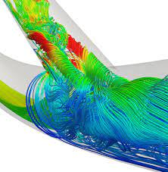
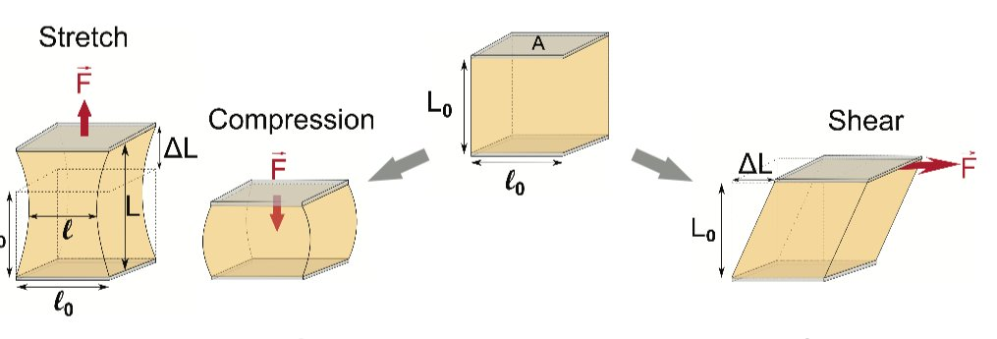
Applications: Biomechanics
Cardiovascular fluid mechanics and dynamics
Cell mechanics
Solid mechanics of biological materials
Biological viscoelastic solids and fluids
Notes:
https://www.dicardiology.com/content/studying-blood-flow-dynamics-identify-heart-vessel-failure
https://phys.org/news/2018-06-explores-cell-mechanics.html
https://www.intechopen.com/chapters/40738

Slide 19
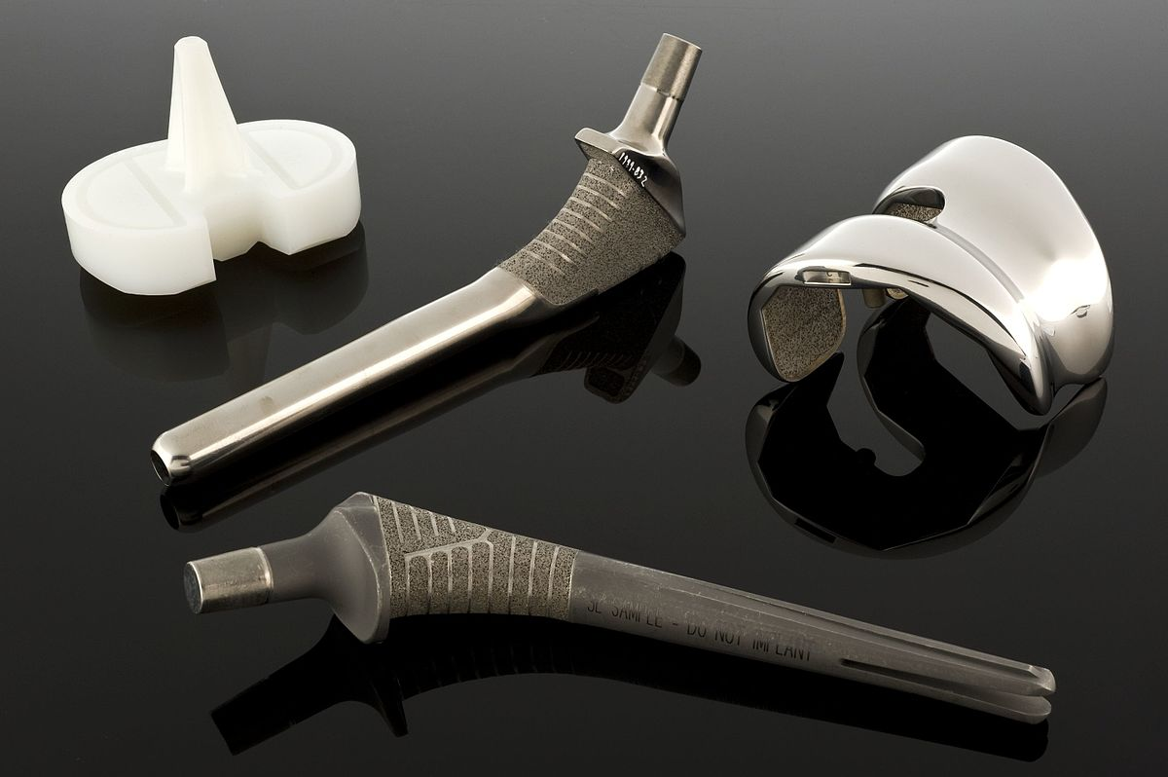
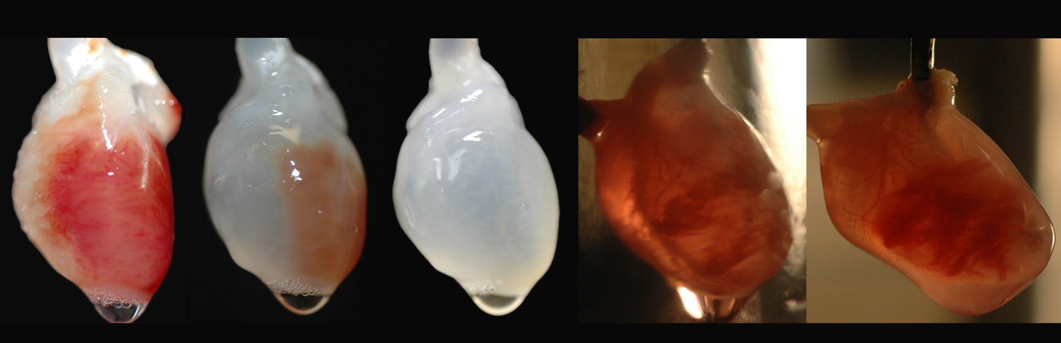
Focus Area: Biomaterials and Tissue Engineering
The field of study in which man-made materials are developed for medical treatments (biomaterials) and living functional tissue is produced (tissue engineering)
What you study
Interactions between materials and cells or tissues (and their effects)
Major body responses (wound healing, immune response, foreign body response)
Characterizing biomaterials (metals, ceramics, polymers)
Natural and synthetic materials
Cell culture
Material biocompatibility
Notes:
https://www.biolinscientific.com/blog/biomaterials-vs-tissue-engineering-what-is-the-difference
https://upload.wikimedia.org/wikipedia/commons/thumb/4/47/Hip_joint_replacement%2C_United_States%2C_1998_Wellcome_L0060175.jpg/1200px-Hip_joint_replacement%2C_United_States%2C_1998_Wellcome_L0060175.jpg
https://www.sciencebuzz.org/sites/default/files/images/Five_Hearts%20copy_0.jpg
https://directorsblog.nih.gov/wp-content/uploads/2015/10/3d_bioprinting_artery2.jpg

Slide 20
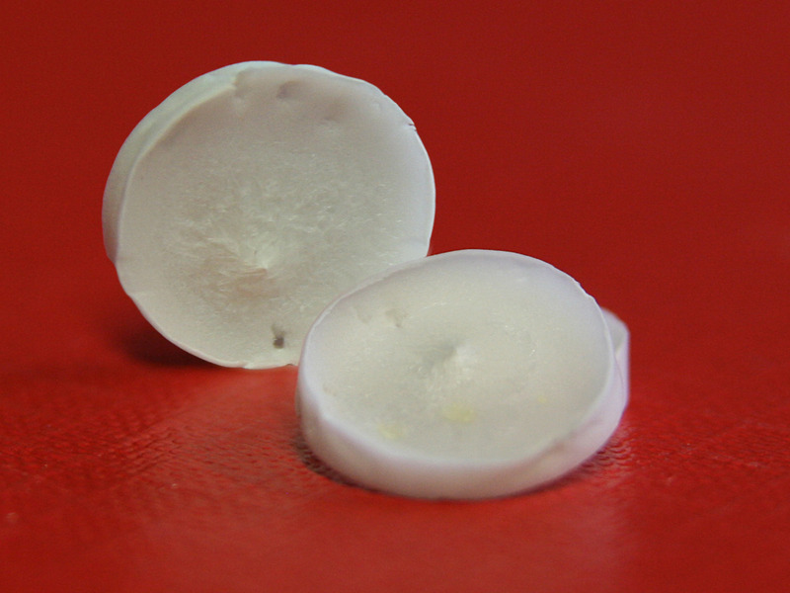
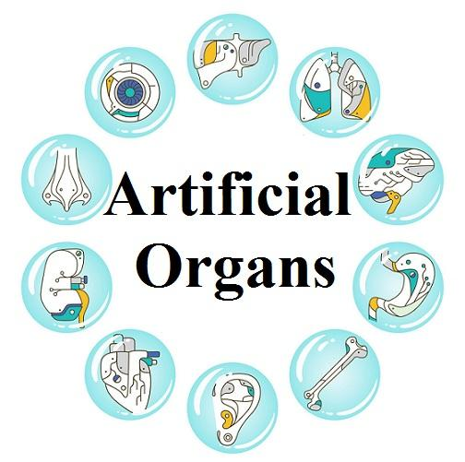
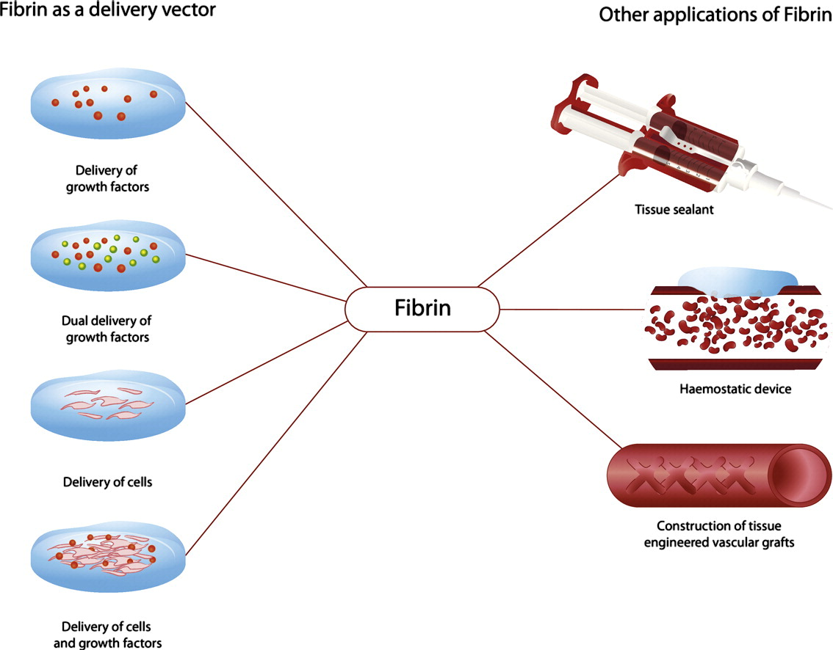
Applications: Biomaterials and Tissue Engineering
Artificial organs
Wound healing
Bioscaffolds
Collagen biomaterials
Implant failure and material reactions
Notes:
https://www.openpr.com/news/1876594/outstanding-growth-of-artificial-organs-market-is-estimated#prid-1876594
https://www.sciencedirect.com/science/article/pii/S016836591400666X
https://phys.org/news/2012-01-scientists-silk-tasar-silkworm-scaffold.html

Slide 21
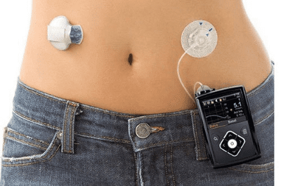
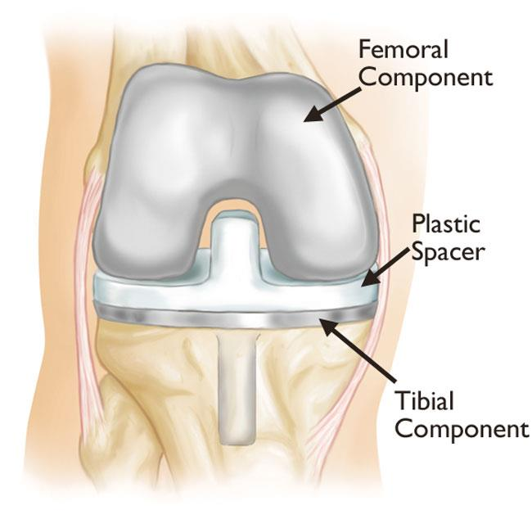
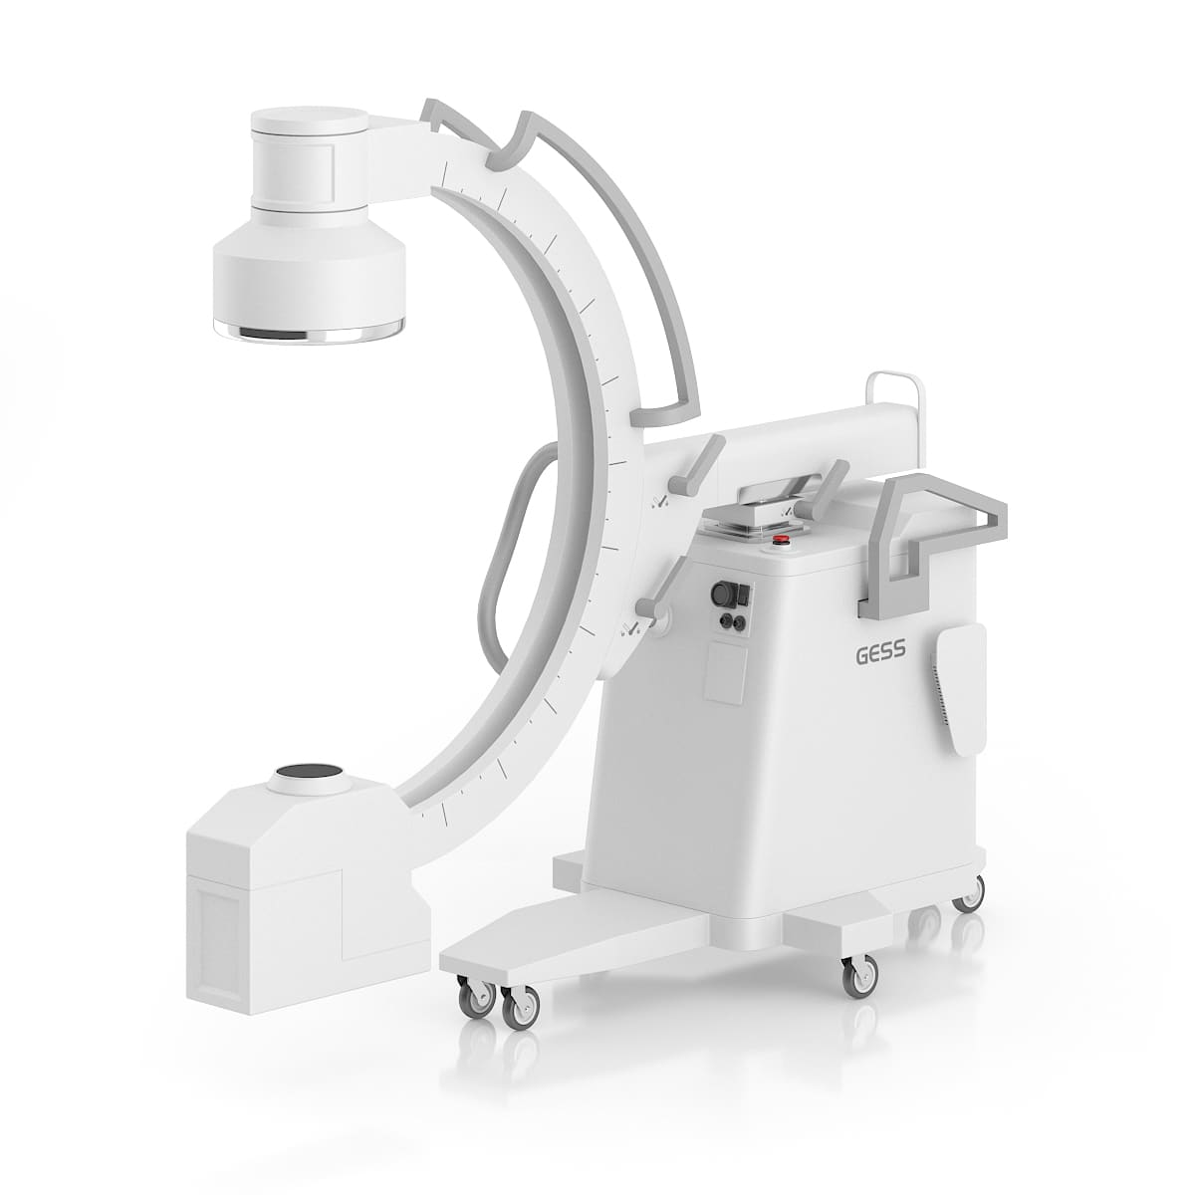
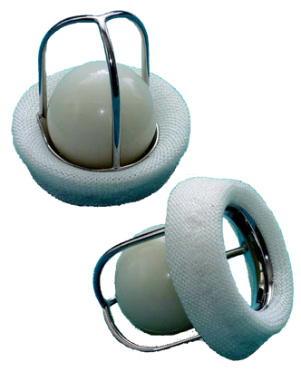
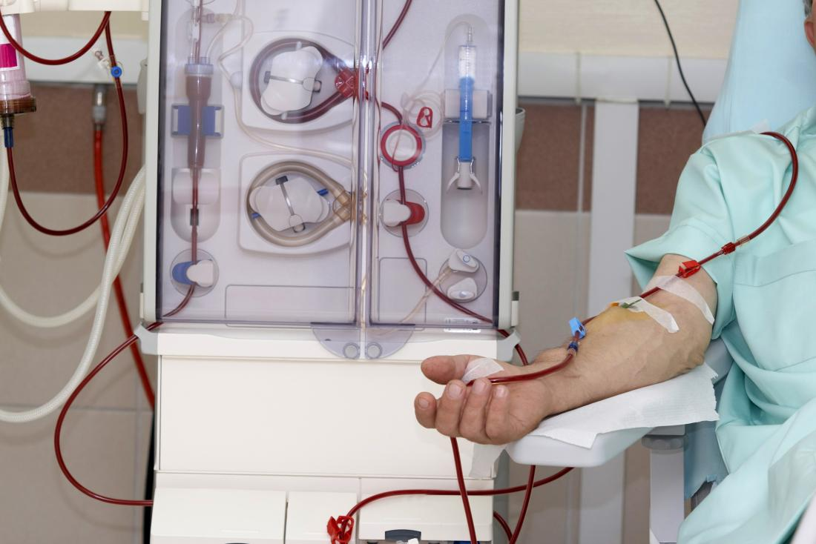
Focus Area: Biomedical Devices
The field of study that produces instruments, machines, implants, in vitro reagents, software, materials, and other related articles for the safe and effective prevention, diagnosis, treatment, and rehabilitation of illness and disease for human beings
What you study
Instrumentation and measurement
Diagnostic vs. therapeutic devices
Integrated Systems technology
Device fabrication
Interaction with cells, tissues, organs
Notes:
https://link.springer.com/chapter/10.1007/978-3-030-24237-4_1#:~:text=Biomedical%2Fmedical%20devices%20are%20instruments,and%20disease%20for%20human%20beings.
https://orthoinfo.aaos.org/en/treatment/revision-total-knee-replacement/
https://www.cthsurgery.com/uploads/2/6/5/4/26542699/editor/caged-ball-valve.png?1519602967
https://www.drwf.org.uk/news-and-events/news/first-insulin-pump-acts-artificial-pancreas-launched-people-type-1-diabetes
https://cdn-prod.medicalnewstoday.com/content/images/articles/152/152902/dialysis-can-carry-out-the-function-of-the-kidneys.jpg
https://cgaxisimages.fra1.cdn.digitaloceanspaces.com/2015/01/cgaxis_models_55_06a.jpg

Slide 22
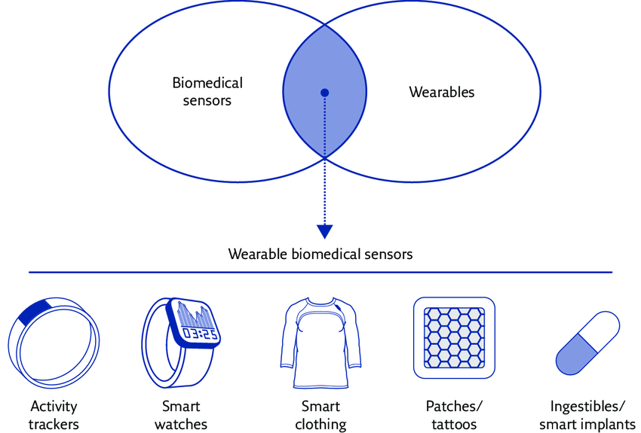
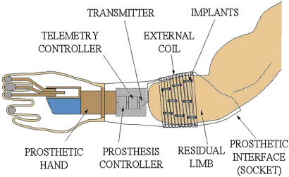
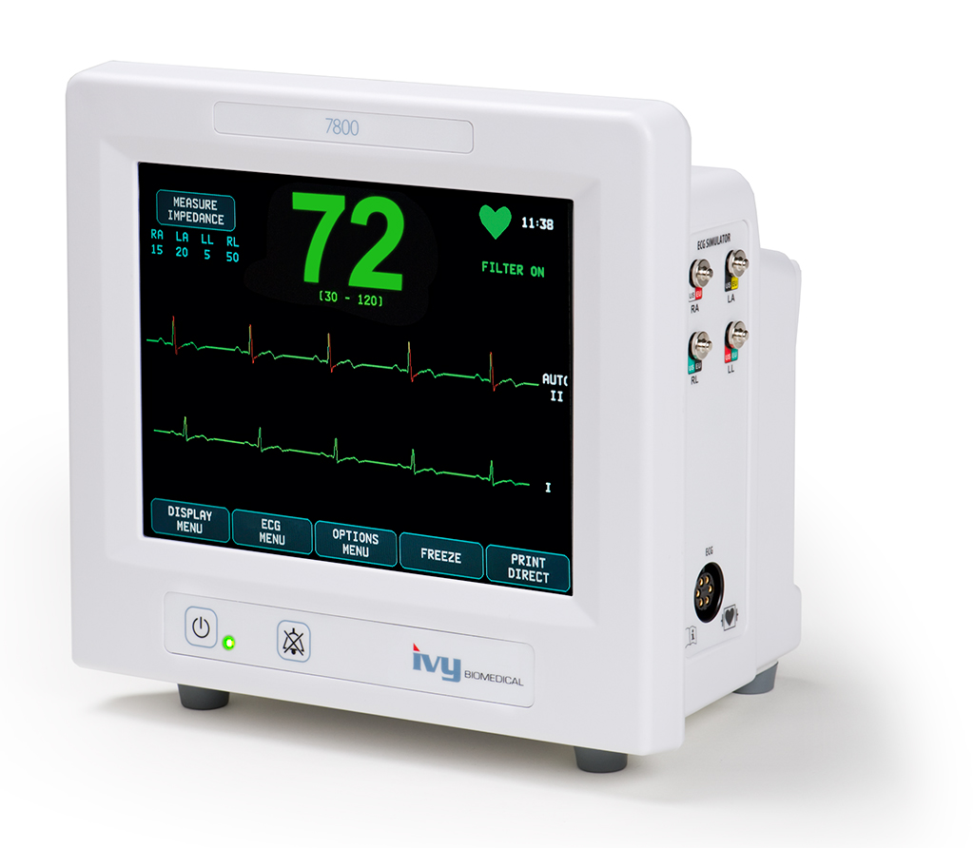
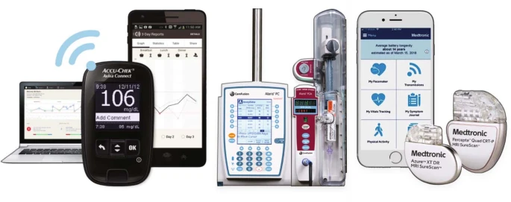
Applications: Biomedical Devices
Sensors
Actuators
Diagnostic devices
Therapeutic devices
Instruments
Systems
Software
Notes:
https://www.researchgate.net/profile/Andrea-Aliverti/publication/318648627/figure/fig3/AS:667765149032451@1536219026226/Wearable-biomedical-sensors-Reproduced-and-modified-from-2-with-permission-from-the.png
https://www.ivybiomedical.com/model-7800.html
https://www.sciencedirect.com/science/article/pii/B9780128183182000039
https://www.nature.com/articles/s41551-019-0426-z

Slide 23
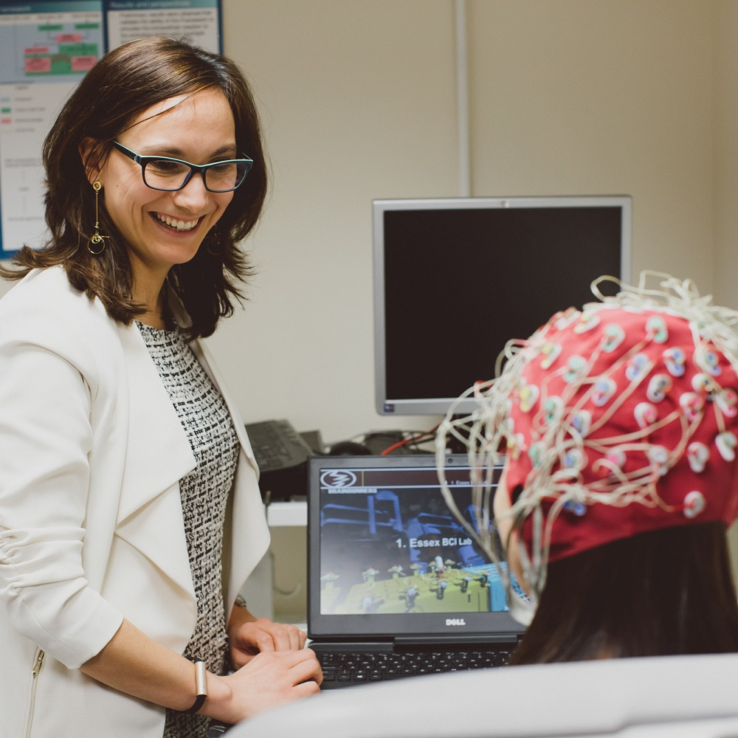
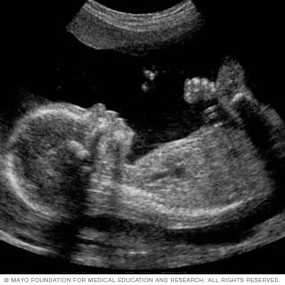
Focus Area: Bioimaging and Signal Processing
The field of study centered on methods and instruments used to acquire, process, and visualize structural or functional images of living objects or systems at desired spatial and temporal scales
What you study
Medical imaging
Methods
Types
Signal processing
Image analysis
Neural engineering
Electrical signals of brain and heart
Notes:
https://bioengineering.gatech.edu/node/5335#:~:text=Bioimaging%20refers%20to%20methods%20and,used%20visualize%20fixed%20biological%20samples.
https://www.essex.ac.uk/-/media/header-images/faculty-of-science-and-health/csee/brain-computer-interfaces-lab-1000x1000.jpg?h=1000&w=1000&la=en
https://www.mayoclinic.org/tests-procedures/fetal-ultrasound/about/pac-20394149
https://www.aclsmedicaltraining.com/rhythm-recognition/

Slide 24
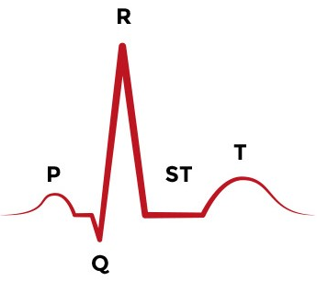
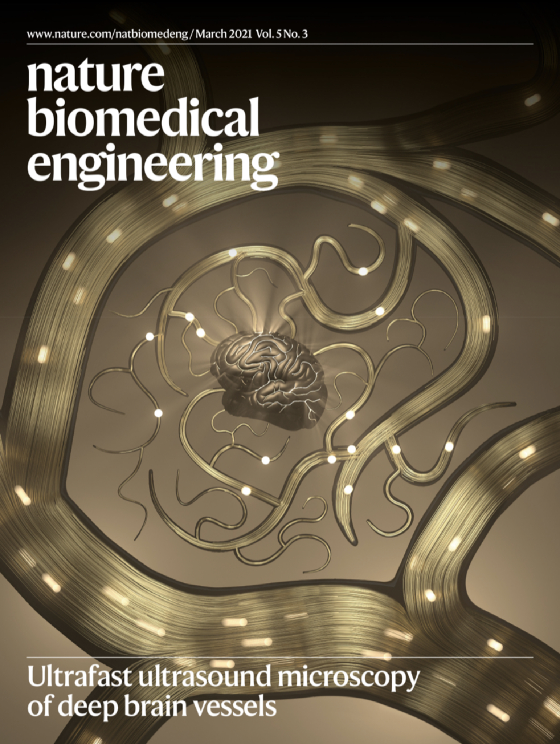
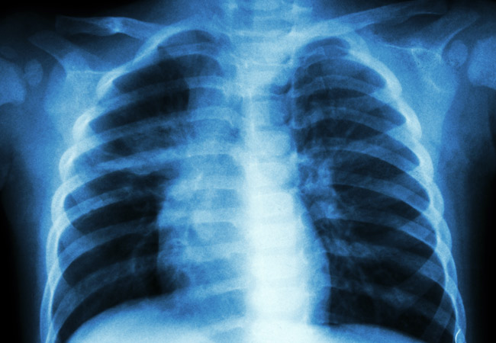
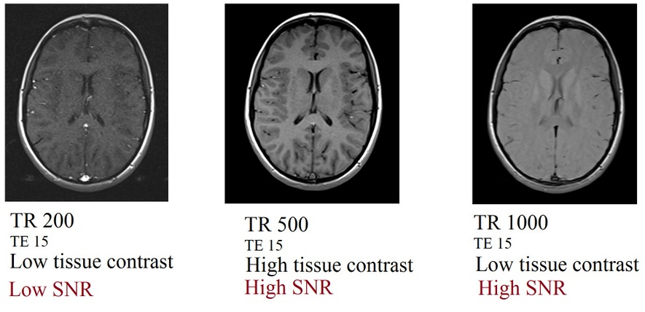
Applications: Bioimaging and Signal Processing
Electrocardiograms
Neuron functions
Heart functions
Imaging modalities (microscopy, ultrasound, X-ray, CT, PET, MRI, etc.)
Image qualities (contrast, signal, spatial resolution)
Notes:
https://www.aclsmedicaltraining.com/wp-content/uploads/2020/09/ACLS-Figure-21.jpg
https://pbs.twimg.com/media/Ewre1JQWYAAMsEP?format=jpg&name=4096x4096
https://consultqd.clevelandclinic.org/chest-x-ray-prior-to-thyroidectomy-is-it-really-needed/
https://mrimaster.com/images/technique/SNR%20IMAGE/Repetition%20time%20(TR)%20and%20SNR%20relation%20in%20MRI.jpg

Slide 25
Focus Area: Cellular and Molecular Biotechnology
The field of study focused on the practical application of cellular and molecular knowledge with the aim of enhancing or improving production in microorganisms or cell cultures
What you study
Biological regulation (signaling, endocrine system, hormones)
Cell culture
Cell morphology
Genetics
Diffusion, transport, and delivery
Binding kinetics
Notes:
https://www.wur.nl/en/education-programmes/master/msc-programmes/msc-biotechnology/specialisations-of-biotechnology/cellular-and-molecular-biotechnology.htm#:~:text=Focus%20on%20the%20practical%20application,micro%2Dorganisms%20or%20cell%20cultures.
https://www.gea.com/en/binaries/Pharma%20Product%20fermentation_tcm11-5956_w710.jpg
https://blog.genofab.com/hubfs/Stock%20Images/plasmid-black-tube.jpg
https://manometcurrent.com/wp-content/uploads/2021/06/Microfluidics.jpg
https://www.fda.gov/files/iStock-157317886.jpg

Slide 26
Applications: Cellular and Molecular Biotechnology
Protein manufacturing
Pharmaceuticals
Virus manufacturing
Genetic engineering
Vaccines
Bioreactors
Microfluidics
Notes:
https://www.practicallyscience.com/wp-content/uploads/2015/05/michaelis-menton-intuition-v2-op.jpg
https://pharmsci.uci.edu/can-pharmaceutical-sciences-major/
https://www.sciencedirect.com/science/article/pii/S2468451118300291

Slide 27
Focus Area: Neuroengineering
The field of study that involves the use of engineering technology to study the function of various neural systems
What you study
Neuroimaging techniques
Neural anatomy
Action potentials
Nervous system modulation
Notes:
https://www.engr.wisc.edu/department/biomedical-engineering/research/neuroengineering/
https://bioe.uw.edu/wp-content/uploads/neural-monitoring.png
https://www.myhealthyclick.com/wp-content/uploads/2021/02/New-Vestibular-Implant-Improves-Balance-and-Movement-in-Patients-with-Inner-Ear-Disorder.jpg
https://media.springernature.com/relative-r300-703_m1050/springer-static/image/art%3A10.1038%2Fnature.2013.12439/MediaObjects/41586_2013_Article_BFnature201312439_Figc_HTML.jpg

Slide 28
Applications: Neuroengineering
Implantable technology and materials
Neural prosthetics
Cochlear implants
Retinal implants
Touch restoration
Vestibular implants
bladder/bowel control
Brain-computer interfaces
Sensor and motor prosthesis
Notes:
https://www.todaysmedicaldevelopments.com/article/haptics-medical-device-design-neuroprosthetics-amputees-111016/
https://cdn.the-scientist.com/assets/articleNo/68762/aImg/42181/bci-article-s.png
https://miro.medium.com/max/1128/1*eNp_4IFB9bZOeCVqdXKg5A.jpeg

Slide 29
BME Design Process: How Biomedical Engineers Approach Problems
Define the Constraints

Slide 30
Identify the problem
Engineering
Identify the needs
Create a problem statement
Who has the problem/need?
What is the problem/need?
Why is it important?
Medicine
Identify the symptoms
Utilize diagnostic tests and assessments to define the problem
Imaging tests
Physical exams
Patient histories

Slide 31
Define the constraints
Engineering
Describe conditions that must be met with design solution
Limit design possibilities by excluding or requiring additional specifications
Cost
Size
Weight
Material
Medicine
Describe conditions that must be met with treatment method
Limit treatment options based on various factors
Cost
Time
Patient values
Medical expertise

Slide 32
Generate ideas
Engineering
Brainstorm multiple solutions
Study existing solutions
Identify aspects of existing solutions that can be utilized or improved
Research
Medicine
Consider alternative treatment methods
Surgery vs. medications
Examine existing treatments
Determine current downfalls
Research

Slide 33
Select approach
Engineering
Describe advantages and disadvantages of all possible solutions
Ensure that design criteria and constraints are satisfied
Identify an optimal approach
Medicine
Describe risks and benefits of each treatment option
Ensure that treatment plan is appropriate for patient’s diagnosis and prognosis
Identify an optimal treatment plan

Slide 34
Develop design
Engineering
Refine approach based on problem specifics
Establish design function and structure
Build prototype
Create simulations
Medicine
Refine approach based on patient specifics
Establish treatment component
Design device
Develop pharmaceutical

Slide 35
Test solution
Engineering
Iterate design process to improve current work and identify any remaining flaws
Continuously evaluate feedback and possible improvements or upgrades available for design
Medicine
Clinical trials to identify any common flaws or dangers associated with a treatment
Patient follow-ups post treatment to ensure successful individual therapy

Slide 36
Ethics/Morals
From the Biomedical Engineering Society (BMES) Code of Ethics
Professional Obligations
Use knowledge, skills, and abilities to enhance the safety, health, and welfare of the public
Strive by action, example, and influence to increase the competence, prestige, and honor of the the BME profession
Health Care Obligations
Regard responsibility toward and rights of patients, including those of confidentiality and privacy as their primary concern
Consider the larger consequences of their work in regard to cost, availability, and delivery of healthcare
Notes:
https://www.bmes.org/files/CodeEthics04.pdf
https://pubmed.ncbi.nlm.nih.gov/9315431/

Slide 37
Ethics/Morals
Research Obligations
Comply fully with legal, ethical, institutional, governmental, and other applicable research guidelines, respecting the rights of and exercising the responsibilities to colleagues, humans and animal subjects, and the scientific and general public
Publish and/or present properly credited results of research accurately and clearly
Training Obligations
Honor the responsibility not only to train BME students in proper professional conduction in performing research and publishing results, but also to model such conduct before them
Keep training methods and content free from inappropriate influence from special interests
Notes:
https://www.bmes.org/files/CodeEthics04.pdf
https://en.wikipedia.org/wiki/File:Scales_Of_Justice.svg

Slide 38
Resources & Images used to create this presentation Links accurate as of 12/20/2021
Slide 5:
Dorrier, Jason. “If the Body Is a Machine, Can It Be Maintained Indefinitely?” Singularity Hub, Singularity Education Group, 3 Aug. 2014, https://singularityhub.com/2014/08/03/on-the-road-to-the-fountain-of-youth/.
Wapcaplet. “File:Diagram of the Human Heart (Cropped).Svg.” Wikimedia Commons, 2 June 2006, https://commons.wikimedia.org/wiki/File:Diagram_of_the_human_heart_(cropped).svg
Slide 6: InovaNewsroom. “Wound Healing Center at Inova Loudoun Treats Complex Wound and Ostomy Cases.” Inova Newsroom, Inova Health System, 19 May 2017, https://www.inovanewsroom.org/ilh/2017/05/wound-healing-center-at-inova-loudoun-treats-complex-wound-and-ostomy-cases/.
Slide 7: Metcalfe, Tom. “This Is Your Brain, in Glorious Color.” NBCNews.com, NBCUniversal News Group, 15 June 2021, https://www.nbcnews.com/science/science-news/brain-glorious-color-rcna1192.
Slide 8: Inspiring. “Good and Bad Food. Thumbs Silhouette with Healthy and Junk Food.” Shutterstock, Shutterstock, Inc., https://www.shutterstock.com/image-vector/good-bad-food-thumbs-silhouette-healthy-1069892234.
Slide 9:
Sudowoodo. “Senses Icon Set Stock Illustration.” IStock, 17 Oct. 2017, https://www.istockphoto.com/vector/senses-icon-set-gm862112534-142884135.
“Full Visible Spectrum.” Orca Grow Film, California Grow Films LLC, https://www.orcagrowfilm.com/Articles.asp?ID=145.
“Sense of Smell.” Nature Scent, Nature Scent of the Ozarks Inc., 2018, https://naturescent.com/sense-of-smell/.

Slide 39
Resources & Images used to create this presentation Links accurate as of 12/20/2021
Slide 10:
Sudowoodo. “Senses Icon Set Stock Illustration.” IStock, 17 Oct. 2017, https://www.istockphoto.com/vector/senses-icon-set-gm862112534-142884135.
“Ears and hearing.” DK Find Out!, Dorling Kindersley Limited, 2021, https://www.dkfindout.com/us/human-body/senses/ears-and-hearing/.
Dragon Images, Dragon. “Female Hand Touching Prickly Cactus.” Shutterstock, Shutterstock, Inc., https://www.shutterstock.com/image-photo/female-hand-touching-prickly-cactus-260096384.
Slide 11:
Barreto, Daniela. “Set of Different Bacteria and Viruses, for Medical Info Graphics. Hand Drawn Line Art Cartoon Vector Illustration.” Shutterstock, Shutterstock, Inc., https://www.shutterstock.com/image-vector/set-different-bacteria-viruses-medical-info-560228722.
Cluett, Jonathan. “Materials Used to Make a Cast.” Verywell Health, Verywell Health, 7 June 2020, https://www.verywellhealth.com/what-is-a-cast-for-broken-bones-made-out-of-2549317.
Smith, Irene. “Massage Therapy's Role in the Growing Hospice Movement.” MASSAGE Magazine, 12 Oct. 2016, https://www.massagemag.com/massage-therapys-role-in-the-growing-hospice-movement-40833/.
Genome Research Limited. “What Types of Mutation Are There?” Your Genome, https://www.yourgenome.org/facts/what-types-of-mutation-are-there.
Slide 12: bsd555. “Biomedical Engineering Word Concepts Banner.” IStock, Getty Images, 23 Apr. 2020, https://www.istockphoto.com/vector/biomedical-engineering-word-concepts-banner-biotechnology-for-health-healthcare-gm1220302093-357262972

Slide 40
Resources & Images used to create this presentation Links accurate as of 12/20/2021
Slide 13:
“10 Science Clipart Images.” KindPNG.com, Shenzhen BestAI Internet Co., https://www.kindpng.com/imgv/TwxRmxx_10-science-clipart-images-download-for-free-hd/.
“Bot Gears - Mechanical Engineering Clipart.” PngKit.com, https://www.pngkit.com/view/u2q8a9q8w7o0u2e6_bot-gears-mechanical-engineering-clipart/.
Slide 14:
“History.” Navigate the Circuit, American Institute for Medical and Biological Engineering (AIMBE), https://navigate.aimbe.org/why-bioengineering/history/.
Baicus, Anda. “History of polio vaccination.” World journal of virology vol. 1,4 (2012): 108-14. doi:10.5501/wjv.v1.i4.108.
“End Chronic Kidney Disease Neglect.” Nature, Springer Nature Limited, 11 Mar. 2020, https://www.nature.com/articles/d41586-020-00691-4.
Turina, Marko. “File:First Pacemaker (Siemens-Elema 1958).Jpg.” Wikimedia Commons, University Hospital, Zurich, 9 Apr. 2009, https://commons.wikimedia.org/wiki/File:First_pacemaker_(Siemens-Elema_1958).jpg.
Hawk, Alan. “File:Hufnagel Heart Valve15111214-Photos 309.Jpg.” Wikimedia Commons, 23 Aug. 2010, https://commons.wikimedia.org/wiki/File:Hufnagel_heart_Valve15111214-photos_309.jpg.
Davis, Charles Patrick. “What Is Polio? Symptoms and Vaccine.” Edited by Jerry R Balentine, MedicineNet, WebMD, https://www.medicinenet.com/polio_facts/article.htm.

Slide 41
Resources & Images used to create this presentation Links accurate as of 12/20/2021
Slide 15:
“History.” Navigate the Circuit, American Institute for Medical and Biological Engineering (AIMBE), https://navigate.aimbe.org/why-bioengineering/history/.
“1972: First Recombinant DNA.” Genome.gov, National Human Genome Research Institute, 26 Apr. 2013, https://www.genome.gov/25520302/online-education-kit-1972-first-recombinant-dna#:~:text=The%20first%20production%20of%20recombinant,host%20cell%2C%20often%20a%20bacterium.
Image Citations
U.S. Department of Energy, Human Genome Project. “File:Logo HGP.jpg.” Wikimedia Commons, 19 June 2006, https://commons.wikimedia.org/wiki/File:Logo_HGP.jpg.
Designua. “Plasmid and Recombinant DNA. Bacterial DNA in Which a Foreign DNA Fragment Is Inserted into a Plasmid Vector. .” Shutterstock, Shutterstock, Inc., https://www.shutterstock.com/image-vector/plasmid-recombinant-dna-bacterial-which-foreign-794366641.

Slide 42
Resources & Images used to create this presentation Links accurate as of 12/20/2021
Slide 16:
Borelli, Giovanni Alfonso. “File:Giovanni Borelli - Lim Joints (De Motu Animalium).Jpg.” Wikimedia Commons, 1 Jan. 1980, https://commons.wikimedia.org/wiki/File:Giovanni_Borelli_-_lim_joints_(De_Motu_Animalium).jpg.
Kandola, Aaron. “What to Know about Heart Pacemakers.” Medical News Today, Healthline Media, 11 Mar. 2019, https://www.medicalnewstoday.com/articles/324662#outlook.
Tontonoz Wednesday, Matthew. “Genetic 'Scars' Provide Clues for Tailoring Cancer Treatment.” Memorial Sloan Kettering Cancer Center, Memorial Sloan Kettering Cancer Center, 11 Oct. 2017, https://www.mskcc.org/news/genetic-scars-provide-clues-tailoring-cancer-treatment.
Vision Online Marketing Team. “UC Berkeley Announces Advanced Bioimaging Center, Aims to Promote Imaging Technology in Life Sciences.” Automate, A3 Association for Advancing Automation, 31 Mar. 2020, https://www.automate.org/blogs/uc-berkeley-announces-advanced-bioimaging-center-aims-to-promote-imaging-technology-in-life-sciences.
Market Research Future. “Tissue Engineering Market to Garner USD 53,424.00 Million by 2024, with a CAGR of 17.84% .” Medgadget, Medgadget, Inc., 20 June 2019, https://www.medgadget.com/2019/06/tissue-engineering-market-to-garner-usd-53424-00-million-by-2024-with-a-cagr-of-17-84-global-industry-size-share-new-technology-trends-business-growth-opportunities.html
Slide 17:
“Biomechanics.” McCormick School of Engineering, Northwestern University, https://www.mccormick.northwestern.edu/biomedical/research/areas/biomechanics.html.
Goldin, Ian, and Chris Kutarna. “Our Michelangelo Moment: How to Protect the Legacy of Our Own Renaissance.” The Irish Times, The Irish Times, 3 June 2016, https://www.irishtimes.com/culture/books/our-michelangelo-moment-how-to-protect-the-legacy-of-our-own-renaissance-1.2671635.

Slide 43
Resources & Images used to create this presentation Links accurate as of 12/20/2021
Slide 18:
“Studying Blood Flow Dynamics to Identify the Heart of Vessel Failure.” DAIC, Diagnostic and Interventional Cardiology, 16 Aug. 2016, https://www.dicardiology.com/content/studying-blood-flow-dynamics-identify-heart-vessel-failure.
Arizona State University. “New Study Explores Cell Mechanics at Work.” Phys.org, Science X, 19 June 2018, https://phys.org/news/2018-06-explores-cell-mechanics.html.
Sasaki, Naoki. “Viscoelastic Properties of Biological Materials.” IntechOpen, IntechOpen, 7 Nov. 2012, https://www.intechopen.com/chapters/40738.
Slide 19:
Kasemo, Bengt. “Biomaterials vs Tissue Engineering - What Is the Difference?” Biolin Scientific, Biolin Scientific, 5 May 2020, https://www.biolinscientific.com/blog/biomaterials-vs-tissue-engineering-what-is-the-difference.
Science Museum, London. “Hip Joint Replacement, United States, 1998.” Wellcome Collection, Wellcome Collection, https://wellcomecollection.org/works/fpnvsmum.
Zia, Sonia & Mozafari, Masoud & G., Natasha & Tan, Aaron & Cui, Zhanfeng & Seifalian, Alexander. (2015). Hearts beating through decellularized scaffolds: whole-organ engineering for cardiac regeneration and transplantation. Critical reviews in biotechnology. 36. 1-11. 10.3109/07388551.2015.1007495.
“Bioprinting.” Advanced BioMatrix, Advanced BioMatrix, https://advancedbiomatrix.com/bioprinting/.

Slide 44
Resources & Images used to create this presentation Links accurate as of 12/20/2021
Slide 20:
Business Industry Reports. “Outstanding Growth of Artificial Organs Market Is Estimated to Reach US$ 25030 Million by 2023.” OpenPR.com, OpenPR, 6 Dec. 2019, https://www.openpr.com/news/1876594/outstanding-growth-of-artificial-organs-market-is-estimated.
Whelan D, Caplice NM, Clover AJ. Fibrin as a delivery system in wound healing tissue engineering applications. J Control Release. 2014;196:1-8. doi:10.1016/j.jconrel.2014.09.023.
Max Planck- Gesselschaft. “Scientists Use Silk from the Tasar Silkworm as a Scaffold for Heart Tissue.” Phys.org, Science X, 30 Jan. 2012, https://phys.org/news/2012-01-scientists-silk-tasar-silkworm-scaffold.html.
Slide 21:
Lam R.H.W., Chen W. (2019) Introduction to Biomedical Devices. In: Biomedical Devices. Springer, Cham. https://doi.org/10.1007/978-3-030-24237-4_1.
Image Citations
Foran, Jared R.H., and Michael B. Cross. “Revision Total Knee Replacement - Orthoinfo - Aaos.” OrthoInfo, American Academy of Orthopaedic Surgeons, May 2021, https://orthoinfo.aaos.org/en/treatment/revision-total-knee-replacement/.
“Mechanical Prosthesis.” CThSurgery.com, Cardiothoracic Surgery, https://www.cthsurgery.com/mechanical-prosthesis.html.
“First Insulin Pump That Acts like an Artificial Pancreas Launched for People with Type 1 Diabetes.” Diabetes Research & Wellness Foundation, Diabetes Research & Wellness Foundation, 16 Apr. 2015, https://www.drwf.org.uk/news-and-events/news/first-insulin-pump-acts-artificial-pancreas-launched-people-type-1-diabetes.
Biggers, Alana. “What Is Dialysis, and How Can It Help?” Medical News Today, MediLexicon International, 17 July 2018, https://www.medicalnewstoday.com/articles/152902.
“X-Ray Machine.” CGAxis, CGAxis, https://cgaxis.com/product/x-ray-machine/

Slide 45
Resources & Images used to create this presentation Links accurate as of 12/20/2021
Slide 22:
Aliverti, Andrea. (2017). Wearable technology: Role in respiratory health and disease. Breathe. 13. e27-e36. 10.1183/20734735.008417.
Model 7800, Ivy Biomedical Systems, https://www.ivybiomedical.com/model-7800.html.
Hemalatha, R.J., et al. “Biomedical Instrument and Automation: Automatic Instrumentation in Biomedical Engineering.” Handbook of Data Science Approaches for Biomedical Engineering, 2020, pp. 69–101., https://doi.org/10.1016/b978-0-12-818318-2.00003-9.
Gordon, W.J., Stern, A.D. Challenges and opportunities in software-driven medical devices. Nat Biomed Eng 3, 493–497 (2019). https://doi.org/10.1038/s41551-019-0426-z.
Slide 23:
“BioImaging.” Georgia Tech: Bioengineering Interdisciplinary Graduate Program, Parker H Petit Institute for Bioengineering & Bioscience, https://bioengineering.gatech.edu/node/5335#:~:text=Bioimaging%20refers%20to%20methods%20and,used%20visualize%20fixed%20biological%20samples.
Image Citations
“Brain-Computer Interfaces and Neural Engineering.” University of Essex, University of Essex, https://www.essex.ac.uk/departments/computer-science-and-electronic-engineering/research/brain-computer-interfaces-and-neural-engineering.
Mayo Clinic Staff. “Fetal Ultrasound.” Mayo Clinic, Mayo Foundation for Medical Education and Research, https://www.mayoclinic.org/tests-procedures/fetal-ultrasound/about/pac-20394149.
“Rhythm Recognition.” ACLS Medical Training, ACLS Medical Training, https://www.aclsmedicaltraining.com/rhythm-recognition/.

Slide 46
Resources & Images used to create this presentation Links accurate as of 12/20/2021
Slide 24:
“Rhythm Recognition.” ACLS Medical Training, ACLS Medical Training, https://www.aclsmedicaltraining.com/rhythm-recognition/.
Pamies, Pep. “Ultrafast Ultrasound Microscopy of Deep Brain Vessels.” Nature News, Nature Publishing Group, 16 Mar. 2021, https://bioengineeringcommunity.nature.com/documents/mar-21.
Mikhael, Alexandra, and Christian Nasr. “Chest X-Ray Prior to Thyroidectomy: Is It Really Needed?” Consult QD, Cleveland Clinic, 16 Apr. 2018, https://consultqd.clevelandclinic.org/chest-x-ray-prior-to-thyroidectomy-is-it-really-needed/.
“Signal-to-Noise Ratio (SNR) and Image Quality.” MRIMaster, MRIMaster, https://mrimaster.com/technique%20SNR.html.
Slide 25:
“Specialisation Cellular and Molecular Biotechnology.” WUR, Wageningen University & Research, https://www.wur.nl/en/education-programmes/master/msc-programmes/msc-biotechnology/specialisations-of-biotechnology/cellular-and-molecular-biotechnology.htm#:~:text=Focus%20on%20the%20practical%20application,micro%2Dorganisms%20or%20cell%20cultures.
Image Citations
“Pharma Fermenters.” GEA, GEA Group, https://www.gea.com/en/products/distillation-fermentation/fermenters/pharma-fermenters.jsp.
“What Is Plasmid Design?” GenoFAB, GenoFAB, 22 Aug. 2019, https://blog.genofab.com/plasmid-design.
nextmsc. “Microfluidics Market Research Report and Forecast 2021.” The Manomet Current, The Manomet Current, 29 June 2021, https://manometcurrent.com/microfluidics-market-research-report-and-forecast-2021-fluidigm-corporation-agilent-technologies-bio-rad-laboratories-inc/.
Center for Biologics Evaluation and Research. “Vaccines.” FDA, U.S. Food and Drug Administration, 27 Jan. 2021, https://www.fda.gov/vaccines-blood-biologics/vaccines.

Slide 47
Resources & Images used to create this presentation Links accurate as of 12/20/2021
Slide 26:
Douglass, Eugene, and Chad Miller. “Binding #2: The Michaelis-Menton Equation.” Practically Science, Practically Science, 18 May 2014, https://www.practicallyscience.com/binding-kinetics-101-2-the-michaelis-menton-equation/.
“What Can I Do with a Pharmaceutical Sciences Major?” UCI School of Pharmacy and Pharmaceutical Sciences, UCI School of Pharmacy and Pharmaceutical Sciences, 11 Aug. 2020, https://pharmsci.uci.edu/can-pharmaceutical-sciences-major/.
Lee, Esther J., et al. “Adeno-Associated Virus (AAV) Vectors: Rational Design Strategies for Capsid Engineering.” Current Opinion in Biomedical Engineering, vol. 7, Sept. 2018, pp. 58–63., https://doi.org/10.1016/j.cobme.2018.09.004.
Slide 27:
“Neuroengineering.” College of Engineering - University of Wisconsin-Madison, University of Wisconsin-Madison, https://www.engr.wisc.edu/department/biomedical-engineering/research/neuroengineering/.
Stone, Mark. “UW Bioengineering Advances Solutions to Neural Engineering Challenges with New Research Area.” UW Bioengineering | University of Washington Department of Bioengineering, Center for Sensorimotor Neural Engineering, 26 Oct. 2020, https://bioe.uw.edu/announcing-neural-engineering/.
“Cochlear Implant Surgery.” Johns Hopkins Medicine, The Johns Hopkins University, The Johns Hopkins Hospital, and Johns Hopkins Health System, https://www.hopkinsmedicine.org/health/treatment-tests-and-therapies/cochlear-implant-surgery.
Greenemeier , L. FDA Approves First Retinal Implant. Nature (2013). https://doi.org/10.1038/nature.2013.12439.

Slide 48
Resources & Images used to create this presentation Links accurate as of 12/20/2021
Slide 28:
Imran, Alishba. “Robotic Hand That Can See for Itself.” The Knowledge Society, TKS, https://tks.world/artificial-intelligence/robotic-hand-that-can-see-for-itself/.
Graczyk EL, Schiefer MA, Saal HP, Delhaye BP, Bensmaia SJ, Tyler DJ. The neural basis of perceived intensity in natural and artificial touch. Sci Transl Med. 2016;8(362):362ra142. doi:10.1126/scitranslmed.aaf5187.
Willett, F.R., Avansino, D.T., Hochberg, L.R. et al. High-performance brain-to-text communication via handwriting. Nature 593, 249–254 (2021). https://doi.org/10.1038/s41586-021-03506-2.
Slide 36:
“Biomedical Engineering Society Code of Ethics - BMES.” BMES, Biomedical Engineering Society, Feb. 2004, https://www.bmes.org/files/CodeEthics04.pdf.
Saha, S, and P S Saha. “Biomedical ethics and the biomedical engineer: a review.” Critical reviews in biomedical engineering vol. 25,2 (1997): 163-201.
Slide 37:
“Biomedical Engineering Society Code of Ethics - BMES.” BMES, Biomedical Engineering Society, Feb. 2004, https://www.bmes.org/files/CodeEthics04.pdf.
Saha, S, and P S Saha. “Biomedical ethics and the biomedical engineer: a review.” Critical reviews in biomedical engineering vol. 25,2 (1997): 163-201.
“File:Scales of Justice.svg.” Wikipedia, Wikimedia Foundation, 29 Sept. 2020, https://en.wikipedia.org/wiki/File:Scales_Of_Justice.svg.

