Slide 1
Insulin & Diabetes
Created and edited by: Avika Bansal, Chemical Engineering, Biomedical Engineering, 2023

Slide 2
This educational resource for high school audiences was developed as a project by Carnegie Mellon student, Avika Bansal, for the course Experiential Learning through Projects, Section O, taught by Dr. Conrad Zapanta and Dr. Judith Hallinen during the summer of 2020.

Slide 3
CAUTION: If you are attempting an experiment, it is important to make sure that you are following all safety steps. All experiments should be completed with supervision of a adult. Weather permitting, we recommend taking messy experiments outside. Remember to wear safety gear like gloves, aprons, and goggles, especially for experiments with chemical reactions!
The materials and information presented may be used for educational purposes as described in the Terms of Use at www.cmu.edu/gelfand and parents/legal guardians are responsible for taking all necessary safety precautions for the experiments. To the maximum extent allowed under law, Carnegie Mellon University is not responsible for any claims, damages or other liability arising from using the materials or conducting the experiments.
Be SAFE and enjoy the modules!

Slide 4
What is Insulin?
A naturally occuring energy storage hormone released by the pancreas
helps cells to consume and use the carbs, fats, proteins after eating
When food is consumed:
Digestive system converts carbohydrates into glucose molecules which are released into the bloodstream
More glucose in blood = higher blood sugar levels = pancreas secretes insulin to return blood glucose levels to homeostasis
Notes:
When food is consumed, the digestive system converts carbohydrates into glucose molecules and then releases the glucose into the bloodstream. So naturally, blood sugar levels rise after eating. These elevated levels signal the pancreas to secrete insulin into the bloodstream to bind to insulin receptors on cell membranes, allowing the cells to receive, use, or store the glucose as needed.
Source: https://www.verywellhealth.com/how-insulin-works-in-the-body-1087716

Slide 5
More About Insulin...
If there is a lack of insulin in the blood or if cells are not using insulin properly, glucose levels remain high!
This is also called insulin resistance:
Misshapen insulin cannot bind to cell receptors
Cells do not have enough insulin receptors
Effects of insulin malfunctioning
Hypoglycemia
Long term complications kidney, eye, nerve, heart damage
Notes:
Source: https://www.verywellhealth.com/how-insulin-works-in-the-body-1087716

Slide 6
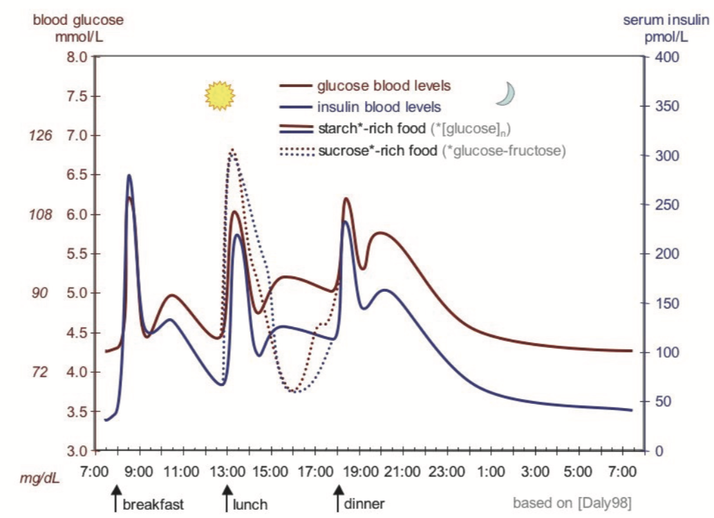
Insulin Kinetics
Credit for this image to Dr. Steven Chase of the Biomedical Engineering Department at Carnegie Mellon University. Also found on https://en.wikipedia.org/wiki/Blood_sugar_level
Notes:
Focus on the glucose and insulin blood levels
Explain the axes of the graph, especially the x axis that shows 24 hours of the day, focusing on times where breakfast, lunch, and dinner are eaten
It is easier to see specifically for lunch and dinner peaks, but explain how glucose levels peak first, with insulin levels following closely behind. This is a clear demonstration of how quickly the pancreas can detect blood glucose levels and react by adjusting its insulin secretion accordingly
Source: https://en.wikipedia.org/wiki/Blood_sugar_level

Slide 7
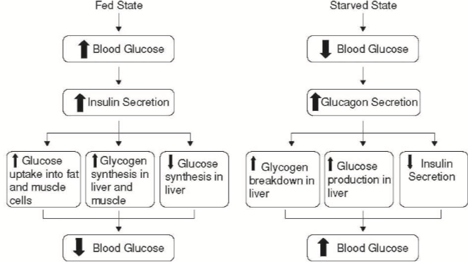
Homeostatic Regulation of Blood Glucose
Credit for this image to Dr. Steven Chase of the Biomedical Engineering Department at Carnegie Mellon University
Notes:
This slide is geared towards AP Biology students who have an in-depth knowledge of how hormones interact with each other.
Two new hormones are introduced here: Glycogen and Glucagon
“When the body feels extra glucose is needed in the blood, the pancreas will release the hormone glucagon which triggers the conversion of glycogen into glucose for release into the bloodstream.”
Source: https://www.diabetes.co.uk/body/glycogen.html

Slide 8
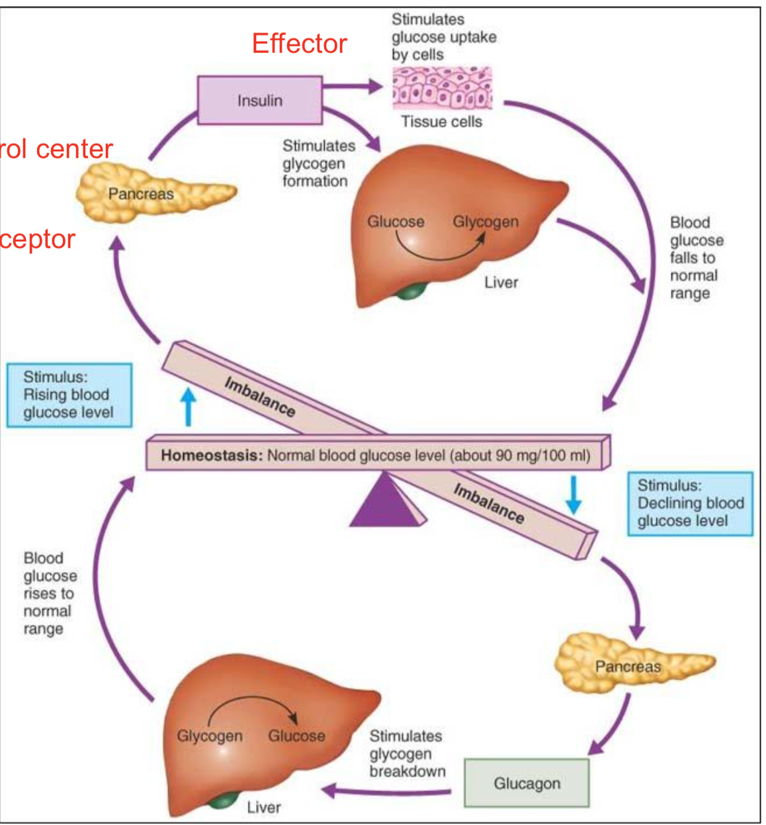
Homeostatic Regulation of Blood Glucose
Credit for this image to Niroshini Nirmalan through the Anaesthesia & Intensive Care Medicine Journal.
Notes:
This slide is geared towards AP Biology students who have an in-depth knowledge of how hormones interact with each other, and can help explain the same process in the previous slide in a more interactive visual way.
The top loop shows when blood glucose levels are higher than normal, while the bottom loop shows what happens when blood glucose levels are lower than normal.
Image Source: https://www.anaesthesiajournal.co.uk/article/S1472-0299(17)30172-8/abstract

Slide 9
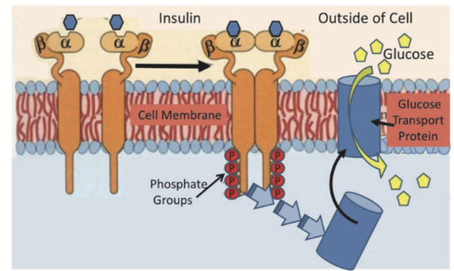
Insulin Receptor Tyrosine Kinase Interaction
https://www.dietdoctor.com/a-new-paradigm-of-insulin-resistance
Notes:
Additional image for AP Biology students to visualize the relationship between insulin, insulin receptors, and glucose. Once both insulin and the phosphate groups are bound the the receptor, it triggers the glucose transport protein to allow glucose to travel from outside of the cell to inside the cell.
Image Source: https://www.dietdoctor.com/a-new-paradigm-of-insulin-resistance

Slide 10
What is Diabetes?
When body blood sugar levels are too high
OR
Blood glucose levels are higher than normal due to improper use by cells
Type 1
Genetic (diagnosed in young children and adults )
Body is not able to produce its own insulin
Beta cells in pancreas that produce insulin are attacked by immune system
Daily insulin supplements to digest glucose from meals
Type 2
A developed condition over time
The body is less able to develop insulin
Some causes:
Age 45+
Family history of diabetes
Lack of physical activity
Notes:
Cover the difference in treatments between the 2 types of diabetes. Since the body naturally cannot produce its own insulin in type 1 diabetes, treatment includes insulin, exercise, and a healthy diet. But, for type 2 diabetes, the initial treatment would be meal planning, weight loss, and exercising. However, that might not be enough to bring down blood glucose levels, which is where medications come in. If that is not enough, they might have to take insulin as well. All in all, for both types of diabetes, physical activity and diet are the two most important things to act upon.
Diabetes also causes several side effects such as heart disease, stroke, and eye and food problems, for which additional medications are prescribed (including aspirin for heart health, drugs for high cholesterol, high blood pressure medications)
Source: https://www.niddk.nih.gov/health-information/diabetes/overview/what-is-diabetes

Slide 11
Existing Diabetes Treatments
Other than insulin, there are a few ways to manage diabetes:
Bariatric surgery
Artificial pancreas
Pancreatic islet transplantation
Notes:
Bariatric surgery is weight loss surgery, specifically for people who experience obesity. This can be a useful step to start managing type 2 diabetes.
The artificial pancreas senses blood glucose levels and releases either glucose or glucagon as needed
Pancreatic islet transplantation→ pancreatic islets are cell clusters in pancreas that make insulin. Transplantation of these islets into those with type 1 diabetes could help their pancreas to overcome its own immune attack. This method is still in testing.
Source: https://www.niddk.nih.gov/health-information/diabetes/overview/insulin-medicines-treatments

Slide 12
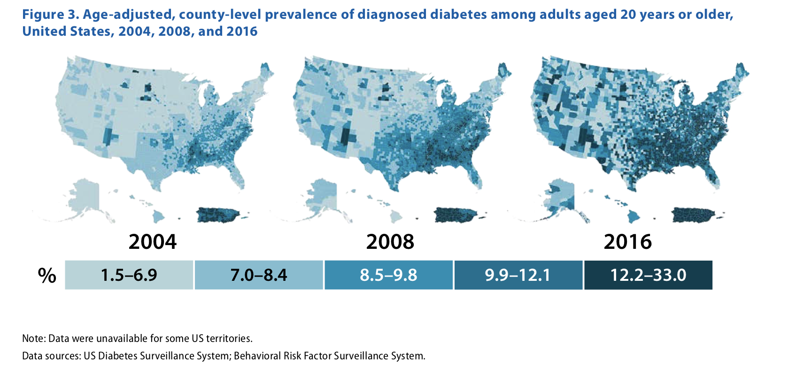
In 2017, diabetes was the 7th leading cause of death in the US
Notes:
Source: https://www.cdc.gov/diabetes/pdfs/data/statistics/national-diabetes-statistics-report.pdf

Slide 13
Diabetes in the US
According to the CDC, in 2018…
An estimated 34.2 million people of all ages—or 10.5% of the US population—had diabetes
34.1 million adults aged 18 years or older— or 13.0% of all US adults—had diabetes
Notes:
Source: https://www.cdc.gov/diabetes/pdfs/data/statistics/national-diabetes-statistics-report.pdf

Slide 14
Characteristics of Insulin
Onset → length of time before insulin reaches the bloodstream and begins lowering blood sugar
Peak time → the time during which insulin is at maximum strength in terms of lowering blood sugar
Duration → how long insulin continues to lower blood glucose
Notes:
Source: https://www.diabetes.org/diabetes/medication-management/insulin-other-injectables/insulin-basics

Slide 15
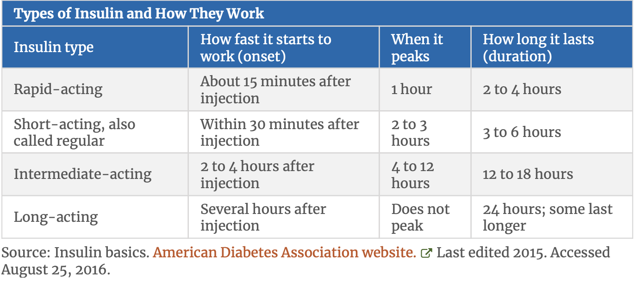
Types of Insulin and How They Work
Notes:
Source: https://www.diabetes.org/diabetes/medication-management/insulin-other-injectables/insulin-basics

Slide 16
Existing Insulin Delivery Techniques
Needle and Syringe
Pen
Pump
Inhaler
Injection port
Jet Injector
**Oral medication
Notes:
Needle and syringe can ensure anywhere from 1-4 shots in a day
Pen is more expensive than a needle and syringe but much easier to use
Pump delivers insulin 24 hours a day in small, steady doses, and mimics the body’s normal release of insulin
**IMPORTANT CLARIFICATION! Oral insulin medications such as pills are currently still in development. Insulin is easily degraded by stomach acids, and therefore rendered useless. But, if there is a way to create these pills so they can bypass the stomach acids and still be active when they reach the liver, that would be most ideal.
Sources: https://www.medicinenet.com/diabetes_treatment/article.htm#what_is_the_treatment_for_diabetes
https://www.mayoclinic.org/diseases-conditions/type-1-diabetes/diagnosis-treatment/drc-20353017

Slide 17
NOW...
Build Your Own Insulin Capsule!!!

Slide 18
Build Your Own Insulin Capsule!!!
Instructions:
Using your knowledge about the different types of insulin, create different types of capsules
Draw a sketch of your capsule
Explain how it works
Test your capsule
Record the onset, duration, and peak time of your capsules
Explain how you would improve your capsule and why?
Materials:
Bath bombs, water, tissue paper, zipper storage bags
& anything else you can find!

Slide 19


Activity Scenario Examples:
Create a rapid acting capsule with an onset of 15 seconds and a duration of 3 minutes
Create an intermediate acting capsule with an onset of 3 minutes and duration of 3 minutes
Other scenarios as determined by the instructor or students
www.cmu.edu/gelfand
www.cmu.edu/bme

Slide 20
Insulin and Diabetes
Questions?
Hardest part of activity?
Interesting discoveries?

