Slide 1
Biomedical Engineering Focus Areas: An Introduction
Created and edited by: Olivia Olshevski, MS BME, 2021
Renee Morton, MS BME, 2020
Dr. Rosalyn Abbott, Faculty Biomedical Engineering

Slide 2
This educational resource for middle and high school audiences was developed as a project by Carnegie Mellon student, Olivia Olshevski, for the course Directed Study, taught by Dr. Conrad Zapanta and co-advised by Dr. Judith Hallinen during the fall of 2021.
NOTE: Sources for content and for images that are included in these slides can be found in the accompanying Slide Guide and on the slides at the end of this file.

Slide 3
CAUTION: If you are attempting an experiment, it is important to make sure that you are following all safety steps. All experiments should be completed with supervision of a adult. Weather permitting, we recommend taking messy experiments outside. Remember to wear safety gear like gloves, aprons, and goggles, especially for experiments with chemical reactions!
The materials and information presented may be used for educational purposes as described in the Terms of Use at www.cmu.edu/gelfand and parents/legal guardians are responsible for taking all necessary safety precautions for the experiments. To the maximum extent allowed under law, Carnegie Mellon University is not responsible for any claims, damages or other liability arising from using the materials or conducting the experiments.
Be SAFE and enjoy the module!

Slide 4
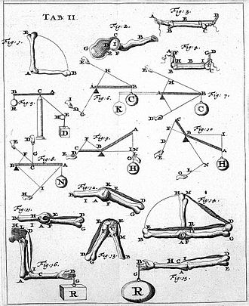
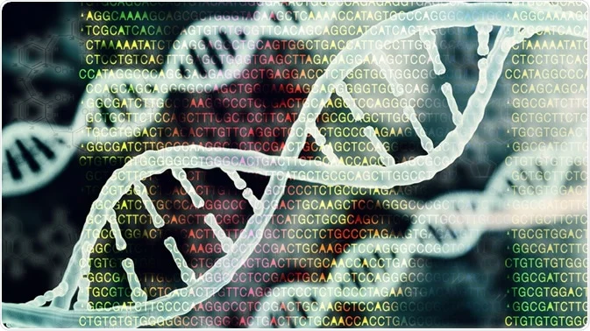
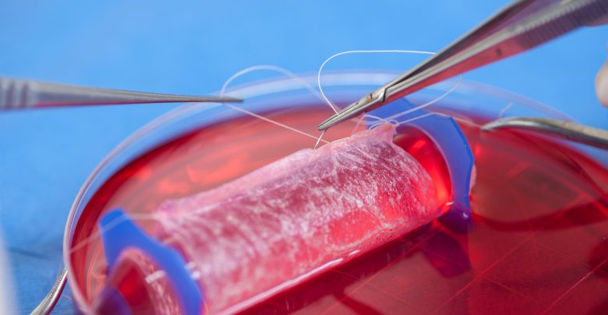
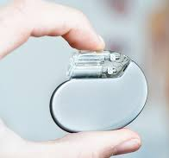
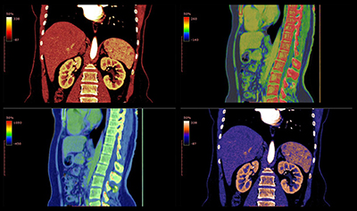
What do biomedical engineers do?
BME Focus Areas
Biomechanics
Biomaterials and Tissue Engineering
Biomedical Devices
Bioimaging and Signal Processing
Cellular and Molecular Biotechnology
Neuroengineering
Notes:
https://upload.wikimedia.org/wikipedia/commons/thumb/d/d5/Giovanni_Borelli_-_lim_joints_%28De_Motu_Animalium%29.jpg/330px-Giovanni_Borelli_-_lim_joints_%28De_Motu_Animalium%29.jpg
https://encrypted-tbn0.gstatic.com/images?q=tbn:ANd9GcQI8EQKBULQ7TrIN1wUT-VfCGwcGG-dCfL3og&usqp=CAU
https://www.azolifesciences.com/image.axd?picture=2020%2F10%2Fshutterstock_671206474.jpg
https://www.automate.org/userAssets/aiaUploads/image/AIA-LS-MAR2020-T4-1128537982-BLOG.jpg
https://www.medgadget.com/wp-content/uploads/2019/06/Tissue-Engineering-Market.jpg

Slide 5
Biomechanics

Slide 6
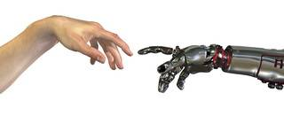
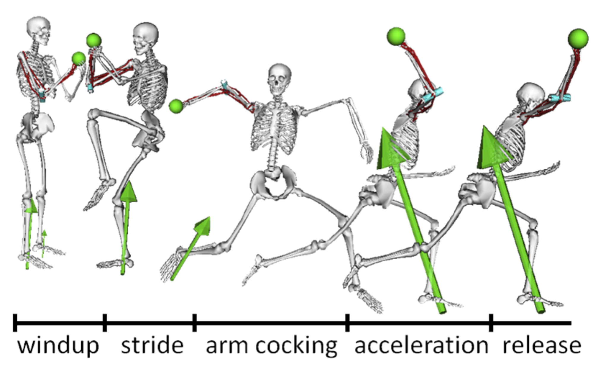
Definition & Scope: Biomechanics
The scientific study of the mechanics of living structures (or of structures produced by organisms) -Nature definition
What you study
Mechanical properties of tissues (macro and micro)
Micromechanics
Solid mechanics
Viscoelasticity
Fluid mechanics
Entropic force, diffusive force, osmotic force
Notes:
https://www.mccormick.northwestern.edu/biomedical/images/baseball-min.jpg
https://www.cedtechnologies.com/wp-content/uploads/2013/02/b2ap3_thumbnail_bio.jpg

Slide 7
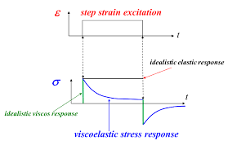
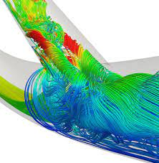
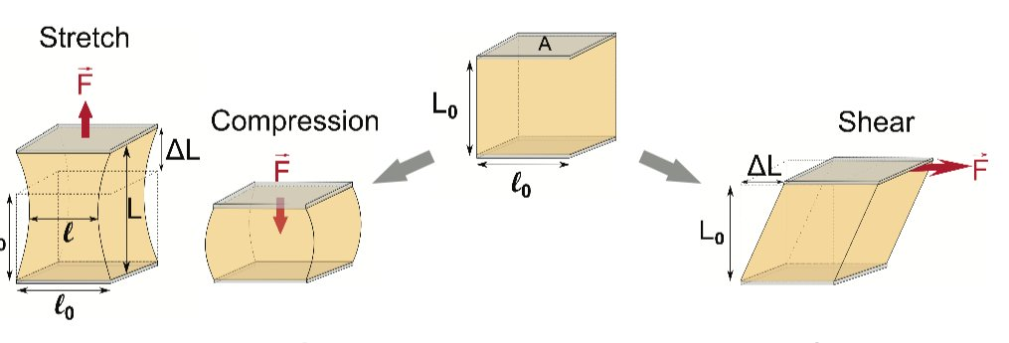
Applications: Biomechanics
Cardiovascular fluid mechanics and dynamics
Cell mechanics
Solid mechanics of biological materials
Biological viscoelastic solids and fluids
Notes:
https://www.dicardiology.com/content/studying-blood-flow-dynamics-identify-heart-vessel-failure
https://phys.org/news/2018-06-explores-cell-mechanics.html
https://www.intechopen.com/chapters/40738

Slide 8
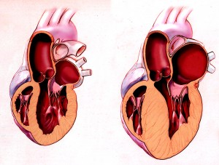
Example 1: Cardiovascular Mechanics
Notes:
https://www.yalescientific.org/2015/03/how-to-detect-a-troubled-heart/
https://seas.yale.edu/news-events/news/lab-grown-tissue-engineer-may-prevent-unexpected-heart-problems
https://seas.yale.edu/news-events/news/seeking-sensors-heart-stuart-campbell-wins-career-award
https://www.nsf.gov/awardsearch/showAward?AWD_ID=1653160&HistoricalAwards=false
https://journals.physiology.org/doi/full/10.1152/ajpheart.00055.2020

Slide 9
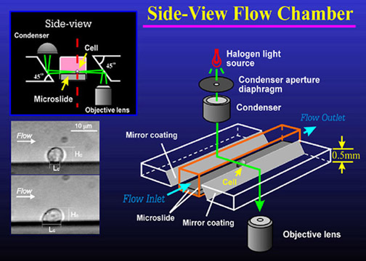
Example 2: Cellular Biomechanics
Notes:
https://doi.org/10.1007/BF02684196
https://sites.psu.edu/cellmech/projects/

Slide 10
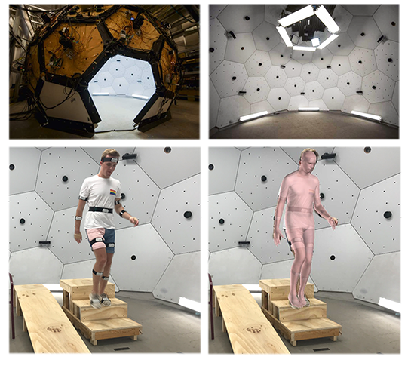
CMU Connection: Natural Environment Biomechanics (Musculoskeletal Biomechanics Lab)
Notes:
https://www.meche.engineering.cmu.edu/faculty/halilaj-musculoskeletal-biomechanics-lab.html
The operational cost associated with traditional motion capture systems has inhibited clinical translation and discouraged large movement analysis studies. Recent advances in computer vision and wearable sensing offer untapped potential for movement analysis in natural environments, but the effectiveness of these technologies in estimating movement biomechanics within clinically tolerable errors is still limited. To address the shortfalls of current algorithms, we are working on new approaches for estimation of clinically relevant outcomes from wearable sensors and video.

Slide 11
Biomaterials and Tissue Engineering

Slide 12
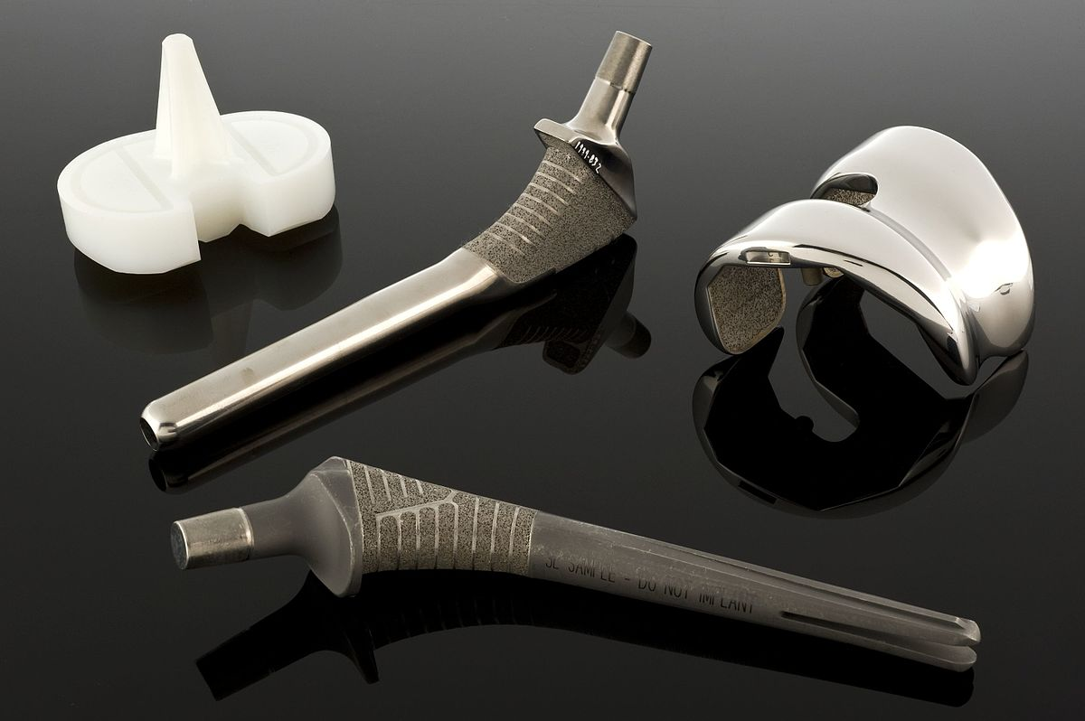
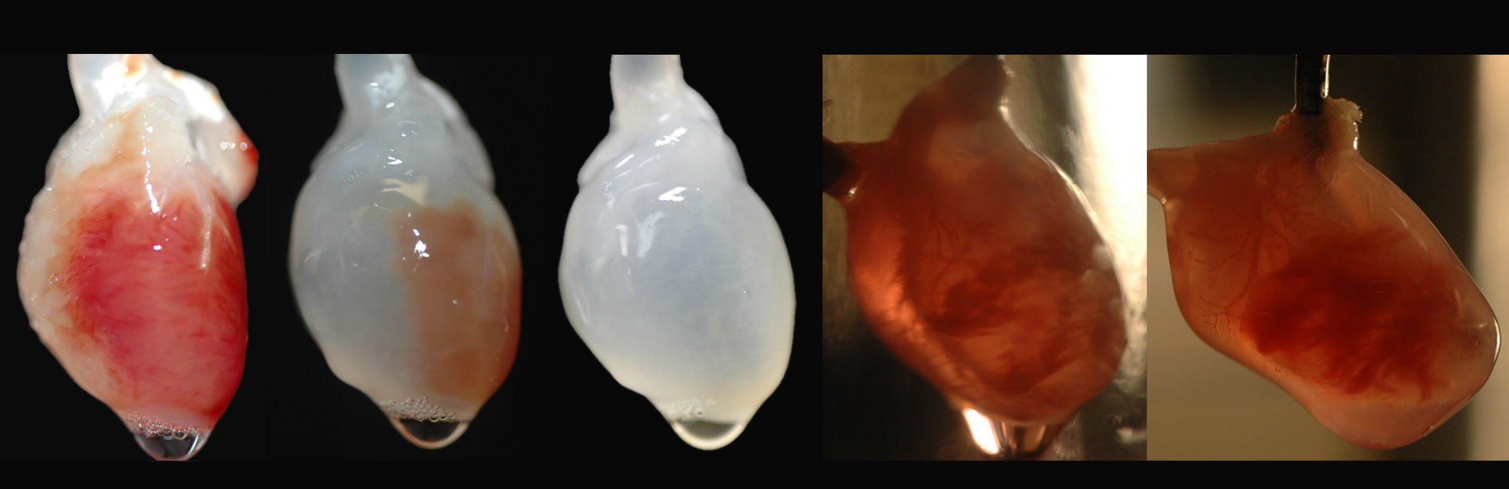
Definition & Scope: Biomaterials and Tissue Engineering
The field of study in which man-made materials are developed for medical treatments (biomaterials) and living functional tissue is produced (tissue engineering)
What you study
Interactions between materials and cells or tissues (and their effects)
Major body responses (wound healing, immune response, foreign body response)
Characterizing biomaterials (metals, ceramics, polymers)
Natural and synthetic materials
Cell culture
Material biocompatibility
Notes:
https://www.biolinscientific.com/blog/biomaterials-vs-tissue-engineering-what-is-the-difference
https://upload.wikimedia.org/wikipedia/commons/thumb/4/47/Hip_joint_replacement%2C_United_States%2C_1998_Wellcome_L0060175.jpg/1200px-Hip_joint_replacement%2C_United_States%2C_1998_Wellcome_L0060175.jpg
https://www.sciencebuzz.org/sites/default/files/images/Five_Hearts%20copy_0.jpg
https://directorsblog.nih.gov/wp-content/uploads/2015/10/3d_bioprinting_artery2.jpg

Slide 13
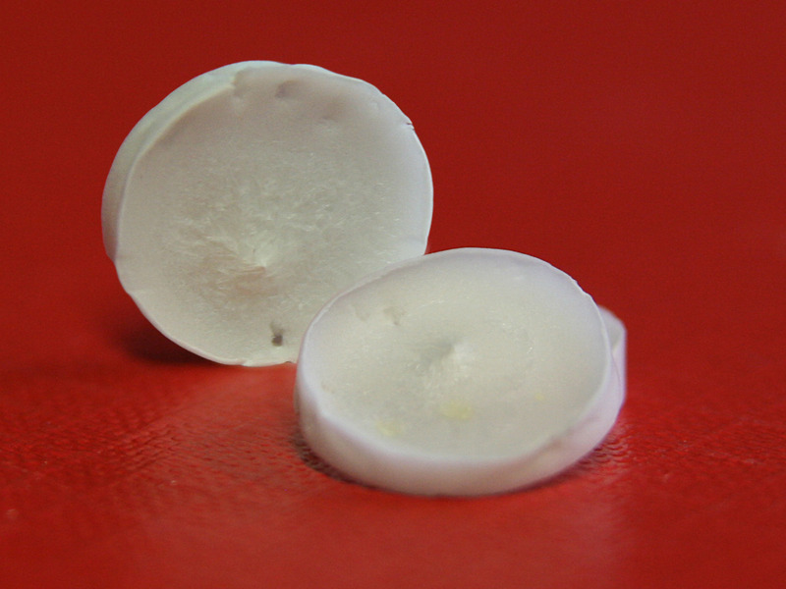
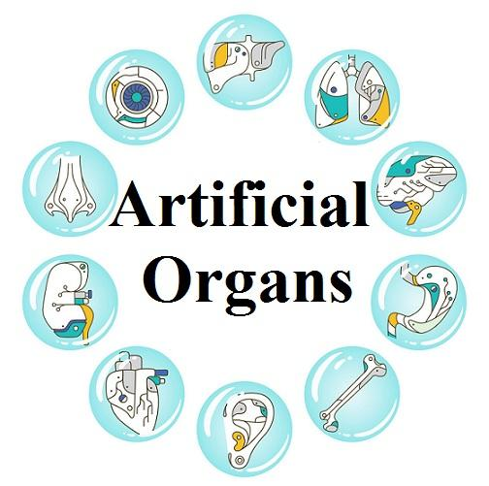
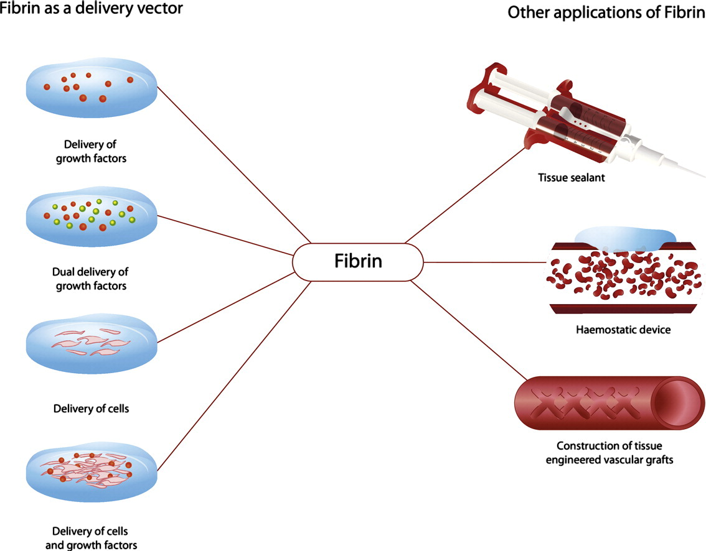
Applications: Biomaterials and Tissue Engineering
Artificial organs
Wound healing
Bioscaffolds
Collagen biomaterials
Implant failure and material reactions
Notes:
https://www.openpr.com/news/1876594/outstanding-growth-of-artificial-organs-market-is-estimated#prid-1876594
https://www.sciencedirect.com/science/article/pii/S016836591400666X
https://phys.org/news/2012-01-scientists-silk-tasar-silkworm-scaffold.html

Slide 14
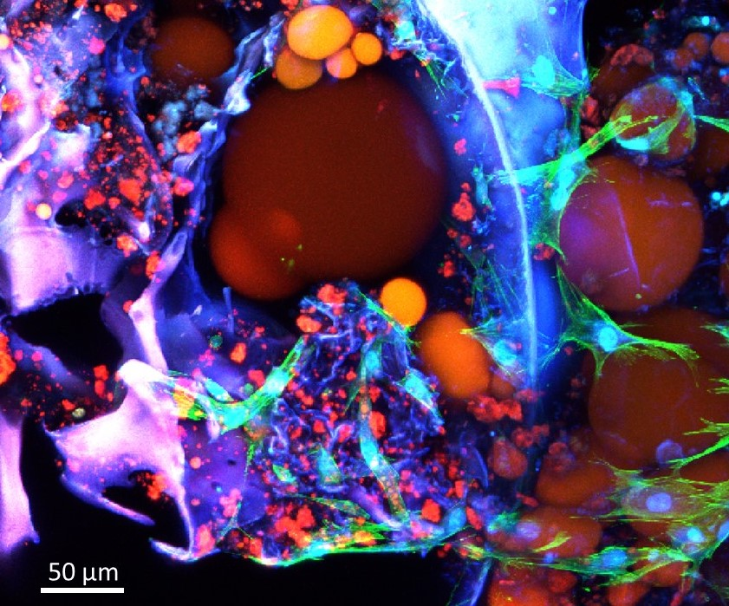
Example 1: Adipose Microenvironments
Notes:
https://www.cmu.edu/bme/abbott-lab/research/index.html

Slide 15
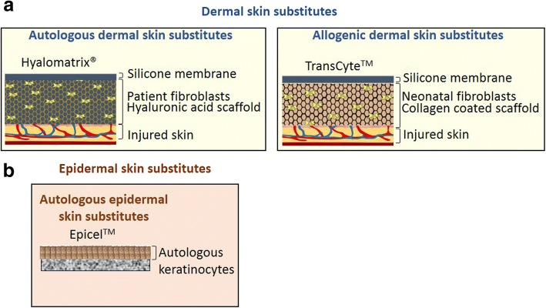
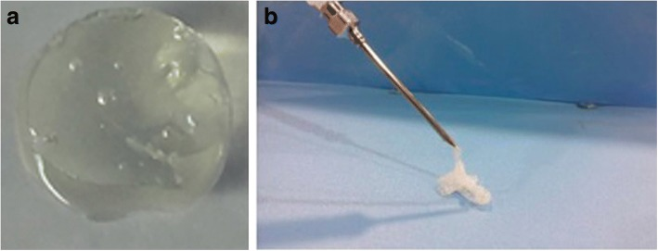
Example 2: Wound-Healing Biomaterials
Notes:
https://www.ncbi.nlm.nih.gov/pmc/articles/PMC6346526/
Keratinocytes: https://en.wikipedia.org/wiki/Keratinocyte#:~:text=Keratinocytes%20are%20the%20primary%20type,90%25%20of%20epidermal%20skin%20cells.&text=Keratinocytes%20form%20a%20barrier%20against,fungi%2C%20parasites%2C%20and%20viruses.
Dermal fibroblasts:
https://en.wikipedia.org/wiki/Dermal_fibroblast#:~:text=Dermal%20fibroblasts%20are%20cells%20within,skin%20to%20recover%20from%20injury.
ECM:
https://en.wikipedia.org/wiki/Extracellular_matrix

Slide 16
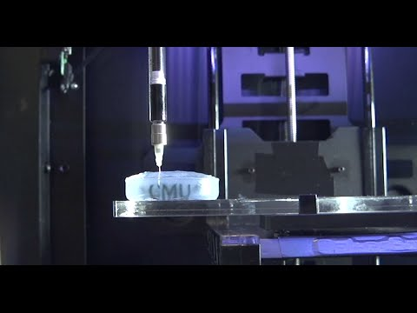
CMU Connection: Regenerative Biomaterials and Therapeutics Group
Notes:
https://www.youtube.com/watch?v=Zfl_tFdt2D4 3D printing

Slide 17
Biomedical Devices

Slide 18
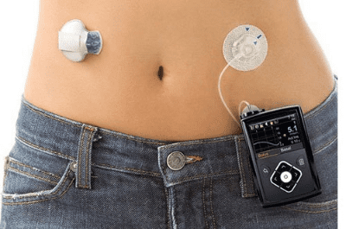
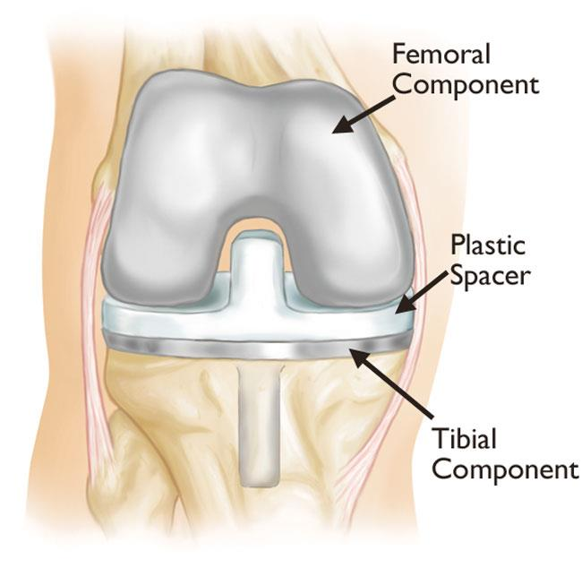
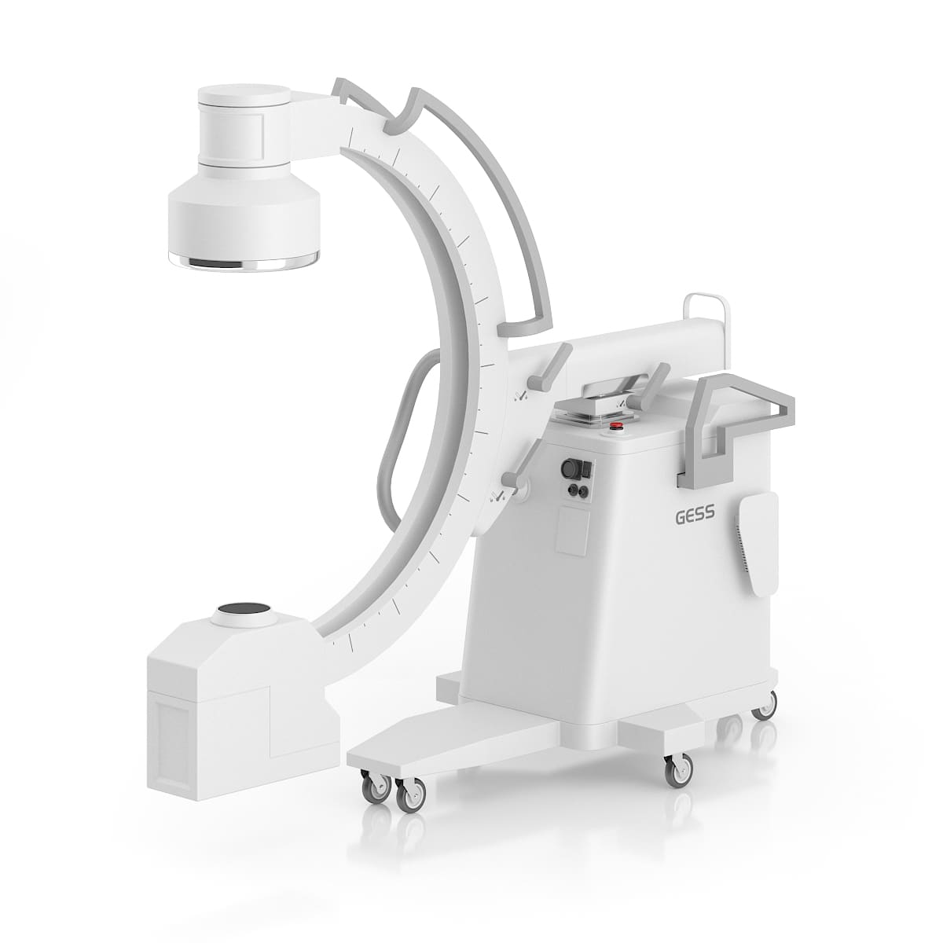
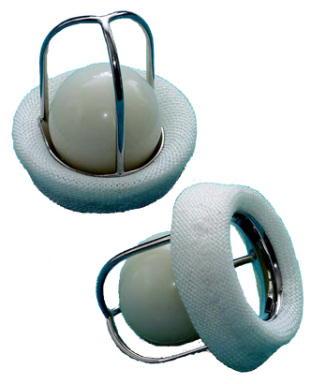
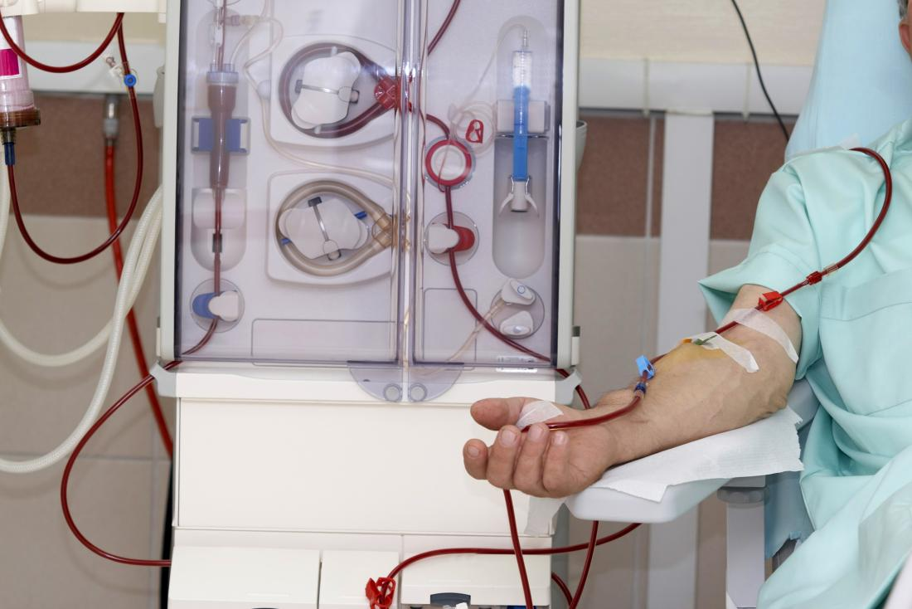
Focus Area: Biomedical Devices
The field of study that produces instruments, machines, implants, in vitro reagents, software, materials, and other related articles for the safe and effective prevention, diagnosis, treatment, and rehabilitation of illness and disease for human beings
What you study
Instrumentation and measurement
Diagnostic vs. therapeutic devices
Integrated Systems technology
Device fabrication
Interaction with cells, tissues, organs
Notes:
https://link.springer.com/chapter/10.1007/978-3-030-24237-4_1#:~:text=Biomedical%2Fmedical%20devices%20are%20instruments,and%20disease%20for%20human%20beings.
https://orthoinfo.aaos.org/en/treatment/revision-total-knee-replacement/
https://www.cthsurgery.com/uploads/2/6/5/4/26542699/editor/caged-ball-valve.png?1519602967
https://www.drwf.org.uk/news-and-events/news/first-insulin-pump-acts-artificial-pancreas-launched-people-type-1-diabetes
https://cdn-prod.medicalnewstoday.com/content/images/articles/152/152902/dialysis-can-carry-out-the-function-of-the-kidneys.jpg
https://cgaxisimages.fra1.cdn.digitaloceanspaces.com/2015/01/cgaxis_models_55_06a.jpg

Slide 19
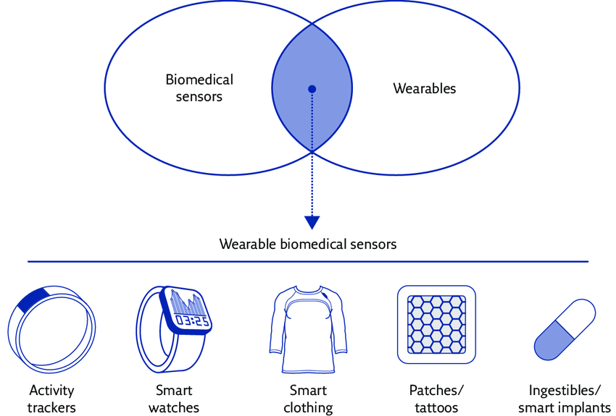
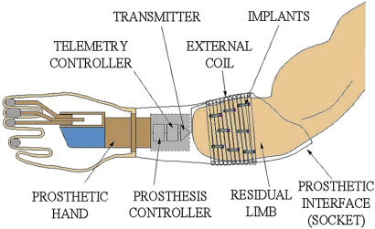
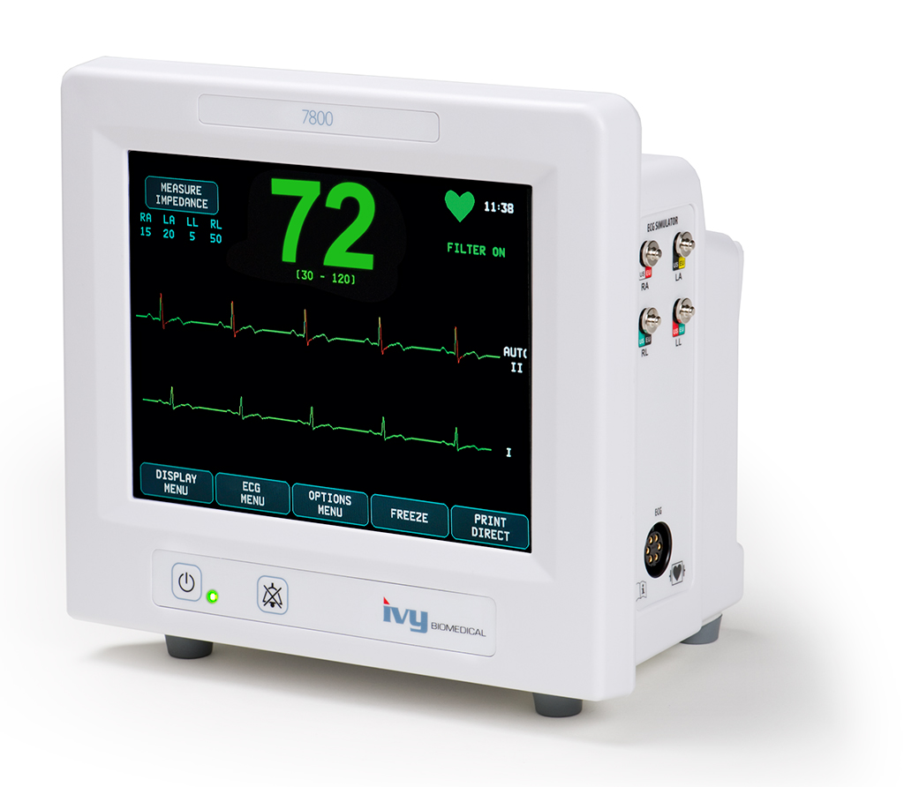
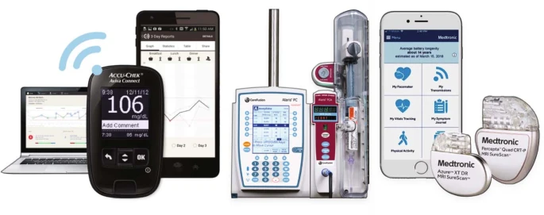
Applications: Biomedical Devices
Sensors
Actuators
Diagnostic devices
Therapeutic devices
Instruments
Systems
Software
Notes:
https://www.researchgate.net/profile/Andrea-Aliverti/publication/318648627/figure/fig3/AS:667765149032451@1536219026226/Wearable-biomedical-sensors-Reproduced-and-modified-from-2-with-permission-from-the.png
https://www.ivybiomedical.com/model-7800.html
https://www.sciencedirect.com/science/article/pii/B9780128183182000039
https://www.nature.com/articles/s41551-019-0426-z

Slide 20
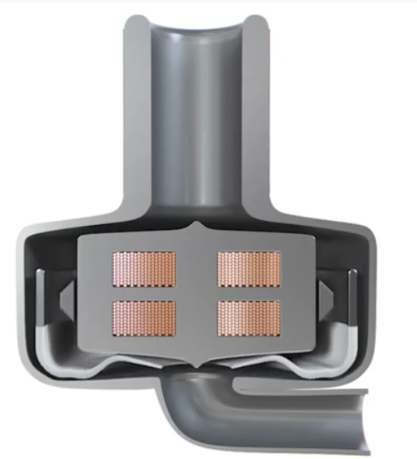
Example 1: Implantable Heart Pump
Notes:
https://cordis.europa.eu/article/id/430046-groundbreaking-implantable-heart-pump-offers-new-hope-for-end-stage-heart-failure-patients
An EU-backed company has developed a novel heart pump that can work in synchrony with the heart without the aid of sensors for over 30 days. This is the first time that a miniaturised pericardial pump has achieved this synchronisation. (Otc 27 2021)
https://www.youtube.com/watch?v=OmA9ubj-DUI&t=2s

Slide 21
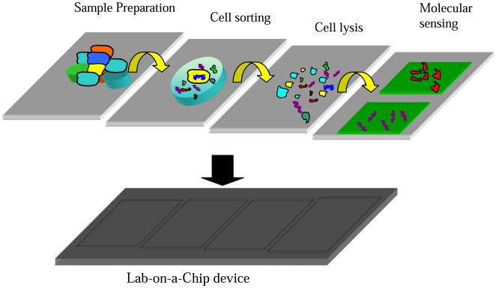
Example 2: Lab on a Chip (BioMEMS)
Notes:
https://www.ncbi.nlm.nih.gov/pmc/articles/PMC3705549/

Slide 22
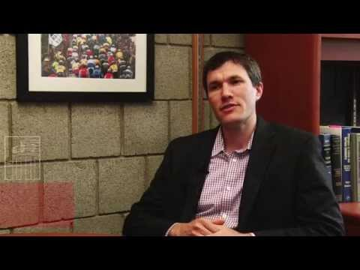
CMU Connection: Ingestible Medical Devices
Notes:
https://www.youtube.com/watch?v=dJkwcSTnPS4
https://www.youtube.com/watch?v=bbUiOrMLpLo&t=1s
Smart pills: https://aabme.asme.org/posts/smart-pills-enable-convenient-diagnostics-and-accurate-therapeutics#:~:text=The%20term%20%E2%80%9Csmart%20pills%E2%80%9D%20refers,image%2C%20pH%20or%20chemical%20sensors.

Slide 23
Bioimaging and Signal Processing

Slide 24
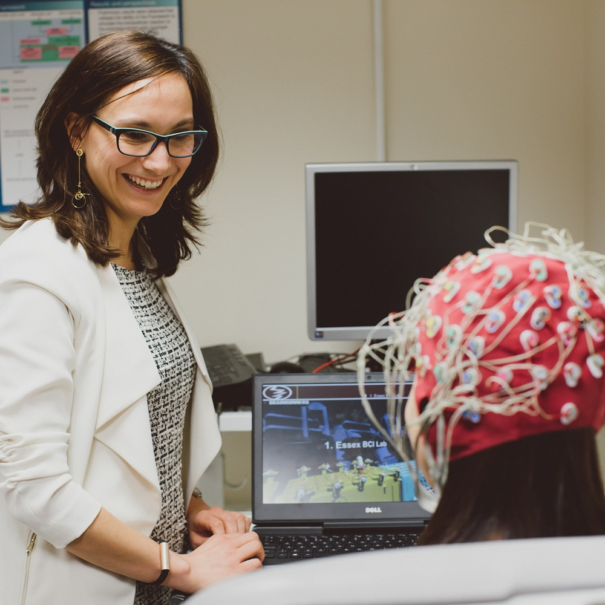
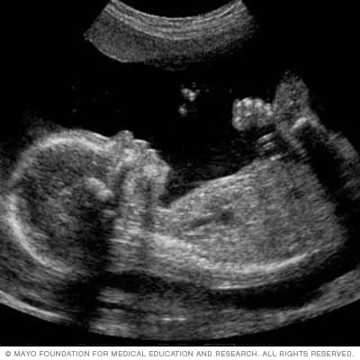
Focus Area: Bioimaging and Signal Processing
The field of study centered on methods and instruments used to acquire, process, and visualize structural or functional images of living objects or systems at desired spatial and temporal scales
What you study
Medical imaging
Methods
Types
Signal processing
Image analysis
Neural engineering
Electrical signals of brain and heart
Notes:
https://bioengineering.gatech.edu/node/5335#:~:text=Bioimaging%20refers%20to%20methods%20and,used%20visualize%20fixed%20biological%20samples.
https://www.essex.ac.uk/-/media/header-images/faculty-of-science-and-health/csee/brain-computer-interfaces-lab-1000x1000.jpg?h=1000&w=1000&la=en
https://www.mayoclinic.org/tests-procedures/fetal-ultrasound/about/pac-20394149
https://www.aclsmedicaltraining.com/rhythm-recognition/

Slide 25
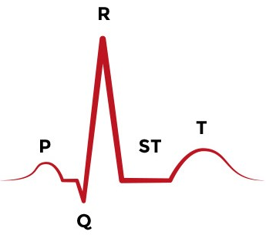
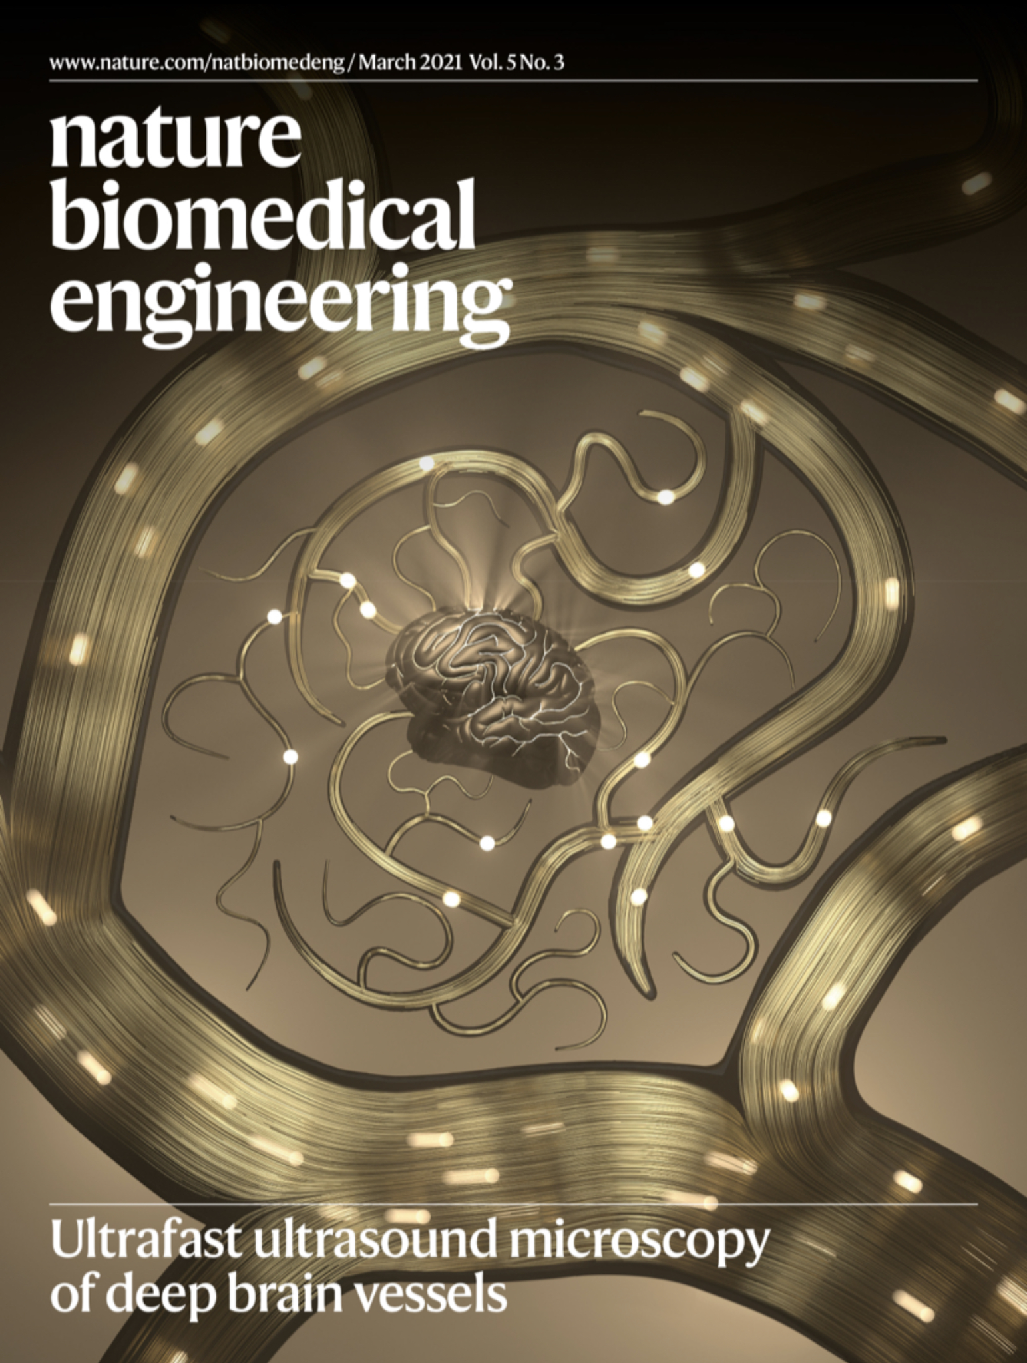
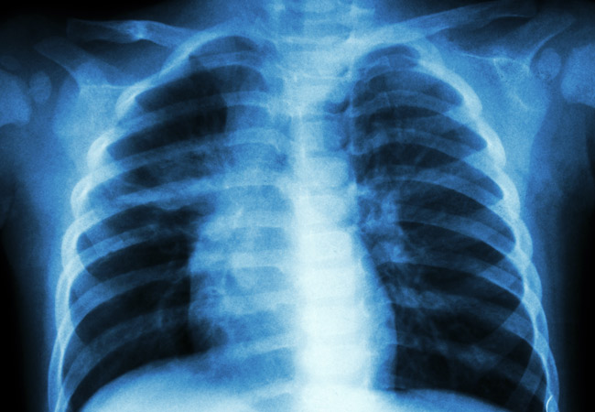
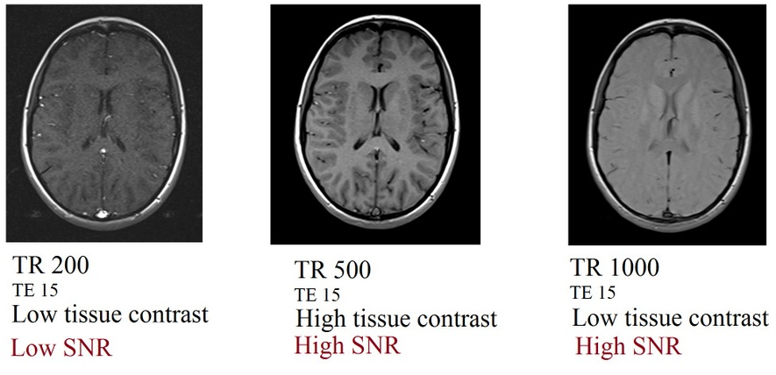
Applications: Bioimaging and Signal Processing
Electrocardiograms
Neuron functions
Heart functions
Imaging modalities (microscopy, ultrasound, X-ray, CT, PET, MRI, etc.)
Image qualities (contrast, signal, spatial resolution)
Notes:
https://www.aclsmedicaltraining.com/wp-content/uploads/2020/09/ACLS-Figure-21.jpg
https://pbs.twimg.com/media/Ewre1JQWYAAMsEP?format=jpg&name=4096x4096
https://consultqd.clevelandclinic.org/chest-x-ray-prior-to-thyroidectomy-is-it-really-needed/
https://mrimaster.com/images/technique/SNR%20IMAGE/Repetition%20time%20(TR)%20and%20SNR%20relation%20in%20MRI.jpg

Slide 26
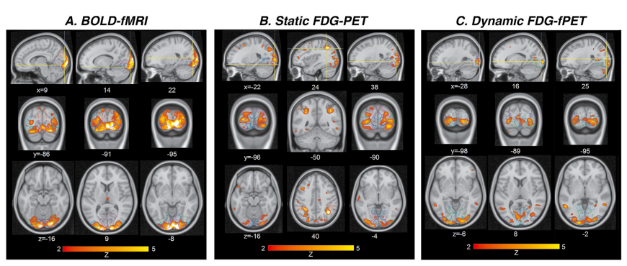
Example 1: Simultaneous BOLD-fMRI and FDG-PET
Notes:
MRI 2 paper (from imaging class)
https://doi.org/10.1016/j.neuroimage.2019.01.003

Slide 27
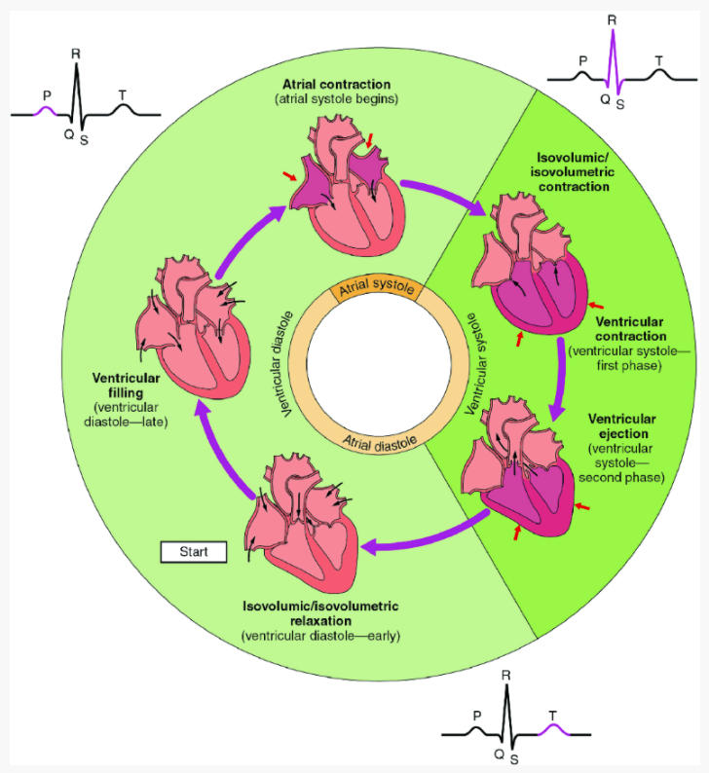
Example 2: ECG Signals
Notes:
https://link.springer.com/chapter/10.1007/978-3-030-47994-7_17

Slide 28
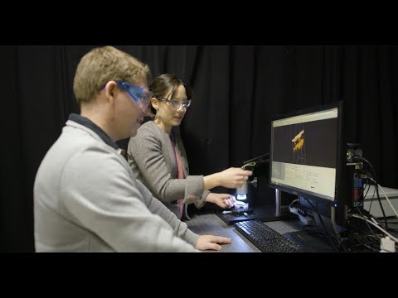
CMU Connection: Biomedical Optics
Notes:
https://www.youtube.com/watch?v=6Y7B3rNbGEY
https://www.cmu.edu/bme/biophotonics/

Slide 29
Cellular and Molecular Biotechnology

Slide 30
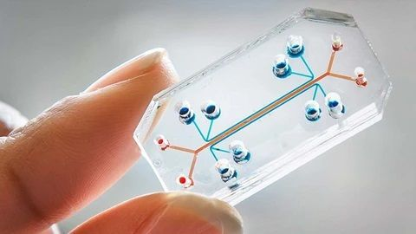
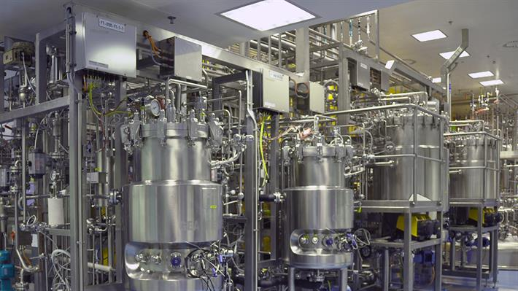
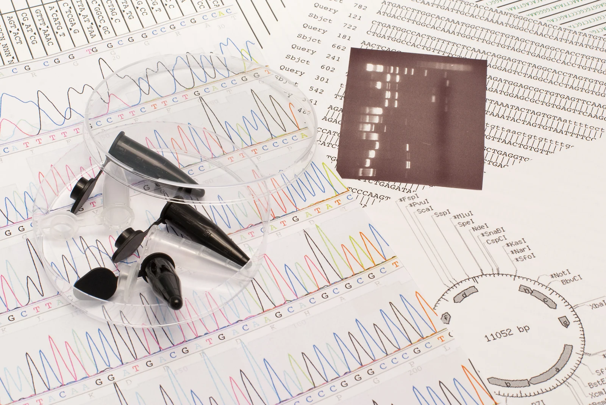
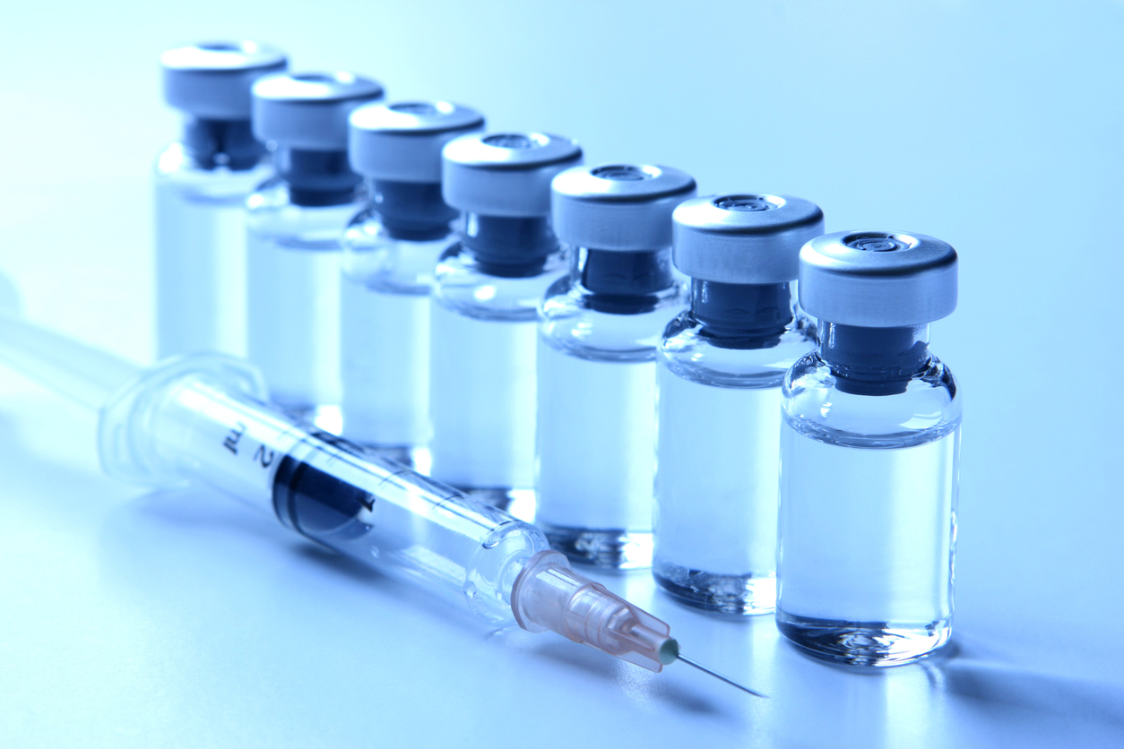
Definition & Scope: Cellular and Molecular Biotechnology
The field of study focused on the practical application of cellular and molecular knowledge with the aim of enhancing or improving production in microorganisms or cell cultures
What you study
Biological regulation (signaling, endocrine system, hormones)
Cell culture
Cell morphology
Genetics
Diffusion, transport, and delivery
Binding kinetics
Notes:
https://www.wur.nl/en/education-programmes/master/msc-programmes/msc-biotechnology/specialisations-of-biotechnology/cellular-and-molecular-biotechnology.htm#:~:text=Focus%20on%20the%20practical%20application,micro%2Dorganisms%20or%20cell%20cultures.
https://www.gea.com/en/binaries/Pharma%20Product%20fermentation_tcm11-5956_w710.jpg
https://blog.genofab.com/hubfs/Stock%20Images/plasmid-black-tube.jpg
https://manometcurrent.com/wp-content/uploads/2021/06/Microfluidics.jpg
https://www.fda.gov/files/iStock-157317886.jpg

Slide 31
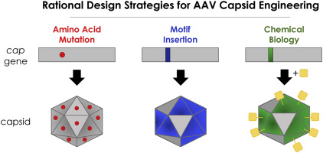
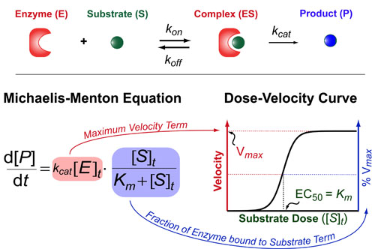
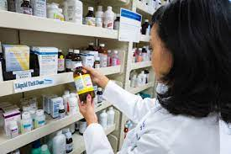
Applications: Cellular and Molecular Biotechnology
Protein manufacturing
Pharmaceuticals
Virus manufacturing
Genetic engineering
Vaccines
Bioreactors
Microfluidics
Notes:
https://www.practicallyscience.com/wp-content/uploads/2015/05/michaelis-menton-intuition-v2-op.jpg
https://pharmsci.uci.edu/can-pharmaceutical-sciences-major/
https://www.sciencedirect.com/science/article/pii/S2468451118300291

Slide 32
Example 1: Vaccine Development
Notes:
https://www.chop.edu/centers-programs/vaccine-education-center/vaccine-details/diphtheria-tetanus-and-pertussis-vaccines
https://www.medpagetoday.com/casestudies/infectiousdisease/93963

Slide 33
Example 2: CRISPR Gene Therapy
Notes:
https://www.frontiersin.org/articles/10.3389/fonc.2020.01387/full
https://seedworld.com/site/wp-content/uploads/2018/11/Screen-Shot-2018-11-16-at-12.12.15-PM-1024x497.png
https://seedworld.com/who-owns-crispr/
https://www.fda.gov/vaccines-blood-biologics/cellular-gene-therapy-products/what-gene-therapy
https://www.livescience.com/58790-crispr-explained.html
https://www.youtube.com/watch?v=6tw_JVz_IEc

Slide 34
CMU Connection: mRNA Drug Delivery
Notes:
https://www.cheme.engineering.cmu.edu/news/2021/08/whitehead-ted-talk-explains-mrna-delivers-hope.html

Slide 35
Neuroengineering

Slide 36
Focus Area: Neuroengineering
The field of study that involves the use of engineering technology to study the function of various neural systems
What you study
Neuroimaging techniques
Neural anatomy
Action potentials
Nervous system modulation
Notes:
https://www.engr.wisc.edu/department/biomedical-engineering/research/neuroengineering/
https://bioe.uw.edu/wp-content/uploads/neural-monitoring.png
https://www.myhealthyclick.com/wp-content/uploads/2021/02/New-Vestibular-Implant-Improves-Balance-and-Movement-in-Patients-with-Inner-Ear-Disorder.jpg
https://media.springernature.com/relative-r300-703_m1050/springer-static/image/art%3A10.1038%2Fnature.2013.12439/MediaObjects/41586_2013_Article_BFnature201312439_Figc_HTML.jpg

Slide 37
Applications: Neuroengineering
Implantable technology and materials
Neural prosthetics
Cochlear implants
Retinal implants
Touch restoration
Vestibular implants
bladder/bowel control
Brain-computer interfaces
Sensor and motor prosthesis
Notes:
https://www.todaysmedicaldevelopments.com/article/haptics-medical-device-design-neuroprosthetics-amputees-111016/
https://cdn.the-scientist.com/assets/articleNo/68762/aImg/42181/bci-article-s.png
https://miro.medium.com/max/1128/1*eNp_4IFB9bZOeCVqdXKg5A.jpeg

Slide 38
Example 1: Retinal Prostheses
Notes:
https://www.cmu.edu/bme/People/Faculty/profile/skelly.html
https://www.proquest.com/docview/1030698789/pageviewPDF/D1794E674F4BACPQ/1?accountid=9902
https://www.scientificamerican.com/article/steps-towards-a-bionic-ey/

Slide 39
Example 2: Cochlear Implant
Notes:
https://www.nidcd.nih.gov/health/cochlear-implants
https://www.hopkinsmedicine.org/health/treatment-tests-and-therapies/cochlear-implant-surgery

Slide 40
CMU Connection: Non-Invasive Mind-Control of Robotic Limbs
Notes:
https://www.youtube.com/watch?v=UkZquERzoOo
https://engineering.cmu.edu/news-events/news/2019/06/20-he-sci-robotics.html

Slide 41
Wrapping Up

Slide 42
Looking Forward: Unanswered Questions in BME
Personalized medicine
Artificial organs
Human-Machine interfaces
Artificial Intelligence
Better understanding of medical conditions
Ethical considerations
Notes:
https://d19d5sz0wkl0lu.cloudfront.net/dims4/default/46c3e97/2147483647/resize/800x%3E/quality/90/?url=https%3A%2F%2Fatd-brightspot.s3.amazonaws.com%2F79%2F90%2F68b113d440d2b07b865cdbf327dd%2Ftelemedicine.jpg
https://www.tandfonline.com/doi/abs/10.1080/03091902.2021.1936237?journalCode=ijmt20
https://sitn.hms.harvard.edu/flash/2019/artificial-intelligence-in-medicine-applications-implications-and-limitations/
https://pubmed.ncbi.nlm.nih.gov/9315431/

Slide 43
You may like more than one of these focus areas… and that’s okay!
Notes:
https://bioe.uw.edu/wp-content/uploads/2013/05/bioengineering-vs-other-disciplines-alt1.png

Slide 44
Content and Image Sources, by slide:
SLIDE 4 Image Citations
Borelli, Giovanni Alfonso. “File:Giovanni Borelli - Lim Joints (De Motu Animalium).Jpg.” Wikimedia Commons, 1 Jan. 1980, https://commons.wikimedia.org/wiki/File:Giovanni_Borelli_-_lim_joints_(De_Motu_Animalium).jpg.
Kandola, Aaron. “What to Know about Heart Pacemakers.” Medical News Today, Healthline Media, 11 Mar. 2019, https://www.medicalnewstoday.com/articles/324662#outlook.
Tontonoz Wednesday, Matthew. “Genetic 'Scars' Provide Clues for Tailoring Cancer Treatment.” Memorial Sloan Kettering Cancer Center, Memorial Sloan Kettering Cancer Center, 11 Oct. 2017, https://www.mskcc.org/news/genetic-scars-provide-clues-tailoring-cancer-treatment.
Vision Online Marketing Team. “UC Berkeley Announces Advanced Bioimaging Center, Aims to Promote Imaging Technology in Life Sciences.” Automate, A3 Association for Advancing Automation, 31 Mar. 2020, https://www.automate.org/blogs/uc-berkeley-announces-advanced-bioimaging-center-aims-to-promote-imaging-technology-in-life-sciences.
Market Research Future. “Tissue Engineering Market to Garner USD 53,424.00 Million by 2024, with a CAGR of 17.84% .” Medgadget, Medgadget, Inc., 20 June 2019, https://www.medgadget.com/2019/06/tissue-engineering-market-to-garner-usd-53424-00-million-by-2024-with-a-cagr-of-17-84-global-industry-size-share-new-technology-trends-business-growth-opportunities.html.
SLIDE 6 Image Citations
“Biomechanics.” McCormick School of Engineering, Northwestern University, https://www.mccormick.northwestern.edu/biomedical/research/areas/biomechanics.html.
Goldin, Ian, and Chris Kutarna. “Our Michelangelo Moment: How to Protect the Legacy of Our Own Renaissance.” The Irish Times, The Irish Times, 3 June 2016, https://www.irishtimes.com/culture/books/our-michelangelo-moment-how-to-protect-the-legacy-of-our-own-renaissance-1.2671635.
Notes:
https://bioe.uw.edu/wp-content/uploads/2013/05/bioengineering-vs-other-disciplines-alt1.png

Slide 45
Content and Image Sources, by slide:
SLIDE 7 Image Citations
“Studying Blood Flow Dynamics to Identify the Heart of Vessel Failure.” DAIC, Diagnostic and Interventional Cardiology, 16 Aug. 2016, https://www.dicardiology.com/content/studying-blood-flow-dynamics-identify-heart-vessel-failure.
Arizona State University. “New Study Explores Cell Mechanics at Work.” Phys.org, Science X, 19 June 2018, https://phys.org/news/2018-06-explores-cell-mechanics.html.
Sasaki, Naoki. “Viscoelastic Properties of Biological Materials.” IntechOpen, IntechOpen, 7 Nov. 2012, https://www.intechopen.com/chapters/40738.
SLIDE 8 Image Citation
Ip, Kevan. “How to Detect a Troubled Heart.” Yale Scientific, Yale Scientific Magazine, 5 Mar. 2015, https://www.yalescientific.org/2015/03/how-to-detect-a-troubled-heart/.
Content Citations
“With Lab-Grown Tissue, an Engineer May Prevent Unexpected Heart Problems.” Yale School of Engineering & Applied Science, Yale University, 11 Jan. 2015, https://seas.yale.edu/news-events/news/lab-grown-tissue-engineer-may-prevent-unexpected-heart-problems.
“Seeking Sensors in the Heart, Stuart Campbell Wins Career Award.” Yale School of Engineering & Applied Science, Yale University, 31 Mar. 2017, https://seas.yale.edu/news-events/news/seeking-sensors-heart-stuart-campbell-wins-career-award.
“Award Abstract # 1653160.” NSF, National Science Foundation, 10 Mar. 2017, https://www.nsf.gov/awardsearch/showAward?AWD_ID=1653160&HistoricalAwards=false.
Ng, Ronald, et al. “Contractile Work Directly Modulates Mitochondrial Protein Levels in Human Engineered Heart Tissues.” American Journal of Physiology-Heart and Circulatory Physiology, vol. 318, no. 6, 5 June 2020, https://doi.org/10.1152/ajpheart.00055.2020.
Notes:
https://bioe.uw.edu/wp-content/uploads/2013/05/bioengineering-vs-other-disciplines-alt1.png

Slide 46
Content and Image Sources, by slide:
SLIDE 9 Image Citation
Dong, Cheng. “Project.” Cellular Biomechanics Laboratory, Pennsylvania State University, Department of Biomedical Engineering, https://sites.psu.edu/cellmech/projects/.
Content Citations
Dong, Cheng. “Project.” Cellular Biomechanics Laboratory, Pennsylvania State University, Department of Biomedical Engineering, https://sites.psu.edu/cellmech/projects/.
Cao, J., Usami, S. & Dong, C. Development of a side-view chamber for studying cell-surface adhesion under flow conditions. Ann Biomed Eng 25, 573–580 (1997). https://doi.org/10.1007/BF02684196.
SLIDE 10 Image and Content Citation
Halilaj, Eni. Musculoskeletal Biomechanics Lab, Carnegie Mellon University, Department of Mechanical Engineering, https://www.meche.engineering.cmu.edu/faculty/halilaj-musculoskeletal-biomechanics-lab.html.
SLIDE 12 Image Citations
Science Museum, London. “Hip Joint Replacement, United States, 1998.” Wellcome Collection, Wellcome Collection, https://wellcomecollection.org/works/fpnvsmum.
Zia, Sonia & Mozafari, Masoud & G., Natasha & Tan, Aaron & Cui, Zhanfeng & Seifalian, Alexander. (2015). Hearts beating through decellularized scaffolds: whole-organ engineering for cardiac regeneration and transplantation. Critical reviews in biotechnology. 36. 1-11. 10.3109/07388551.2015.1007495.
“Bioprinting.” Advanced BioMatrix, Advanced BioMatrix, https://advancedbiomatrix.com/bioprinting/
Content Citation
Kasemo, Bengt. “Biomaterials vs Tissue Engineering - What Is the Difference?” Biolin Scientific, Biolin Scientific, 5 May 2020, https://www.biolinscientific.com/blog/biomaterials-vs-tissue-engineering-what-is-the-difference.
Notes:
https://bioe.uw.edu/wp-content/uploads/2013/05/bioengineering-vs-other-disciplines-alt1.png

Slide 47
Content and Image Sources, by slide:
SLIDE 13 Image Citations
Business Industry Reports. “Outstanding Growth of Artificial Organs Market Is Estimated to Reach US$ 25030 Million by 2023.” OpenPR.com, OpenPR, 6 Dec. 2019, https://www.openpr.com/news/1876594/outstanding-growth-of-artificial-organs-market-is-estimated.
Whelan D, Caplice NM, Clover AJ. Fibrin as a delivery system in wound healing tissue engineering applications. J Control Release. 2014;196:1-8. doi:10.1016/j.jconrel.2014.09.023.
Max Planck- Gesselschaft. “Scientists Use Silk from the Tasar Silkworm as a Scaffold for Heart Tissue.” Phys.org, Science X, 30 Jan. 2012, https://phys.org/news/2012-01-scientists-silk-tasar-silkworm-scaffold.html .
SLIDE 14 Image and Content Citation
Abbott, Rosalyn D. “Adipose Tissue Engineering.” Abbott Lab, Carnegie Mellon University, Departments of Biomedical Engineering and Materials Science and Engineering, https://www.cmu.edu/bme/abbott-lab/research/index.html.
SLIDE 15 Image Citation
Murray, Rachael Zoe et al. “Development and use of biomaterials as wound healing therapies.” Burns & trauma vol. 7 2. 25 Jan. 2019, doi:10.1186/s41038-018-0139-7
Content Citations
Murray, Rachael Zoe et al. “Development and use of biomaterials as wound healing therapies.” Burns & trauma vol. 7 2. 25 Jan. 2019, doi:10.1186/s41038-018-0139-7.
“Keratinocyte.” Wikipedia, Wikimedia Foundation, 28 Oct. 2021, https://en.wikipedia.org/wiki/Keratinocyte.
“Dermal Fibroblast.” Wikipedia, Wikimedia Foundation, 21 June 2021, https://en.wikipedia.org/wiki/Dermal_fibroblast.
“Extracellular Matrix.” Wikipedia, Wikimedia Foundation, 7 Oct. 2021, https://en.wikipedia.org/wiki/Extracellular_matrix.
Notes:
https://bioe.uw.edu/wp-content/uploads/2013/05/bioengineering-vs-other-disciplines-alt1.png

Slide 48
Content and Image Sources, by slide:
SLIDE 16 Video and Content Citations
CMU College of Engineering. “Adam Feinberg Demonstrates 3-D Bioprinting Process.” YouTube, research by Regenerative Biomaterials and Therapeutics Group at CMU, 23 October 2015, https://www.youtube.com/watch?v=Zfl_tFdt2D4.
CMU College of Engineering. “Breakthrough: 3D printing the human heart.” YouTube, research by Regenerative Biomaterials and Therapeutics Group at CMU, 1 August 2019, https://www.youtube.com/watch?v=ivWJOVRA8CQ.
SLIDE 18 Image Citations
Foran, Jared R.H., and Michael B. Cross. “Revision Total Knee Replacement - Orthoinfo - Aaos.” OrthoInfo, American Academy of Orthopaedic Surgeons, May 2021, https://orthoinfo.aaos.org/en/treatment/revision-total-knee-replacement/.
“Mechanical Prosthesis.” CThSurgery.com, Cardiothoracic Surgery, https://www.cthsurgery.com/mechanical-prosthesis.html.
“First Insulin Pump That Acts like an Artificial Pancreas Launched for People with Type 1 Diabetes.” Diabetes Research & Wellness Foundation, Diabetes Research & Wellness Foundation, 16 Apr. 2015, https://www.drwf.org.uk/news-and-events/news/first-insulin-pump-acts-artificial-pancreas-launched-people-type-1-diabetes.
Biggers, Alana. “What Is Dialysis, and How Can It Help?” Medical News Today, MediLexicon International, 17 July 2018, https://www.medicalnewstoday.com/articles/152902.
“X-Ray Machine.” CGAxis, CGAxis, https://cgaxis.com/product/x-ray-machine/
Content Citation
Lam R.H.W., Chen W. (2019) Introduction to Biomedical Devices. In: Biomedical Devices. Springer, Cham. https://doi.org/10.1007/978-3-030-24237-4_1.
Notes:
https://bioe.uw.edu/wp-content/uploads/2013/05/bioengineering-vs-other-disciplines-alt1.png

Slide 49
Content and Image Sources, by slide:
SLIDE 19 Image Citations
Aliverti, Andrea. (2017). Wearable technology: Role in respiratory health and disease. Breathe. 13. e27-e36. 10.1183/20734735.008417.
Model 7800, Ivy Biomedical Systems, https://www.ivybiomedical.com/model-7800.html.
Hemalatha, R.J., et al. “Biomedical Instrument and Automation: Automatic Instrumentation in Biomedical Engineering.” Handbook of Data Science Approaches for Biomedical Engineering, 2020, pp. 69–101., https://doi.org/10.1016/b978-0-12-818318-2.00003-9.
Gordon, W.J., Stern, A.D. Challenges and opportunities in software-driven medical devices. Nat Biomed Eng 3, 493–497 (2019). https://doi.org/10.1038/s41551-019-0426-z.
SLIDE 20 Image Citation
CorWave. “CorWave LVAD.” YouTube, research by CorWave company, 6 Dec 2019, https://www.youtube.com/watch?v=OmA9ubj-DUI&t=2s
Content Citations
“Groundbreaking Implantable Heart Pump Offers New Hope for End-Stage Heart Failure Patients.” CORDIS, Community Research and Development Information Service (CORDIS), European Commission, 19 May 2021, https://cordis.europa.eu/article/id/430046-groundbreaking-implantable-heart-pump-offers-new-hope-for-end-stage-heart-failure-patients.
CorWave. “CorWave LVAD.” YouTube, research by CorWave company, 6 Dec 2019, https://www.youtube.com/watch?v=OmA9ubj-DUI&t=2s.
SLIDE 21 Image and Content Citation
James, Teena et al. “BioMEMS -Advancing the Frontiers of Medicine.” Sensors (Basel, Switzerland) vol. 8,9 6077-6107. 26 Sep. 2008, doi:10.3390/s8096077
Notes:
https://bioe.uw.edu/wp-content/uploads/2013/05/bioengineering-vs-other-disciplines-alt1.png

Slide 50
Content and Image Sources, by slide:
SLIDE 22 Image Citations
American Chemical Society. “Battery you can swallow could enable future ingestible medical devices.” YouTube, research by Bettinger Group at CMU, 23 August 2016, https://www.youtube.com/watch?v=dJkwcSTnPS4.
Frost & Sullivan. “Smart Pills Enable Convenient Diagnostics and Accurate Therapy.” The Alliance of Advanced BioMedical Engineering, The Alliance of Advanced BioMedical Engineering, 2017, https://aabme.asme.org/posts/smart-pills-enable-convenient-diagnostics-and-accurate-therapeutics.
Video Citation
CMU College of Engineering. “Chris Bettinger: Edible Electronics.” YouTube, research by Bettinger Group at CMU, 21 August 2014, https://www.youtube.com/watch?v=dJkwcSTnPS4
SLIDE 24 Image Citations
“Brain-Computer Interfaces and Neural Engineering.” University of Essex, University of Essex, https://www.essex.ac.uk/departments/computer-science-and-electronic-engineering/research/brain-computer-interfaces-and-neural-engineering.
Mayo Clinic Staff. “Fetal Ultrasound.” Mayo Clinic, Mayo Foundation for Medical Education and Research, https://www.mayoclinic.org/tests-procedures/fetal-ultrasound/about/pac-20394149.
“Rhythm Recognition.” ACLS Medical Training, ACLS Medical Training, https://www.aclsmedicaltraining.com/rhythm-recognition/
Content Citation
“BioImaging.” Georgia Tech: Bioengineering Interdisciplinary Graduate Program, Parker H Petit Institute for Bioengineering & Bioscience, https://bioengineering.gatech.edu/node/5335#:~:text=Bioimaging%20refers%20to%20methods%20and,used%20visualize%20fixed%20biological%20samples.
Notes:
https://bioe.uw.edu/wp-content/uploads/2013/05/bioengineering-vs-other-disciplines-alt1.png

Slide 51
Content and Image Sources, by slide:
SLIDE 25 Image Citations
“Rhythm Recognition.” ACLS Medical Training, ACLS Medical Training, https://www.aclsmedicaltraining.com/rhythm-recognition/.
Pamies, Pep. “Ultrafast Ultrasound Microscopy of Deep Brain Vessels.” Nature News, Nature Publishing Group, 16 Mar. 2021, https://bioengineeringcommunity.nature.com/documents/mar-21.
Mikhael, Alexandra, and Christian Nasr. “Chest X-Ray Prior to Thyroidectomy: Is It Really Needed?” Consult QD, Cleveland Clinic, 16 Apr. 2018, https://consultqd.clevelandclinic.org/chest-x-ray-prior-to-thyroidectomy-is-it-really-needed/.
“Signal-to-Noise Ratio (SNR) and Image Quality.” MRIMaster, MRIMaster, https://mrimaster.com/technique%20SNR.html.
SLIDE 26 Image Citation
Jamadar, Sharna D., et al. “Simultaneous Task-Based Bold-Fmri and [18-F] FDG Functional Pet for Measurement of Neuronal Metabolism in the Human Visual Cortex.” NeuroImage, vol. 189, 1 Apr. 2019, pp. 258–266., https://doi.org/10.1016/j.neuroimage.2019.01.003
Content Citations
“Magnetic Resonance Imaging (MRI).” National Institute of Biomedical Imaging and Bioengineering, U.S. Department of Health and Human Services, https://www.nibib.nih.gov/science-education/science-topics/magnetic-resonance-imaging-mri.
“Positron Emission Tomography (PET).” Johns Hopkins Medicine, He Johns Hopkins University, The Johns Hopkins Hospital, and Johns Hopkins Health System, https://www.hopkinsmedicine.org/health/treatment-tests-and-therapies/positron-emission-tomography-pet.
Jamadar, Sharna D., et al. “Simultaneous Task-Based Bold-Fmri and [18-F] FDG Functional Pet for Measurement of Neuronal Metabolism in the Human Visual Cortex.” NeuroImage, vol. 189, 1 Apr. 2019, pp. 258–266., https://doi.org/10.1016/j.neuroimage.2019.01.003.
Notes:
https://bioe.uw.edu/wp-content/uploads/2013/05/bioengineering-vs-other-disciplines-alt1.png

Slide 52
Content and Image Sources, by slide:
SLIDE 27 Content Citation
Xie C. (2020) Biomedical Signal Processing: An ECG Application. In: Celi L., Majumder M., Ordóñez P., Osorio J., Paik K., Somai M. (eds) Leveraging Data Science for Global Health. Springer, Cham. https://doi.org/10.1007/978-3-030-47994-7_17.
SLIDE 28 Video Citation
CMU College of Engineering. “Jana Kainerstorfer: Biomedical Optics for Monitoring Disease.” YouTube, research by Biophotonics Lab at CMU, 28 June 2017, https://www.youtube.com/watch?v=6Y7B3rNbGEY
Content Citations
CMU College of Engineering. “Jana Kainerstorfer: Biomedical Optics for Monitoring Disease.” YouTube, research by Biophotonics Lab at CMU, 28 June 2017, https://www.youtube.com/watch?v=6Y7B3rNbGEY.
Kainerstorfer, Jana. Biophotonics Lab, Carnegie Mellon University, Department of Biomedical Engineering, https://www.cmu.edu/bme/biophotonics/.
SLIDE 30 Image Citations
“Pharma Fermenters.” GEA, GEA Group, https://www.gea.com/en/products/distillation-fermentation/fermenters/pharma-fermenters.jsp.
“What Is Plasmid Design?” GenoFAB, GenoFAB, 22 Aug. 2019, https://blog.genofab.com/plasmid-design.
nextmsc. “Microfluidics Market Research Report and Forecast 2021.” The Manomet Current, The Manomet Current, 29 June 2021, https://manometcurrent.com/microfluidics-market-research-report-and-forecast-2021-fluidigm-corporation-agilent-technologies-bio-rad-laboratories-inc/.
Center for Biologics Evaluation and Research. “Vaccines.” FDA, U.S. Food and Drug Administration, 27 Jan. 2021, https://www.fda.gov/vaccines-blood-biologics/vaccines
Content Citation
“Specialisation Cellular and Molecular Biotechnology.” WUR, Wageningen University & Research, https://www.wur.nl/en/education-programmes/master/msc-programmes/msc-biotechnology/specialisations-of-biotechnology/cellular-and-molecular-biotechnology.htm.
Notes:
https://bioe.uw.edu/wp-content/uploads/2013/05/bioengineering-vs-other-disciplines-alt1.png

Slide 53
Content and Image Sources, by slide:
SLIDE 31 Image Citations
Douglass, Eugene, and Chad Miller. “Binding #2: The Michaelis-Menton Equation.” Practically Science, Practically Science, 18 May 2014, https://www.practicallyscience.com/binding-kinetics-101-2-the-michaelis-menton-equation/.
“What Can I Do with a Pharmaceutical Sciences Major?” UCI School of Pharmacy and Pharmaceutical Sciences, UCI School of Pharmacy and Pharmaceutical Sciences, 11 Aug. 2020, https://pharmsci.uci.edu/can-pharmaceutical-sciences-major/.
Lee, Esther J., et al. “Adeno-Associated Virus (AAV) Vectors: Rational Design Strategies for Capsid Engineering.” Current Opinion in Biomedical Engineering, vol. 7, Sept. 2018, pp. 58–63., https://doi.org/10.1016/j.cobme.2018.09.004.
SLIDE 32 Image Citation
Kneisel, Kate. “Did Tdap Shot Delay Immunogenicity of COVID Vaccine?” Medpage Today, Medpage Today, 9 Aug. 2021, https://www.medpagetoday.com/casestudies/infectiousdisease/93963
Content Citation
Offit, Paul A. “A Look at Each Vaccine: Diphtheria, Tetanus and Pertussis Vaccines.” Children's Hospital of Philadelphia, The Children's Hospital of Philadelphia, 7 Apr. 2020, https://www.chop.edu/centers-programs/vaccine-education-center/vaccine-details/diphtheria-tetanus-and-pertussis-vaccines
Notes:
https://bioe.uw.edu/wp-content/uploads/2013/05/bioengineering-vs-other-disciplines-alt1.png

Slide 54
Content and Image Sources, by slide:
SLIDE 33 Image Citation
Deering, Julie. “Who Owns CRISPR?” Seed World, Seed World Media, 16 Nov. 2018, https://seedworld.com/who-owns-crispr/.
Content Citations
Uddin, Fathema, et al. “CRISPR Gene Therapy: Applications, Limitations, and Implications for the Future.” Frontiers in Oncology, vol. 10, 7 Aug. 2020, https://doi.org/10.3389/fonc.2020.01387.
Center for Biologics Evaluation and Research. “What Is Gene Therapy?” FDA, U.S. Food and Drug Administration, 25 July 2018, https://www.fda.gov/vaccines-blood-biologics/cellular-gene-therapy-products/what-gene-therapy.
Vidyasagar, Aparna. “What Is CRISPR?” LiveScience, Future US Inc., 20 Oct. 2021, https://www.livescience.com/58790-crispr-explained.html.
TED-Ed. “How CRISPR lets you edit DNA - Andrea M. Henle.” YouTube, lesson by Andrea M. Henle and directed by Adam Wells, 24 January 2019, https://www.youtube.com/watch?v=6tw_JVz_IEc
SLIDE 34 Video Citation
Whitehead, Kathryn A. “The Tiny Balls of Fat That Could Revolutionize Medicine.” TED, TED Conferences, LLC., 9 Aug. 2021, https://www.ted.com/talks/kathryn_a_whitehead_the_tiny_balls_of_fat_that_could_revolutionize_medicine/up-next.
Content Citations
Whitehead, Kathryn A. “The Tiny Balls of Fat That Could Revolutionize Medicine.” TED, TED Conferences, LLC., 9 Aug. 2021, https://www.ted.com/talks/kathryn_a_whitehead_the_tiny_balls_of_fat_that_could_revolutionize_medicine/up-next.
Noone, Ryan. “Whitehead's TED Talk Explains MRNA, Delivers Hope.” Carnegie Mellon University, Department of Chemical Engineering, Carnegie Mellon University , 9 Aug. 2021, https://www.cheme.engineering.cmu.edu/news/2021/08/whitehead-ted-talk-explains-mrna-delivers-hope.html
Notes:
https://bioe.uw.edu/wp-content/uploads/2013/05/bioengineering-vs-other-disciplines-alt1.png

Slide 55
Content and Image Sources, by slide:
SLIDE 36 Image Citations
Stone, Mark. “UW Bioengineering Advances Solutions to Neural Engineering Challenges with New Research Area.” UW Bioengineering | University of Washington Department of Bioengineering, Center for Sensorimotor Neural Engineering, 26 Oct. 2020, https://bioe.uw.edu/announcing-neural-engineering/.
“Cochlear Implant Surgery.” Johns Hopkins Medicine, The Johns Hopkins University, The Johns Hopkins Hospital, and Johns Hopkins Health System, https://www.hopkinsmedicine.org/health/treatment-tests-and-therapies/cochlear-implant-surgery.
Greenemeier , L. FDA Approves First Retinal Implant. Nature (2013). https://doi.org/10.1038/nature.2013.12439
Content Citation
“Neuroengineering.” College of Engineering - University of Wisconsin-Madison, University of Wisconsin-Madison, https://www.engr.wisc.edu/department/biomedical-engineering/research/neuroengineering/.
SLIDE 37 Image Citations
Imran, Alishba. “Robotic Hand That Can See for Itself.” The Knowledge Society, TKS, https://tks.world/artificial-intelligence/robotic-hand-that-can-see-for-itself/.
Graczyk EL, Schiefer MA, Saal HP, Delhaye BP, Bensmaia SJ, Tyler DJ. The neural basis of perceived intensity in natural and artificial touch. Sci Transl Med. 2016;8(362):362ra142. doi:10.1126/scitranslmed.aaf5187.
Willett, F.R., Avansino, D.T., Hochberg, L.R. et al. High-performance brain-to-text communication via handwriting. Nature 593, 249–254 (2021). https://doi.org/10.1038/s41586-021-03506-2.
Notes:
https://bioe.uw.edu/wp-content/uploads/2013/05/bioengineering-vs-other-disciplines-alt1.png

Slide 56
Content and Image Sources, by slide:
SLIDE 38 Image Citation
“Dr. Shawn K. Kelly.” Biomedical Engineering - College of Engineering - Carnegie Mellon University, Carnegie Mellon University, https://www.cmu.edu/bme/People/Faculty/profile/skelly.html.
Content Citations
“Dr. Shawn K. Kelly.” Biomedical Engineering - College of Engineering - Carnegie Mellon University, Carnegie Mellon University, https://www.cmu.edu/bme/People/Faculty/profile/skelly.html.
Eisenberg, Anne. "Plugging into the Eye, with a New Design." New York Times (1923-), Oct 25, 2009, pp. 1. ProQuest, https://www.proquest.com/historical-newspapers/plugging-into-eye-with-new-design/docview/1030698789/se-2?accountid=9902.
Horder, Jamie. “Steps toward a Bionic Eye.” Scientific American, Springer Nature America, Inc., 15 Feb. 2011, https://www.scientificamerican.com/article/steps-towards-a-bionic-ey/.
SLIDE 39 Content and Image Citations
“Cochlear Implant Surgery.” Johns Hopkins Medicine, The Johns Hopkins University, The Johns Hopkins Hospital, and Johns Hopkins Health System, https://www.hopkinsmedicine.org/health/treatment-tests-and-therapies/cochlear-implant-surgery.
“Cochlear Implants.” National Institute of Deafness and Other Communication Disorders, U.S. Department of Health and Human Services, 24 Mar. 2021, https://www.nidcd.nih.gov/health/cochlear-implants.
Notes:
https://bioe.uw.edu/wp-content/uploads/2013/05/bioengineering-vs-other-disciplines-alt1.png

Slide 57
Content and Image Sources, by slide:
SLIDE 40 Video Citation
CMU College of Engineering. “Bin He: Breakthrough in Non-Invasive Mind-Control of Robotic Limbs.” YouTube, research by He Lab at CMU, 20 June 2019, https://www.youtube.com/watch?v=UkZquERzoOo.
Content Citations
CMU College of Engineering. “Bin He: Breakthrough in Non-Invasive Mind-Control of Robotic Limbs.” YouTube, research by He Lab at CMU, 20 June 2019, https://www.youtube.com/watch?v=UkZquERzoOo.
Durham, Emily. “First-Ever Noninvasive Mind-Controlled Robotic Arm.” College of Engineering at Carnegie Mellon University, Carnegie Mellon University, 2021, https://engineering.cmu.edu/news-events/news/2019/06/20-he-sci-robotics.html.
Shih, Jerry J et al. “Brain-computer interfaces in medicine.” Mayo Clinic proceedings vol. 87,3 (2012): 268-79. doi:10.1016/j.mayocp.2011.12.008.
SLIDE 42 Image Citation
Kimberl, Maggie. “Healthcare Jobs 2.0: The Future of Healthcare and Tech.” ATD, ATD, 31 Jan. 2019, https://www.td.org/insights/healthcare-jobs-20-the-future-of-healthcare-and-tech
Content Citations
Harpreet Pal Singh & Parlad Kumar (2021) Developments in the human machine interface technologies and their applications: a review, Journal of Medical Engineering & Technology, 45:7, 552-573, DOI: 10.1080/03091902.2021.1936237.
Greenfield, Daniel. “Artificial Intelligence in Medicine: Applications, Implications, and Limitations.” Science in the News, Science in the News, 19 June 2019, https://sitn.hms.harvard.edu/flash/2019/artificial-intelligence-in-medicine-applications-implications-and-limitations/.
Saha, S, and P S Saha. “Biomedical ethics and the biomedical engineer: a review.” Critical reviews in biomedical engineering vol. 25,2 (1997): 163-201.
Moffatt, Stanley Saamoah. “Ethics of Biomedical Engineering: The Unanswered Questions.” Significances of Bioengineering & Biosciences, vol. 1, no. 1, 15 Dec. 2017, https://doi.org/10.31031/sbb.2017.01.000505.
SLIDE 43 Image Citation
“Is Bioengineering Right for Me?” UW Bioengineering | University of Washington Department of Bioengineering, University of Washington, https://bioe.uw.edu/academic-programs/about-bioengineering/.
Notes:
https://bioe.uw.edu/wp-content/uploads/2013/05/bioengineering-vs-other-disciplines-alt1.png

