Slide 1
Hydropower
August 18, 2013
Notes:
Presentation
Working with hydropower

Slide 2
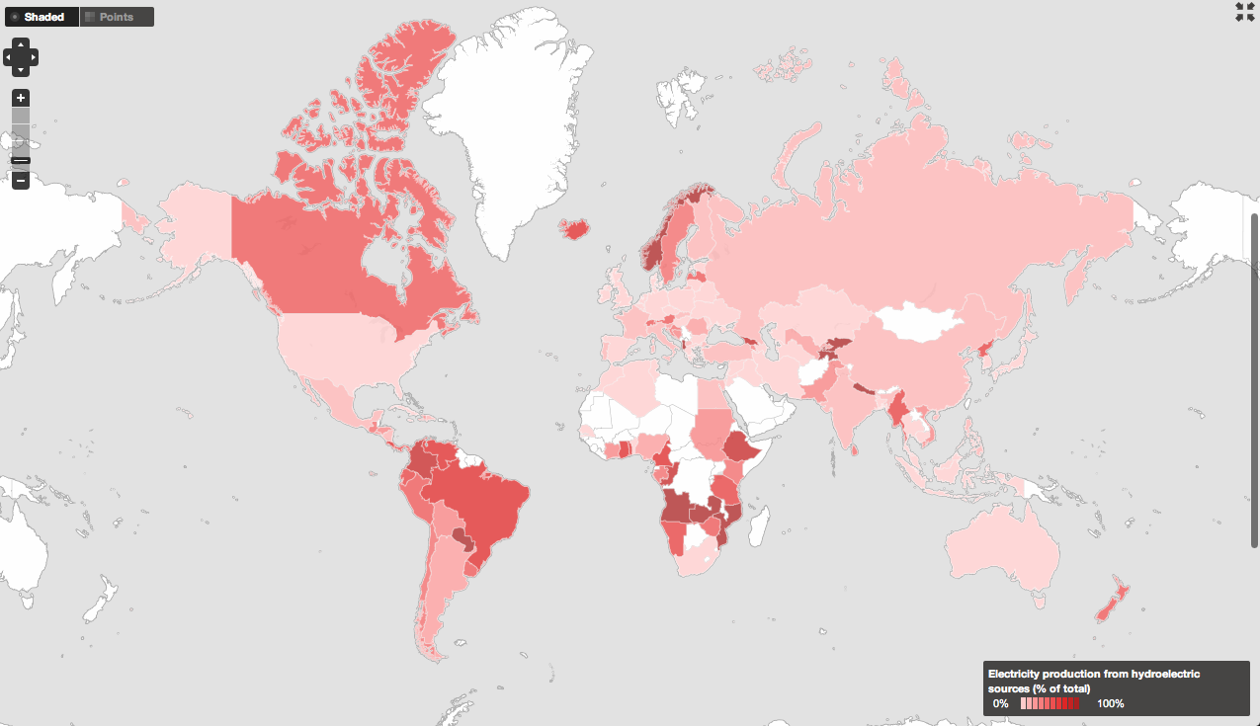
Almost every country has at least a little bit of hydropower.

Slide 3
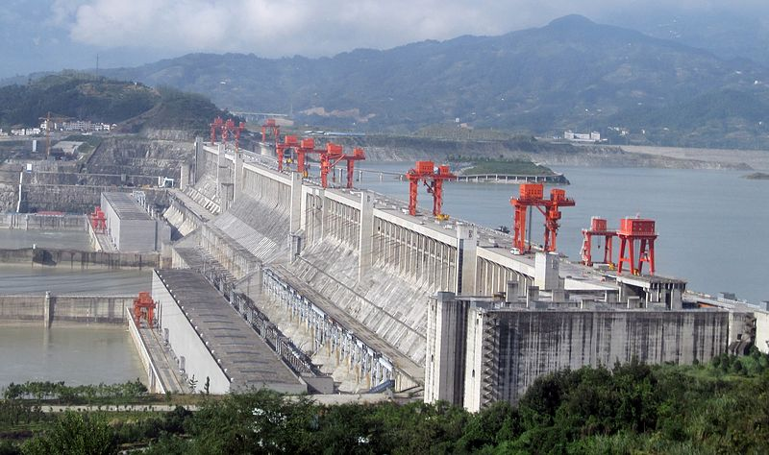
The largest power plant of any kind in the world is the Three Gorges Dam.
Location: China. Installed Capacity: 22.500 GW
Figure courtesy of Wikipedia
Notes:
http://en.wikipedia.org/wiki/File:ThreeGorgesDam-China2009.jpg

Slide 4
In its simplest form, hydropower comes from potential energy
P= g * ρ * Q * H_{l}
P_{th} = power theoretically available (W)
ρ = density (kg/m³) (~ 1000 kg/m³ for water)
Q = water flow (m³/s)
g = acceleration of gravity (9.81 m/s²)
H = falling height, head (m)
It can also be derived from flowing water, but that is rare and we will not discuss that here.
Notes:
List of efficiency
Hydro: 92%
Coal: ?
gas: ?
Wind>?

Slide 5
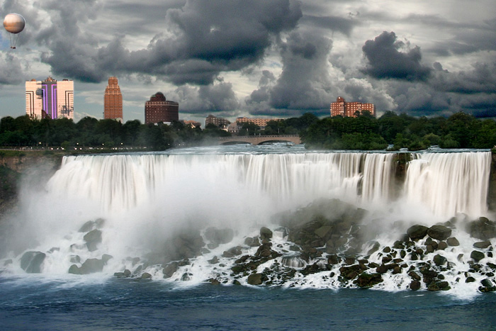
What would be the height (H) and water flow (Q) on Niagara Falls?
Water Flow (Q)
Height (H)
Figure courtesy of Wikipedia
Notes:
http://en.wikipedia.org/wiki/File:Niagara_Falls_before_a_rain_storm_(2007).jpg

Slide 6
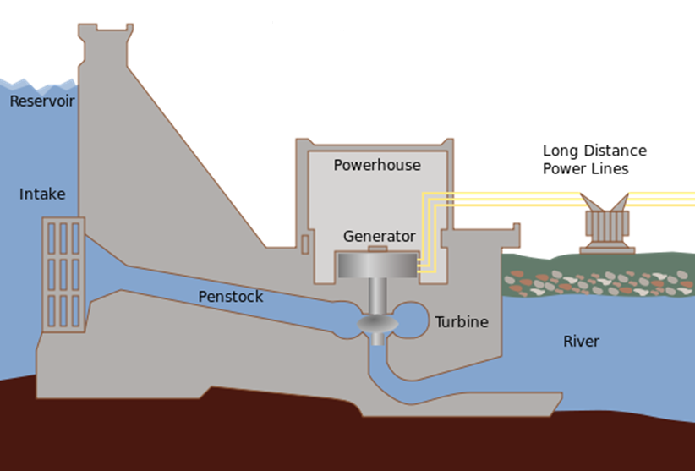
What would be the height (H) and water flow (Q) on this dam?
Height (H)
Water Flow (Q)
Figure courtesy of Wikipedia
Notes:
http://en.wikipedia.org/wiki/File:Hydroelectric_dam.svg

Slide 7
Yes, water flows from the reservoir across the generator to make electricity.
Figure courtesy of Wikipedia
Notes:
http://en.wikipedia.org/wiki/File:Hydroelectric_dam.svg

Slide 8
Hydropower pros
High efficiency
Flexibility
Reliable
Mature technology
Cheap
Relatively pollution free

Slide 9
Hydropower cons
Source of greenhouse gases (due to displaced trees and increase in algae).
Decreases water quality
Floods large areas (e.g., people’s homes)
Multiple legal issues (e.g., international discussions over water rights)

Slide 10
Environmental & Social Impacts
Environment
  Local x Regional impacts
  Water quality
  Sediments
  Fish and the fish transposing systems
  GHG fluxes in the reservoirs
Social
  The dam construction
  People Reallocation
  Land use
  Conflicts

