Slide 1
Consumer Preferences
August 18, 2013

Slide 2

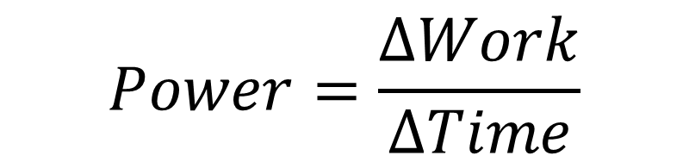
What is Power?
Power is the rate at which work is performed.
Equations:
$$Force=mass∗acceleration$$
$$Work=Force∗∆distance$$
$$Power=\frac{∆Work}{∆Time}$$

Slide 3


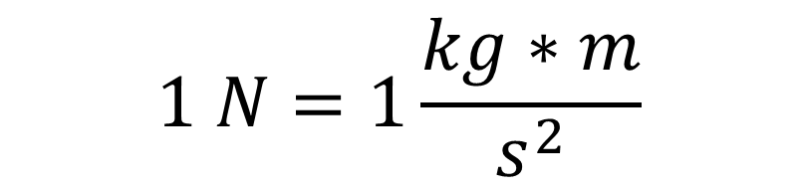
What are the units of Force, Work, and Power?
Force: Newton (N)
Work: Joule (J)
Power: Watt (W)
where kg=kilogram, m=meter, s= second
$$1 N=1\frac{kg∗m}{s^{2}}$$
$$1 J=1 N∗m$$
$$1 W=1 \frac{J}{s}$$

Slide 4
What is a Watt?
Example:
Suppose a man, who has a mass of 70 kg, needs to climb a 5-meter high wall in 6 seconds. How much work would he do and how much power would he need to accomplish this feat?

Slide 5
Hold on! What is energy?
Energy is Work.
One way to measure Energy is to measure the amount of power in a certain time period.
  kWh is the most common unit used to express the amount of electricity, especially for billing purposes.
    1 KWh = 1000 W-h
    1 kWh = 3.6 MJ
  MWh are sometimes used when describing energy from a power plant.
Example: How much electricity is consumed by a 60 W light bulb operating for one hour?

Slide 6
US v.s. World Energy Use
On average, how much electricity is used per person per year in the US? How about in other countries?
Notes:
Connect to the internet. Click on the hyperlink on the text “On average….” . This should pull up a Google docs figure with Electricity concumption.

Slide 7
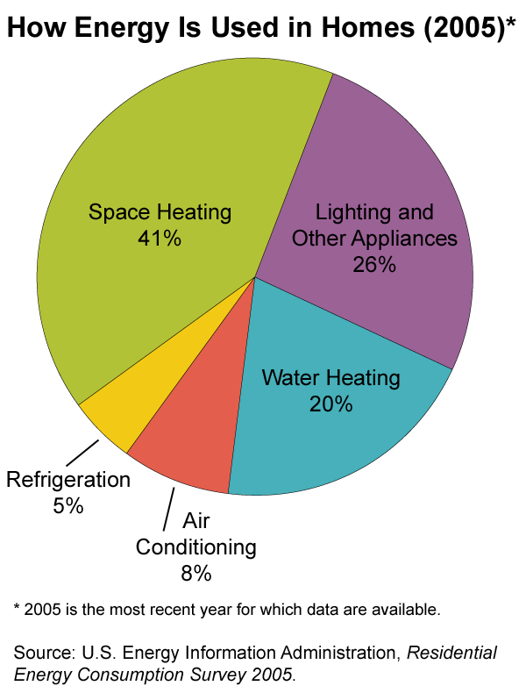
US Residential Energy Usage
Lighting accounts for 10 to 15 % of residential Energy usage!

Slide 8
Lighting Experiment
Compare the light bulbs

Slide 9
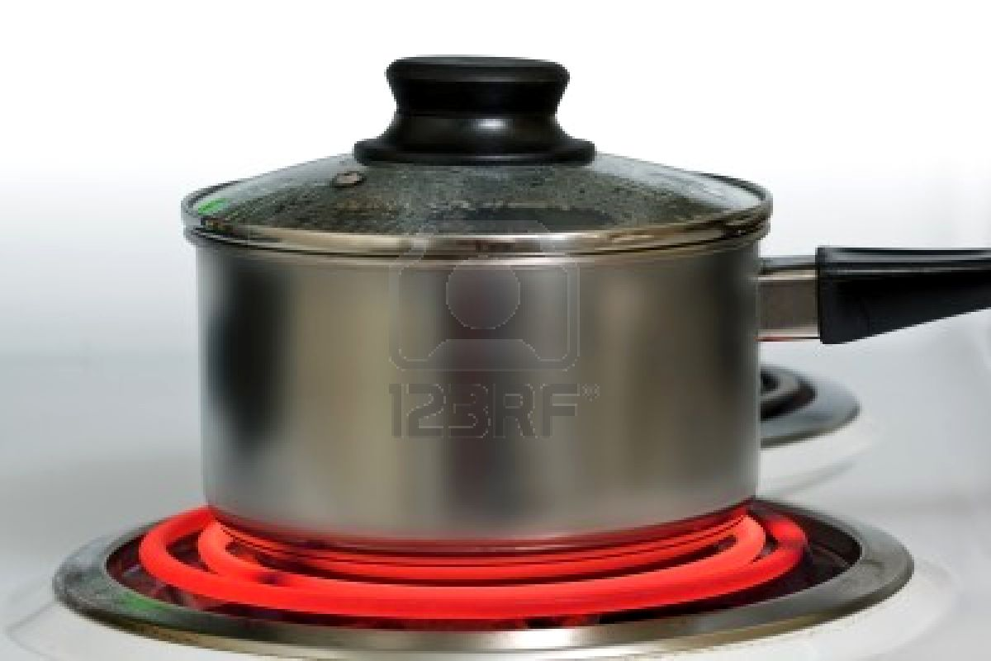
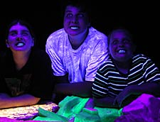
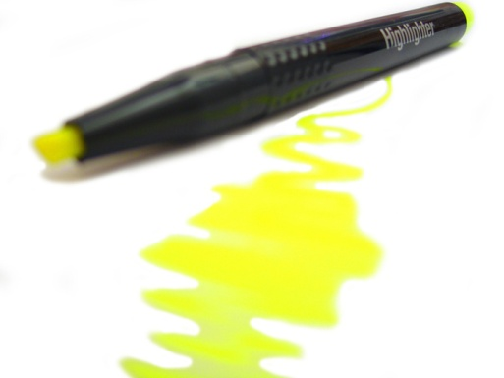
How is our lighting produced?
Incandescence
  Light emitted due to high
  temperature
  Color of the light is determined by the temperature of the object.
Fluorescence
  Highlighter
  UV light at museums, etc.
Figure Courtesy of 123rf
Figure Courtesy of NASA
Notes:
http://www.123rf.com/photo_7430711_brushed-steel-pot-on-red-hot-electric-stove.html
http://disc.sci.gsfc.nasa.gov/oceancolor/additional/science-focus/ocean-color/science_focus.shtml/fluorescence.shtml

Slide 10
Let’s have a look at light bulbs
Incandescent vs. Compact Fluorescent Light
  Heat
  Brightness (Lux)
Color comparison
  Soft white (2700K)
  Bright white (3500K)
  Daylight (5000K)

Slide 11
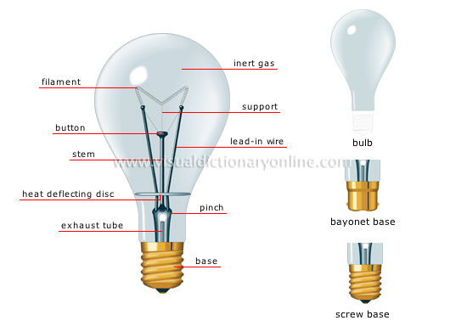
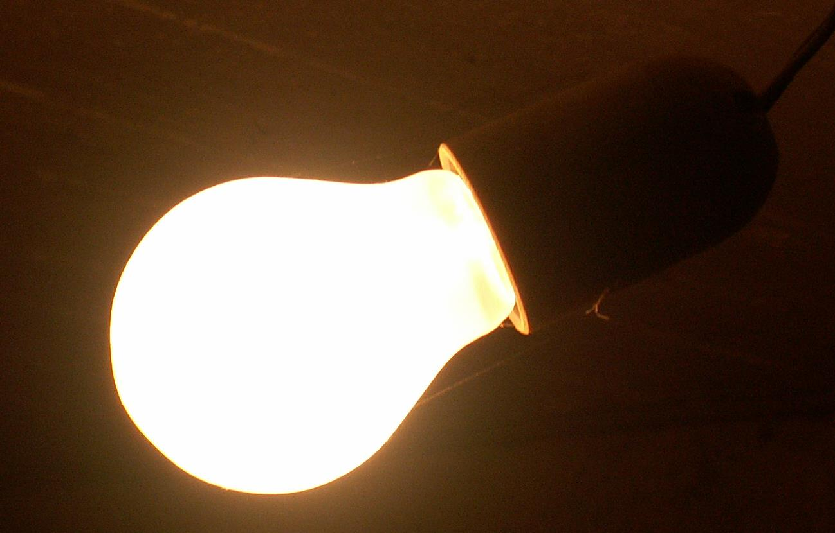
Lighting technologies
Incandescent lamp
Less than $1
Source: http://visual.merriam-webster.com/house/electricity/lighting/incandescent-lamp.php

Slide 12
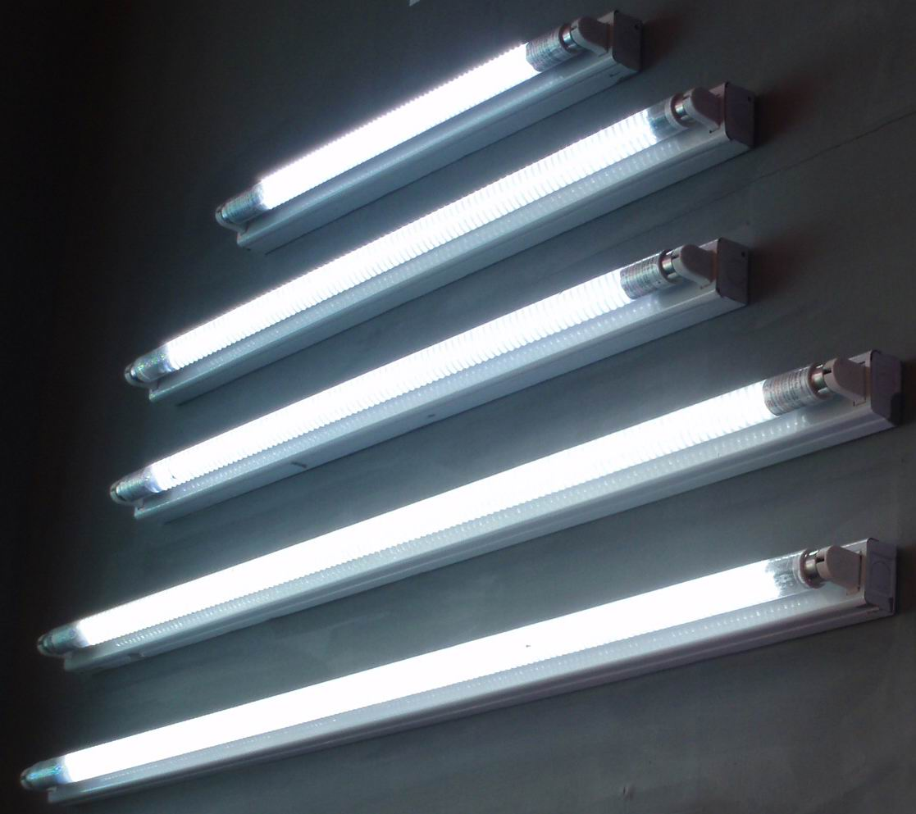
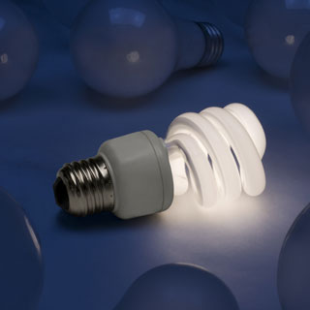
Lighting technologies
Fluorescent lamp
Around $2 ~$5
Tubular Fluorescent Lamp
Compact Fluorescent Lamp (CFL)
Source: http://motohata.com/2011/05/10/fluorescent-lamps-energy-efficient/

Slide 13
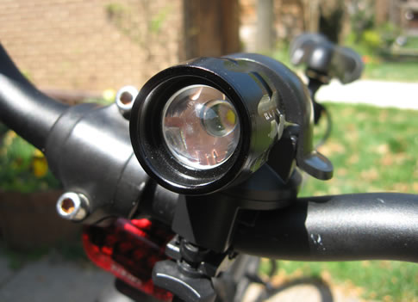
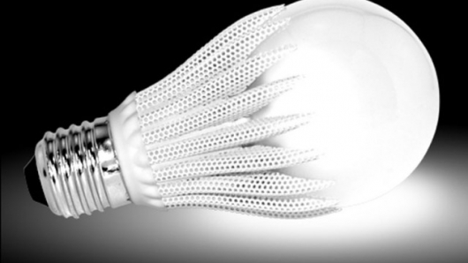
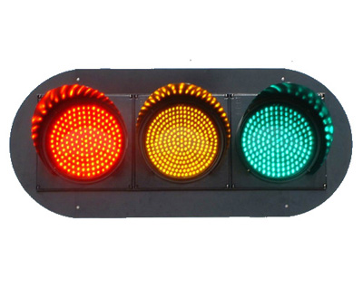
Lighting technologies
Light Emitting Diode (LED)
Around $20 ~$40
Source: http://www.gadgetvenue.com/geobulb-led-light-bulb-costs-120-03305214/
http://www.metaefficient.com/bicycles/bright-led-bike-light.html

Slide 14
How are they similar?
Incandescent vs. Compact Fluorescent Lamp (CFL)
Overlapping range of color
Almost identical in terms of brightness
  Ranging from 350 lm to 1800 lm
  Luminous flux (Lumen, lm)
    Total light output from a source
  Illuminance (Lux, lx)
    From the perspective of a receiver
    Light input per unit surface area (1 lx = 1 lm/m² )
Incandescent
CFL

Slide 15
How are they different?
CFLs, compared with incandescent lamps,
last about nine to ten times longer.
use less energy.
  Incandescent: About 5% of input energy is converted to light.
  CFL, LED: About 20% is converted to light. (4x)
  The rest is wasted as heat.
are more expensive.
contain mercury.

Slide 16
Which is better? - Economics
High price and low energy cost (CFL)
vs.
Low price and high energy cost (Incandescent)
Lifetime matters!

Slide 17
Which is better? – Mercury risk
Mercury
  It can damage the central nervous system, kidneys, and liver.
  CFLs contain small amount of mercury (4~5mg).
  Largest source: coal-fired power plants (50% of total in the U.S.)

Slide 18
Lighting Experiment
Compare the light bulbs

Slide 19
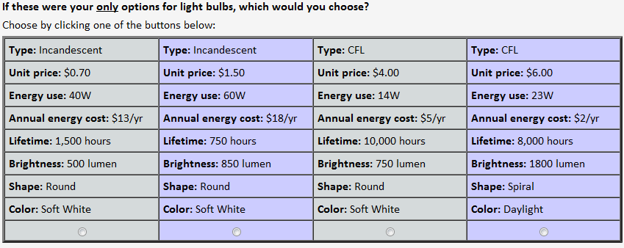
Additional Choice Task #1
Please answer these three questions and write what you think during the process. For example,
Was it hard because of too many factors? Did you look at just a couple things and ignore others?

Slide 20
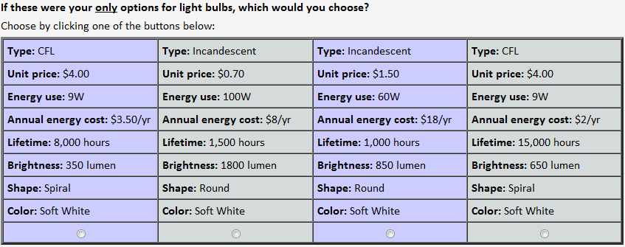
Additional Choice Task #2

Slide 21
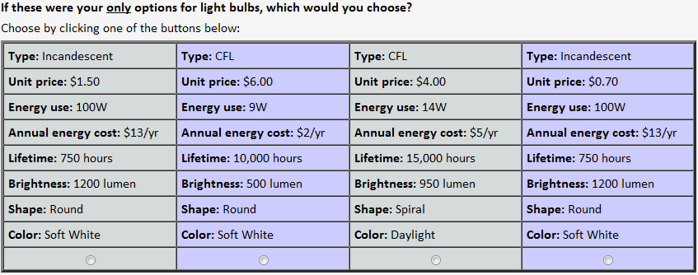
Additional Choice Task #3

Slide 22
U.S. legislation on lighting efficiency
Energy Independence and Security Act of 2007 (EISA)
  Mandates that all light bulbs be 30% more efficient in 2012 and 60% more efficient in 2020
    Incandescent bulbs will be subject to higher energy efficiency standards
Better Use of Light Bulbs (BULB) Act
  Tried to repeal EISA but was not successful
    The House voted it down on 7/12/2011.
  “A massive Big Brother intrusion into our homes and our lives.” - Member of the U.S. House of Representatives

