Slide 1
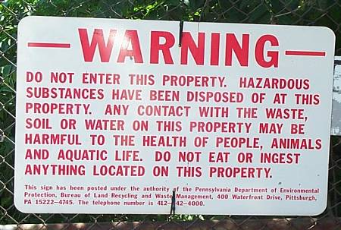
Brownfields Identification Cards Each card lists “hypothetical” contaminants that have been found. Use the Contaminant Chart to identify what might have been on the site.
Carnegie Mellon University
Pennsylvania Department of Environmental Protection Grant EEF#06-0087

Slide 2
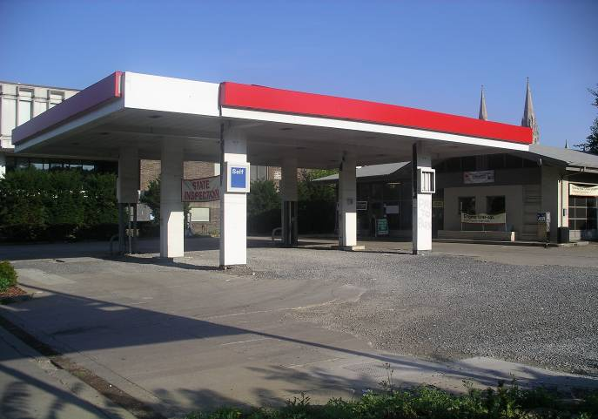
1
Contaminants Found:
Gasoline, Diesel Fuel, Metals, Petroleum Hydrocarbons,
Underground Storage Tanks,
Waste Oil, Solvents, Paint

Slide 3
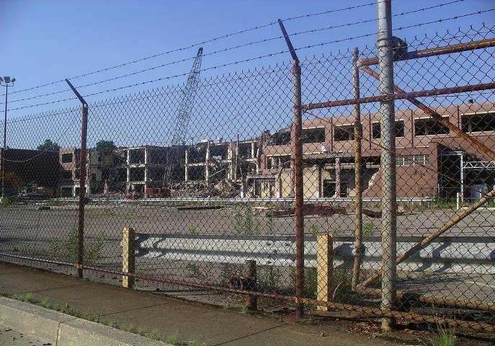
2
Contaminants Found:
Heavy Metals, Dusts, Acids

Slide 4
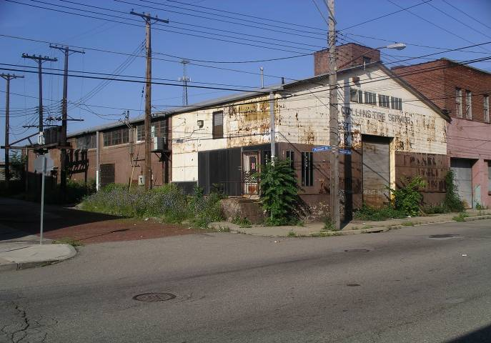
3
Contaminants Found:
Toluene, Benzene

Slide 5
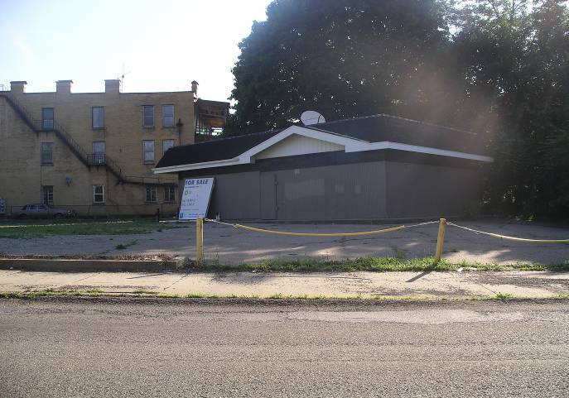
4
Contaminants Found:
Gasoline, Diesel Fuel, Metals, Petroleum Hydrocarbons,
Underground Storage Tanks

Slide 6
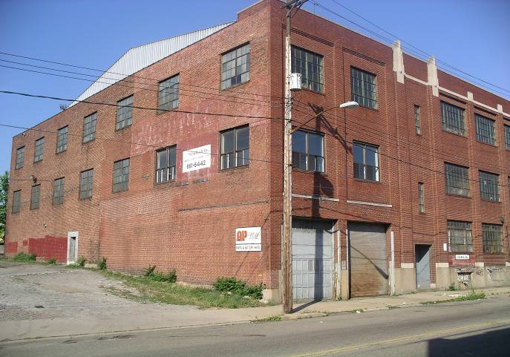
5
Contaminants Found:
Nickel, Lead, Cadmium, Acids, Copper, Zinc, Arsenic, Chromium

Slide 7
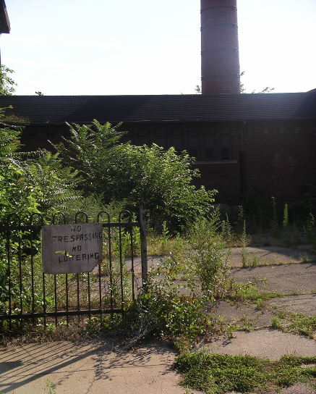
6
Contaminants Found:
Cadmium, Chromium, Cyanide, Copper, Nickel

Slide 8
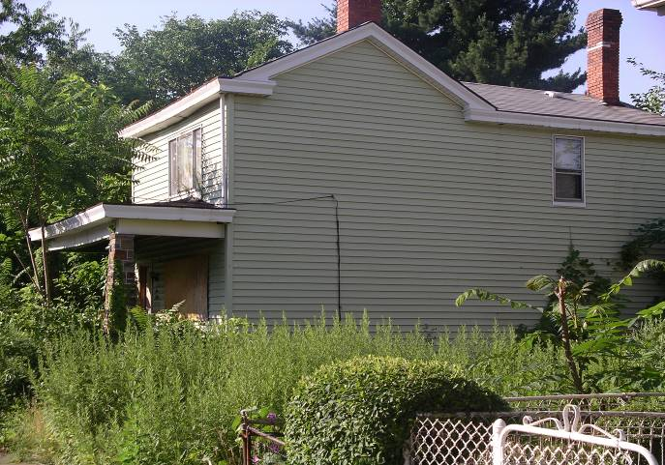
7
Contaminants Found:
Hairbrush, Household Products

Slide 9
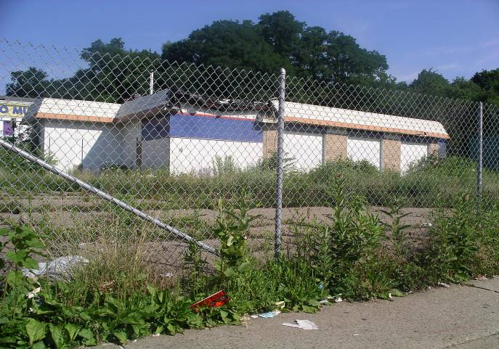
8
Contaminants Found:
Metals, Metal Dust, Solvents, Paint, Waste Oil, Scrap Metal,
Gasoline, Diesel Fuel, Underground Storage Tanks, Petroleum Hydrocarbons

Slide 10
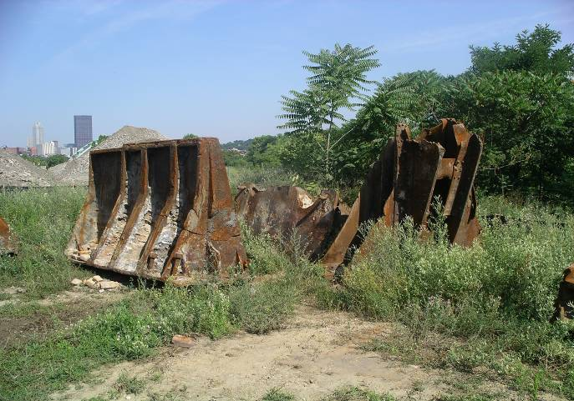
9
Contaminants Found:
Metals, Inorganics, Acids, Toxic Compounds,
Semi-Volatile Organics Including Those In Oil and Grease,
Volatile Organic Compounds

Slide 11
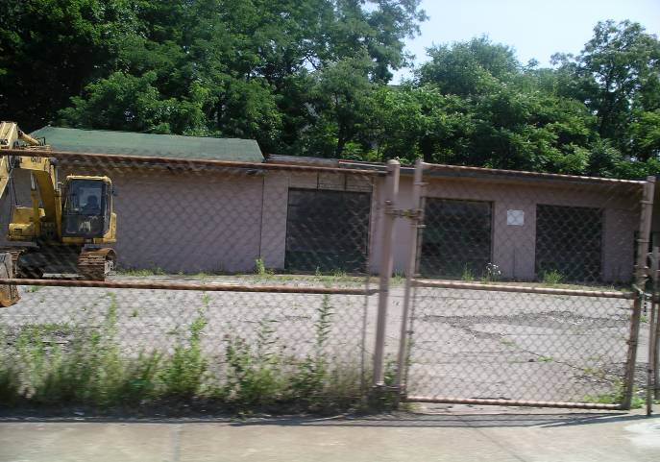
10
Contaminants Found:
Solvents, Paints, Cyanide, Acids, Heavy Metals

Slide 12
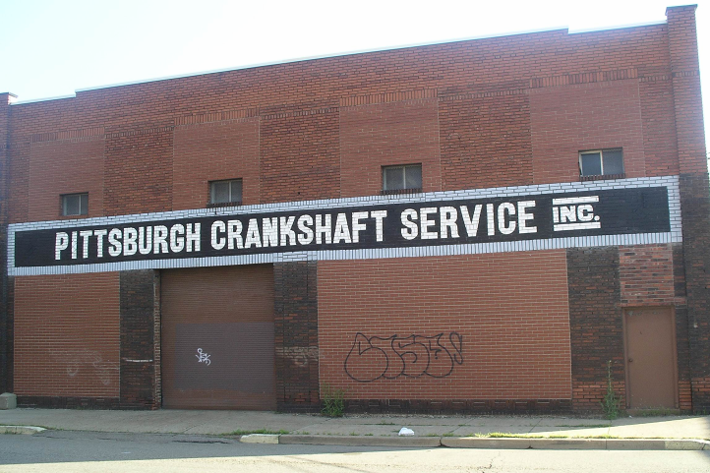
11
Contaminants Found:
Metals, Dioxin, Degreasing Agents, Waste Oils

Slide 13
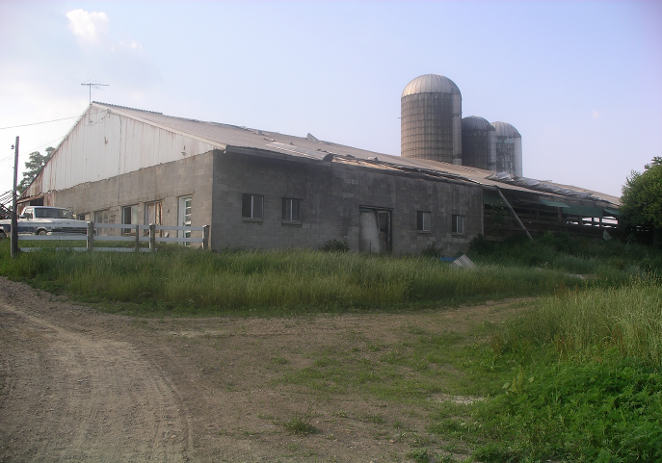
12
Contaminants Found:
Copper, Pesticides, Insecticides, Herbicides, Grain Fumigants,
Arsenic

Slide 14
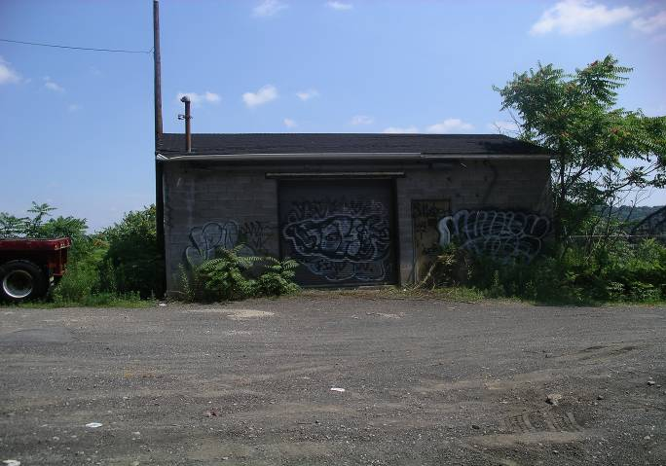
13
Contaminants Found:
Metals, Metal Dust, Solvents, Paint, Waste Oil, Scrap Metal

Slide 15
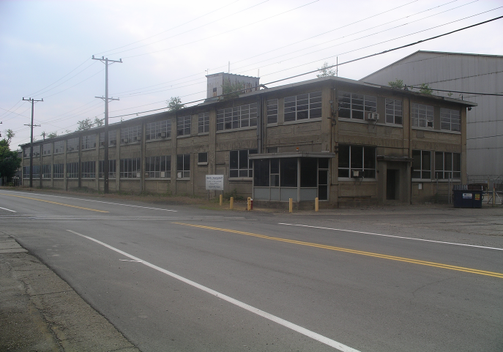
14
Contaminants Found:
Heavy Metals, Dusts, Acids

Slide 16
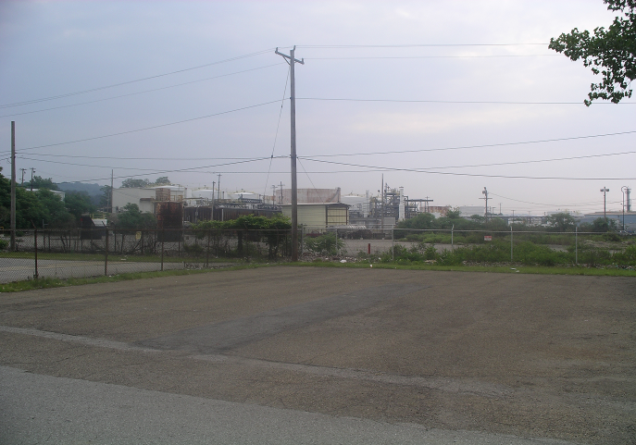
15
Contaminants Found:
Sulfur Compounds, Cyanide, Aluminum,
Lead, Iron, Nickel, Chromium

Slide 17
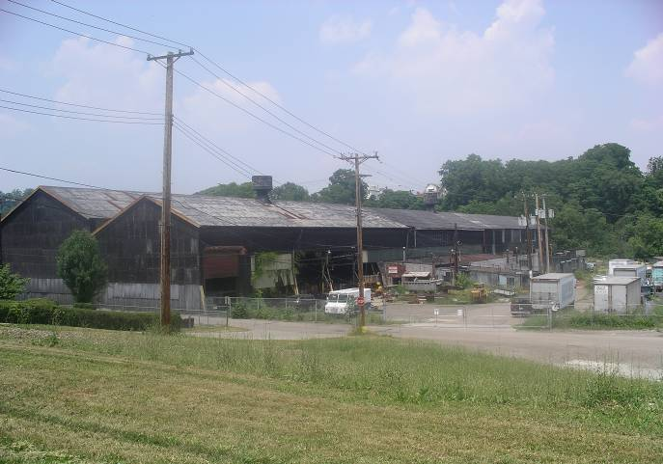
16
Contaminants Found:
Creosote, PCP, Arsenic, Zinc, Chromium, Copper,
PCBs, Beryllium, Dioxin, Wood Preservatives

Slide 18
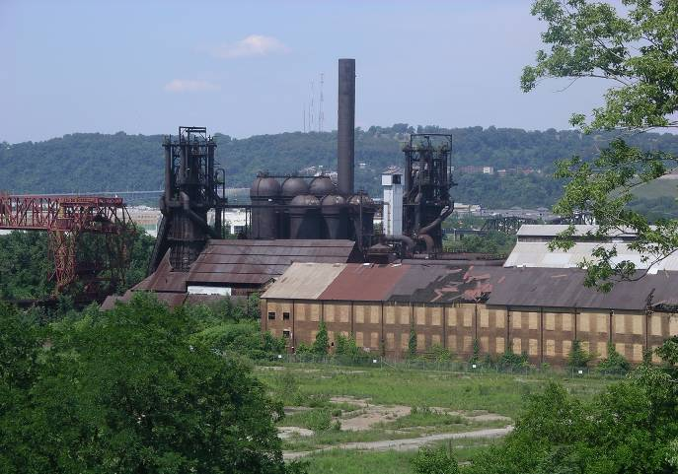
17
Contaminants Found:
Metals, Inorganics, Acids, Toxic Compounds,
Semi-Volatile Organics Including Those In Oil and Grease,
Volatile Organic Compounds

Slide 19
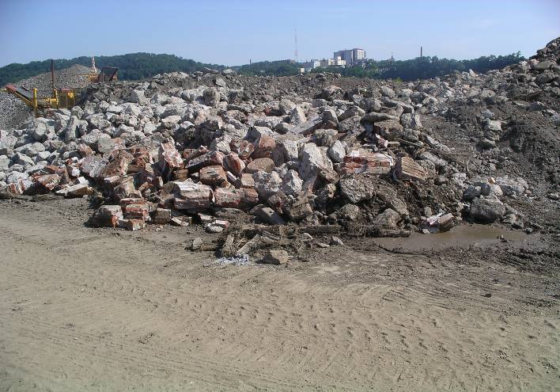
18
Contaminants Found:
Metals, Household Products, Ammonia, Methane, Pesticides

Slide 20
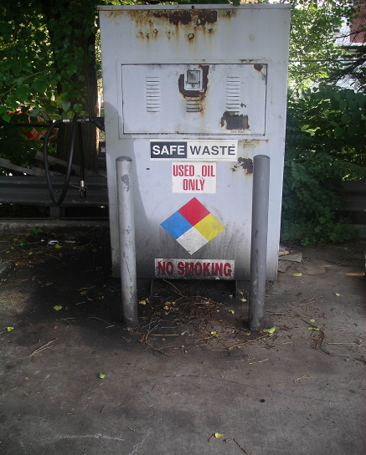
19
Contaminants Found:
Petroleum Hydrocarbons, Benzene, Toluene, Ethylbenzene, Xylene, Fuels, Oil, Grease

Slide 21
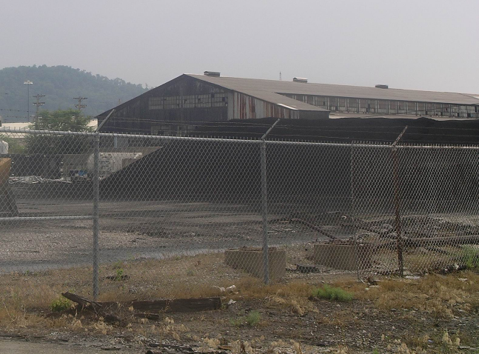
20
Contaminants Found:
Metals, Inorganics, Acids, Toxic Compounds,
Semi-Volatile Organics Including Those In Oil and Grease,
Volatile Organic Compounds

Slide 22
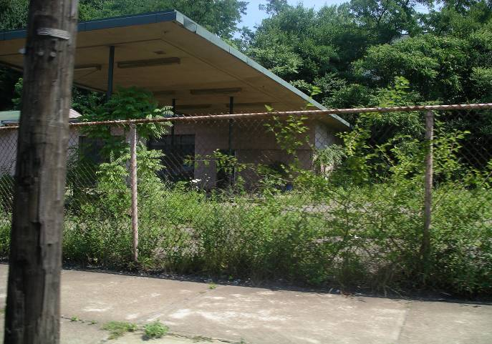
21
Contaminants Found:
Gasoline, Diesel Fuel, Metals, Petroleum Hydrocarbons,
Underground Storage Tanks

Slide 23
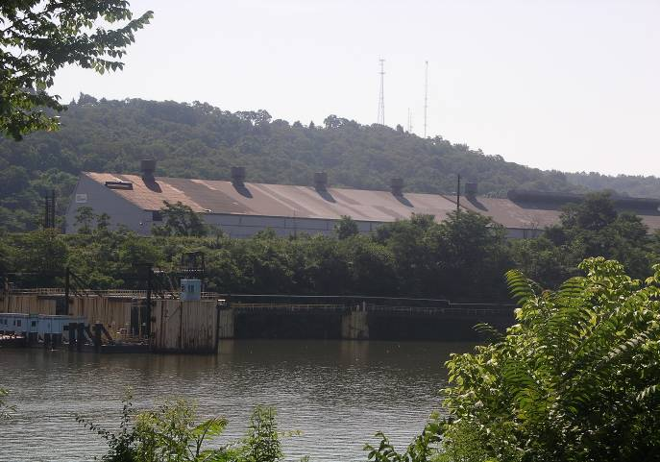
22
Contaminants Found:
Metals, Inorganics, Acids, Toxic Compounds,
Semi-Volatile Organics Including Those In Oil and Grease,
Volatile Organic Compounds

Slide 24
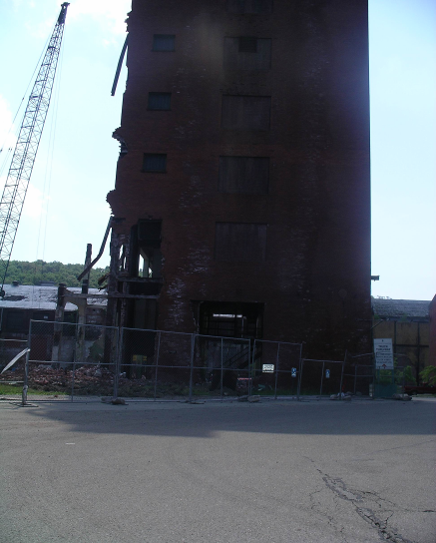
23
Contaminants Found:
Organic Solvents, Inorganic Solvents, Metals and Metal Dust, Paint, Heavy Metals, Pesticides, Photographic Waste, Waste Oil

Slide 25
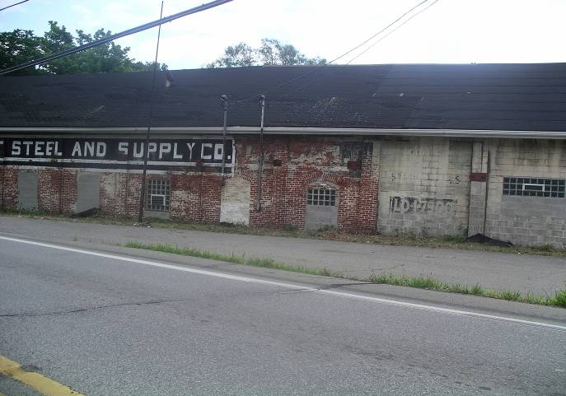
24
Contaminants Found:
Metals, Inorganics, Acids, Toxic Compounds,
Semi-Volatile Organics Including Those In Oil and Grease,
Volatile Organic Compounds

Slide 26
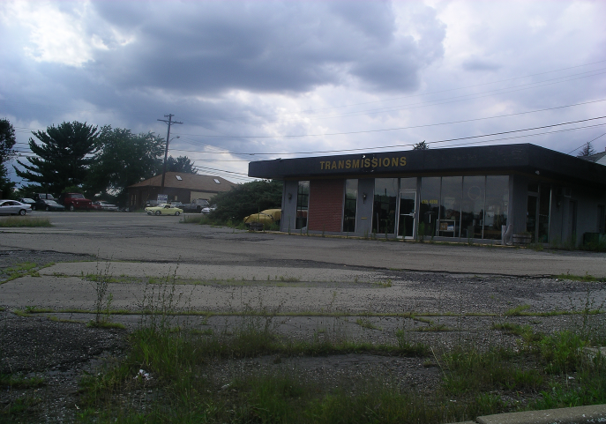
25
Contaminants Found:
Metals, Metal Dust, Solvents, Paint, Waste Oil,
Scrap Metal, Gasoline, Diesel Fuel, Petroleum Hydrocarbons,
Underground Storage Tanks

Slide 27
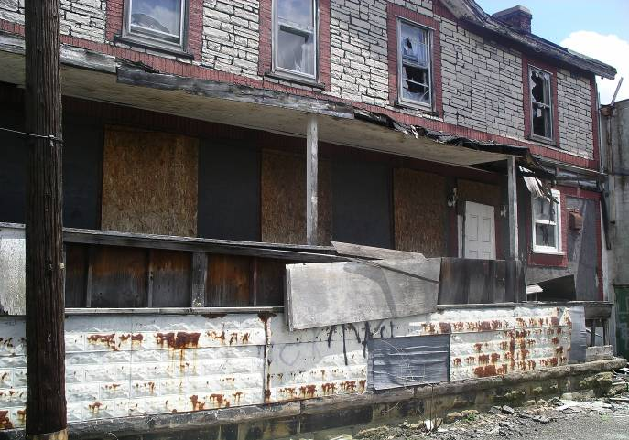
26
Contaminants Found:
Broken Glass, Shampoo, Furniture

Slide 28
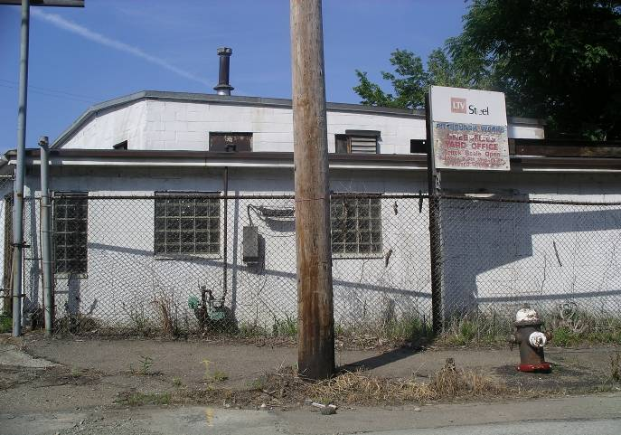
27
Contaminants Found:
Metals, Inorganics, Acids, Toxic Compounds,
Semi-Volatile Organics Including Those In Oil and Grease,
Volatile Organic Compounds

Slide 29
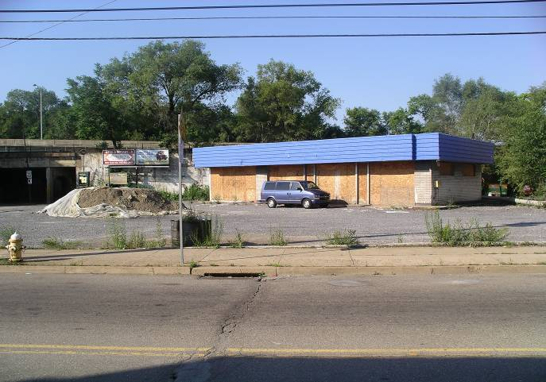
28
Contaminants Found:
Gasoline, Diesel Fuel, Metals, Petroleum Hydrocarbons,
Underground Storage Tanks

Slide 30
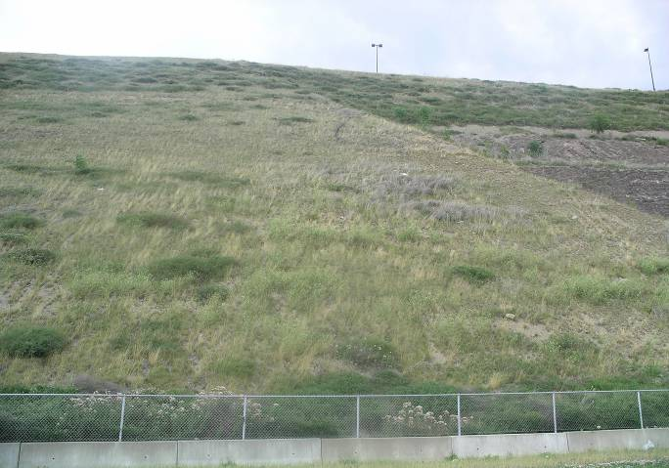
29
Contaminants Found:
Slag, Heavy Metals

Slide 31
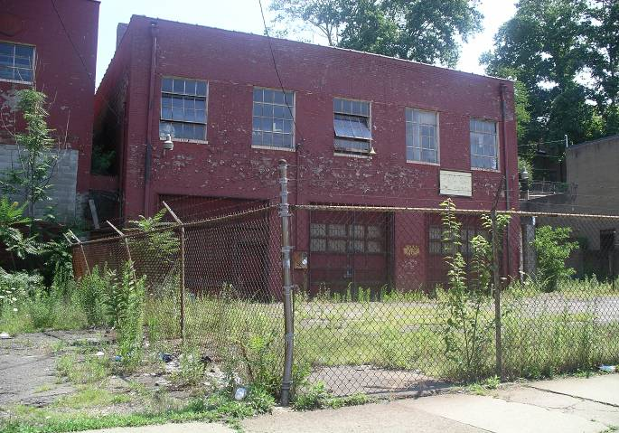
30
Contaminants Found:
Solvents, Paints, Cyanide, Acids, Heavy Metals

Slide 32
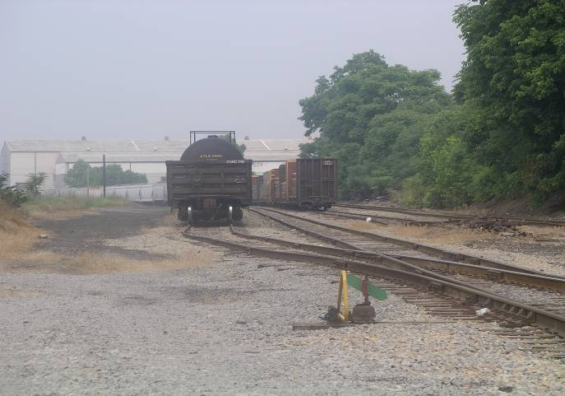
31
Contaminants Found:
Petroleum Hydrocarbons, Benzene, Toluene,
Ethylbenzene, Xylene, Solvents, Fuels, Lead, Oil and Grease, PCBs

Slide 33
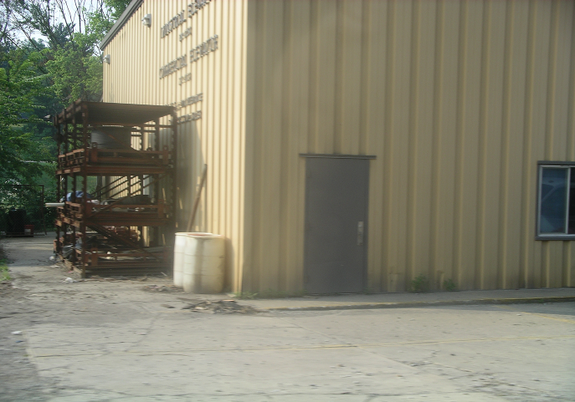
32
Contaminants Found:
Toluene, Benzene

Slide 34
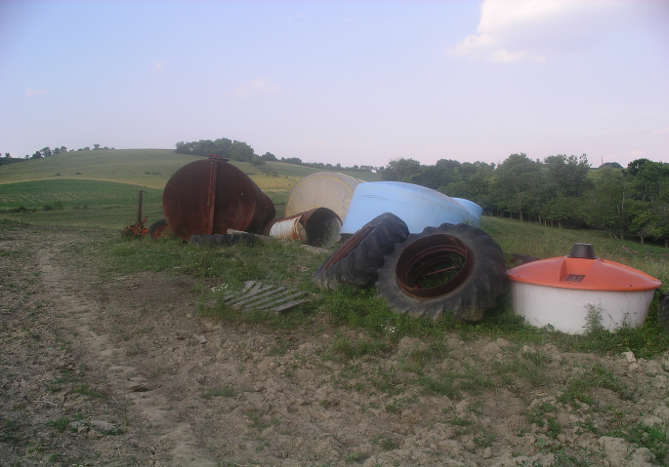
33
Contaminants Found:
Copper, Pesticides, Insecticides, Herbicides,
Grain Fumigants, Arsenic

Slide 35
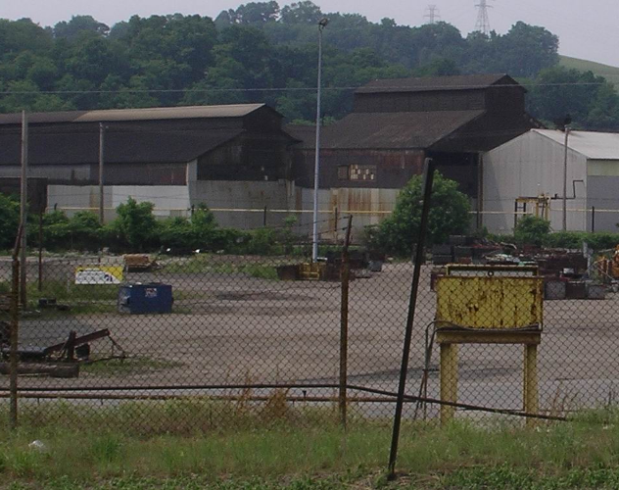
34
Contaminants Found:
Arsenic, Lead

Slide 36
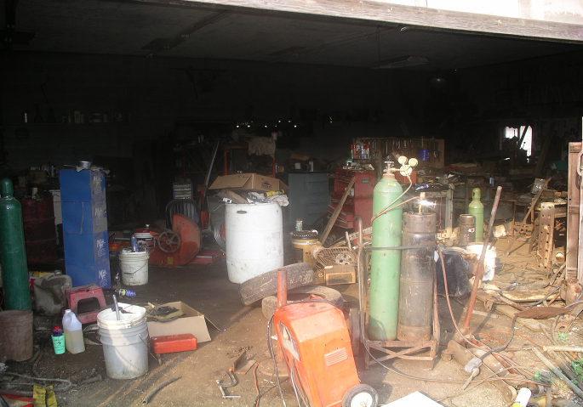
35
Contaminants Found:
Metals, Dioxin, Degreasing Agents, Waste Oils

Slide 37
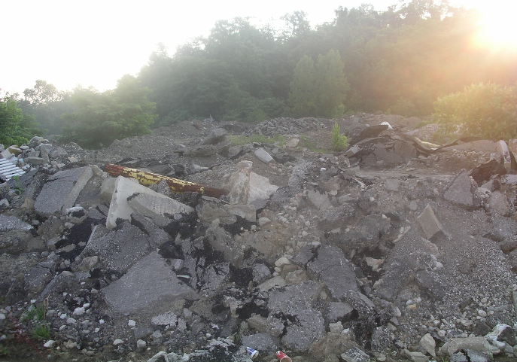
36
Contaminants Found:
Metals, Household Products, Ammonia, Methane, Pesticides

Slide 38
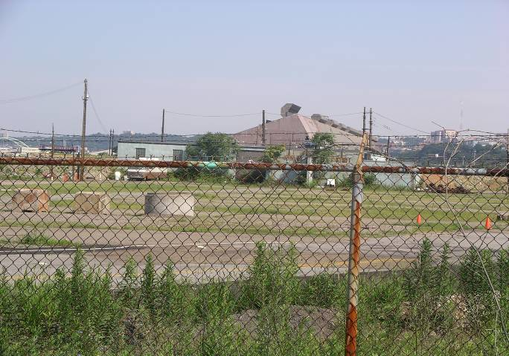
37
Contaminants Found:
Heavy Metals, Dusts, Acids

Slide 39
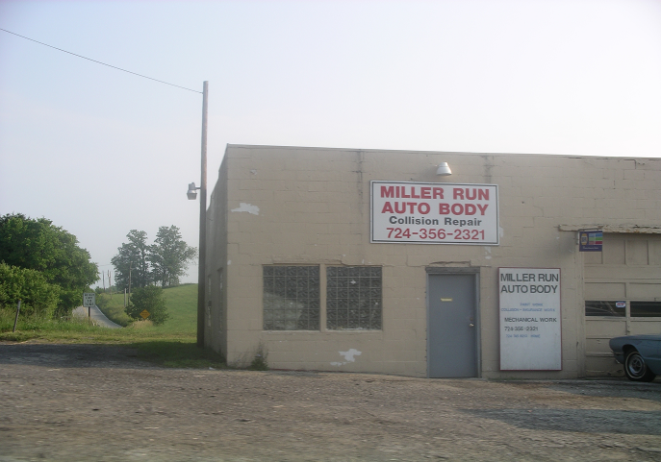
38
Contaminants Found:
Metals, Metal Dust, Solvents, Paint, Waste Oil, Scrap Metal

Slide 40
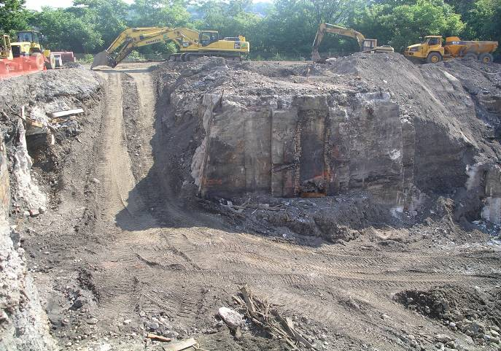
39
Contaminants Found:
Arsenic, Lead

Slide 41
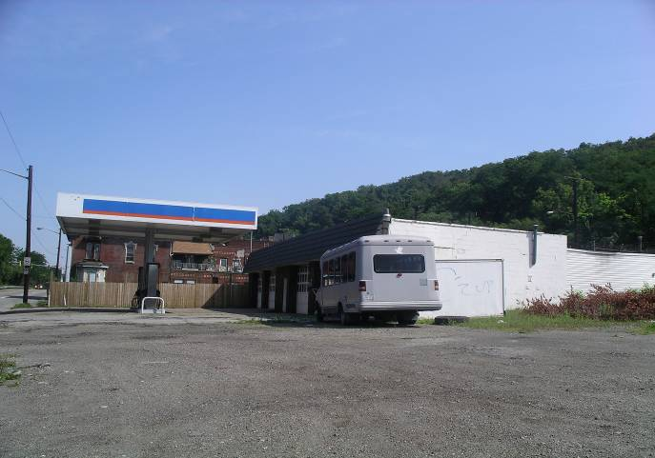
40
Contaminants Found:
Gasoline, Diesel Fuel, Metals, Petroleum Hydrocarbons,
Underground Storage Tanks

