Slide 1






Applying Computational Causal Discovery in Biomedicine
Greg Cooper, University of Pittsburgh
Richard Scheines, Carnegie Mellon University
11/3/2018

Slide 2
Outline
Motivation
Basics of Causal Graphical Models
Searching for Causal Structure
Examples

Slide 3
  Counterfactual Reasoning Requires Causal Knowledge
    I would not have been late to work if I had set an alarm
Get to Work by 8
Set Alarm
Wake at 7
    I would have finished the race if I had dyed my hair black
Age
Grey Hair
Endurance
Notes:
Statistics, Computer Science, Philosophy, etc.
America, Europe, Japan

Slide 4
  Policy Reasoning Requires Causal Knowledge
    Raising taxes on beer will lower underage consumption
    Lowering infant mortality will lower the birthrate
    X Requiring people to wear shorts in Pittsburgh in January 2019 will make it warmer in January 2019
Notes:
Statistics, Computer Science, Philosophy, etc.
America, Europe, Japan

Slide 5

  Explanation Requires Causal Knowledge
    The length of the shadow is explained by the height of the flagpole and the position of the sun
    X The height of the flagpole is not explained by the length of the shadow and the position of the sun
Notes:
Statistics, Computer Science, Philosophy, etc.
America, Europe, Japan

Slide 6
  Observational Prediction Does NOT
  Require Causal Knowledge
    People carrying umbrellas at noon
    predicts
    rain in the afternoon
    Among children ages 5-10,
    shoe size predicts reading level
Notes:
Statistics, Computer Science, Philosophy, etc.
America, Europe, Japan

Slide 7
Causal Inference Requires More than Probability
Prediction from Observation ≠ Prediction from Intervention
P(Run Mile < 7 min. | Hair = gray)
≠
P(Run Mile < 7 min. | do(Hair = gray))
In general: P(Y=y | X=x, Z=z) ≠ P(Y=y | do(X=x), Z=z))
Causal Prediction vs. Statistical Prediction:
Non-experimental data
(observational study)
P(Y,X,Z)
P(Y=y | X=x, Z=z)
Background Knowledge
Causal structure
P(Y=y | do(X=x), Z=z)

Slide 8




30 Years of Advances
  1988 → 2018: tremendous progress in:
    Mathematical representations of causal systems
    Deriving counterfactuals, policy, and predictions from causal graphical models
    Reliable and useful discovery algorithms for finding causal structure from a combination of data and background knowledge
  These methods will be essential to future AI.
Notes:
Statistics, Computer Science, Philosophy, etc.
America, Europe, Japan

Slide 9
Modern Theory of
Statistical Causal Models
Graphical
Models
Intervention & Manipulation
Discovery Algorithms (Computational
Causal Discovery)
Testable Constraints
(e.g., Independence)
Counterfactuals
Notes:
1

Slide 10
Causal Estimation vs. Causal Search
Estimation (Potential Outcomes)
Causal Question: Effect of Zidovudine on Survival among HIV-positive men (Hernan, et al., 2000)
Problem: confounders (CD4 lymphocyte count) vary over time, and
they are dependent on previous treatment with Zidovudine
Estimation method discussed: marginal structural models
Assumptions:
  Treatment measured reliably
  Measured covariates sufficient to capture major sources of confounding
  Model of treatment given the past is accurate
Output: Effect estimate with confidence intervals
Fundamental Problem: Estimation/inference is conditional on the model
Notes:
1

Slide 11
Causal Estimation vs. Causal Search
Search (Causal Graphs)
Causal Question: Which genes regulate flowering in Arbidopsis?
Problem: Over 25,000 potential genes.
Method: Computational causal discovery
Assumptions:
  RNA microarray measurement reasonable proxy for gene expression
  Causal Markov assumption
  Etc.
Output: Suggestions for follow-up experiments
Fundamental Problem: The number of causal graphs grows super-exponentially with the number of variables
Notes:
1

Slide 12
Basic Causal Discovery Workflow
Both observational and experimental data
Causal
Analysis
Data
Causal Graphs
Prior Knowledge

Slide 13
Basic Causal Discovery Workflow
The main goal of search methods is to suggest causal hypotheses that are novel, significant, and likely valid.
Causal Hypotheses
Causal
Analysis
Data
Causal Graphs
Prior Knowledge

Slide 14
Basic Causal Discovery Workflow
Experiments
Causal Hypotheses
Causal
Analysis
Data
Causal Graphs
Prior Knowledge

Slide 15
Basic Causal Discovery Workflow
Experiments
Causal Hypotheses
Causal
Analysis
Data
Causal Graphs
Prior Knowledge

Slide 16

Which genes regulate flowering time in Arabidopsis thaliana?
Example*
* Stekhoven DJ, et al. Causal stability ranking. Bioinformatics 28 (2012) 2819-2823.
Notes:
Why is this an interesting question to answer?: Timing of flowering is an important agronomical trait that greatly affects yield. Thus, improved knowledge about genes controlling flowering time is of substantial economic value.

Slide 17
Observational Data
n = 47 Arabidopsis thaliana gene expression profiles of 4-day old seedlings for which subsequent flowering time was also measured
Affymetrix ATH1 arrays with expression measurements on 21,440 A. thaliana genes

Slide 18
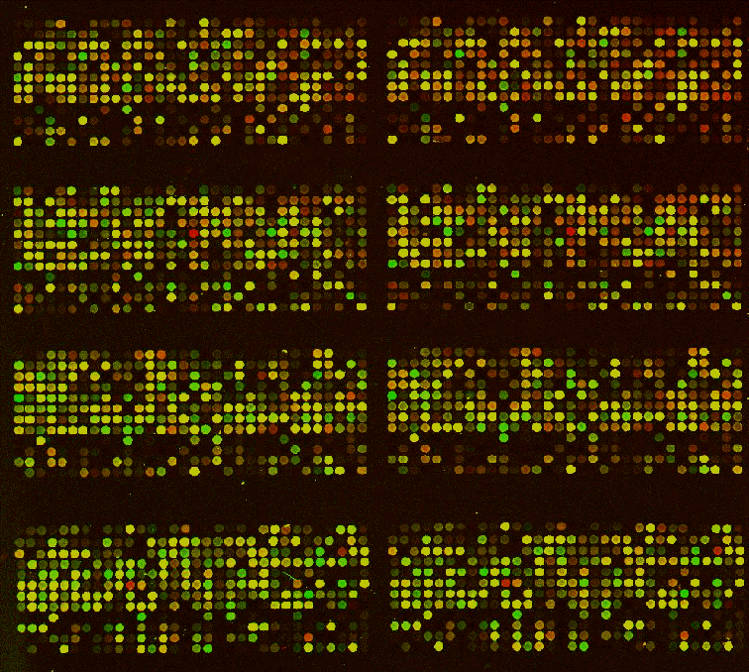
Causal Analysis
Observational data:
Microarray measurements (X) and flowering time (Y)
Causal
Analysis
(CStaR)
Causal graph on the variables in X and Y

Slide 19
Candidate Gene Selection
Candidate gene regulators of flowering time
Select those genes that
are predicted by the
graph to reliably cause the
most substantial changes
in flowering time (Y)
Observational data:
Microarray measurements (X) and flowering time (Y)
Causal
Analysis
(CStaR)
Causal graph on the variables in X and Y

Slide 20
Candidate Regulators of Flowering Time
Considered the 25 genes that caused the most substantial changes in flowering time, according to the causal graph analysis
5 of those 25 genes were known regulators of flowering
13 of those 25 genes were not known regulators and mutant seeds for each of them were available

Slide 21
Experimental Investigation
Experiments
Candidate gene regulators of flowering time
Observational data:
Microarray measurements (X) and flowering time (Y)
Causal
Analysis
(CStaR)
Causal graph on the variables in X and Y

Slide 22
Experimental Details
Used seeds of Columbia Arabidopsis thaliana wild-type and T-DNA homozygous insertion mutants obtained from Nottingham Arabidopsis Stock Centre
Seeds were plated on Murashige and Skoog medium, stratified for 2 days at 4º C, grown on plates for 10 days, and transferred into soil in Conviron growth chambers
Flowering time was measured in days
Seed types yielding 4 or more plants were considered for analysis

Slide 23
Experimental Results
Experiments
Results
Candidate gene regulators of flowering time
Observational data:
Microarray measurements (X) and flowering time (Y)
Causal
Analysis
(CStaR)
Causal graph on the variables in X and Y

Slide 24
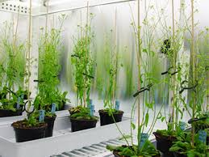
Results
There were 9 seed types, each with a single gene insertion, that yielded 4 or more plants
Of those 9, there were 4 that had a statistically significantly shorter flowering time (p < 0.05) than the control, wild-type plants
Greenhouse experiments
on flowering time

Slide 25
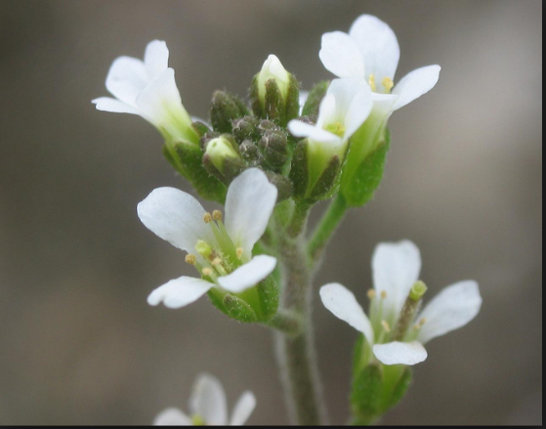
Conclusions
Overall, 4 out of 13 (31%) gene-altered seeds produced statistically significantly shorter flowering time than did wild-type plants
The experimental efficiency was high for performing experiments based on causal network analysis of observational gene-expression data

Slide 26
Outline
Motivation
Basics of Causal Graphical Models
Searching for Causal Structure
Examples

Slide 27
Representing Causal Structure
Represent Qualitative Causal Structure: Directed Graphs
Represent Manipulations/Interventions
Represent Quantitative Causal Relationships: Attach Probability to Causal Structure

Slide 28
Causal Graphs
Causal Graph G = {V,E}
Each edge X → Y represents a direct causal claim:
X is a direct cause of Y relative to V
Years of Education
Income
Years of Education
Skills and Knowledge
Income
Notes:
1. don’t define causality - but will introduce axioms to connect probability to causality
2. many fields proceed without agreement on definition - probability, “force” in mechanics, interpretation of quantum mechanics, etc.
3. a number of different kinds of graphs represent probability distributions and independence - advantage of directed graphs is also represents causal relations
4. will introduce several extensions

Slide 29
Tetrad Demo & Hands-On
Age
Hair_Color
Endurance
Build and Save two causal graphs:
Build the graph above
Build your own graph with 4 variables
Notes:
Build 2 causal graphs - one for smoking, yf, lc

Slide 30
Modeling Ideal Interventions
Interventions on the Effect
Post-experimental System
Pre-experimental System
Sweaters
On
Room Temperature

Slide 31
Modeling Ideal Interventions
Interventions on the Cause
Post-experimental System
Pre-experimental System
Sweaters
On
Room
Temperature

Slide 32
Interventions & Causal Graphs
    Model an ideal intervention by adding an “intervention” variable outside the original system as a direct cause of its target.
Pre-intervention graph
Intervene on Income
“Hard” Intervention
“Soft” Intervention
Notes:
Fat Hand - intervention - cholesterol drug -- arythmia

Slide 33
Interventions & Causal Graphs
Pre-intervention Graph
X2
X5
X1
X4
X3
X6
Intervention:
Hard intervention on both X1, X4
Soft intervention on X3
X2
X5
I
X1
X4
Post-Intervention Graph?
S
X3
I
X6
Notes:
Fat Hand - intervention - cholesterol drug -- arythmia

Slide 34
Interventions & Causal Graphs
Pre-intervention Graph
X2
X5
X1
X4
X3
X6
Intervention:
Hard intervention on both X1, X4
Soft intervention on X3
X2
X5
I
X1
X4
Post-Intervention Graph?
S
X3
I
X6
Notes:
Fat Hand - intervention - cholesterol drug -- arythmia

Slide 35
Interventions & Causal Graphs
Pre-intervention Graph
X2
X5
X1
X4
X3
X6
Intervention:
Hard intervention on X3
Soft intervention on X4 and X6
X2
X5
X1
X4
Post-Intervention Graph?
X3
X6
S
I
S
Notes:
Fat Hand - intervention - cholesterol drug -- arythmia

Slide 36
Interventions & Causal Graphs
Pre-intervention Graph
X2
X5
X1
X4
X3
X6
Intervention:
Hard intervention on X3
Soft intervention on X4 and X6
X2
X5
X1
X4
Post-Intervention Graph?
X3
X6
S
I
S
Notes:
Fat Hand - intervention - cholesterol drug -- arythmia

Slide 37
Interventions & Causal Graphs
Age
Pre-intervention Graph
Hair Color
Endurance
Hair Color _||_ Endurance
Notes:
Fat Hand - intervention - cholesterol drug -- arythmia

Slide 38

Interventions & Causal Graphs
Age
Pre-intervention Graph
Hair Color
Endurance
Hair Color _||_ Endurance
Age
Paint Hair Gray
Hair Color
Endurance
Hair Color _||_ Endurance
Notes:
Fat Hand - intervention - cholesterol drug -- arythmia

Slide 39
Representing Causal Structure
Represent Qualitative Causal Structure: Directed Graphs
Represent Manipulations/Interventions
Attach Probabilities

Slide 40
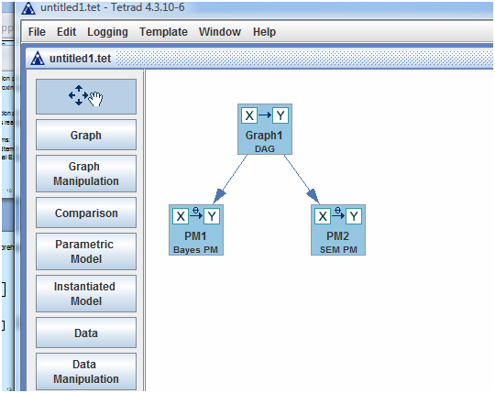
Parametric Models

Slide 41
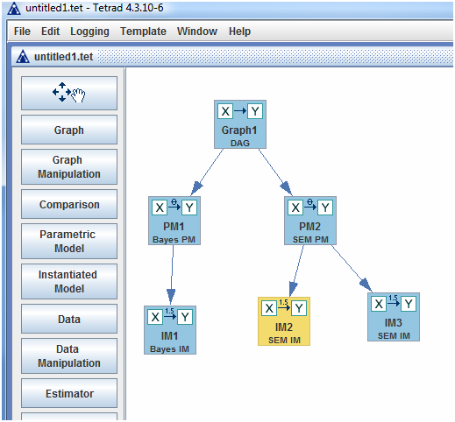
Instantiated Models

Slide 42
Causal Bayes Networks
Age
[Young, Old]
The joint distribution factors
according to the Causal Graph:
Hair Color
[Dark, Gray]
Endurance
[Good, Bad]
P(A,HC,E) =
P(A)
P(HC| A)
P(E | A)

Slide 43
Causal Bayes Networks
Age
[Young, Old]
The joint distribution factors
according to the Causal Graph:
Hair Color
[Dark, Gray]
Endurance
[Good, Bad]
P(A,HC,E) =
P(A)
P(HC| A)
P(E | A)
= f(θ)
All variables binary: θ =
{θ_{1,} θ_{2,}θ_{3,}θ_{4,}θ_{5,} }
P(A = y) = θ₁
P(A = o) = 1 - θ₁
P(HC = d | A = y) = θ₂ P(E = g | A = y) = θ₄
P(HC = g | A = y) = 1- θ₂ P(E = b | A = y) = 1- θ₄
P(HC = d | A = o) = θ₃ P(E = g | A = o) = θ₅
P(HC = g | A = o) = 1- θ₃ P(E = b | A = o) = 1- θ₅

Slide 44
Calculating the Effect of a Hard Intervention
Age
[Young, Old]
P(A,HC,E) = P(A) P(HC|A) P(E| A)
Hair Color
[Dark, Gray]
Endurance
[Good, Bad]
P(A) P(E|A)
Age
[Young, Old]
P_{m} (A,HC,E) =
P(HC| Hard)
Hard
Hair Color
[Dark, Gray]
Endurance
[Good, Bad]

Slide 45
Calculating the Effect of a Soft Intervention
Age
[Young, Old]
P(A,HC,E) = P(A) P(HC|A) P(E| A)
Hair Color
[Dark, Gray]
Endurance
[Good, Bad]
P(A) P(E|A)
Age
[Young, Old]
P_{m} (A,HC,E) =
P(HC| A, Soft)
Soft
Hair Color
[Dark, Gray]
Endurance
[Good, Bad]

Slide 46
Tetrad Demo & Hands-On
Use the DAG you built for Age, HC, and E
Define the Bayes PM (# and values of categories for each variable)
Attach a Bayes IM to the Bayes PM
Fill in the Conditional Probability Tables
(make the values plausible)
Notes:
Build 2 causal graphs - one for smoking, yf, lc

Slide 47
Structural Equation Models
Causal Graph:
Education
Income
Longevity
Structural Equations:
For each variable X ∈ V, an assignment equation:
X := f_{X}(immediate-causes(X), ε_{X})
Exogenous Distribution: Joint distribution over the exogenous variables : P(ε)
Notes:
1. example of recursive structural equation model without correlated errors
2. can show that assumption of independence of errors guarantees correctness of probabilitic interpretation
3. this represents both probability and causality

Slide 48



Linear Structural Equation Models
Causal Graph:
Path Diagram:
$$ε_{Education}$$
Education
Education
β₁
β₂
Income
Longevity
Income
Longevity
$$ε_{Income}$$
$$ε_{Longevity}$$
Equations:
Education := ε_{Education}
Income := β₁ Education + ε_{income}
Longevity := β₂ Education + ε_{Longevity}
Exogenous Distribution:
P(ε_{ed}, ε_{Income}, ε_{Longevity} )
- ∀i≠j ε_{i} ⊥ ε_{j} (pairwise independence)
- no variance is zero
E.g.
(ε_{ed}, ε_{Income}, ε_{Longevity} ) ~N(0,Σ²)
− Σ² diagonal,
- no variance is zero
Structural Equation Model:
V = BV + E
Notes:
1. example of recursive structural equation model without correlated errors
2. can show that assumption of independence of errors guarantees correctness of probabilitic interpretation
3. this represents both probability and causality

Slide 49
Outline
Motivation
Basics of Causal Graphical Models
Searching for Causal Structure
Examples

Slide 50
Basic Components Needed to Learn
Causal Graphical Models from Data
  Causal graphical model representation
  Causal graph search
  Causal graph evaluation

Slide 51
Causal Graph Search
X
Y
Z
X
Y
Z
X
Y
Z
X
Y
Z
X
Y
Z
X
Y
Z
X
Y
Z

Slide 52
The Number of Causal Graphs as a Function of the Number of Measured Variables*
Number of nodes | Number of Causal Models
1 | 1
2 | 3
* Assumes there are no latent variables and no directed cycles.

Slide 53
The Number of Causal Graphs as a Function of the Number of Measured Variables*
Number of nodes | Number of Causal Models
1 | 1
2 | 3
3 | 25
4 | 543
* Assumes there are no latent variables and no directed cycles.

Slide 54
The Number of Causal Graphs as a Function of the Number of Measured Variables*
Number of nodes | Number of Causal Models
1 | 1
2 | 3
3 | 25
4 | 543
5 | 29,281
6 | 3,781,503
7 | 1.1 x 10⁹
8 | 7.8 x 10¹¹
9 | 1.2 x 10¹⁵
10 | 4.2 x 10¹⁸
* Assumes there are no latent variables and no directed cycles.

Slide 55
The Need for Heuristic Search
  Common approach is greedy search
    Strategies: Forward, backward, both
    + Often fast, if the network is not dense with arcs
    - Only searches a small portion of all possible networks

Slide 56
Types of Data Include …
  Experimental data – controlled manipulation of some variables and observation of the others
  Observational data – observation only, with no manipulation
  Both

Slide 57
Types of Data Include …
  Experimental data – controlled manipulation of some variables and observation of the others
  Observational data – observation only, with no manipulation
  Both

Slide 58
Causal Graph Evaluation
  Constraint based
  Score-based

Slide 59
Main Methods for Learning
Causal Graphs from Data
  Constraint based: Finds the causal graphs that are consistent with statistical independence tests (e.g, Chi-square tests) applied to the data
  Example
    Causal graph being evaluated:
    Constraints found so far in the data:
    Dep(X, Y)
    So, this model is consistent with this constraint.
X
Y

Slide 60

Main Methods for Learning
Causal Graphs from Data
  Score base (e.g., Bayesian): Assigns a score to a causal graph, according to how well it is supported by the data and background knowledge
  Example
    Causal graph being evaluated:
    Model score:
    P(data | X → Y) P(X → Y) $∝$ P(X → Y | data)
X
Y

Slide 61
Latent Confounders
  A latent confounder is an unmeasured node that causes one or more measured nodes
  In Tetrad, a latent confounder is represented with a double-headed arrow as follows:
H
X
Y
X
Y

Slide 62
Causal Graph Search
When Modeling Latent Confounders
  Tetrad contains algorithms, such as GFCI, that search for causal graphs that may contain latent confounders
  Tetrad represents an equivalence class of such causal graphs using PAGS that contain the following edge types
X
Y
X
Y
X
Y
X
Y
X
Y
X
Y
X
Y

Slide 63
Causal Graph Search
When Not Modeling Latent Confounders
  Tetrad contains algorithms, such as FGES, that search for causal networks that are assumed to not contain latent confounders, which is termed causal sufficiency.
  Tetrad represents an equivalence class of such causal networks using so-called patterns that contain the following edge types
X
Y
X
Y
X
Y
X
Y

Slide 64
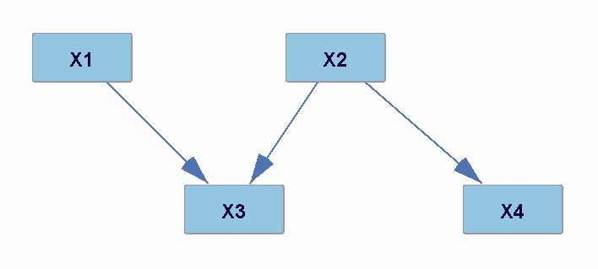
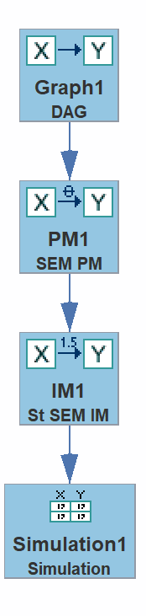
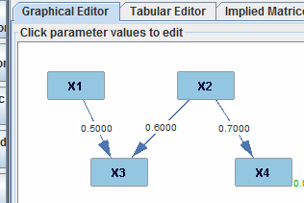
Tetrad Demo and Hands-on
Build the DAG :
Parameterize as a SEM
Add an standardized SEM IM
(as shown to the right)
Generate simulated data N=1000

Slide 65
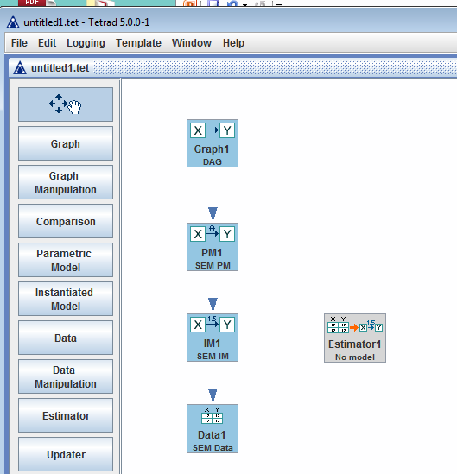
Estimation

Slide 66
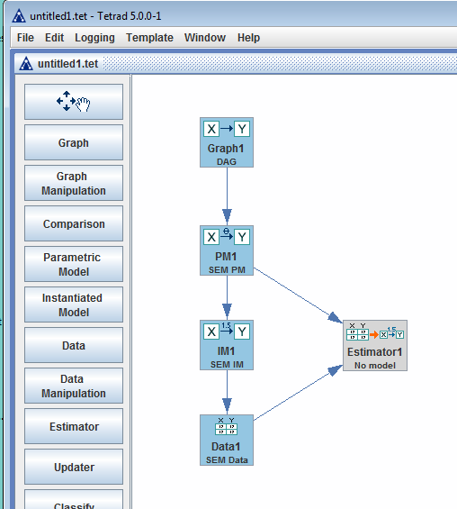
Estimation

Slide 67
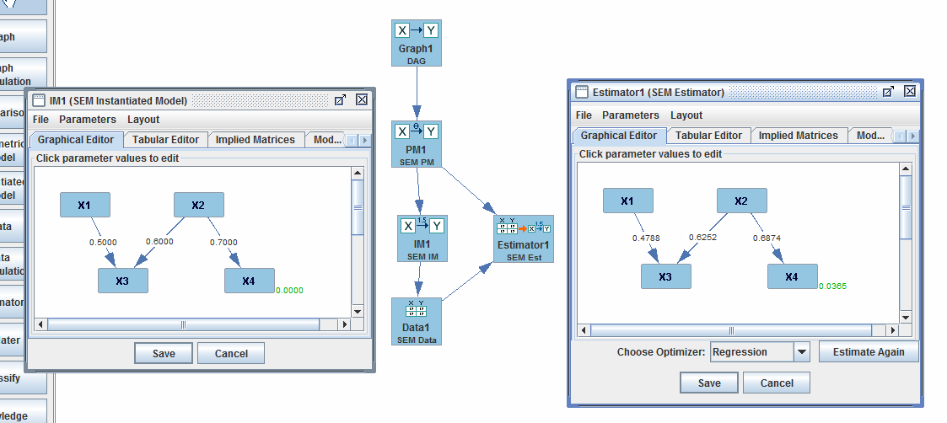
Estimation

Slide 68
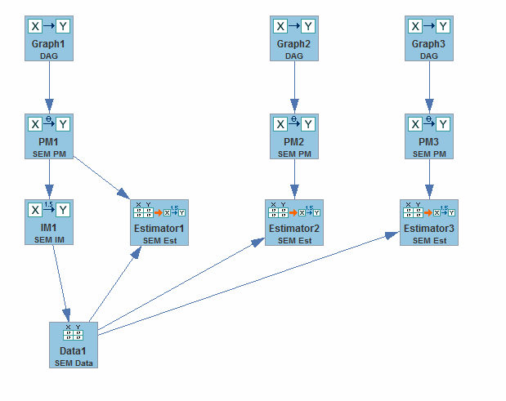
Tetrad Demo and Hands-on
Create two DAGs with the same variables – each with one edge flipped, and attach a SEM PM to each new graph (copy and paste by selecting nodes, Ctl-C to copy, and then Ctl-V to paste)
Estimate each new model on the data produced by original graph
Check p-values of:
  Edge coefficients
  Model fit
Save session as:
“estimation2”

Slide 69
Break

Slide 70
Outline
Motivation
Basics of Causal Graphical Models
Searching for Causal Structure
Examples

Slide 71
Causal Consequences
Testable Statistical Predictions
Causal
Structure
D-separation
Causal Markov Axiom
Causal Graphs
e.g., Conditional Independence
X _||_ Z | Y
∀x,y,z P(X = x, Z=z | Y=y) =
P(X = x | Y=y) P(Z=z | Y=y)

Slide 72
Bridge Principles
Directed Acyclic Causal Graph over V ⇒ Constraints on P(V)
  V₁,V₂ causally disconnected ⇔
  V₁ not a cause of V₂, and
  V₂ not a cause of V₁, and
  There is no common cause Z of V₁ and V₂
  Weak Causal Markov Assumption
  V₁,V₂ causally disconnected ⇒ V₁ _||_ V₂
Notes:
1

Slide 73
Bridge Principles
Acyclic Causal Graph over V ⇒ Constraints on P(V)
  Weak Causal Markov Assumption
  V₁,V₂ causally disconnected ⇒ V₁ _||_ V₂
  General Structural Equation Models
  Causal Markov Axiom
If G is a causal graph, and P is a probability distribution over the variables in G, then <G,P> satisfies the Causal Markov Axiom iff:
Every variable V is independent of its non-effects,
conditional on its immediate causes.
Notes:
1

Slide 74
Bridge Principles
Acyclic Causal Graph over V ⇒ Constraints on P(V)
  Causal Markov Axiom
  Acyclicity
  d-separation criterion
  Causal Graph
  Graphical Independence Oracle
  Z
  Z _||_ Y₁ | X Z _||_ Y₂ | X
  Z _||_ Y₁ | X,Y₂ Z _||_ Y₂ | X,Y₁
  Y₁ _||_ Y₂ | X Y₁ _||_ Y₂ | X,Z
  X
  Y₁
  Y₂
Notes:
1

Slide 75
Model Search
Testable Statistical Predictions
Causal
Structure
Discovery Algorithm
Equivalence Class of Causal Graphs
Conditional Independence
X _||_ Z | Y
∀x,y,z P(X = x, Z=z | Y=y) =
P(X = x | Y=y) × P(Z=z | Y=y)
X
Y
Z
X
Y
Z
X
Y
Z
Notes:
Causation is important because it estimates the effects of possible actions, which can guide which actions we choose to take.
The concept is a general one and includes predicting the response of a cell to a drug, as well as
predicting how a given patient is likely to respond to alternative surgical procedures, for example.

Slide 76
Methods for Learning Causal Graphs from Observational Data
  Constraint-based
  Bayesian

Slide 77
The Constraint-Based Method
  Determine constraints that hold among the nodes (e.g., independence conditions based on statistical tests).
  Evaluate each causal graph (being searched) to determine if it is consistent with the constraints.
  Output the set of causal graphs that are consistent with all the constraints

Slide 78
A Hypothetical Example of the Constraint-Based Method
  Three binary variables X, Y, Z
  The following is known:
  X occurs before Y
  X occurs before Z
  For instance
    X: gene mutation status
    Y: gene expression level
    Z: disease status
  Question: Does Y cause Z?

Slide 79

A Hypothetical Example of the Constraint-Based Method
  Suppose statistical testing yields the following constraints
    dep(X, Y), dep(Y, Z), dep(X, Z), ind(X, Z | Y)
  Consider the consistency of these constraints with respect to the following causal graphs:
X
X
Y
Z
X
Y
Z
H
X
X
Y
Z
X
Y
Z
X
X
Z
Y
H
X
Y
Z
None of them satisfy all 4 constraints
90 additional causal networks

Slide 80
Summary of the Constraint-Based
Causal Discovery Method
  Reduces a large number of causal graph possibilities to just those graphs consistent with the constraints obtained from the data (e.g., from 96 to 3)
  Looks for causal relationships that are common across those graphs (e.g., Y → Z).

Slide 81
A Real Application of the Constraint-Based Method
Epigenome-wide association data implicate DNA methylation as an intermediary of genetic risk in rheumatoid arthritis. Liu Y, Aryee MJ, Padyukov L, et al. Nature Biotechnology 31 (2013) 142-147.
Goal: Determine whether specific sites of DNA methylation causally influence acquiring rheumatoid arthritis

Slide 82
Observational Data
354 ACPA positive rheumatoid arthritis (RA) cases and 337 controls from Sweden
X: SNPs measured with Illumina Human Hap chip
Y: Methylation positions measured with Illumina HumanMethylation450 array
Z: RA status (yes/no)
X
Y
Z

Slide 83
Causal Analysis
SNP array
measurements (X)
Causal
Analysis
Methylation array
measurements (Y)
Causal graphs on the variables
X, Y, and Z
Rheumatoid arthritis
status (Z)

Slide 84
Hypothesis Generation
Candidate methylations that causally
influence RA
SNP array
measurements (X)
Select those X, Y, Z triplets
that have constraints
supporting that Y is an
unconfounded cause of Z
Causal
Analysis
Methylation array
measurements (Y)
Causal graphs on the variables
X, Y, and Z
Rheumatoid arthritis
status (Z)

Slide 85
Candidate Differential Methylation Positions (DMP) that Causally Influence RA
Found 535 SNP-DMP pairs (in the MHC region) that satisfied the four needed constraints on X, Y, and Z
These pairs consisted of 264 unique SNPs and 9 unique DMPs
These 9 DMPs are candidate causes of RA

Slide 86
Experimental Investigation
Experiments
Candidate methylations that causally
influence RA
SNP array
measurements (X)
Select those X, Y, Z triplets
that have constraints
supporting that Y is an
unconfounded cause of Z
Causal
Analysis
Methylation array
measurements (Y)
Causal grahs on the variables
X, Y, and Z
Rheumatoid arthritis
status (Z)

Slide 87
Experimental Details
Evaluated a separate set of patient cases to assess whether methylation differences occurred in these 9 DMPs
Used 12 RA cases and 12 controls
Extracted monocytes from whole blood using flow cytometry
Measured DNA methylation levels using Illumina 450K methylation arrays
Compared methylation levels for the 9 DMPs in cases versus matched controls

Slide 88
Experimental Results
Experiments
Results
Candidate methylations that causally
influence RA
SNP array
measurements (X)
Select those X, Y, Z triplets
that have constraints
supporting that Y is an
unconfounded cause of Z
Causal
Analysis
Methylation array
measurements (Y)
Causal graphs on the variables
X, Y, and Z
Rheumatoid arthritis
status (Z)

Slide 89
Results
All 9 DMPs showed methylation changes in the same direction as in the original analysis
Three of the 9 there were statistically significant at p < 0.05, one at p = 0.06, and one at p = 0.11. (Recall that there were only 12 cases and 12 controls)

Slide 90
Conclusions
Although this reproducibility experiment had a small number of samples, its overall results are consistent with the original study
30% of the DMPs in the reproducibility experiment had statistically significant changes that were in the same direction as in the original study
Additional experimental validation is still needed

Slide 91
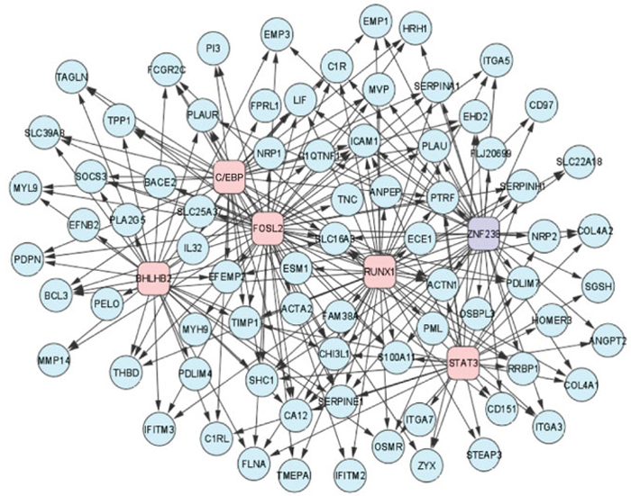
General Constraint-Based
Causal Discovery Algorithms
  They find general patterns of statistical dependency among the measured variables that are consistent with the causal graphs that they output
  They make the following assumptions:
    There is a causal model M that has generated the data
    Independence relationships in M entail independence relationships in the data
    Independence relationships in the data entail independence relationships in M

Slide 92
Outline
Motivation
Basics of Causal Graphical Models
Searching for Causal Structure
Examples

Slide 93
College Plans (Search)
Load in College_plans_data
  Use file: College_plans_data
  Set Variables = discrete
Enter Background Knowledge:
  Tier 1: Sex , SES
  Tier 2: IQ
  Tier 3: pe, cp
Add search node
  Choose FCI (Allow Latent Common Causes)
Add another search node
  Choose FCI (Allow Latent Common Causes)
  Set Bootstrap = 100

Slide 94
Cancer Example
Background
  Cancer
  The Cancer Genome Atlas (TCGA)
  Analysis problem
  FGES algorithm
  Analysis plan
Run Tetrad on prepared data

Slide 95
Estimated New Cancer Cases in U.S. in 2008*
Men
745,180
Women
692,000
Prostate 25%
Lung & bronchus 15%
Colon & rectum 10%
Urinary bladder 7%
Non-Hodgkin 5% lymphoma
Melanoma of skin 5%
Kidney & renal pelvis 4%
Oral cavity 3%
Leukemia 3%
Pancreas 3%
All Other Sites 20%
26% Breast
14% Lung & bronchus
10% Colon & rectum
6% Uterine corpus
4% Non-Hodgkin
lymphoma
4% Thyroid
4% Melanoma of skin
3% Ovary
3% Kidney & renal pelvis
3% Leukemia
23% All Other Sites
*Excludes basal and squamous cell skin cancers and in situ carcinomas except urinary bladder.
Source: American Cancer Society, 2008.
This slide courtesy of Dr. Adrian Lee
Notes:
Now we will turn our attention to the number of new cancers anticipated in the US this year. It is estimated that about 1.4 million new cases of cancer will be diagnosed in 2008. Cancers of the prostate and breast will be the most frequently diagnosed cancers in men and women, respectively, followed by lung and colorectal cancers in both men and in women.

Slide 96
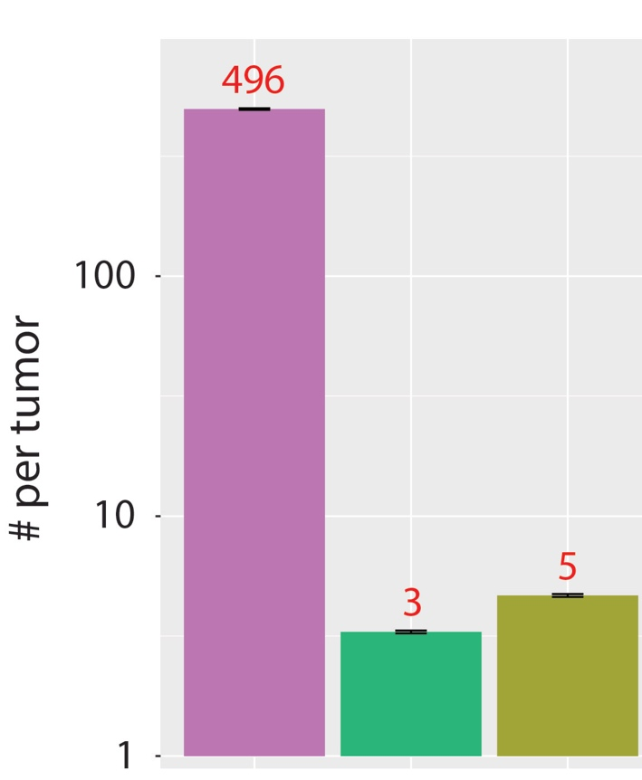
Many Genomic Alterations,
Yet Few Known Drivers
SGAs
Kandoth
Lawrence
Kandoth et al, Nature 502:333, 2013
Lawrence et al, Nature, 505:495, 2014

Slide 97
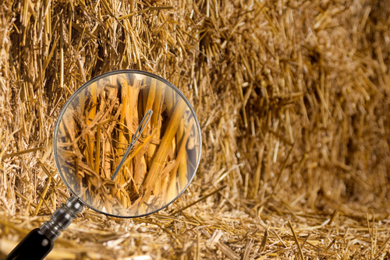
Many Genomic Alterations,
Yet Few Known Drivers

Slide 98
The Cancer Genome Atlas (TCGA)
The Cancer Genome Atlas (TCGA) is the result of a comprehensive and coordinated effort to accelerate the understanding of the molecular basis of cancer through the application of genome analysis technologies, including large-scale genome sequencing.
Launched in 2006 and nearing completion.
The overarching goal of TCGA is to improve our ability to diagnose, treat, and prevent cancer.
To achieve this goal in a scientifically rigorous manner, the National Cancer Institute (NCI) and the National Human Genome Research Institute (NHGRI) used a phased-in strategy to construct the TCGA datasets.
https://wiki.nci.nih.gov/display/TCGA/Introduction+to+TCGA

Slide 99
TCGA: Cancer Types
https://tcga-data.nci.nih.gov/tcga/

Slide 100
TCGA: Cancer Types
https://tcga-data.nci.nih.gov/tcga/

Slide 101
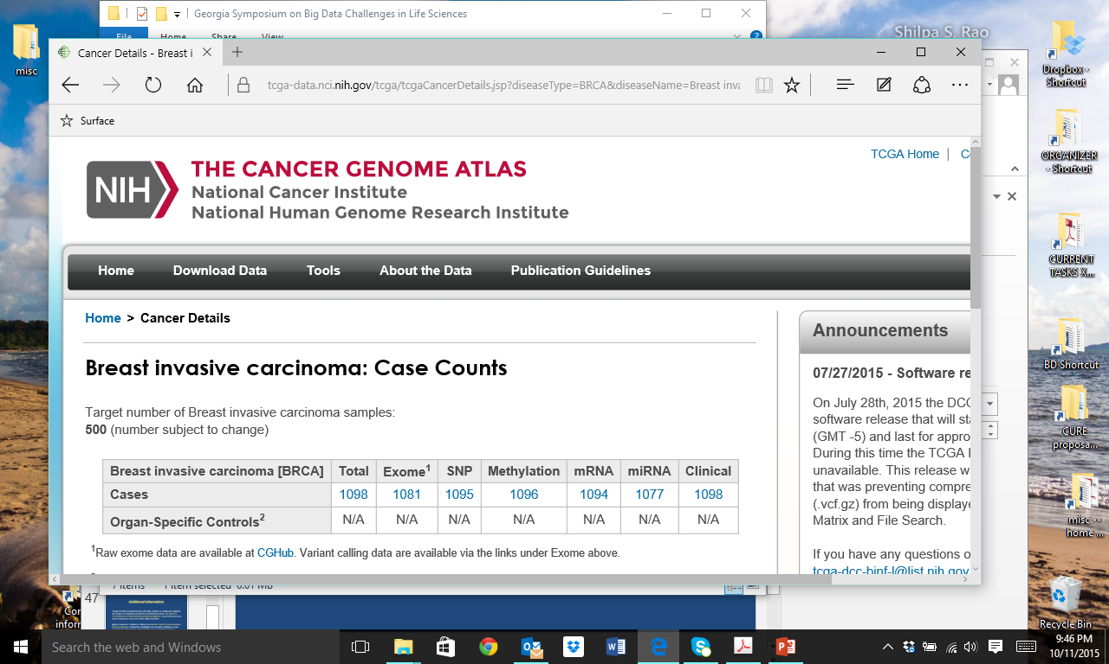
TCGA:
Summary of Types of Breast Cancer Data

Slide 102
The Analysis Problem
Basic framework (assumptions):
  DNA damage → mRNA expression changes → cancerous cells → cancer
  Somatic genomic alterations (SGAs) in DNA are largely responsible for
  initiating cancer
  SGAs cause cancer through differential expression of genes (DEGs)
  Those SGAs that cause DEGs well are good candidates as drivers of
  cancer
Task: Find SGAs that cause the DEGs in breast cancer

Slide 103
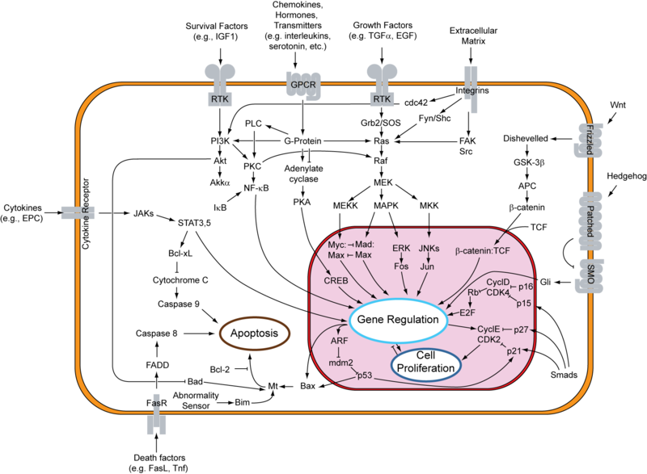
From Drivers to Pathways
Genomic drivers are the root causes of cell signaling pathway activities which control cellular function, including cancerous function
A goal is to develop therapeutic strategies targeting pathways, rather than individual proteins
The Hallmarks of Cancer. D Hanahan and RA Weinberg.
Cell, Vol. 100, 57–70, January 7, 2000.

Slide 104
Search a Bipartite Graph Using the FGES Algorithm
SGA₁
SGA₂
SGA₂
SGA₃
DEG₁
DEG₂
DEG₃
DEG₄
DEG₅
DEG₆
SGA - somatic genomic alteration:
As used here, it indicates both nonsynonymous somatic mutations and copy number alterations; a gene sequence variable is coded as 1 if altered (SGA ) and 0 if not (not SGA).
DEG - differentially expressed gene
It indicates which genes are differentially expressed, relative to a baseline (e.g., normal tissue); a gene expression variable is coded as a 1 if differentially expressed (DEG) and 0 if not (not DEG).
Main assumptions in analyzing causal relationships between SGAs and DEGs:
  DEGs do not cause SGAs
  SGAs and DEGs are not confounded

Slide 105
The Greedy Equivalence Search (GES) Algorithm*
Searches over equivalence classes of Bayesian networks (patterns)
Uses a Bayesian score
It is a greedy algorithm that has a forward stepping phase and a backward stepping phase
If a Bayesian network (BN) is generating the data (and it is a perfect map), GES is guaranteed to find the data generating BN in the large sample limit
FGES is an optimized version of GES
  Optimized for a single processor
  Parallelized to run on multiple processors
* Chickering, D. M. Optimal structure identification with greedy search. The Journal of Machine Learning Research 3 (2002): 507-554.

Slide 106
The Mini-TCGA Breast Cancer Dataset
We created a specialized subset of the TCGA Breast Invasive Carcinoma (BRCA) dataset
  Data sources
  UCSC Xena: https://xenabrowser.net/datapages/
  Broad GDAC Firehose: https://gdac.broadinstitute.org/
  Selected those tumors that have measurements of (1) whole exome, (2) copy number, and (3) gene expression. N = 851 tumors.
  Variables are SGAs and DEGs
    SGA = 1 if non-synonymous mutation or dramatic copy number alteration (GASTIC score); otherwise 0.
    We selected 6 SGAs that are well known breast cancer drivers*
    DEG = 1 if expression more than 2 SD from mean of normal-cells distribution; otherwise 0.
    We selected 60 DEGs that are most frequently regulated by the SGAs according to the TCI algorithm.**
* Bailey MH, et al. Comprehensive Characterization of Cancer Driver Genes and Mutations. Cell 173 (2018) 371-385.
** Cooper G, Cai C, Lu X: Tumor-specific Causal Inference (TCI): A Bayesian Method for Identifying Causative Genome Alterations
within Individual Tumors. bioRxiv 2017.

Slide 107
Mini-TCGA Data Analysis Plan
Load the mini-TCGA data into Tetrad
Add background knowledge that constrains the search to a bipartite graph from SGAs to DEGs
Apply FGES to the dataset, given the background knowledge
View the causal network that is generated

Slide 108
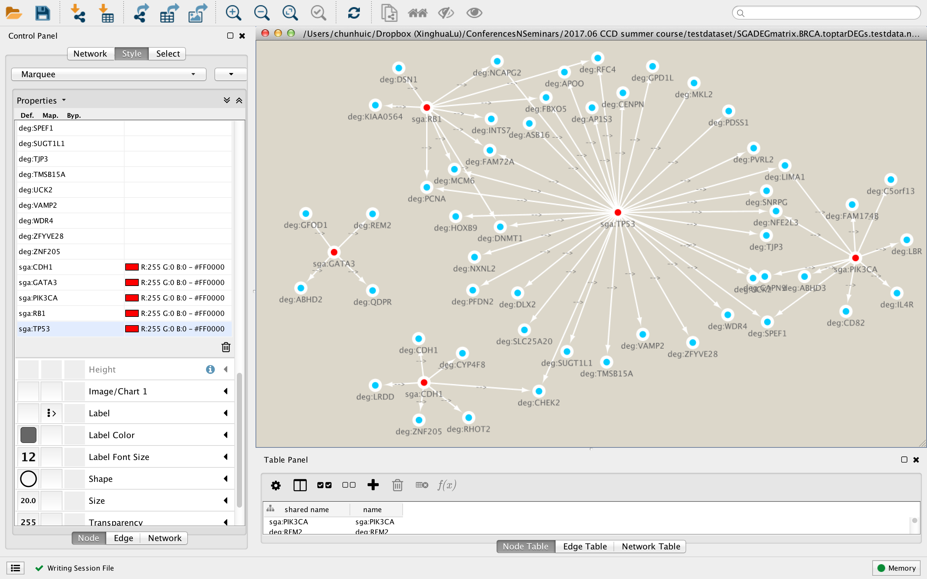
Viewing the Network in Cytoscape*
* https://bd2kccd.github.io/docs/cytoscape-tetrad/

Slide 109
Summary and Pointers

Slide 110
Summary
Representing causal systems
  Causal Graphs
  Interventions
  Causal Bayesian Networks (attach probabilities)
Derive testable predictions/constraints
Causal Markov Axiom & d-separation
Search
  Generate causal structure hypotheses via search
  Determine causal structures consistent with testable constraints
Notes:
Build 2 causal graphs - one for smoking, yf, lc

Slide 111
Pointers
Training
Software
Literature
Conferences

Slide 112

Training and Software
www.ccd.pitt.edu

Slide 113
Suggested Readings
Lagani V, Triantafillou S, Ball G, Tegner J, Tsamardinos I.
Probabilistic computational causal discovery for systems biology.
In: Uncertainty in Biology: A Computational Modeling Approach.
Editors: Geris L, Gomez-Cabrero D (2016, Springer).
[Find via Google Scholar using the title.]
Pearl J, Glymour M, Jewell NP. Causal Inference in Statistics: A Primer (2016, John Wiley & Sons).

Slide 114
Selected Conferences
Conference on Uncertainty in Artificial Intelligence (UAI)
http://www.auai.org/
Conference on Artificial Intelligence and Statistics
https://www.aistats.org/aistats2018/
Neural Information Processing (NIPS) Conference
https://nips.cc/Conferences/2018/Schedule
Conference on Probabilistic Graphical Models (PGM)
http://pgm2018.utia.cz/

Slide 115
Acknowledgements
  The Center for Causal Discovery (CCD) is supported by grant U54HG008540 awarded by the National Human Genome Research Institute through funds provided by the trans-NIH Big Data to Knowledge (BD2K) initiative (www.bd2k.nih.gov).
  The content of this presentation is solely the responsibility of the authors and does not necessarily represent the official views of the National Institutes of Health.
  Thanks to Dr. Chunhui Cai and the CCD Cancer Group for help in developing the breast cancer example.

