Slide 1
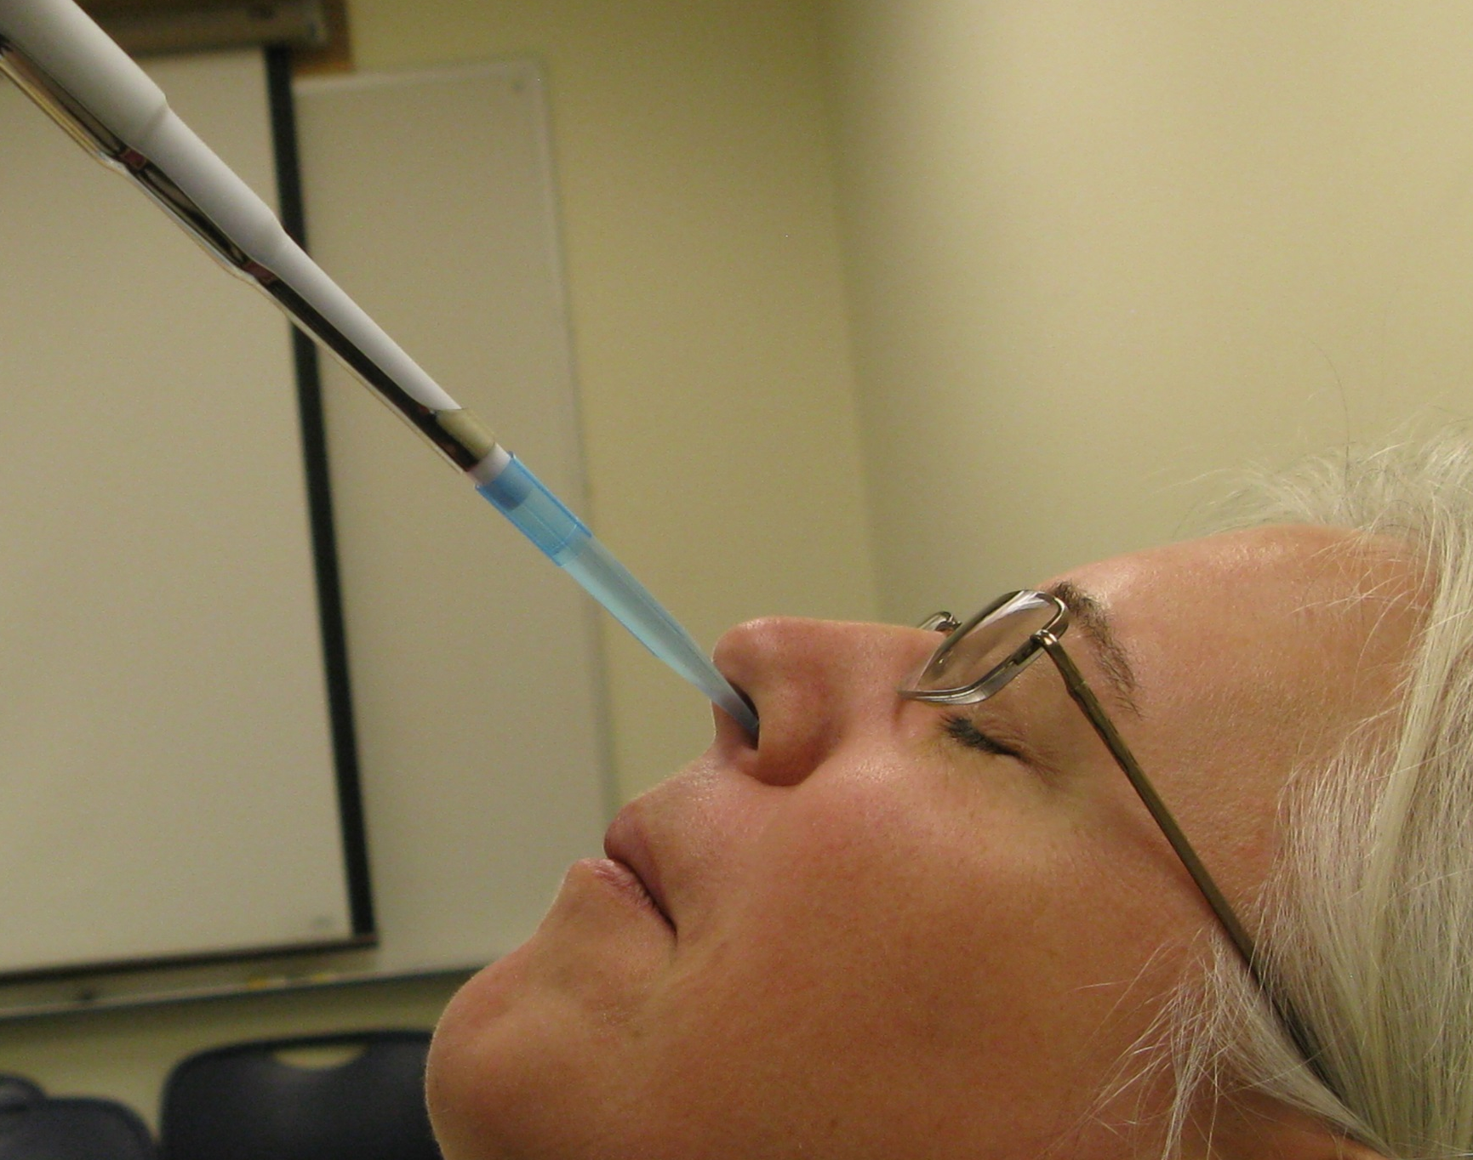
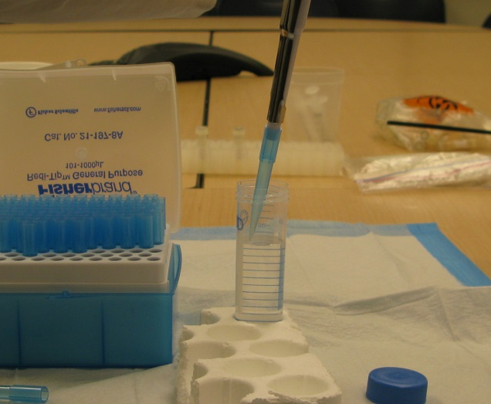
Inoculation with Challenge Virus
Laboratory for the Study of Stress, Immunity and Disease

Slide 2
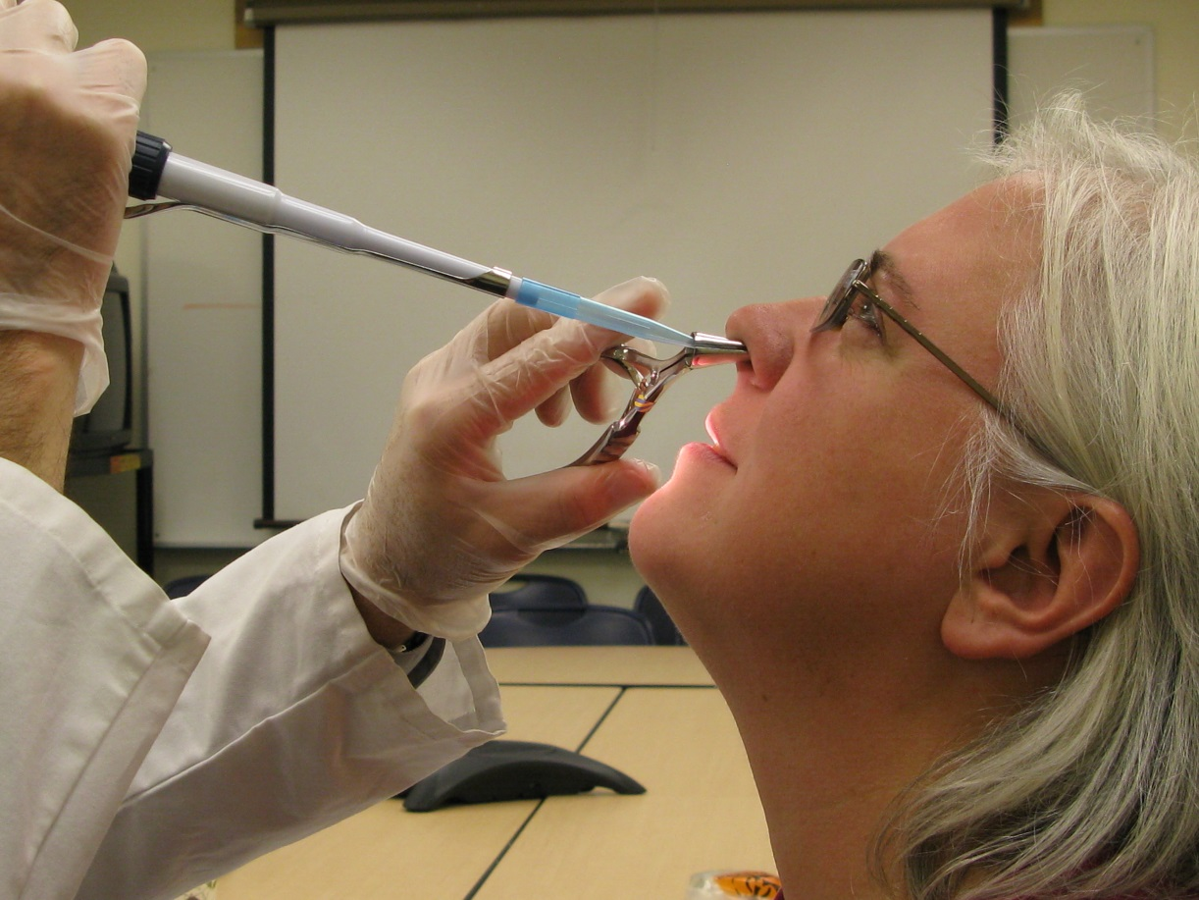
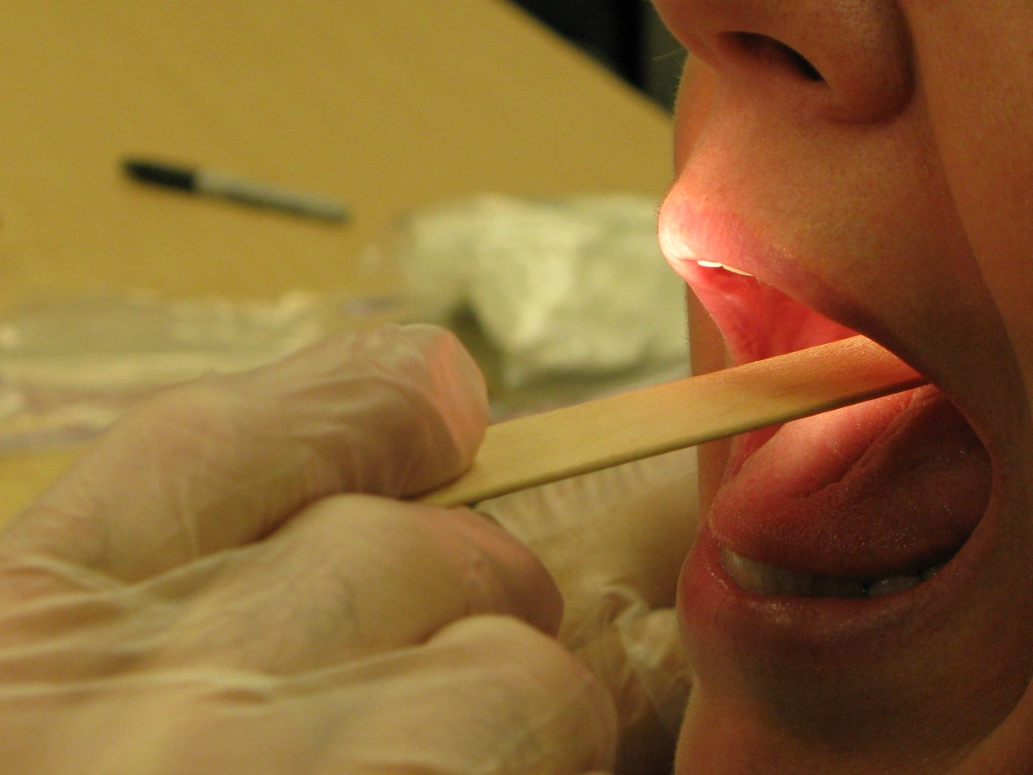
Nasal Mucociliary Clearance
Laboratory for the Study of Stress, Immunity and Disease

Slide 3
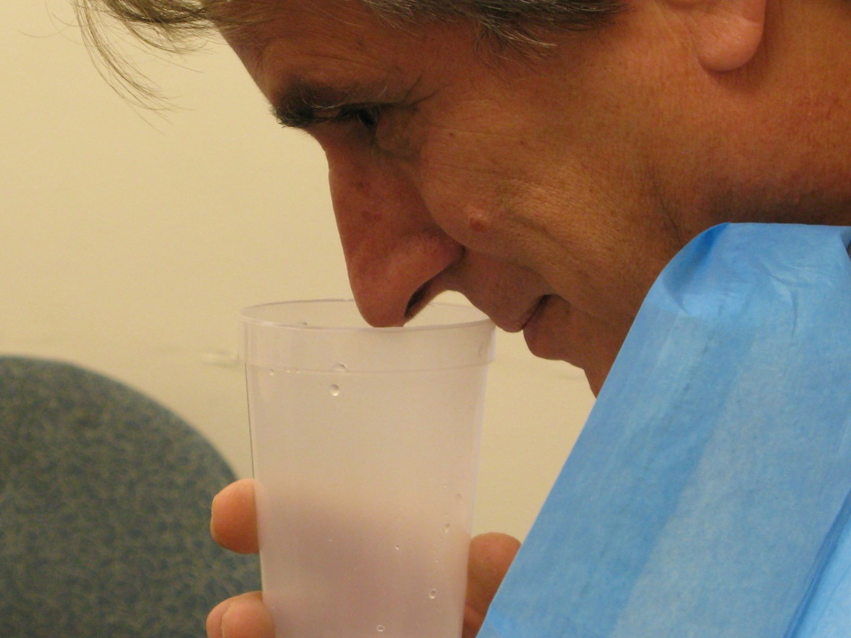
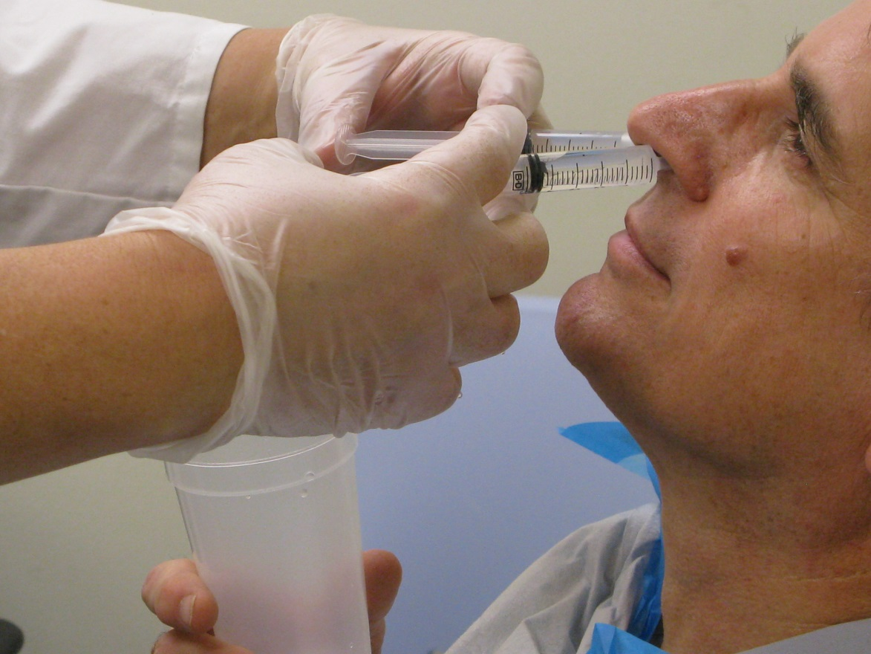
Nasal Wash
Laboratory for the Study of Stress, Immunity and Disease

Slide 4
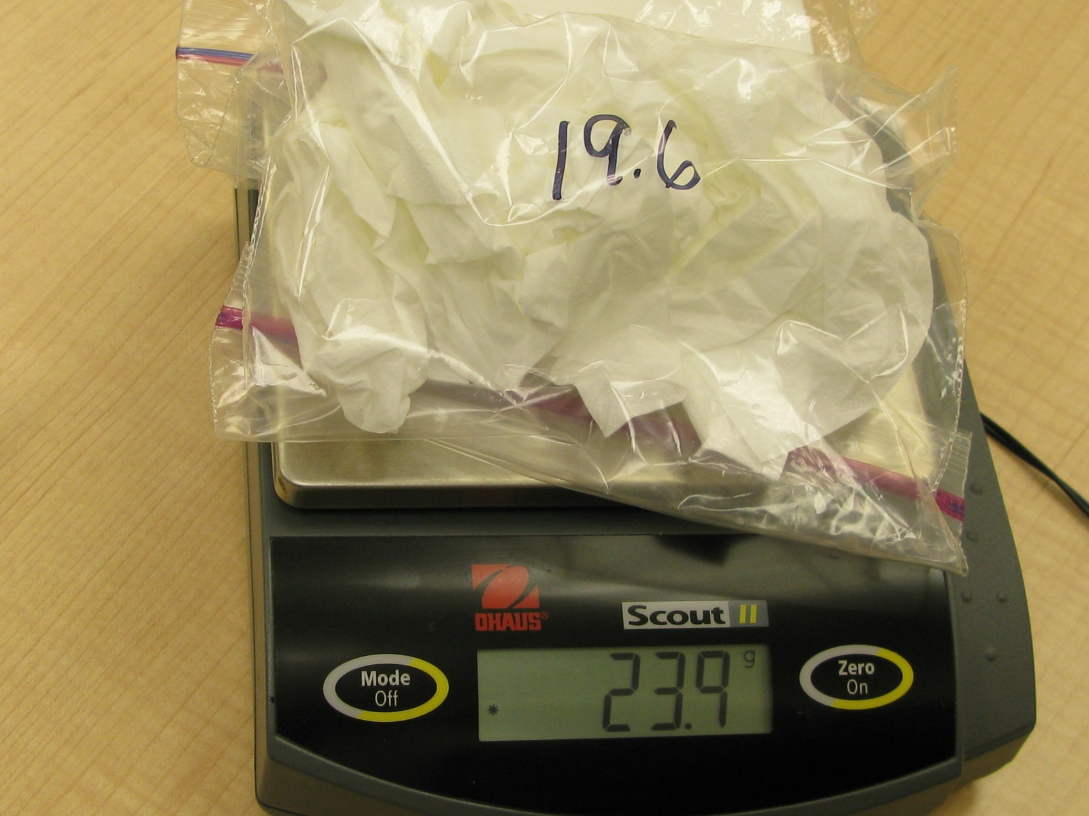
Nasal Mucus Weights
Laboratory for the Study of Stress, Immunity and Disease

Slide 5
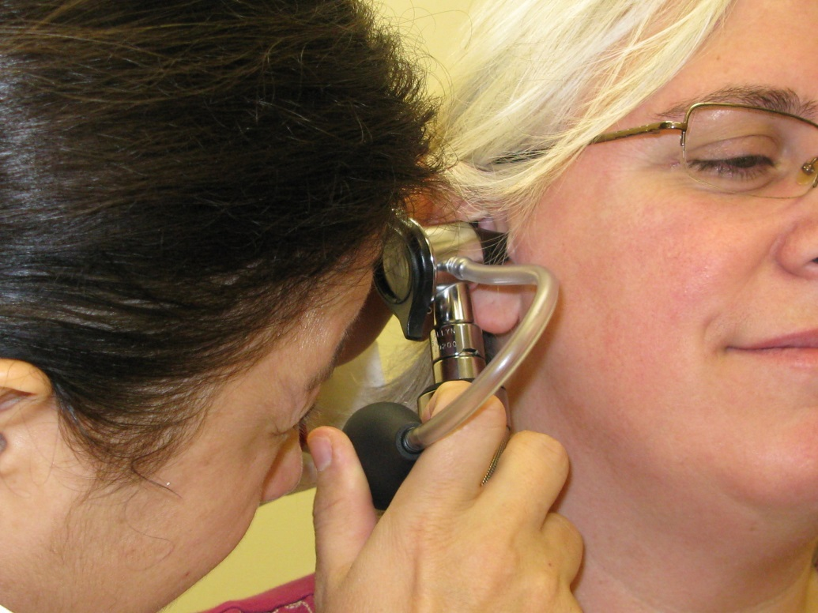
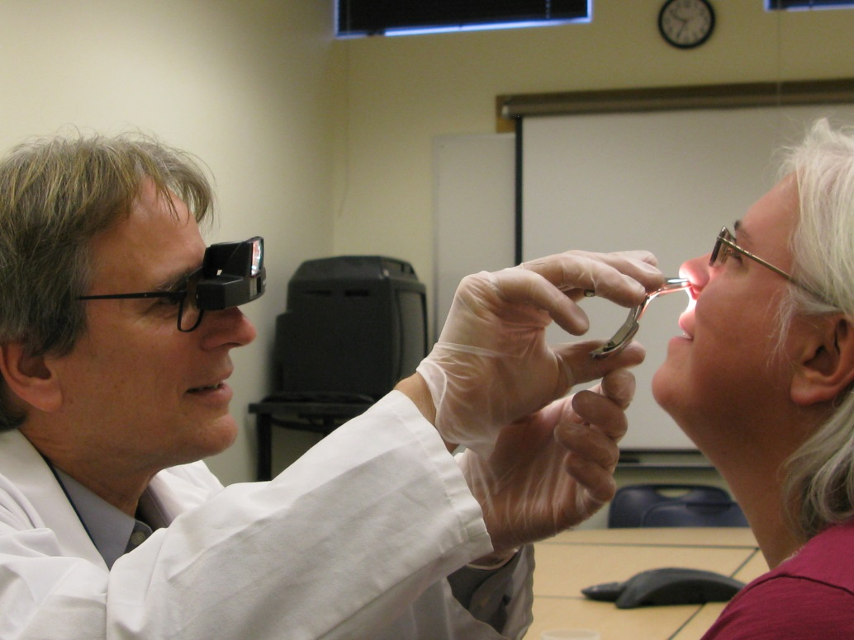
Ear, Nose, and Throat Exam
Laboratory for the Study of Stress, Immunity and Disease

Slide 6
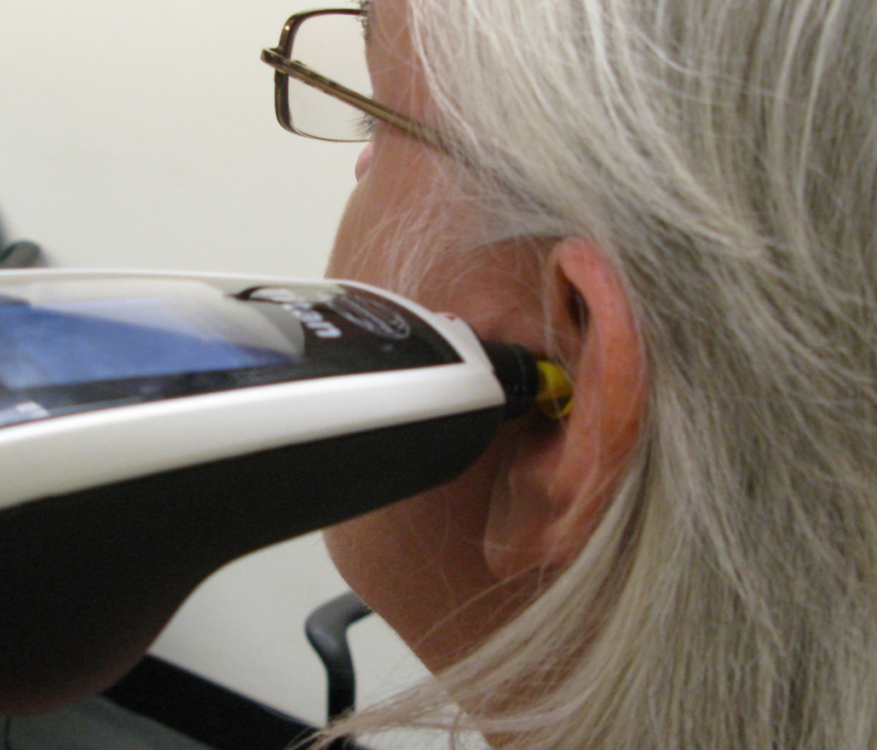
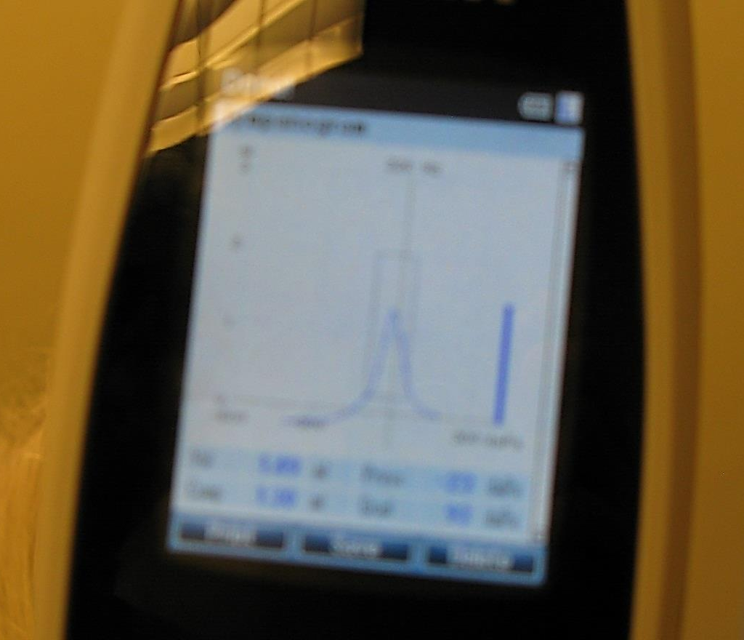
Tympanometry
Laboratory for the Study of Stress, Immunity and Disease

Slide 7
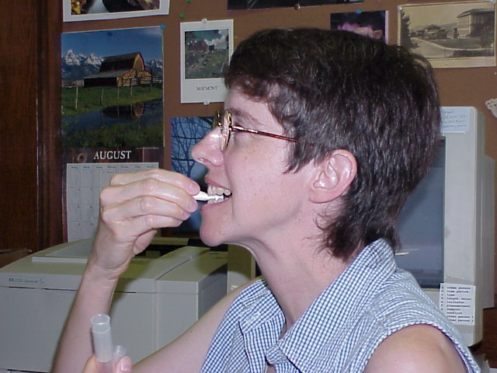
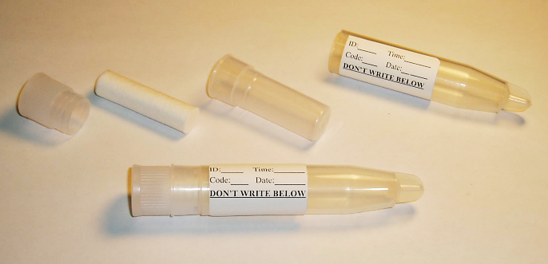
Salivary Cortisol
Laboratory for the Study of Stress, Immunity and Disease

