Slide 1
Thermodynamics
Calorimetry: The Experimental Measurement of Heat

Slide 2
Outline
Background
Exothermic vs Endothermic Reactions
Heat Capacity
Specific Heat
Specific Heat of Selected Substances and Mixtures
Relevance

Slide 3
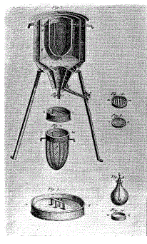





Background
Thermodynamics: Study of interactions among work, energy, and heat
Calorimetry: Experimental measurement of heat
How did they first measure heat?
Antoine Lavoisier (1782)
World’s first ice-calorimeter
Published in his book
“Elements of Chemistry”

Slide 4
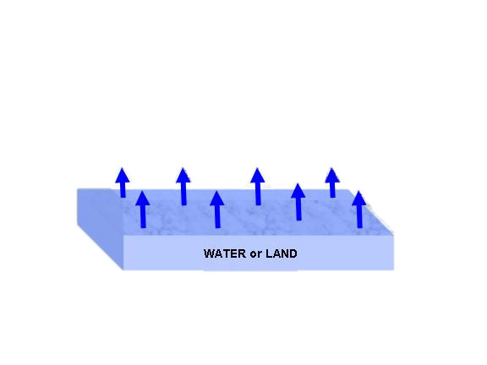
Exothermic vs. Endothermic Reactions
Exothermic
Endothermic
Reaction that gives off heat
to its surroundings
  A candle flame
  Burning sugar
  Rusting iron
  Making ice cubes
  Forming bonds
Reaction that absorbs heat
from its surroundings
  Forming cation from atom in gas phase
  Producing sugar by photosynthesis
  Cooking an egg
  Melting ice cubes
  Breaking bonds
Pop Quiz!
Is evaporation of water H₂O (l) → H₂O(g) an endothermic or exothermic reaction?
Notes:
It’s endothermic because hydrogen bonds break during phase transition to form a gas state if it were an exothermic process, you will overheat after you sweat instead of cooling down

Slide 5

Heat Capacity
Objects differ in their abilities to transform heat transfer into temperature change
  Heat Capacity (denoted by letter “C”)
    Measurement of the amount of heat required to change a substance’s temperature by a certain amount
C = q
ΔT
An object has a heat capacity of 57.5 J/K.
If its temperature changes from 150.4ºC to 121.8ºC, how much heat is transferred?
C= Heat Capacity (J/K)
q= quantity of heat transferred
ΔT= temperature change
-1,640 J
1640 joules of heat are released by the object
Notes:
Δελτα Τ= 121.8δεγρεεσ Χ− 150.4 δεγρεεσ Χ = −28.6 δεγρεεσ Χελσιυσ = −28.6 Κ
Χ= θ / δελτα Τ
Θ= Χ δελτα Τ = 57.5ϑ/Κ ∗ −28.6 Κ = −1,640 ϑ

Slide 6
Specific Heat
Heat capacity per unit mass
  Specific Heat (denoted by letter “C_{p}”)
    Measurement of the amount of heat required to change a substance’s temperature by a certain amount
C_{p}=C = q
m mΔT
Calculate the heat absorbed by 50.0 g of Cu(s) as it changes its temperature from 300 K to 500K.
C= Heat Capacity (J/ g K)
q= quantity of heat transferred
m= mass
ΔT= temperature change
3,850J
3850 joules of heat are absorbed by Cu(s)
Notes:
Cp= C/m = q/m delta T
Q= Cp m delta T = (0.385 J/ g K) (50.0g) (200 K ) = 3,850 J

Slide 7

Specific Heats of Selected Substances and Mixtures
Substance | Cp (J/g K)
Ag(s) | 0.235
Al (s) | 0.897
Au(s) | 0.129
Ca(s) | 0.647
CaCO₃ (s) | 0.920
Cu(s) | 0.385
Fe(s) | 0.449
H₂O (s) | 2.06
H₂O (l) | 4.19
H₂O (g) | 2.02
Cp(Ag) < Cp (H2O)
Cp (metal ) < Cp (nonmetal)
Small specific heat= substance translate heat transfer to relatively large temperature change

Slide 8
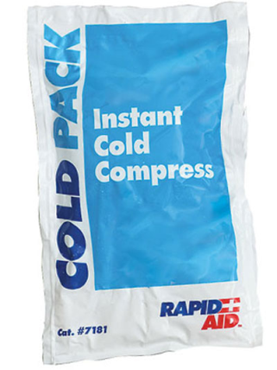
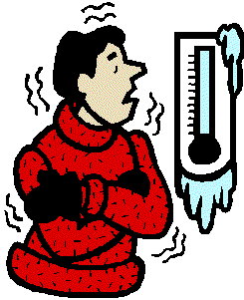
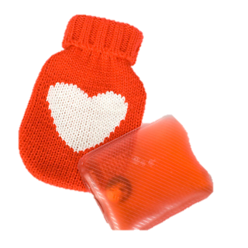
Relevance
How do these work?

