Slide 1

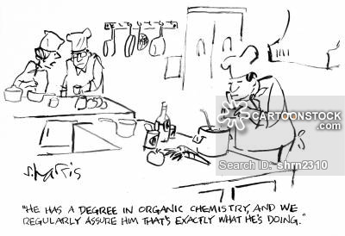


Edible Emulsions

Slide 2
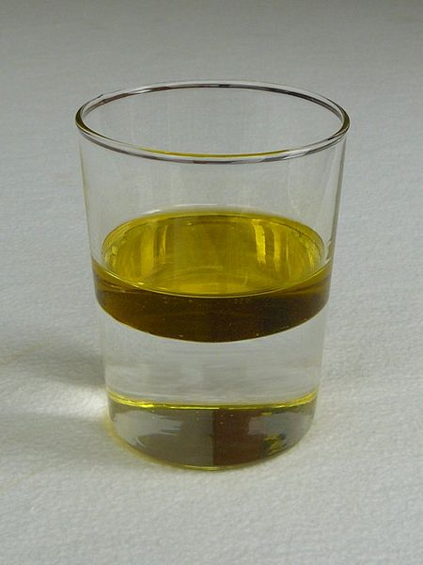
“Water and oil don’t mix.”

Slide 3
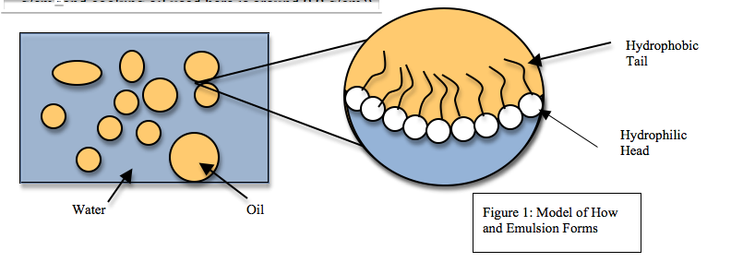
“Water and oil don’t mix” – at a microscopic level
Water is polar.
Oil often contains one polar end and one non-polar end.
It is favorable to organize the molecules such that the polar water molecules are interacting with the polar ends of the oil, and not the non-polar ends.

Slide 4
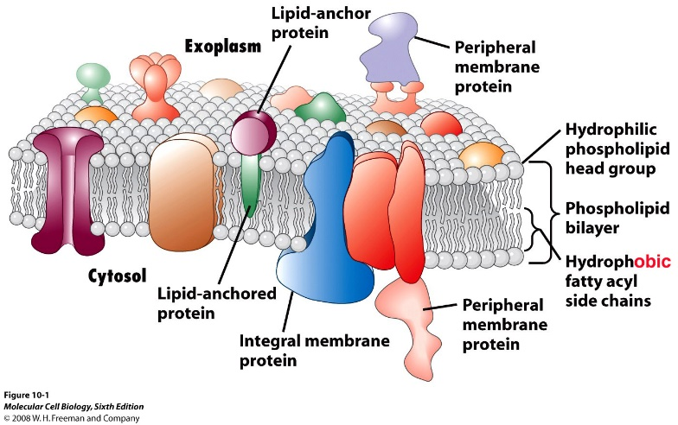
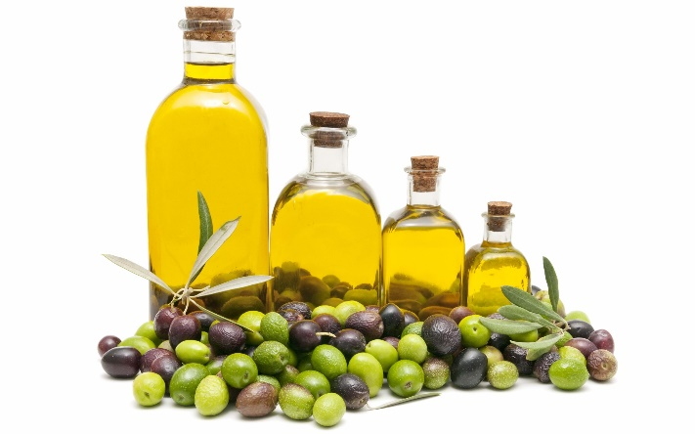


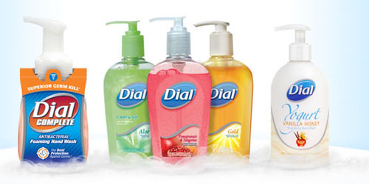
Oil and its family are essential components of life
Biological system
  Lipid bilayer Cellular membrane
  Blood-brain barrier
Everyday tools
  Detergent/cleaning tools
  Energy/fuel source
  cooking

Slide 5
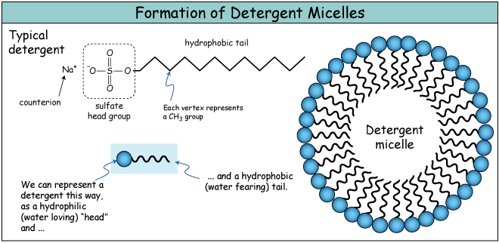
How does detergent/soap remove dirt and oil from clothing/skin?
As detergent is applied, an emulsion of oil (or other nonpolar organic compounds) and water is formed.
The hydrophobic ends in detergent trap the nonpolar compounds inside.
The outside of detergent miscelles is hydrophilic; this along with other hydrophilic dirts can be washed off with water.

Slide 6
Food and other everyday examples of emulsions
 |  | Dispersed phase (droplets, bubbles, particles)
 |  | Gas | Liquid | Solid
Continuous phase | Gas | Gas/gas mixture (air) | Liquid aerosol (deodorant spray, vegetable oil spray, fog/clouds, sneeze) | Solid aerosol (powder fire extinguisher, smoke, asthma inhaler)
 | Liquid | Foam (meringue, whipped cream, soap foam) | Emulsion (mayonnaise, butter, vinaigrette) | Suspension (fruit juice, drinking chocolate, milk, paint, tooth paste)
 | Solid | Solid foam (bread, foam rubber, pumice) | Gel (jelly, cheese, boiled egg, meat, vegetable- and fruit flesh) | Solid suspension (coloured plastic, granite)

Slide 7
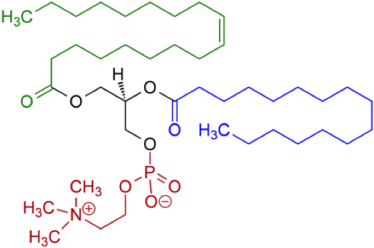
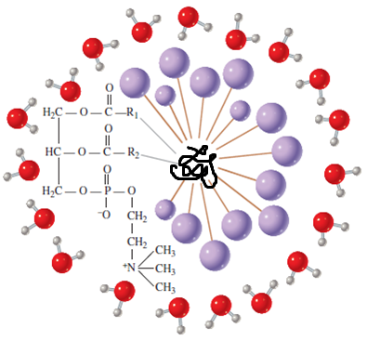
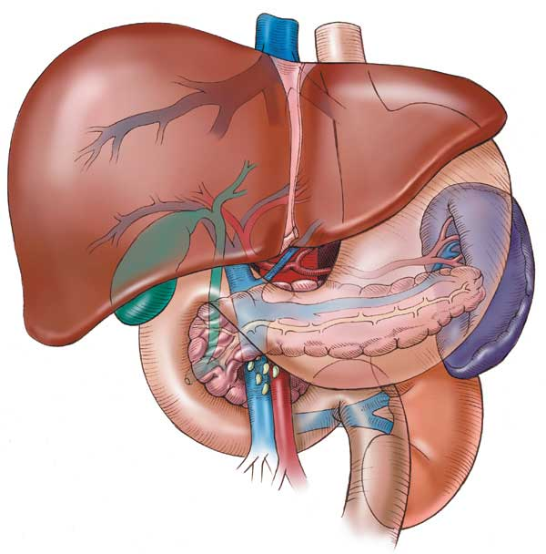
“Melting” gum with chocolate!? How does it work?
Polyene – the basic component of the gum base
Lecithin in chocolate
Break down by saliva
Polyene
Metabolism

Slide 8
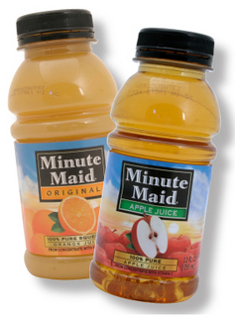
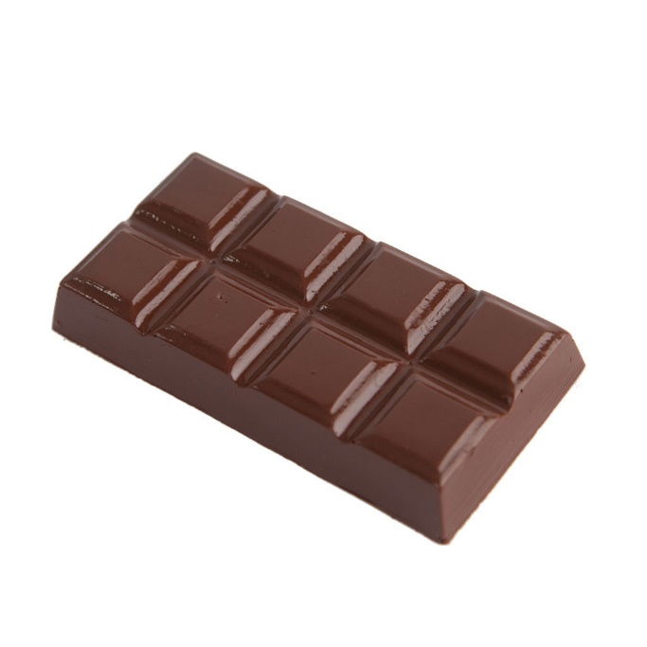
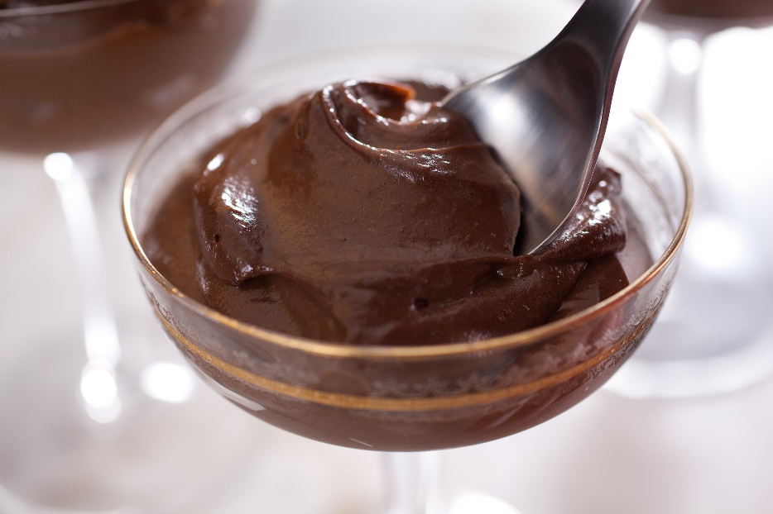
Chocolate Chantilly – How does it work?!?!

Slide 9
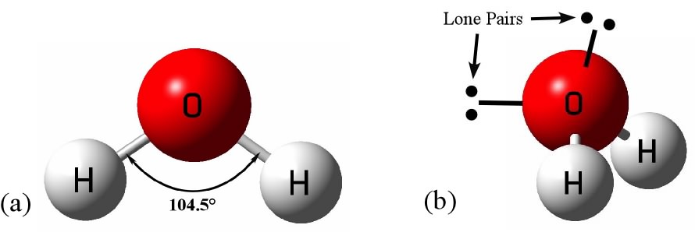
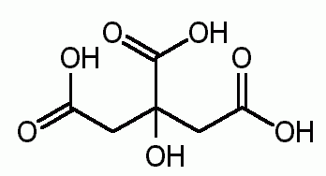
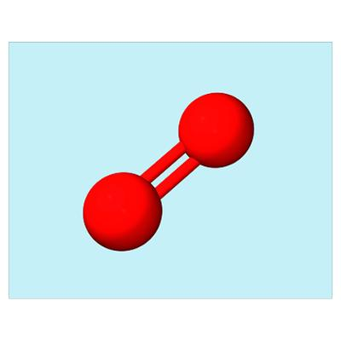
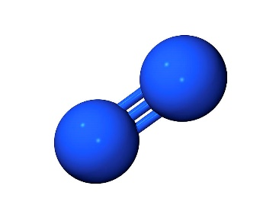
Main ingredients of each component
Chocolate Bar
Juice
Lecithin (Amphiphilic, i.e. contains both polar (hydrophilic) and nonpolar (hydrophobic) regions)
Water (Polar)
Citric Acid (Polar/ionic)
Air molecules (N₂, O₂)

Slide 10
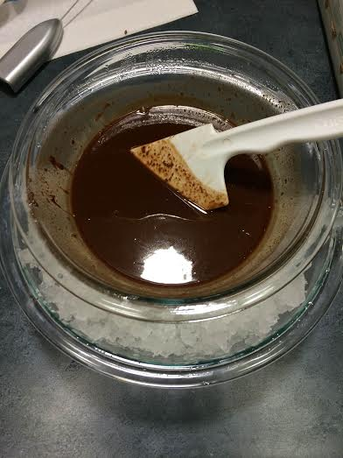
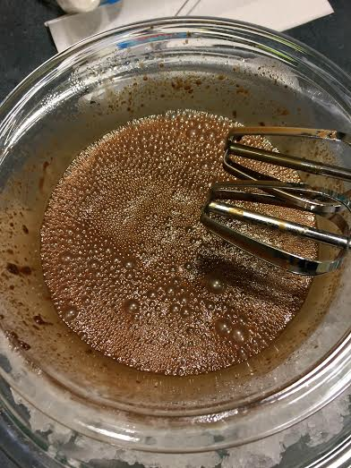
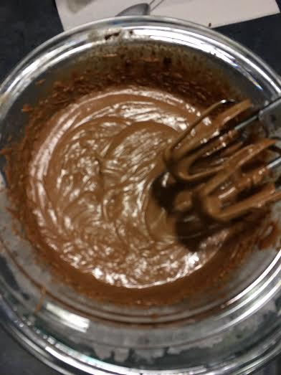
Chocolate Chantilly – the procedure

Slide 11
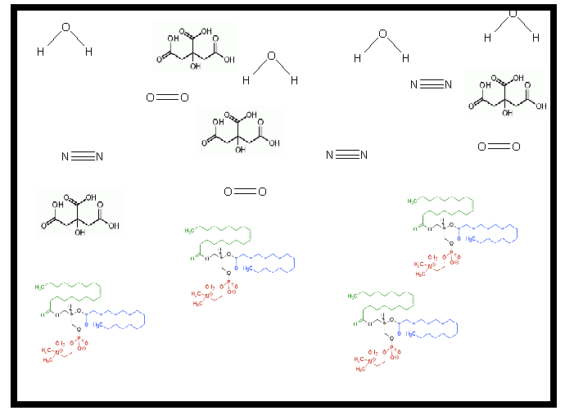
Melt chocolate/juice mixture in high temperature
The mixture is still heterogeneous, i.e. compounds within are not well mixed.
Inside the bowl: chemical compounds are not mixed.

Slide 12
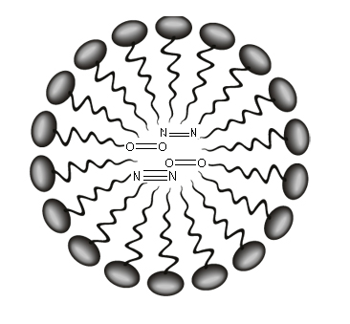
When the mixture is mixed thoroughly, lecithins aggregate due to hydrophobic interaction.
Since air molecules (e.g. N₂, O₂) are non-polar, they are trapped within the hydrophobic sphere formed by lecithins.
As a result, bubble forms

Slide 13
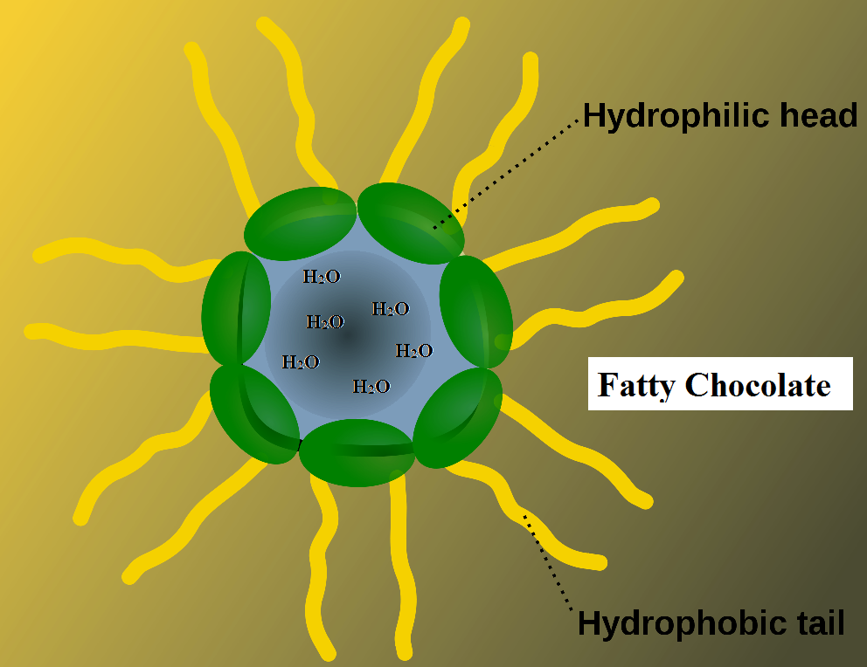
After thorough mixing, the gas molecules are released and the bubbles disappear.
The hydrophilic ends of lecithin form around water and citric acid molecules.
Chocolate Chantilly is ready!!

Slide 14
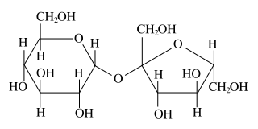
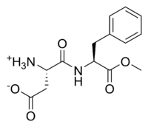
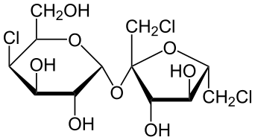
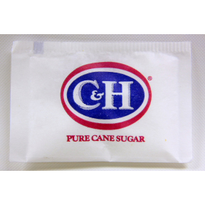
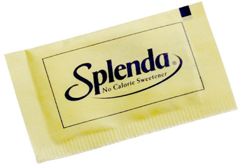
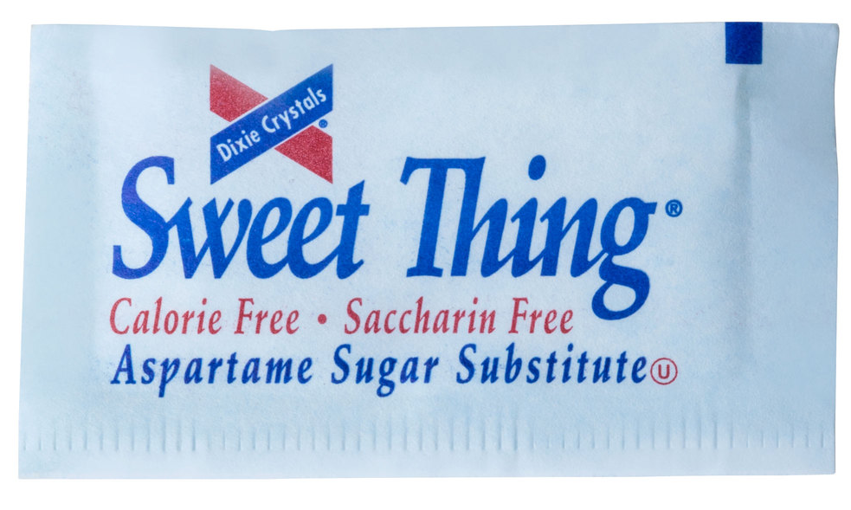
Your everyday sweeteners
Sucrose
Aspartame
Sucralose

Slide 15
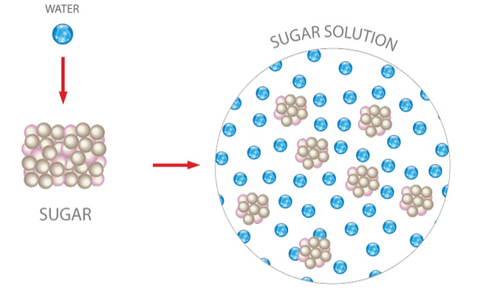
What are the factors in determining solubility?
Temperature
  Higher temperature increases solubility, and vice versa.
Solvent
  More polar solvents, such as water, dissolve the polar sucrose better.
  Less polar solvents, such as acetone (nail polishing), dissolves sucrose not as efficiently.
Functional groups on the molecule
  Different functional groups on a molecule can affect the polarity, and therefore the solubility.
Sucrose
Sucralose

Slide 16
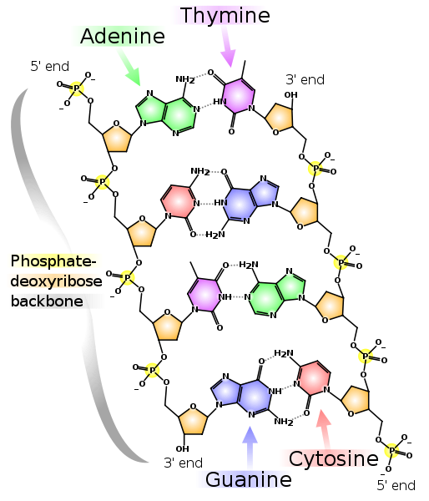
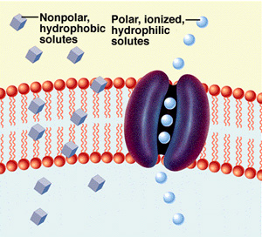
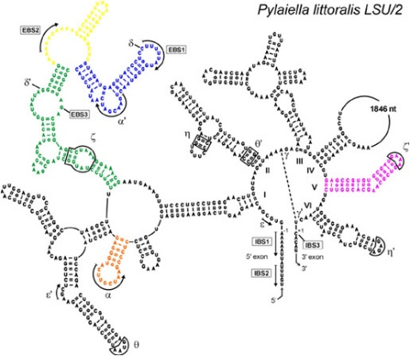
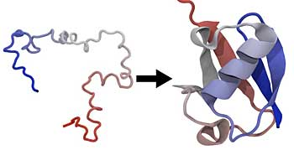
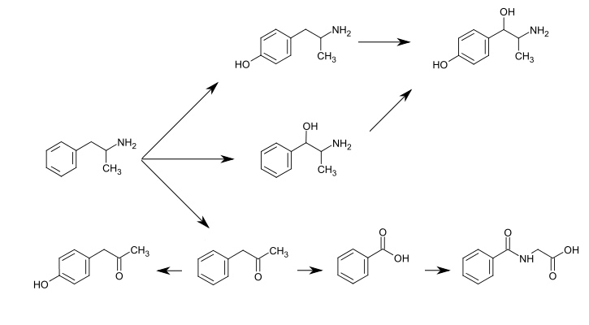
Impact in the Biological System
Nucleic acid and protein folding due to hydrophobic/ hydrophilic effects – their structures have significant contributions to their functions!
O₂ gas can diffuse readily into cells without help.
Metabolism of Amphetamine, a medicinal compound targeting the central nervous system. As shown in the diagram, more hydrophilic groups are added to the parent compound during metabolism in order to facilitate excretion of the drug from the body.

Slide 17
References
http://cdn.shopify.com/s/files/1/0387/2401/products/bar-solid-dark_ade26d20-29bb-4e23-b425-f3e6439363b5_1024x1024.jpg?v=1404319914
http://www.chowstatic.com/assets/recipe_photos/29197_vegan_chocolate_mousse.jpg
http://s3.amazonaws.com/rapgenius/Minute-Maid-Juice1.jpg
http://images.fineartamerica.com/images-medium-large/nitrogen-molecule-dr-tim-evans.jpg
http://upload.wikimedia.org/wikipedia/commons/e/e5/Citric_acid_structure.png
http://images.cpcache.com/merchandise/514_400x400_NoPeel.jpg?region=name:FrontCenter,id:68913273,w:16
https://tnrtb.files.wordpress.com/2013/05/figure-1.jpg
http://upload.wikimedia.org/wikipedia/commons/thumb/1/1a/Micelle_scheme2-en.svg/2000px-Micelle_scheme2-en.svg.png
http://www.biologycorner.com/resources/membrane_transport_01.jpg
http://www.bnl.gov/today/body_pics/2012/07/protein-fold-350px.jpg
https://farm3.staticflickr.com/2821/11235182875_7567f5f052_m.jpg
http://www.cgm.cnrs-gif.fr/IMG/jpg/figure1_bis.jpg
http://www.bio.miami.edu/tom/courses/protected/MCB6/ch10/10-01corrected.jpg
http://oliveoilexplorer.com/wp-content/uploads/2012/12/Olive-Oil.jpg
http://cdn.wonderfulengineering.com/wp-content/uploads/2014/05/What-is-Petroleum-Engineering-6.jpg
http://www.washinghands.net/images/dial-liquid-hand-soap.jpg
http://www.minimus.biz/images/F08-0106700-1100bg.jpg
http://www.savingeveryday.net/wp-content/uploads/2011/05/splenda.jpg
http://www.webstaurantstore.com/images/products/extra_large/63359/351472.jpg
http://www.funkidslive.com/wp-content/uploads/2012/08/Kitchen-Chemistry.jpg
http://lowres.cartoonstock.com/food-drink-chemist-chemistry-organic_chemist-degree-qualification-shrn2310_low.jpg

