Slide 1
Cost-effective transmission, co-optimizing with customer renewable demand, and improving efficiency
CEDM CEIC Seminar
Jennie Chen, WRI, ReGrid
May 4, 2022

Slide 2
Abstract
The U.S. is about to ramp up electric transmission buildout, and that's good news generally for clean energy. However, the way we plan transmission in relation to generation and load could be co-optimized, the efficiency of the grid itself could be improved, including reducing losses from various transmission components, and siting could better use existing rights of ways to mitigate impact to communities, sensitive environmental areas and cultural heritage sites. Further, transmission equipment itself could be improved to avoid leaking gases that are tens of thousands times greater than CO2 in global warming potential. What are some of the regulatory and other changes we could implement to better incentivize efficiency in building out power system infrastructure? We will discuss the problems and some ideas, some of which will be published in upcoming whitepapers with R Street Institute and the Clean Energy Buyers Institute.

Slide 3
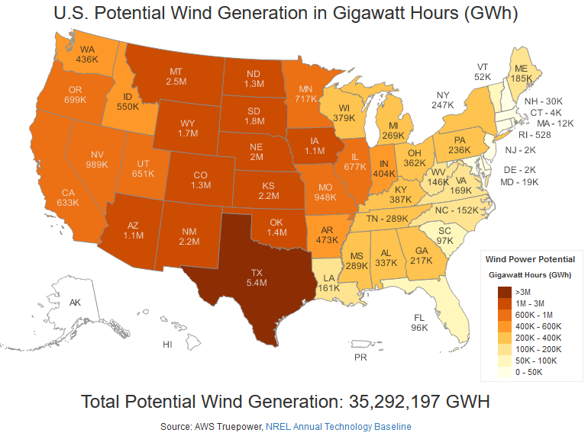
Large-scale renewables need to reach customers via transmission
https://windexchange.energy.gov/maps-data/321

Slide 4
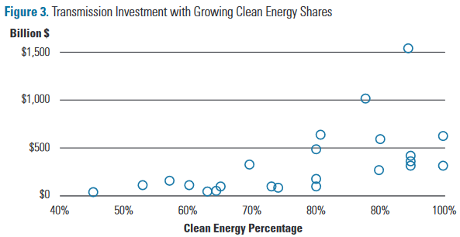
How much will transmission cost?
Independent estimates indicate that to meet our growing clean electricity demands, we’ll need to expand transmission systems by 60% by 2030 and may need to triple those systems by 2050.
https://www.energy.gov/policy/queued-need-transmission

Slide 5
Administration recognizes need, has goals to facilitate transmission
Building a Better Grid Initiative: catalyze the nationwide development of new and upgraded high-capacity electric transmission lines, as enabled by Bipartisan Infrastructure Law
Identify national transmission needs and support the buildout of long-distance, high voltage transmission facilities that are critical to reaching President Biden’s goal of 100% clean electricity by 2035 and a zero emissions economy by 2050.
https://www.energy.gov/oe/building-better-grid-initiative

Slide 6
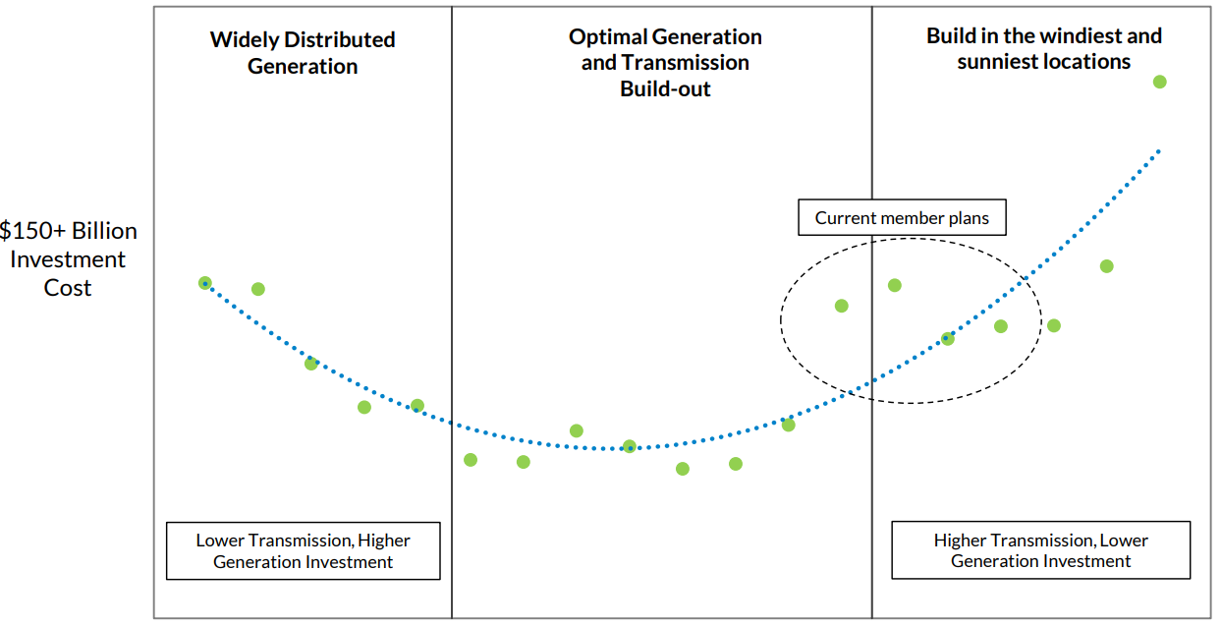
Where to site generation, transmission and large load?
Building where it’s windiest and sunniest not necessarily least cost because transmission is expensive
September 2020 – MISO System Planning Committee of the Board of Directors,
https://cdn.misoenergy.org/20200915%20System%20Planning%20Committee%20of%20the%20BOD%20Item%2007%20Long%20Range%20Transmission%20Planning473488.pdf

Slide 7
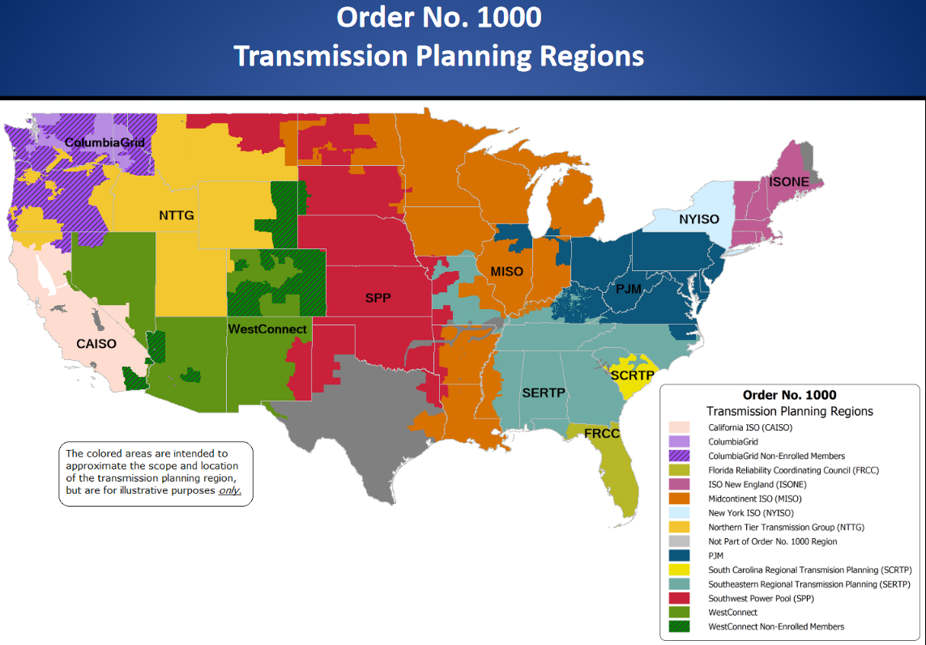
Transmission planning today
FERC in charge of ensuring wholesale electricity rates are reasonable
Open access to transmission on a regional basis needed to fulfill this mandate
FERC Orders 890 and 1000 require open regional transmission planning with method of allocating costs

Slide 8
Cost-of service rate recovery not good for efficiency
More efficient tech:
Grid Enhancing Technologies: can direct flow of power, provide information that can increase flows
Non-Transmission Alternatives: reducing or shifting load through EE, DR, storage, DERs
Advanced conductors (lower line losses, higher capacity, can use same ROWs)
SF6-free: https://www.regrid.net/home/the-current-blog/sf-in-infrastructure
How can we encourage the uptake of these technologies?

Slide 9
Siting, permitting, land-use issues
Extremely contentious, landowner, environmental, cultural heritage, EJ concerns
Leverage existing transmission ROWs as well as others ROWs
E.g., SOO Green: HVDC Link will be built along an operating railroad from the Mason City, Iowa area to the Chicago area. https://www.soogreenrr.com/construction/
How can we encourage using existing ROWs? Incorporate siting risks earlier in planning phase.
Related process and timing issues – how to balance addressing stakeholders concerns with building clean energy projects at speed and scale needed to accomplish policy goals?

Slide 10
Related processes: load forecasting
Long term load forecasts determine future generation capacity and transmission needs
But does not flag demand that is renewable
In regions with capacity markets, the increased load may lead to more gas build and not more transmission build to access renewables
Need a way to tag renewable or other specific generation needs

Slide 11
Some ideas for solutions
Regulatory incentives
FERC incentives, performance-based rates
Mandates
DOE authority to set appliance efficiency standards => grid efficiency standards
Best available tech
Set standard and force tech development?
https://www.nrdc.org/experts/jennifer-chen/lost-transmission-worlds-biggest-machine-needs-update
Planning reform – FERC Order 1000
https://www.ferc.gov/news-events/news/ferc-issues-transmission-nopr-addressing-planning-cost-allocation
Still needs interregional planning and means of accounting for corporate renewable demand
Mapping Tools – ANL Energy Zones Mapping tool (https://ezmt.anl.gov/)
Includes environmentally sensitive areas, cultural heritage sites
Should enable stakeholders to supplement data
Should update with EJ Screen, existing ROWs suitable for transmission
Should use it early as part of transmission planning process

