Slide 1
Monetizing Commercial and Industrial Assets in Demand Side Energy Markets
Dailey Tipton – VP & GM PJM

Slide 2


AGENDA
Introduction – Dailey Tipton
CPower History
Demand Response Overview
  How big is it?
  What is the outlook?
CPower and PJM
What is the next horizon for Demand response in PJM?
How does the emergence of Microgrid’s impact the DR Market?
Q&A
CPowerEnergyManagement.com | 844-276-9371

Slide 3

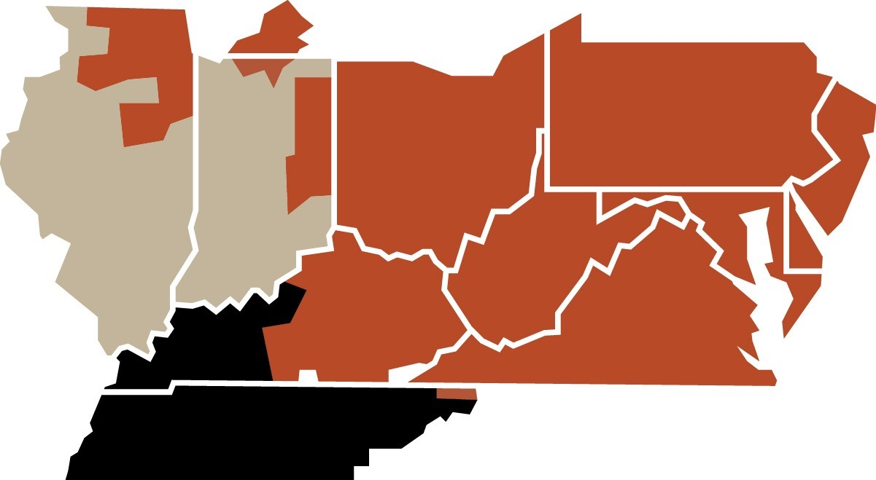














Dailey Tipton
Vice President and GM, PJM

Slide 4



Who is Cpower?
123 dedicated employees
North American experience. Local expertise.
44+ demand-side programs
3,500 MWs enrolled
15+ utility programs
1,400+ customers, across 9,000 sites
Demand-side solutions including: energy efficiency, generator analysis
End-to-end, in-house, full service operations, dispatch and fulfillment
Trusted by several states as the CSP of record for demand side management
DR aggregator and certified Energy Efficiency M&V provider
Experienced Demand-side Energy Management Solutions for your industry
Notes:
Russ

Slide 5







Our history
2014 – CPower is formed when Comverge and Constellation formed the independent demand management company
2015 – CPower Acquires Demand Response Partners a NY-based demand response company
2016 – CPower Acquires Energy Connect from JCI, growing its customer and team expertise in the CA and PJM markets. CPower is now one of the largest demand side management companies in the US
2017 – CPower acquires eCap Networks, expanding its EE measurement and verification capacity in PJM
2018 – CPower announces expansion into IESO in Ontario, making it the largest demand side only service provider in North America with more than 1,500 customers at over 9,000 sites
Built on the Best
Experience & Expertise
Notes:
Russ

Slide 6












C&I Demand Side resources to generate and maximize revenues from grid operator and utility programs
Grid Operators / Utilities
CPower
C&I Customers
CPower has a nationwide reach serving major grid operators and utilities in the United States:
Customer energy assets are optimized and made available to the grid through CPower
MWs MWs
CPower serves over 1,400 unique
C&I customers and 8,950 sites
Grid Operator / Utility Needs
Customer Resources
CPower delivers an optimized set of customers to meet the ISO and Utilities needs for the grid
CPower finds customers and monetizes their energy assets
$ $
Grid Operator/Utility Pays CPower
CPower maintains a facilitation fee
CPower pays the customer remainder
Lower long-term peak demand Solutions: Capacity DR and distributed generation
Correct short-term grid imbalances Solutions: Fast-Acting DR and distributed generation
Permanent reduction in electricity demand
Solutions: Energy efficiency and distributed generation
Flexible and targeted demand reduction by geography
    Solutions: All DERs
Demand response
Energy efficiency
Distributed generation:
SOURCE: CPower management

Slide 7


The total addressable market will grow ~11.7-13.0% p.a. through 2030, with breakout growth opportunities in DG/EE and flexibility services
ISO Capacity DR Utility DR Flexibility services for balancing renewables
International ISO DR DG / EE
17-30 Market CPower’s total addressable market (TAM), $Mn (nominal) ’17-’30 CAGR % growth ($Mn)
4,540-5,270¹
4.1-6.3%²
275-475
670-870
+11.7-13.0% p.a.
275-305
5.5-6.5%
140-170
545
2,635-3,025
5.2%
265
540-700
175-205
2,300
420
18%³
2,030
1,080
395
1,200
14%⁴ 750-1,250
135
280
750 – 1,250
270
300 - 500
2017 2023 2030
Reflects 2023-2030 growth, as this is a new market segment
The range shown here reflects the impact of $200M from short duration load capacity aggregation and $500M in the uncertainty of flexibility services market size
The range shown here reflects the $200M from short duration load capacity aggregation. Seasonal aggregation ($40M of revenue) is included in the base forecast of $670M 3 DG/EE section here includes generator sets
4 Represents 2023-2030 estimated CAGR
SOURCE: NERC; ISO estimates

Slide 8








Competitors
Now
Notes:
8
Overview of three programs:
Emergency
Day-Ahead Economic
Real-Time Economic

Slide 9
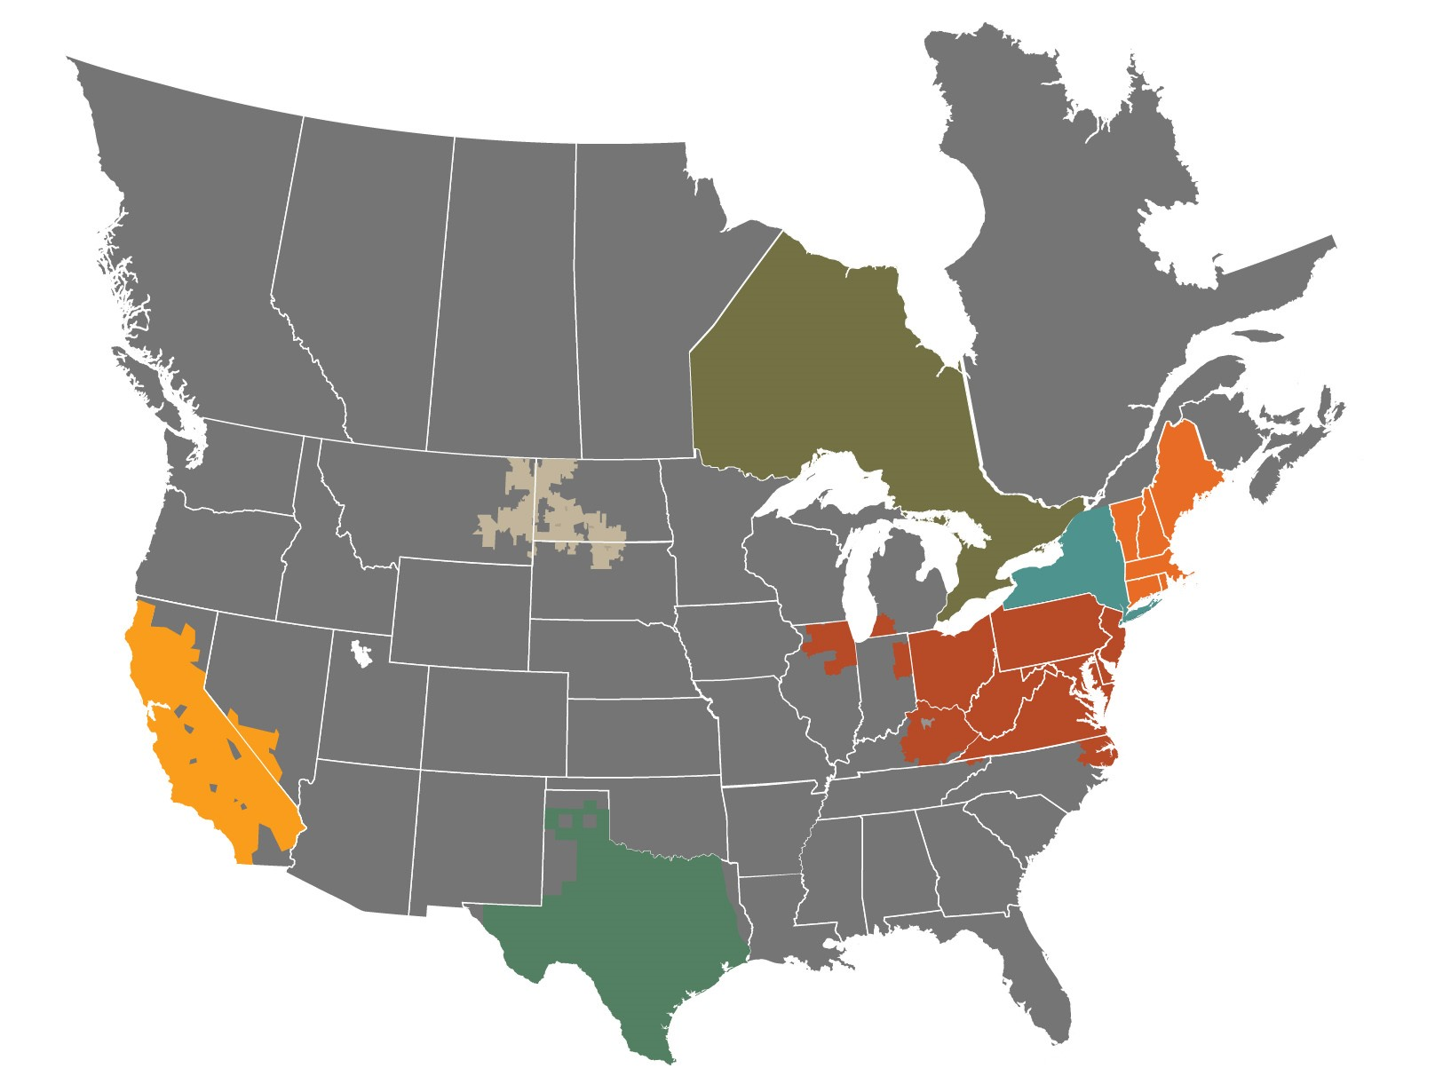

VALUES BY MARKET
NY | Gross Value (Per MW-Yr)
Capacity | $20K - $90K
Utility | $27,5K - $180K
Ancillary | $50K
DR-related rebates | $800K /MW (50% cap)
Energy Efficiency | $14K - $31K
IESO | Gross Value (Per MW-Yr)
Capacity | ~ $70K - $85K
ISO-NE | Gross Value (Per MW-Yr)
Capacity | $35K - $132,960K
Economic | $44/MW-hr
Winter Reliability | $3K - $5K
Energy Efficiency | $84K
NGrid | $20K + >$15K
MISO/MDU | Gross Value (Per MW-Yr)
Capacity | $30K - $50K
PJM | Gross Value (Per MW-Yr)
Capacity | $14,998-82,278K
Ancillary | $20-$30K
Economic | $17K (~200-hrs)
Utility (PA) | $16,800 - $24K
Energy Efficiency | $14K - $31K
CAISO | Gross Value (Per MW-Yr)
Capacity
a. BIP (PG&E) | $96K - $108K
b. DRAM (SCE) | Proprietary
c. CBP (PG&E, SCE, SDG&E) | $55,850 - $71,390
LCR | $109K
ERCOT | Gross Value (Per MW-Yr)
Capacity | $55K
Ancillary | $95K
Utility | $31,5 - $40K
Municipal | Varies by Muni

Slide 10
TYPES OF ENERGY PROGRAMS
Demand Response Programs: Programs designed to balance grid load in response to anticipated excess of demand or unanticipated loss of supply. In contrast, permanent programs offer savings and incentives for permanent reductions in load.
Permanent
Responsive
Payments made for responses to peak energy curtailment
KW
KW
0
Hours in the day
24
0
Hours in the day
24
Energy Efficiency
Capacity > Excessive Demand
Ancillary > Loss of supply
Economic > Price Initiated
Utility > Local programs

Slide 11

PJM MARKET OVERVIEW
PJM
First and largest of the open energy markets in the US
Serving 13 states + DC.
65 million people served
More than 176,500 MWs of generation capacity
82K miles of transmission.
Major demand-side energy management programs are available in PJM:
Emergency Capacity
Energy Efficiency
Economic, Synch Reserve
Frequency Regulation
PLC Management
2020/2021, summer DR programs will exit the market and the only capacity product will be Capacity Performance (CP)
The capacity market in PJM is dictated by market prices and auction mechanisms
Notes:
Russ

Slide 12
PJM AUCTION MECHANISMS
Reliability Pricing Model (RPM)
Base Residual Auction (BRA)
Conducted to allow for the procurement of resource commitments to satisfy the PJM region’s capacity forecast for the Delivery Year and allocates the cost of those commitments to Load Serving Entities (LSEs) through a Locational Reliability Charge.
An RPM Base Residual Auction for a Delivery Year is typically held during the month of May, three years prior to the actual Delivery Year.
Incremental Auction (IA)
3 auctions allow PJM to make adjustments due to reliability requirement and market changes as well as allow participants to make adjustments to their capacity commitments.
Notes:
Russ

Slide 13
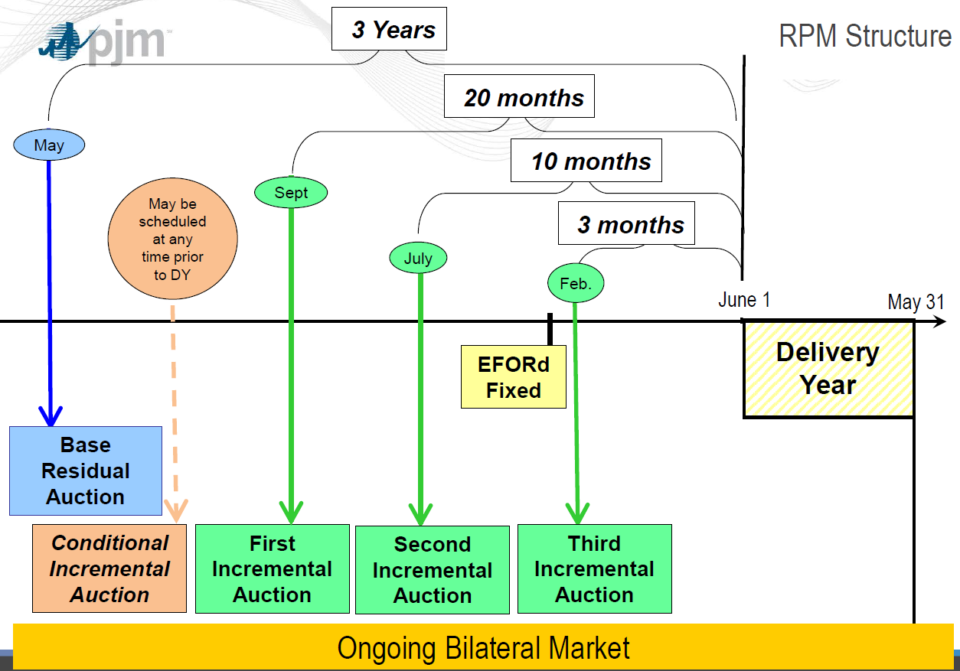
RPM - Timeline
Notes:
13
Overview of three programs:
Emergency
Day-Ahead Economic
Real-Time Economic

Slide 14
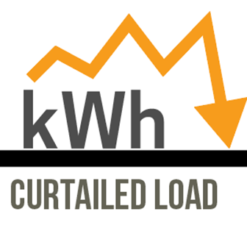
FACTORS EFFECTING PJM AND DR
2014, Polar Vortex – PJM seeks year round reliability
CP comes into the market in 16/17 with a goal 60-70%, 80-90% up to 100% by 2021
Summer only Capacity DR is not offered in 2021
Cleared DR varies YOY (fluff DR), but DR participation is NOT dropping off for actual enrolled amounts (~9,300 MW avg since 2013).
Notes:
Russ

Slide 15
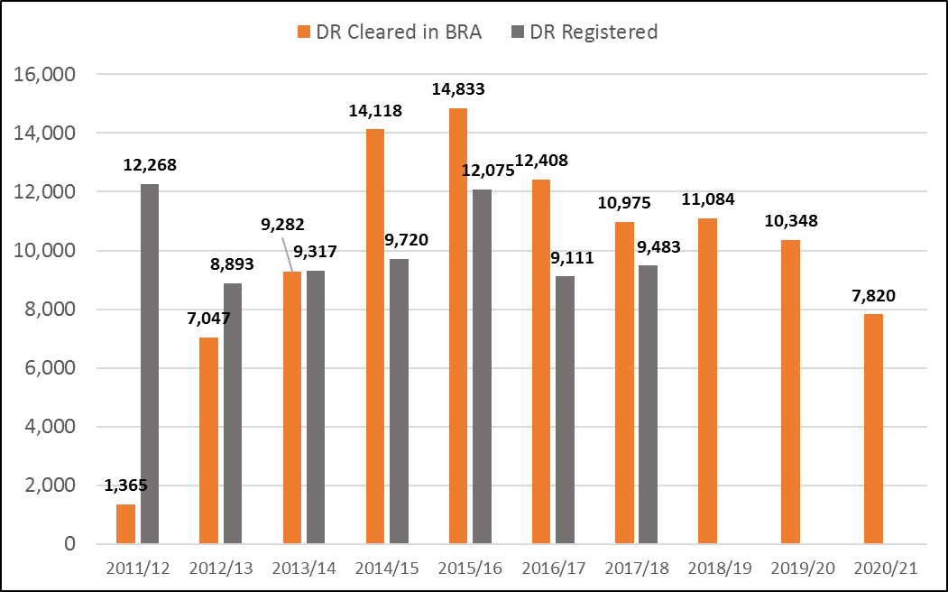
PJM AUCTION RESULTS
Base Residual Auction (BRA) in MWs
Notes:
Russ

Slide 16
PJM AUCTION RESULTS
DR BRA capacity price changes overtime
Notes:
Russ

Slide 17

BRIEF OVERVIEW: PJM PROGRAMS
Capacity:
  Base
  Capacity Performance
Energy Efficiency
Economic Load Response
Synchronized Reserves
Frequency Regulation
Peak Load Contribution (PLC) Management
Utility Programs
  PA Act 129: PennPower, West PennPower, MetEd, PECO, PPL
Notes:
Russ

Slide 18
Economic DR – Participation Requirements
Participate in both the Day-Ahead and Real-Time Economic Energy Markets
If a Day-Ahead Demand Response offer clears in the market, the associated resource will be obligated to perform during that operating hour. Any excess curtailment capability not selected in the Day-Ahead market may participate in the Real-Time market.
A Customer Baseline Load (CBL) is used as a proxy for what the load would have been absent load reduction. A default CBL is calculated for weekdays, Saturdays, and Sundays/holidays, but an Alternative CBL may be used if approved.
Each CBL must be certified by PJM. The CSP is required to notify PJM of any significant operational changes that may affect the load, requiring a reevaluation of the current CBL
Economic use of Generation for curtailment has become complicated.
Notes:
18
Overview of three programs:
Emergency
Day-Ahead Economic
Real-Time Economic

Slide 19
Ancillary Services Demand Response
Ancillary Services support the reliable operation of the transmission system as it moves electricity from generating sources to retail customers
PJM’s Ancillary Market Demand Response Programs are:
  Synchronized Reserve (SR)
  Frequency Regulation (FR)
    Note: individual resources cannot be committed for both synchronized reserve and regulation during the same hour
PJM requires mandatory training for CSPs to participate in Ancillary Services programs. The CPower Dispatch Team has completed this training for 2018.
Notes:
19
Overview of three programs:
Emergency
Day-Ahead Economic
Real-Time Economic

Slide 20
Synch Reserve DR – Eligibility Requirements
Reserves are additional generation capacity or load reduction above the expected load. Scheduling excess resources protects the power system against the uncertain occurrence of future operating events, including loss of energy or load forecasting errors
There are two tiers of Synchronized Reserve participation:
  Tier 1: Voluntary reduction during a PJM Synchronized Reserve event
  Tier 2: Offers that clear in the hourly market as well as mandatory reduction during an event
Synchronized Reserve Resources are either Economic (Tier 1) or Non-Economic (Tier 2)
  Tier 1: Able to respond within 10 minutes to PJM dispatcher request (primarily generators)
  Tier 2: Demand Resources that are offered into the Synchronized Reserve Market and cleared. Offers must be submitted the day prior to the operating day and also respond within 10 minutes
Requirements:
  Ten-minute response time;
  One-minute metering;
  Minimum .1 MW offer;
  24-hour All-Call availability
Notes:
20
Overview of three programs:
Emergency
Day-Ahead Economic
Real-Time Economic

Slide 21
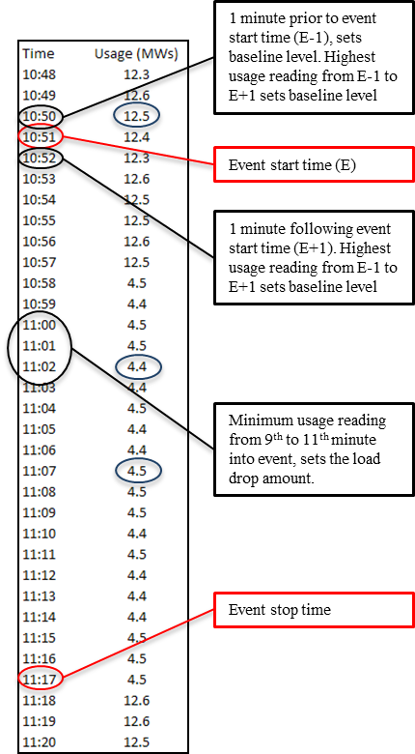
Synch Reserve DR – Compliance
    In order to determine the amount of non-compliance shortfall a SR Resource provides, the event usage must be compared to a baseline measurement.
To allow for small fluctuations and possible telemetry delays,
the resource load at the start of the event is defined as the highest metered
load between one (1) minute prior to and one (1) minute following the
start of the event. Similarly, a resource‘s load ten minutes after the event
is defined as the lowest load achieved between nine (9) and eleven (11)
minutes after the start of the event. All resources must maintain a load
level less than or equal to that which was achieved as of ten minutes after
the event for the duration of the event or thirty (30) minutes from the start of
the event, whichever is shorter. The response actually credited to a given
resource will be reduced by the amount the MW load of that resource
rises above the level achieved after ten (10) minutes by either the end of the
event or after 30 minutes from the start of the event, whichever is shorter.
Notes:
21
Overview of three programs:
Emergency
Day-Ahead Economic
Real-Time Economic

Slide 22
Frequency Regulation - Eligibility
Regulation is a variable amount of generation (or Demand Response) energy under automatic control, which is independent of economic cost signals and is obtainable within five minutes.
    Regulating resources correct for small load changes that cause the power system to operate above or below 60 Hz for a sustained period of time.
Demand Resources must meet the following requirements to participate in PJM’s Frequency Regulation market:
    Able to receive and react to a dynamic regulation control signal from PJM;
    Real-Time telemetry;
    Respond as called upon within 3 minutes;
    Minimum .1 MW offer;
    Resource certification and testing requirements, approved by PJM.
Notes:
22
Overview of three programs:
Emergency
Day-Ahead Economic
Real-Time Economic

Slide 23
Pennsylvania Act 129
  PA Act 129 was signed into law in 2008 and set goals for PA utilities for savings and demand reduction. PA’s ACT 129 has already completed Phases 1 and 2 and Phase 3 started June 2017 and will continue through May 2020.
  CPower has been awarded all or portions of several PA utilities' C&I Demand Response program.
  These are energy programs aiming to reduce the utilities’ demand during the summer peaks. PA Act 129 events will be dispatched for durations of four hours not to exceed 24 hours in a summer. Events will be called when PJM’s Day Ahead load forecast reaches 96% of the system’s peak load.
  Compliance is measured via an approved EDC CBL methodology. Customers must be tested for 1 hour absent a PA ACT 129 event. Customers will be compensated for a minimum of 8 hours of revenue based on compliance.
Notes:
23
Overview of three programs:
Emergency
Day-Ahead Economic
Real-Time Economic

Slide 24
Get Paid for Events at $1,000/MWh
Get paid for 8-hours even if an actual event is not called when you perform at the committed level during a test*
How Much Will I Earn?
Payment per MWh | Test Event | 1 Event | 2 Events | 3 Events | 4 Events | 5 Events | 6 Events
Total Payment $1,000/MWh for each Participating MWh | $8,000 | $8,000 | $8,000 | $12,000 | $16,000 | $20,000 | $24,000
You are paid for 8- hours even if a real event is never called** when you perform during the test. If one event is called you are paid for 2 events ($1,000x8, or two-four-hour events, excluding test) |  |  | You are paid for performance for each 4-hour event from 2-6 events in the season
Example: If you enroll 2MWs in the Demand Response Program and participate in each event – you would earn a minimum of $16,000 (Test event and/or 1 event) and up to $48,000 maximum (if 6 events were called).
You must show up for all events to get paid for those events.
Example: If an actual event is called you must show up for both to be paid for 8-hours
** Must perform at committed MW amount during the test and/or events
Notes:
Susan

Slide 25
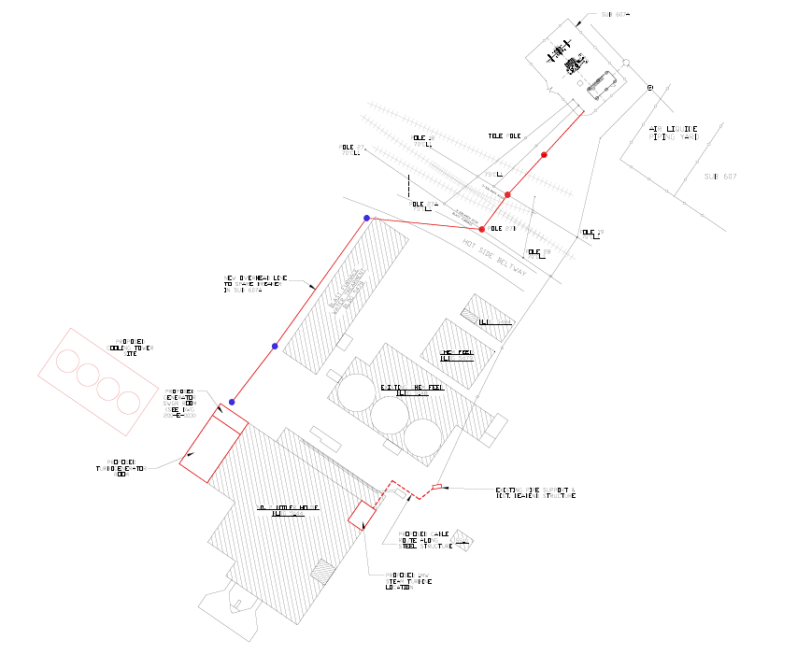
Energy Efficiency
CPower M&V and PJM EE program drive more revenue
 | Description | PJM Value
Project 1 | A waste heat recovery project started up was continued in 2016 which uses steam generated from excess blast furnace gas to generate 1.125 MW of electric power. BFG would have been flared if not used for this application. | $35,400.
Project 2 | Middletown Works also considered a larger project using waste heat recovery into a larger steam generator capable of 15 MW of power, but was determined to not be financially viable. | $885,000- $1,020,000
CPower successfully monetized 11MW of waste heat recovery
Above provides an example of the possible value of EE to AK Steel
Figure on the left is a AKS conceptual drawing of BFG Recovery
Notes:
Russ

Slide 26
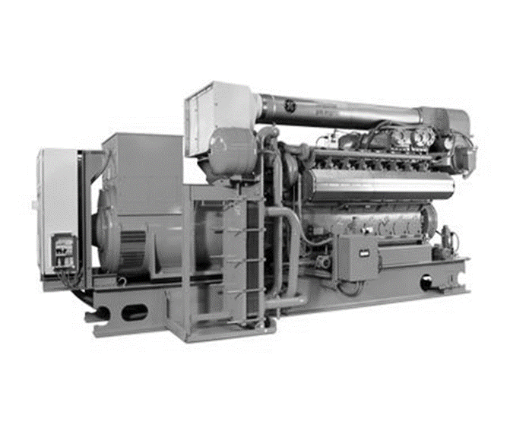
GENERATION – What’s Changed?
On May 1, 2016, US EPA Vacatur Implemented
Eliminated Emergency Generation use in DR
Non-emergency generators allowed for DR
CPower drafted following procurement specifications for New non-emergency generator
Comply with federal Non-Emergency requirements for:
  emergency DR,
  non-emergency DR,
  peak shaving or,
  other non-emergency use

Slide 27
STACKING PROGRAMS
Understanding your organization’s operations and capabilities is paramount. Three fundamental questions can help begin the framework for your demand management strategy:
WHAT can be curtailed?
HOW QUICKLY can it be curtailed?
HOW LONG can curtailment be sustained?
WHAT PROJECTS should be considered for long term energy goals?
Demand Response
“Stacking” $$
Demand Management
“Stacking” $$
Economic
Synch Reserve
+
PLC Management
$ (Saving & Earning)
=
ACT 129 Programs
Energy Efficiency
Load Shifting
Capacity (Emergency, CP)
Notes:
Russ

Slide 28
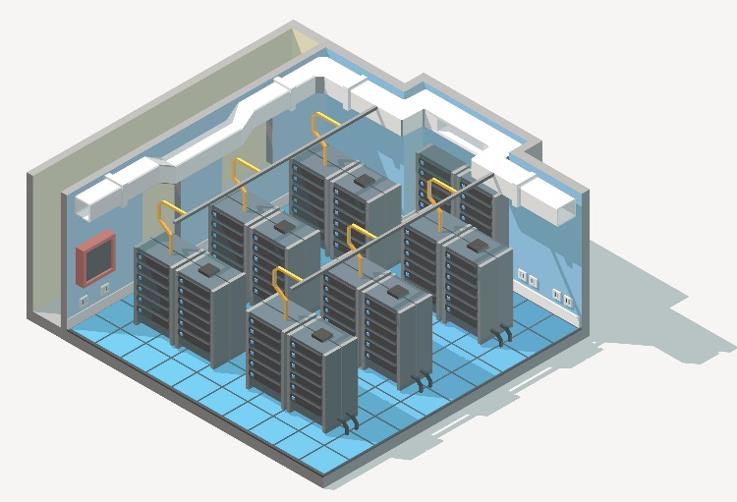

Cpowered™ Capabilities
for Data Centers
A CPowered™ Strategy is tailored to leverage your existing energy assets in a way that optimizes the experience for your team, your buildings, and your customers.
Assess
Plan
Execute
Controls: Integration with all BMS Systems
24x7 monitoring and dispatching
Energy Efficiency
Custom curtailment planning, risk mitigation
Dedicated account management
Gen Sets
Timely and accurate reporting and payments
UPS
SOP Development
Market and regulatory advocacy

Slide 29

OUTLOOK FOR DEMAND RESPONSE
Richmond, VA
Notes:
Russ

Slide 30
CPower Seasonal Load Strategy
Seasonal operation and load profile as well as curtailment strategy are the keys to understanding the CP program.
Facilities with flat year-round loads with the ability to curtail the same way should see little impact to their curtailment amount as they transition to CP.
Facilities that peak shave (PLC Management) or are unable to curtail the same loads in the winter as the summer will have excess winter or summer load shedding capabilities.
Facility with a lower load profile in the winter than the summer will have excess Summer loads.
In all cases, CPower is defining unique opportunities to allow customers to derive value from excess loads based on load Profiles.
Capacity Performance
Compliance Period |  | June - Oct and May 10:00am - 10:00pm, Nov - April 6am - 9pm
Number and Duration of Events |  | June - Oct and May: 12 hour duration; Nov - April: 15 hour duration. Unlimited Events
Lead Time and Energy Rate | 30 min | $1,849/MWh
 | 60 min | $1,425/MWh
 | 120 min | $1,100/MWh
Noncompliance Penalty Rate | $/MWh | Vary by Zone and DY
Metering |  | Minimum 1 hour utility grade interval meter
CBL Methodology | Summer | FSL (June - Oct, May)
 | Non-Summer | FSL (Nov - Apr)

Slide 31
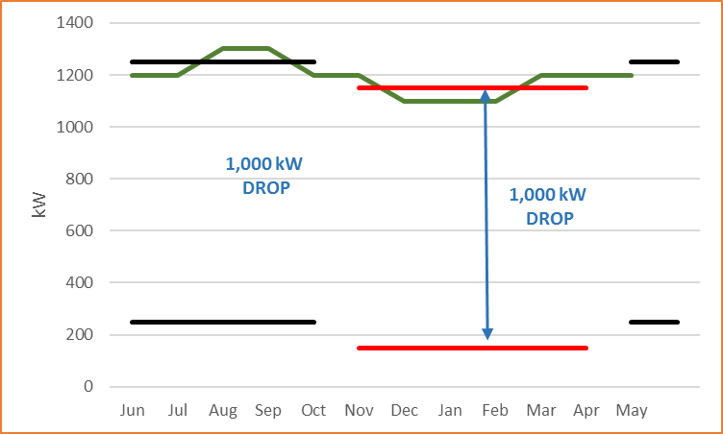
Year-Round Consistent load - CP Capability
Facility with a year-round flat load. Summer PLC/FSL and Winter PLC/FSL both allow for same curtailment amount. Customer would be a 1,000 kW CP load drop candidate.
2020/21
$/MW-YEAR
LDA | ZONE | CP
EMAAC | AECO | $68,573
 | DPL | $68,573
 | JCPL | $68,573
 | PECO | $68,573
 | RECO | $68,573
 | PSEG | $68,573
MAAC | METED | $31,405
 | PENELEC | $31,405
 | PPL | $31,405
 | BGE | $31,405
 | PEPCO | $31,405
RTO | AEP | $27,933
 | APS | $27,933
 | ATSI | $27,933
 | DAY | $27,933
 | DOM | $27,933
 | DUQ | $27,933
 | EXPC | $27,933
DEOK | DEOK | $47,450
COMED | COMED | $68,664
Calculations for CP Revenue for year-round customer.
Annual Revenue USD = Load Drop (1MW) * $/MW-Year
(Note: Customer % applied to all Values)

Slide 32
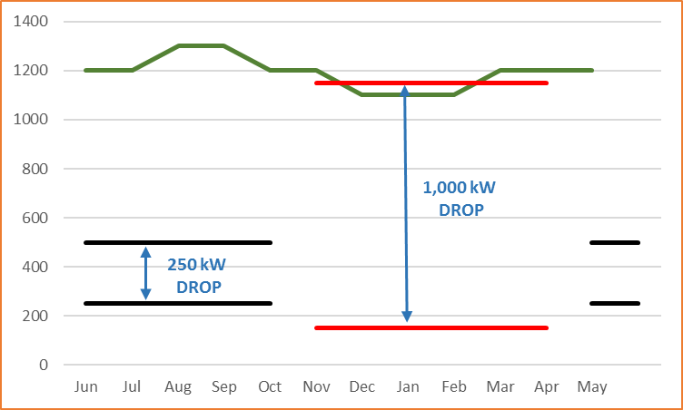
Excess Winter Load - CP Capability
Facility has a Summer PLC/FSL that is lower than the Winter PLC/FSL. Customer would be a 250 kW CP load drop candidate with 750 kW of excess Winter load drop capabilities
2020/21
$/MW-YEAR
LDA | ZONE | CP
EMAAC | AECO | $68,573
 | DPL | $68,573
 | JCPL | $68,573
 | PECO | $68,573
 | RECO | $68,573
 | PSEG | $68,573
MAAC | METED | $31,405
 | PENELEC | $31,405
 | PPL | $31,405
 | BGE | $31,405
 | PEPCO | $31,405
RTO | AEP | $27,933
 | APS | $27,933
 | ATSI | $27,933
 | DAY | $27,933
 | DOM | $27,933
 | DUQ | $27,933
 | EXPC | $27,933
DEOK | DEOK | $47,450
COMED | COMED | $68,664
Calculations for CP Revenue for year-round “Winter Excess” customer.
Annual Revenue USD = (Winter Load Drop(1MW)*(6 Months) * $/MW-Year) + (Summer Load Drop (.25MW)*(6Months) * $/MW-Year)
Customer % Split applied to all Values

Slide 33
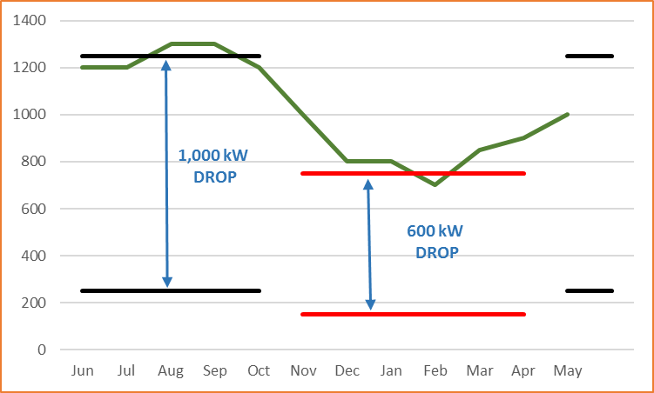
Excess Summer Load - CP Capability
Facility with a lower load profile in the winter than the summer. The Winter PLC/FSL is lower than the Summer PLC/FSL. Customer would be a 600 kW CP load drop candidate with 400 kW of excess Summer load drop capabilities.
2020/21
$/MW-YEAR
LDA | ZONE | CP
EMAAC | AECO | $68,573
 | DPL | $68,573
 | JCPL | $68,573
 | PECO | $68,573
 | RECO | $68,573
 | PSEG | $68,573
MAAC | METED | $31,405
 | PENELEC | $31,405
 | PPL | $31,405
 | BGE | $31,405
 | PEPCO | $31,405
RTO | AEP | $27,933
 | APS | $27,933
 | ATSI | $27,933
 | DAY | $27,933
 | DOM | $27,933
 | DUQ | $27,933
 | EXPC | $27,933
DEOK | DEOK | $47,450
COMED | COMED | $68,664
Calculations for CP Revenue for year-round “Summer Excess” customer.
Annual Revenue USD = (Winter Load Drop(.6MW)*(6 Months) * $/MW-Year) + (Summer Load Drop (1MW)*(6Months) * $/MW-Year)
Customer % Split applied to all Values

Slide 34
Three Forces Driving
Industry Transformation
Multiple megatrends underpin the industry transition:
Declining load growth as a result of distributed energy resources (EE and DG)
Greater customer choice and demand for more (sustainable) energy options
Increased policies and regulations to reduce carbon emissions
Shifting power-generating sources
Search for shareholder value: new ventures and increased M&A
Merging of mega industries around growth opportunities
Transition toward an increasingly clean, decentralized, intelligent and mobile grid architecture: the Energy Cloud
Disruption of traditional processes is a prevailing industry trend creating threat and opportunity
Technology Innovation
Policy and Regulation
Market Demand

Slide 35
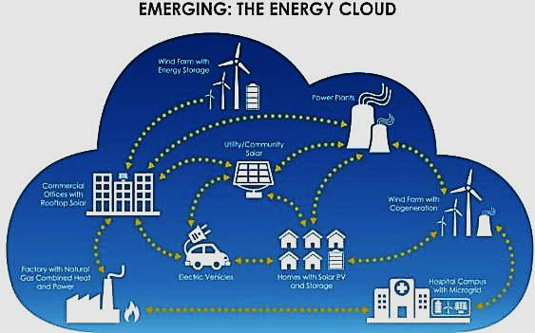
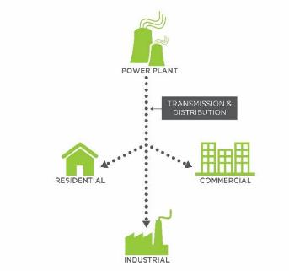
Changing Industry Dynamics
From Traditional Grid to the Energy Cloud
TODAY: Traditional Power Grid
Central, One-Way Power System
EMERGING: The Energy Cloud*
Distributed, Two-Way Power Flows

Slide 36
DER in the United States
Next 10 years
Annual Installed DER Power Capacity Additions
by DER Technology, United States: 2017-2026
Observation
DER deployments will reach 30 GW in 2017 in the US, versus new generation (19.7GW)
Drivers
Declining System Costs
Supporting Policies and Incentives
New Business Models
Reliability Concerns
Product Availability
Access to Financing
(Source: Navigant Research)

Slide 37

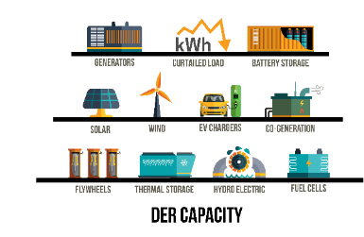
DER & Demand Response
Traditional Demand Response (DR) Mentality
  DR means “curtailment”
  Emergency or economically driven
The DER DR Mentality
  Capacity value as important as Energy value
  Funding source to achieve Resiliency & Sustainability
  Activation of assets and NOT curtailing load
  Can support shorter lead times and more event hours
  No impact on operations
  More sophisticated strategy

Slide 38

CPower PJM Team
Professional Demand Side Management Team
Executive Management
Sales Executives
Engineering
Enrolments, Settlements, Payments
Finance
Metering
IT Support & Development, Marketing
Data Quality
SR Management,
ACT 129 Program
EE Program Market Development
Regulatory Leadership
Meter & Development
Over 50+ dedicated resources within PJM region, are on the job every day!
Notes:
Russ

Slide 39


QUESTIONS?
Please contact CPower with any questions!
https://cpowerenergymanagement.com/markets/pjm-interconnection/
Dailey Tipton - 484.947.9334– Dailey.Tipton@cpowerenergymanagment.com

