Slide 1

Updated April 12, 2017

Slide 2
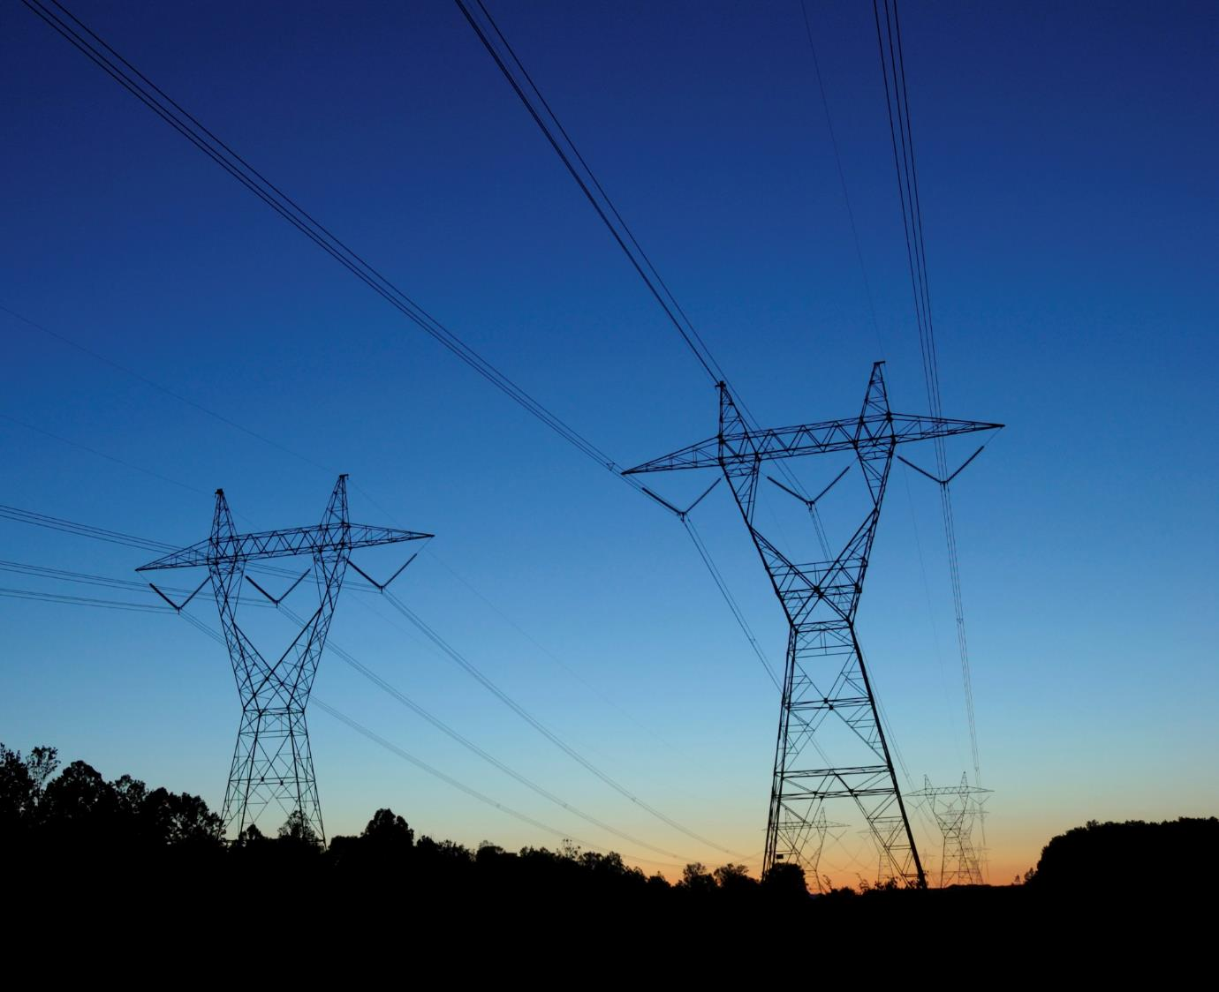
Our Mission
Helping our members work together to keep the lights on …
today and in the future.

Slide 3
Our Beginning
In 1941, 11 member utilities pooled electricity to power aluminum plant at Jones Mill needed for critical defense
Maintained after WWII to continue benefits of regional coordination
Notes:
SPP’s story began just after the attack on Pearl Harbor in 1941, when America had an immediate need to build airplanes. Aluminum is made from bauxite, and Arkansas had the largest bauxite deposit in the nation. A plant was opened at Jones Mill, Ark., to produce aluminum around the clock.
Jones Mill required 120,000 kW of power to operate at full capacity, 24x7. However, the total power installed in the entire state of Arkansas was only 100,000 kW. There wasn’t enough time to build new power plants.
On December 14, 1941, 11 regional utilities formed the Southwest Power Pool. The pooled power allowed Jones Mill to produce aluminum throughout the war.
The original 11 companies in SPP were: Arkansas Power and Light, Louisiana Power and Light, Mississippi Power and Light, Southwestern Gas and Electric Company, Public Service Commission of Oklahoma, Nebraska Power and Light, Texas Power and Light, Southwestern Power and Light, Oklahoma Gas and Electric, Kansas Gas and Electric, and Empire District Electric.
After the war, SPP continued to exist as a voluntary organization because our members recognized the growing interdependence of the electric grid, and realized the benefit in coordinating with neighboring utilities. Since World War II, one of SPP’s key roles has been to bring its members together to discuss and make decisions about issues that impact the region.

Slide 4

SPP At a Glance
Located in Little Rock
Approx. 600 employees
Jobs in IT, electrical engineering, operations, settlements and more
24x7 operation
Full redundancy and backup site
Notes:
Was completed in July 2012.

Slide 5

Regulatory Environment
Incorporated in Arkansas as 501(c)(6) nonprofit corporation
Federal Energy Regulatory Commission (FERC)
  Regulated public utility
  Regional Transmission Organization
North American Electric Reliability Corporation (NERC)
  Founding member
  Regional Entity
Notes:
5
SPP is regulated by the Federal Energy Regulatory Commission (FERC). SPP was approved as a FERC Regional Transmission Organization (RTO) in 2004. We operate subject to a tariff that is filed with and governed by FERC. This tariff contains over 5,000 pages of rates, terms and conditions for providing transmission service to our eligible customers to move wholesale electric power within and across our footprint.
SPP is a founding member of the North American Electric Reliability Council (NERC). We became a NERC Regional Entity in 2007, which gives us the responsibility of enforcing reliability standards for users, owners, and operators of the bulk power system in the SPP footprint.

Slide 6
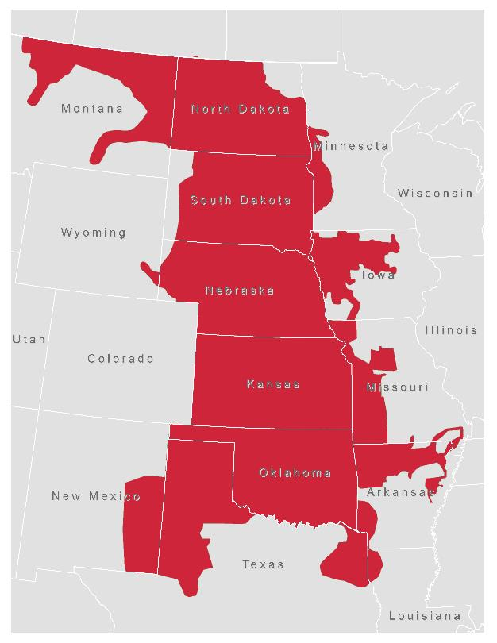
The SPP Footprint:
Members in 14 States
Arkansas
Kansas
Iowa
Louisiana
Minnesota
Missouri
Montana
Nebraska
New Mexico
North Dakota
Oklahoma
South Dakota
Texas
Wyoming
Notes:
The SPP Regional Transmission Organization manages the power grid in all or part of 14.

Slide 7
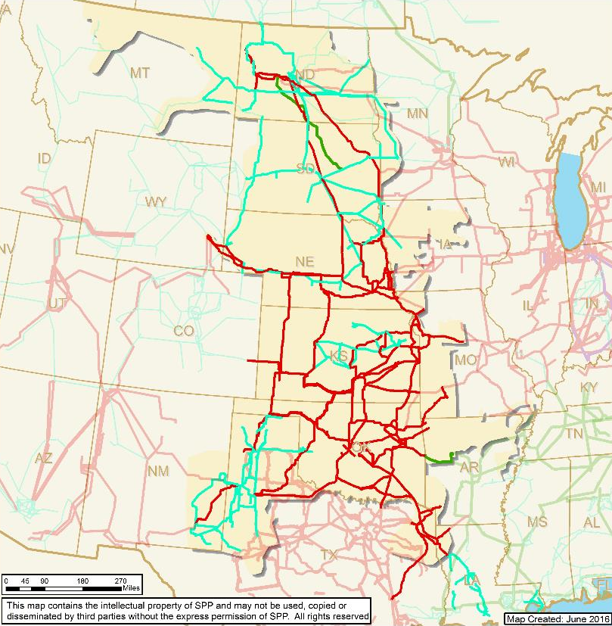
Operating Region
Miles of service territory: 546,000
Population served: 17.5M
Generating Plants: 790
Substations: 4,835
Miles of transmission:
65,755
  69 kV 16,808
  115 kV 15,512
  138 kV 9,471
  161 kV 5,596
  230 kV 7,518
  345 kV 10,758
  500kV 92

Slide 8
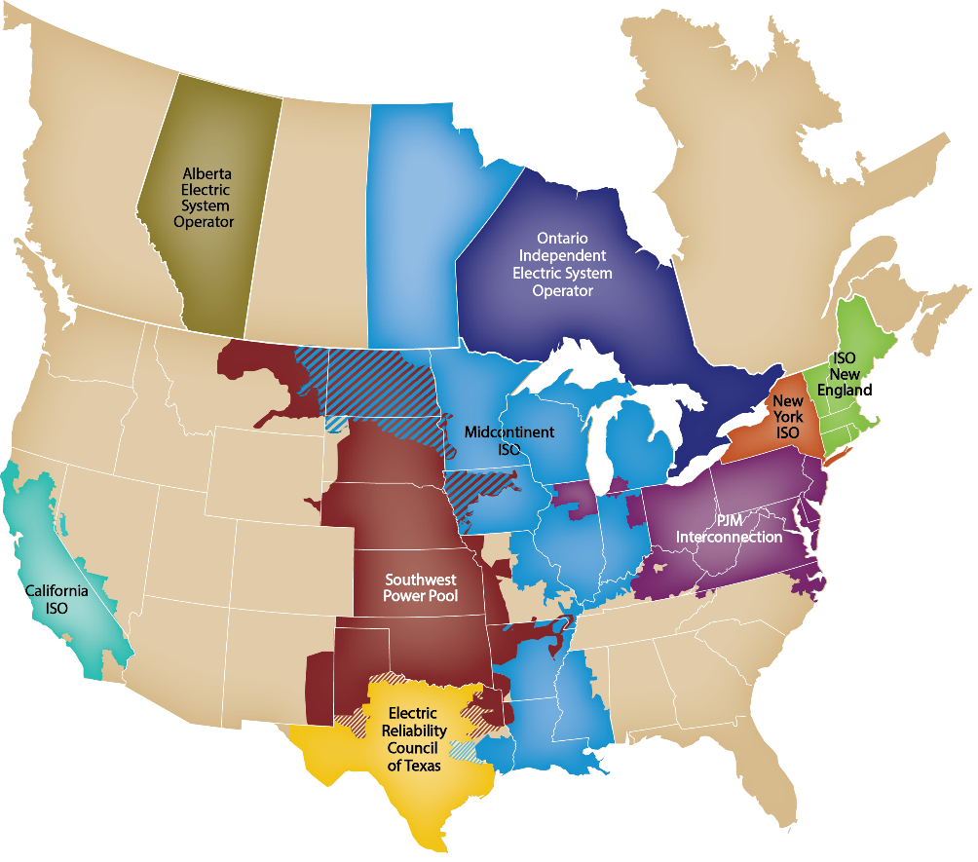
North American
Independent System Operators (ISO) and Regional Transmission Organizations (RTO)
Notes:
This map depicts the 10 other FERC-approved Independent System Operators and Regional Transmission Organizations in the United States and Canada.

Slide 9
SPP’s 95 Members:
Independence Through Diversity
As of April 12, 2017
Notes:
SPP has one of the most diverse memberships of any Regional Transmission Organization. This diversity helps ensure independence; we carefully balance diverse interests in our decision-making processes.
Investor Owned Utilities: Traditional vertically-integrated utilities
Cooperatives: Rural electric cooperatives
Municipals: Cities
State Agencies: State-created agencies that own/operate facilities
Independent Power Producers/Wholesale Generation: Entities that develop and own generation, but don’t own transmission
Independent Transmission Companies - Entities that develop and own transmission, but don’t own generation
Marketers: Entities that own no facilities or transmission, but buy/sell excess capacity

Slide 10

The SPP Difference
Relationship-based
Member-driven
Independence Through Diversity
Evolutionary vs. Revolutionary
Reliability and Economics Inseparable
Notes:
Our relationships with our members are very important to us. Our members drive SPP’s major decisions and plans for the future. We have a diverse membership and an independent Board of Directors that make decisions in an evolutionary rather than revolutionary way. Our members’ needs have changed over the years, and a deliberate evolutionary process has guided our growth. We believe that we can’t discuss electric reliability without also discussing economic issues that impact us all. As a single organization addressing both reliability and economic issues, we provide cost-effective choices and bring efficiency to our members and our region.

Slide 11
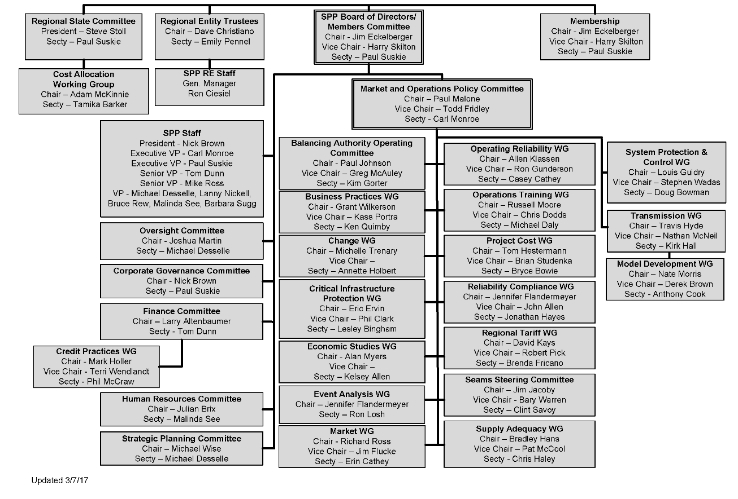
Facilitation
Notes:
More than 500 stakeholders are involved in SPP’s organizational structure of committees, working groups, and ad hoc task forces. This member involvement drives SPP’s decision-making and strategic direction.
Any and all opinions are heard loudly and clearly in organizational group meetings. The rosters of our organizational groups match the diverseness of the membership, requiring representatives from across the footprint and recognizing different member types and sizes.

Slide 12

Our Major Services
  Facilitation
  Reliability Coordination
  Balancing Authority
  Transmission Service/Tariff Administration
  Market Operation
  Transmission Planning
  Training
  Standards Setting
  Compliance Enforcement
OUR APPROACH:
Regional, Independent, Cost-Effective and Focused on Reliability
Notes:
We offer a number of services for our members, including:
Facilitating meetings and decision-making processes
Monitoring the grid to maintain electric reliability
Processing requests for use of the transmission grid under a tariff with consistent rates and terms for all participants
Operating a wholesale energy market
Ensuring that users, owners, and operators of the bulk transmission system are in compliance with federal reliability standards
Creating regional reliability standards
Planning for future transmission needs
With all of our services, we focus on being regional, independent, and cost-effective. Our overarching goal is maintaining electric reliability.

Slide 13

Milestones
1968 Became NERC Regional Council
1980 Implemented telecommunications network
1991 Implemented operating reserve sharing
1994 Incorporated as nonprofit
1997 Implemented reliability coordination
Notes:
1968: NERC was formed in response to a blackout in the northeast. SPP was a founding member.
1980: SPP’s members implemented a telecommunications network to facilitate information sharing.
1991: Reserve sharing allows all member systems to rely further on each other, reducing the reserves they each have to hold and making more power available for sale.
1997 - 2001: SPP added more services to provide regional benefit: reliability coordination, tariff administration, and scheduling.
2006: SPP began offering services on a contract basis.
SPP did not even exist as a legal entity until 1994, and from 1941-1998 the SPP membership agreement was one paragraph. Many of our member companies have been working together for decades; these relationships are SPP’s foundation and why being relationship-based is a key corporate strategy.

Slide 14
Milestones
1998 Implemented tariff administration
2004 Became FERC-approved Regional
Transmission Organization
2007 Launched EIS market; became NERC
Regional Entity
2009 Integrated Nebraska utilities
2010 FERC approved Highway/Byway cost
allocation methodology and Integrated
Transmission Planning Process
Notes:
1968: NERC was formed in response to a blackout in the northeast. SPP was a founding member.
1980: SPP’s members implemented a telecommunications network to facilitate information sharing.
1991: Reserve sharing allows all member systems to rely further on each other, reducing the reserves they each have to hold and making more power available for sale.
1997 - 2001: SPP added more services to provide regional benefit: reliability coordination, tariff administration, and scheduling.
2006: SPP began offering services on a contract basis.
SPP did not even exist as a legal entity until 1994, and from 1941-1998 the SPP membership agreement was one paragraph. Many of our member companies have been working together for decades; these relationships are SPP’s foundation and why being relationship-based is a key corporate strategy.

Slide 15
Milestones
2012 Moved to new Corporate Center
2014 Launched Integrated Marketplace
Became regional Balancing Authority
2015 Integrated System joins SPP
Notes:
1968: NERC was formed in response to a blackout in the northeast. SPP was a founding member.
1980: SPP’s members implemented a telecommunications network to facilitate information sharing.
1991: Reserve sharing allows all member systems to rely further on each other, reducing the reserves they each have to hold and making more power available for sale.
1997 - 2001: SPP added more services to provide regional benefit: reliability coordination, tariff administration, and scheduling.
2006: SPP began offering services on a contract basis.
SPP did not even exist as a legal entity until 1994, and from 1941-1998 the SPP membership agreement was one paragraph. Many of our member companies have been working together for decades; these relationships are SPP’s foundation and why being relationship-based is a key corporate strategy.

Slide 16
Growth in Responsibilities
$ TRANSACTIONS (IN MILLIONS)

Slide 17

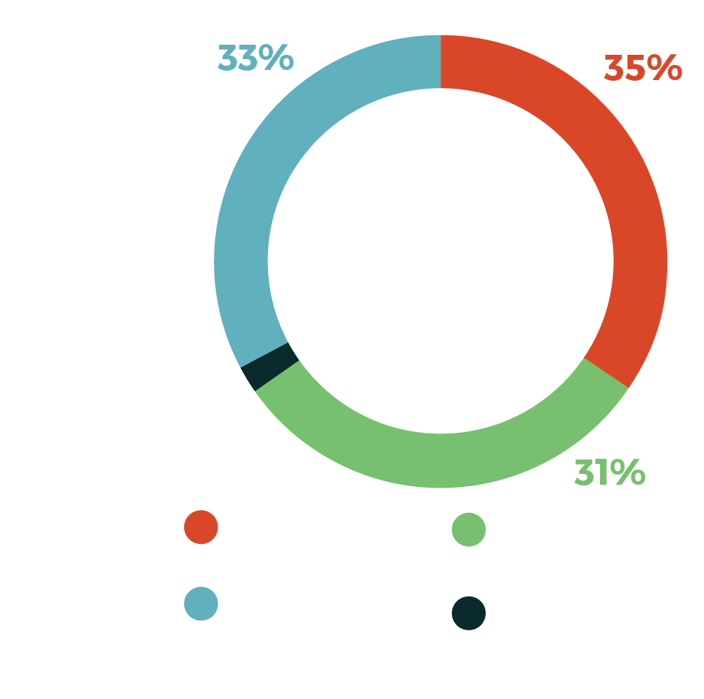
The VALUE OF SPP
Transmission planning, market administration, reliability coordination, and other services provide net benefits to SPP’s members in excess of more than $1.7 billion annually at a benefit-to-cost ratio of 11-to-1.
A typical residential customer using 1,000 kWh saves $5.71/month because of the services SPP provides.
Notes:
As SPP works diligently to ensure the supply of the most reliable and cost-efficient electric power for our entire region, we create value for our members through our expertise and the economies of scale afforded by our business model. Transmission planning, market administration, reliability coordination, and other professional services provide net benefits to SPP’s members in excess of $1.4 billion annually at a benefit-to-cost ratio of more than 10-to-1. This means for the typical end-use customer using 1,000 kWh per month, a $100 bill would be $105.65 without the services SPP provides.
In 2014, we launched our Integrated Marketplace – arguably the biggest and most impactful single effort in our organization’s history – and we did so on time and on budget with the highest degree of quality, something no other Regional Transmission Organization accomplished. In their first year of operation, SPP’s markets delivered $380 million in net savings to our members and their customers, paying for themselves in less than a year. Analysis has shown the continued value of our markets, with nearly $500 million in benefits annually.

Slide 18

Market Facts
185 participants
790 generating resources
2016 Marketplace Settlements ~ $20 billion
50,622 MW coincident peak load (7/21/16)
Wind penetration record: 54.22% (3/19/17 @ 00:55)

Slide 19

SPP’s IT Infrastructure
166,000+ data points updated every 2-30 seconds
Operations model solves 47,150 x 80,548 matrix every two minutes
Approx. 2,000 servers
More than 2.14 petabytes of storage
Notes:
SPP has a large IT staff and a very complex IT environment to support regional transmission grid operations.

Slide 20
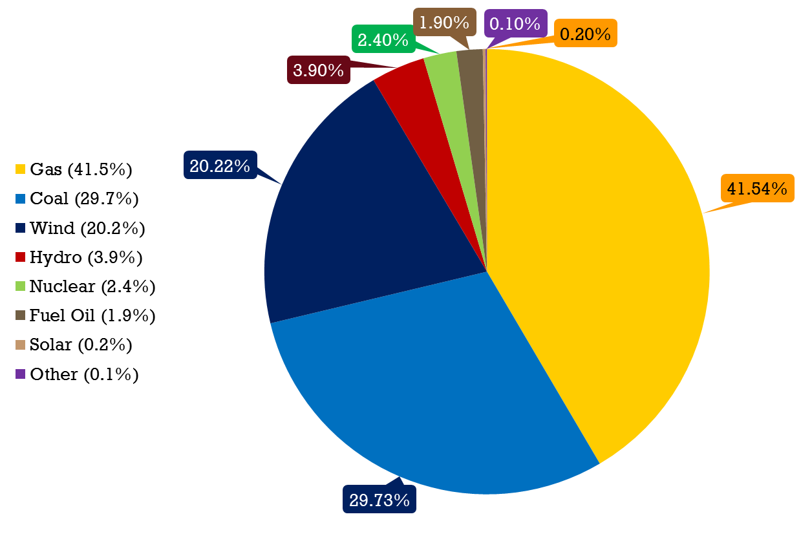
gENERATING Capacity* by Fuel Type
(87,086 MW total)
* Figures refer to nameplate capacity as of 1/1/18

Slide 21
2017 Energy production BY
Fuel Type (259,554 GWh total)
Notes:
The energy consumption number represents the summed hourly average of the amount of energy used by retail customers in the market footprint.

Slide 22
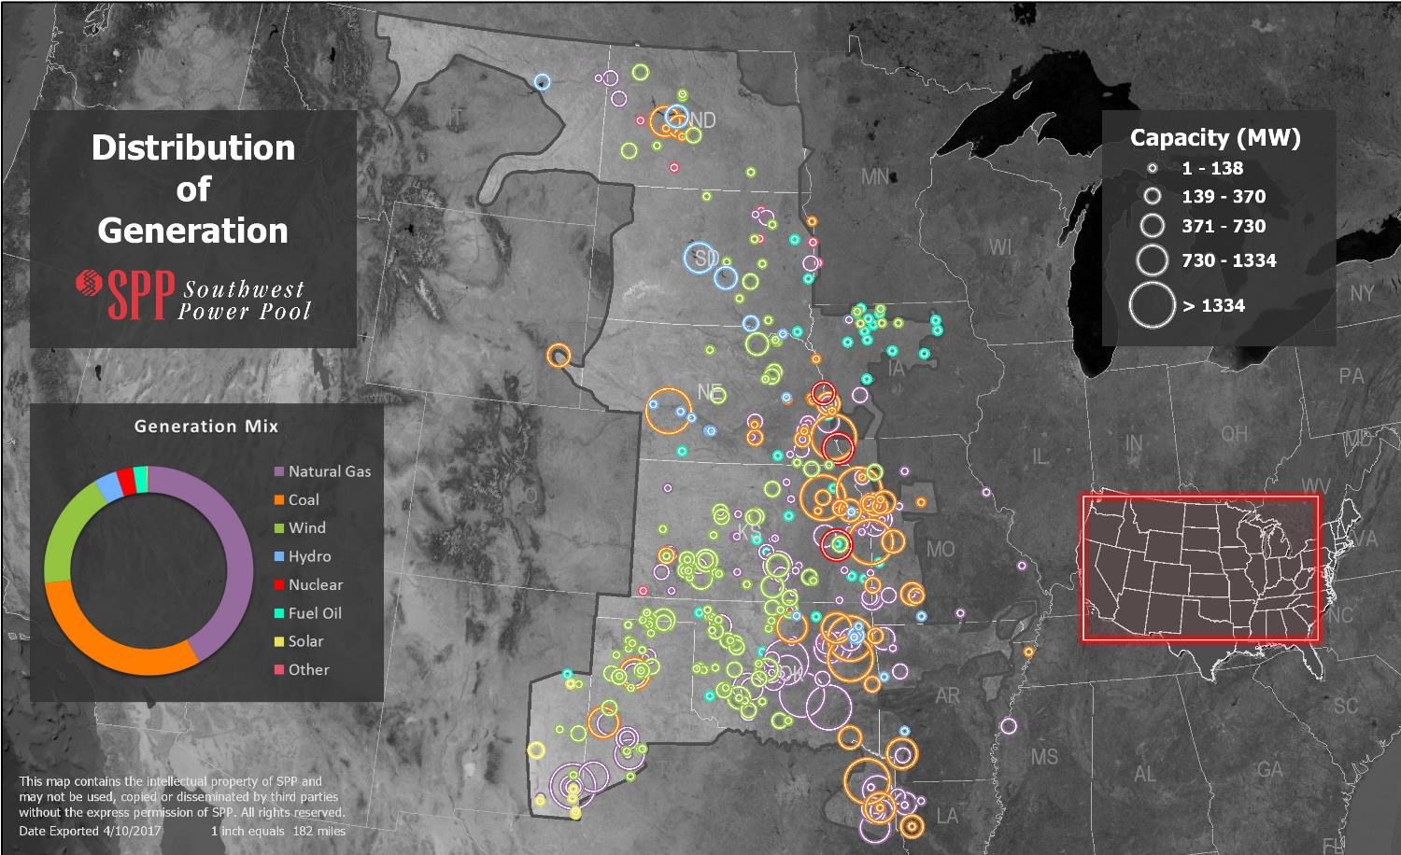

Slide 23
Transmission Investment Directed by SPP
$ Million
$6.9 B in completed projects
$3 B in scheduled projects

Slide 24
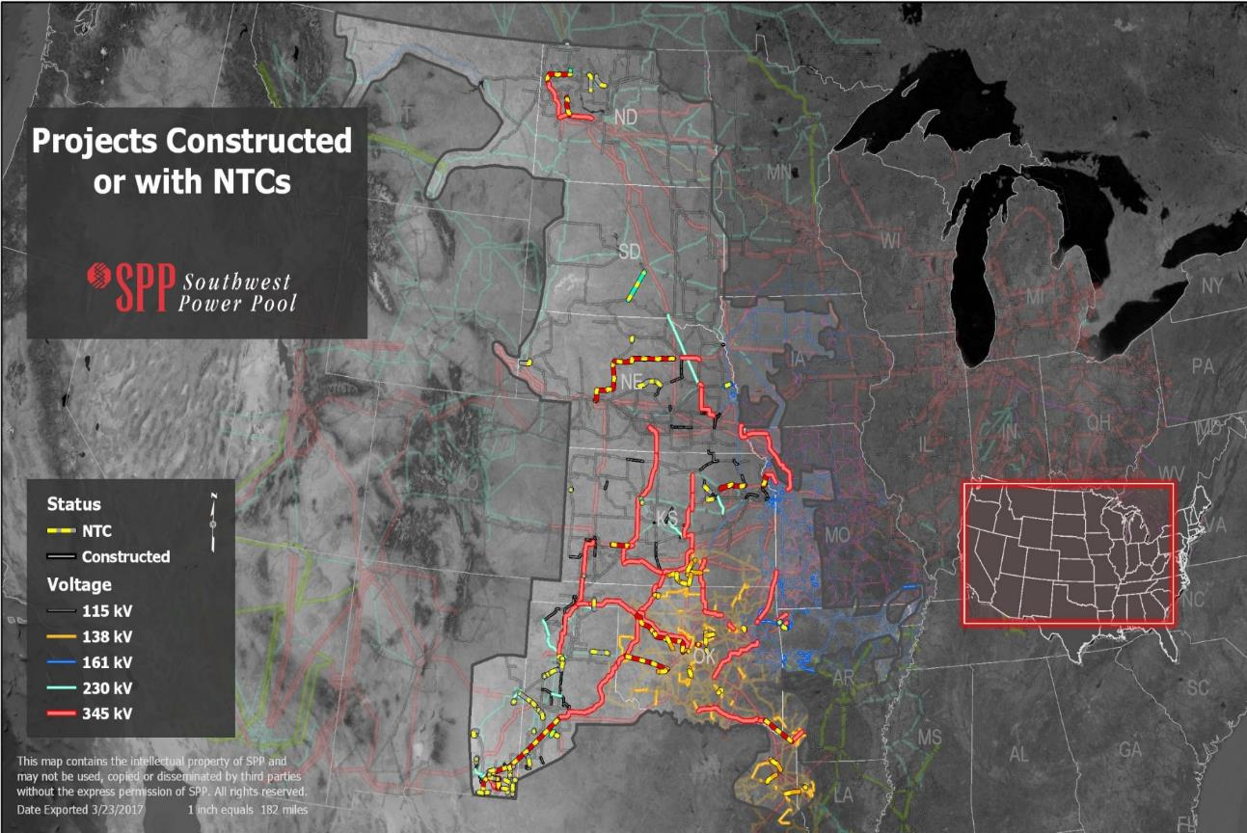
Future Investment ($B)
> 300 kV | 1.9
100 – 300 kV | 1.4
< 100 kV | .2
Total | 3.5

Slide 25
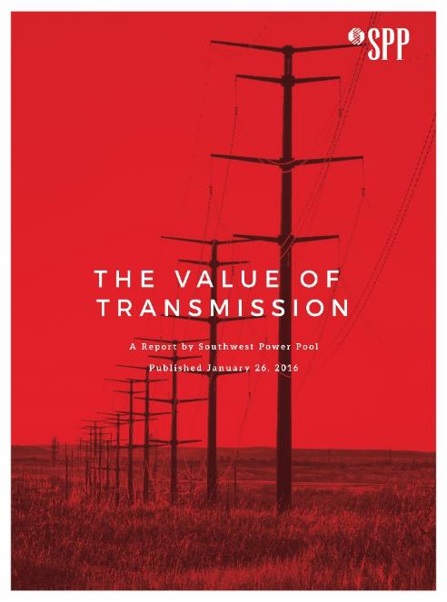
SPP’s Value of Transmission Study
Evaluated 348 projects from 2012-14, representing $3.4B of transmission investment
Evaluated benefit metrics
  Adjusted Production Cost (APC) Savings
  Reliability and Resource Adequacy Benefits
  Generation Capacity Cost Savings
  Market Benefits
  Other industry and SPP-accepted metrics
APC Savings alone calculated at more than $660k/day, or $240M/year.
Overall NPV of all benefits for considered projects are expected to exceed $16.6B over 40 years.
For every $1 of transmission investment made in 2012-2014, SPP expects at least $3.50 of benefit to be provided to rate-payers

Slide 26
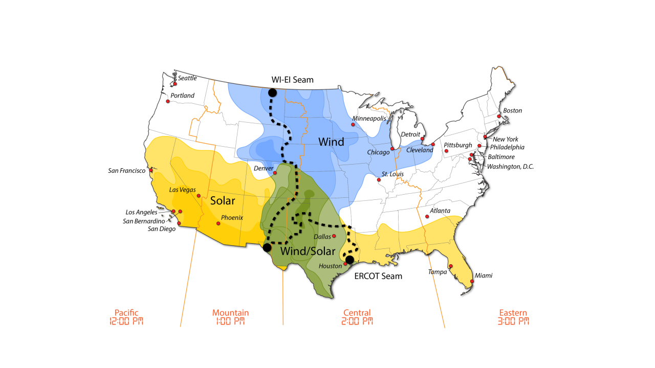
SPP renewable “breadbasket”

Slide 27
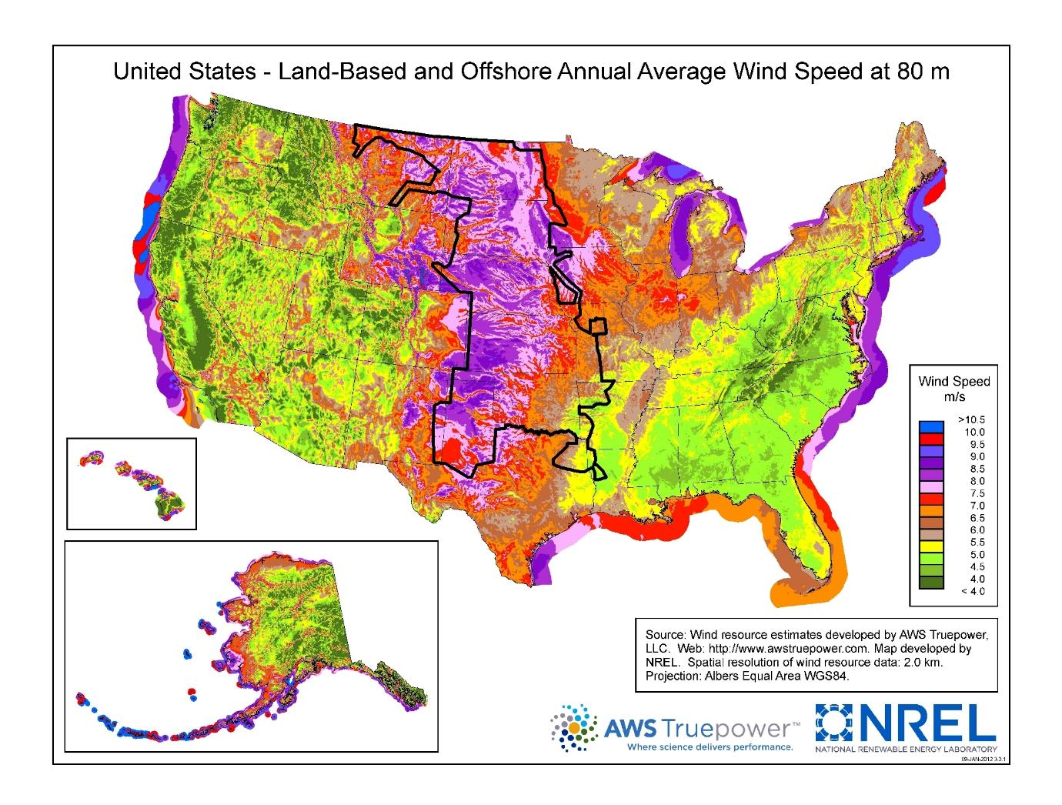
The highest wind speed in the country is within SPP Balancing Authority
Notes:
Focus on Nebraska region. West Nebraska has large potential wind profile.

Slide 28
Wind Capacity Installed by Year

Slide 29

Wind Penetration
177 windfarms
9,112 wind turbines
Wind Penetration Record: 58.49% (3/11/18)
Wind Peak: 15,690 MW (12/15/17)

Slide 30
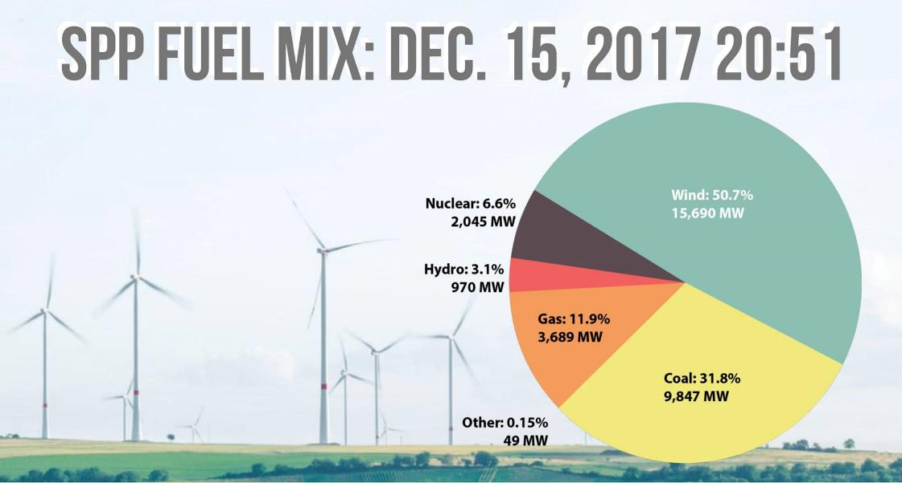
wind Peaks
Peak Wind Penetration level: 58.49% 3/11/18
  October 2017 Forecasted almost 70% penetration but redispatched down due to Transmission outages and congestion
Peak instantaneous Wind output: 15,690 MW 12/15/17
  Installed wind capacity 17,700 GW and growing
  Summer Peak Load: 51 GW April Minimum Load: 20 GW

Slide 31
Pending Generator Interconnection Requests
MW Requested by Generation Type
February 26, 2018

Slide 32

Denmark hits 140% Wind Penetration…
Let’s compare Denmark wind to Kansas wind

Slide 33
Denmark versus Kansas Wind
Peak Days Compared | Denmark: July 9, 2015 | Kansas: April 24, 2017
Wind Penetration | 116% | 106%
Load | 3,236 MW | 3,507 MW
Wind generation | 3,768 MW | 3,712 MW
Other Non-Wind Generation | 498 MW | 1,518 MW
Exports | 1,030 MW | 1,723 MW
System Summary | Denmark | Kansas
Peak Demand | 6,100 MW | 9,290 MW
Total Non-Wind Generation | 6,300 MW | 10,783 MW
Total Wind Generation | 6,000 MW | 4,731 MW
Interties | With 3 Countries | With 5 States
Note: Denmark and Kansas do not balance load and generation within respective area

Slide 34
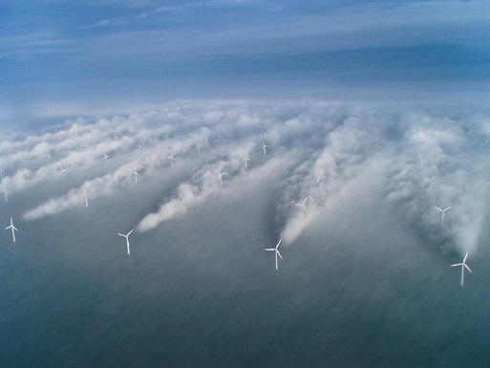
How high can we go?
Wind generation technology improvements continue to help
Fossil units must provide more flexibility, reduce minimum run output and shorten start times
Ramp capability will be an important market aspect in the future
Transmission expansion has dramatically helped deliver new resources to load and reduced energy prices
We must have dispatchable generation available
Production Tax Credit will impact growth
Solar is expected to grow
Wind penetration limit is system dependent!!
  Potential for 75% wind penetration today
  Total annual wind energy approaching 30%

Slide 35
SPP Min and Max Percent of Generation Mix Per Fuel Type - 2017

Slide 36
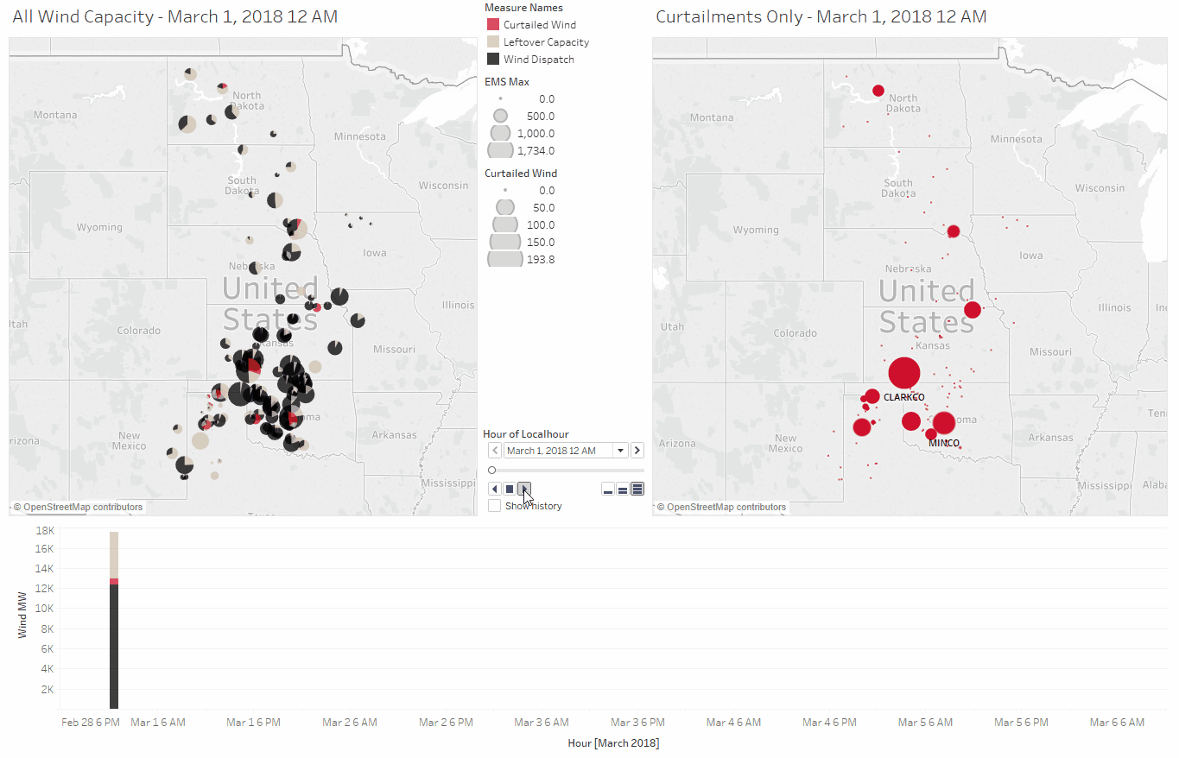
Hourly wind fleet composition (3/1/18 – 3/6/18)

Slide 37
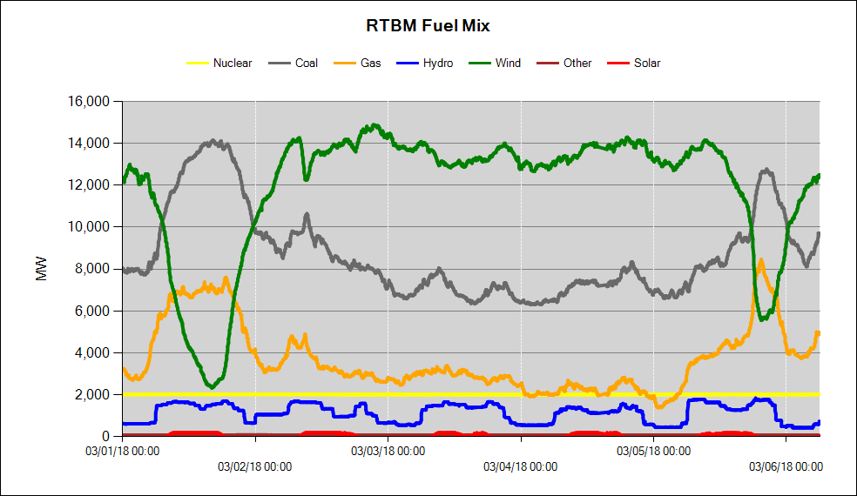
Variability + reliability requires fuel diversity

Slide 38
Updated April 12, 2017

