Slide 1
Things I Know, Thought I Knew, and
Didn’t Know About Texas Electricity
Karl Pfirrmann
Retired Electric Utility Executive
Allegheny Energy
PJM Interconnection
Unaffiliated Director
Electric Reliability Council of Texas (ERCOT) Board of Directors
April 18, 2018
Carnegie Mellon University

Slide 2
General Disclaimer Statement
Opinions expressed by me are mine and mine alone. Although I sit on the ERCOT Board of Directors, they do not represent the official position of ERCOT, its Board, management or staff or of the Public Utility Commission of Texas.
ALL INFORMATION CONTAINED HEREIN, IS PROVIDED "AS IS" WITHOUT ANY WARRANTIES OF ANY KIND. ERCOT MAKES NO REPRESENTATIONS WITH RESPECT TO SAID INFORMATION AND DISCLAIMS ALL EXPRESS AND IMPLIED WARRANTIES AND CONDITIONS OF ANY KIND, INCLUDING WITHOUT LIMITATION, REPRESENTATIONS, WARRANTIES OR CONDITIONS REGARDING ACCURACY, TIMELINESS, COMPLETENESS, NON-INFRINGEMENT, MERCHANTABILITY OR FITNESS FOR ANY PARTICULAR PURPOSE.

Slide 3
The Role of FERC over ISOs and RTOs
Federal Energy Regulatory Commission (FERC) Order 2000
  Initiated formation of ISOs and RTOs (other than ERCOT).
  ERCOT separately designated by the Public Utility Commission of Texas as the “Independent Organization” in the ERCOT Region (Texas Public Utility Regulatory Act § 39.151).
Federal Power Act grants FERC broad jurisdiction over:
  (1) transmission of electric energy in interstate commerce (from one state and consumed in another state in the United States), (2) sale of electric energy at wholesale in interstate commerce (sale for resale), and (3) all facilities for such transfer or sale of electric energy in interstate commerce.
ERCOT not subject to FERC “interstate commerce” jurisdiction
  Electric energy generated in the ERCOT Region is not generally transmitted or sold in interstate commerce (except in limited circumstances that FERC acknowledges do not trigger jurisdiction).
North American Electric Reliability Corporation (NERC)
  After the 2003 Northeast Blackout Congress amended the Federal Power Act to enable FERC to certify an “Electric Reliability Organization” tasked with establishing and enforcing reliability standards applicable to the entire bulk-power system—FERC subsequently certified NERC.
  FERC maintains jurisdiction over NERC, regional entities (in Texas it’s the Texas Regional Entity - TRE), and all users, owners and operators of the bulk-power system (including ERCOT) for purposes of (1) approving standards and (2) enforcing compliance.

Slide 4
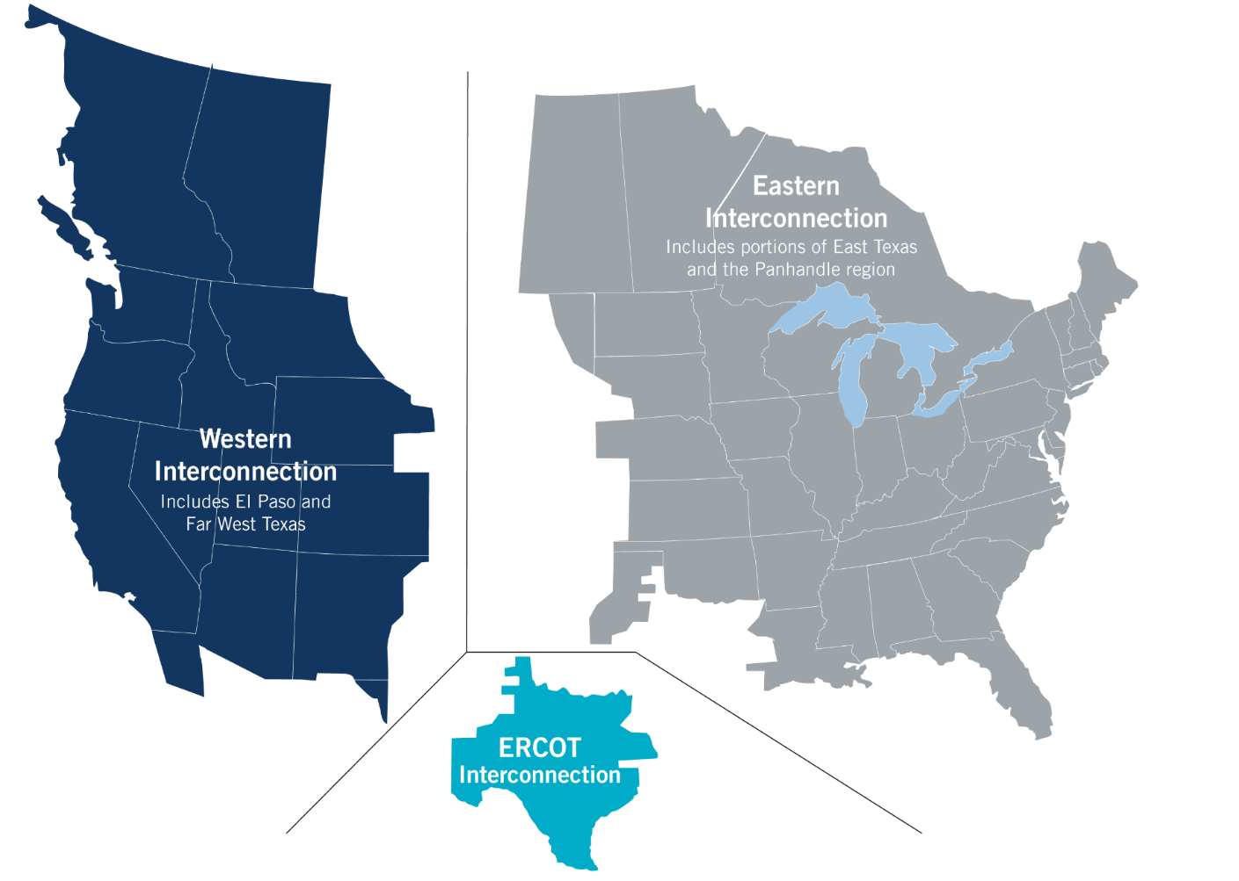
What is ERCOT?
The Texas Legislature restructured the Texas electric market in 1999 and assigned ERCOT four primary responsibilities:
System reliability
Competitive wholesale market
Open access to transmission
Competitive retail market
ERCOT is a membership-based 501(c)(4) nonprofit corporation, governed by a board of directors and subject to oversight by the Public Utility Commission of Texas and the Texas Legislature.
ERCOT is not a market participant and does not own generation or transmission/distribution wires.

Slide 5
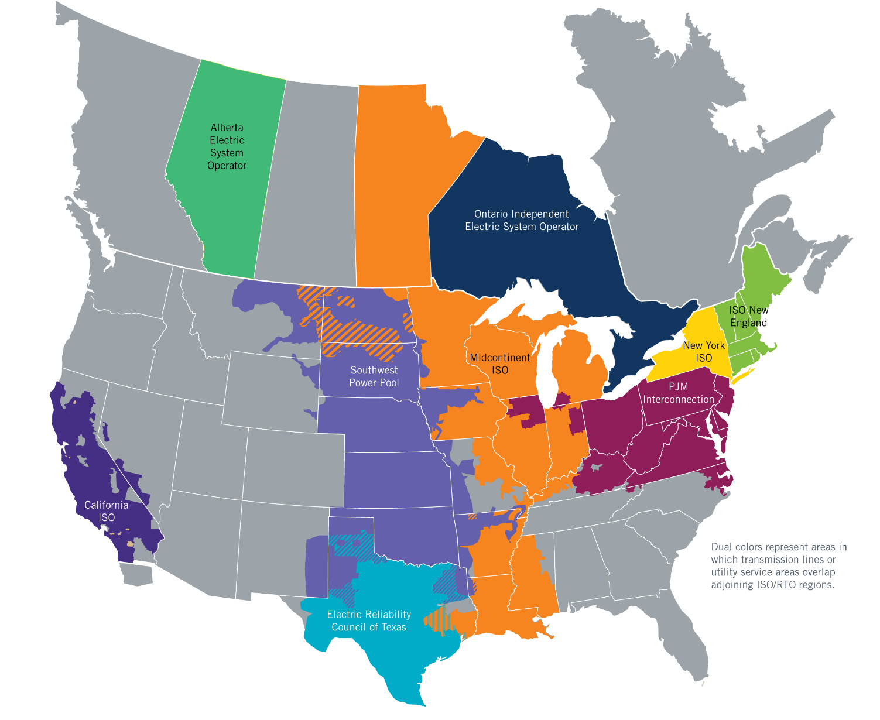
ISOs and RTOs
ERCOT is one of nine independent system operators and regional transmission organizations in the U.S. and Canada.
Together, ISO/RTOs serve about two-thirds of electric consumers in the U.S. and more than half of consumers in Canada.

Slide 6
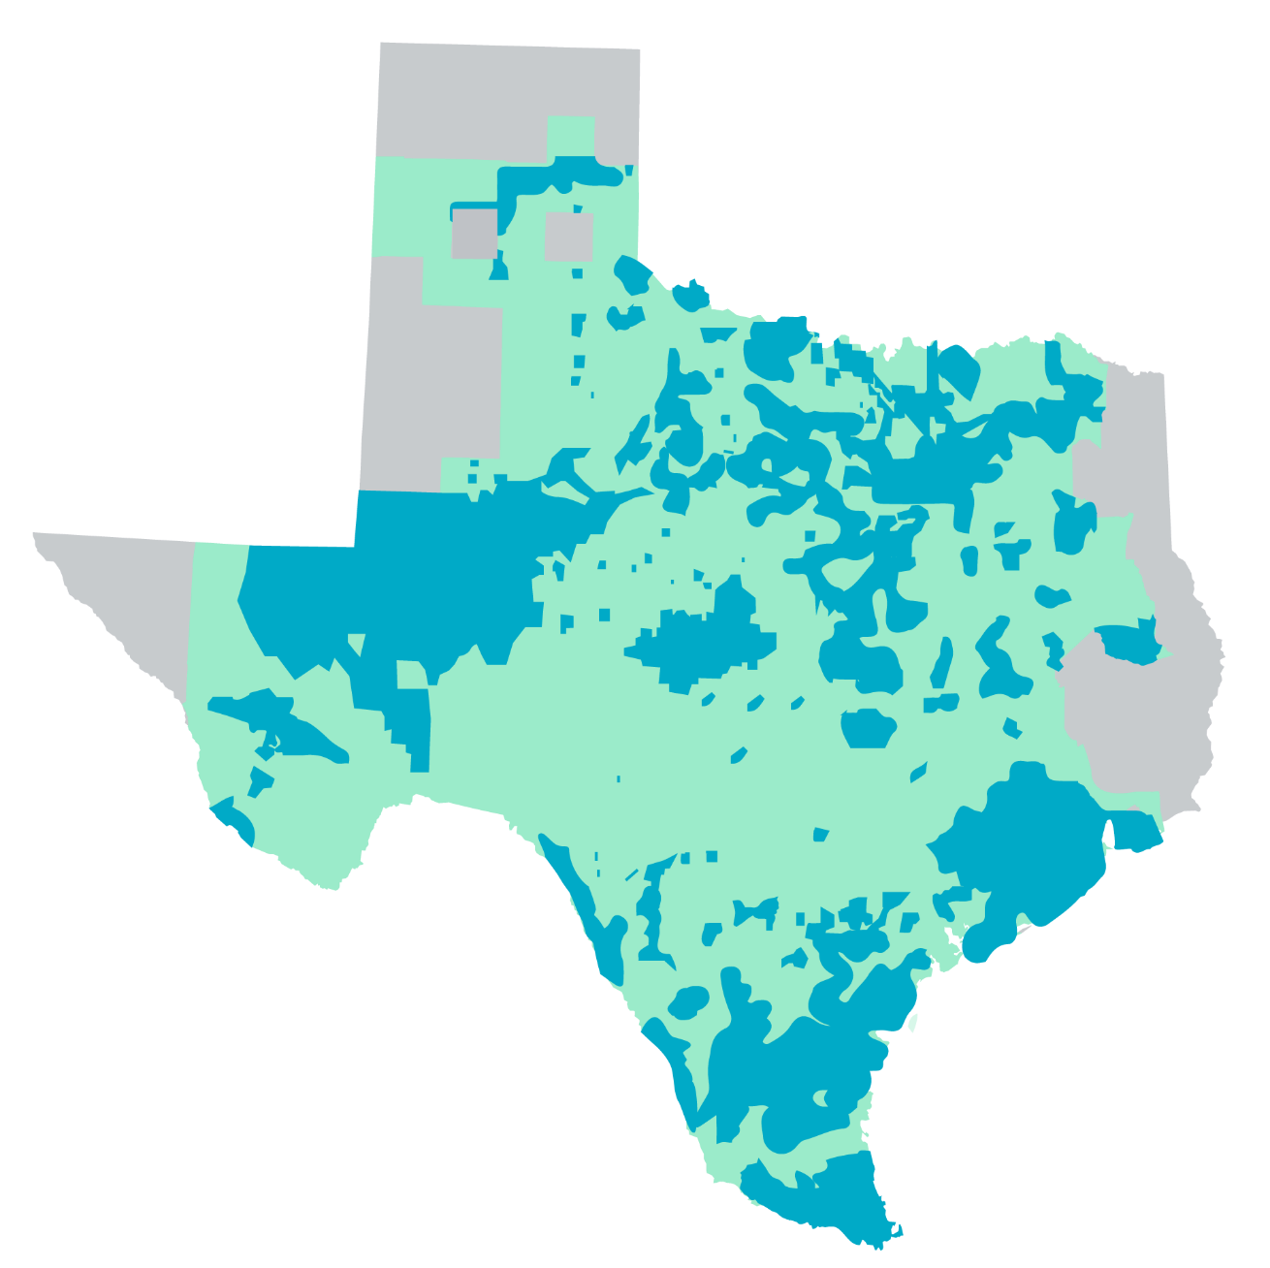
ERCOT includes Competitive, Municipal and Cooperative Service Areas
Competitive Retail Area
Municipally Owned Utilities and Electric Co-Ops

Slide 7
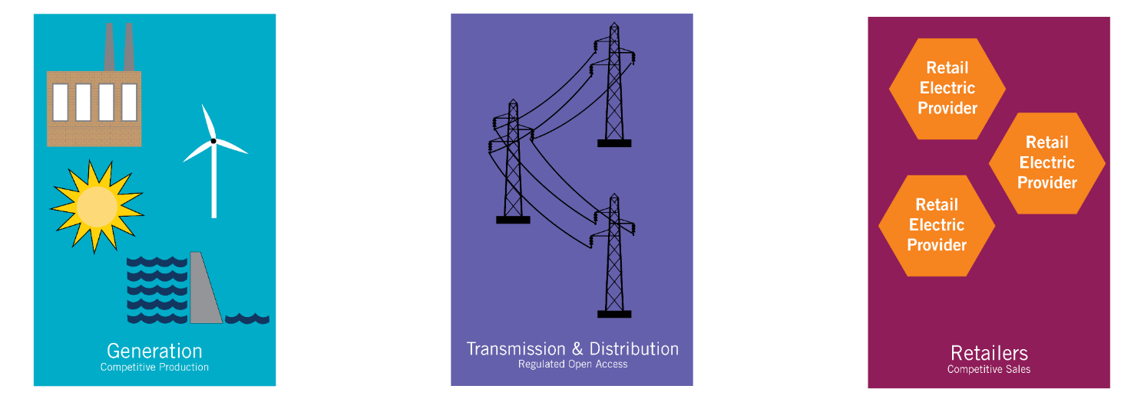
Texas Competitive Model
• Generating units are owned by privately owned companies
  Except for municipal and cooperative units
Compete in ERCOT market to serve load
  Market is overseen by PUC.
• Transmission and distribution lines and related facilities are owned and operated by regulated utilities.
  Utilities are regulated by PUC.
• Consumer’s electric load is served by competitive retailers.
  Except in municipal and cooperative utility areas

Slide 8
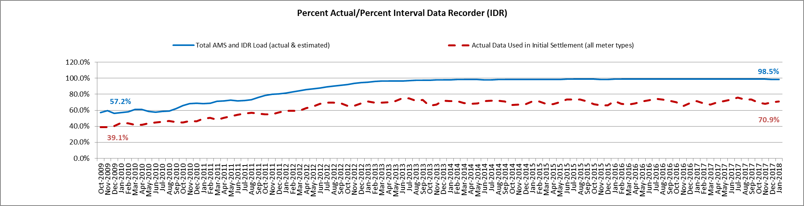
Advanced Meter Settlement Impacts – January 2018
Delta represents the quantity of load estimated for initial settlements
January 2018: At month end, settling 7.1M ESIIDs using Advanced Meter data.

Slide 9
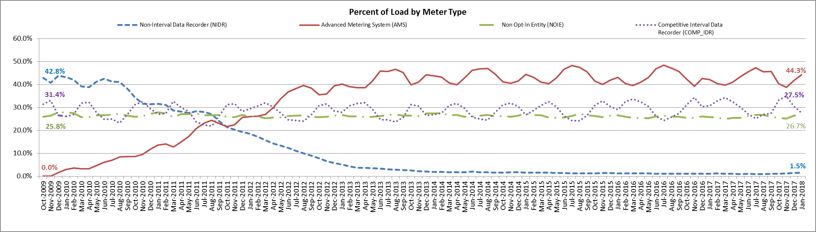

Advanced Meter Settlement Impacts – January 2018
Most of delta can be attributed to competitive IDR meters (large loads in competitive areas)
January 2018: 98.5% of the load in ERCOT is settled with 15-min interval data (AMS, Competitive IDR, and NOIE IDR).

Slide 10
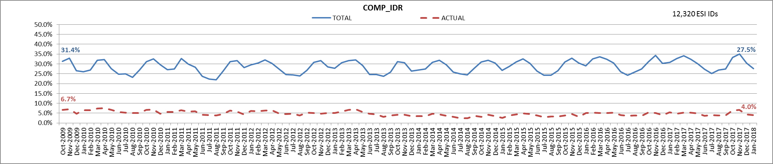
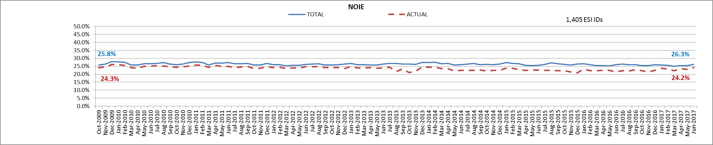

Competitive IDR Metering (Initial vs. Final)
January 2018
Delta represents the quantity of load estimated for initial settlements. This graph includes only data for large loads in competitive areas.

Slide 11

Energy Market
Market participants bring generation on-line; ERCOT may start additional generation needed to maintain reliability.
Market participants submit offers for generation output.
ERCOT clears the market every five
minutes, using the generation with
the lowest bids to serve the load,
subject to transmission constraints.
Prices received by generators
signal whether more or less
output is needed from generators
in that area at that time.
In general, the set of generator
output levels produced by this
process is the lowest cost way that
doesn’t overload the transmission system
to meet the system load for each five minute interval.
$2.54
$86.46
Prices

Slide 12
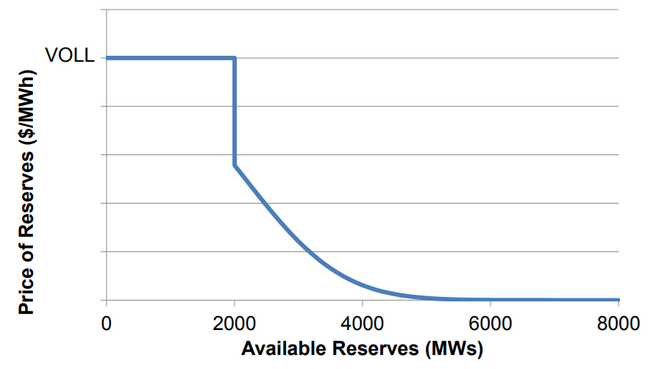
Energy Market Continued
The Day-Ahead Market is voluntary or purely financial.
Energy prices can reach as high as $9,001 per MWh.
There is no capacity market. Only Ancillary Services receive capacity payments.
Normal supply and demand pricing outcomes can be modified to reflect system reliability conditions and operational out-of-merit dispatch.
  Operating Reserve Demand Curve modifies the price to reflect the reliability value of dispatching reserves.
  Security Constrained Economic Dispatch is also rerun when a unit is committed out-of-merit to place a value on any energy produced up to it Low-Sustainable-Limit (LSL) which is offered in at a price of $0 for all units.
ORDC Curve

Slide 13
Wholesale Energy Prices

Slide 14
2018 Summer Reserve Margin Changes
2018 Summer Reserve Margin Changes Since May 2017 CDR
+2.0%
-1.3%
-1.3%
-6.1%
-1.2%
-1.7%
18.9%
-1.4%
+0.1%
9.3%
Summer 2018 Reserve Margin (May CDR 2017)
2018 Load Forecast Adjustment (1,175 MW)
ERS Update (764 MW)
Retirements (4,334 MW)
Delayed Delayed Gas
Extended Other Factors Outages and
Mothballs
(1,025 MW)
Summer 2018 Reserve Margin (Dec CDR 2017)
Renewable Projects
Projects (1,193 MW)
(881 MW Peak Contribution)

Slide 15
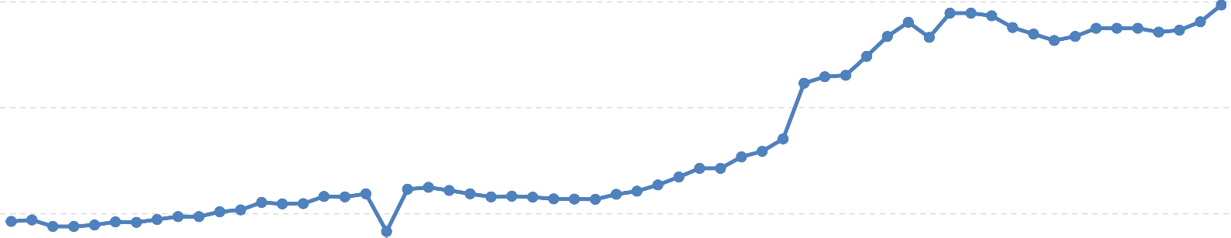
Forward Prices for August 2018
$250
$200
$150
$100
$50
$0
1/2/2018
1/4/2018
1/8/2018
1/10/2018
1/12/2018
1/16/2018
1/18/2018
1/22/2018
1/24/2018
1/26/2018
1/30/2018
2/1/2018
2/5/2018
2/7/2018
2/9/2018
2/13/2018
2/15/2018
2/19/2018
2/21/2018
2/23/2018
2/27/2018
3/1/2018
3/5/2018
3/7/2018
3/9/2018
3/13/2018
3/15/2018
3/19/2018
3/21/2018
3/23/2018
ERCOT North 345KV Real-Time Peak Fixed Price Future - ERCOT - North 345KV Hub Real-Time

Slide 16
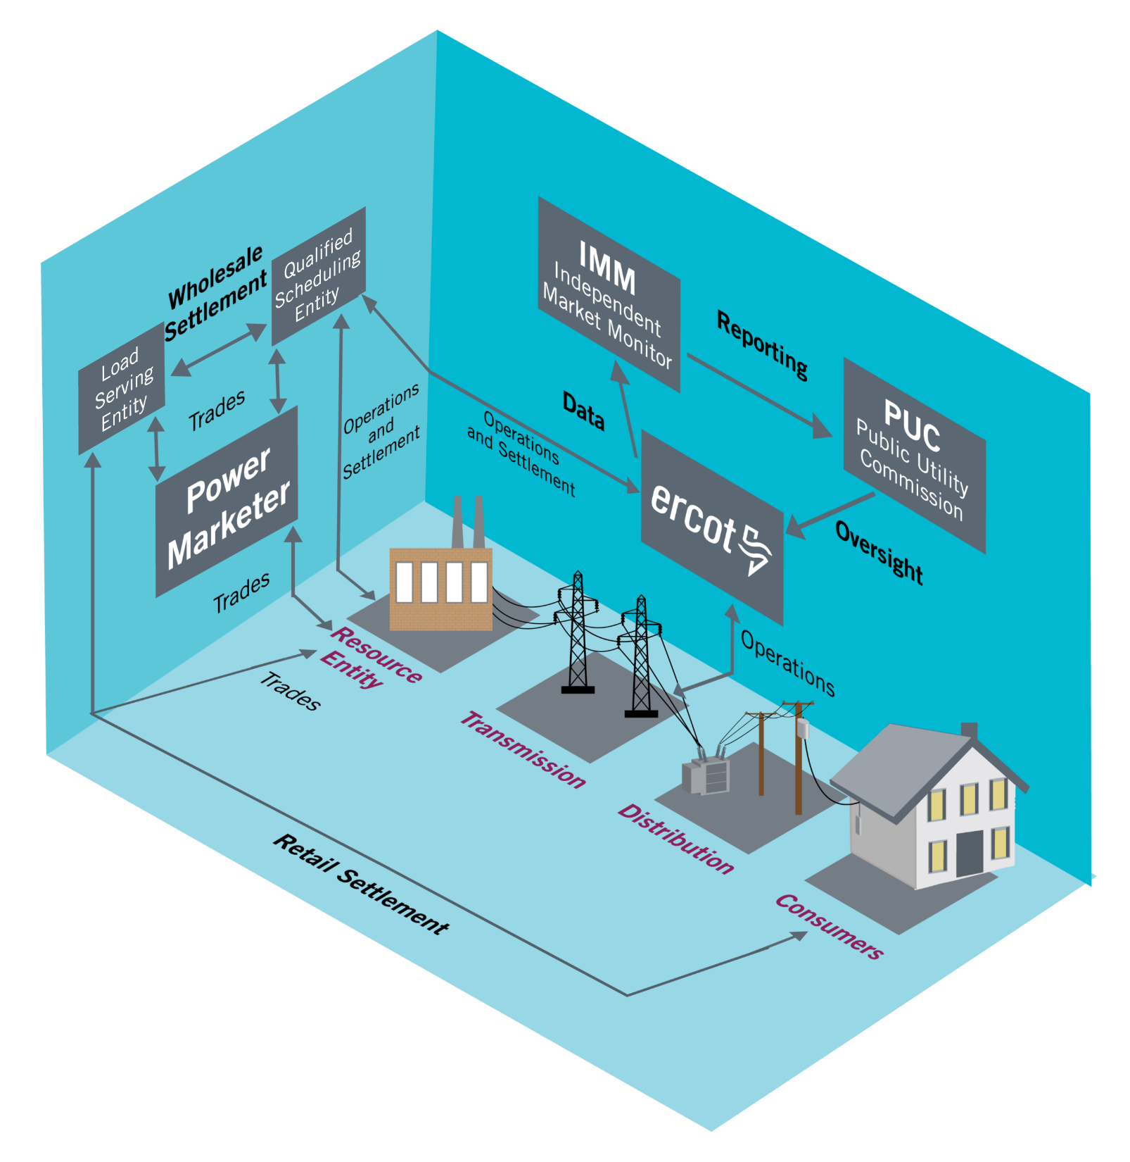
Market Relationships

Slide 17
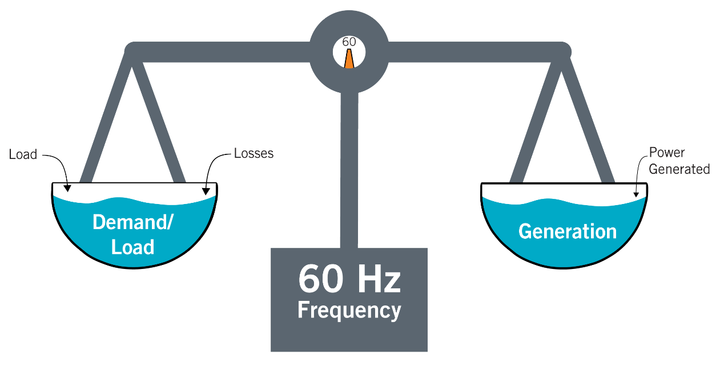
Power Supply (Generation) Must Match Load (Demand)
The fundamental concept behind ERCOT operations is that generation has to match load at all times
In other words, a 1 MW reduction in load has the same effect on the grid as a 1 MW increase in generation.

Slide 18
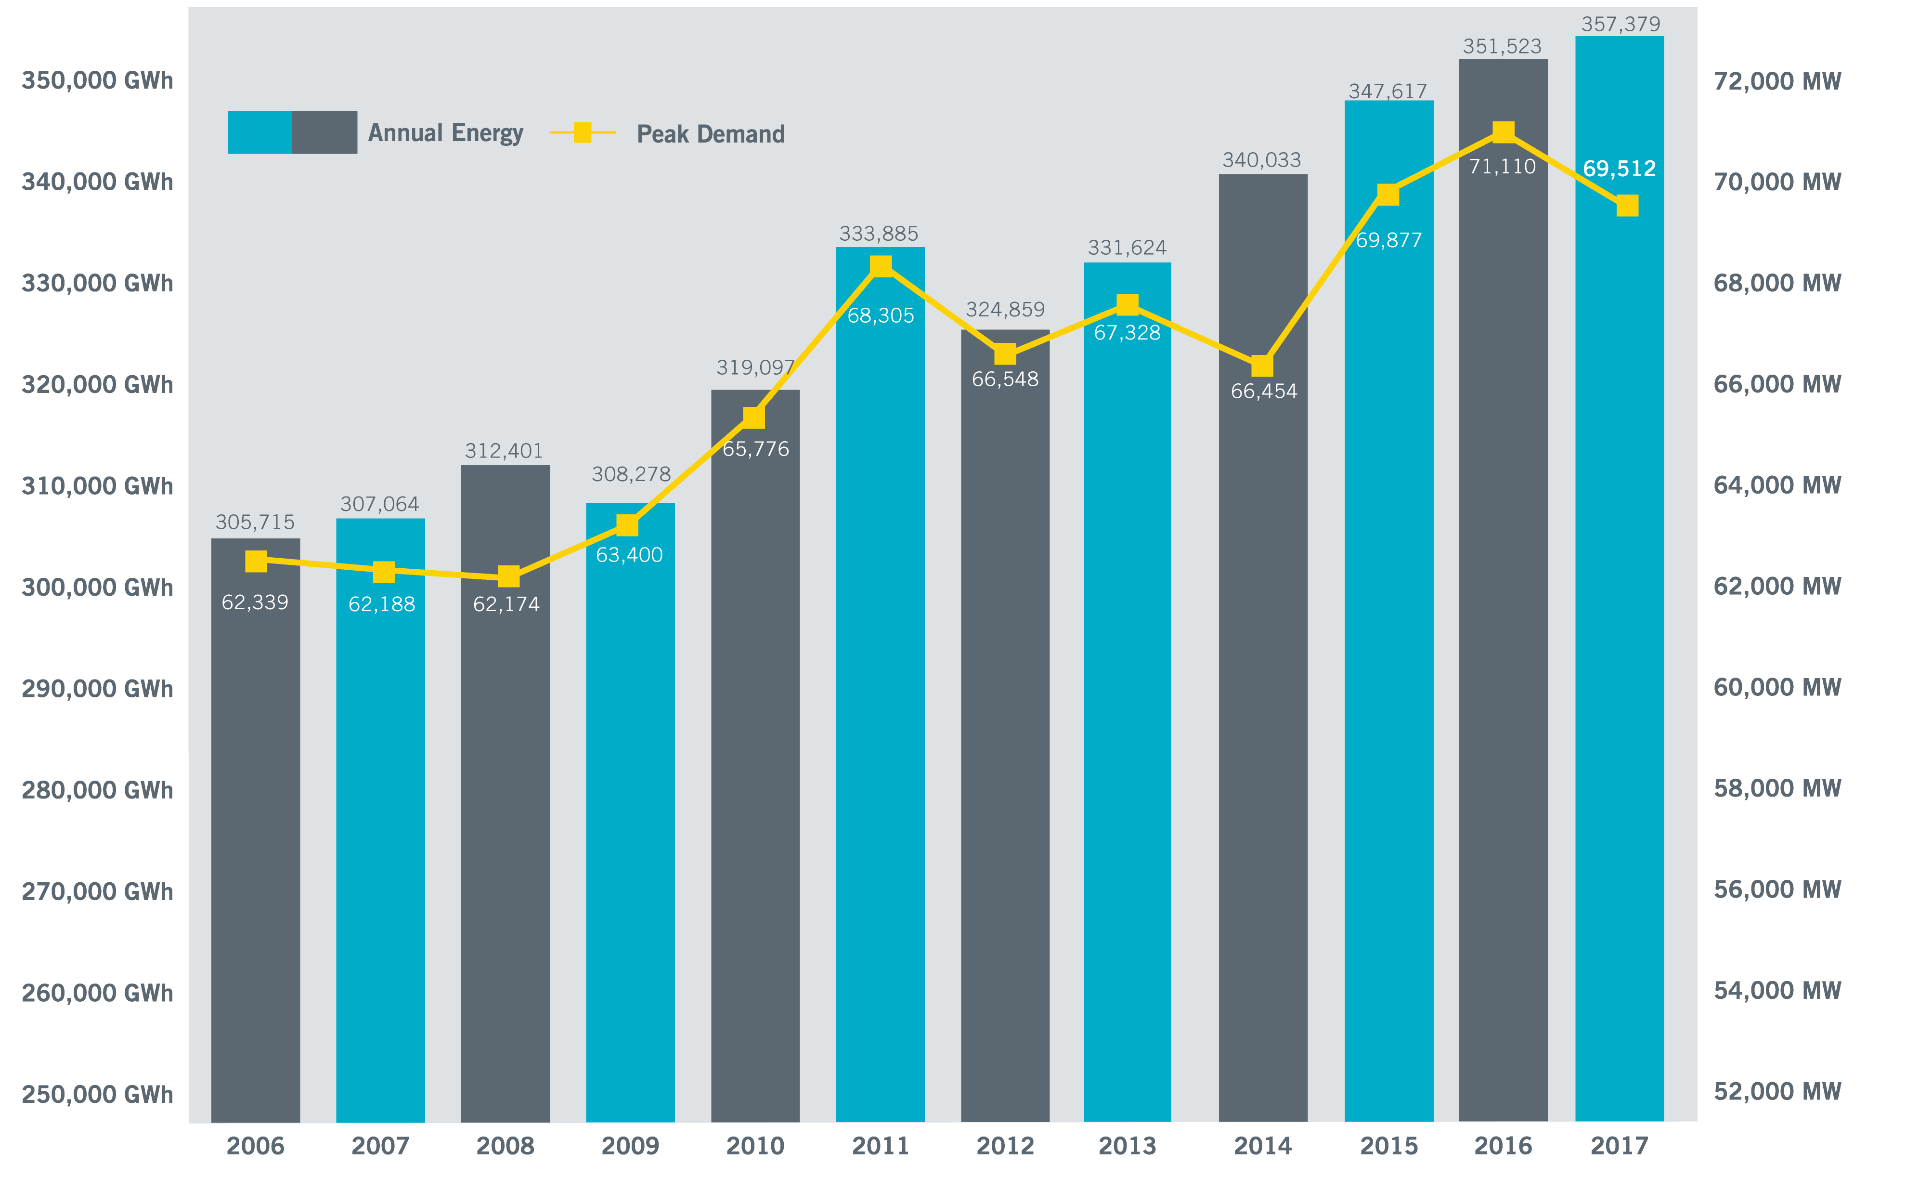
ERCOT Annual Energy and Peak Demand (2005-2017)
Energy CAGR = 1.4%
Peak Demand CAGR = 1.0%

Slide 19
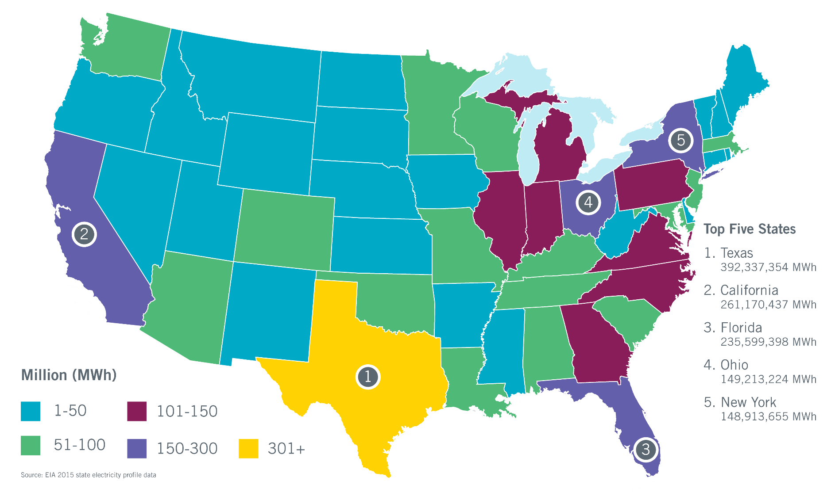
Texas Leads Nation in Electricity Sales
In 2015, retail sales to industrial customers in Texas (110.2 million MWh) were more than twice as high as in #2 California (52.6 million MWh).
Industrial load represents 28% of total Texas sales.

Slide 20
Current Records
Peak Demand Record: 71,110 megawatts (MW)
Aug. 11, 2016, 4-5 p.m.
Weekend Record: 68,368 MW
Saturday, July 29, 2017, 4-5 p.m.
Winter Peak Record: 65,750* MW
Jan. 17, 2018, 7-8 a.m.
Wind Generation Records (instantaneous)
Output: 17,541 MW
  Feb. 19, 2018, 10:05 p.m.
Penetration (load served): 54%
  Oct. 27, 2017, 4 a.m.
  Total Load = 28,416 MW*
Recent Monthly Peak Demand Records
2018
January: 65,750* MW (Jan. 17, 7-8 a.m.)
2017
January: 59,650 MW (Jan. 6, 6-7 p.m.)
April: 53,486 MW (April 28, 4-5 p.m.)
May: 59,264 MW (May 26, 4-5 p.m.)
June: 67,633 MW (June 23, 4-5 p.m.)
July: 69,512 MW (July 28, 4-5 p.m.)
October: 62,333 MW (Oct. 9, 4-5 p.m.)
*New records are preliminary, subject to change in final settlement

Slide 21
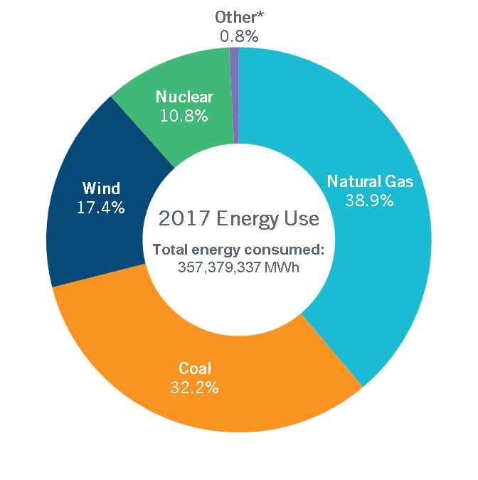
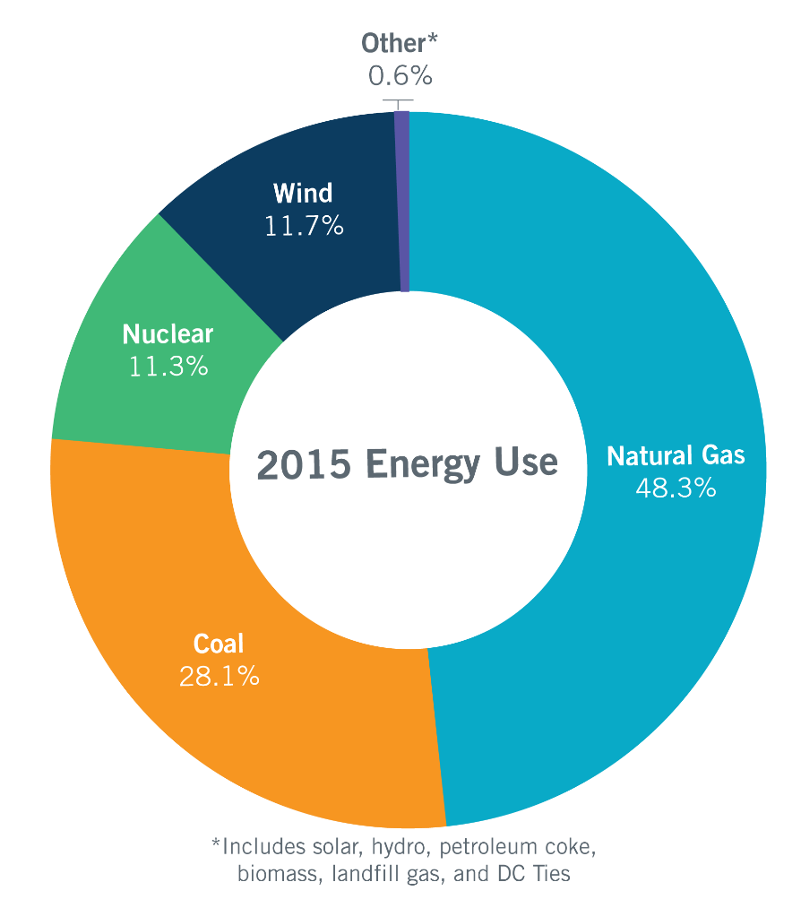
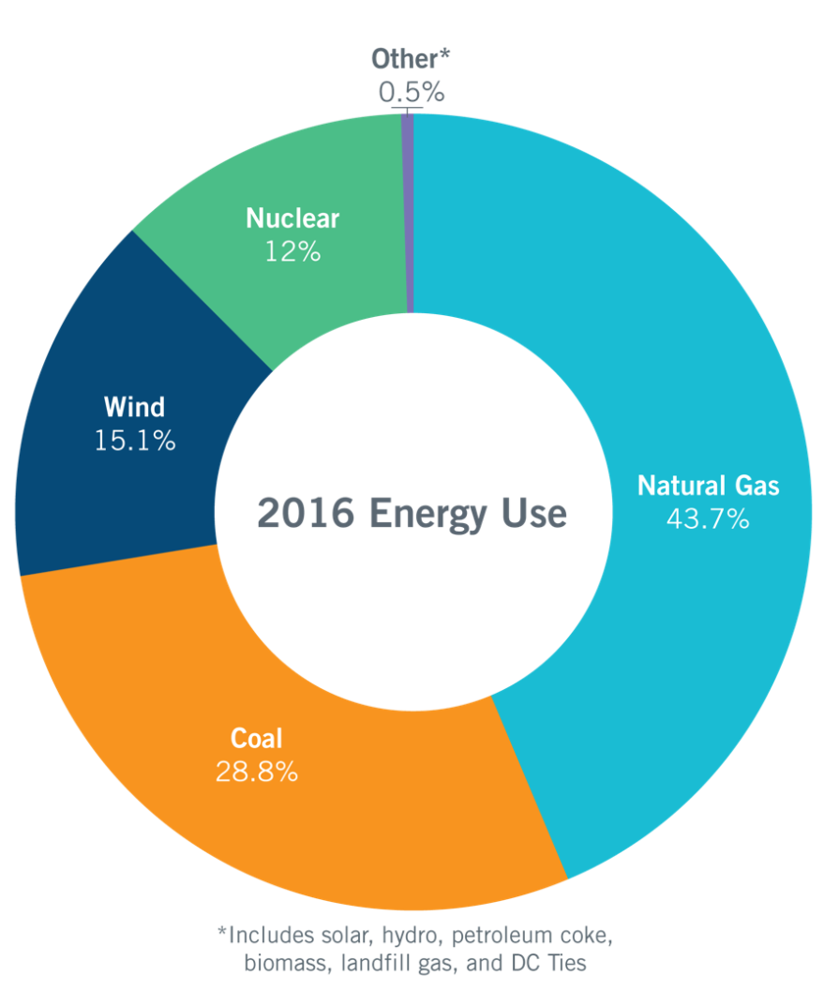
Energy Use Comparison
Total energy consumed:
347,617,436 MWh
Total energy consumed:
351,523,351 MWh
*includes solar, hydro, petroleum coke, biomass, landfill gas, distillate fuel oil, net DC Tie and Block Load Transfer imports/exports, and an adjustment for Wholesale Storage Load

Slide 22
Changes in the Resource Price Stack (pre-2017 retirements)
ERCOT Bid Stack with Natural Gas Price = $4.50/MMBTu

Slide 23
Changes in the Resource Price Stack (pre-2017 coal retirements)
ERCOT Bid Stack with Natural Gas Price = $2.50/MMBTu

Slide 24
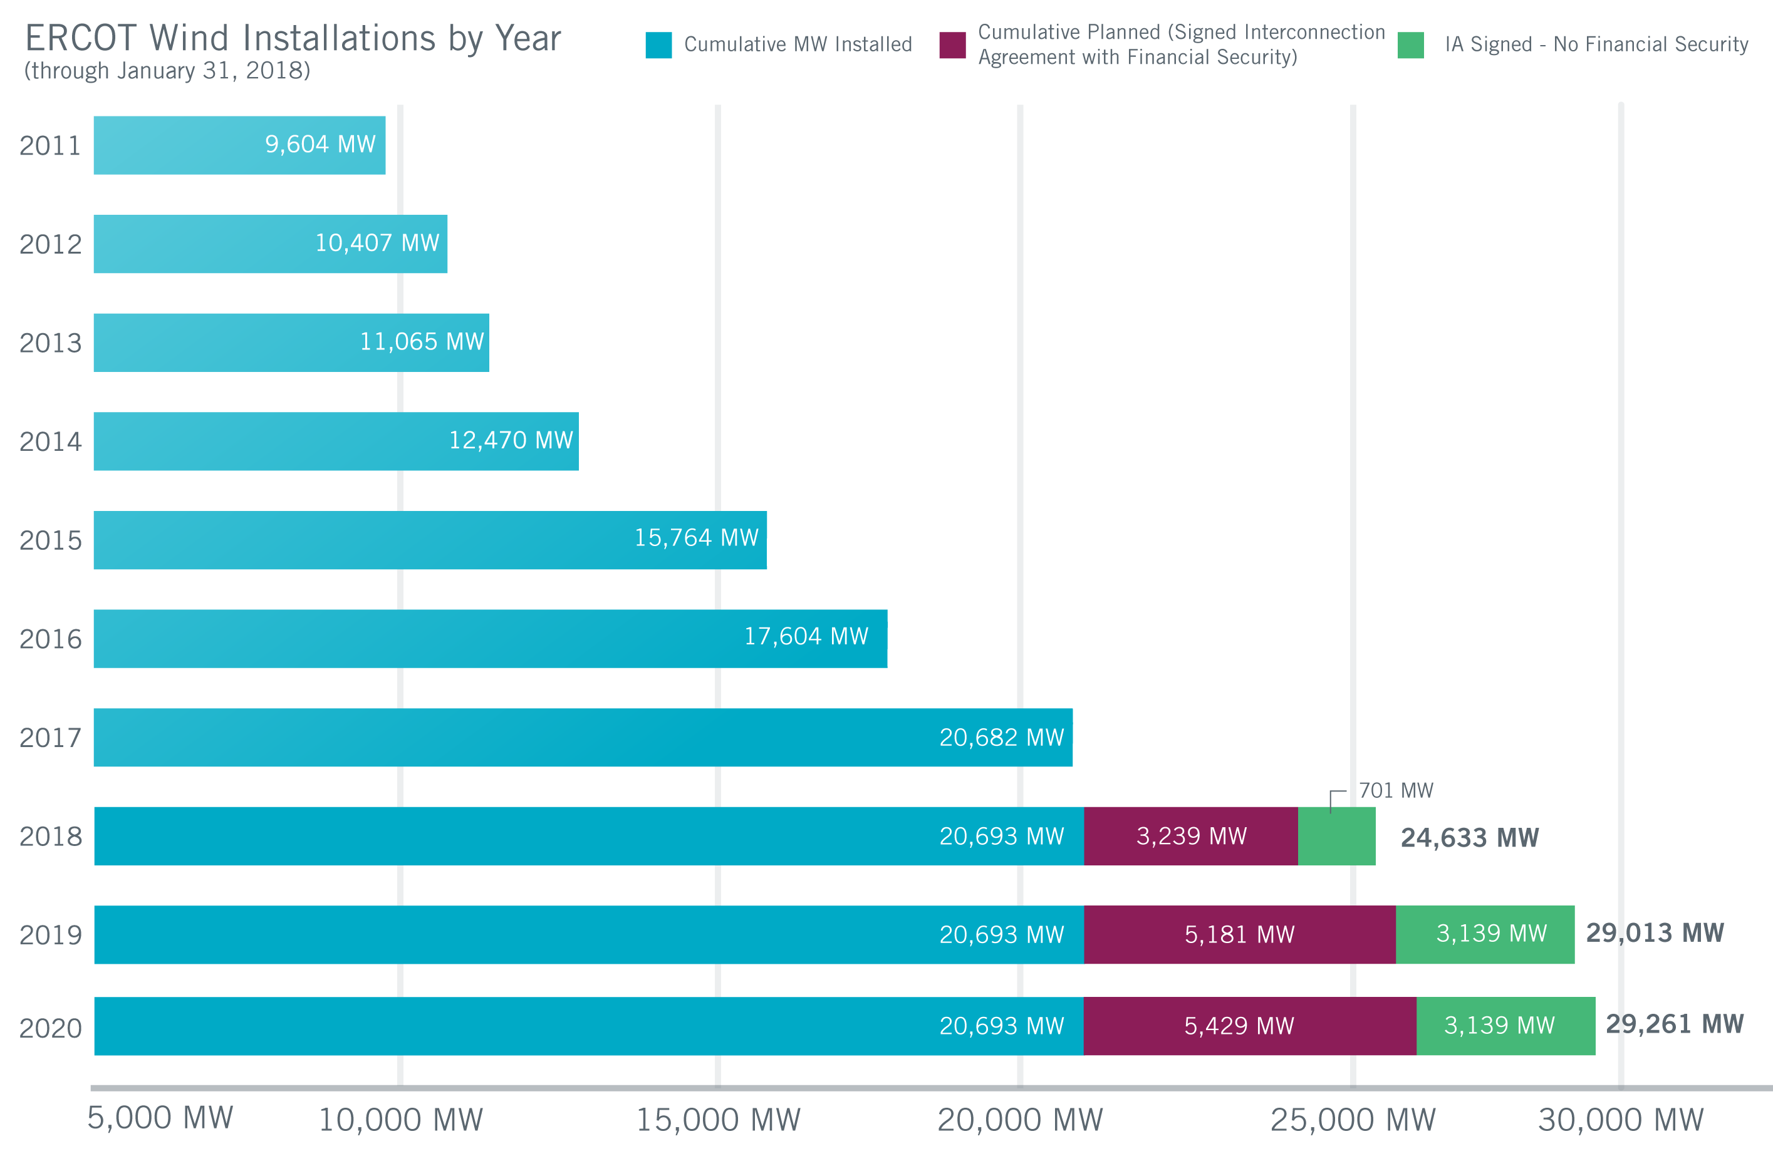
Wind Generation Capacity – January 2018
Steady growth continues, with some spikes.
Largest annual increase: 3,294 MW in 2015
(A close second: 3,220 MW in 2008)
Incentives, uncertainty and other factors affect construction decisions and schedules.
Not all planned projects will get built.
Texas continues to lead U.S. in wind capacity.
Future outcomes uncertain

Slide 25
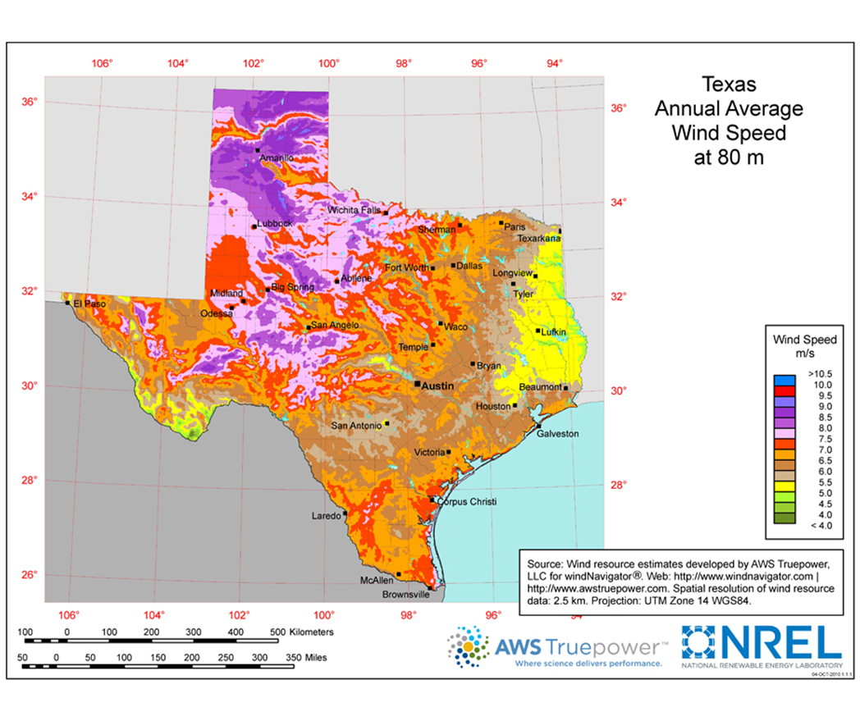
Wind Resource Estimate Map
The ERCOT system of open access allows renewable generation to be located in areas with the best natural resources.

Slide 26
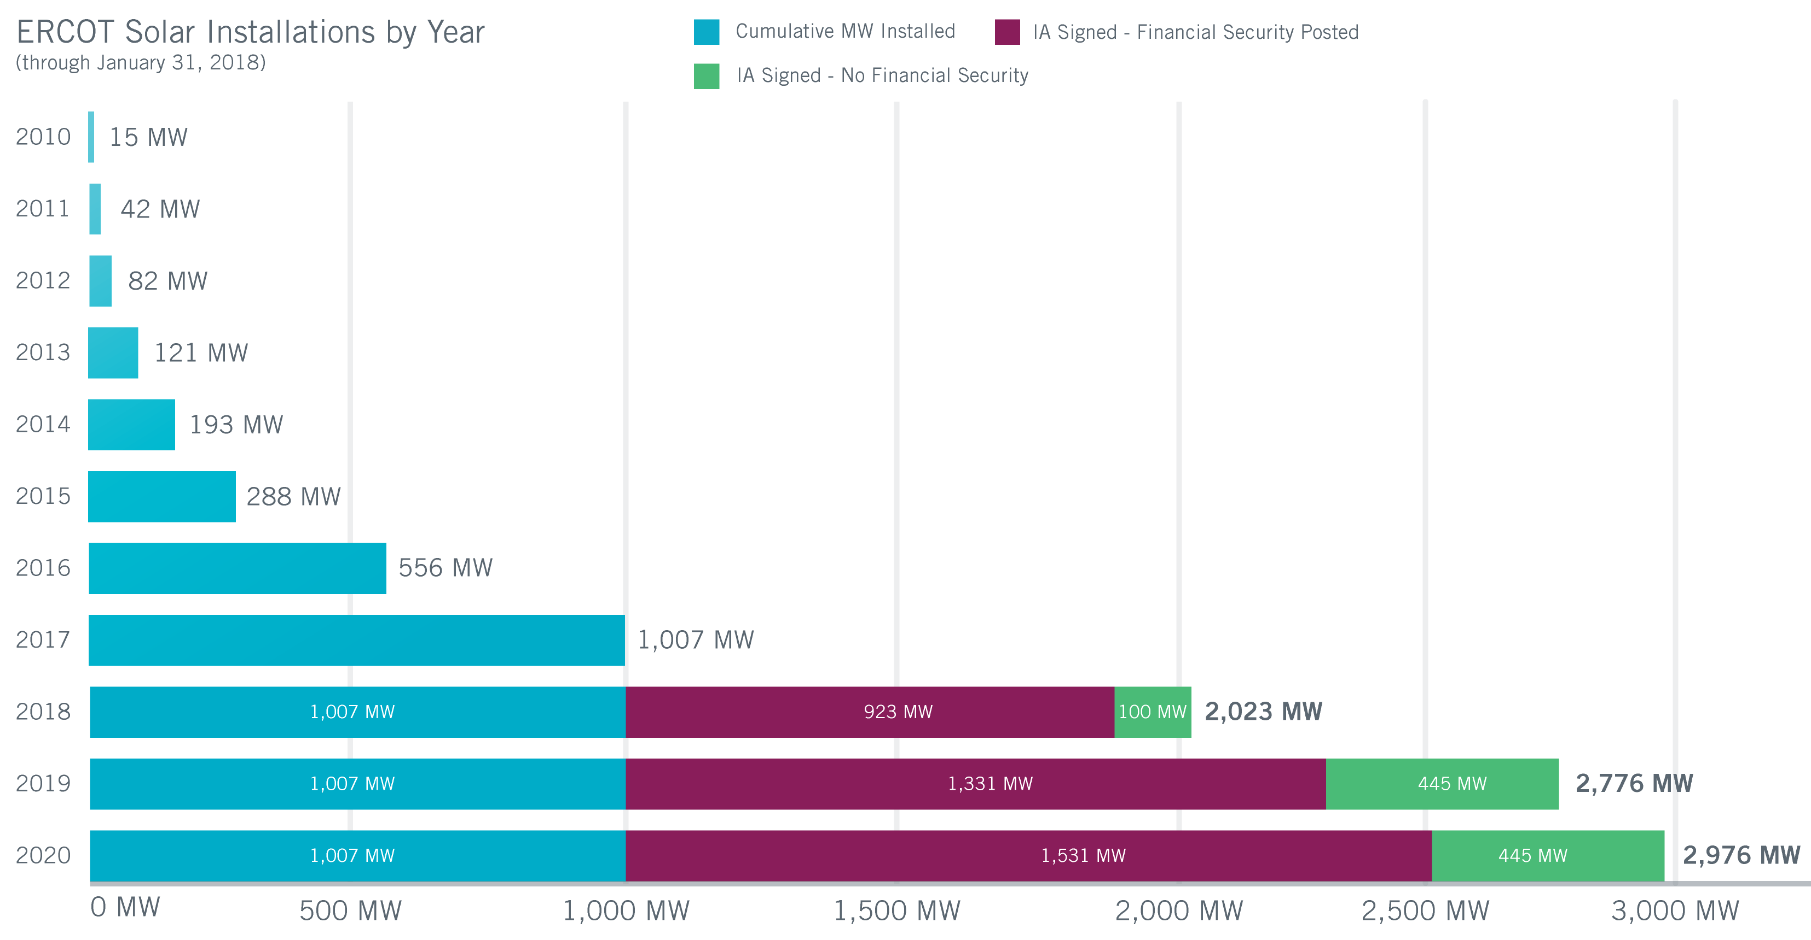
Utility Scale Solar Generation Capacity – January 2018
Future outcomes uncertain
The data presented here is based upon the latest registration data provided to ERCOT by the resource owners and can change without notice. Any capacity changes will be reflected in current and subsequent years' totals. Scheduling delays will also be reflected in the planned projects as that information is received. This chart reflects planned units in the calendar year of submission rather than installations by peak of year shown.

Slide 27
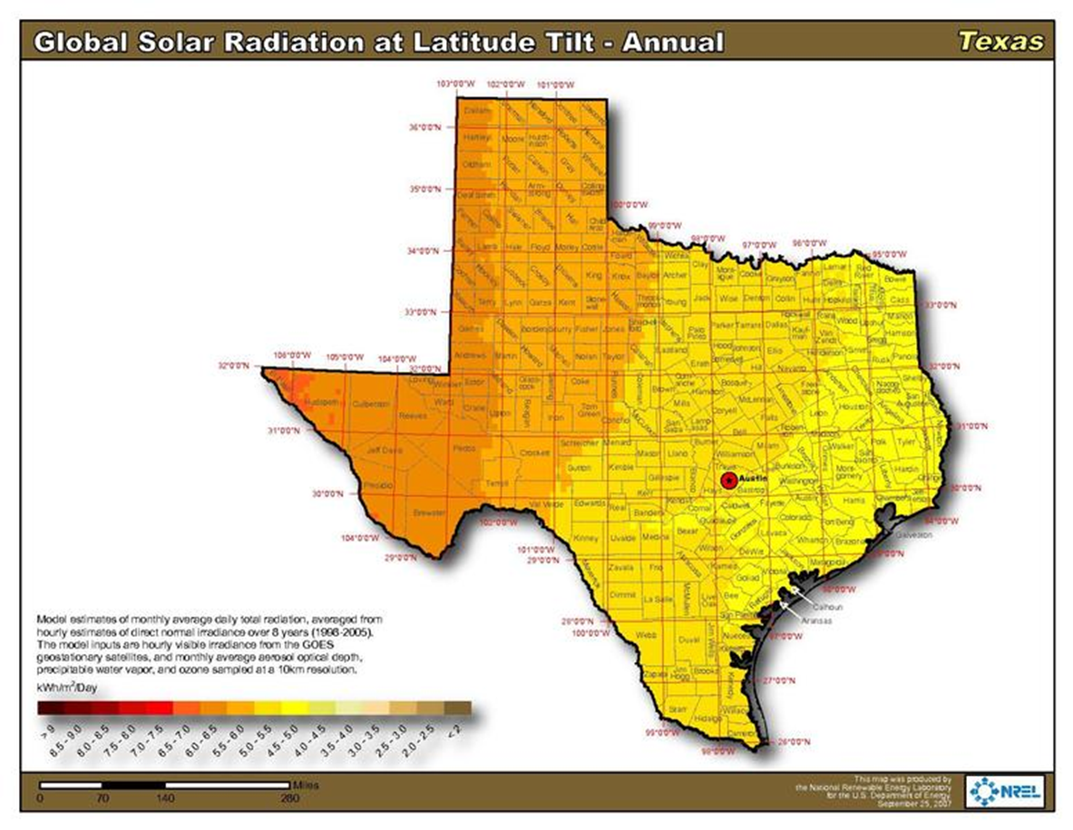
Solar Resource Estimate Map

Slide 28
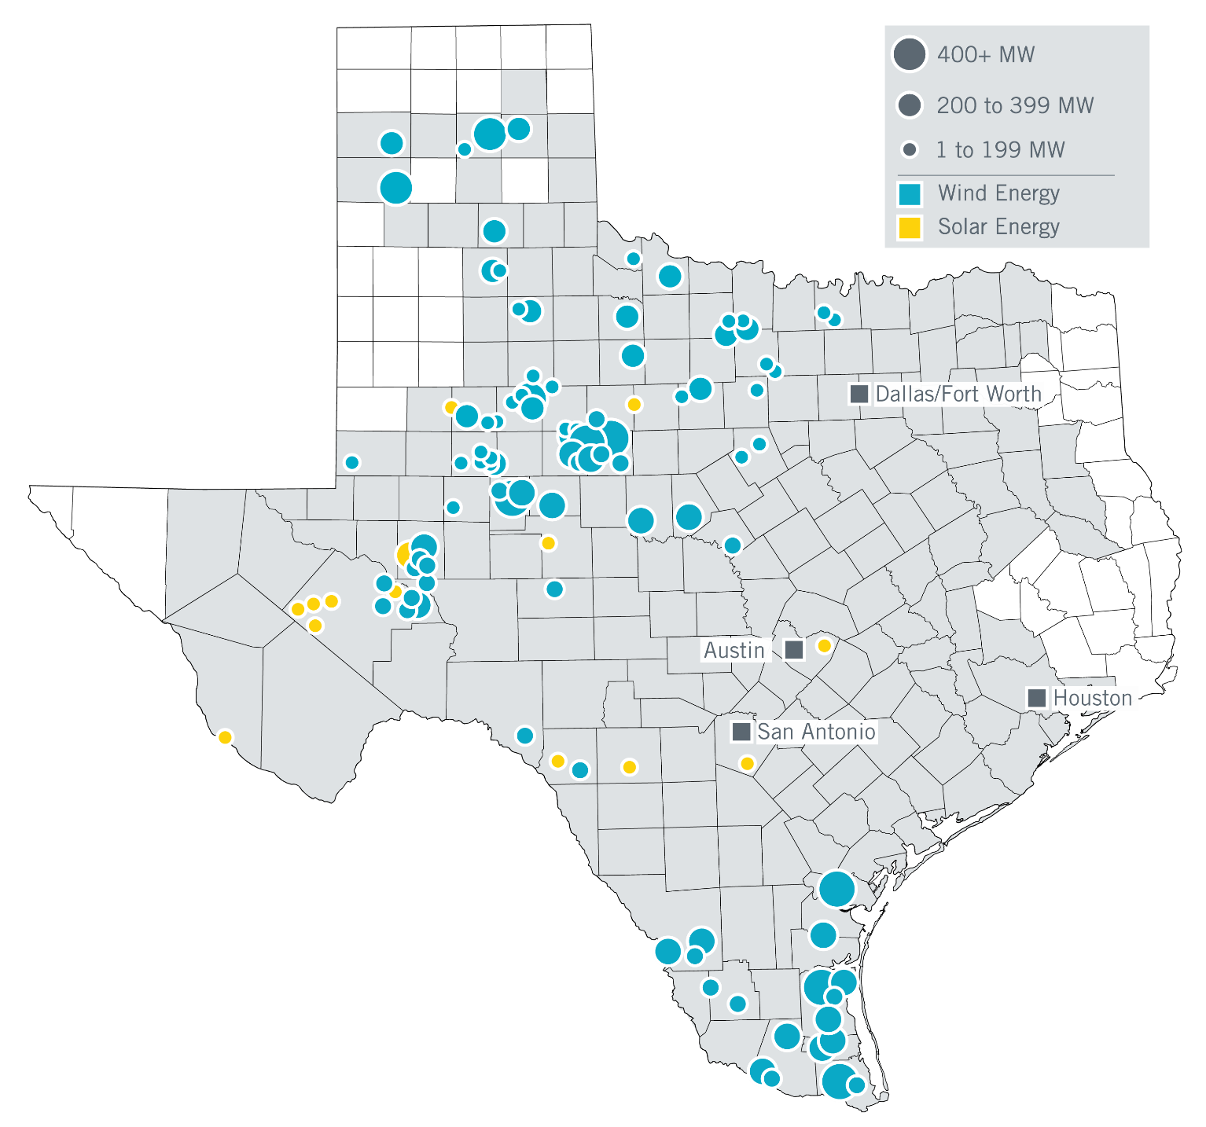

Utility Scale Renewable Energy in the ERCOT Region
Renewable generation is typically not located near major load centers.
As of January 2018

Slide 29
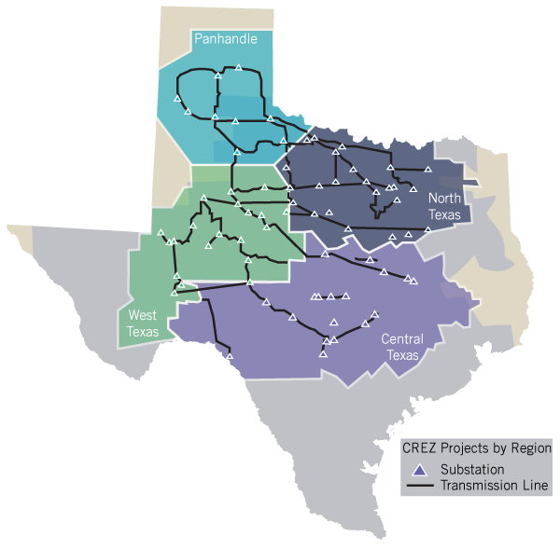
Competitive Renewable Energy Zone Transmission Map
(CREZ)
Completed in 2011
Transmission plan designed to serve approximately 18.5 GW
  ~3,600 right-of-way miles of 345-kV
  $6.8 billion project cost
Lines are open access; use not limited to wind

Slide 30
Problems Associated with Generation Moving Further from Load
Long line impedances are sometimes compensated with series capacitors which require system operators to monitor and protect against Sub-Synchronous Oscillations (SSO/SSR).
Moving power over long distances results in increased losses.
Voltage stability awareness and limits become more important as power is moved over longer distances.
ERCOT has made substantial investments in people, technology, and infrastructure in order to mitigate these problems and adjust to a changing portfolio of generation resources. Without this investment, the level of renewable integration would not be possible.

Slide 31
Reliability Risk Desk Addition in the Control Room
Goal is improved quantitative analysis and dynamic consideration of particular risks:
  Wind and solar forecast errors
  Net Load ramps
  Low inertia
  Variable Ancillary Service needs
Additional resources added in January 2017:
  One additional operator per shift
  New monitoring and analytical tools
    Capacity Availability Tool (looks ahead for ramping issues and Non-Spin shortages)
    Inertia Monitor (looks ahead 24 hours for inertia shortages)
    Wind and Solar Forecast displays (graphically highlight regional performance)
    Monitor screens specific to the Rio Grande Valley and Panhandle regions
Evolving Needs
Risks
Operational
Monitoring
and Analysis
Operating
Actions

Slide 32
Estimates of Distributed Energy Resources (DER) Penetration in ERCOT
  DER generation is typically invertor-based and connected to the distribution system.
  Units less than 1 MW:
    Approx. 30,000 units (mainly rooftop solar)
    Approx. 250 MW
  Units greater than 1 MW:
    140 units (~90% diesel or natural gas)
    More than 850 MW
    Most are registered with ERCOT
  This is a different picture than what you’ll find in other regions (i.e., California reports over 4,000 MW of rooftop solar, not including Los Angeles).
  ERCOT is currently in the process of mapping registered DER so that they can eventually receive Locational Marginal Pricing and, at some point in the future, be considered for Security Constrained Economic Dispatch.

Slide 33
ERCOT Challenges & Opportunities
Adapting to the changing resource mix
  Operate reliably as the generation fleet experiences cycles of retirement and investment.
  Enable flexible responses to dynamic system conditions through improved processing of grid simulations, which allows comprehensive real-time stability assessments.
Increasing Distributed Energy Resources
  Establish visibility, integrate and respond to potentially millions
  of new resources that are not currently visible.
Maintaining secure systems
  Recognize and mitigate increased cybersecurity risks.
  Leverage industry and government collaboration.

Slide 34





















Grid Security Collaboration
Federal/National
State
Industry
National Labs
Critical Infrastructure Protection Working Group (CIPWG)
Grid Resilience Working Group (GRWG)

Slide 35
ERCOT Challenges & Opportunities
Supporting and ensuring grid and market resilience
  Be prepared to operate if ERCOT’s energy management or market systems become unavailable.
  Develop systems with adverse conditions in mind (we have recent examples in Texas).
  Resist fragile environments.
Managing amid increasing complexity
  Facilitate development and testing of increasingly complex and inter-related IT systems.
  Train operators for a more unpredictable system.
  Develop modern, useful interfaces for sharing information with those we serve.

Slide 36
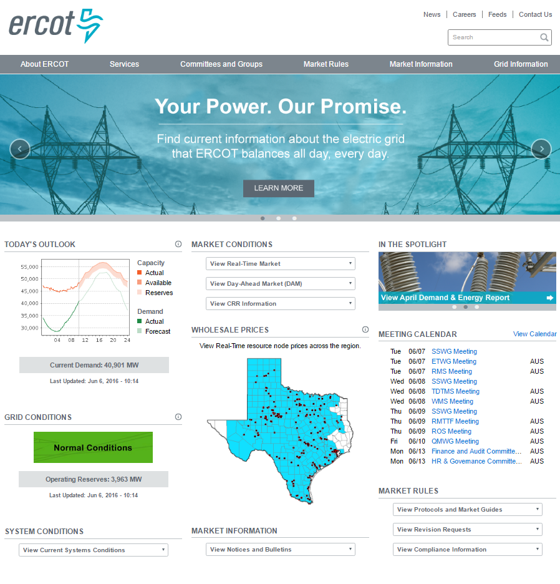
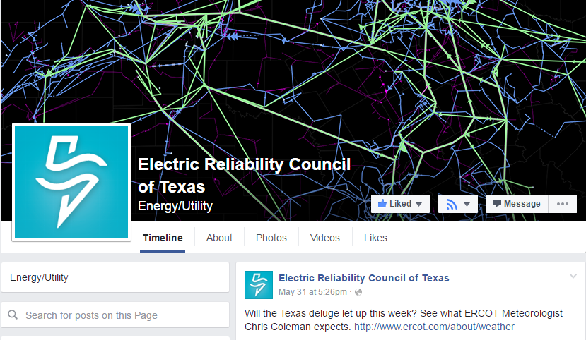


ERCOT Communication Channels
ERCOT website – www.ercot.com
Today’s Outlook and grid conditions
Daily and seasonal weather
Market information, prices and more
Social media – join us!
Twitter: @ERCOT_ISO
Facebook: Electric Reliability Council of Texas
LinkedIn: ERCOT
ERCOT mobile app
Real-time updates
Wholesale pricing
Information sharing

