Slide 1
Transportation

Slide 2
Learning Objectives
Understand that gasoline combustion moves the vehicle as well as emit greenhouse gases.
Understand that carbon emissions from vehicles are very large due to the scale of driving that occurs annually .
Understand that alternative fuel vehicles have lower tailpipe emissions but overall emissions are not necessarily lower.
Understand that alternative fuel vehicles can emit less carbon than conventional internal combustion engine vehicles but face challenges such as increased cost and lack of fueling infrastructure.
Understand that buses emit more carbon than individual cars but have a larger passenger capacity.

Slide 3
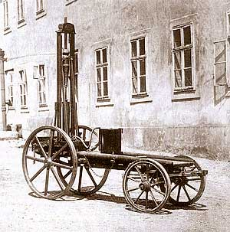
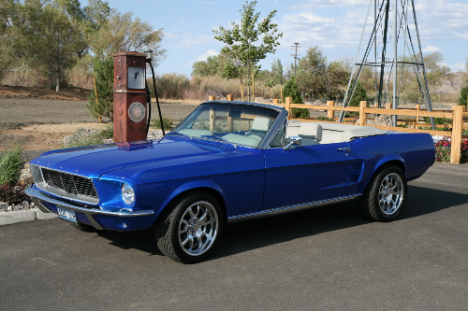
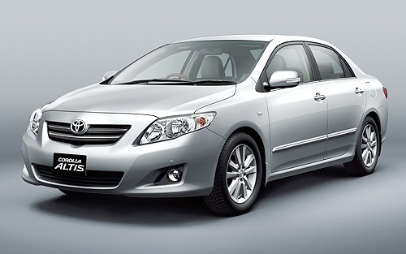
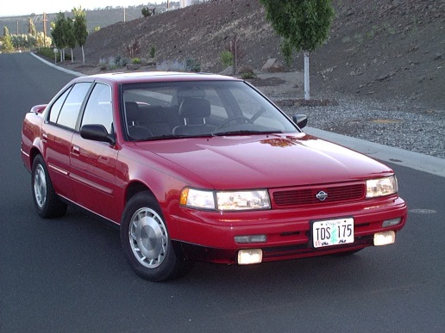
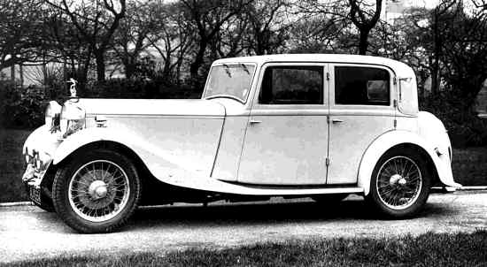
The Internal Combustion Engine
Cars have operated using the internal combustion engine for over a hundred years!
?

Slide 4
How does a car work?
+
???
Movement!
What happens here?
Smog!

Slide 5
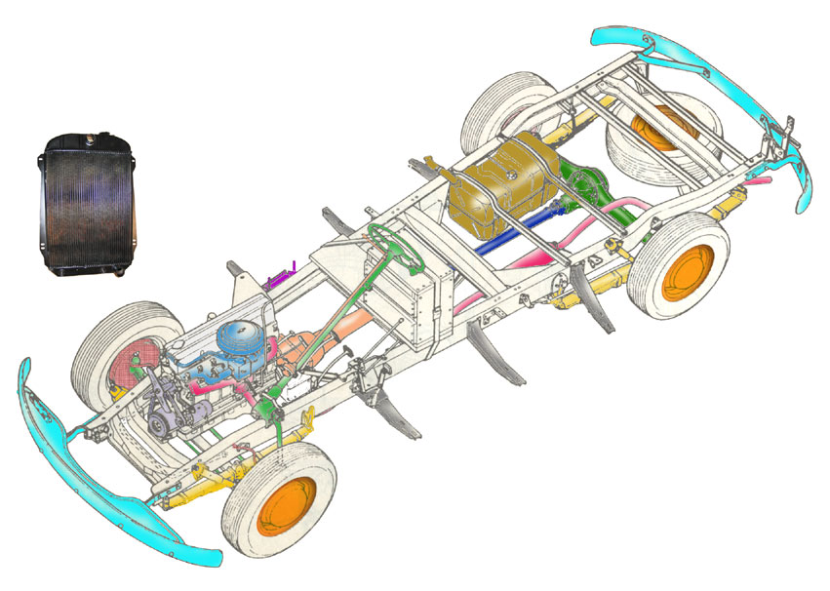
How does a car work?
Gasoline is pumped into the car and stored in the gas tank
Gasoline explodes in the car engine!
Explosions move the pistons moving the crankshaft, moving the transmission, moving the wheels
4. Exhaust (smoke and gases) from the exploded gasoline leave the car through the tailpipe.

Slide 6
A bunch of stuff comes out the tailpipe of an internal combustion engine.
On average, about half a pound of carbon dioxide comes out of the tailpipe for every one mile driven.
Half a pound doesn’t seem like a lot, but people drive a LOT!
If we added up the total distance driven by all US drivers in one year, how long would this distance be?
200 million drivers
15,000 miles driven annually by each driver

Slide 7
Answer - Total emissions are quite high!
US cars emit 0.75x10⁹ short tons (0.7x10⁹ metric tons) of carbon dioxide every year.
That’s equivalent to the weight of 4 million blue whales!

Slide 8
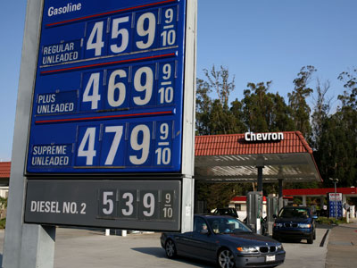
Why should we move away from oil?
Limited resource
Gas is also getting expensive!

Slide 9
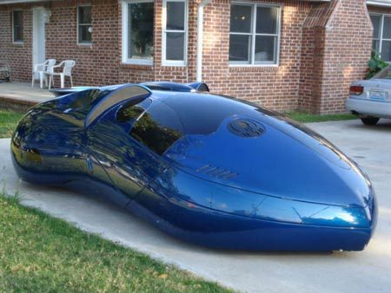
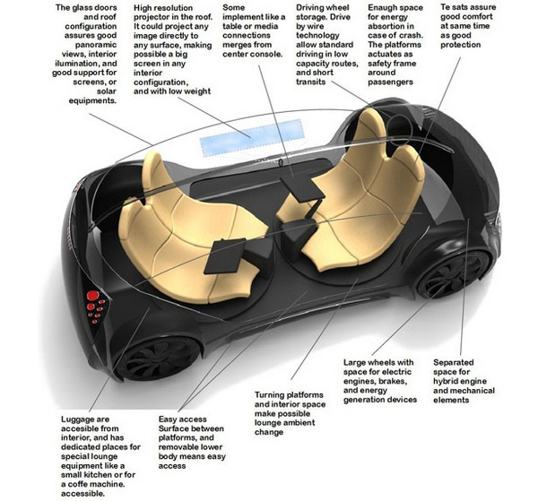
Cars of the future may emit less.
What will a car look like in 50 years?

Slide 10
Alternative fuel vehicles
Although many new car designs are being developed, one of the most radical changes is the shift away from gasoline as a fuel.
Other fuel sources?
Electricity
Biofuels
Hydrogen Gas
Natural Gas

Slide 11
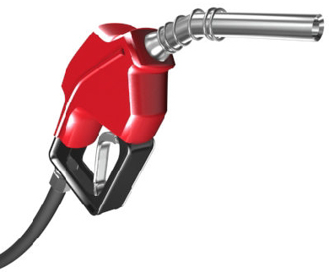
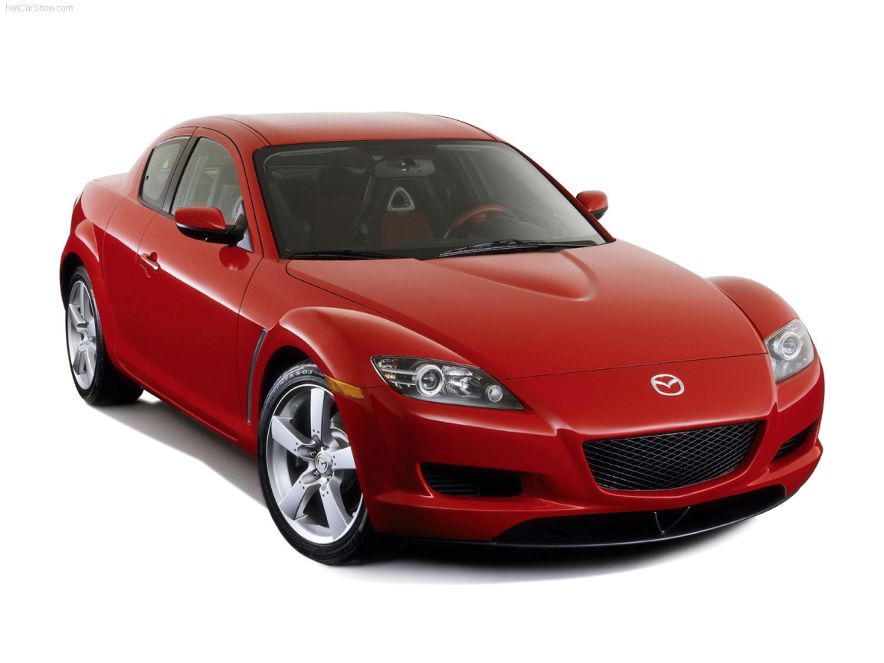
Gas Car
Input: Gasoline
Output: 1 pound of carbon dioxide every 2 miles

Slide 12
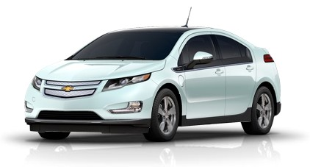
Electric Car
Input: Electricity
Output: Nothing! Energy comes from batteries, which don’t emit anything.

Slide 13
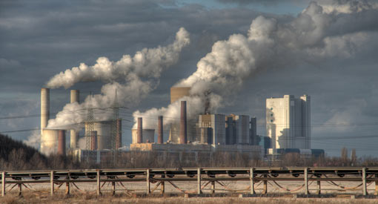
But, where does the electricity come from?
Amount of emissions depends on the type of power plant
Input: Electricity
From power plants!
Output: Nothing! Energy comes from batteries, which don’t emit anything.

Slide 14
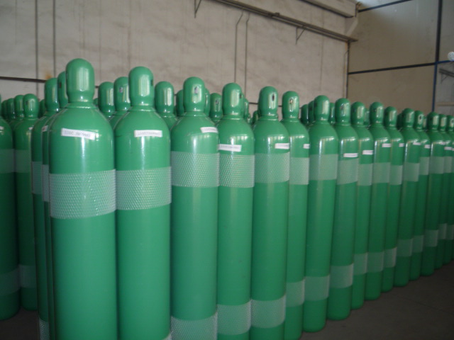
Hydrogen Car
Input: Hydrogen Gas
Output: Water

Slide 15
But, hydrogen can take a lot of energy to produce!
Input: Hydrogen Gas
Output: Water

Slide 16
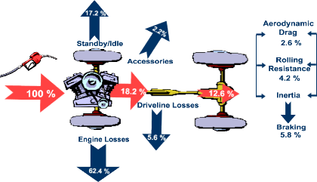
Alternative Fuel Upsides
Eliminates localized pollution
Efficiency gains from electric motor in vehicles
Reduced reliance on foreign oil
Cleaner than gasoline assuming we move to power sources such as solar or wind

Slide 17
Alternative Fuel Downsides
Doesn’t necessarily reduce emissions, depends on where the fuel comes from and how it’s made.
Very expensive! The car can cost twice or three times as much up front.
New cars require other support, for gasoline cars there are gas stations. Electric cars need charging stations, hydrogen cars need hydrogen gas stations.

Slide 18
Public transit is another way of saving fuel.
Yes, emissions are higher for a bus than for a car.
On average, one bus emits as much as five cars!

Slide 19
But one bus can also take 50 cars off the road!

Slide 20
Behavior and perception changes can also save fuel.
Very difficult! Even if people care about the environment, they still need to drive to work, get groceries, drive kids, etc.
Driving less and/or saving fuel was not something people cared about in the past.

Slide 21
Shift in perception
Fuel efficiency is finally becoming an important attribute for consumers buying a vehicle due to high gas prices.
Manufacturers have responded: in 2000, none of the car commercials featured during the Super Bowl mentioned fuel efficiency. In 2012, 12 of 14 of the car commercials had fuel efficiency as a selling point – including all truck commercials!
Improvements to fuel efficiency after 20 years of flat fuel efficiency.

