Slide 1
How Power Plants Work

Slide 2
What is electricity?
Charge is one of the fundamental characteristics of matter
Particles like protons and electrons have a certain charge associated with them
Whenever charge builds up in a particular location, there are associated fields and potentials that are created
Since protons are several orders of magnitude heavier than electrons, we are interested in the movement of electrons
In semiconductor physics, engineers use the movement of both electrons and the absence of electrons, known as holes, to model structures
Basically, electricity is the phenomenon associate with the
presence and flow of electric charge

Slide 3
What are some sources of electricity?
Lightning. Electrostatic discharge between electrically charged regions between clouds, or a cloud and the Earth's surface
Batteries. Converts electrochemical energy into electrical energy
Solar Panels. Generates electrons (and holes) upon exposure to light via the photoelectric effect
Piezoelectric Materials. Crystals that generate electrons in response to applied mechanical stress
Generators. Generates electricity by rotating a magnetic rotor inside conducting stator windings

Slide 4
Where do we get electricity from?
Power plants (coal, natural gas, nuclear), hydro-dams, wind turbines, solar panels
Which provides the most electricity for us?
Coal
Natural Gas
Nuclear
Hydro
Everything else
Notes:
Which provides the most

Slide 5
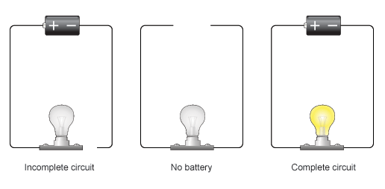
What does a circuit look like?
Source: BBC
Notes:
http://www.bbc.co.uk/bitesize/ks3/science/energy_electricity_forces/electric_current_voltage/revision/2/

Slide 6
Basic theory describing electricity.
Kirchoff's Current Law: All currents into a node sum to zero
Kirchoff's Voltage Law: All voltages in a loop sum to zero
Ohm's Law: V = IR
Electric power in a circuit: P = IV = V2=R = I 2R
Voltage is measured in volts (V)
Current is measured in amperes (A)
Resistance is measured in ohms (Ω)

Slide 7
Alternating current vs. Direct current
AC power is like an ocean wave
DC power is like a river current

Slide 8
Comparison of AC vs DC
AC
Easier to transform between voltages
Cheaper, simpler, and more reliable than DC
Fewer voltage losses during transmission
Used for motors in refrigerators and washer/dryers
DC
First to be installed in urban areas
More expensive, more intricate, and less reliable than AC
More voltage losses during transmission
Used for computers and other electronic devices

Slide 9
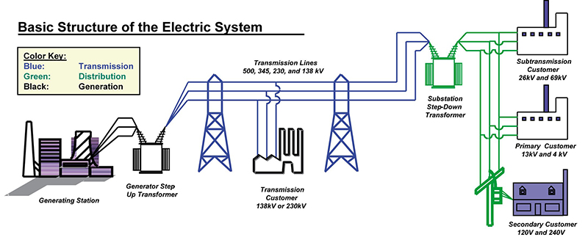
Basic Structure of the Electric System
Source: U of Idaho
Notes:
http://www.webpages.uidaho.edu/sustainability/chapters/ch06/ch06-p3a.asp

Slide 10
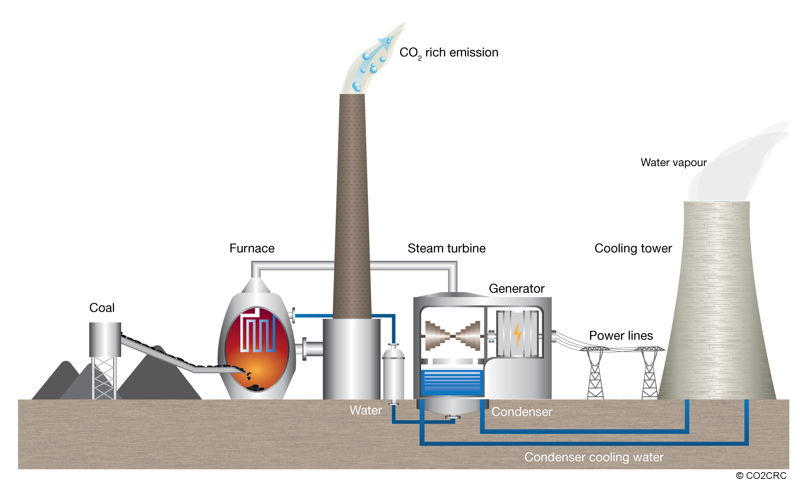
Basic structure of a power plant
Figure Source: CO2CRC
Notes:
http://www.co2crc.com.au/images/imagelibrary/cap_diag/coal-fired-power-plant_media.jpg

Slide 11
Power plant process (wet side)
Bring in the fuel
Process the fuel
Burn the fuel
Heat steam in the boiler, creating higher pressure steam
Power the turbine
Condense the steam using cool water to remove waste heat
Dispose of by-products (carbon dioxide, ash, etc.)

Slide 12
Power at your house process (dry side)
Transform the generator output
Transmit the energy to your house
Step down the voltage for distribution
Turn on your lightbulb

