Slide 1
How Power Plants Work

Slide 2
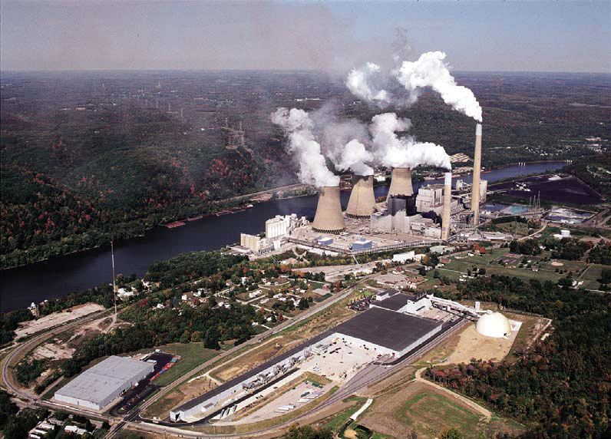
Smoke or steam?
Figure: Allegheny Sierra Club
Notes:
http://alleghenysc.org/wp-content/uploads/2009/07/shippingsport.jpg

Slide 3
Key Takeaways
“This increase [in atmospheric concentration of CO₂ and other GHGs] is primarily the result of burning coal, oil and natural gas…”
“To stop serious climate change, we will have to reduce global CO₂ emissions by about 80%. That means an enormous change in the world’s energy systems.”

Slide 4
Where does electricity come from?
Power plants (coal, natural gas, nuclear), hydro-dams, wind turbines, solar panels
Which provides the most electricity for us?
Coal
Natural Gas
Nuclear
Hydro
Everything else
Notes:
Which provides the most

Slide 5
How to calculate emissions due to electricity produced by different fuel types?
Fuel Carbon Intensity
Conversion Efficiency
Electricity Generated
Emissions Factor
Total Emissions

Slide 6
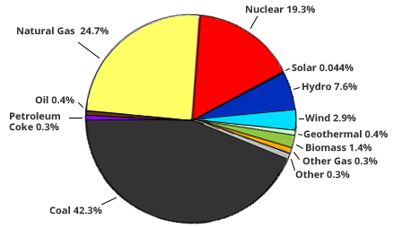
U.S. electric energy mix
Figure: Environmental Protection Agency
Notes:
http://www.epa.gov/cleanenergy/images/pie_chart_fuel_mix.png

Slide 7
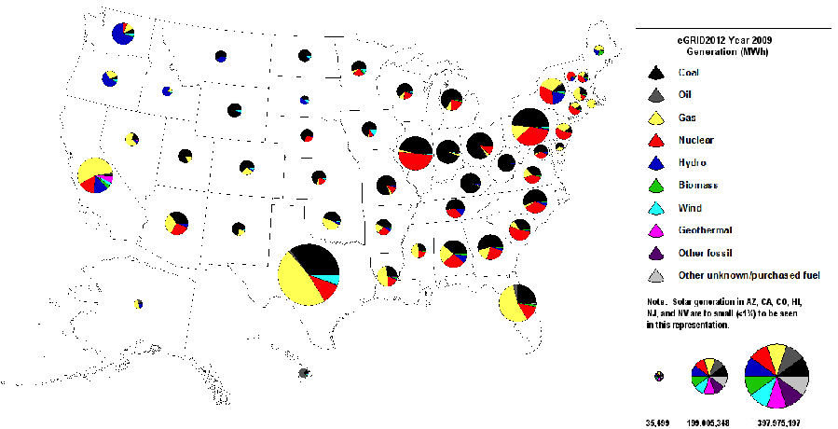
Year 2009 Generation by Fuel Type
Figure: eGrid 2012
Notes:
http://www.epa.gov/cleanenergy/energy-resources/egrid/index.html

Slide 8
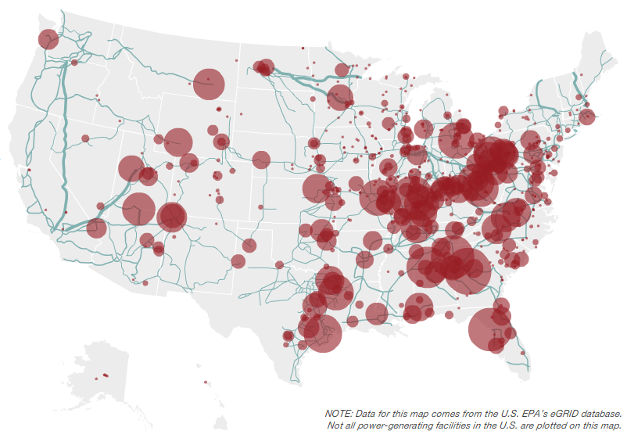
Coal Plants
Figure: eGrid 2012
Notes:
600 coal plants
Provide 50% of electricity
http://www.epa.gov/cleanenergy/energy-resources/egrid/index.html

Slide 9
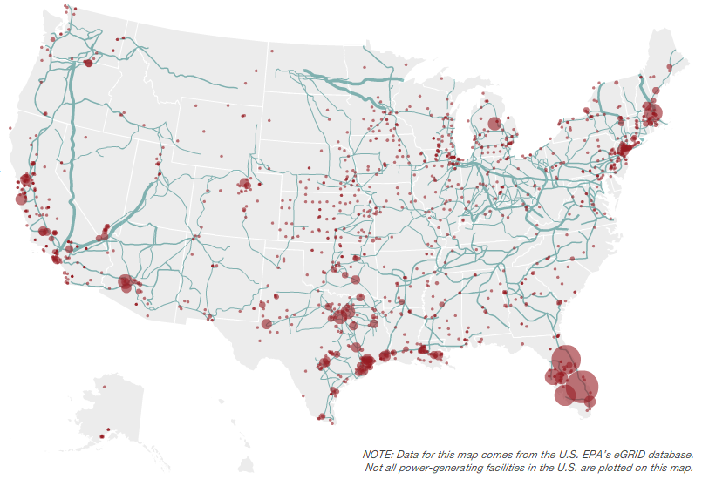
Natural Gas
Figure: eGrid 2012
Notes:
Mostly in CA, TX, FL
About 500 natural gas plants, but smaller than coal
http://www.epa.gov/cleanenergy/energy-resources/egrid/index.html

Slide 10
How to calculate emissions due to electricity produced by different fuel types?
Fuel Carbon Intensity
Conversion Efficiency
Electricity Generated
Emissions Factor
Total Emissions

Slide 11
Fuel Carbon Intensity
http://www.eia.gov/oiaf/1605/coefficients.html

Slide 12
How to calculate emissions due to electricity produced by different fuel types?
Fuel Carbon Intensity
Conversion Efficiency
Electricity Generated
Emissions Factor
Total Emissions

Slide 13
Demonstration
Play around with pinwheels, finding right angle to blow in order to get them spinning fast.
Hold two pinwheels in line and blow such that they both spin. Observe speed of second (downwind) pinwheel. Remove first pinwheel and observe change in speed in second. Why does this occur?
Is all of the energy in your breath converted into rotational energy of pinwheel?
How could you increase the fraction of breath energy converted into rotational energy?
What is efficiency and how does it relate to what we have just done?

Slide 14
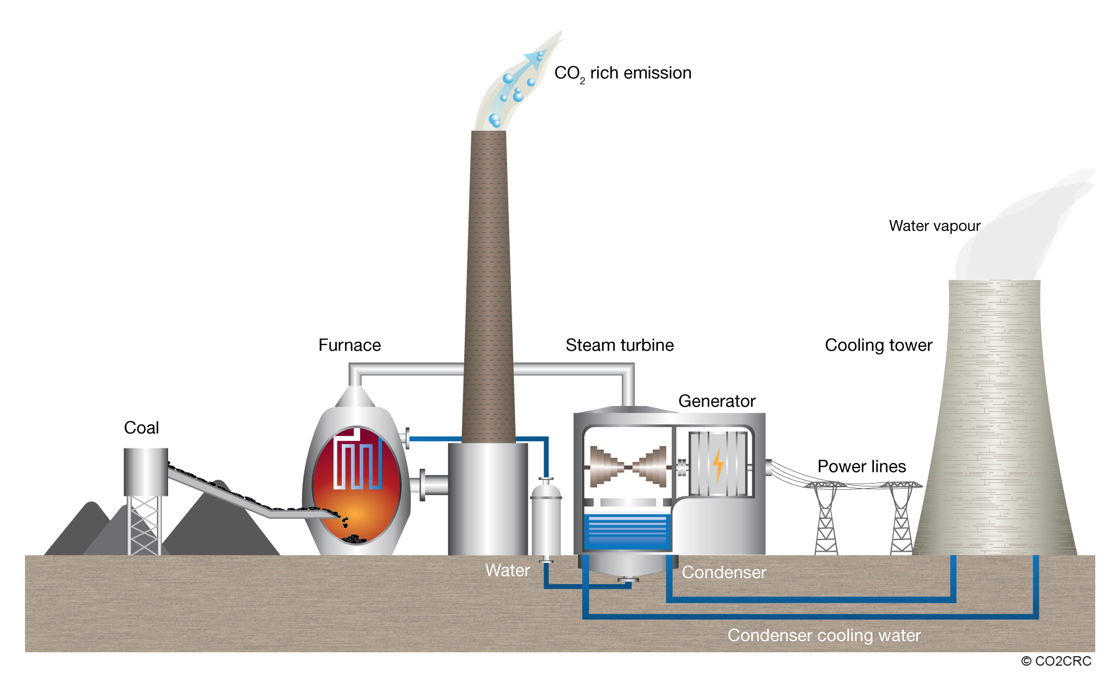
Steam Turbine (Coal shown here)
Figure Source: CO2CRC
Notes:
http://www.co2crc.com.au/images/imagelibrary/cap_diag/coal-fired-power-plant_media.jpg

Slide 15
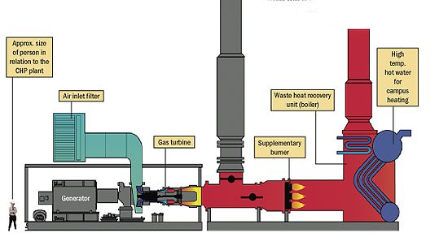
Gas turbine (college campus)
Figure Source: University of Calgary
Notes:
http://www.ucalgary.ca/news/files/news/images/cogen_diagram.jpg

Slide 16
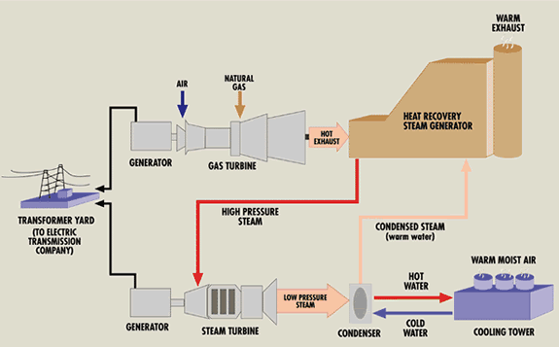
Natural Gas Combined Cycle Plant
Figure: Northwest and Intermountain Power Producers Coalition
Notes:
http://www.nippc.org/technology/index.tpl?cntid=105475498113479

Slide 17
Efficiencies
Type | Efficiency
Steam Turbine (coal, oil, gas) | 30%-40%
Gas Turbine | 25%-50%
Combined Cycle | 45%-70%

Slide 18
How to calculate emissions due to electricity produced by different fuel types?
Fuel Carbon Intensity
Conversion Efficiency
Electricity Generated
Emissions Factor
Total Emissions

Slide 19
Summary
Fuel Carbon Intensity
Conversion Efficiency
Electricity Generated
Coal: High
Oil: Medium
Natural Gas: Low
Steam Turbine (Coal, Gas, Oil): Low-Medium
Gas Turbine: Low-Medium
Gas Combined Cycle: Medium-High
Coal: High
Gas: Medium
Oil: Low
Emissions Factor
Total Emissions
Coal: High
Gas: Medium
Oil: Abiguous

Slide 20
Summary
Figure Source: CO2CRC
Notes:
http://www.co2crc.com.au/images/imagelibrary/cap_diag/coal-fired-power-plant_media.jpg

Slide 21
What do we do?
Some ideas:
Energy efficiency
Demand reduction
CCS
Renewables

