Slide 1
Power Generation: Coal versus Nuclear
Coal Furnace
Steam Turbine
Generator
Steam
Electricity
Liquid Water
Notes:
With any ‘classic generation facility’, you have a vessel that burns a fuel – like coal, oil, or gas – to heat up a fluid like water. That water turns to steam, which turns a turbine, which turns a generator, which produces electricity. By the time the steam gets to the other end of the turbine, it cools down into water, and pumps send it back to the combustion vessel.

Slide 2
Power Generation: Coal versus Nuclear
Nuclear Reactor
Coal Furnace
Steam Turbine
Generator
Steam
Electricity
Liquid Water
Notes:
The only difference between a coal plant and a nuclear plant is that, in the coal plant, you burn coal to boil water. In a nuclear plant, nuclear reactions boil water. So the plumbing is the same everywhere except here.
Water enters the nuclear reactor, the nuclear reactions boil the water, the water turns to steam, and that steam turns the turbine, which turns the generator, and so on, much the same as a coal plant.
Now, what does it mean when I say nuclear reactions boil water?

Slide 3
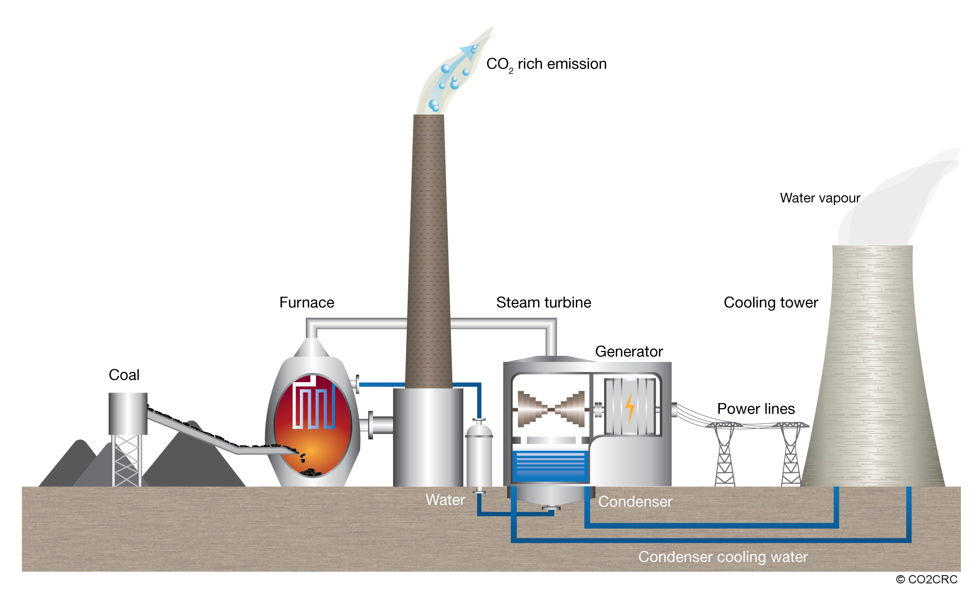
Power Generation: Coal versus Nuclear
Figure Source:
Euronuclear
Figure Source: CO2CRC
Notes:
http://www.co2crc.com.au/images/imagelibrary/cap_diag/coal-fired-power-plant_media.jpg
http://www.euronuclear.org/1-information/energy-uses.htm
The only difference between a coal plant and a nuclear plant is that, in the coal plant, you burn coal to boil water. In a nuclear plant, nuclear reactions boil water. So the plumbing is the same everywhere except here.
Starting from a Coal power plant, you replace the coal with the nuclear.
Water enters the nuclear reactor, the nuclear reactions boil the water, the water turns to steam, and that steam turns the turbine, which turns the generator, and so on, much the same as a coal plant.
Due to the nuclear process, there is no CO2 emitted.

Slide 4
Safety
How safe is nuclear power?
Would you live next to a nuclear plant?
Car accidents – 1 in 83
Being murdered – 1 in 210
Walking down the street – 1 in 630
Drowning – 1 in 1,100
Accident at a nuclear plant – 1 in 125,000
?
http://reason.com/archives/2006/08/11/dont-be-terrorized

